Slide 1
Lesson 6: Handling Errors
Reference:
Research Software Engineering with Python by Damien Irving, Kate Hertweck, Luke Johnston, Joel Ostblom, Charlotte Wickham, and Greg Wilson
https://merely-useful.tech/py-rse/errors.html

Slide 2
Two types of errors:
Internal error: an error in the program itself, like trying to access elements beyond the end of an array
External error: an error caused by something outside the program, like network outages or opening a file that doesn’t exist

Slide 3
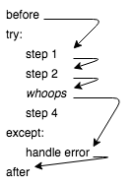
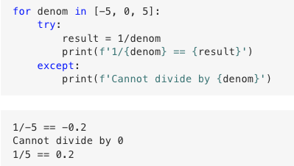
Exceptions

Slide 4
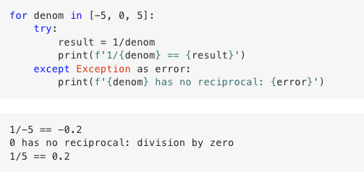
Exceptions
Python (and other languages) store information about the error in an object.
We can catch an exception and inspect it when debugging:

Slide 5
Exceptions
Notes:
Ask students to open a py file and write this code

Slide 6
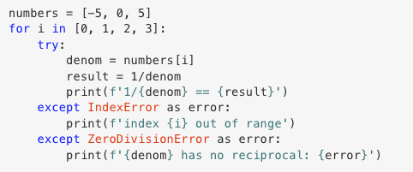
Try it out:

Slide 7
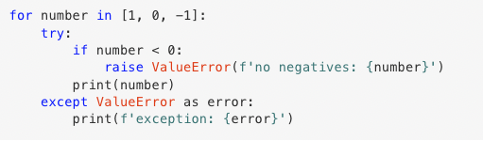
Raise Exceptions Explicitly:

Slide 8
Most Common Exception Errors:
ArithmeticError: something has gone wrong in a calculation.
IndexError and KeyError: something has gone wrong indexing a list or lookup something up in a dictionary.
OSError: thrown when a file is not found, the program doesn’t have permission to read it, and so on.
More information on Python’s built-in exceptions at: https://docs.python.org/3/library/exceptions.html#exception-hierarchy

Slide 9
Exceptions: Throw Low, Catch High
If an exception occurs inside a function and there is no except for it there, Python checks to see if whoever called the function is willing to handle the error.
It keeps working its way up through the call stack until it finds a matching except.
If there isn’t one, Python takes care of the exception itself.

Slide 10
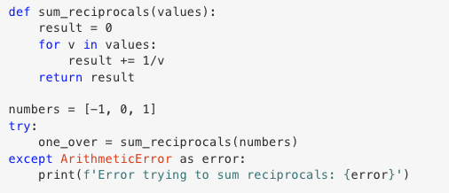
Exceptions: Throw Low, Catch High
Write most of your code without exception handlers, but put a few handlers in the higher-level functions of your program to catch and report all errors.

Slide 11
Exceptions: Throw Low, Catch High
Simplified Code Maintenance: Inner functions and methods remain cleaner and more focused on their specific tasks, making the code easier to maintain and understand.
Enhanced Debugging: Catching exceptions at a higher level allows for more comprehensive error reporting and logging. It provides a better context for the error, making it easier to trace the root cause.
Scalability: As applications grow, this approach scales better. It's more efficient to have centralized error handling rather than scattered exception handling throughout the code.

Slide 12
Writing Useful Error Messages
Tell the user what they did, not what the program did.
Putting it another way, the message shouldn’t state the effect of the error, it should state the cause.
Be spatially correct.
i.e., point at the actual location of the error. Few things are as frustrating as being pointed at line 28 when the problem is really on line 35.
Be as specific as possible without being or seeming wrong from a user’s point of view.
For example, “file not found” is very different from “don’t have permissions to open file” or “file is empty.”
Write for your audience’s level of understanding.
For example, error messages should never use programming terms more advanced than those you would use to describe the code to the user.

Slide 13
Writing Useful Error Messages
Do not blame the user, and do not use words like fatal, illegal, etc.
The former can be frustrating—in many cases, “user error” actually isn’t—and the latter can make people worry that the program has damaged their data, their computer, or their reputation.
Do not try to make the computer sound like a human being.
In particular, avoid humor: very few jokes are funny on the dozenth re-telling, and most users are going to see error messages at least that often.
Use a consistent vocabulary.
This rule can be hard to enforce when error messages are written by several different people, but putting them all in one module makes review easier.

Slide 14
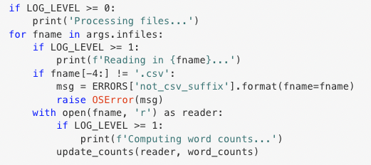
Reporting Errors: Logging
Logging frameworks:
let us leave debugging statements in our code and turn them on or off at will
can send an output to any of several destinations

Slide 15
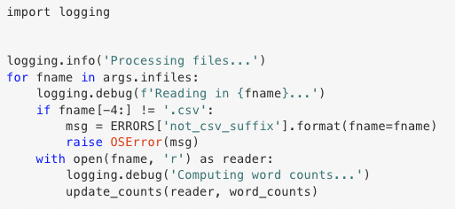
Using the Python logging library

Slide 16
Logging Levels:
DEBUG: very detailed information used for localizing errors.
INFO: confirmation that things are working as expected.
WARNING: something unexpected happened, but the program will keep going.
ERROR: something has gone badly wrong, but the program hasn’t hurt anything.
CRITICAL: potential loss of data, security breach, etc.

Slide 17
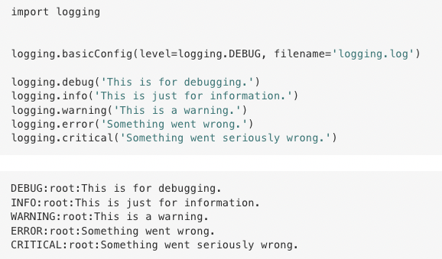
Logging levels: Customizing logging messages

