Slide 1
Lesson 5: Testing Software
Reference:
Research Software Engineering with Python by Damien Irving, Kate Hertweck, Luke Johnston, Joel Ostblom, Charlotte Wickham, and Greg Wilson
https://merely-useful.tech/py-rse/testing.html

Slide 2
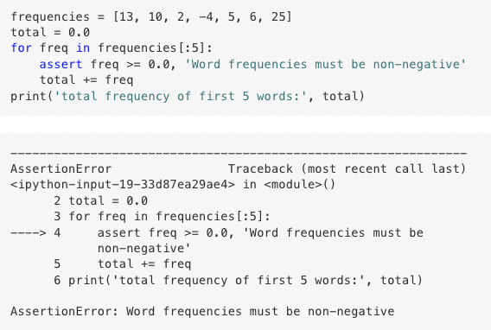
Assertions
Defensive programming assumes that mistakes will happen, and guards against them.
One way to guard against them is adding assertions, which checks that something must be true at a certain point in the program, and halts the program if something unexpected happens.
We can add user-defined error messages to indicate the error.

Slide 3
Assertions (generally) fall into three categories:
A precondition is something that must be true at the start of a function in order for it to work correctly.
A postcondition is something that the function guarantees is true when it finishes.
An invariant is something that is true for every iteration in a loop. The invariant might be a property of the data, or it might be something like, “the value of highest is less than or equal to the current loop index.”

Slide 4
Unit testing
A unit test checks of the correctness of a single unit of software.
What constitutes a “unit” is subjective, but typically it means the behavior of a single function in one situation.
A unit test will typically have:
a fixture, which is the thing being tested (e.g., an array of numbers);
an actual result, which is what the code produces when given the fixture; and
an expected result that the actual result is compared to.

Slide 5
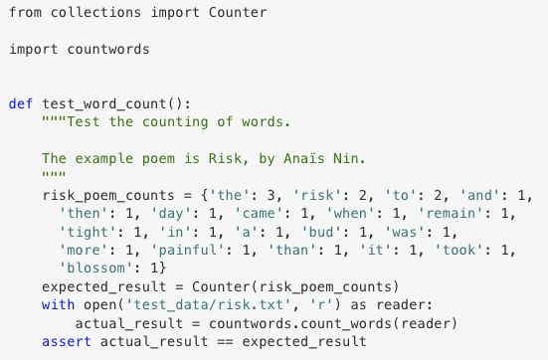
Testing Frameworks
Pytest is a testing framework that simplifies the creation, organization, and execution of tests.
Tests are put in files whose names begin with test_.
Each test is a function whose name also begins with test_.
These functions use assert to check results.
To add more tests, we simply write more test_ functions in this py file!

Slide 6
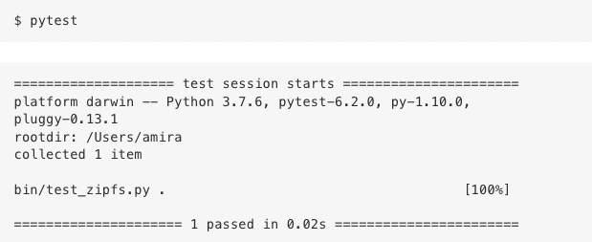
Testing Frameworks
The pytest library comes with a command-line tool called pytest.
When we run it with no options, it searches for all files in or fellow the working directory whose names match the pattern test_*.py

Slide 7
Testing Floating-Point Values
How do we write tests when we don’t know precisely what the right answer is?
Check if the actual value is within some tolerance of the expected value.
The tolerance can be expressed as the absolute error, which is the absolute value of the difference between two,
or the relative error, which the ratio of the absolute error to the value we’re approximating

Slide 8
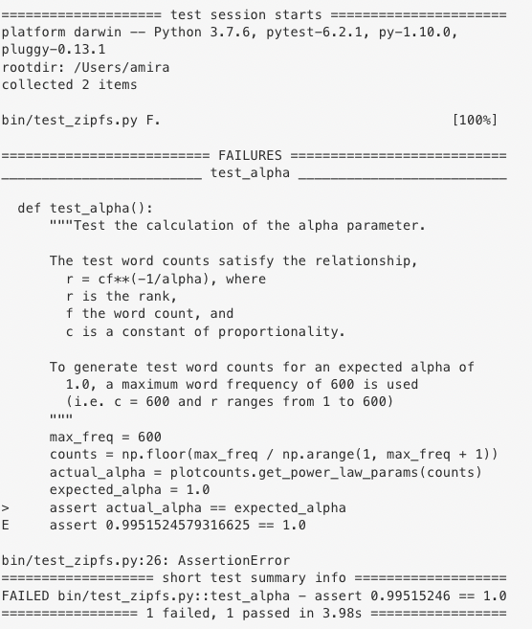
This might actually be close enough to 1 for the purposes of the test.

Slide 9
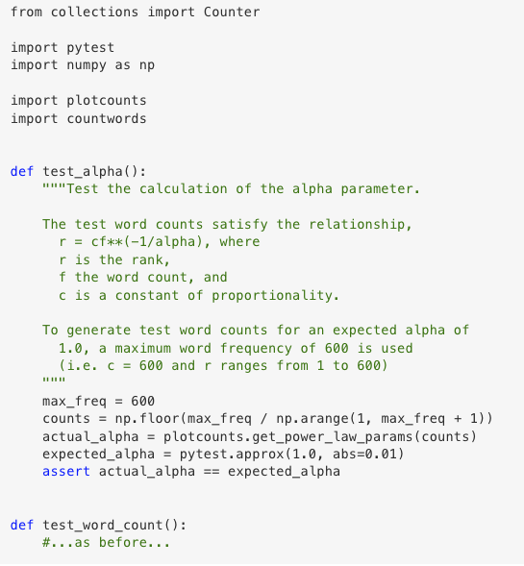
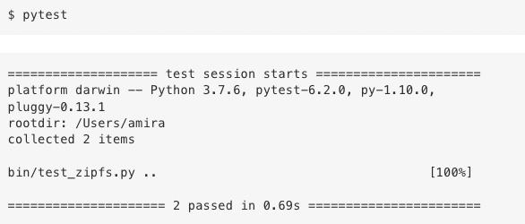
… so we can set an appropriate tolerance.

Slide 10
Integration Testing
Integration testing is a test that checks whether the parts of a system work properly when put together.
Integration tests are structured the same way as unit tests:
a fixture is used to produce an actual result that is compared against the expected result.
However, creating the fixture and running the code can be considerably more complicated

Slide 11
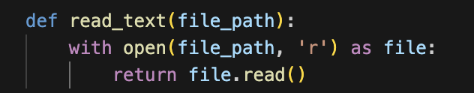
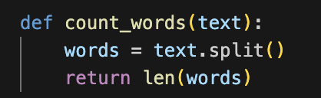
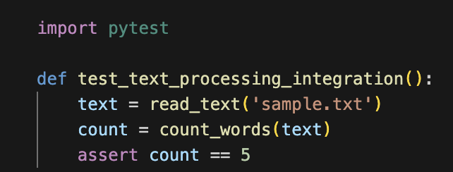
Example: Testing functions used to read in a txt file and count the 5 words

Slide 12
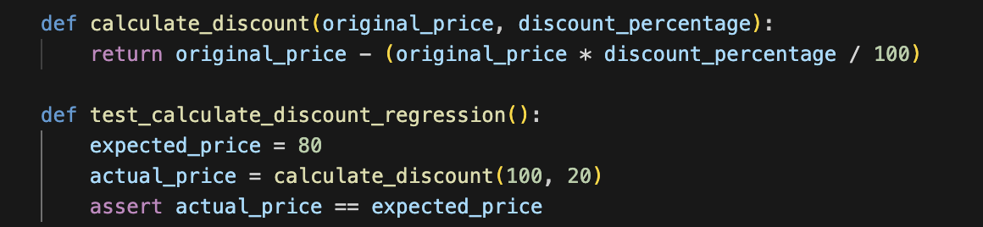
Regression Testing
When we don’t know the answer, we can use regression tests to compare today’s answer with a previous one.
This doesn’t guarantee that the answer is right—if the original answer is wrong, we could carry that mistake forward indefinitely—but it does draw attention to any changes (or “regressions”).

Slide 13
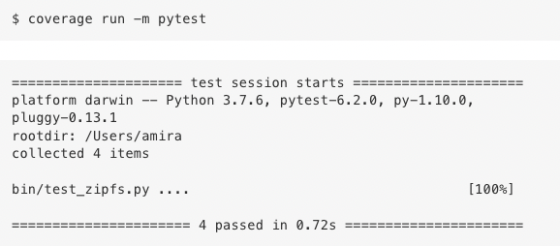
Test Coverage
How much of our code do the tests we’ve written check? We can use the coverage library to get the percentage of lines of code that have been tested.

Slide 14
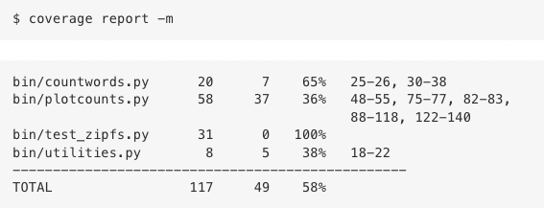
Test Coverage

Slide 15
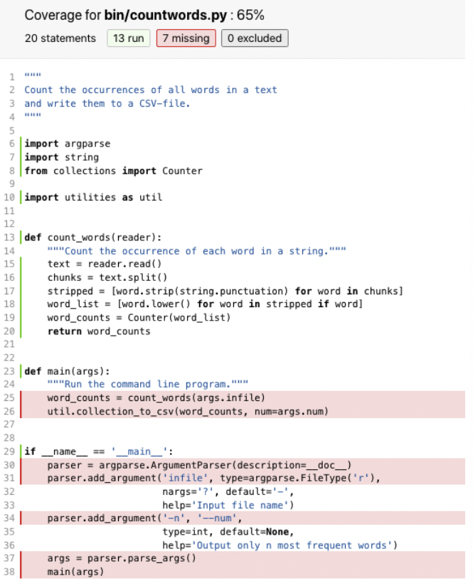
Test Coverage
If we run coverage html at the command line and open htmlcov/index.html, we can click on the name of our scripts and get colorized line-by-line display.
Notes:
Note here that how much test coverage that is required can vary. I.e. medical software should be 100% accurate, or software widely used. But lower than that is ok in small cases, or when the software is really simple (i.e., writing tests that check for proper types in a data set)

Slide 16
Continuous Integration
runs tests automatically whenever a change is made
can also be set up to alert programmers how their changes may affect others systems (i.e., warning a Windows user that a change would break things for a Mac user)
Travis CI:
popular tool that integrates well with Github
every time a change is committed to a repo, Travis CI:
creates a fresh environment
makes a fresh clone of the repo
runs whatever commands the project’s managers have set up

Slide 17
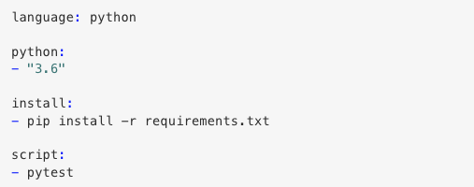
Continuous Integration: Travis CI
To prep for Travis CI, first add a file called .travis.yml to the root directory of the repo

Slide 18
Continuous Integration: Travis CI
To prep for Travis CI, first add a file called .travis.yml to the root directory of the repo
which programming language to use
which version(s) to use
the name of the file listing the libraries that need to be installed
the command to run to execute project scripts

Slide 19
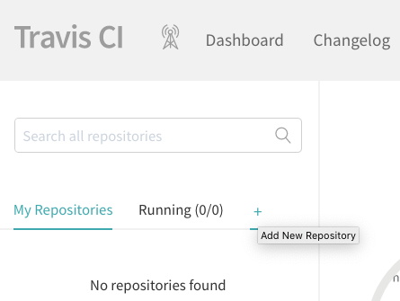
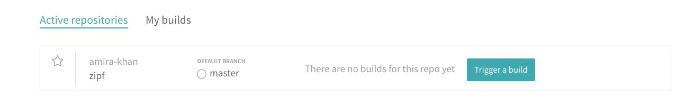
Continuous Integration: Travis CI
Create an account on https://www.travis-ci.com/ (if we don’t already have one).
Link our Travis CI account to our GitHub account (if we haven’t done so already).
Tell Travis CI to watch the repository that contains our project.

Slide 20
When to test?
Option 1: Test Driven Development
Rather than writing code and then writing tests, we write tests first and then write just enough code to make them pass
Advocates claim that it leads to better code because:
Writing tests clarifies what the code is actually supposed to do.
It eliminates confirmation bias.
If someone has just written a function, they are predisposed to want it to be right, so they will bias their tests towards proving that it is correct instead of trying to uncover errors.
Writing tests first ensures that they actually get written.

Slide 21
When to test?
Option 2: Checking-Driven Development (recommended)
Writing just a few lines of code and testing it before moving on rather than writing several pages of code and then spending hours on testing
For example: every time we add a step to our pipeline and look at its output, we also add a check of some kind to the pipeline to ensure that what we are checking remains true if it were run on other data or if the pipeline evolves

