Slide 1
Lesson 3b: Creating Packages with Python
Reference:
Research Software Engineering with Python by Damien Irving, Kate Hertweck, Luke Johnston, Joel Ostblom, Charlotte Wickham, and Greg Wilson
https://merely-useful.tech/py-rse/packaging.html

Slide 2
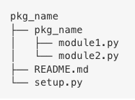
Creating a Python Package
A generic package folder hierarchy has:
a top level directory names after the package
that contains a directory that is also named after the package
that contains the package’s source files
*Search the Python Package Index https://pypi.org/ to check which names are already taken!*

Slide 3
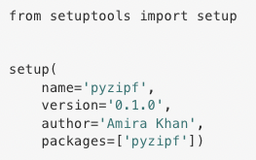
Creating a Python package
Using setuptools allows everyone, regardless of Python distribution, to use our package.
To use setup, we have to make a file called setup.py in the directory above the root directory.
The set up file looks like this:
(Packages parameter is straightforward, since we only have one package directory. In more complex projects, the find_packages function from setuptools can automatically find all packages)

Slide 4



Virtual Environments
Creating a virtual environment:
Virtual environments isolate package dependencies from the main Python installation.
They:
Allow easy install/uninstall for testing
Ensure package works in an empty environment
Are created with conda or virtualenv
Activating it:
($ conda deactivate to deactivate)
Once we’ve done this, the python command runs the interpreter in pyzipf/bin:

Slide 5

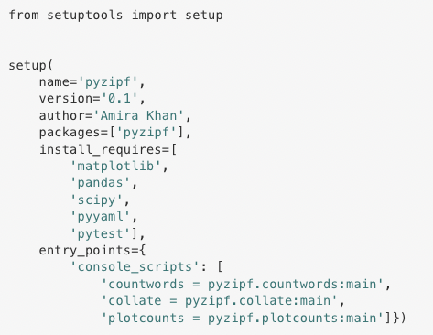
Installing a Development Package
-e indicates that we want to install the package in “editable” mode
which means that any changes we make in the package code are directly available to use without having to reinstall the package
The . means “install from the current directory.”
List dependencies with install_requires in setup.py
Lets pip handle dependencies automatically
Make scripts executable as command line tools via entry_points
Map script functions to command names
Add to setup.py

Slide 6
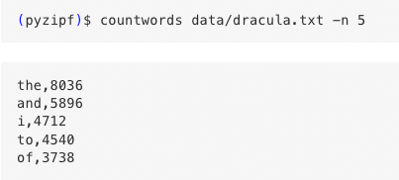
… and now we can use commands directly from the Unix shell!

Slide 7


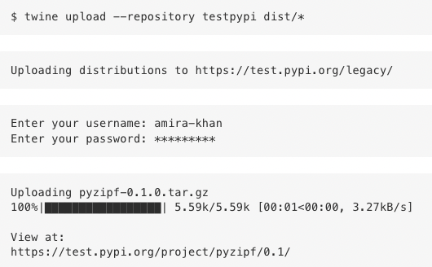
Distributing Packages
In order for people to run pip install pyzipf to use out package, we need to use setuptools to create a source distribution. Then:
Make a free account on PyPl
Install twine, the preferred tool for uploading packages to PyPl
Follow the Python Packaging User guide to upload our distribution from the dist folder, using the --repository option to specify the TestPyPl repo
… and we’re happy with our package at TestPyPl, we can go through the same process to put it on the main PyPl repo.

Slide 8

Documenting Packages
Sphinx:
a document generator for more complex Python packages, often used in combination with a free online hosting service called Read the Docs
can scan Python code for function names and docstrings and export that information to HTML format for hosting on the web
uses a format called reStructuredText (reST)
plain-text markup format that can be rendered to HTML or PDF
Renaming our README to an rst:
note that there are formatting differences for rst files

Slide 9


Documenting Packages
Install Sphinx and create a docs/ directory at the top of the repo
Use quickstart to create a minimal set of documentation that includes the package-level info in the README.rst, and function-level info in the docstrings made along the way

Slide 10
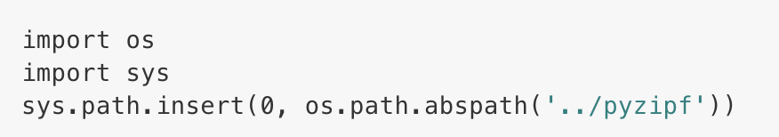

Documenting Packages
Quickstart creates a file called conf.py in the docs directory that configures Sphinx. First, we need to add the following code to the Path setup:
We will also change the “general configuration” section to add autodoc to the list of Sphinx extensions we want:

Slide 11
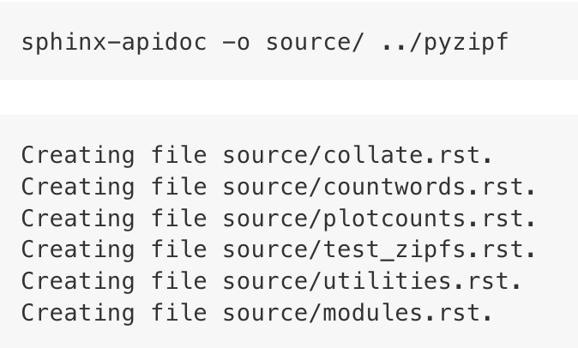
Documenting Packages
We can now generate a Sphinx autodoc script that generates information about each of our modules and puts it in corresponding .rst files in the docs/source directory:
… and now we can generate our webpage!

Slide 12
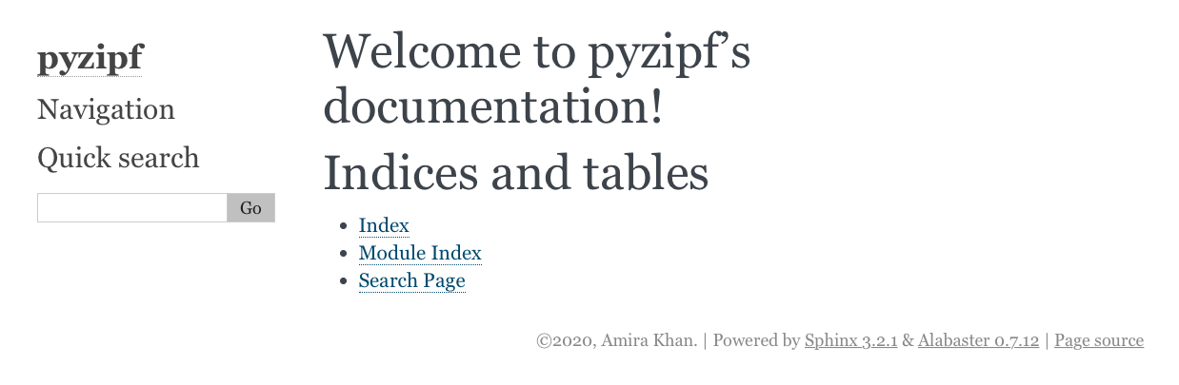

If we run make html and open docs/_build/index.html in a web browser, we’ll see a landing page.
Now, we create a requirements_docs.txt file that contains this line (where the version number is found by running pip freeze):
Anyone wanting to build the documentation (including us, on another computer) now only needs run pip install -r requirements_docs.txt

Slide 13
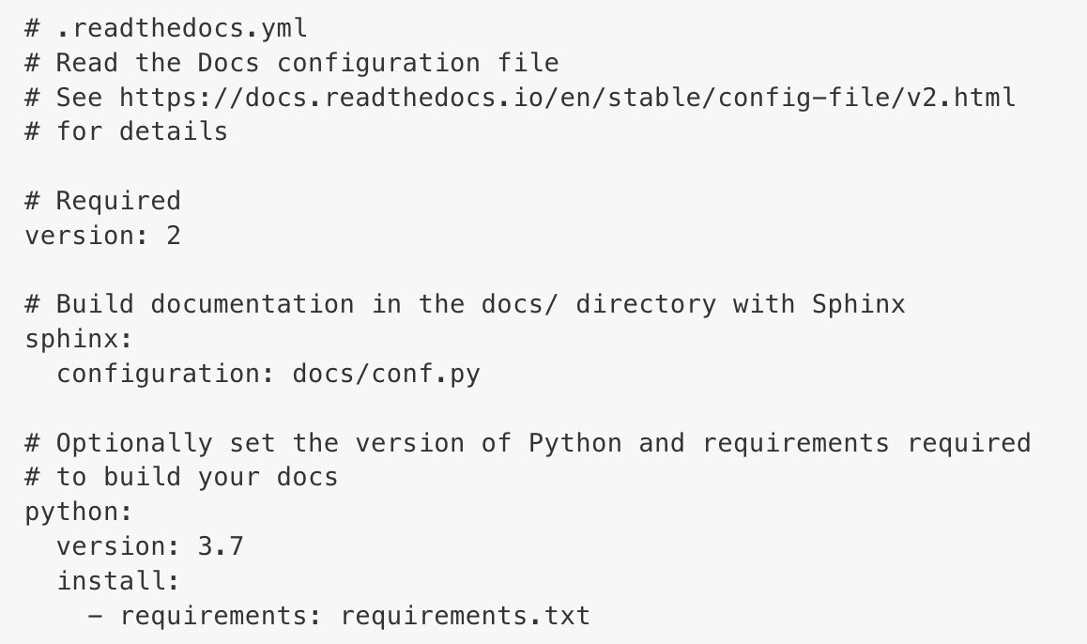
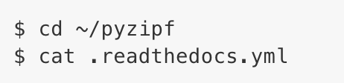
Hosting Documentation Online
Read the Docs
a community-supported site that hosts software documentation free of charge.
integrates with GitHub so that documentation is automatically re-built every time updates are pushed to the project’s GitHub repository
We need to create and save a Read the Docs configuration file in the root directory of our pyzipf package:

Slide 14
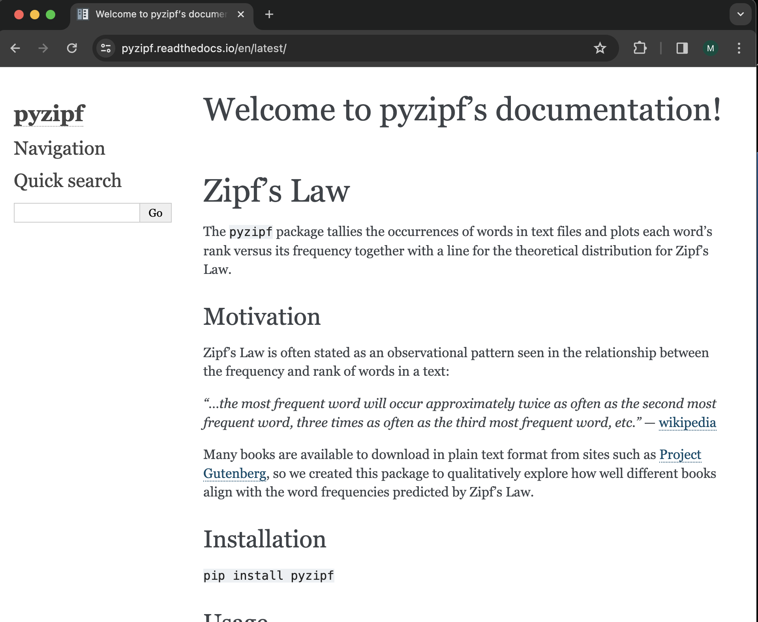
Hosting Documentation Online
https://pyzipf.readthedocs.io/

Slide 15

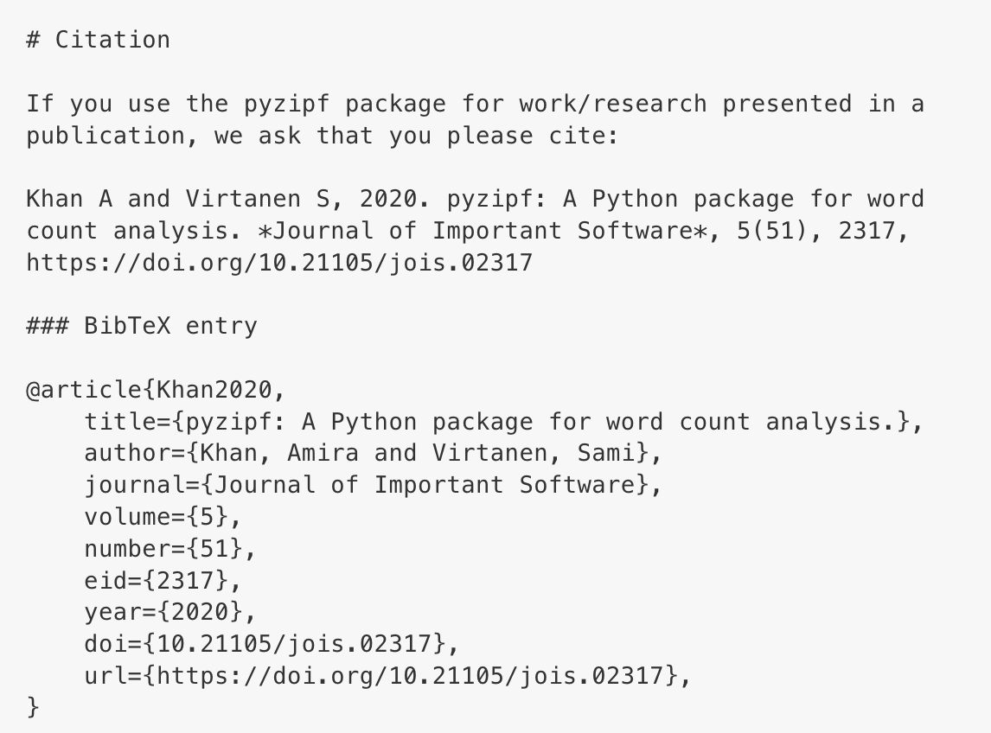
Software Journals
Zenodo integrates with GitHub so that we can obtain a DOI
Some research disciplines have journals devoted to describing particular types of software (e.g., Geoscientific Model Development)
There are also generic software journals such as the Journal of Open Research Software and the Journal of Open Source Software.
Once you’ve obtained a DOI and possibly published with a software journal, the last step is to tell users how to cite your new software package

