Slide 1
Lesson 7: APIs
Application Programming Interfaces

Slide 2
What is an API?
API stands for Application Programming Interface
Allows software programs to communicate with each other
Provides structured way to expose data and functionality from an application to other applications
Allows other developers to access and integrate with an application without needing to understand complex implementation details

Slide 3




Spotify API:
Access Spotify music catalog data
Get info on artists, albums, tracks
Manage user libraries and playlists
Analyze audio features and metrics
Reddit API:
Programmatic access to Reddit
Get submissions and comments from subreddits
Get metadata on Reddit content
Create bot integrations
OpenWeatherMap API:
Access current and historical weather data
Get weather forecasts by city location
Temperature, precipitation, humidity etc
Weather alerts, wind speed and direction
Multiple data formats and languages
Google Maps API:
Integrate Google Maps into web/mobile apps
Generate maps, routes, location searches
Add markers, overlays and customizations
Calculate distances and travel times

Slide 4
Public APIs vs Private APIs
Public vs private refers to access and visibility
Public APIs
Available openly on the internet for any developer to use
Just need to sign up and get an API key in order to access
Examples: Twitter, Spotify, YouTube
Private APIs
Access is restricted and requires authorization
Only usable by internal apps or trusted external partners
Useful for exposing internal data and functionality safely
Examples: APIs for internal tooling, bank partnerships

Slide 5
REST vs SOAP
REST vs SOAP differ in underlying protocol, flexibility, and complexity
REST
Uses simple HTTP requests to GET, POST, PUT, DELETE data
Generally returns data in easy to parse formats like JSON
Good for public-facing APIs, mobile applications
Tend to be faster and more flexible
SOAP
Uses XML for requests and responses
Follows stricter set of protocols and standards
Defines rigid contract for security, transactions etc
Useful for enterprise applications and internal systems
Provides more built-in security features
Can be more complex and verbose to implement

Slide 6
API Keys
Unique string that acts like a password obtained by registering as a developer
Lets the API identify the source of requests, enabling usage tracking and access limits
Prevents abuse and provides API security
Most APIs require adding key to request headers
Example header:
X-Api-Key: 23748237842823442
Keep your key secret - don't share or expose!

Slide 7
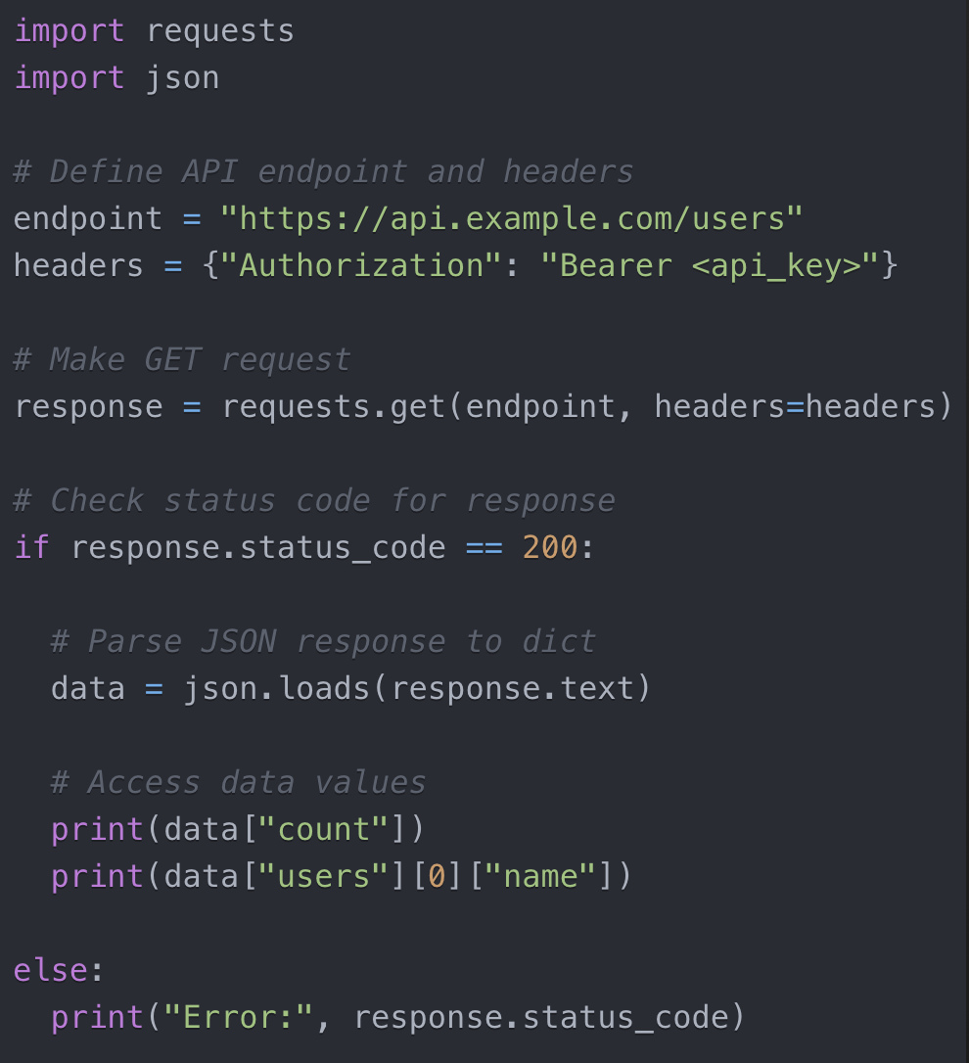
Making API Requests
HTTP requests allow client apps to connect to server APIs over the web
Common HTTP methods used:
GET - Retrieve data
POST - Submit data to be processed
PUT - Update existing data
DELETE - Delete data
The endpoint URL follows a structure defined in docs, like:
https://api.service.com/v1/users
Can include query parameters to filter data
?type=customer&region=eu
Most APIs require authorization header with API key

Slide 8
Parsing Responses
JSON format:
Human-readable collection of key-value pairs
Easy to access values programmatically
XML format:
Nested structured format with opening and closing tags
Can use libraries like ElementTree to parse
Query to extract specific elements
Steps to parse:
1. Make request
2. Receive raw string response
3. Parse string into workable structure
4. Extract values needed for app

Slide 9
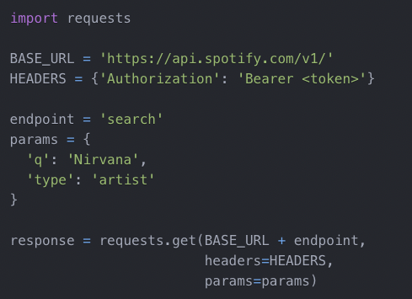
Class Exercise:
Notes:
Have students break into groups, explore the Spotify documentation, and write a request to download and visualize data.

