Slide 1

Building software: Version control with Git
Data Sciences Institute
University of Toronto
Simeon Wong

Slide 2
Asking questions
Zoom chat during class
Feel free to post and answer questions at any time
Please use the raise hand feature for verbal questions
Pre- / Post-class office hours with Tong
Email
simeonm.wong@mail.utoronto.ca
tong.su@mail.utoronto.ca

Slide 3
Course objective
How to write robust software in a team that we, our colleagues, and the public can trust and use with confidence.

Slide 4
What is version control?
Git: Introduction
A system that records changes to a file or a set of files over time
Enables us to recall a specific version later
e.g. Copying files to another directory to save past versions is a form of version control.
While it is simple, it lacks flexibility and ability to handle complexity

Slide 5
What is version control?
Git: Introduction
Version Control Systems (VCS) can do a number of things and can be applied on nearly any type of file on our computers:
revert files to a previous state
revert entire project to a previous state
compare changes over time
see who modified something last
who introduced an issue and when
recover lost files

Slide 6
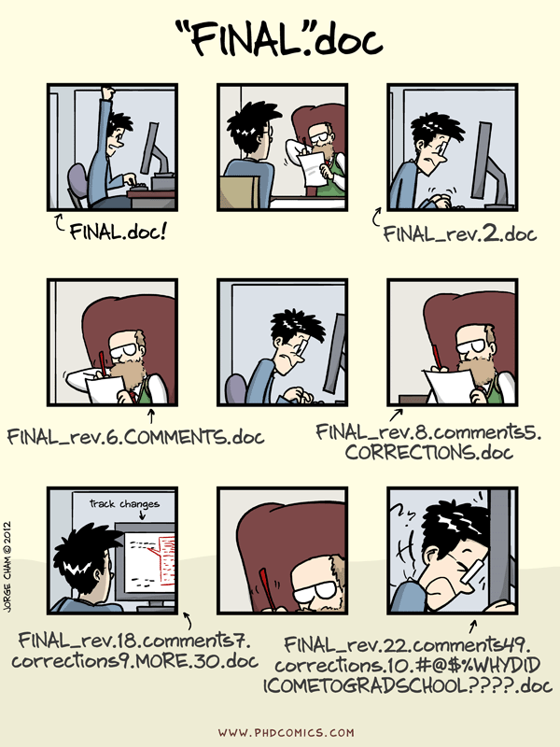
Why version control for software?
Git: Introduction

Slide 7
Why version control for software?
Git: Introduction
Robust software is documented as it is written
Log changes and reasoning for why changes are made
Working in teams requires code-specific version control
Changing one part of a code project can affect behaviour in seemingly unrelated features
In-progress state of one component can render the entire program temporarily unusable (e.g. syntax error)
Backup of your work

Slide 8

System check!
Git: Installation
Open your terminal
Type
git --version
You should see something like this:

Slide 9
Installing Git
Git: Installation
Please see the environment setup instructions in the Onboarding repository:
https://github.com/UofT-DSI/Onboarding/tree/main/environment_setup

Slide 10
$> Interactive live coding
Git configuration
Setup identity information on the Git command line:
git config --list
git config --global user.name
git config --global user.email
git config --global core.editor “code --wait”
Notes:
NTFY

Slide 11
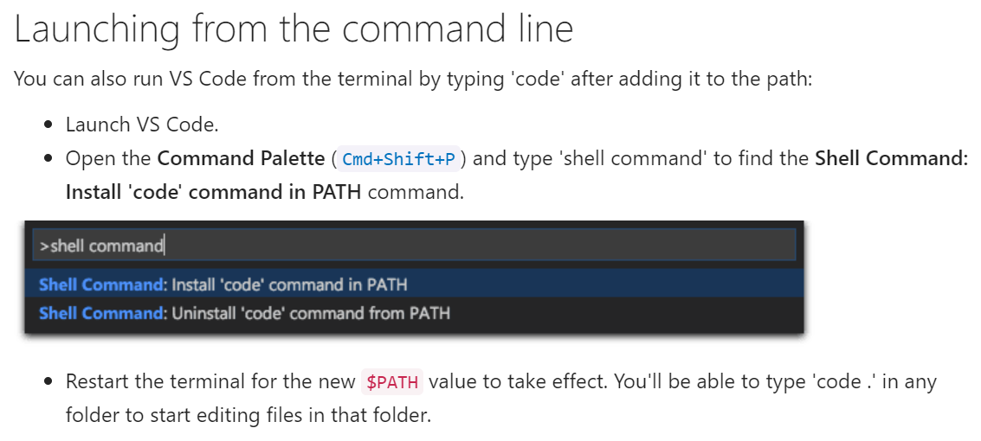

Slide 12
Getting help
Git
git help <verb>
git <verb> --help
Git reference manual: https://git-scm.com/docs

Slide 13
What questions do we have?

Slide 14
Meet our analyst, Alex
Git: Introduction
Alex is a data engineer
Alex works on a team at a mid-sized company
Alex is starting a new project:
develop a data processing pipeline that aggregates sales data from multiple sources into a centralized data warehouse
develop a new module for the sales business intelligence dashboard with this analysis
Follow along as Alex uses Git to simplify her work

Slide 15
$> Interactive live coding
Git: Getting started
Alex sets up a code repository before writing any code.
mkdir myproject ; cd myproject
git init
Initialize a new repository
Create README.md
git status
Query the current state
Notes:
NTFY

Slide 16

Add to cart
Git: Basic commands
Staging
We need to tell Git which files it should track
Indicate that the current state of a file should be tracked by adding it to the git staging area
git add myscript1.py README.md
Note: If a file is modified after staging, this doesn’t change the copy in the staging area
myscript1.py
myscript1.py
README.md
README.md
myscript2.py
mynotebook.ipynb

Slide 17
Add to cart
Git: Basic commands
Remove from staging: git reset <file>
Update staging area with new changes: git add <file>
Add all files in the repository folder: git add -A

Slide 18
$> Interactive live coding
Git: Basic commands
Alex adds her README file into staging.
git add README.md
git status
Query the current state
git reset README.md
git status
Notes:
NTFY

Slide 19
Commit staged changes
Git: Basic commands
Applies to all changes in the staging area, but not changes made since adding to staging
Appends to the git tree (repository history) with a commit message
The tree can have multiple branches (more on this tomorrow)
Staging
myscript1.py
main
initial
add analysis to myscript1.py update README
first script
add README file
README.md

Slide 20
$> Interactive live coding
Git: Basic commands
Alex makes a commit with her README file.
git add README.md
git status
Query the current state
git commit
Also try:
git commit -m “commit message here”
git commit -a
Notes:
NTFY

Slide 21
Best practices for git commits
Git: Basic commands
Commit messages are extremely important:
for our own records as a reminder for we did
when collaborating with others
Commit often
mistakes are easier to locate and fix
Committed code can always be fixed with another commit

Slide 22
Exercise: Commit some files
Git: Basic commands
Try staging and committing some more files:
your Python files that you wrote earlier in this course
random files you create now
Try different parameters:
git add -A add all files to staging
git reset unstage files
git commit -am “msg” commit all modified files with message

Slide 23
Tracking changes with Alex
Git: Basic commands
Follow along as Alex uses Git to simplify her work
Created a new repository: git init
Added a new file to staging: git add README.md
Committed that file to the version history: git commit
Checked status of repository: git status

Slide 24
What questions do we have?

Slide 25
Tracking changes with Alex
Git: History
Oh no, Alex’s current code has an error!
She wants to find out what changed in her code since the last commit

Slide 26
Viewing commit history
Git: History
To see a history of our commits:
git log
For more details:
git log --stat
For less details:
git log --oneline

Slide 27
Looking for differences
Git: History
Compare the current directory with a previous commit
git diff <commit id>
Compare two different commits using
git diff <commit 1 id> <commit 2 id>

Slide 28
$> Interactive live coding
Git: History
Alex looks through the commit history and compares differences.
git log --stat
git diff <commit id>
Notes:
NTFY

Slide 29
Tracking changes with Alex
Git: History
Oh no, Alex’s current code has an error!
She compared her current file with one from before and wants to revert to a previous version

Slide 30
Reverting to a previous commit
Git: History
Revert the entire repository to a previous commit:
git switch -c <newname> <commit id>
Revert a single file to a previous commit:
git restore -s <commit id> <file name>
Be careful: this could overwrite uncommitted changes
create new branch
source to revert to

Slide 31
$> Interactive live coding
Git: History
Alex looks through the commit history and reverts her code to a previous known good state.
git log --stat
git switch -c prev1 <commit id>
git restore -s <commit id> <file>
Notes:
NTFY

Slide 32
Tracking changes with Alex
Git: History
Follow along as Alex uses Git to simplify her work
Looked through the history: git log
Compared differences: git diff
Reverted to a previous version: git restore

Slide 33
What questions do we have?

Slide 34
GitHub
Git: Remote repositories
GitHub is an online service for hosting and collaborating on code
Based on Git version control software
Graphical display of code history, commit messages
Code review, project management, and many other useful features!

Slide 35
Login to GitHub in the command-line
Git: Remote repositories
Git Credential Manager stores your GitHub account details safely:
enables the Git command to authenticate with GitHub
without needing to type your password every time
Check if you’re logged in:
git-credential-manager github list
If not, login on Git Credential Manager:
git-credential-manager github login

Slide 36
Tracking remote repositories
Git: Remote repositories
Manage remote repositories you are tracking using git remote
View list of tracked repositories
git remote -v
Add / remove tracked repositories
git remote add <nickname> <url>
git remote rm <nickname>
Default name is origin

Slide 37


Git push
Git: Remote repositories
Upload new commits using
git push <remote nickname> <branch name>
git push origin main
Can only push commits with matching histories
local
local
A
B
C
D
A
B
C
D
x
origin
origin
A
B
C
D
E
F
G

Slide 38
$> Interactive live coding
Git: Remote repositories
Alex uploads her code to GitHub.
Create a repository on GitHub
git remote add origin <url>
git remote -v
git push origin main
Notes:
NTFY

Slide 39
What questions do we have?

Slide 40
Tracking changes with Alex
Git: Remote repositories
Alex is asked by a teammate to help with a part of their code.
Alex needs to:
download their code
make edits
track her changes
upload her changes

Slide 41
Cloning a remote repository
Git: Remote repositories
Cloning downloads an entire code repository and all its history
Enables quick browsing and navigation through history
Allows you to add your commits to that history!
git clone <url>

Slide 42
$> Interactive live coding
Git: Remote repositories
Alex downloads her colleagues’ repository.
cd ~
git clone https://github.com/dtxe/DSI_assignmentpkg
git status
git log
Notes:
NTFY

Slide 43
Tracking changes with Alex
Git: Remote repositories
Alex is asked by a teammate to help with a part of their code.
Alex needs to:
download their code
make edits
track her changes
upload her changes

Slide 44
$> Interactive live coding
Git: Remote repositories
Alex makes edits to the code.
git commit -am “commit message”
git status
git log
git push
Why doesn’t this work?
Notes:
NTFY

Slide 45
Forking a repo on GitHub
Git: Remote repositories
We don’t usually have permission to edit/write to other people’s repositories
To make changes, we can fork (create a working copy of) a public repository that we can write to
Then, we can ask the original repository owner to incorporate our changes
This is called a Pull Request (we will discuss this later!)

Slide 46
$> Interactive live coding
Git: Remote repositories
Alex makes a copy of the repo and uploads her changes.
Fork https://github.com/dtxe/DSI_assignmentpkg
git remote rename origin upstream
git remote add origin <your repo>
git push origin main
Notes:
NTFY

Slide 47
Tracking changes with Alex
Git: Remote repositories
Alex is asked by a teammate to help with a part of their code.
Alex needs to:
download their code git clone
make edits git add
track her changes git commit
upload her changes git push
update tracked repos git remote

Slide 48
What questions do we have?

Slide 49
Course objective
How to write robust software in a team that we, our colleagues, and the public can trust and use with confidence.

Slide 50
Homework #1
Due tomorrow before class
Create a README.md file, commit, then upload to GitHub
Detailed instructions on the GitHub repo

