Slide 1

Building software: Version control with Git
Data Sciences Institute
University of Toronto
Simeon Wong
Notes:
Hi everyone, welcome back to our 3rd week of Data Science Fundamentals

Slide 2
Course objective
How to write robust software in a team that we, our colleagues, and the public can trust and use with confidence.

Slide 3



Alex’s new data pipeline
Git: Branching
Alex is a data engineer at a mid-sized company working on a new data processing pipeline and BI dashboard module

Slide 4

Alex’s new data pipeline
Git: Branching
Alex is a data engineer at a mid-sized company working on a new data processing pipeline and BI dashboard module

Slide 5
Alex’s new data pipeline
Git: Branching
Alex is a data engineer at a mid-sized company working on a new data processing pipeline and BI dashboard module
Alex has a basic data pipeline and most of the BI module written
Alex is currently working on expanding the data pipeline with more features. The expanded pipeline is not yet working, but……
She has a big client meeting coming up and they want a demo!

Slide 6
Alex’s new data pipeline
Git: Branching
Alex can use Git to go back to the last working state of her basic data pipeline
Alex can finish up the BI module on another branch
Present the amazing new BI module and wow then client
Then merge her dashboard work back into the main branch incorporating both the in-progress pipeline and finished BI module
finish_dashboard
main

Slide 7
$> Interactive live coding
Git: Branching
Finish the dashboard on a separate branch.
Clone https://github.com/dtxe/DSI_branch_demo
git clone https://github.com/dtxe/DSI_branch_demo
Switch to good commit
git switch -c finish_dashboard 6539845acab60c73ab50b65d58d9e39fd4a10119
Finish the dashboard
touch dashboard ; git add –A ; git commit –m “finish dashboard”
finish_dashboard
main
Notes:
git switch -c finish_dashboard <commit id>

Slide 8
$> Interactive live coding
Git: Branching
Merge the dashboard work into the main branch.
Switch to main
git switch main
Merge finish_dashboard
git merge finish_dashboard
finish_dashboard
main

Slide 9
Tracking changes with Alex
Git: Branching
Follow along as Alex uses Git to simplify her work
Create a new branch from a commit git switch
Merge changes from another branch git merge

Slide 10
Questions?

Slide 11
Listing branches
Git: Branching
List branches in your repo with
git branch -v
$> Let’s try it now!

Slide 12
Deleting branches
Git: Branching
Delete branches in your repo with
git branch –d <branch name>
Git will warn you if your branch contains work that hasn’t been incorporated into the main branch yet
But it is best practice to check before deleting anyways!
Pop-quiz: How do we check what commits are in a branch?

Slide 13
Deleting branches
Git: Branching
Delete branches in your repo with
git branch –d <branch name>
Git will warn you if your branch contains work that hasn’t been incorporated into the main branch yet
But it is best practice to check before deleting anyways!
$> Let’s try it now!
Create a branch, make a commit, try deleting, merge, try deleting again

Slide 14
$> Deleting branches
Git: Branching
git switch –c newbranch
touch newfile ; git add –A ; git commit –m “newfile”
git switch main
git branch –d newbranch
>>> Error: branch is not fully merged
git merge newbranch
git branch –d newbranch
>>> Success!

Slide 15
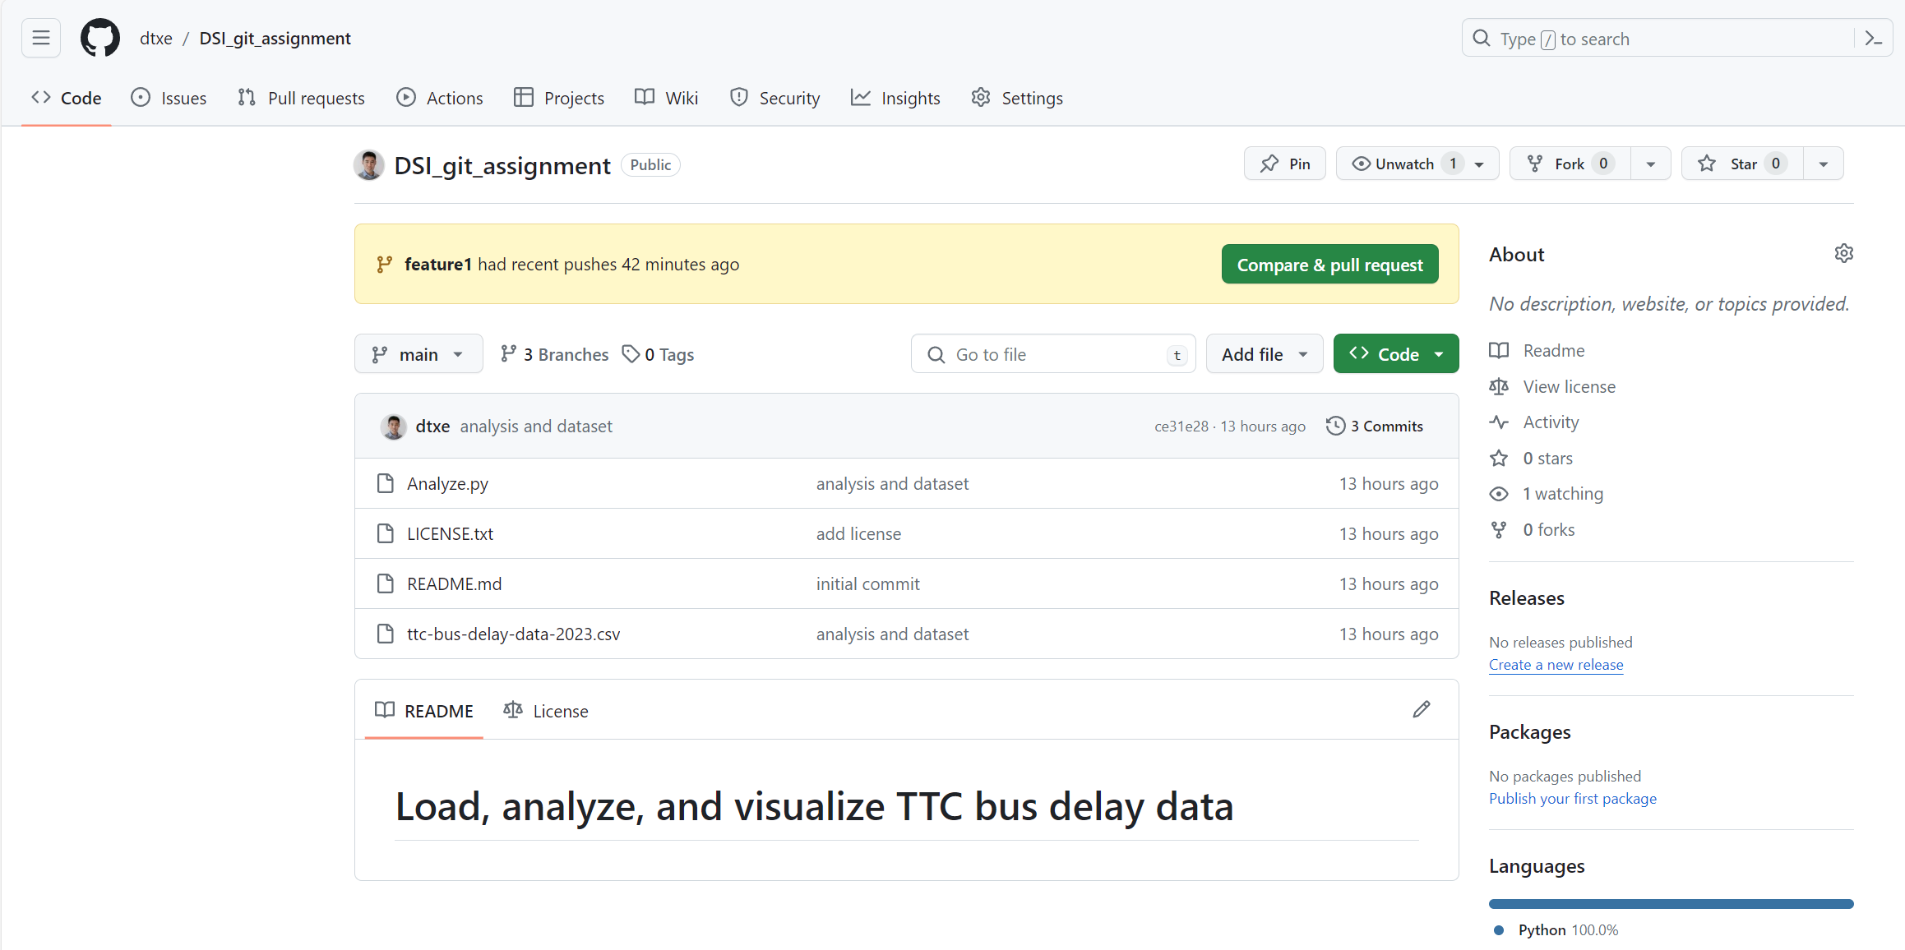
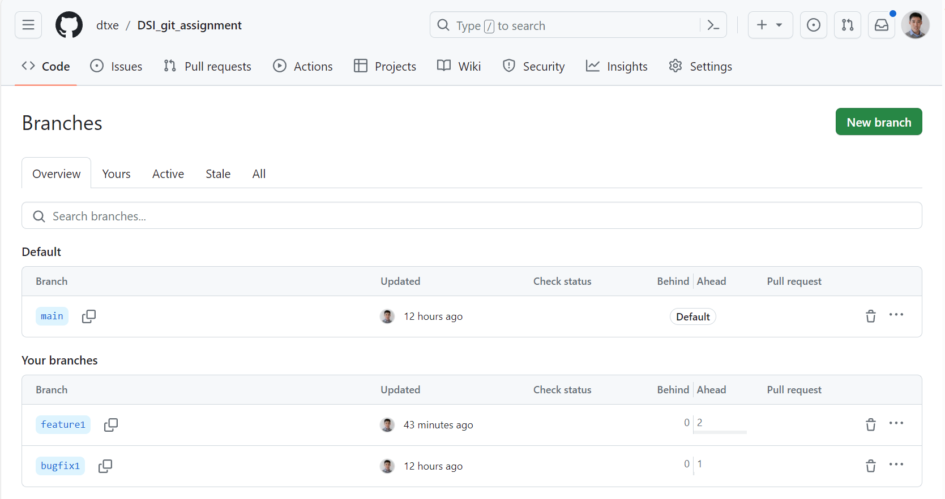
Branches on GitHub
Git: Branching
Quick overview of branch content relative to main
$> Let’s try it now!

Slide 16
Git fetch
Git: Branching
Ask git to download from remote repositories
Does not change your current working directory
Enables subsequent merge from or switch to remote branches
git fetch upstream newfeature
THEN git merge upstream/newfeature
OR git switch -c newfeature upstream/newfeature

Slide 17
Pull = Fetch + Merge
Git: Branching
The combined fetch and merge happens very often
Combined into the verb pull
git pull upstream newfeature
essentially performs:
git fetch upstream newfeature
git merge upstream/newfeature

Slide 18
Questions?

Slide 19
Git in VSCode
Git: Branching
Basic git commands are built-in with VSCode
Staging files, Commits, Branches
View relationship between git commits intuitively with Git Graph
$> Let’s try it now!

Slide 20
Questions?

Slide 21
Everything is a branch
Git: Branching
Including forks!
We can merge from local branches, forks, remote branches, etc…

Slide 22
Branch workflows
Git: Branching
Multiple long-running branches are helpful for large projects
Features are developed in their own branches, based on release commits
feature2
feature1
main
release

Slide 23
Branch workflows
Git: Branching
Branches can have various levels of stability
Code can graduate/merge from feature/topic branches when stable
Features can be developed in parallel and merged into main
feature2
feature1
main
release

Slide 24
Branch workflows
Git: Branching
Branches can be user forks too
user1/main
user2/feature1
main
release

Slide 25
Questions?

Slide 26
Merge conflicts
Git: Merge conflicts
Code might be modified in both branches that are being merged
Git does not know which change (or neither or both) should be kept
More recent is not always the right one!
Git will alert you that you need to step in.

Slide 27
$> Interactive live coding
Git: Merge conflicts
git switch main
Edit mycode, commit
git switch -c feature2
Edit mycode, commit
git switch main ; git merge feature2 ;
Resolve conflict, complete merge
Manually edit to remove the merge conflict indicators.
nano mycode
git commit –am “resolve merge conflict”

Slide 28
Questions?

Slide 29
.gitignore
Git: Ignoring files
Why?
Large data files, intermediate output, secret keys, etc…
Defined in the .gitignore file
Specify path with wildcards
Best practice: use existing .gitignore templates
Find them on GitHub: https://github.com/github/gitignore/blob/main/Python.gitignore

Slide 30
Course objective
How to write robust software in a team that we, our colleagues, and the public can trust and use with confidence.

Slide 31
Homework #2
Due tomorrow before class
Clone a repo, merge some branches, resolve a conflict
This homework is also part of the Git Assignment
Detailed instructions on the GitHub repo

