Slide 1
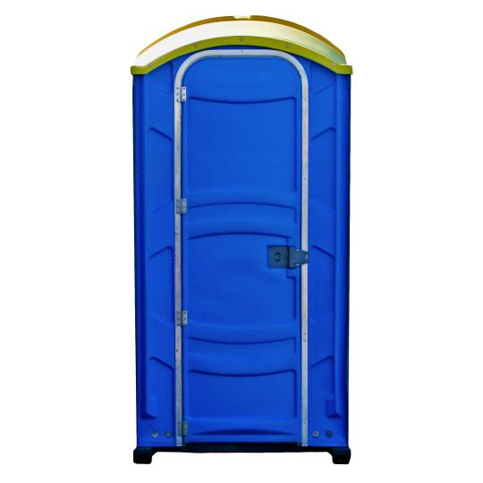
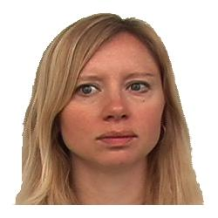
In this task you will be vividly imagining each object interacting with a person or scene.
After imagining the pair for 5 seconds, you will rate how vividly you are able to imagine the person/scene and object on a scale from 1 (not vivid at all) to 7 (very vivid).
You will have 5 seconds to select your response using the 1-7 number keys. After selecting your response press Enter to submit your answer.
2 3 4 5 6 7
not vivid very vivid
Press any key to begin

