Slide 1







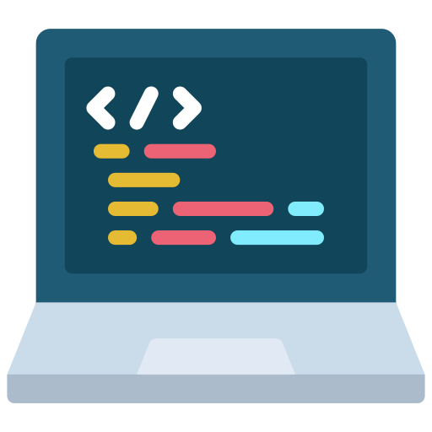
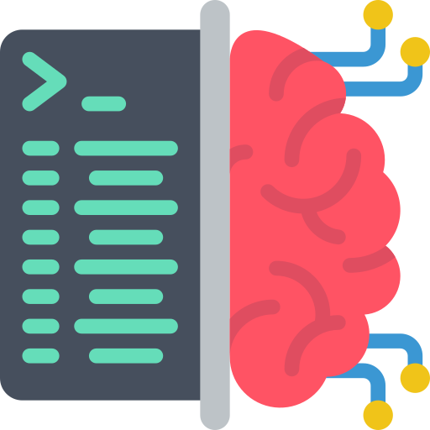

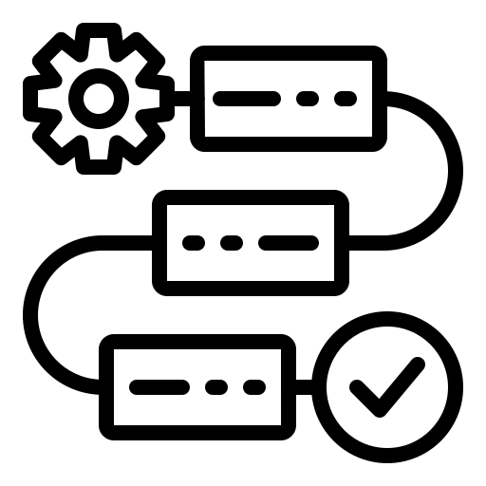
What can we do (today)?
Provides LLMs
Leverages LLMs
ChatGPT
Claude
Gemini
GitHub Copilot
Ollama
OpenClaw
Not all tools can do all tasks. But users can get the most from them when combining them,
Both Ollama and OpenClaw allow running local LLMs
Writing/ Searching
Programming
Data Processing (models)
Image Generation
Agentic workflows
george.vegayon@utah.edu -- https://ggvy.cl

