Slide 1
Android Mobile development
Theodore Chaikalis MSc Phd
chaikalis.gr
chaikalis@uom.edu.gr
Notes:
android studio installation
phone drivers
Building a Simple User Interface
Starting Another Activity
Activity Lifecycle

Slide 2
Info
Apps for mobile devices (Smartphones, tablets)
Android programming framework (mostly java & xml)
Hands on ONLY
Use of Git Version Control through GitHub

Slide 3
Info (2)
Our Projects will be stored here:
https://github.com/UomMobileDevelopment
Useful tools
Git - https://git-scm.com/
Java jdk - http://www.oracle.com/technetwork/java/javase/downloads/jdk8-downloads-2133151.html
Android Studio - https://developer.android.com/studio/index.html

Slide 4
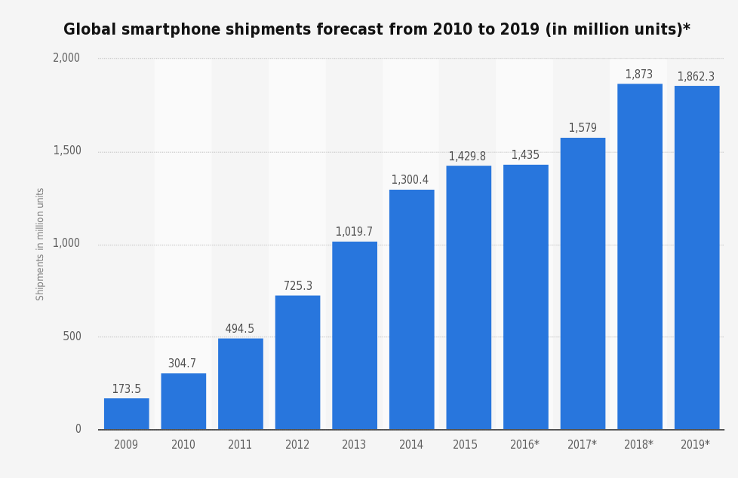

Slide 5
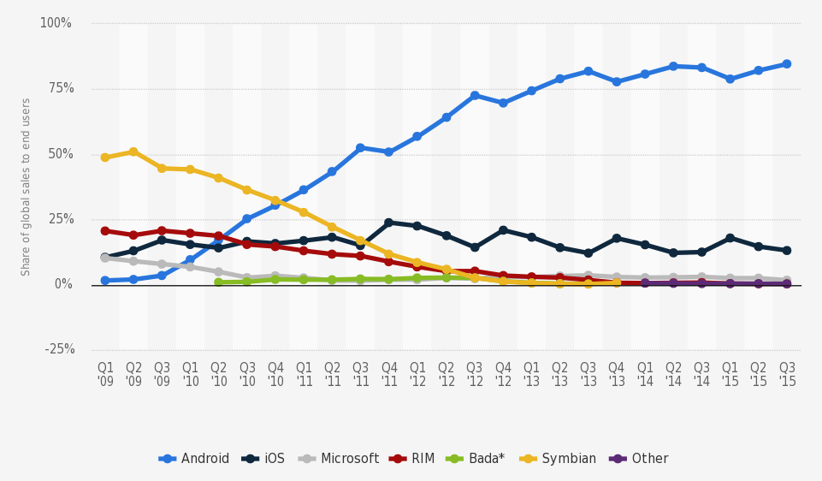

Slide 6
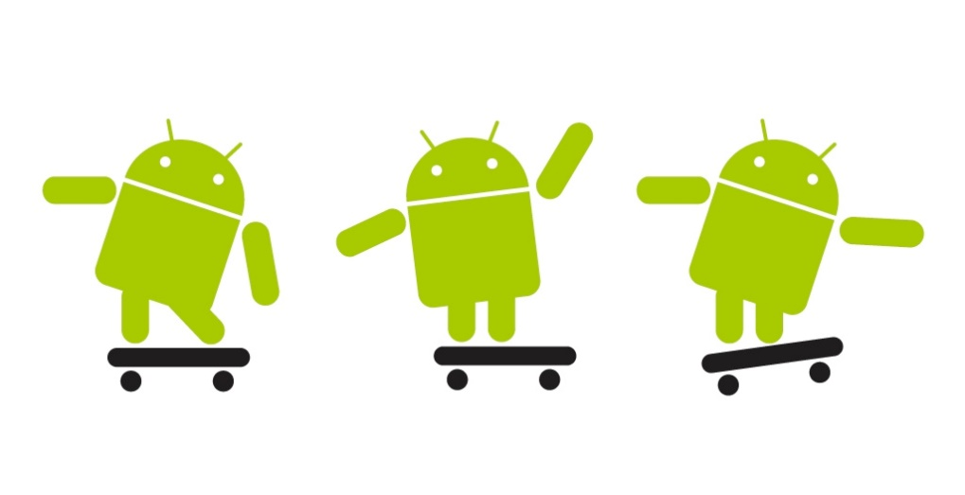
Σχετικά με το μάθημα (3)
Android Development

Slide 7
Today’s topics
Android Studio Configuration
Android SDK
Emulator
Git – BitBucket
Hello World App
Activity basics
XML files

Slide 8
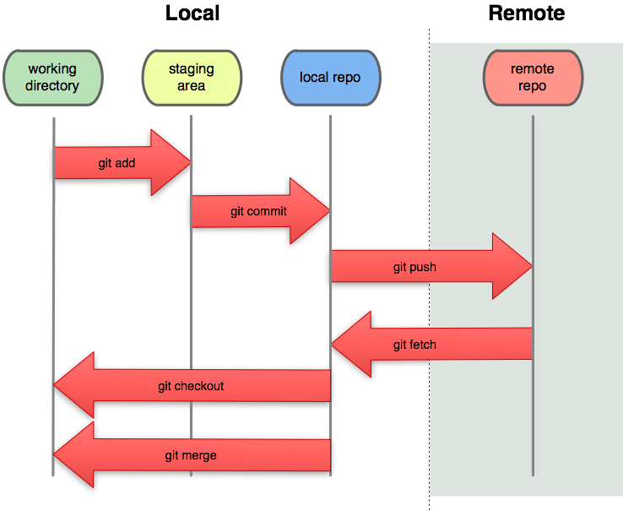
Git work flow
Initialize git repository
Work locally
Add / edit files
Commit changes
PUSH changes to remote

Slide 9
Git

Slide 10
BitBucket
Everybody should crate an account
Will be our codebase

Slide 11
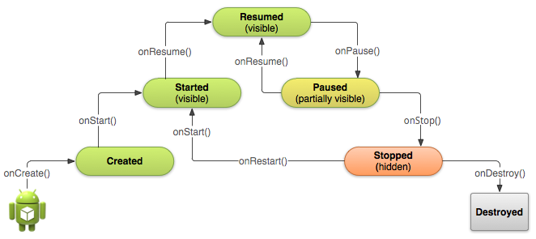
Activity Lifecycle
Notes:
Depending on the complexity of your activity, you probably don't need to implement all the lifecycle methods. However, it's important that you understand each one and implement those that ensure your app behaves the way users expect. Implementing your activity lifecycle methods properly ensures your app behaves well in several ways, including that it:
Does not crash if the user receives a phone call or switches to another app while using your app.
Does not consume valuable system resources when the user is not actively using it.
Does not lose the user's progress if they leave your app and return to it at a later time.
Does not crash or lose the user's progress when the screen rotates between landscape and portrait orientation.

