Slide 1
Mobile Development
7^{ο} Μάθημα

Slide 2
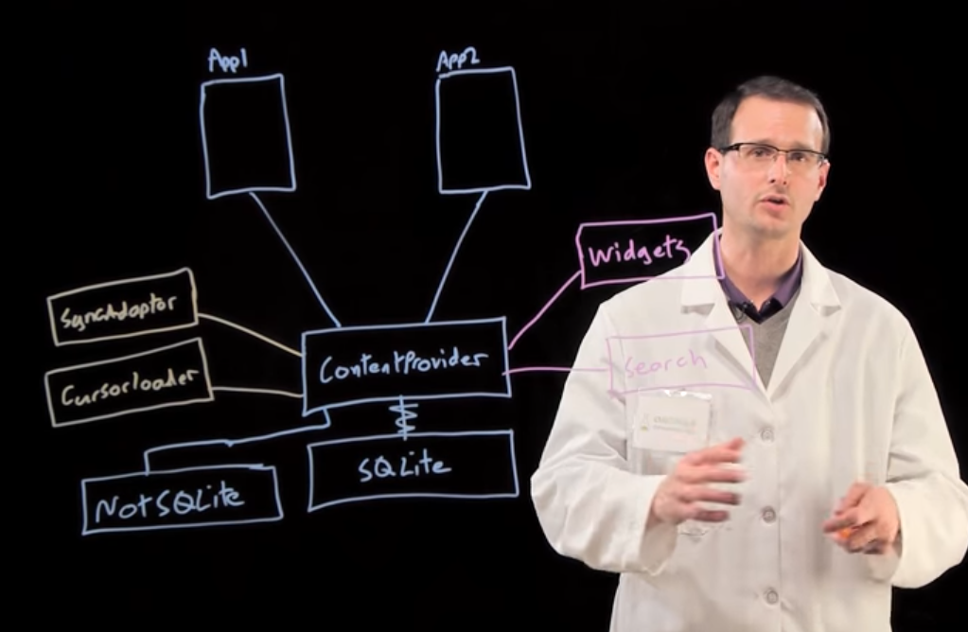
Content Providers

Slide 3
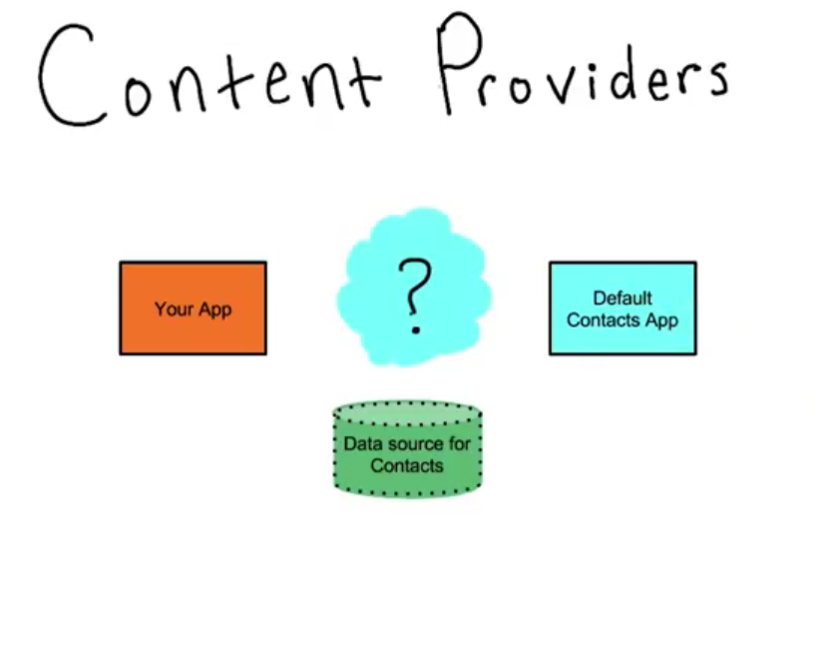
What is a content provider?

Slide 4
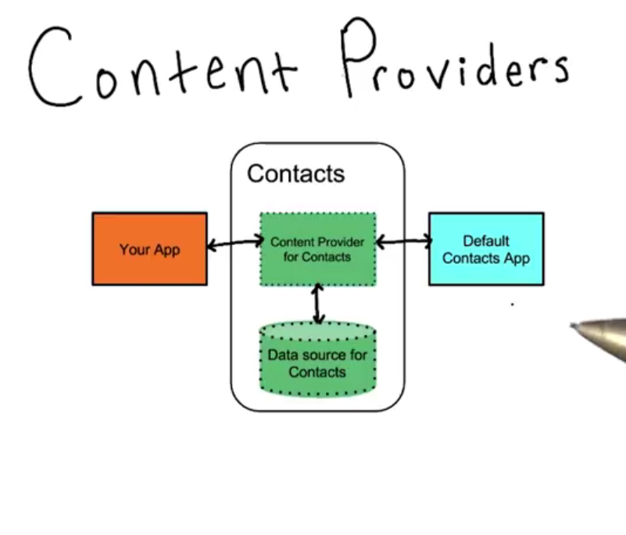
What is a content provider?

Slide 5
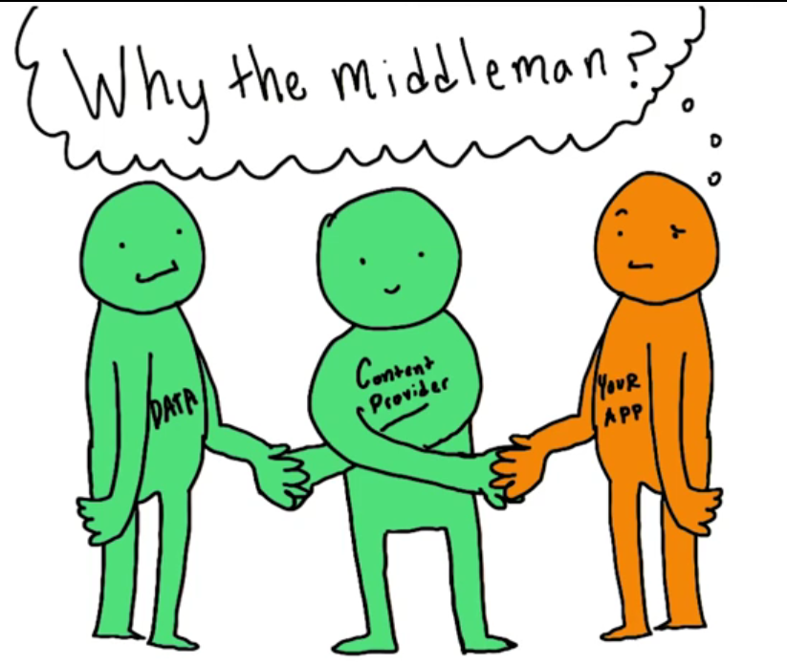
Do I need them?

Slide 6
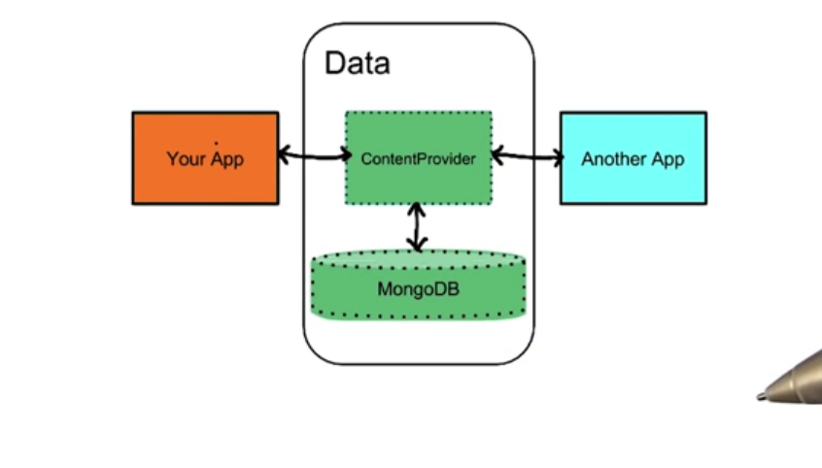
Do I need them?

Slide 7
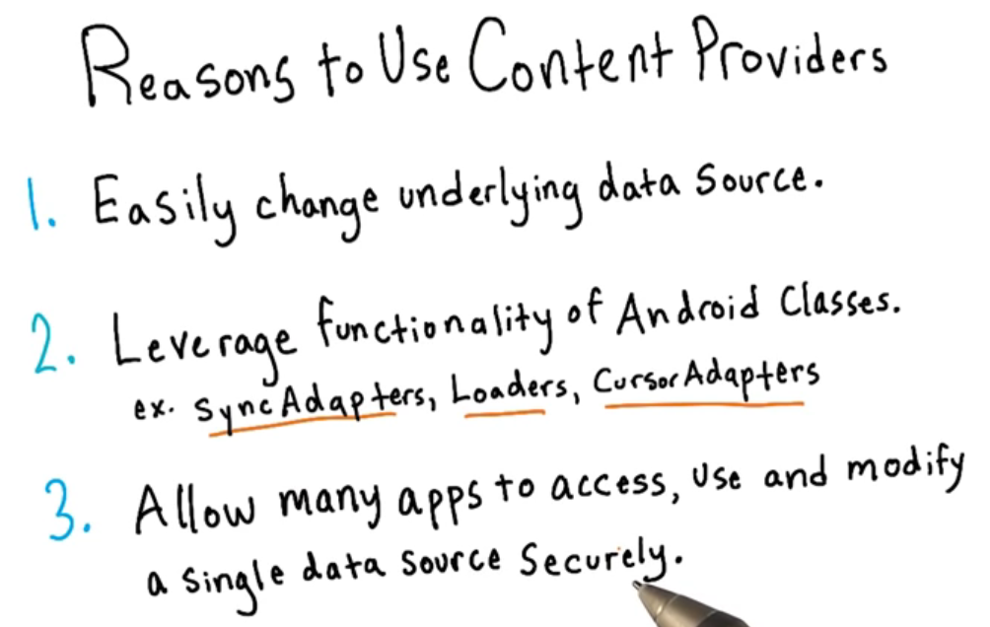
Do I need them?

Slide 8
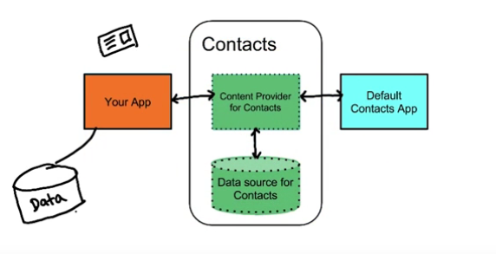
Do I need them?

Slide 9
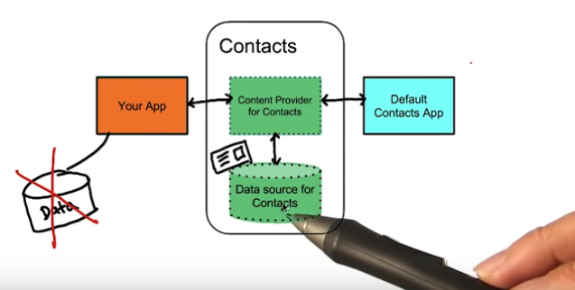
Do I need them?

Slide 10
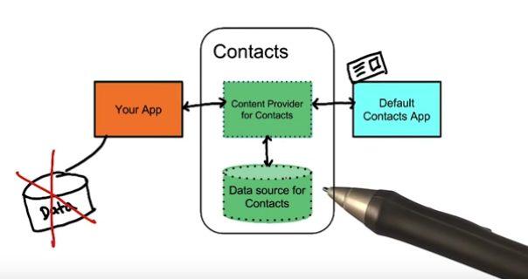
Do I need them?

Slide 11
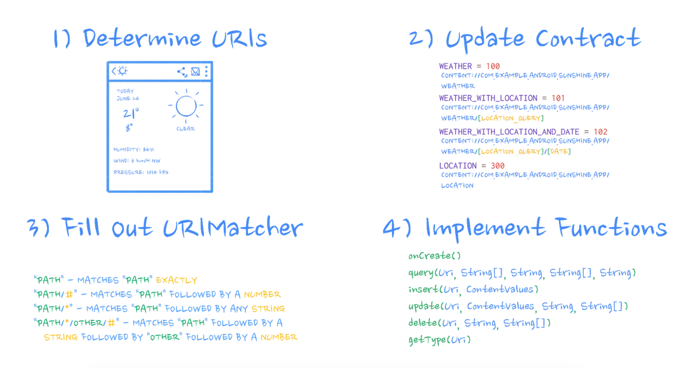
Our Content Provider: Weather Provider
Provider
Lesson: https://classroom.udacity.com/courses/ud258/lessons/3372188753/concepts/34096686680923#

Slide 12
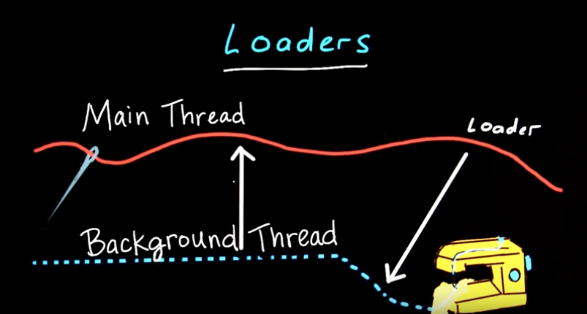
Loaders
Loaders Are Awesome
AsyncTaskLoader is a Loader that uses an AsyncTask behind the scenes to do its work.

Slide 13
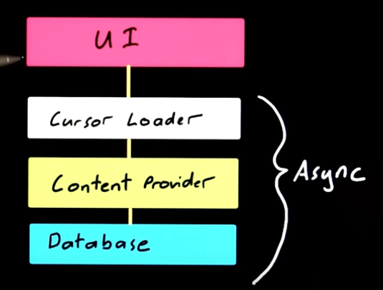
Loaders
- Είναι ο καλύτερος τρόπος φόρτωσης δεδομένων στο UI
- Μπορούν να παρακολουθούν την πηγή των δεδομένων έτσι ώστε να ανανεώνουν το UI όταν πρέπει

Slide 14
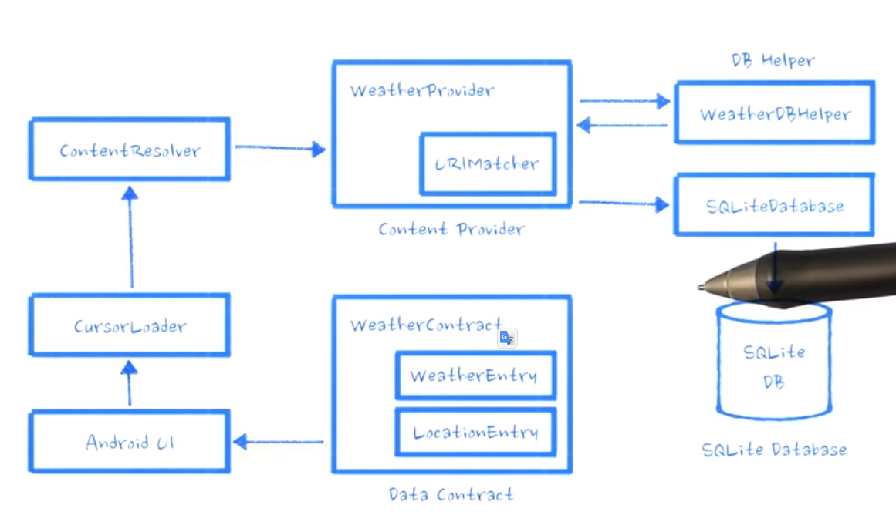
CursorLoader με WeatherProvider

Slide 15
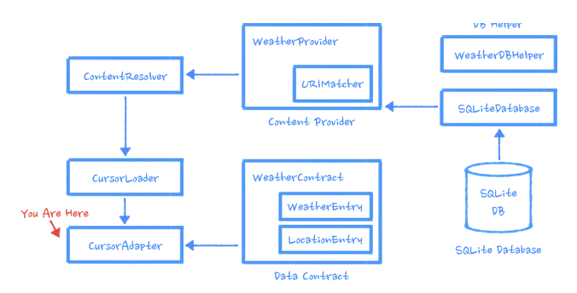
CursorLoader με WeatherProvider
List view

Slide 16
Refactoring Forecast Fragment to prepare it for Loader

Slide 17
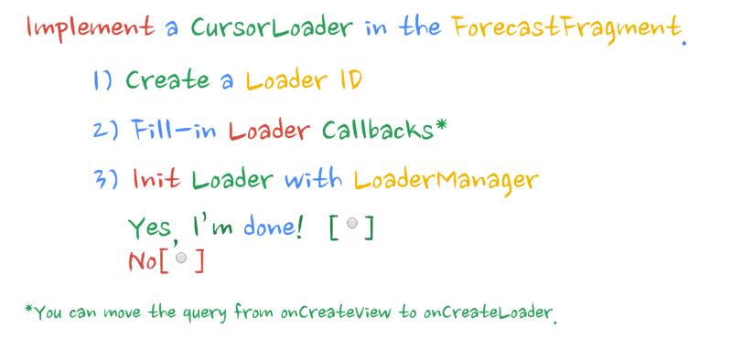
Χρήση Loader στην Forecast Fragment
see section: Use of Loaders in Forecast Fragment

