Slide 1
Mobile Development
7^{ο} Μάθημα

Slide 2
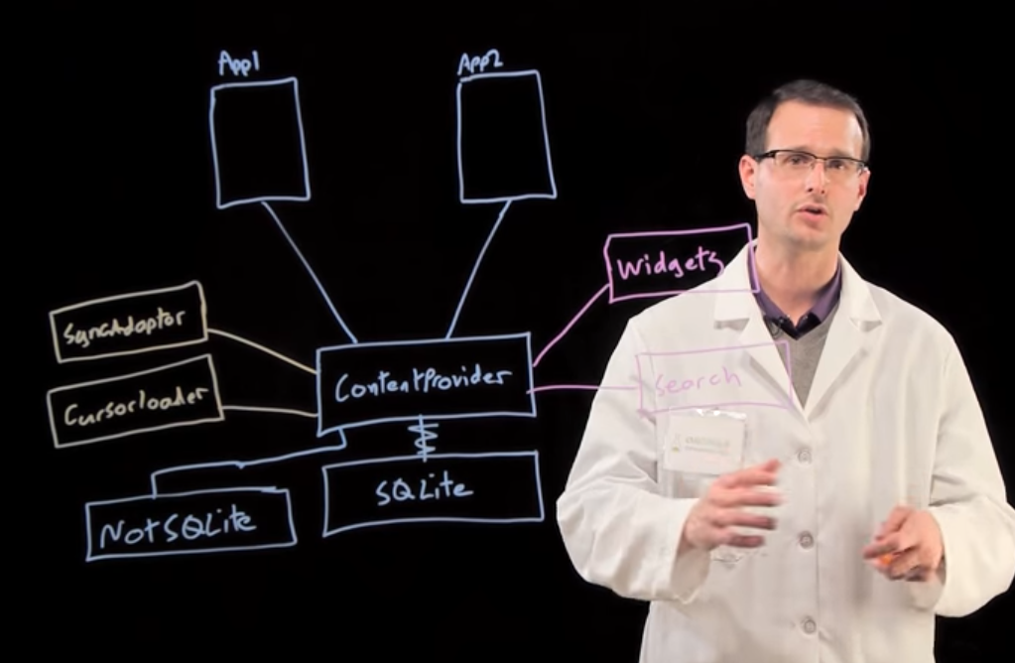
Content Providers

Slide 3
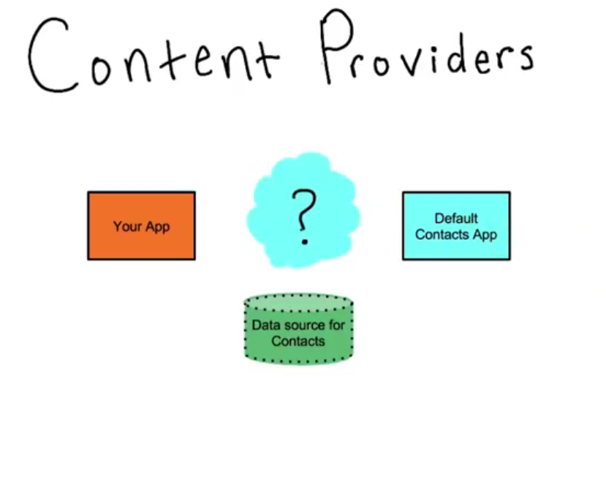
What is a content provider?

Slide 4
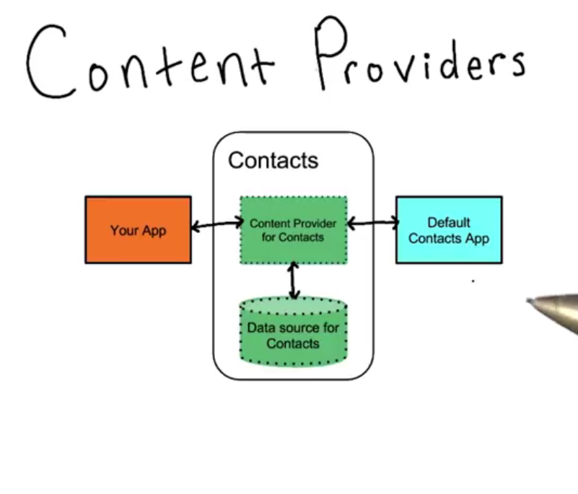
What is a content provider?

Slide 5
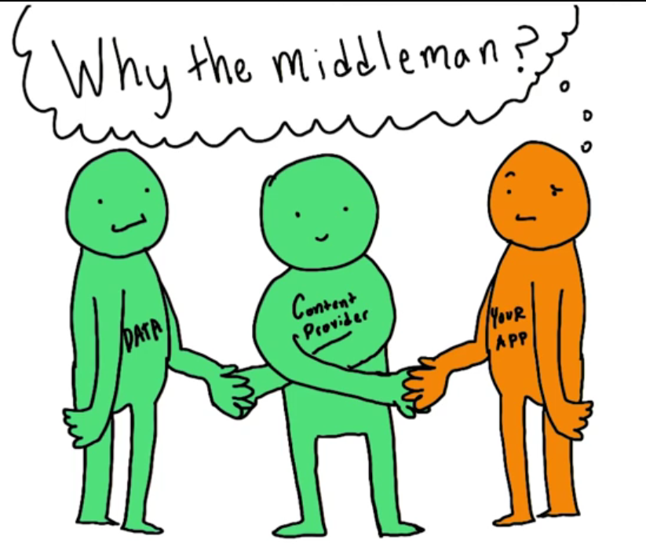
Do I need them?

Slide 6
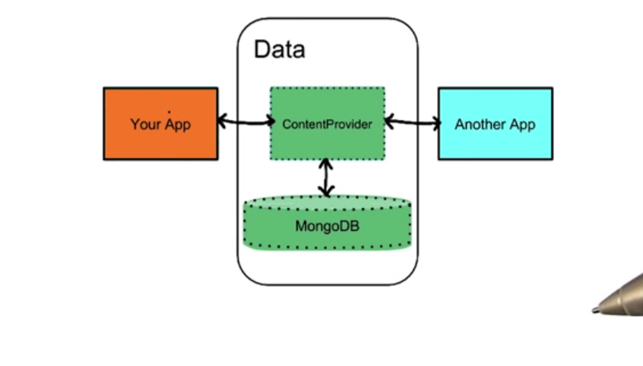
Do I need them?

Slide 7
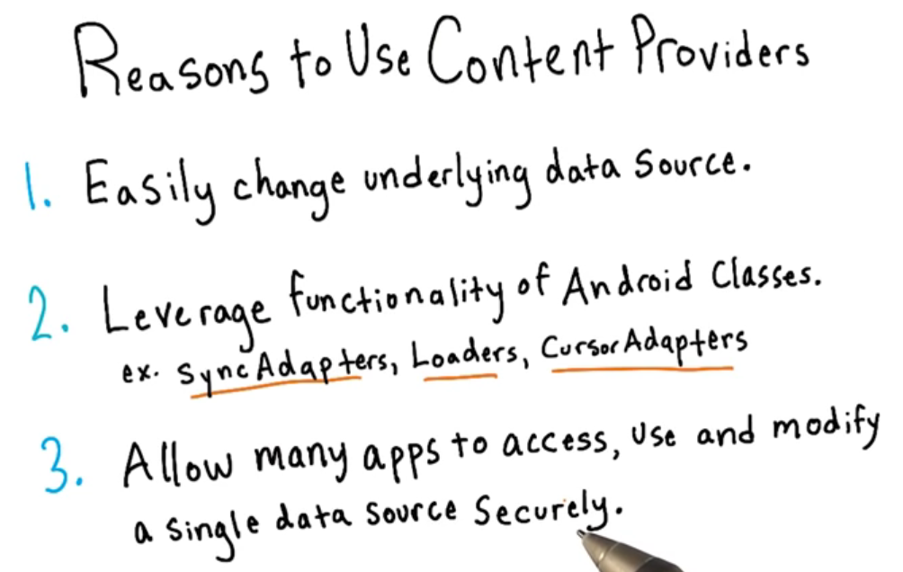
Do I need them?

Slide 8
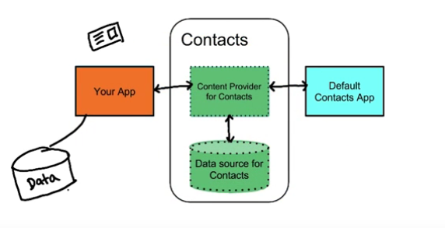
Do I need them?

Slide 9
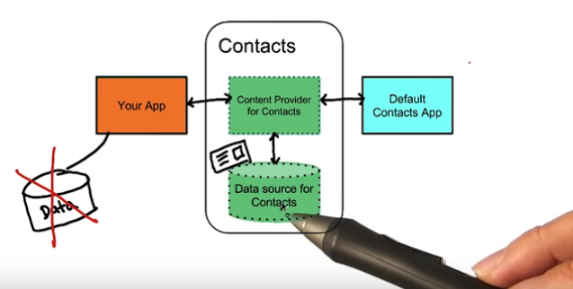
Do I need them?

Slide 10
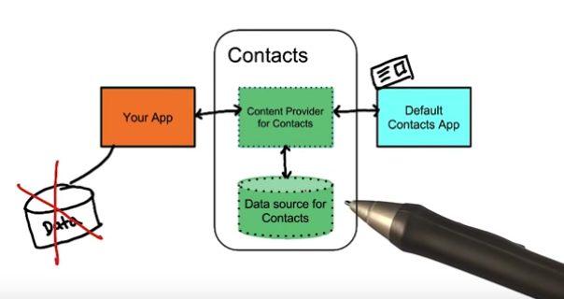
Do I need them?

Slide 11
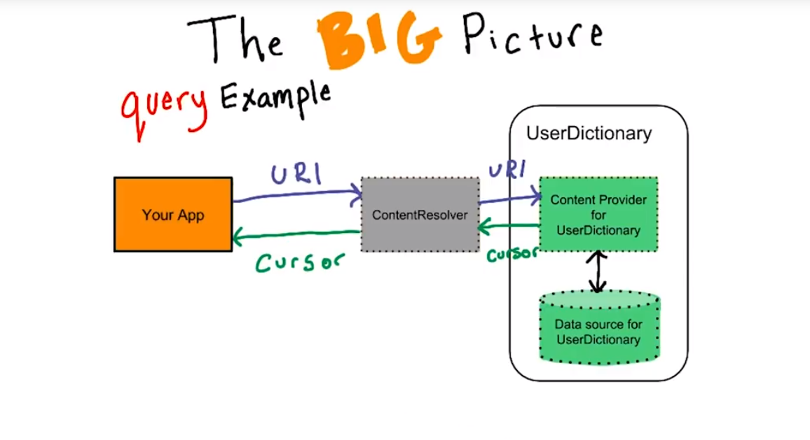
Do I need them?

Slide 12
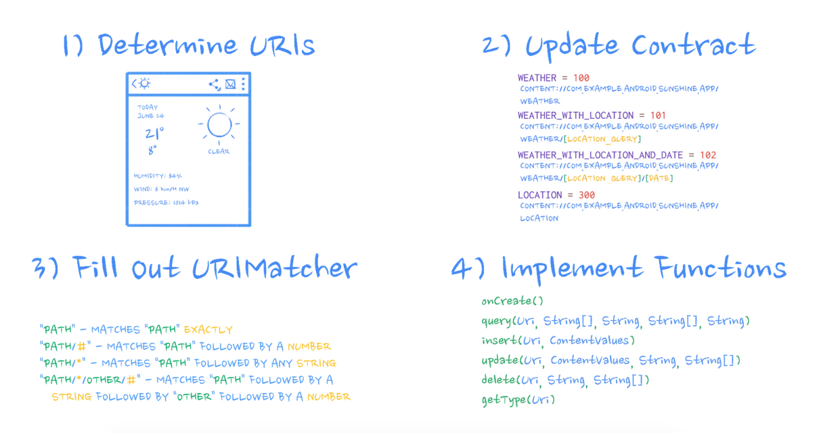
Our Content Provider: Weather Provider
Provider
Lesson: https://classroom.udacity.com/courses/ud258/lessons/3372188753/concepts/34096686680923#

Slide 13
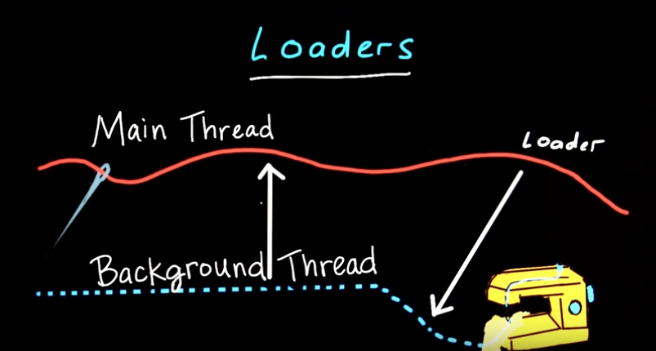
Loaders
Loaders Are Awesome
AsyncTaskLoader is a Loader that uses an AsyncTask behind the scenes to do its work.

Slide 14
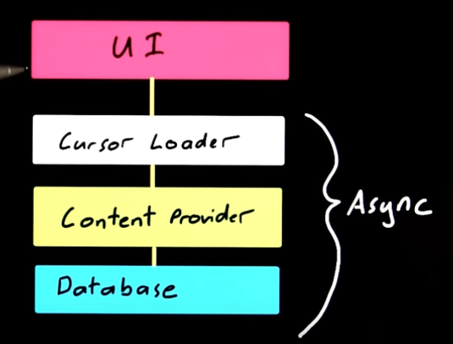
Loaders
- Είναι ο καλύτερος τρόπος φόρτωσης δεδομένων στο UI
- Μπορούν να παρακολουθούν την πηγή των δεδομένων έτσι ώστε να ανανεώνουν το UI όταν πρέπει

Slide 15
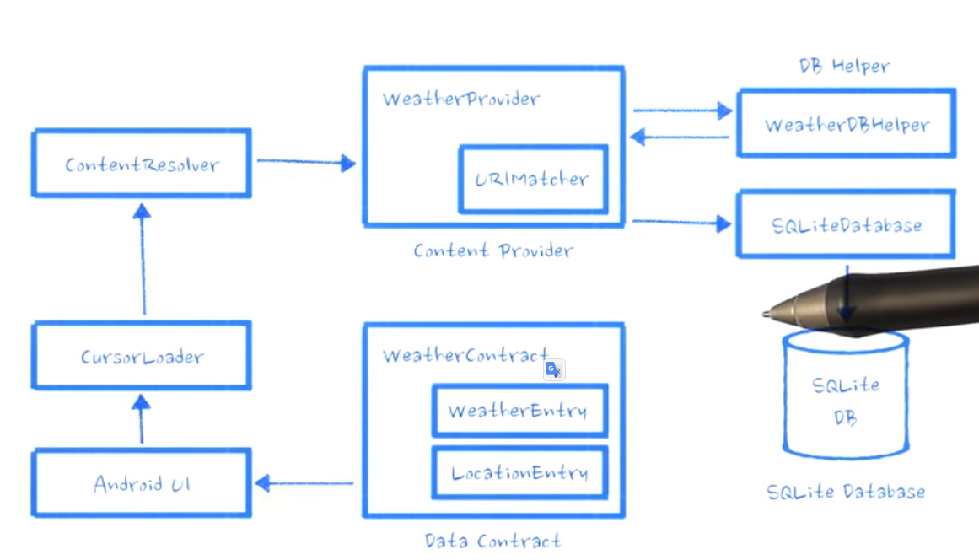
CursorLoader με WeatherProvider

Slide 16
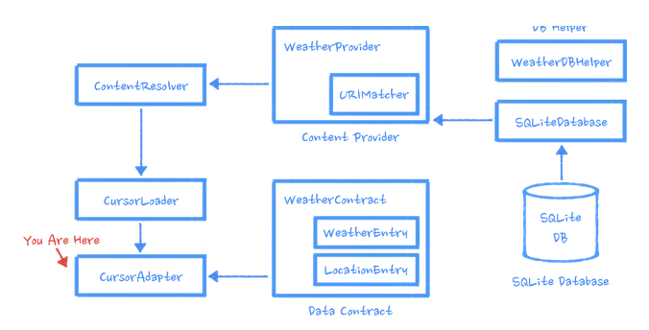
CursorLoader με WeatherProvider
List view

Slide 17
Introduce Weather Provider
Get code from here:
https://github.com/udacity/Sunshine-Version-2/tree/lesson_4_content_provider_starter_code
TestProvider.java
TestUriMatcher.java
TestWeatherContract.java
should be put in app/src/androidTest/java/com/example/android/sunshine/app/data:
TestFetchWeatherTask.java
should be put in app/src/androidTest/java/com/example/android/sunshine/app/
WeatherProvider.java
should be put into app/src/main/java/com/example/android/sunshine/app/data
FetchWeatherTask.java
should be placed here /app/src/main/java/com/example/android/sunshine/app

Slide 18
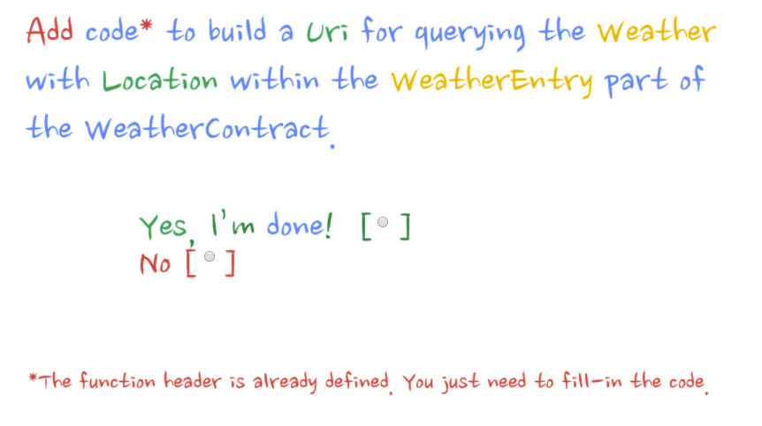
Exercise
Notes:
Please Uncomment the following in TestWeatherContract
testBuildWeatherLocation

Slide 19
Uri Matcher

Slide 20
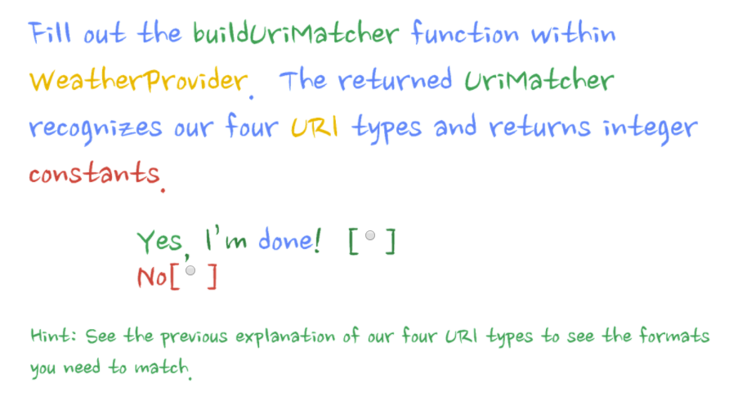

Slide 21
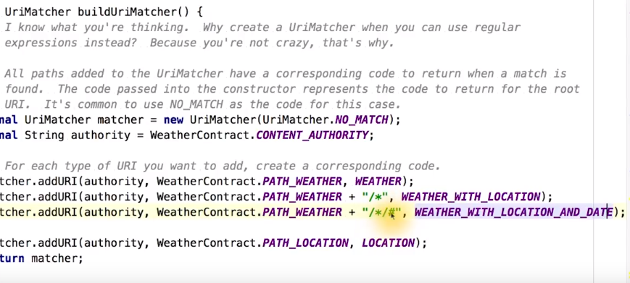

Slide 22
Refactoring Forecast Fragment to prepare it for Loader

Slide 23
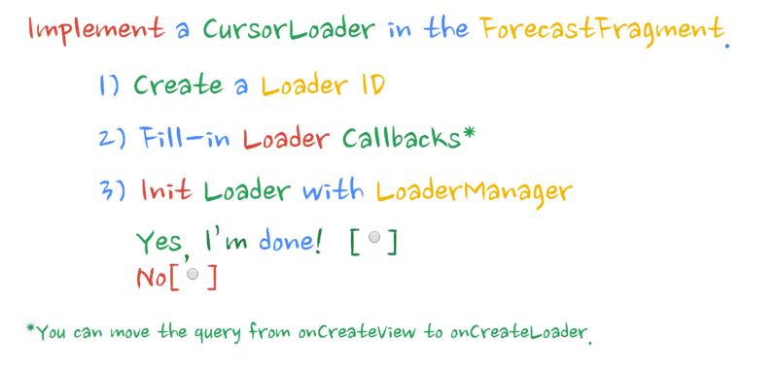
Χρήση Loader στην Forecast Fragment
see section: Use of Loaders in Forecast Fragment

