Slide 1
Book Inventory Management System
Xie Wenhao (Group Leader)
Mario Uesaka

Slide 2


The bottleneck / Solution

Slide 3
Project Review
Implemented Function
1. Search function that matches partial or full title/author.
2. Book sorting function.

Slide 4
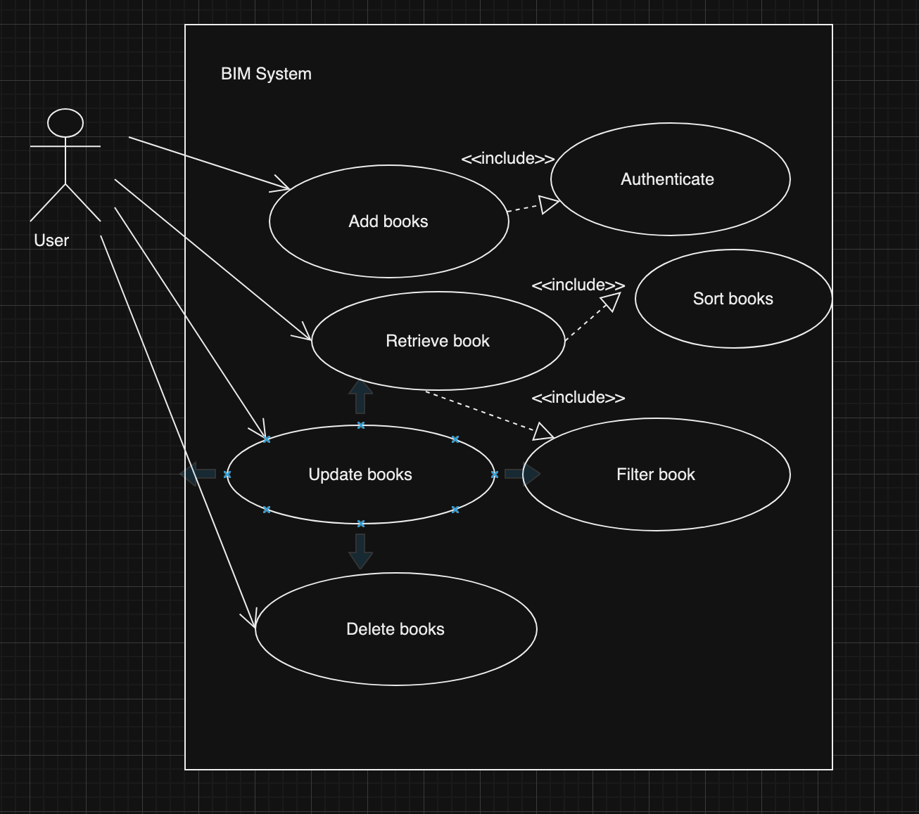
Use case diagram
Functional behaviour of the system
A user interacts with the BIM system
The system allows:
Add, Retrieve, Delete and Update

Slide 5
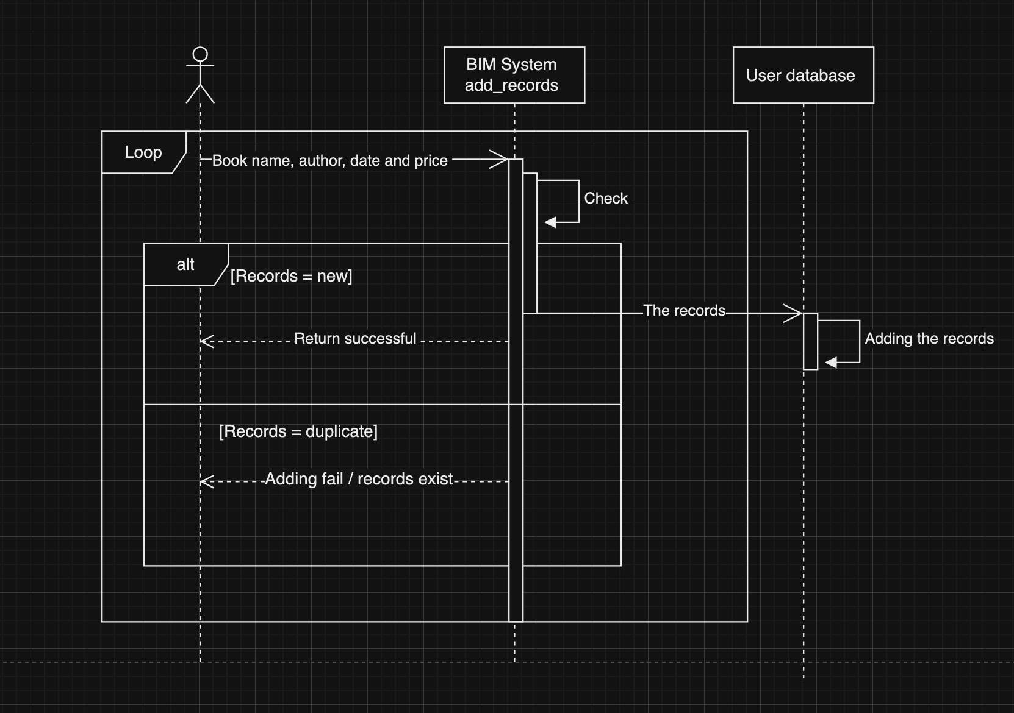
Sequence Diagram / Add function

Slide 6
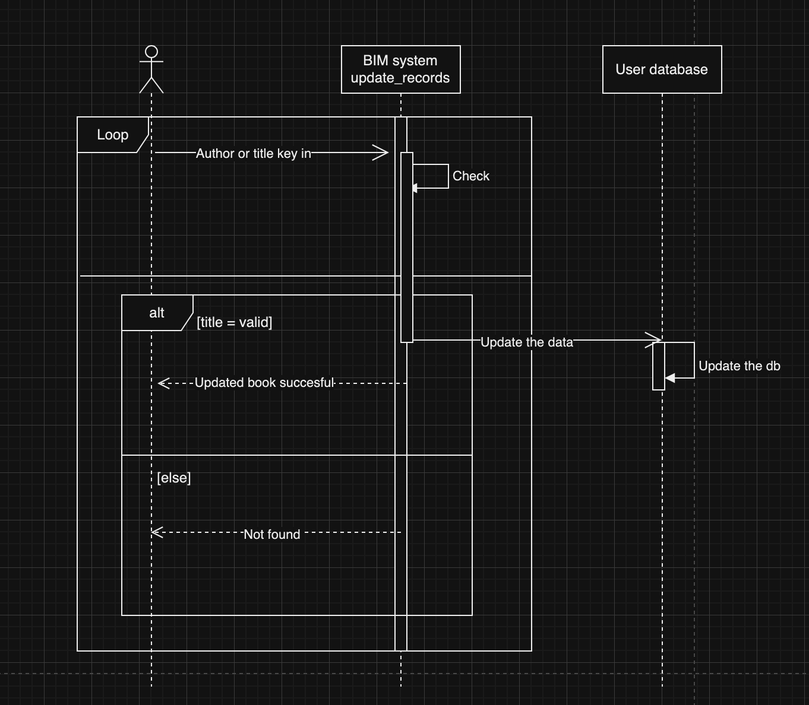
Sequence Diagram / Update feature

Slide 7
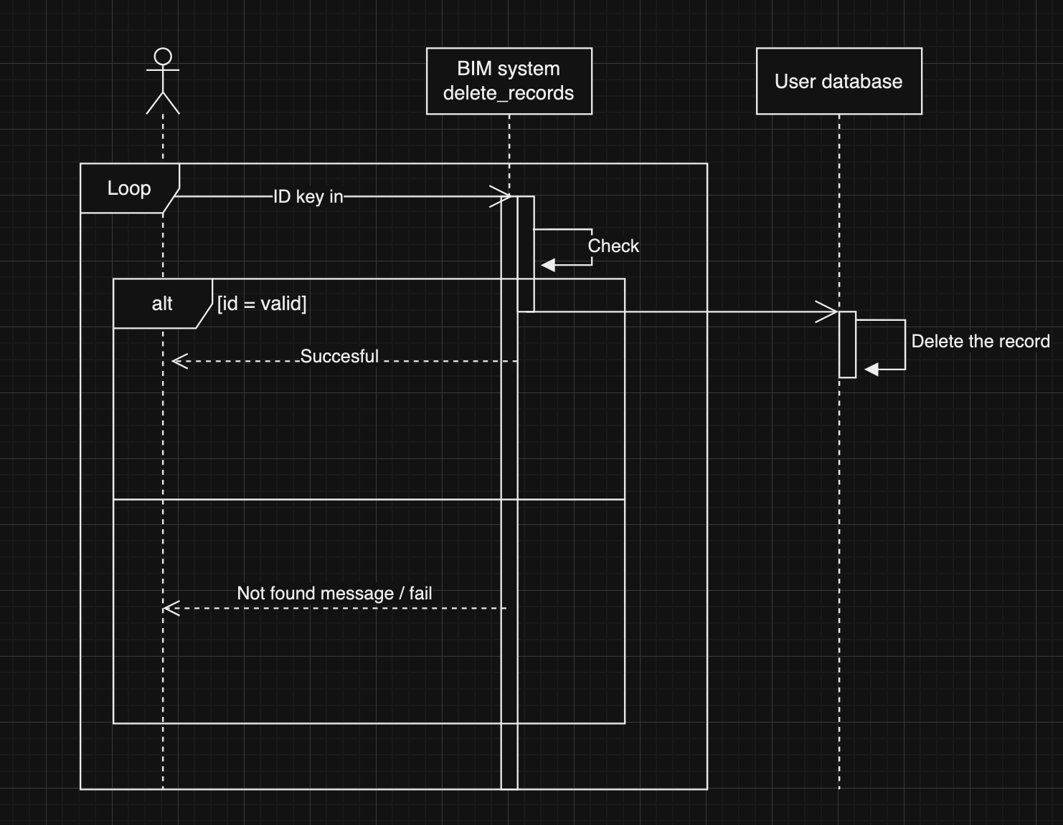
Sequence Diagram / Delete feature

Slide 8
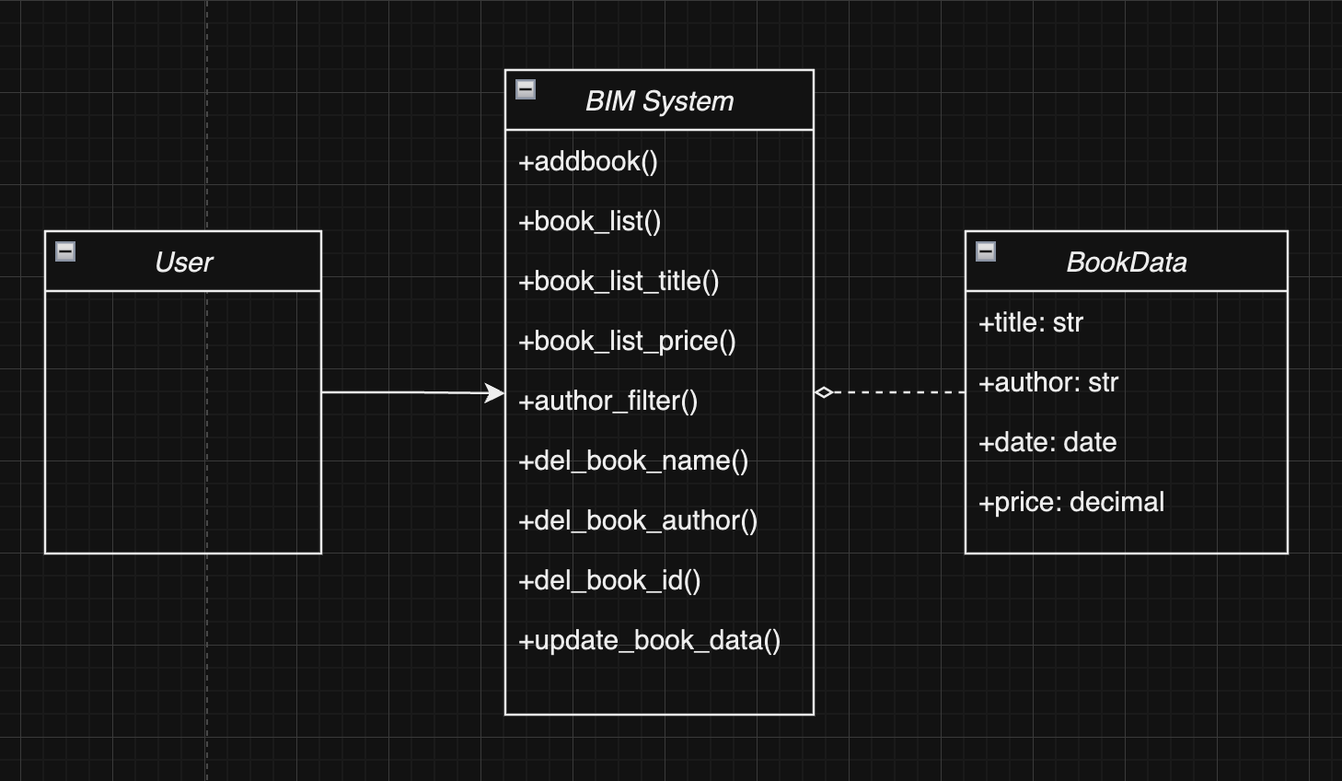
Class Diagram
Notes:
The relationship between the user and the BIM system is wrong

Slide 9
Enhancement
1.Adjusted the input method to improve program readability and usability.
2.Merged the book deletion by ID function and removed extra features.

Slide 10
Demo

Slide 11
New Function Introduction
Book addition function using the Google Books API.
User can enter only the book title or author and use the Google Books API to automatically complete the remaining book details.
URL:http://127.0.0.1:8000/add/?title=<partial or full title>(&author=<author>)

Slide 12
New Function Introduction
Feature for adding multiple books
Users can add multiple books at once by entering a list.
URL:http://127.0.0.1:8000/adds/?books=<list>

Slide 13
New Function Introduction
Feature for deleting multiple books
Users can delete multiple books at once by entering the title or ID.
URL:http://127.0.0.1:8000/dels/?title=<title>&id=<id>

