Slide 1
Online Auction

Slide 2
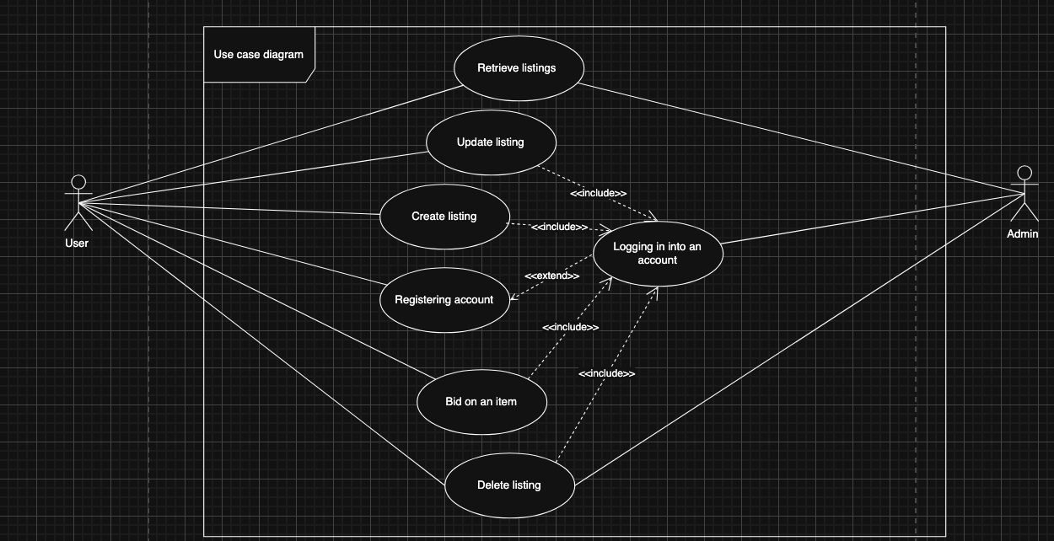
Use Case

Slide 3
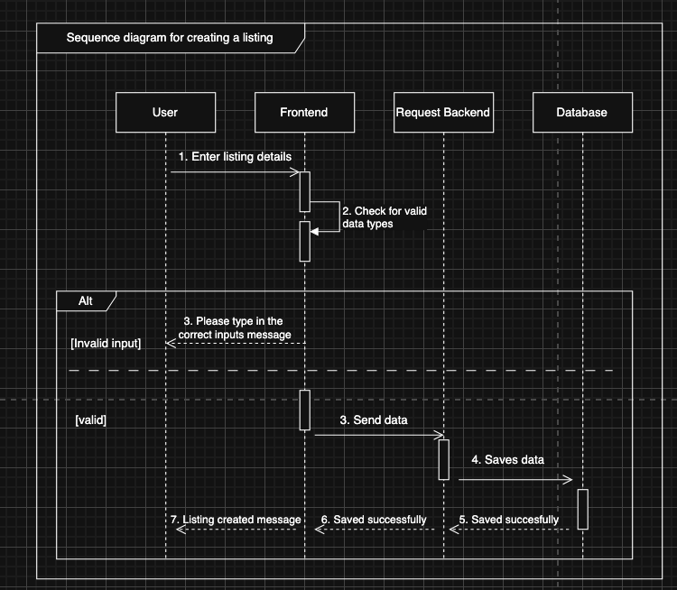
Sequence Diagram: Creating an item

Slide 4
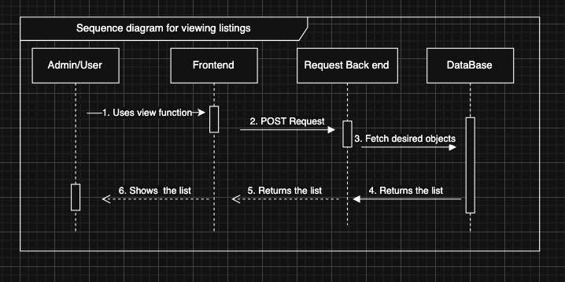
Sequence Diagram: Retrieving an item

Slide 5
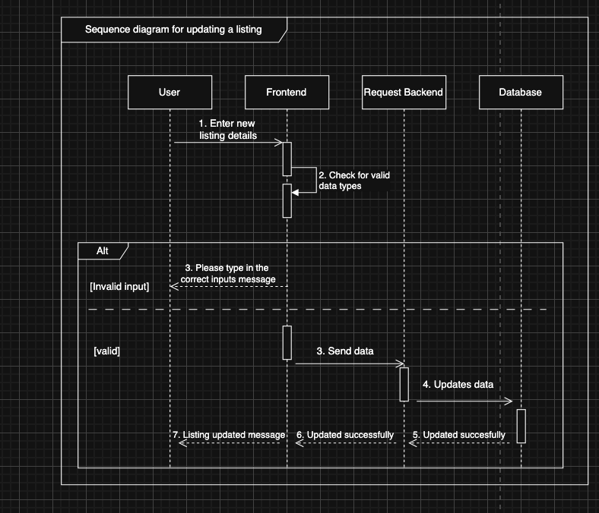
Sequence Diagram: Updating an item

Slide 6
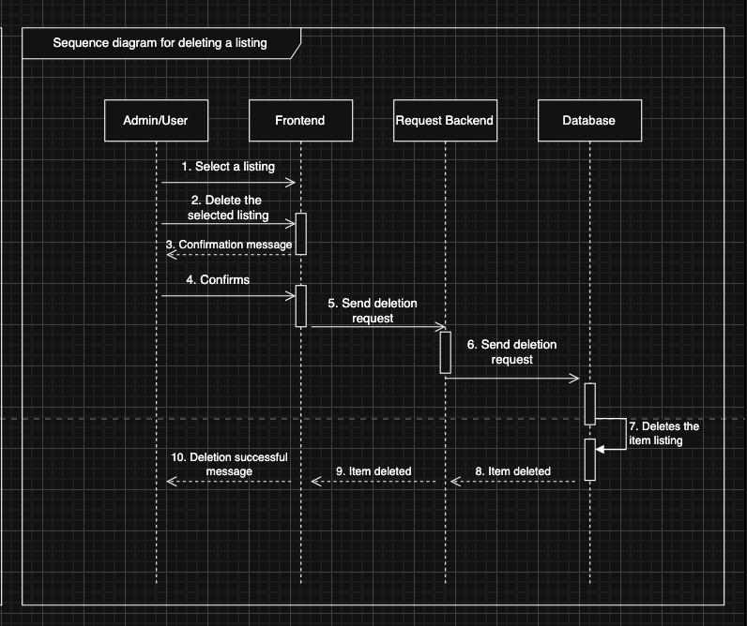
Sequence Diagram: Deleting an item

Slide 7
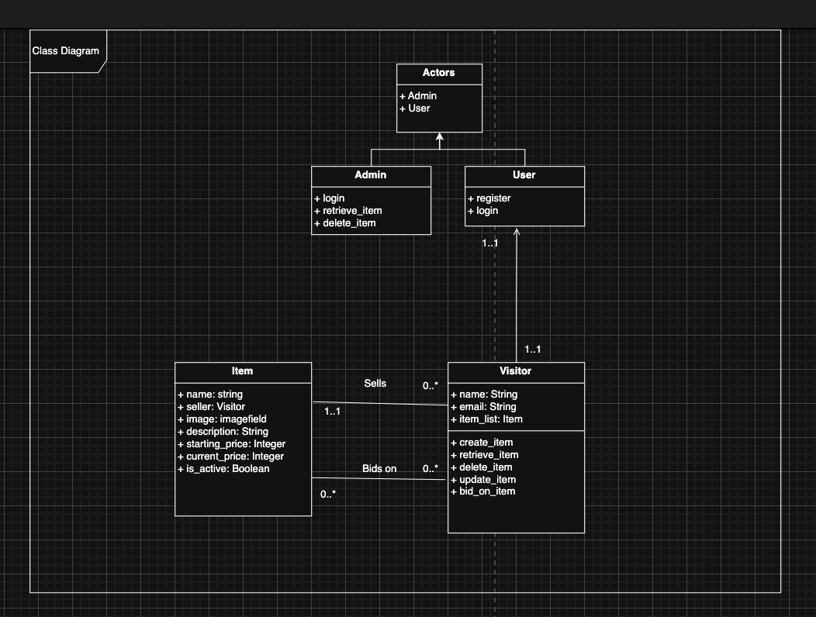
Class Diagram

Slide 8
Demo

