Slide 1

Indian Institute of Technology Kharagpur
Department of Energy Science and Engineering | BTP2 — Spring Semester 2025-26
KGMiner
Enhanced Knowledge Graph Mining with Ontology-Constrained Multi-Pass Extraction and Graph-RAG for Scientific Literature
Upanshu Jain | Roll No: 22BT10035
4,722
2,996
Supervisor: Prof. Amit Ghosh
Typed Triples
Unique Entities
Mentor: Mr. Sayan Saha Roy (PhD Scholar)
226
+170.6%
PubMed Articles
Recall Gain
Biotechnology and Biochemical Engineering

Slide 2
Presentation Outline
1
Background & Motivation
BTP1 achievements and identified gaps
2
Objectives of BTP2
Four core limitations to address
3
KGMiner Pipeline
6-stage automated architecture
4
Key Results
4,722 triples, 170.6% recall gain, Graph-RAG
5
Query Output Comparison
BTP1 vs KGMiner verbatim response
6
Conclusion & Future Work
Contributions and next steps

Slide 3
Background: BTP1 (NEKO Implementation)
What we achieved — and what remained unsolved
✓ BTP1 Achievements
✗ Critical Gaps Identified
▸ Implemented NEKO workflow locally (free-tier LLMs)
▸ Processed 1,088 Rhodococcus abstracts from PubMed
▸ Built knowledge graph with 180+ unique nodes
▸ Demonstrated advantage over zero-shot GPT-4 queries
▸ Validated data provenance and traceability
▸ Untyped relationships — no activation vs inhibition
▸ Single-pass extraction missed secondary details
▸ Keyword-only queries — required exact entity names
▸ Hallucination risk in answer synthesis
▸ No quantitative metric capture
BTP2 Goal: Directly address each of these 4 limitations through the KGMiner architecture.

Slide 4
Objectives of BTP2
Four targeted architectural improvements
01
02
Ontology-Constrained Triple Extraction
Multi-Pass Extraction with Refinement
Replace untyped associations with (Subject, Relation, Object) triples using a 13-relation controlled biological vocabulary
Apply 3 sequential extraction passes + 1 independent validation pass per abstract to improve recall
03
04
Graph-RAG Querying with Semantic Search
Anti-Hallucination Answer Generation
Enable full natural-language queries via embedding-based semantic search over 4,722 typed triple embeddings
Trace every claim in generated answers to specific extracted triples and source PMIDs — no ungrounded synthesis

Slide 5
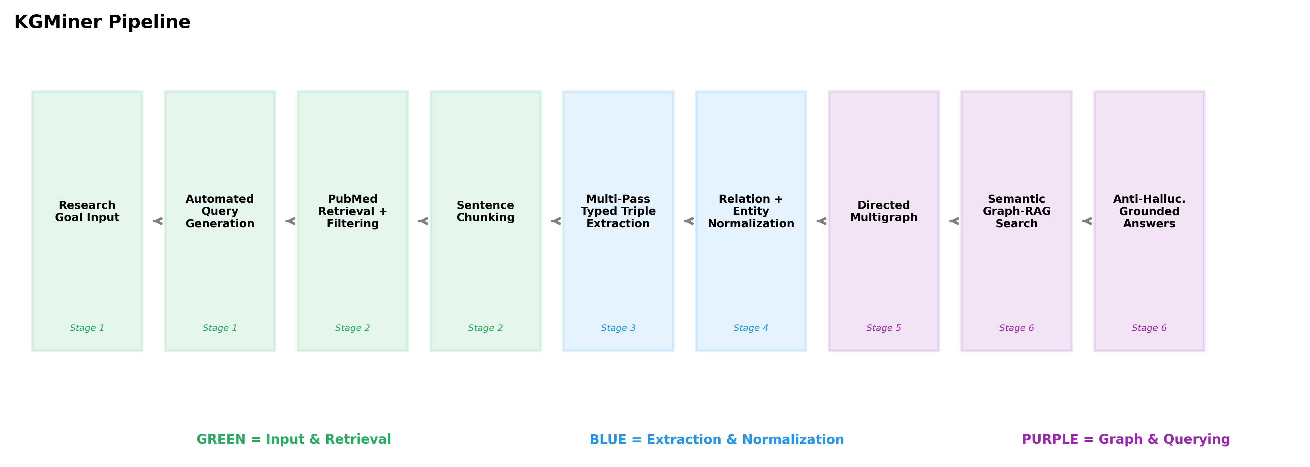
KGMiner: 6-Stage Pipeline Architecture
Stage 1
Stage 2
Stage 3
Stage 4
Stage 5
Stage 6
Automated Query Gen
→
Literature Retrieval
→
Ontology Extraction
→
Normaliz- ation
→
Graph Construction
→
Graph-RAG Querying
LLM decomposes research goal → 3 PubMed queries
PubMed Entrez API with relevance filtering
3-pass LLM extraction 13-relation vocabulary
Embedding-based entity deduplication + chains
NetworkX directed multigraph with typed edges
Semantic search + anti- hallucination synthesis

Slide 6
Controlled Ontology: 13-Relation Biological Vocabulary
Replaces untyped associations with semantically typed predicates
activates
A → promotes activity of B
inhibits
A → suppresses activity of B
produces
A → synthesizes compound B
encodes
Gene A → encodes protein B
is_a
A → is a subtype/class of B
has_capability
Organism A → can perform B
increases
A → upregulates quantity of B
decreases
A → downregulates quantity of B
has_metric
Entity A → has measured value B
integrated_in
Gene/pathway A → embedded in B
is_host_for
Organism A → hosts pathway/gene B
is_variant_of
Strain A → variant of organism B
depends_on
Process A → requires factor B
Result: 73.5% of 4,722 triples use canonical vocabulary • 41 raw relation synonyms → 13 canonical types • 26.5% non-canonical captured as extended triples

Slide 7
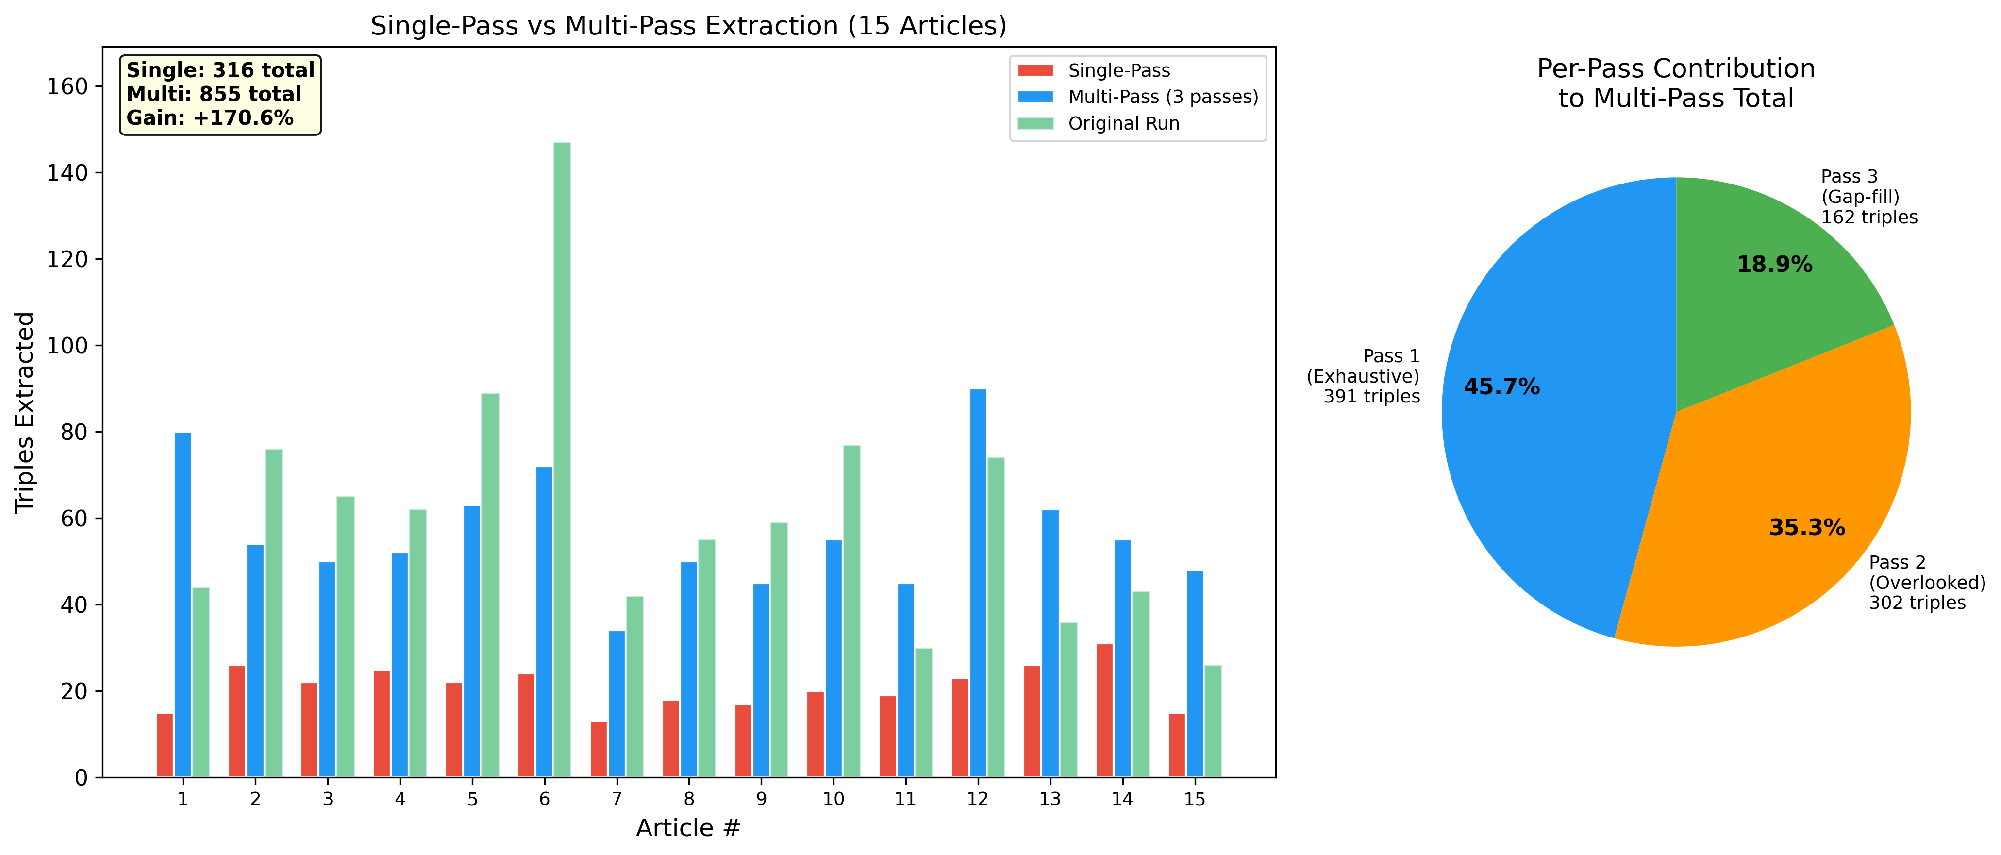
Multi-Pass Extraction: Closing the Recall Gap
3 sequential passes + 1 independent validation pass per abstract
Pass Design
Pass 1 — Exhaustive
Extract ALL entity-relation triples from the full abstract
Pass 2 — Overlooked Scan
Re-read abstract focusing on secondary/implied relationships missed in Pass 1
Pass 3 — Gap-Filling
Extract implied relationships and supporting context not yet captured
Validation Pass
Independent single-pass extraction; used to compute Jaccard stability score
316 triples (single-pass) → 855 triples (multi-pass) +170.6% recall on 15-article ablation study
Pass 1: 45.7% • Pass 2: 35.3% • Pass 3: 18.9% Each pass contributes meaningfully — diminishing returns

Slide 8
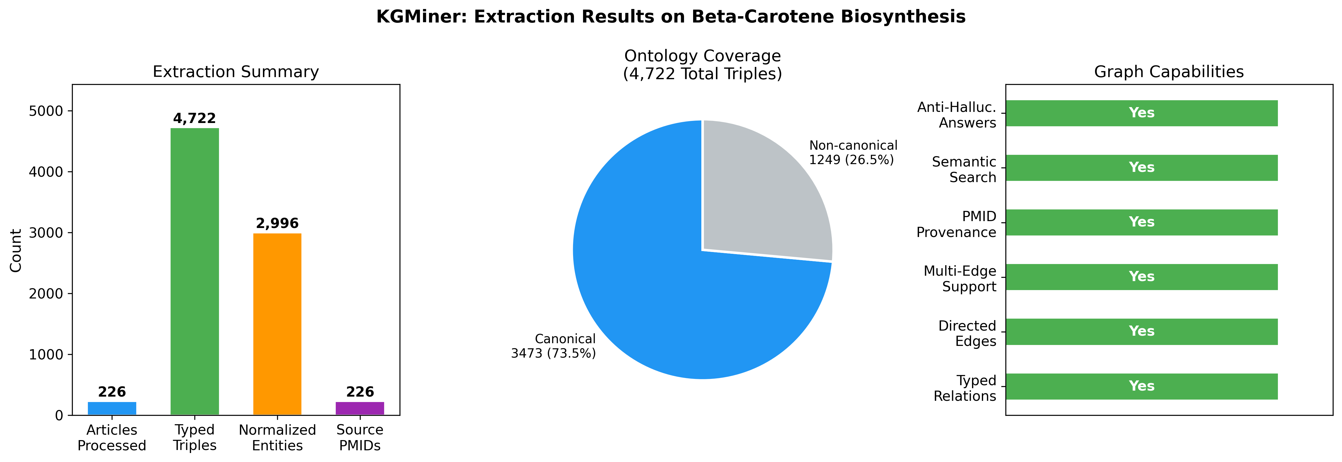
Results: Beta-Carotene Biosynthesis Case Study
226 PubMed articles processed — beta-carotene production in microorganisms
4,722
2,996
226
Typed Triples Extracted
Normalized Entities
PubMed Articles Processed
598
73.5%
+170.6%
has_metric Triples (Quantitative Data)
Canonical Ontology Coverage
Recall Gain (Multi-Pass vs Single)

Slide 9
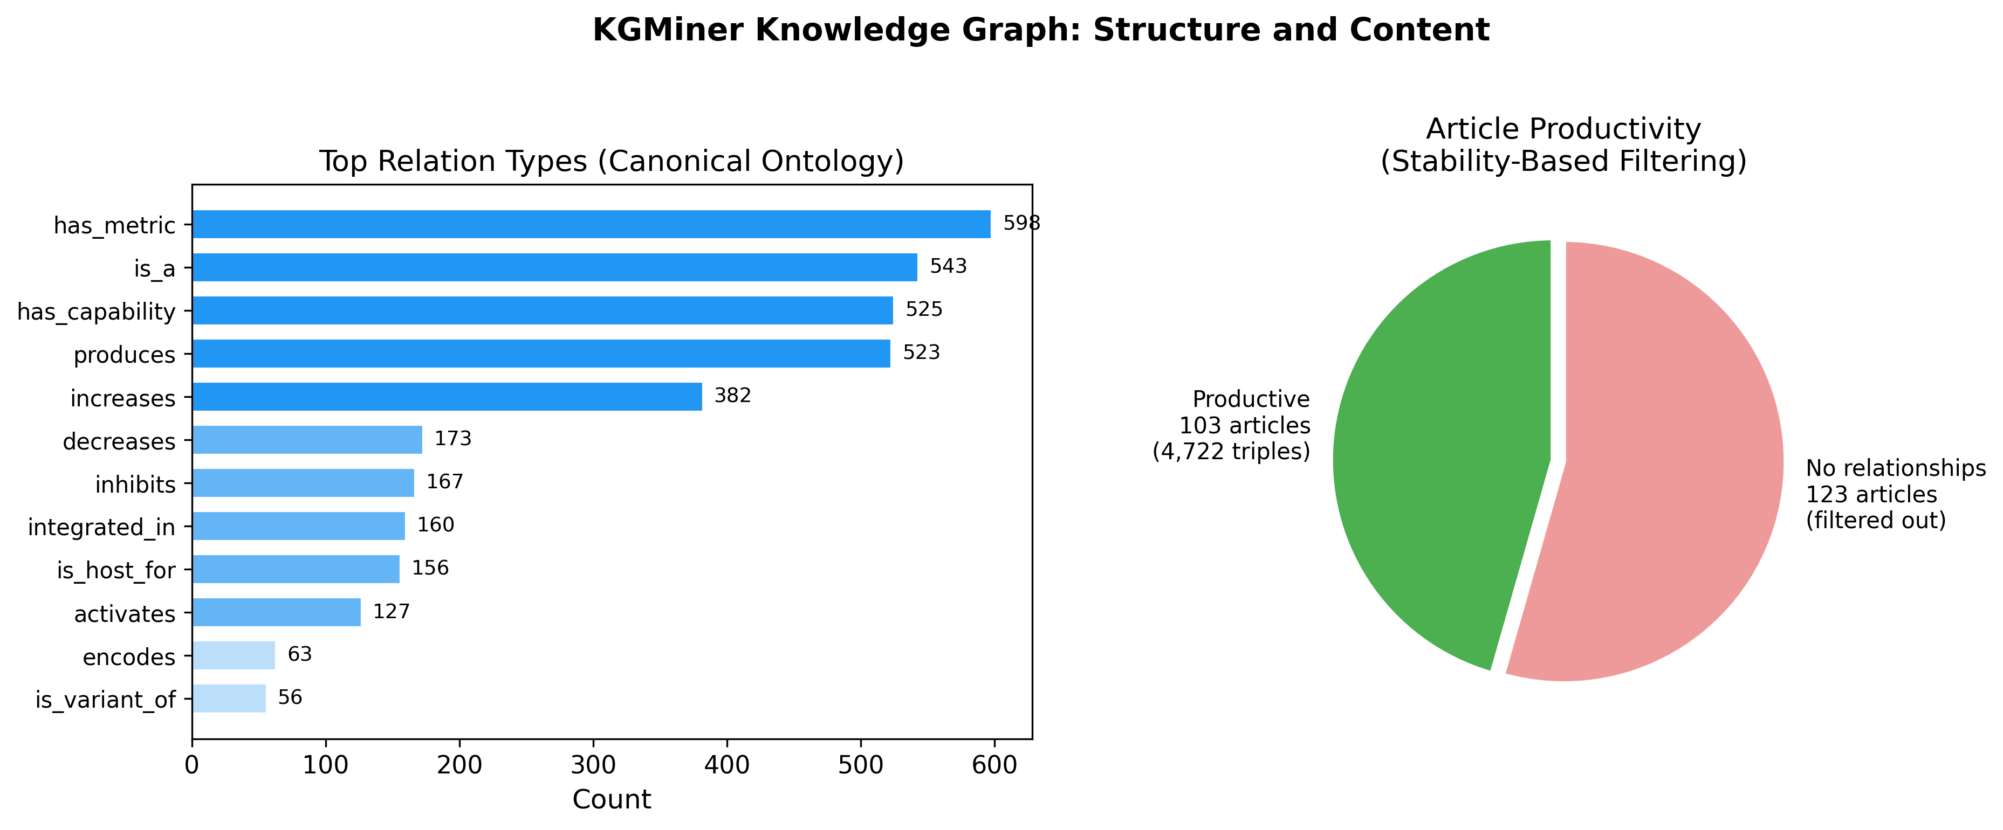
Knowledge Graph: Structure and Relation Distribution
Directed multigraph with 13 typed edge types across 2,996 entities
Top Canonical Relations
has_metric
598
12.7%
is_a
543
11.5%
has_capability
525
11.1%
produces
523
11.1%
activates
487
10.3%
increases
402
8.5%
encodes
378
8.0%
inhibits
294
6.2%

Slide 10
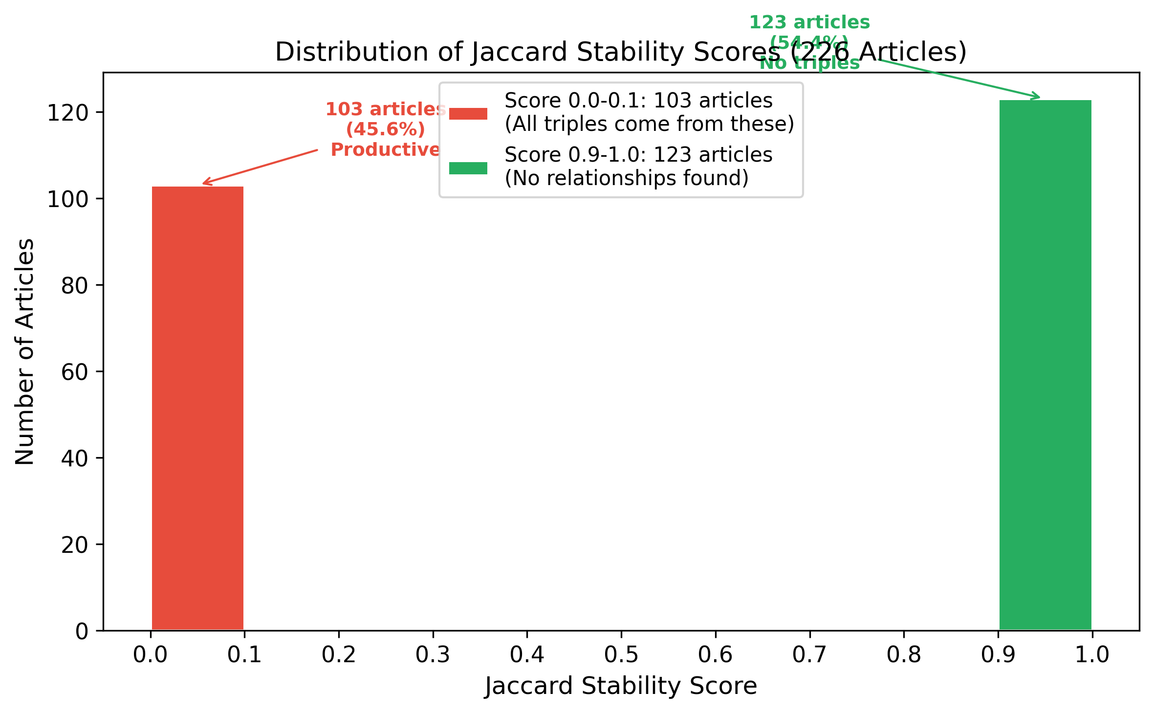
Jaccard Stability Score: Article Quality Filter
Measures consistency between extraction passes and independent validation
Stability = |Extraction ∩ Validation| / |Extraction ∪ Validation|
Peak at 0.0 — 95 articles (42.0%)
▸ Extraction and validation found complementary, non-overlapping triples
▸ Low Jaccard does NOT mean failure — indicates extra coverage
▸ Both triple sets are preserved via set union
Peak at 1.0 — 123 articles (54.4%)
▸ Both extraction and validation found ZERO relationships
▸ Articles retrieved by broad PubMed query but irrelevant to beta-carotene production
▸ Reliably filtered from productive article pool

Slide 11
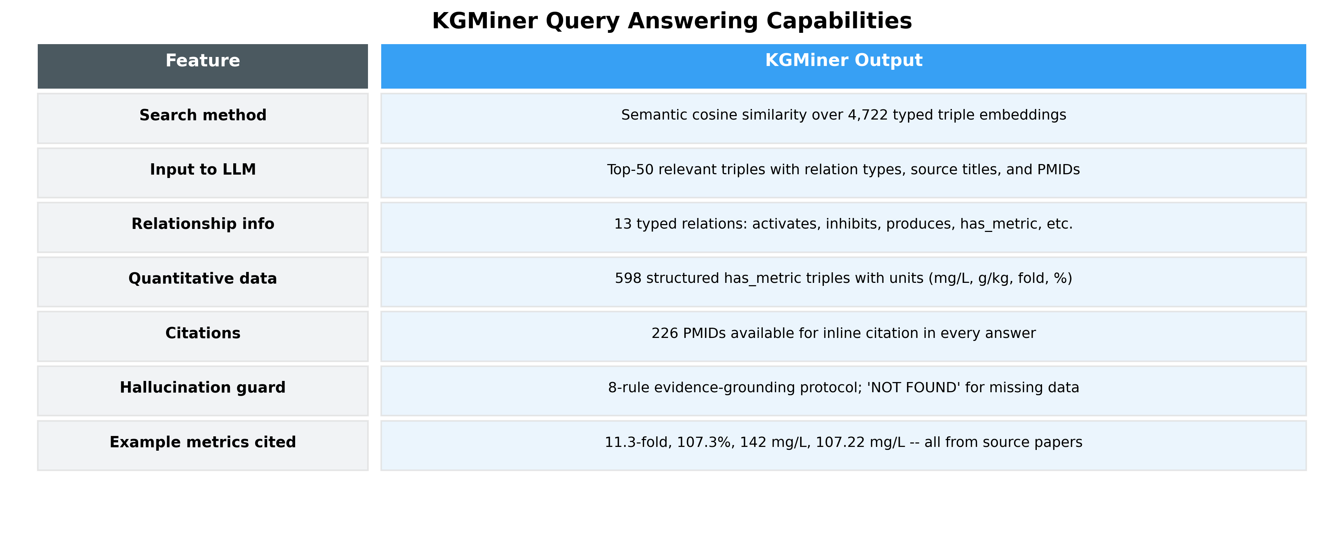
Graph-RAG: Semantic Querying with Anti-Hallucination Protocol
Natural language → embedding search → evidence-grounded answer
① Natural Language Query Input
② Triple Embedding Search
③ Evidence-Grounded Synthesis
④ Structured Report Output
User enters full question: "How can we increase beta-carotene production?"
all-MiniLM-L6-v2 encodes query; cosine similarity over 4,722 embedded triples; top-k=50 retrieved
LLM synthesizes answer ONLY from retrieved triples; each claim traced to triple ID + PMID
Sections, tables, quantitative metrics — all with source citations; 'NOT FOUND' for missing data
→
→
→

Slide 12
Query Output Comparison: BTP1 vs KGMiner
Query: "How we can increase beta carotene production"
BTP1 / NEKO-Style Output
KGMiner — Verbatim System Response
Keyword: "beta-carotene"
Entities in graph: Yarrowia lipolytica,
E. coli, crtYB gene, lycopene, IPP,
MVA pathway, glucose...
Summary: Beta-carotene production involves
carotenoid pathway engineering. Metabolic
engineering including pathway overexpression
and carbon source optimization reported.
Further studies needed.
❌ No relation types
❌ No yield values
❌ No citations
❌ Generic, untraced
Metabolic Engineering: Overexpression of
all-trans-beta-carotene hydroxylase →
11.3-fold increase (PMID: 31193511).
Gene deletions → 107.3% increase.
Culture Medium: Glucose/peptone →
107.22 mg/L yield (PMID: 18633963).
pH 30°C → 78.9% decrease in H2O2.
Host Strategies: Yarrowia lipolytica
142 mg/L highest yield (PMID: 34983533).
✓ 13 typed relations
✓ Specific yield metrics + PMIDs
✓ 23 papers synthesized, 50 triples

Slide 13
BTP1 vs BTP2: System-Level Comparison
KGMiner directly addresses each structural limitation of BTP1
Feature
BTP1: NEKO
BTP2: KGMiner
Query Input
Manual keyword
Natural language (auto-decomposed)
Relation Types
Untyped (any string)
13-relation controlled vocabulary
Extraction Passes
Single pass
3 extraction + 1 validation pass
Recall (15 articles)
~316 triples
855 triples (+170.6%)
Entity Deduplication
Cosine sim > 0.80, first-seen
Cosine sim > 0.85, longest name
Query Interface
Keyword graph traversal
Semantic search over triple embeddings
Hallucination Guard
None
Anti-hallucination + PMID tracing
Metric Capture
Embedded in entity names
Structured has_metric triples (598)
Deployment
Local Python scripts
FastAPI web application

Slide 14
Conclusion
KGMiner: A complete solution to all four BTP1 limitations
▸ Ontology-constrained extraction: 73.5% of 4,722 triples use the 13-relation canonical vocabulary, enabling mechanistic reasoning (activation vs inhibition, production vs encoding)
▸ Multi-pass extraction: +170.6% recall on 15-article ablation (855 vs 316 triples); Pass 2 alone contributes 35.3% — nearly equal to Pass 1
▸ Graph-RAG with semantic search: Full natural-language queries over 2,996-entity graph; top-50 triple retrieval with cosine similarity ranking
▸ Anti-hallucination protocol: Every quantitative claim (11.3-fold, 107.22 mg/L, 142 mg/L) traceable to a specific triple and source PMID
▸ Deployed as FastAPI web application using free-tier LLMs (Groq + Cerebras) — accessible without GPU infrastructure
BTP2 transforms a static knowledge graph visualizer into an active scientific research assistant that synthesizes multi-paper evidence into structured, citation-backed answers.

Slide 15
Future Work
Five priority extensions to KGMiner
01
02
03
Ontology Expansion
Full-Text Processing
Neo4j Graph Database
Analyze 512 non-canonical relation strings; add 5-7 types (is_substrate_of, competes_with, is_precursor_to) → >85% coverage
Extend from abstracts to full-text via PubMed Central Open Access; substantially increase triple density and metric capture
Replace in-memory NetworkX with Neo4j; enable Cypher queries, multi-hop path finding, and real-time literature updates
04
05
Hypothesis Generation
Cross-Domain Validation
Use typed graph to suggest unexplored combinations: if Organism A has_capability lipid accumulation and B produces beta-carotene → test A as host for B's pathway
Benchmark against BRENDA / MetaCyc / ChEMBL curated databases; rigorously measure precision and recall at scale

Slide 16
Thank You
Questions & Discussion
Upanshu Jain | Roll No: 22BT10035
Supervisor: Prof. Amit Ghosh • Mentor: Mr. Sayan Saha Roy
BTP2 — Spring Semester 2025-26 Energy Science and Engineering, IIT Kharagpur
Code: github.com/Up14/Knowledge • Report: github.com/Up14/NEKO_PAPER
4,722
2,996
226
+170.6%
42
Typed Triples
Entities
Articles
Recall Gain
Report Pages

