Slide 1

BREADWICH
THIRD PART
Notes:
Teste Notas

Slide 2
Kanban Boards
We will now present you with the markdown files that are present on our GitHub repository

Slide 3
Total number of commits for every team member

Slide 4
Daily commits

Slide 5
Methodology - project distribution
The project was divided in 5 parts with each part being attributed to one team member:
Registration of Ingredient’s Suppliers – Bruno Lopes
Sandwich Registration – César Costa
Registration of Sandwich Orders – Diogo Lima
Ingredients and Calendar Improvement – Fernando Botelho
Inventory Management – João Fernandes

Slide 6
Methodology - variables
All variables must be UPPER-CASE
If more than word, should be separated by hyphen, e.g.: THIS-IS-AN-EXAMPLE
If more than one level is required, levels must be incremented by 5, except from first to second level, e.g.: 01, 05, 10, 15, 20, …
All PIC clauses should be aligned and the size of the variable must be written with three digits, e.g.: PIC 9(003)
All common variables should be defined by the team and used across all parts of the project

Slide 7
Methodology - paragraphs/sections
All paragraphs and sections should be named in UPPER-CASE
If more than one word, should be separated by hyphens, e.g.: THIS-IS-AN-EXAMPLE SECTION
All parts of the project must be well structured with good use of PERFORM cycles
The use of GO TO is strictly forbidden

Slide 8
Methodology - comments and common rules
Explicit and objective with only the necessary information to interpret the programm
Indentation is mandatory and is used along the project whether in the declaration of variables or in the lines of code
e.g.:
THIS-IS-A-SECTION SECTION
PERFORM UNTIL X = 1
IF X = 0 THEN
ADD 1 TO X
END-IF
END-PERFORM
EXIT SECTION

Slide 9
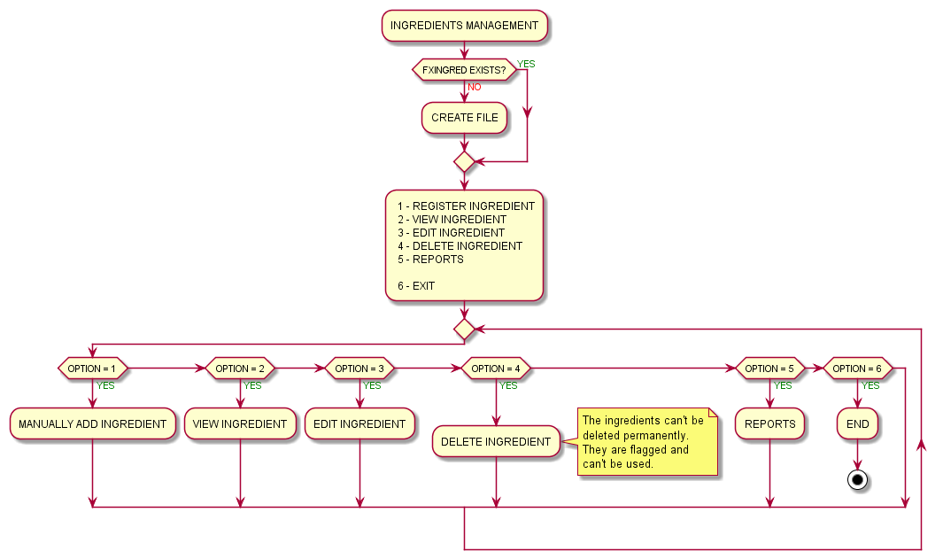
Activity diagram - ingredients management

Slide 10
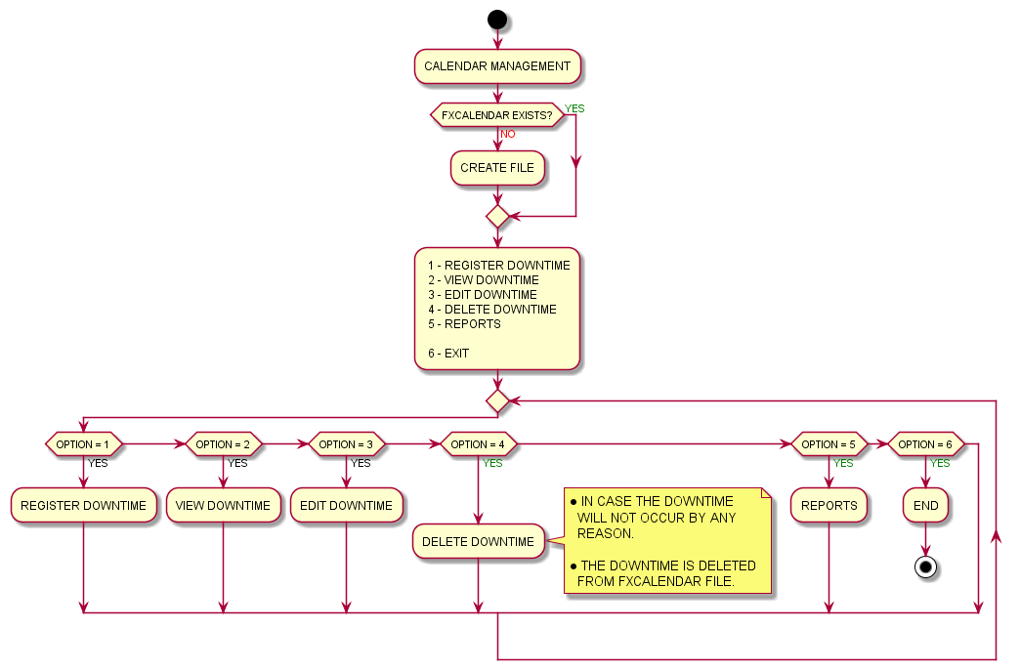
Activity diagram - calendar management

Slide 11
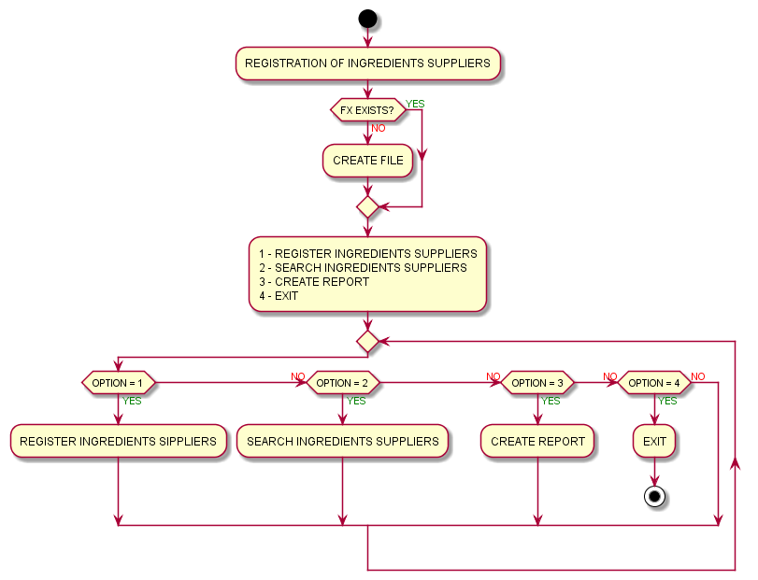
Activity diagram - registration of ingredients suppliers

Slide 12
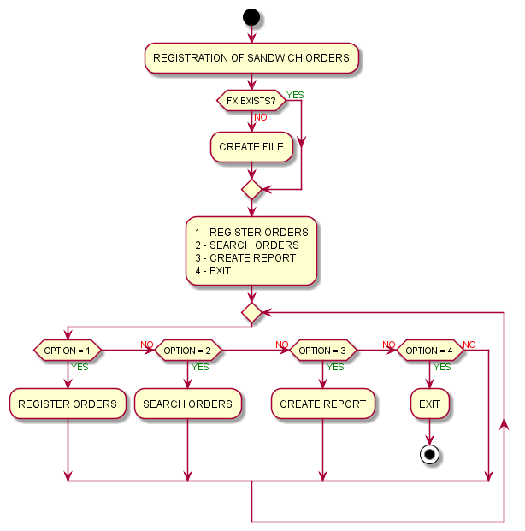
Activity diagram - registration of sandwich orders

Slide 13
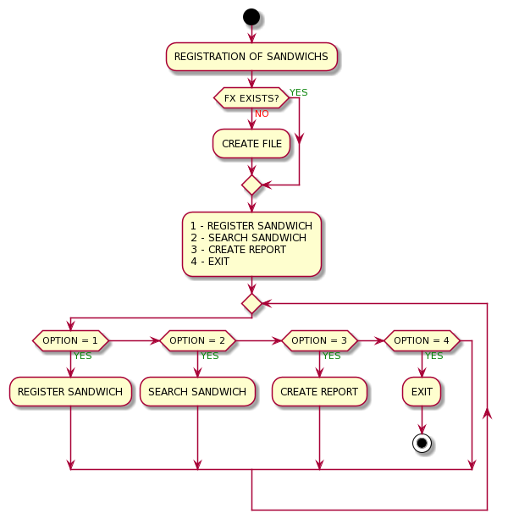
Activity diagram - sandwich registration

Slide 14
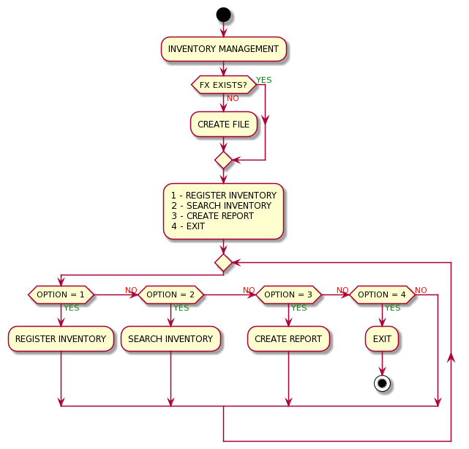
Activity diagram - inventory management

Slide 15
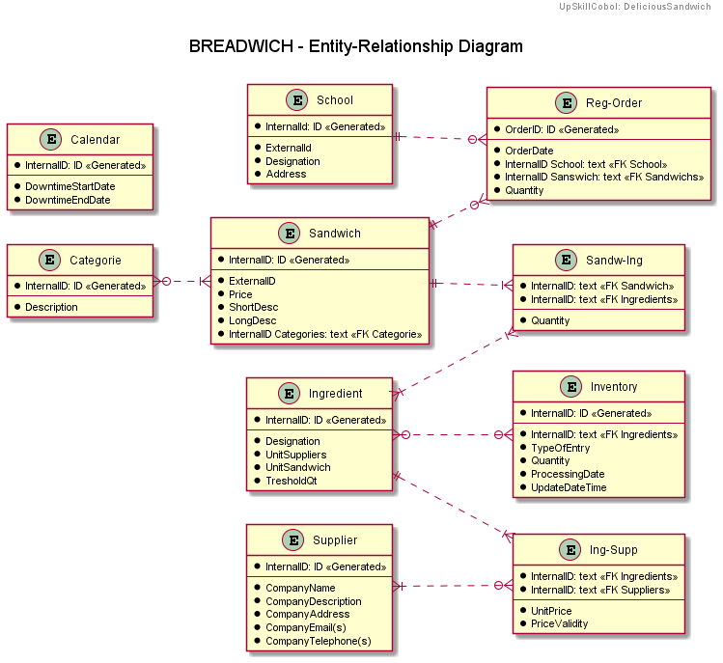
Entity-relation diagram

Slide 16
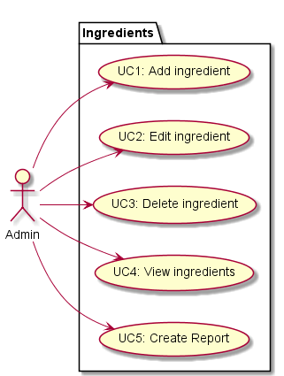
Use case diagram - ingredients management

Slide 17
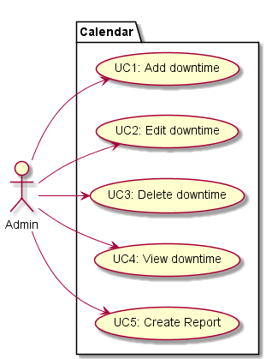
Use case diagram - calendar management

Slide 18
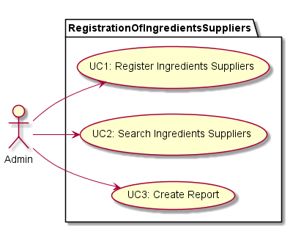
Use case diagram - registration of ingredients suppliers

Slide 19
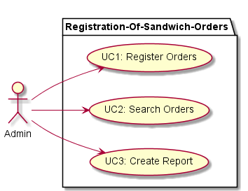
Use case diagram – registration of sandwich orders

Slide 20
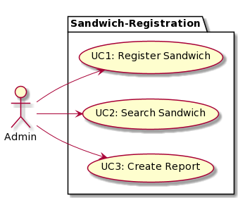
Use case diagram - sandwich registration

Slide 21
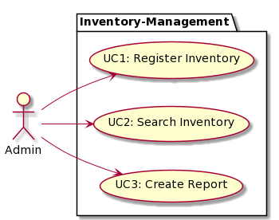
Use case diagram - inventory management

Slide 22
Functionalities successfully concluded
Ingredients Management – All functionalities have been successfully concluded without known bugs
Calendar Management – All functionalities have been successfully concluded without known bugs
Registration of Ingredients Suppliers – All functionalities have been successfully concluded without known bugs
Registration of Sandwich Orders – All functionalities have been successfully concluded without known bugs
Sandwich Registration – All functionalities have been successfully concluded without known bugs
Inventory Management – No functionalities have been concluded

Slide 23
Test cases
We will now present you with the markdown files that are present on our GitHub repository

Slide 24
Quality in use / multilanguage / maintainability
The application has full support for multilanguage, both Portuguese and English are fully implemented
To change the language all you have to do is copy the files from the CONSTANTS folder of the desired language
Every module is consistent in the way it’s built so it’s easier to maintain the code
All the menus are similar so it’s easier to go from module to module

Slide 25
INSTALLATION GUIDE
We will now present you with the markdown file that are present on our GitHub repository

Slide 26
Unsolved problems / possible enhancements
Creating the Inventory Management (part of the application)
Improve the Categories Module (adding sub-values to the categories)
More effective stock management

