Slide 1
BREADWICH COMPANY

Slide 2
This file is an introduction of the second part of the project DeliciousSandwich.
The team has 5 members and the group name is BreadWich.
This part has 5 modules, each module assign to each member team.
Members | Bruno Lopes | César Costa | Diogo Lima | Fernando Botelho | João Fernandes
Assignments | Ingredients Management | Schools Management | Calendar Management | Suppliers Management | Categories Management
I N T R O D U C T I O N

Slide 3
Methodology
Variables
All upper-cases;
If more than one word, should be separated by a hífen;
The variables levels are 1, 5, 10, 15…;
In case we need to add a level between the declared variables, we add 2 to the main level;
The PIC clauses should be align and the size should be written in 3 digits;
The variable names will be defined by the team and will be used in all 5 modules.

Slide 4
Methodology
Paragraphs/sections:
All upper-cases;
If more than one word, should be separated by a hyphen;
The program must be well structured with a good use of PERFORM function;
The use of GO TO function is strictly forbidden;

Slide 5
Methodology
Comments:
Explicit and objetive – only the most necessary information;
All the comments are separated by a line of “*” above and below the comment.

Slide 6
Methodology
Common rules:
Indentation it’s mandatory and it’s gonna be used along the project
e.g.,
01 SCHOOL
05 SCHOOL-ADRESS
10 CPNUM
88 CPNUM-VALID VALUE 10000 THRU 99999
15 CPNUM1 PIC9 (004)

Slide 7
Daily Commits Chart

Slide 8
General Commits Chart

Slide 9
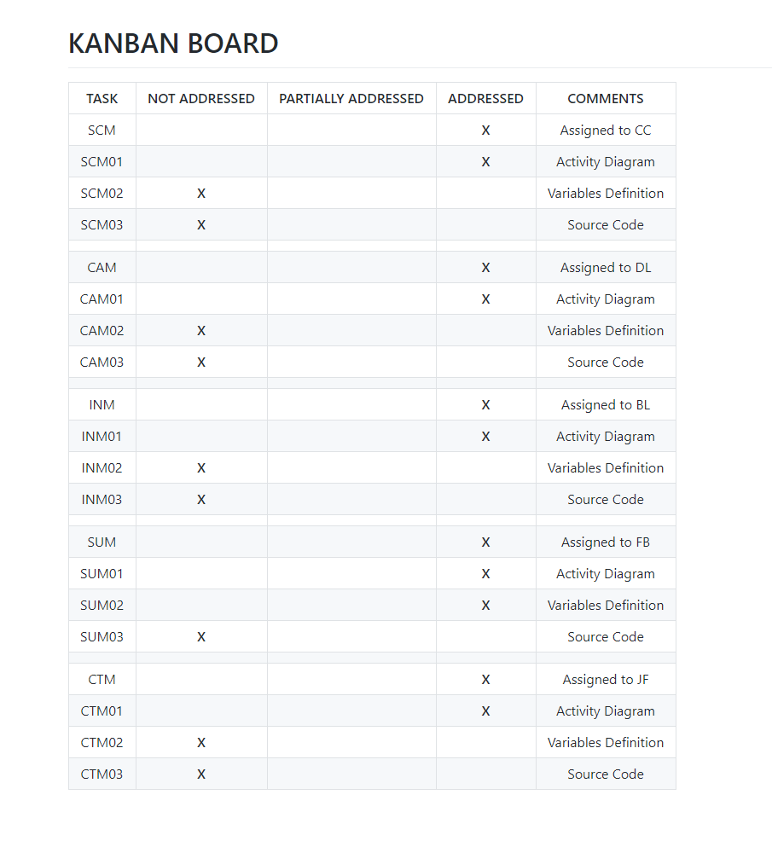
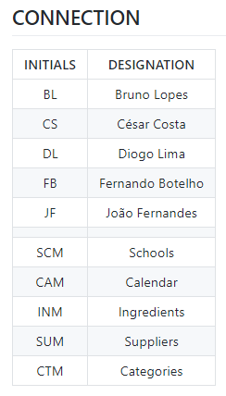
KANBAN BOARD
13-01-2021

Slide 10
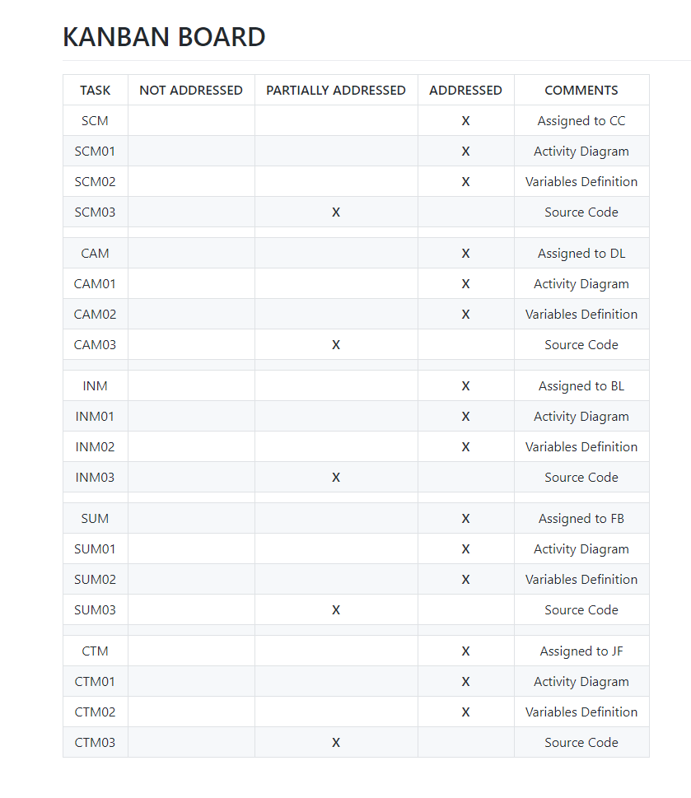
KANBAN BOARD
20-01-2021

Slide 11
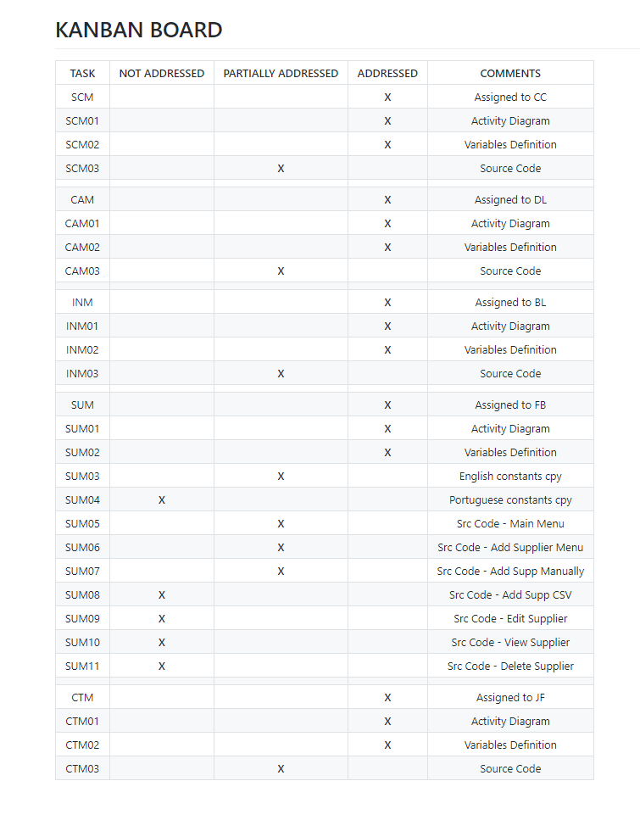
KANBAN BOARD
25-01-2021

Slide 12
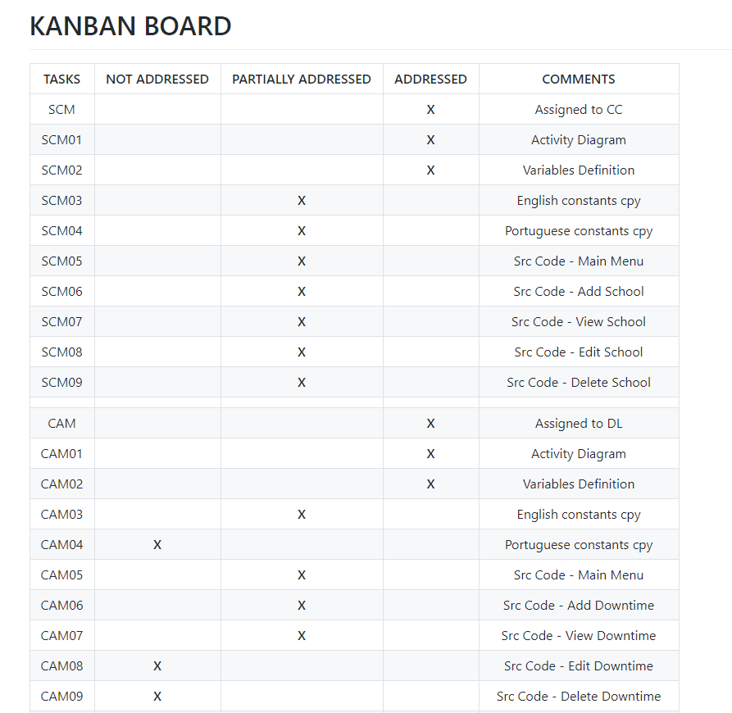
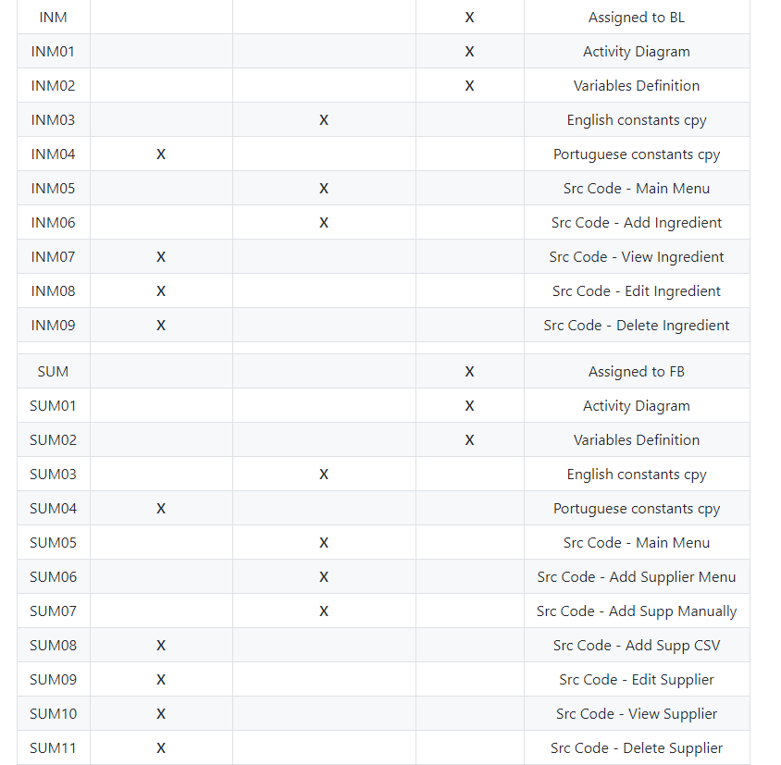
01-02-2021
KANBAN BOARD

Slide 13
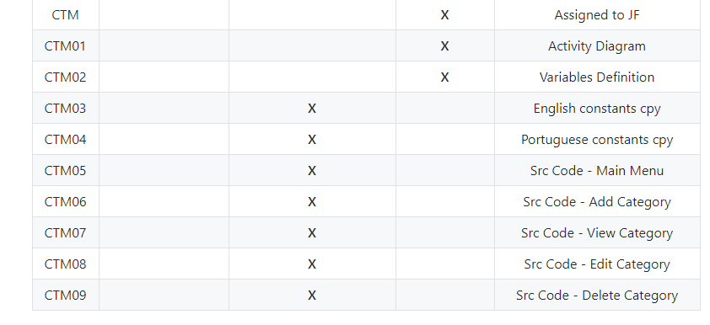
01-02-21
KANBAN BOARD
01-02-2021

Slide 14
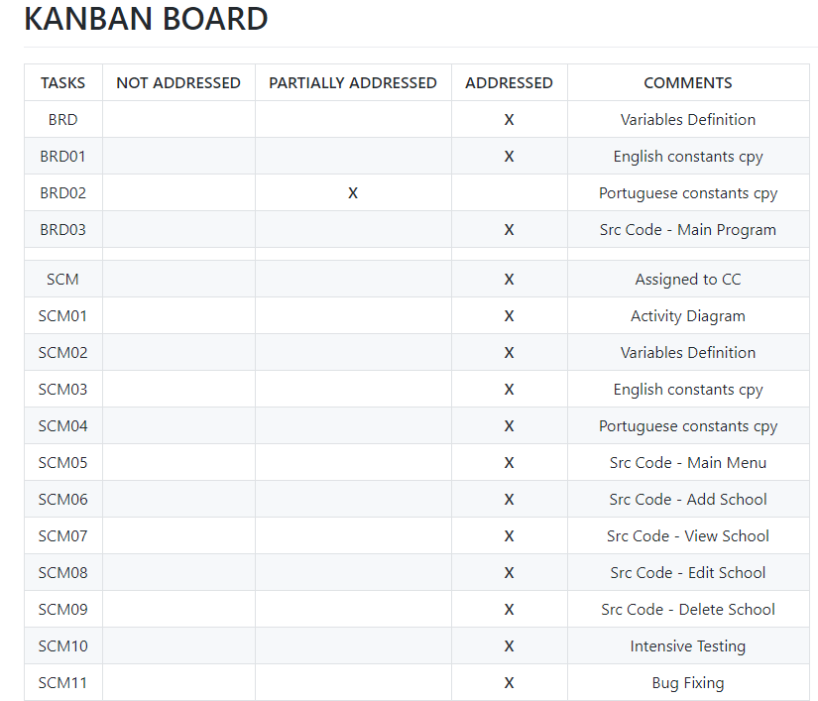
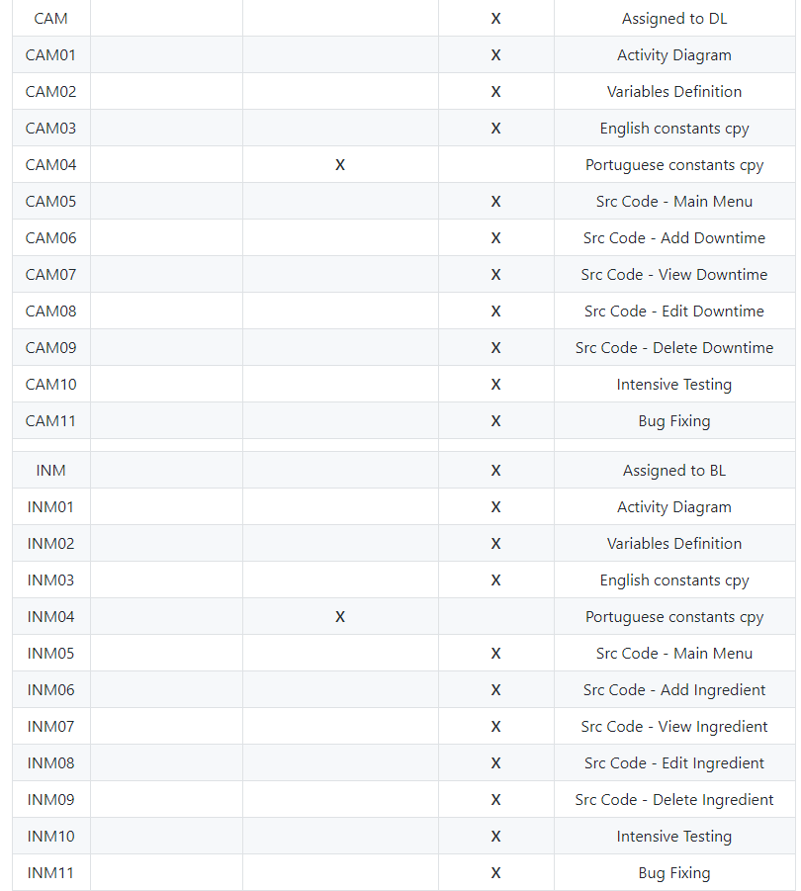
KANBAN BOARD
04-01-2021

Slide 15
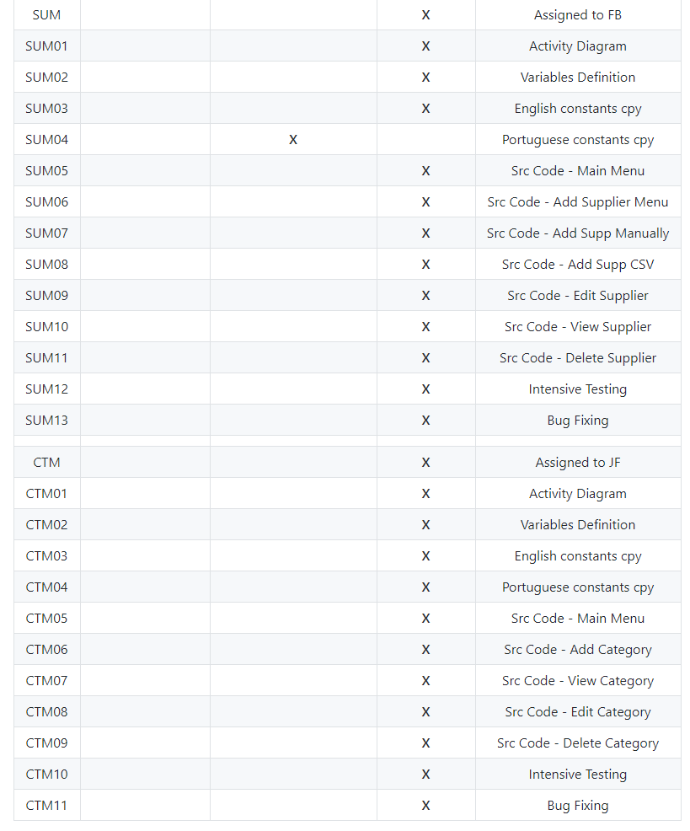
KANBAN BOARD
04-02-2021

Slide 16
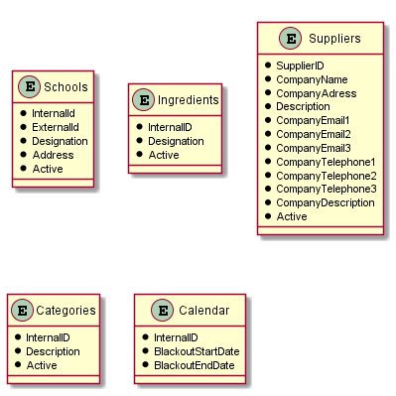
ENTITY-RELATIONSHIP DIAGRAM

Slide 17
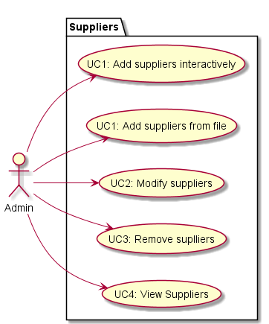
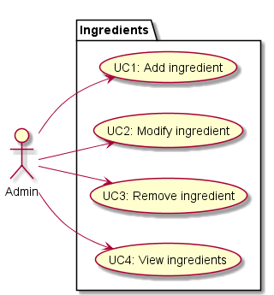
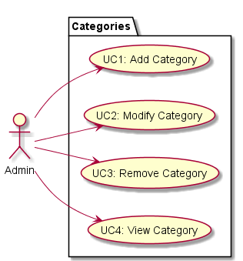
USE CASE DIAGRAM

Slide 18
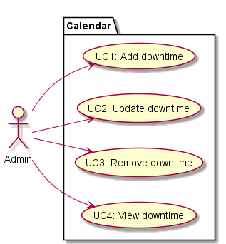
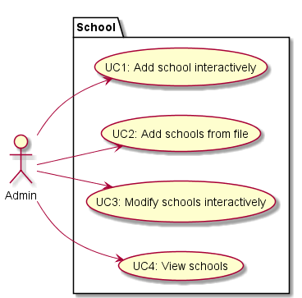
USE CASE DIAGRAM

Slide 19
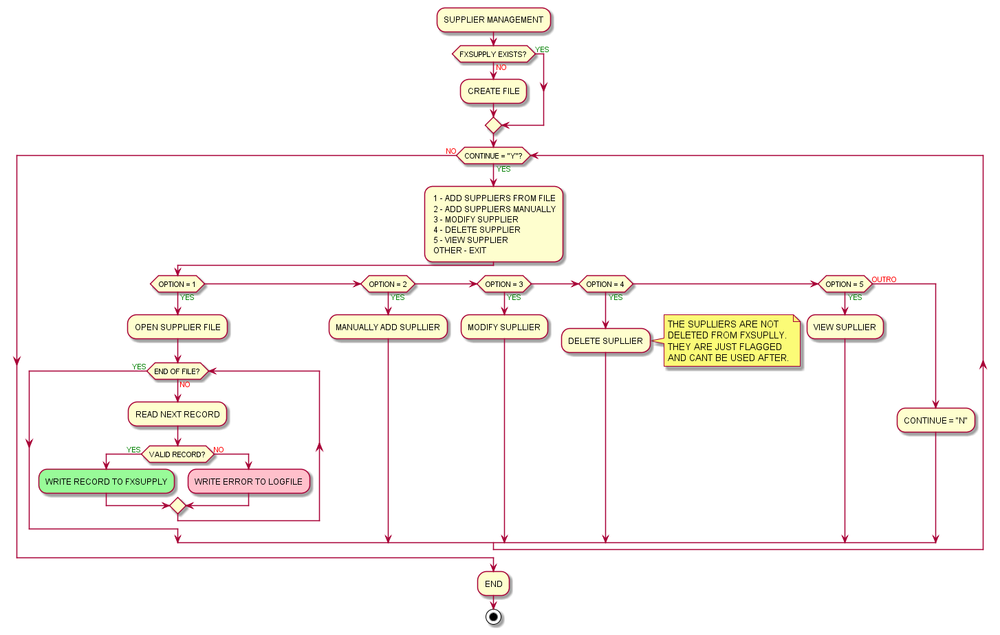
ACTIVITY DIAGRAM
SUPPLIERS MANAGEMENT

Slide 20
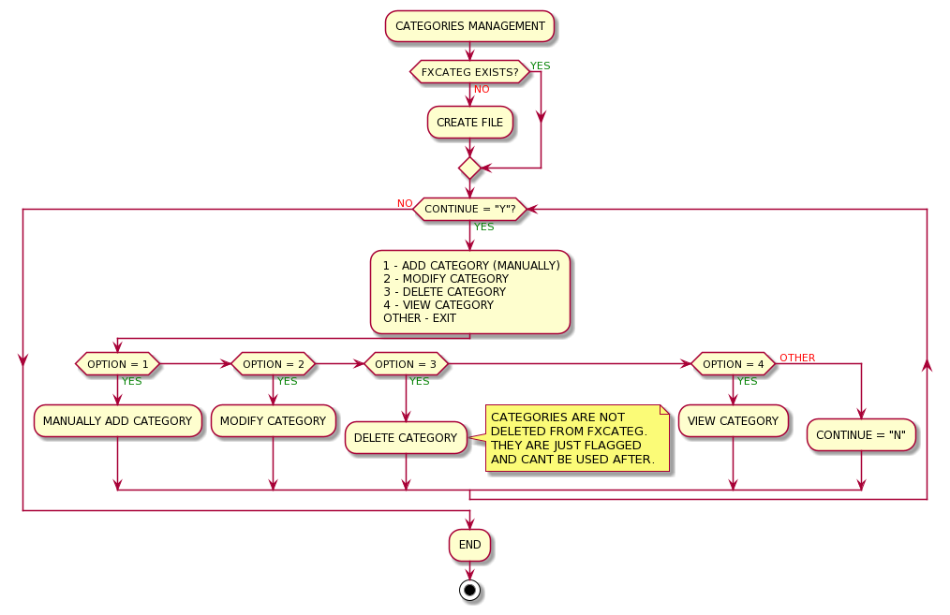
ACTIVITY DIAGRAM
CATEGORIES MANAGEMENT

Slide 21
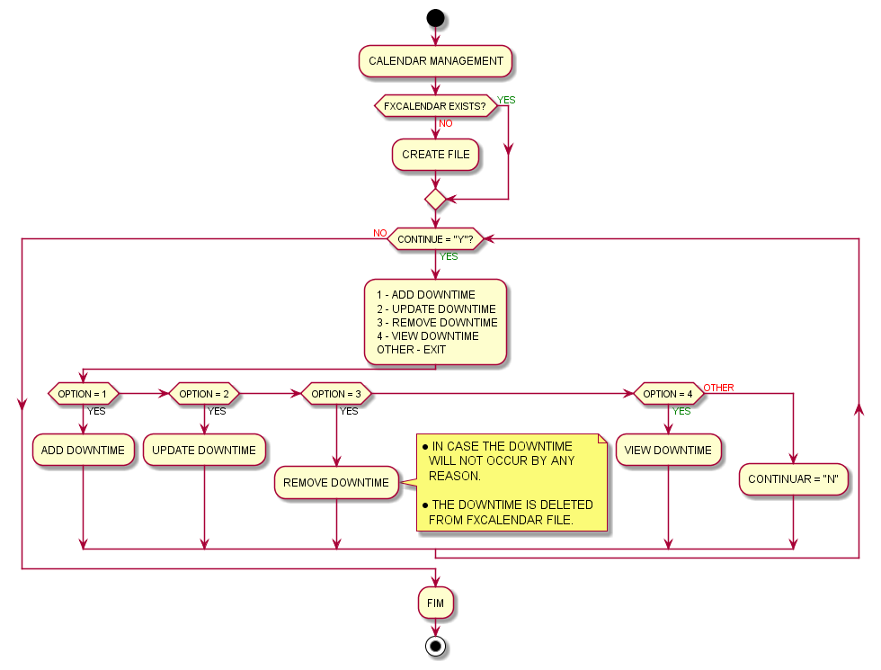
ACTIVITY DIAGRAM
CALENDAR MANAGEMENT

Slide 22
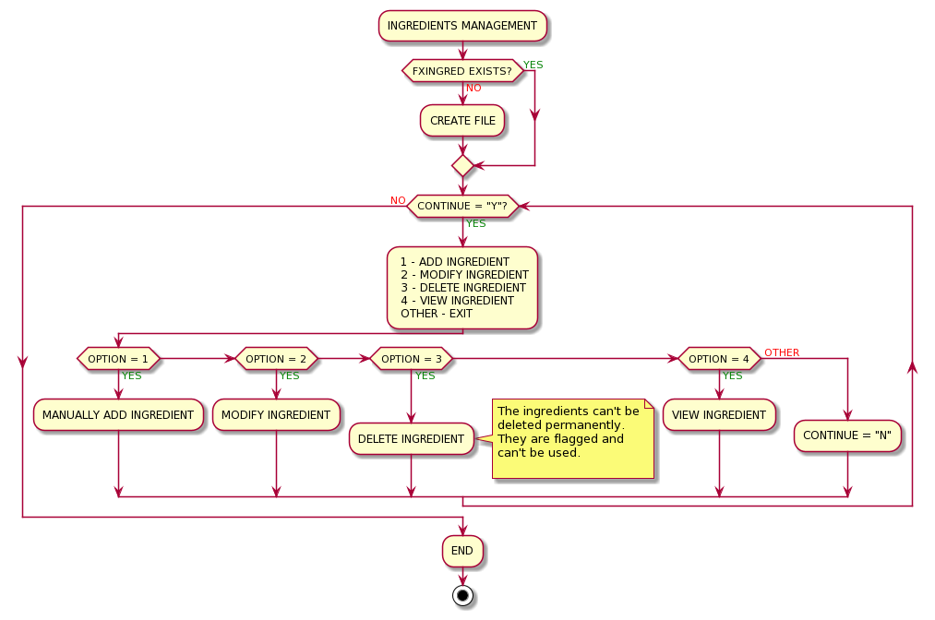
ACTIVITY DIAGRAM
INGREDIENTS MANAGEMENT

Slide 23
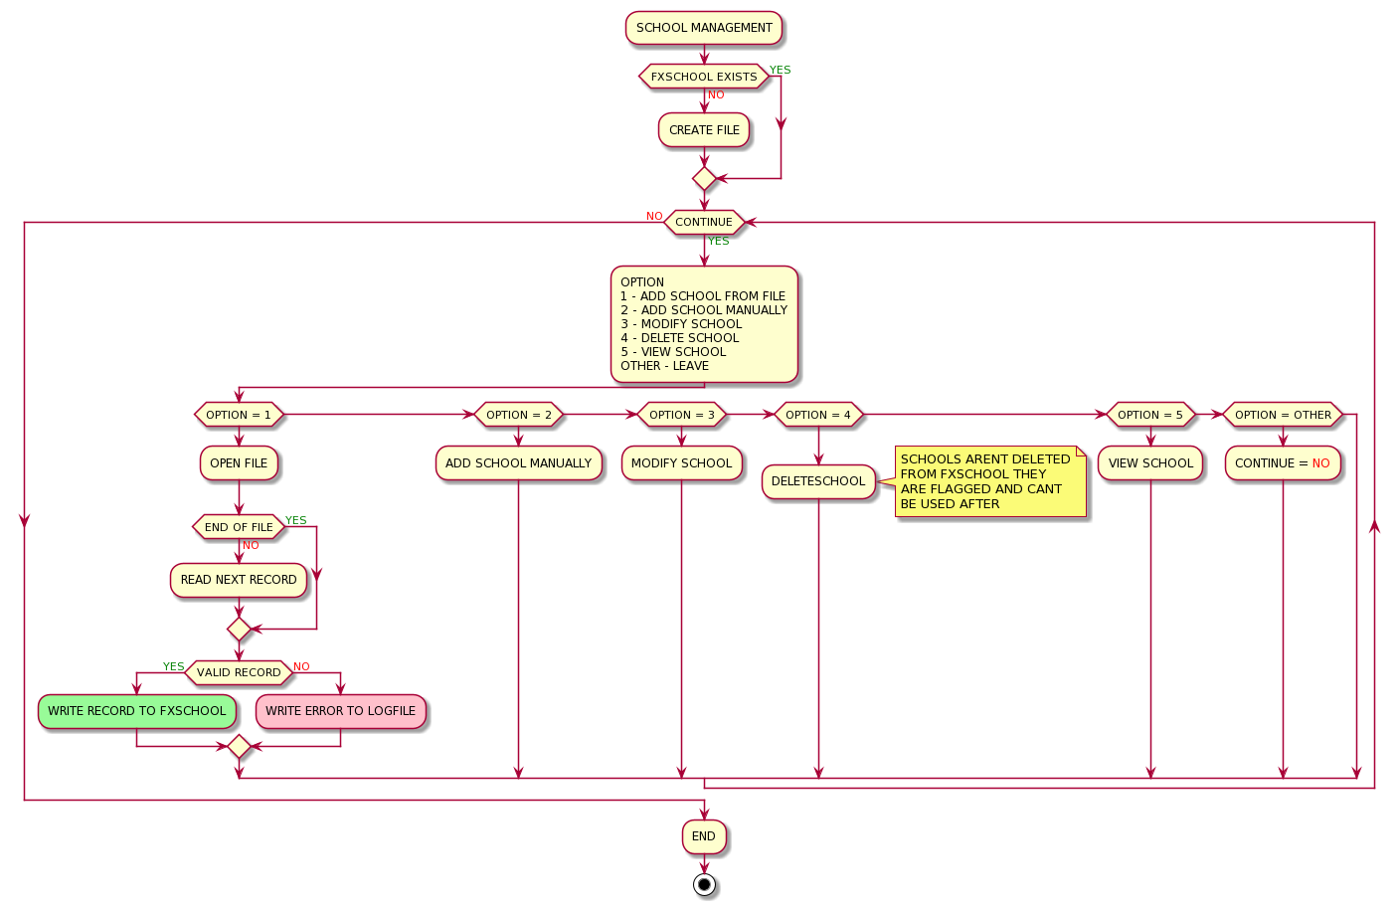
ACTIVITY DIAGRAM
SCHOOLS MANAGEMENT

Slide 24



BREADWICH COMPANY

