Slide 1

PROJECT II
Practical experience on challenging project work in ICT
29.8.2011

Slide 2
By completing this course
You can act as an academic professional member in a goal-oriented project (professional from the point of view of your student colleagues)
Your skills have been developed in two areas (to be clarified in next slides):
  Professionalism in project work
  Expertise on some specified subject area (depending on the project subject)

Slide 3
Professionalism
conducting and showing evidence of project work in managed way
  ability to plan the project (with limited resources)
  ability to manage the progress of the project with the steering group/project team organization
    reporting the progress and results of the project
    use of SG (Steering Group) in decision making and problem resolution
  ability to follow the progress of the project in real time within the project team (weekly/daily meetings)
  ability to work as a responsible project team member
  ability to produce realistic outcome in relation to project resources (ok, good, excellent)
independently; your supervisor will support on your request!

Slide 4
Expertise in specified subject area of the project
ability to search research articles and other up to date information on this subject area (general skills)
ability to apply this information in your project work
ability to evaluate the results of the project and to reflect your practical experiences related to the selected research and previous information on the subject area
ability to disseminate your (increased) expertise in the subject area credible to your student colleagues
  by written report AND orally

Slide 5
Project II
The course comprises of two parts: project work and seminar
  project work: 300 hours/student (2 periods)
  seminar: ca. 70 hours/student (one period)
seminar takes two days: attendance is obligatory for both days!
OBS! The grade is the same for all the project members and will be evaluated by:
  project professionalism = project work and portfolio; 45%
  expertise = expertise gained and the seminar report; 45%
  seminar presentation = oral presentation of project results and expertise; 10%
More detailed evaluation criteria for each of these will be found in Optima

Slide 6
Project II – Evaluation process
The evaluation will be carried out
  Project work:
    By two teachers (your supervisor and the person in charge of the course)
    Based on your work during the project (your supervisor) and the evidence demonstrated by the portfolio (both!)
  Expertise:
    By two teachers (your supervisor and the person in charge of the course)
    Based on your expertise building work during the project, i.e. prestudy, potential wiki, updates etc. (your supervisor) and
    Based on your seminar report (both)
  Seminar presentation:
    By peer evaluation and teacher’s evaluation (all teachers hearing your presentation)

Slide 7
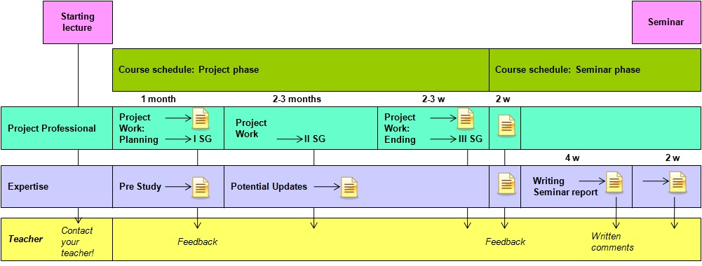
Course structure

Slide 8

CONDUCTING THE PROJECT PHASE:
Planning and conducting the project

Slide 9
Planning and conducting the project 1/3
Project
PROJECT PLAN WILL BE PREPARED BY FOLLOWING THE TEMPLATES AND MODELS OF THE CUSTOMER ORGANIZATION
  strongly suggested: ask your supervisor to give feedback on the project plan well before delivering it (draft in two weeks)
Expertise
Familiarize yourself on the topic of the project with the help of the customer
Study the earlier work within the topic (what is needed)
  competing products/solutions
  research publications around the topic
  you should prepare a short prestudy report on the found material
  content of the prestudy report: short description of the topic, found material and for each item a short description on its relevance on the topic
    this material will be a draft basis for your seminar report
    the supervisor of your project will give feedback and advise
  searching of material(try at least the following):
    http://scholar.google.com
    http://www.nelliportaali.fi/V/?institute=OY&portal=OY&new_lng=fin
    where do you find the most relevant information?

Slide 10
Planning and conducting the project 2/3
THE PROJECT TRIANGLE
Project management is about managing the project triangle
Resources and time are fixed in your projects -> the evolution from goals to results is the main variable here!
RESULTS
GOALS
RESOURCES
TIME

Slide 11
Planning and conducting the project 3/3
Choose your project manager! (at least for starting)
After completing the project plan and the prestudy report you invite the first steering group (SG) meeting
  typically we have 2-3 SG meetings during the project
  TOL is emphasizing the professionalism of all the project work as well as the development of the academic expertise on the subject area
The project will be conducted by following the principles of the customer organisation
  Please note! Project work is 300 hours/student -> this MUST be planned and reported so that TOL will know how this resource has been used in the project
    The project plan of the project needs to have these hours allocated by each task and each student!
    The plan needs also to be updated for SG meetings and reported at the end of the project
    The actual work done for the project MUST be 300 hours (+/-10%) for each student, the project goals and tasks needs to be settled with this resourse
Further information
  http://www.tol.oulu.fi/kurssit/projekti/manuaali/ -> Resurssien seuranta- ja suunnittelulomake

Slide 12
Course structure

Slide 13
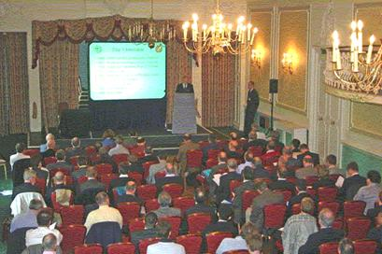
CONDUCTING THE SEMINAR PHASE
AFTER COMPLETING THE PROJECT WORK

Slide 14
Project portfolio and seminar report
Prepare your project portfolio in n two weeks after the final SG meeting of your project and upload it to Optima (note access rights) for evaluation
Prepare a seminar report on the subject area of your expertise
the topic/results of the project or
the methods used or
the other specific expertise gained based on your experiences related to your project or your subject area
Seminar report is not
the final management report of the project
the specifications, designs, code etc. produced in the project nor any combination of these

Slide 15
Seminar report is
Analysis on the new expertise build in the project reported in academic style of writing
  what is the current status of the subject until the project?
  what is new related to the earlier knowledge (literature, products, solutions)?
  what is the relevance of your learning?
  what is the reliability of your results?
The format of the report follows the general guidelines of a scientific publication

Slide 16
Suggested contents of the report
Extent 15-20 pages; your grade will be affected if it is less or more
Introduction (use your prestudy)
  motivation of the topic - why it is important (preferably in relation to research literature)
  short introduction to the content of the report (chapter by chapter)
Background (use your prestudy)
  how this topic has been covered and discussed in (research)literature
  what is the goal of this work; how it has been justified
Description of your experiences: material/construct and used methods
  findings/experiences during the project OR the construction
  methods and practices used to get the findings/construct (i.e. ”research methods”)
Analaysis of results and conclusions
  depending on the nature of the work
    qualitative/quantitative analysis and results
    evaluation/testing of the construct
  relevance of results in relation to (research)literature (reflection)
Summary
References

Slide 17
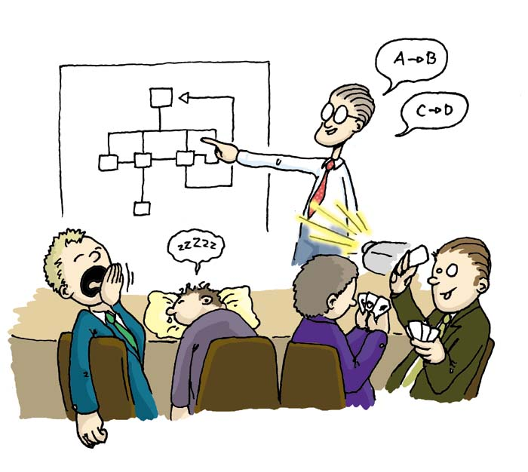
Presentation of the seminar
YOU WILL PREPARE AND GIVE AN ORAL PRESENTATION
  the goal is to show your skills as academic experts on your topic
    the message you try to mediate
    ’selling and marketing’
    good argumentation!
    interesting presentation (how about a video?)
    observe your audience during the presentation
YOU WILL HAVE A TIME SLOT OF 20 MIN + 5 min discussion
  preferably 15-20 min, less/more degreases your grading

Slide 18
Schedule (for autumn semester start)
Enrolment 1.5.-7.8.2011
Starting lecture Mon 29.8.2011
September
  Studying the assignment and relevant material (contact your customer)
  Preparation of the prestudy report (contact your supervisor)
  Preparation of the project plan
  After completing the project plan you should invite the 1st SG meeting
    settle the date at least 2 weeks before
    the invitation/agenda together with plan will be sent by email in advance (>=3 days)
    the project plan will be accepted in the meeting and further meetings scheduled
  At the same time with the project plan complete also the prestudy report and send it to your supervisor by email
    together with project planning agree the subject area of your expertise with your supervisor
    your supervisor gives you advice and feedback on the pre-study report
1. and 2. period
Working with project tasks
The absolute deadline for the project is mid of January!
Project portfolio 2 weeks after the final SG meeting!
In the end of the project, also discuss with your supervisor on the more focused topic of your seminar report. He/she will guide you on how to write it. Suggestion: draft some proposals for the focus areas of the report - then it is more ’academic’ and fruitfull to discuss with your supervisor
3. period
Writing of the seminar report
The seminar report should be uploaded to Optima by Mon 5.3.2012 at 09
Preparation of the oral presentation
Seminar: Thu-Fri 15.-16.3.2012
Evaluation
The final/corrected seminar report to Optima by Fri 30.3.2012
Evaluation/grading meeting (teachers) Week 14-15/2012

Slide 19
Schedule (for spring semester start)
Enrolment 15.9.-30.11.2011
Starting lecture Mon 9.1.2012
January
  Studying the assignment and relevant material (contact your customer)
  Preparation of the prestudy report (contact your supervisor)
  Preparation of the project plan
  After completing the project plan you should invite the 1st SG meeting
    settle the date at least 2 weeks before
    the invitation/agenda together with plan will be sent by email in advance (>=3 days)
    the project plan will be accepted in the meeting and further meetings scheduled
  At the same time with the project plan complete also the prestudy report and send it to your supervisor by email
    together with project planning agree the subject area of your expertise with your supervisor
    your supervisor gives you advice and feedback on the pre-study report
3. and 4. period
Working with project tasks
The absolute deadline for the project is end of May!
Project portfolio 2 weeks after the final SG meeting!
In the end of the project, also discuss with your supervisor on the more focused topic of your seminar report. He/she will guide you on how to write it. Suggestion: draft some proposals for the focus areas of the report - then it is more ’academic’ and fruitfull to discuss with your supervisor
1. period
Writing of the seminar report
The seminar report should be uploaded to Optima by Mon 17.9.2012 at 09
Preparation of the oral presentation
Seminar: Thu-Fri 27.-28.9.2012
The final/corrected report to Optima by Fri 12.10.2012
October
Evaluation/grading meeting (teachers) Week 42-43/2012

Slide 20

Contacts
Tonja.Molin-Juustila@oulu.fi
Jouni.Kokkoniemi@oulu.fi
Juha.Iisakka@oulu.fi
Eeva.Leinonen@oulu.fi
Marjo.Tiikkaja@oulu.fi
Katja.Leiviska@oulu.fi
Jukka.Kontula@oulu.fi
Tero.Vartiainen@oulu.fi

