Slide 1
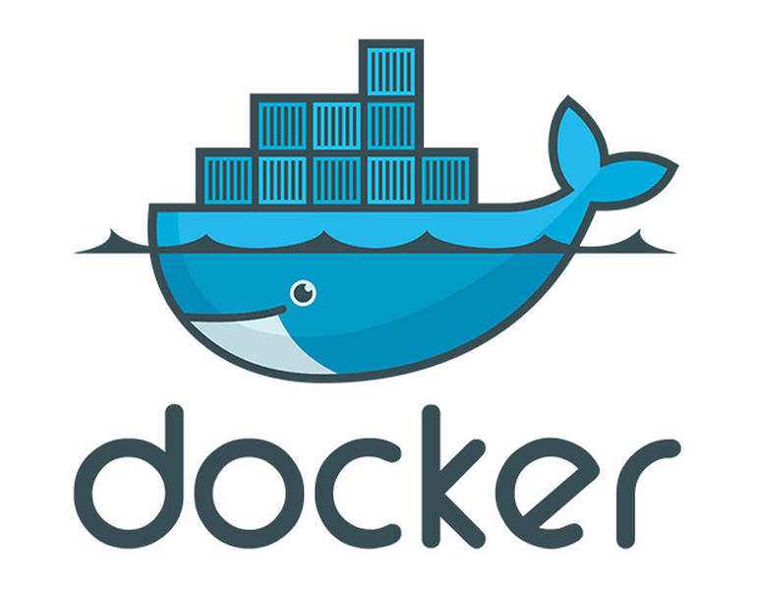
Docker
Presented by: Upasana Ghosh

Slide 2
What is Docker?
Open source tool.
Designed to makes it easier to create, deploy and run applications by using containers.
Containers allow a developer to package up an application with all of the parts it needs, such as libraries and other dependencies, and ship it all out as one package, called image.

Slide 3
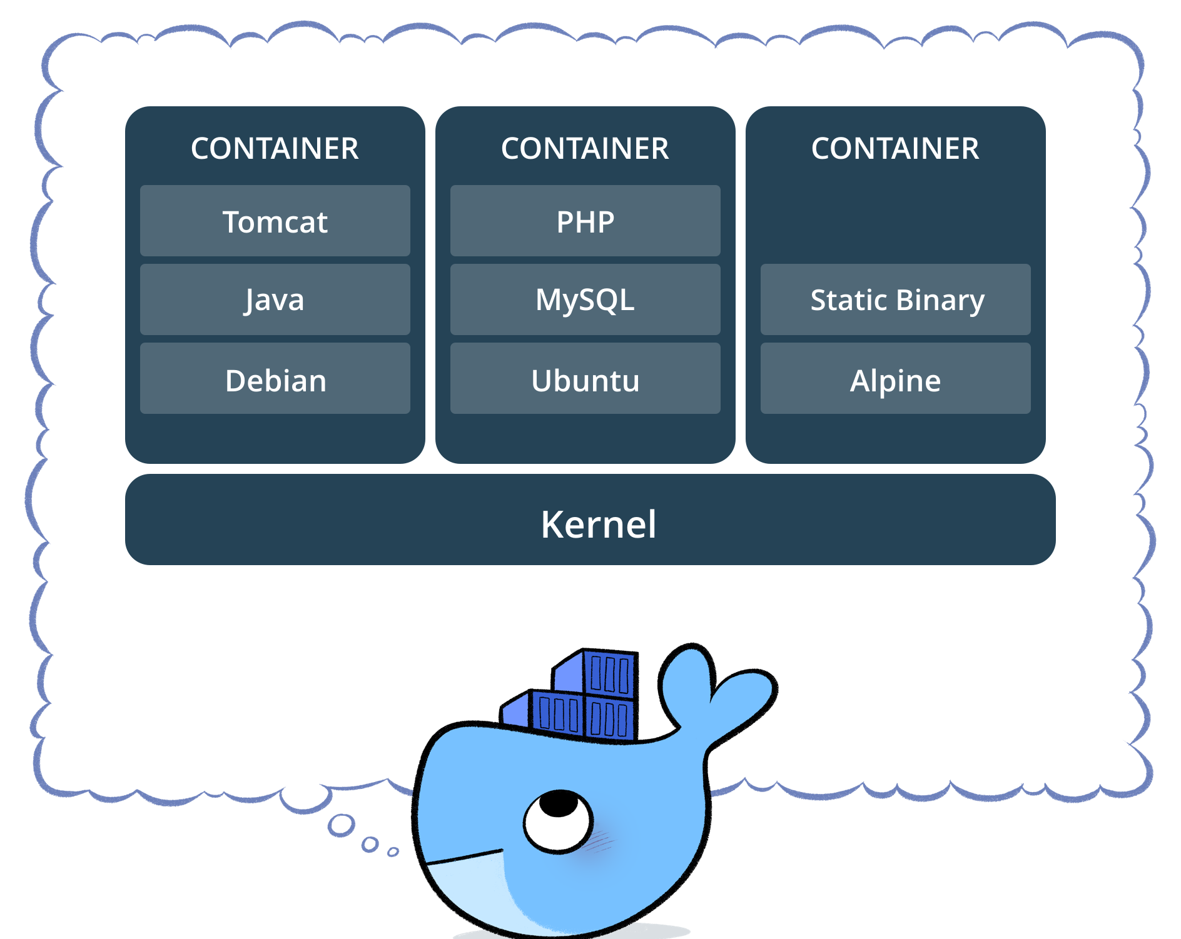
Container Image
Lightweight
Stand-alone
Executable package
Portable
Notes:
Lightweight - Tools are available to decrease the size of image. Ex: Docker docker-squash. http://jasonwilder.com/blog/2014/08/19/squashing-docker-images/
Stand-alone - capable of running on its own
Executable package of a piece of software that includes everything needed to run it: code, runtime, system tools, system libraries, settings.

Slide 4
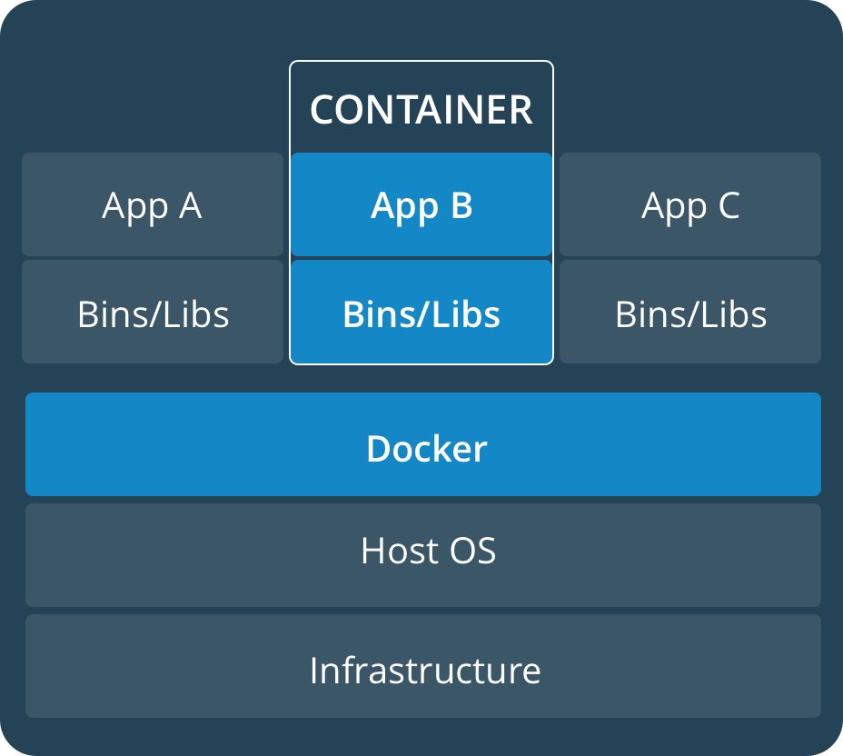
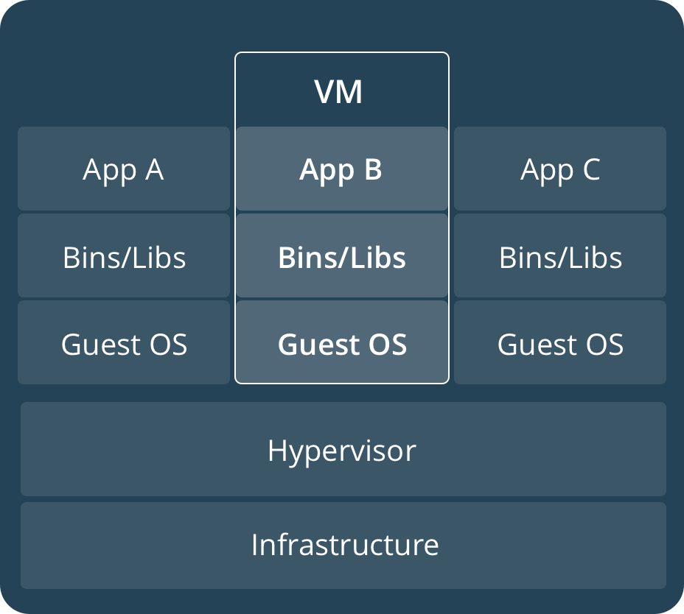
Comparing Containers and Virtual Machines
Virtual Machines
Containers
Notes:
Containers virtualizes the operating system while virtual machine virtualizes the underlying hardware.

Slide 5
Comparing Containers and Virtual Machines
Both provide resource isolation and allocation benefits but are functionally differently.
Containers virtualize the operating system instead of hardware.
Containers are more portable and efficient.
Containers take up less space than VMs (container images are typically tens of MBs in size), and start almost instantly.
Each VM includes a full copy of an operating system, one or more apps, necessary binaries and libraries - taking up tens of GBs. VMs can also be slow to boot.

Slide 6
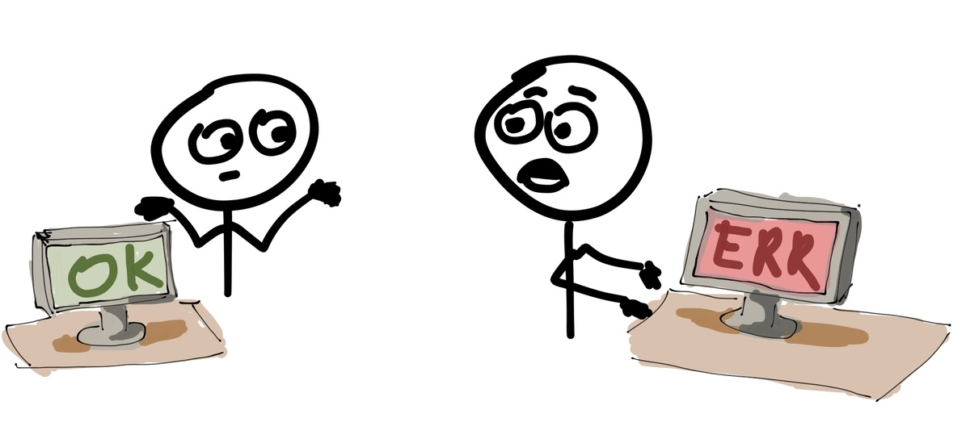
Why docker

Slide 7
Why docker
Ensures that the application will run the same no matter which server or laptop its running on.
This way, it eliminates the “it works on my machine” problem.
Developers will not spend time in setting up environments or debugging environment-specific issues.
Ensures consistent environments from development to production.

Slide 8
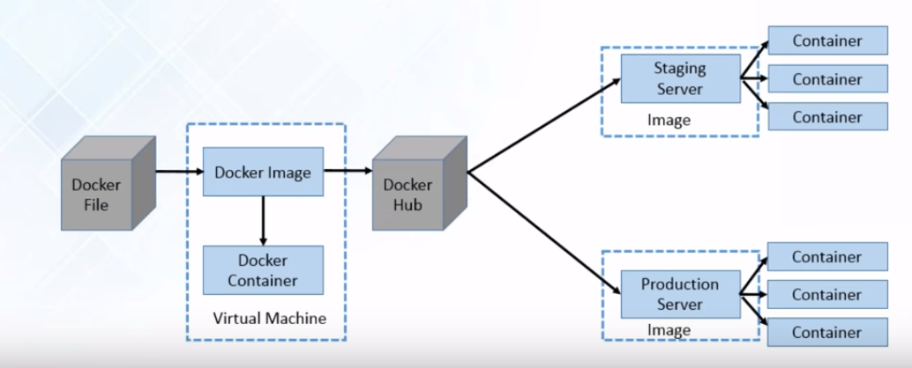
Docker in a nutshell

Slide 9
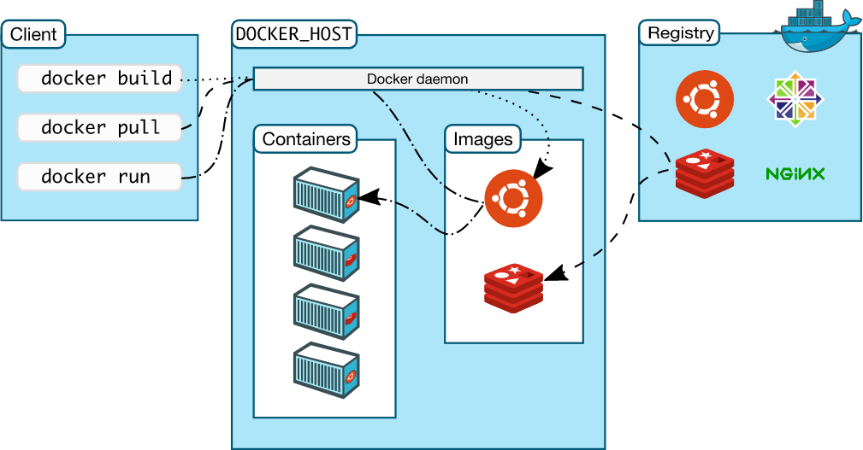
Docker architecture
Notes:
Docker uses a client-server architecture.
The Docker client talks to the Docker daemon, which does the heavy lifting of building, running, and distributing your Docker containers. The Docker client and daemon can run on the same system, or you can connect a Docker client to a remote Docker daemon.
The Docker daemon (dockerd) listens for Docker API requests and manages Docker objects such as images, containers, networks, and volumes.

Slide 10
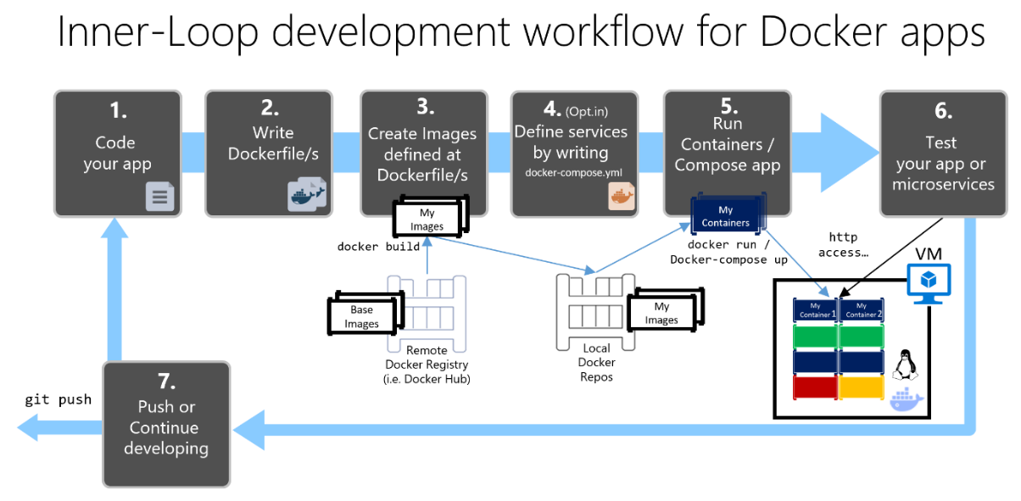
Notes:
Image source: https://docs.microsoft.com/en-us/dotnet/standard/microservices-architecture/docker-application-development-process/media/image1.png
Services allow you to scale containers across multiple managers and workers

Slide 11
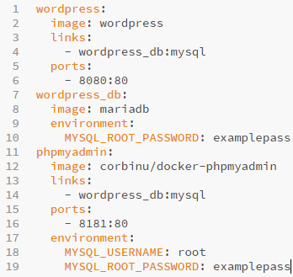
Example: docker-compose.yml
Notes:
Wordpress : is the name of the container
Build from the image that is present is the docker hub
Another container; wordpress_db
Port 80 of docker container will be linked with port 8080 of host machine
Phpmyadmin: intended to handle the administration of MySQL over the Web
Command to execute: docker-compose up -d

Slide 12
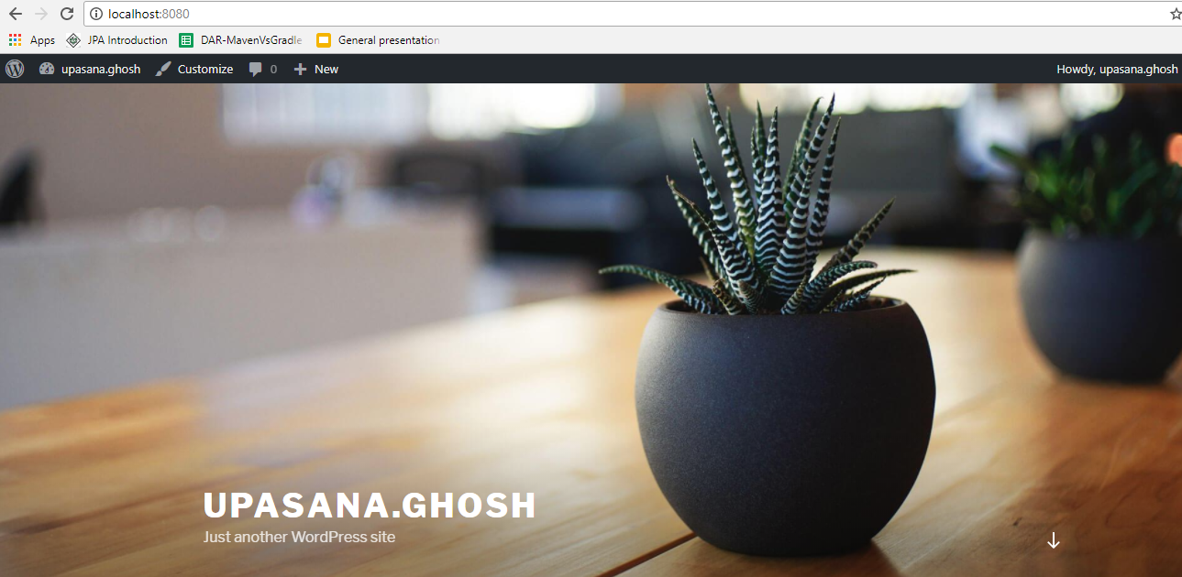
Localhost:8080 (wordpress)

Slide 13
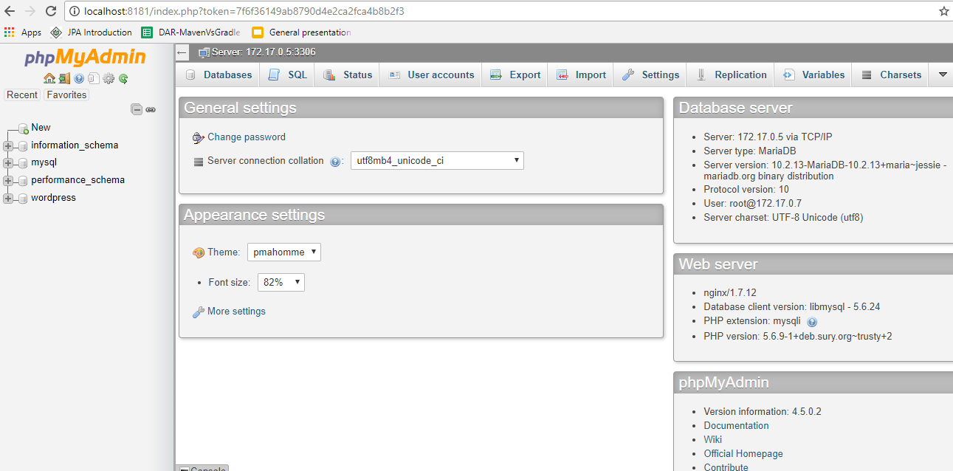
Localhost:8181 (phpMyAdmin)

Slide 14
Container Orchestration
Refers to the automated arrangement, coordination, and management of software containers.
It provides:
Load Balancing
Storage management
Health checks
Auto-[scaling/restart/healing] of containers and nodes
Zero-downtime deploys

Slide 15
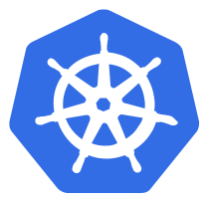
Kubernetes
Open source container orchestration tool.
Used to automate deployments, scaling, and operations of application containers across clusters of hosts
Capable of doing auto-placement, auto-restart, auto-replication and auto-healing of containers extremely well.

Slide 16
Common terms associated with Kubernetes
Kubernetes deploys and schedules containers in groups called pods.
API Server: This component is the management hub for the Kubernetes master node. It facilitates communication between the various components, thereby maintaining cluster health.
Controller Manager: This component ensures that the cluster’s desired state matches the current state by scaling workloads up and down.
Scheduler: This component places the workload on the appropriate node – in this case all workloads will be placed locally on your host.
Kubelet: This component receives pod specifications from the API Server and manages pods running in the host.
Notes:
Each application tier is defined as a pod and can be scaled.
Pods are the atomic unit of a deployment.

Slide 17
References:
https://www.docker.com/
https://docs.docker.com/
https://docs.docker.com/docker-for-windows/install/
https://www.docker.com/what-container
https://kubernetes.io/
https://kubernetes.io/docs/setup/independent/create-cluster-kubeadm/

Slide 18

Thanks!

