Slide 1

An AI Agent for Rapid Evidence-Based Clinical Research Support
By
mTechPesOct24AGrp9
Divya Narasimha Prasanna
Priyanka Jain
Rajani M S
Sunaina Kouser Shukoor
Upadhyay Kiran Maheshchandra

Slide 2

Overview
An AI agent that helps clinical researchers quickly navigate unstructured medical literature and case studies, delivering evidence-based insights and reducing review time from weeks to days.

Slide 3
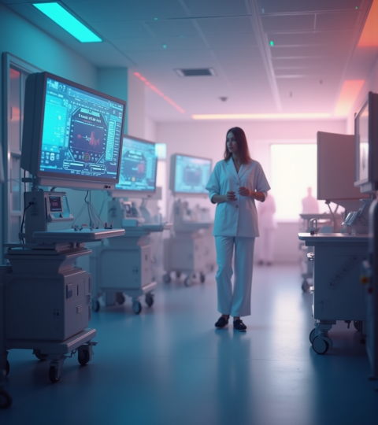
What we have done so far

Slide 4
Literature Survey
Summarization and Simplification of Medical Articles using NLP
In order to improve health literacy, this study compares different transformer-based models(ALBERT, DistilBERT, SciBERT, GPT-2) for extractive summarization of medical articles along with Named Entity Recognition of the medical terms and their simplification using Web Scraping.
Extracting Health Evidence Information from Biomedical Literature using LLMs
With an objective of bridging the gap between research findings and real-world healthcare applications, this study implements a RAG-based LLM(GPT-3.5 turbo, GPT-4, GPT-4 turbo, and GPT-4o ) framework to extract structured PICO-based evidence from biomedical literature which is stored in the form of vector embeddings using FAISS in a knowledge base.
Retrieval-Augmented Generation for Knowledge-Intensive Natural Language Processing Tasks
Combines document retrieval with text generation to produce evidence-based responses using external knowledge, improving factual accuracy and reducing hallucination in language models.
REALM: Retrieval-Augmented Language Model Pre-Training
Introduces retrieval during language model pretraining, enabling models to dynamically access external knowledge and improve factual reasoning without retraining.
Leveraging Passage Retrieval with Generative Models for Open Domain Question Answering
Uses passage retrieval to provide supporting evidence before generating answers, improving accuracy, reasoning, and factual consistency in question answering tasks.
Atlas: Few-shot Learning with Retrieval Augmented Language Models
Uses retrieval-based external memory to enhance few-shot learning performance, enabling language models to work effectively with limited training data and large knowledge sources.
AI Agents in Clinical Medicine
AI agents that combine LLMs with external tools, structured reasoning, and multi-agent collaboration significantly reduce hallucinations and improve multi-step clinical task performance compared to stand-alone LLMs, showing measurable accuracy gains across diverse medical evaluations,showing a median 36% performance gain when architecture is aligned with task complexity.

Slide 5
Bio-Regulatory Event Extraction
LLM-based approaches leverage strong semantic understanding and prompt engineering to extract complex bio-regulatory events with higher precision than traditional NER–RE (Named Entity Recognition + Relation Extraction pipeline) pipelines, demonstrating their potential to reduce cascading errors in biomedical text mining.
Foundational AI Agents in Healthcare
Medical AI agents represent an evolution from isolated predictive models to autonomous, multimodal systems capable of integrating EHRs, imaging, and real-time data to support diagnosis, treatment planning, and adaptive clinical decision-making.
Levels of Evidence in EBM
While the hierarchy of evidence prioritizes randomized controlled trials for guiding clinical decisions, the true reliability of medical research depends on rigorous methodology, and even lower-level evidence plays a critical role in hypothesis generation and innovation.
Federated knowledge retrieval elevates large language model performance on biomedical benchmarks
The BTE-RAG framework reduces biomedical hallucinations by replacing statistical patterns with real-time, federated retrieval from structured databases like the BioThings Explorer API. This approach significantly boosts accuracy—increasing gene-centric task performance by over 24%—to provide a more transparent and reliable tool for clinical research.
Evaluating Retrieval-Augmented Generation vs. Long-Context Input for Clinical Reasoning over EHRs
Retrieval-Augmented Generation (RAG) offers a highly efficient alternative to processing massive, redundant electronic health records by retrieving only task-relevant passages to ground LLM reasoning. This approach achieves performance parity with full-context models while significantly reducing computational costs and token requirements in clinical settings.
Retrieval-Augmented Generation in Medicine: A Scoping Review of Technical Implementations, Clinical Applications, and Ethical Considerations
This scoping review identifies that while RAG addresses medical LLM limitations like hallucinations and static knowledge, most current research relies on public datasets and "Naive RAG" architectures. To achieve clinical readiness, the field must shift toward rigorous clinical validation, private data integration, and improved oversight of safety and bias.

Slide 6
Harnessing LLMs for Medical Insights: NER Extraction from Summarized Medical Text
Produce concise summaries on the unstructured medical data used LLMs like PEGASUS, T5 and GPT-3; with the outperformance on PEGASUS using evaluation metrics. Adopted NER model to extract the vital entities for classification in medical text. NER extraction of vital entities is useful for question-answering.
Biomedical Chat Assistant with Personalized Document Reader Using BioMistral and RAG
Biomedical Chat Assistant is developed which is equipped with a personalized reader for documents, using the capabilities provided by the pretrained BioMistral model and Retrieval-Augmented Generation techniques.

Slide 7

Open Questions
How do we connect all literature survey studies to define project scope and problem statement?
How to choose best suited models for fulfilling our project objectives? Should we do a comparative evaluation using several models?
What should be our next priority after completing literature review?
Where can we get the real dataset for unstructured medical data?
When can we update to Overleaf?
When is the last date to complete the Literature Survey?

Slide 8

Plan for upcoming week and next steps

Slide 9
Continue Literature Survey on relevant research papers and articles.
Search for topic related datasets.
Try defining the problem statement and scope for the project based on literature survey.
Identify challenges/gaps in existing researches and see of we can include them in our project scope.

Slide 10
Key Accomplishments – 15/03
Literature survey of 50 articles encompassing the following framework/models,
Different LLM models
RAG framework for context-aware grounded output
Information retrieval mechanisms
User Interface and prompt template to display the summary of the unstructured medical data
Evaluation metrics
Introduction and Literature Survey in Overleaf for the first submission
Initial draft of flow diagram
15-Mar-26

Slide 11
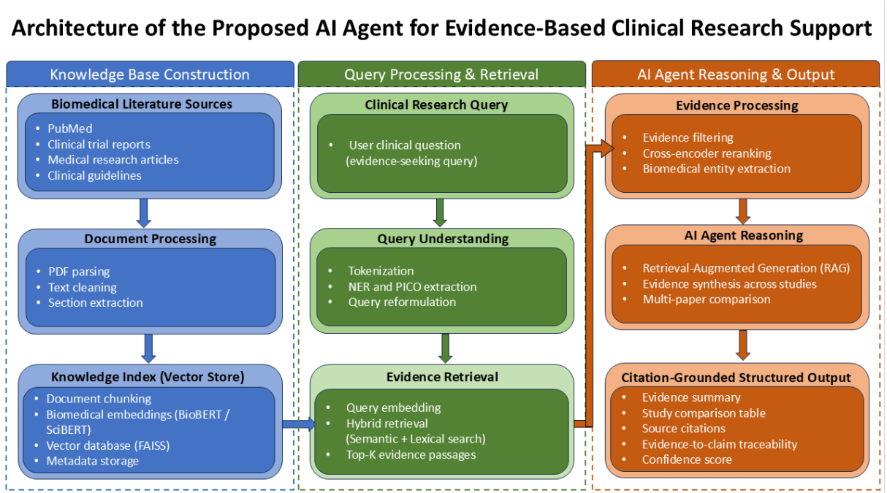
Healthcare Research Assistant Flow Diagram

Slide 12
Next Steps
Work towards the Foundation chapter
Algorithm selection
Real-time dataset/database for the unstructured medical data
User Interface for Question-Answering

Slide 13
Questions
Any protocol to be followed to select?
Database/dataset
Algorithm/models, LLMs
Retrieval and search mechanisms
Is there any upper limit for AI and Similarity score of the report content?
Do we need to submit plagiarism report for entire chapter with every submission?
Is BioMistral a good choice of LLM for our project?
When should we start coding?

Slide 14
Key Accomplishments – 05/04
Completed Literature Survey
Submitted for Plagiarism
- AI score < 20%
- Similarity score = 10%
Started with the Foundation Chapter
Collating the research on BioMistral
- Finding is adapting LoRA for fine-tuning the attention layer that can run on a local machine with the available hardware. Fine-tuning by adding the Low Rank matrices rather than changing the original parameters.
Datasets/PDFs collected from PubMed

Slide 15
Next Steps:
Continue with the Foundation Chapter
Work on the PDF documents, pre-processing steps
Submit the Literature Survey from the Olympus tool

Slide 16
Questions:
Can we continue with the LoRA/QLoRA approach for fine-tuning?
Can we use PubMeb dataset that is in PDF or convert into text format?

Slide 17
Thank you

