Slide 1

Proposed Capstone Project Ideas by
mTechPesOct24AGrp9
Our Team Divya Narasimha Prasanna Priyanka Jain Rajani M S Sunaina Kouser Shukoor Upadhyay Kiran Maheshchandra

Slide 2

Idea 1
AI-based Defect De-Duplication System

Slide 3
Objectives
Our aim
The goal
- To design an AI-based system capable of detecting duplicate defect reports.
- To apply NLP techniques to understand semantic similarity between defect descriptions.
- To implement machine learning / deep learning models for accurate classification.
- To reduce manual triaging effort and improve bug resolution time.
- To build a scalable and deployable prototype for real-world usage.
- Automated identification of duplicate defects with high accuracy (>85%).
- Reduction in manual triaging time by 60–80%.
- Faster bug resolution cycles.
- Scalable prototype suitable for enterprise integration.

Slide 4
Scope
The project scope includes:
- Preprocessing and cleaning of defect report text data.
- Feature extraction using traditional NLP and transformer-based embeddings.
- Training supervised and unsupervised ML models for similarity detection.
- Development of a REST-based or web-based interface for duplicate prediction.
- Performance evaluation using standard NLP metrics.
Out of scope:
- Automated bug fixing.
- Root cause analysis automation.

Slide 5
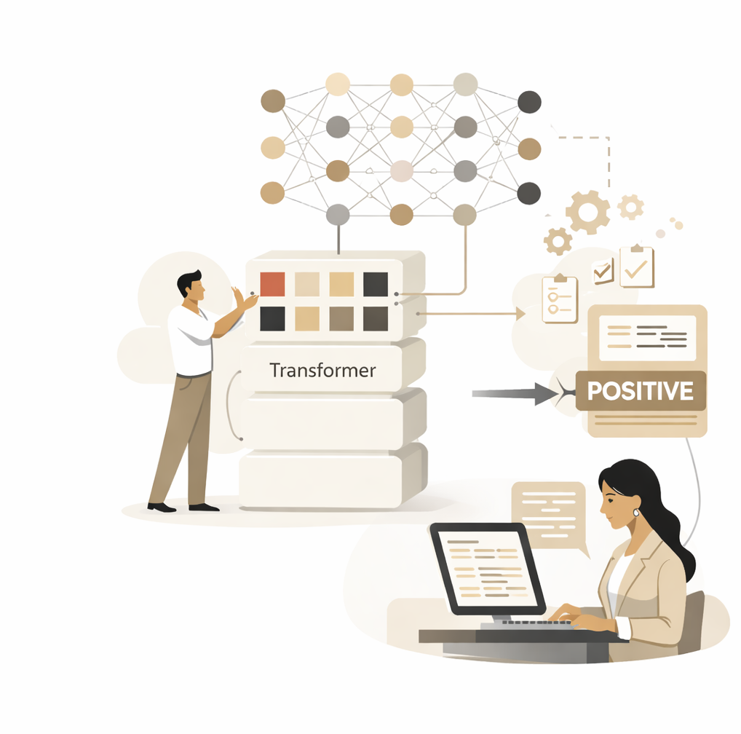
Idea 2
Selection, Optimization, and Performance Analysis of Transformer-Based Language Models for Text Classification

Slide 6
Problem Statement & Gap
Problem Statement:
Multiple transformer-based language models are available
Organizations struggle to decide:
Which model to use?
How much fine-tuning is needed?
What is the trade-off between accuracy and cost?
Most projects focus on one model, not model selection
Gap:
Lack of a systematic comparison framework for model selection under real-world constraints.

Slide 7
Proposed Idea & Use Case
What We Will Do:
Compare multiple transformer-based models:
DistilBERT
BERT
RoBERTa
Apply them to text classification tasks Evaluate using:
Accuracy metrics
Training efficiency
Inference latency
Outcome: Guidelines to select the most suitable model for deployment.
Primary Use Case:
Text Classification (foundational NLP task)
Applicable Domains:
Support ticket classification
Sentiment analysis
Document routing systems
News categorization
The project is domain-agnostic and focuses on model behavior rather than one application.

Slide 8
Data, Techniques & Evaluation
Datasets (Real-World):
AG News :
Real news articles
Multi-class classification
IMDb Movie Reviews :
Real user-written reviews
Binary sentiment classification
Why these datasets?:
Public, real-world, and widely used
Support reproducibility
Cover different classification settings
Models:
DistilBERT (lightweight)
BERT-base
RoBERTa-base
Techniques:
Fine-tuning
Partial layer freezing
Optimizer and learning rate comparison
Evaluation Metrics:
Performance Metrics: Accuracy, Precision, Recall, F1-score
Efficiency Metrics: Training time, GPU memory usage
Inference Metrics: Inference latency

Slide 9
Idea 3
An AI agent that helps clinical researchers quickly navigate unstructured medical literature and case studies, delivering evidence-based insights and reducing review time from weeks to days

Slide 10
Problem
Problem
Clinical researchers spend weeks manually reviewing:
Unstructured medical literature
Case studies
Clinical trial reports
PDFs, guidelines, EMRs, and white papers
This leads to:
Slow evidence synthesis
Information overload
Missed insights
High human effort & cost

Slide 11
Solution
Text Input (PDF/Text)
Text Preprocessing
Parsing
Cleaning
AI Agent
Define the task to extract the structured data by querying
NLP processing
Create vectors
Embeddings
Semantic Relationship
User Interface

Slide 12
Idea 4
Agentic-EdTech Personalized AI Tutor with Long-Term Memory

Slide 13
Problem:
Most existing e-learning platforms provide static or shallow personalization. They adapt content only based on recent quizzes or session-level performance,
Ignoring:
Long-term learning behavior
Forgetting patterns
Learning speed differences
Concept dependencies
This results in one-size-fits-all learning, poor retention, and disengagement.

Slide 14
Solution:
This project proposes an Agentic AI-based Personalized Tutor that:
Acts as an autonomous tutor agent
Observes student interactions continuously
Maintains long-term memory of
Strengths & weaknesses
Learning pace
Mistake patterns
Concept mastery over time
Plans personalized learning paths
Adapts content difficulty in real time
Learns from feedback (student success/failure)
The tutor is not just a recommender — it is an autonomous decision-making agent.
Software & Programming Used: The project is implemented primarily in Python. PyTorch and Stable-Baselines3 are used to build the reinforcement-learning tutor agent, while Gymnasium defines the student–tutor interaction environment. Pandas/NumPy handle student datasets and long-term memory storage, with optional Flask/Streamlit for a demo interface.

Slide 15
Data Source
We can combine Real+synthetic datasets.
Publicly Available Datasets : ASSISTments Dataset
EdNet Dataset : Large-scale real student data
KDD Cup Educational Datasets : ·Student problem-solving sequences
Research Gap:
🔴 Gap 1: Lack of Long-Term Personalization : Most tutoring systems Reset or weakly retain student history and Ignore forgetting and concept decay.
🔴 Gap 2: Limited Agent Autonomy : Use static policies and Do not self-improve teaching strategies
🔴 Gap 3: Poor Adaptation to Learning Pace : Treat all students similarly and Struggle with slow or irregular learners
🔴 Gap 5: Limited Explainability : Black-box tutors reduce trust.

Slide 16
Idea 5
Explainable AI (XAI) for Credit Scoring and Loan Approval

Slide 17
Problem:
"Black box" deep learning models (like XGBoost or Neural Nets) offer high accuracy for credit scoring but lack transparency. This project implements and evaluates Post-hoc Explainability methods to ensure loan approval decisions are fair and understandable.

Slide 18
Solution:
1. Model Training: Train a complex model (Gradient Boosting or Deep Learning) on a dataset like the Indian Credit Dataset
2. Bias Detection: ). Use metrics like Disparate Impact or Demographic Parity to measure if the model discriminates against a protected group (e.g., age or gender).
3. Explainability Layer: Implement SHAP (Shapley Additive Explanations) to generate global and local feature importance plots.
4. Fairness Mitigation: Apply a pre-processing technique (like Reweighting) or in-processing technique (like Adversarial Debiasing) to reduce bias.
5. Dashboard: Build a dashboard (using Streamlit or Dash) that visualizes the "Why" behind a rejection (e.g., "Loan rejected because credit history < 2 years").

Slide 19

Thanks!
Our Team
Divya Narasimha Prasanna
Priyanka Jain
Rajani M S
Sunaina Kouser Shukoor
Upadhyay Kiran Maheshchandra

