Slide 1


3
Derivatives
Copyright © Cengage Learning. All rights reserved.

Slide 2

Derivatives of Trigonometric Functions
3.3
Copyright © Cengage Learning. All rights reserved.

Slide 3
Derivatives of Trigonometric Functions
In particular, it is important to remember that when we talk about the function f defined for all real numbers x by
f (x) = sin x
it is understood that sin x means the sine of the angle whose radian measure is x. A similar convention holds for the other trigonometric functions cos, tan, csc, sec, and cot.
All of the trigonometric functions are continuous at every number in their domains.

Slide 4
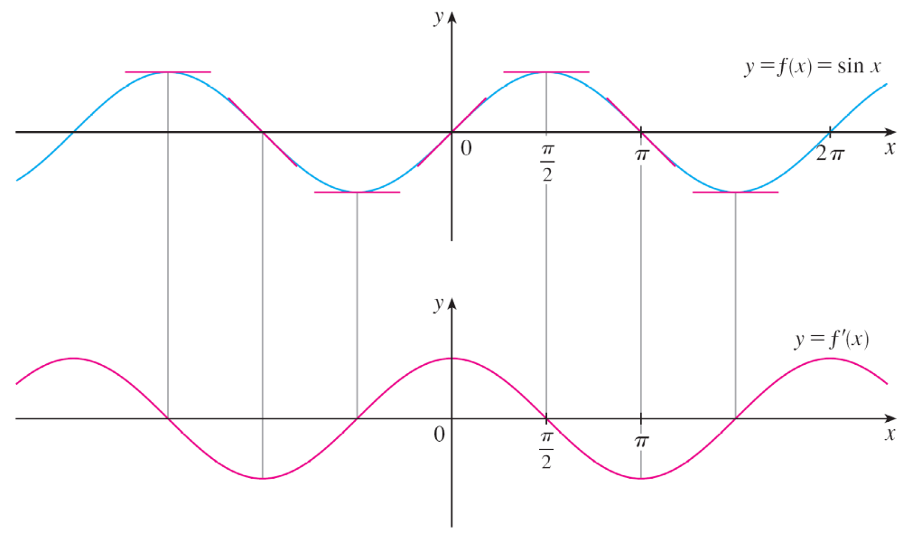
Derivatives of Trigonometric Functions
If we sketch the graph of the function f (x) = sin x and use
the interpretation of f ′(x) as the slope of the tangent to the sine curve in order to sketch the graph of f ′, then it looks as if the graph of f ′ may be the same as the cosine curve.
(See Figure 1).
Figure 1

Slide 5
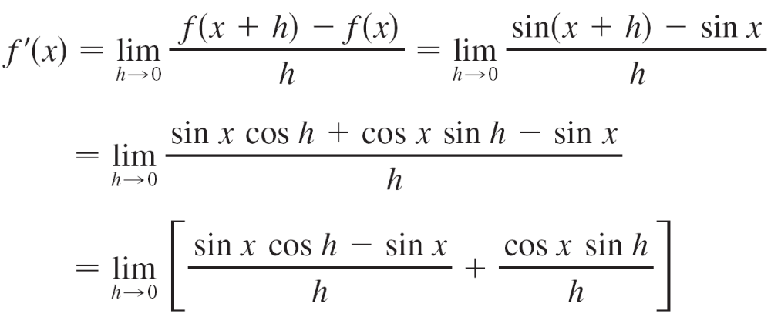
Derivatives of Trigonometric Functions
Let’s try to confirm our guess that if f (x) = sin x, then f ′(x) = cos x. From the definition of a derivative, we have

Slide 6
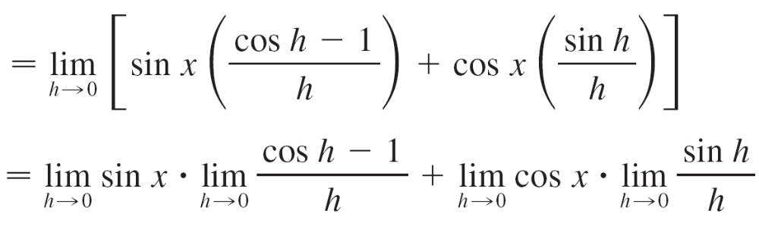



Derivatives of Trigonometric Functions
Two of these four limits are easy to evaluate. Since we regard x as a constant when computing a limit as h → 0, we have
and

Slide 7
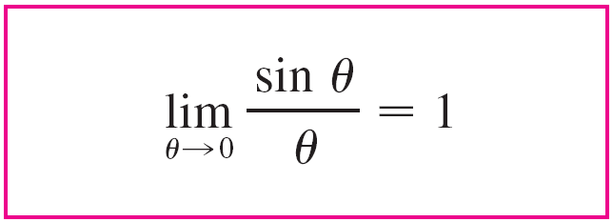

Derivatives of Trigonometric Functions
The limit of (sin h)/h is not so obvious. We made the guess, on the basis of numerical and graphical evidence, that

Slide 8
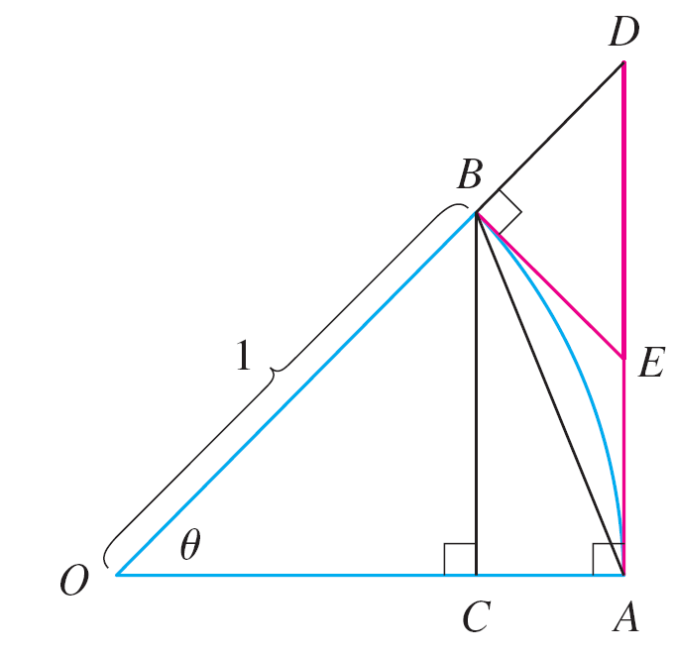
Derivatives of Trigonometric Functions
We now use a geometric argument to prove Equation 2. Assume first that θ lies between 0 and π /2. Figure 2(a) shows a sector of a circle with center O, central angle θ, and radius 1.
BC is drawn perpendicular to OA.
By the definition of radian measure,
we have arc AB = θ.
Also | BC | = | OB | sin θ = sin θ.
Figure 2(a)

Slide 9
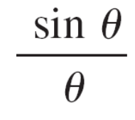
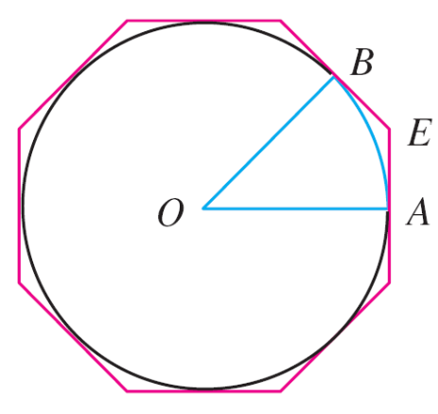
Derivatives of Trigonometric Functions
From the diagram we see that
| BC | < | AB | < arc AB
Therefore sin θ < θ so < 1
Let the tangent lines at A and B
intersect at E. You can see from
Figure 2(b) that the circumference
of a circle is smaller than the
length of a circumscribed polygon,
and so arc AB < | AE | + | EB |.
Figure 2(b)

Slide 10
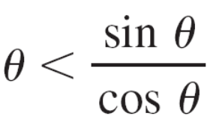
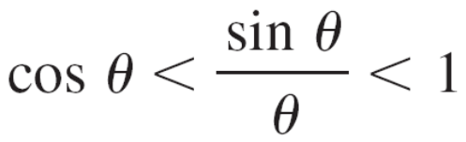
Derivatives of Trigonometric Functions
Thus
θ = arc AB < | AE | + | EB |
< | AE | + | ED |
= | AD | = | OA | tan θ
= tan θ
Therefore we have
so

Slide 11
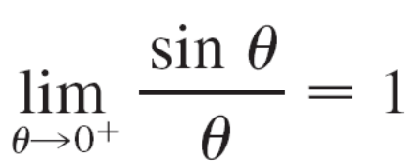
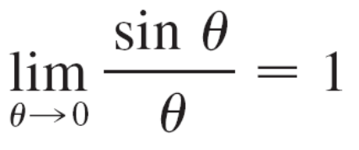
Derivatives of Trigonometric Functions
We know that lim_{θ →0} 1 = 1 and lim_{θ →0} cos θ = 1, so by the Squeeze Theorem, we have
But the function (sin θ)/θ is an even function, so its right and left limits must be equal. Hence, we have
so we have proved Equation 2.

Slide 12

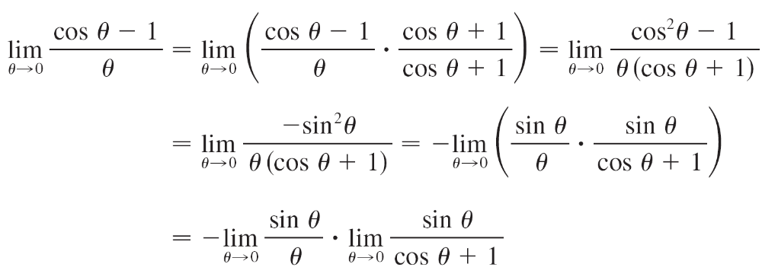
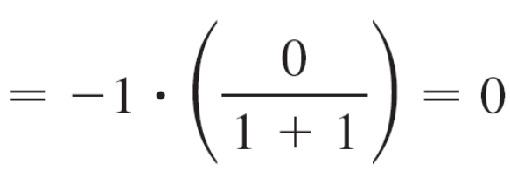
Derivatives of Trigonometric Functions
We can deduce the value of the remaining limit in as follows:
(by Equation 2)

Slide 13
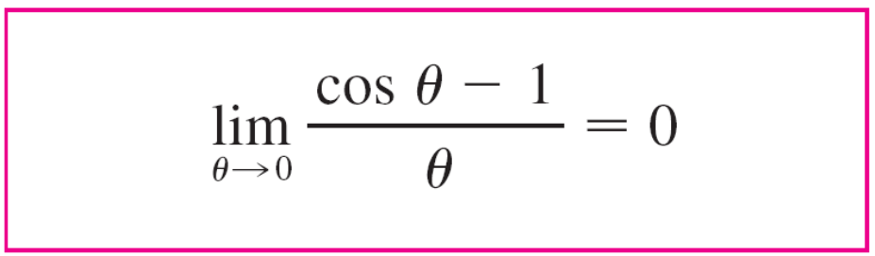




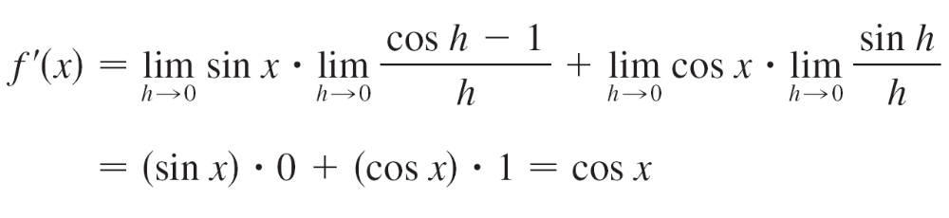
Derivatives of Trigonometric Functions
If we now put the limits and in we get

Slide 14
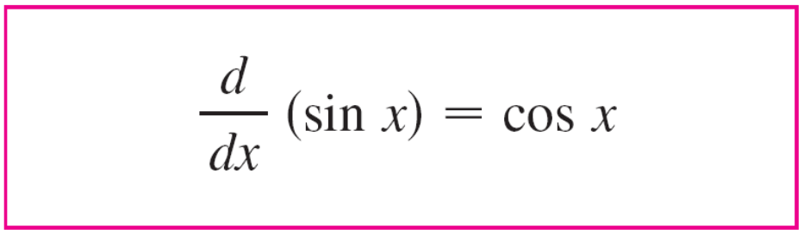

Derivatives of Trigonometric Functions
So we have proved the formula for the derivative of the sine function:

Slide 15
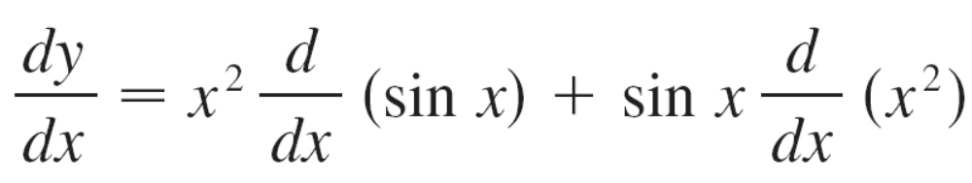

Example 1
Differentiate y = x² sin x.
Solution:
Using the Product Rule and Formula 4, we have

Slide 16
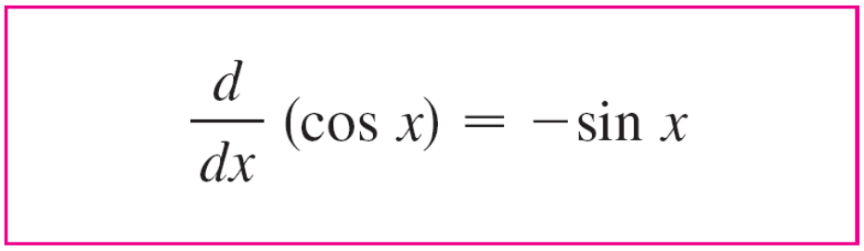

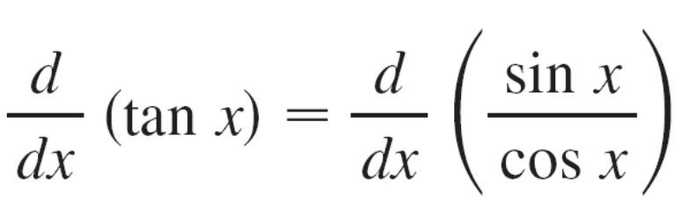
Derivatives of Trigonometric Functions
Using the same methods as in the proof of Formula 4, one can prove that
The tangent function can also be differentiated by using the definition of a derivative, but it is easier to use the Quotient Rule together with Formulas 4 and 5:

Slide 17
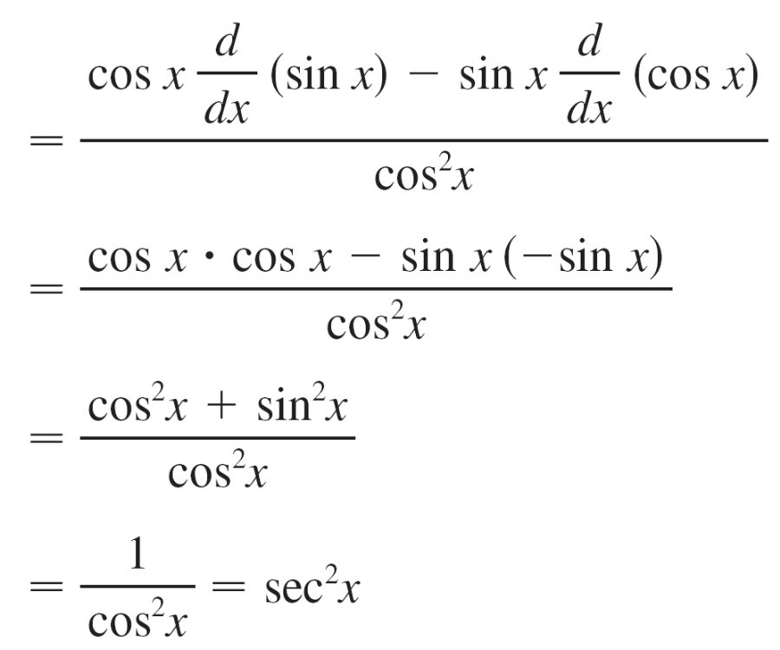
Derivatives of Trigonometric Functions

Slide 18
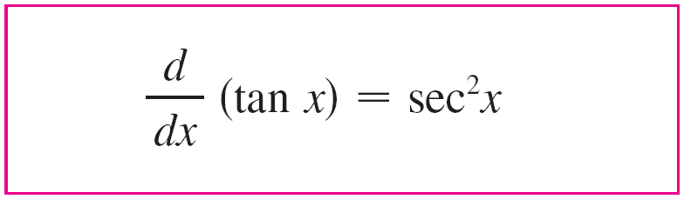

Derivatives of Trigonometric Functions
The derivatives of the remaining trigonometric functions, csc, sec, and cot, can also be found easily using the Quotient Rule.

Slide 19
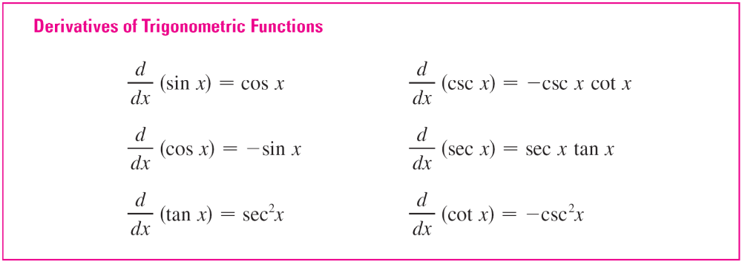
Derivatives of Trigonometric Functions
We collect all the differentiation formulas for trigonometric functions in the following table. Remember that they are valid only when x is measured in radians.

Slide 20
Derivatives of Trigonometric Functions
Trigonometric functions are often used in modeling real-world phenomena. In particular, vibrations, waves, elastic motions, and other quantities that vary in a periodic manner can be described using trigonometric functions. In the following example we discuss an instance of simple harmonic motion.

Slide 21
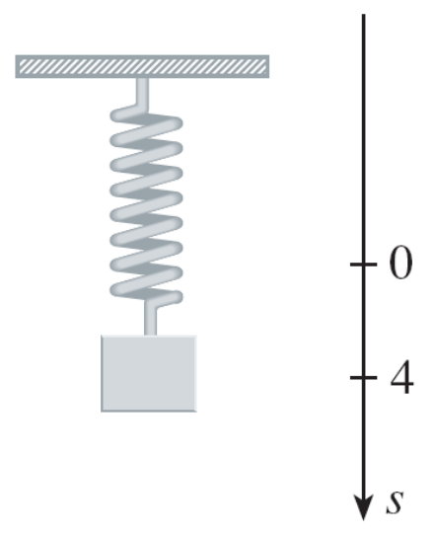
Example 3
An object at the end of a vertical spring is stretched 4 cm beyond its rest position and released at time t = 0. (See Figure 5 and note that the downward direction is positive.)
Its position at time t is
s = f (t) = 4 cos t
Find the velocity and acceleration
at time t and use them to analyze
the motion of the object.
Figure 5

Slide 22
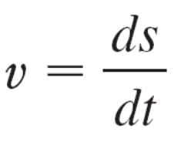
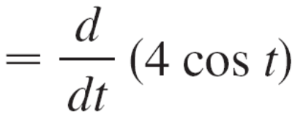
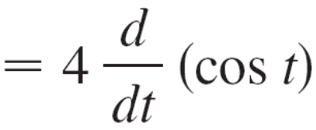

Example 3 – Solution
The velocity and acceleration are

Slide 23
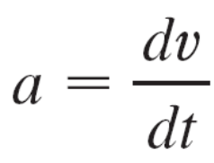
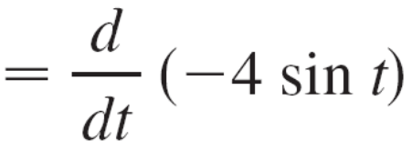
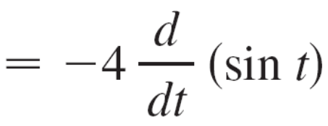

Example 3 – Solution
cont’d
The object oscillates from the lowest point (s = 4 cm) to the highest point (s = –4 cm). The period of the oscillation is 2π, the period of cos t.

Slide 24
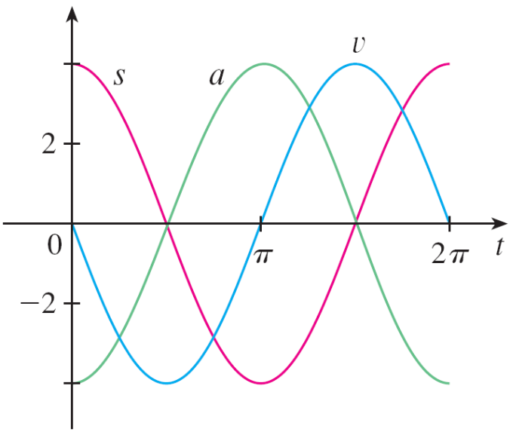
Example 3 – Solution
cont’d
The speed is | v | = 4 | sin t |, which is greatest when | sin t | = 1, that is, when cos t = 0.
So the object moves fastest as it passes through its equilibrium position (s = 0). Its speed is 0 when sin t = 0, that is, at the high and low points.
The acceleration a = –4 cos t = 0 when s = 0. It has greatest magnitude at the high and low
points. See the graphs in Figure 6.
Figure 6

