Slide 1
Queue

Slide 2
Queue Introduction
Like Stack, Queue is a linear structure which follows a particular order in which the operations are performed.
The order is First In First Out (FIFO). A good example of queue is any queue of consumers for a resource where the consumer that came first is served first.
The difference between stacks and queues is in removing. In a stack we remove the item the most recently added; in a queue, we remove the item the least recently added.

Slide 3
Operations on Queue:
Mainly the following four basic operations are performed on queue:
Enqueue: Adds an item to the queue. If the queue is full, then it is said to be an Overflow condition.
Dequeue: Removes an item from the queue. The items are popped in the same order in which they are pushed. If the queue is empty, then it is said to be an Underflow condition.
Front: Get the front item from queue.
Rear: Get the last item from queue.

Slide 4




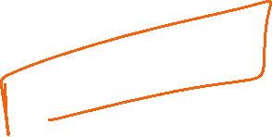






Implement LRU Cache
Problem Statement: “Design a data structure that follows the constraints of Least Recently Used (LRU) cache”.
Implement the LRUCache class:
LRUCache(int capacity) we need to initialize the LRU cache with positive size capacity.
int get(int key) returns the value of the key if the key exists, otherwise return -1.
Void put(int key,int value), Update the value of the key if the key exists. Otherwise, add the key-value pair to the cache.if the number of keys exceeds the capacity from this operation, evict the least recently used key.
The functions get and put must each run in O(1) average time complexity.
Example: Input: ["LRUCache", "put", "put", "get", "put", "get", "put", "get", "get", "get"]
[[2], [1, 1], [2, 2], [1], [3, 3], [2], [4, 4], [1], [3], [4]]
Output: [null, null, null, 1, null, -1, null, -1, 3, 4]

Slide 5




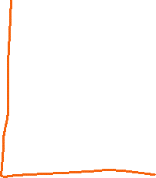


















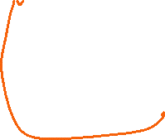











Slide 6











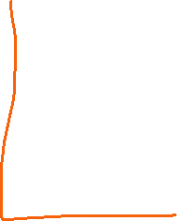












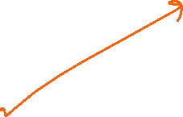










Slide 7
LFU Cache
Design and implement a data structure for a Least Frequently Used (LFU) cache.
Implement the LFUCache class:
LFUCache(int capacity) Initializes the object with the capacity of the data structure.
int get(int key) Gets the value of the key if the key exists in the cache. Otherwise, returns -1.
void put(int key, int value) Update the value of the key if present, or inserts the key if not already present. When the cache reaches its capacity, it should invalidate and remove the least frequently used key before inserting a new item. For this problem, when there is a tie (i.e., two or more keys with the same frequency), the least recently used key would be invalidated.
To determine the least frequently used key, a use counter is maintained for each key in the cache. The key with the smallest use counter is the least frequently used key.
When a key is first inserted into the cache, its use counter is set to 1 (due to the put operation). The use counter for a key in the cache is incremented either a get or put operation is called on it.
The functions get and put must each run in O(1) average time complexity.

Slide 8
Input ["LFUCache", "put", "put", "get", "put", "get", "get", "put", "get", "get", "get"] [[2], [1, 1], [2, 2], [1], [3, 3], [2], [3], [4, 4], [1], [3], [4]]
Output [null, null, null, 1, null, -1, 3, null, -1, 3, 4]

Slide 9
Design and implement a Least Frequently Used(LFU) Cache, to implement the following functions:
Design and implement a data structure for a Least Frequently Used (LFU) cache.
Implement the LFUCache class:
LFUCache(int capacity) Initializes the object with the capacity of the data structure.
int get(int key) Gets the value of the key if the key exists in the cache. Otherwise, returns -1.
void put(int key, int value) Update the value of the key if present, or inserts the key if not already present. When the cache reaches its capacity, it should invalidate and remove the least frequently used key before inserting a new item. For this problem, when there is a tie (i.e., two or more keys with the same frequency), the least recently used key would be invalidated.
To determine the least frequently used key, a use counter is maintained for each key in the cache. The key with the smallest use counter is the least frequently used key.
When a key is first inserted into the cache, its use counter is set to 1 (due to the put operation). The use counter for a key in the cache is incremented either a get or put operation is called on it.
The functions get and put must each run in O(1) average time complexity.

