Slide 2
Linked List
Linked List can be defined as collection of objects called nodes that are randomly stored in the memory.
A node contains two fields i.e. data stored at that particular address and the pointer which contains the address of the next node in the memory.
The last node of the list contains pointer to the null.

Slide 3
Types of Linked List
The following are the types of linked list:
Singly Linked list
Doubly Linked list
Circular Linked list
Doubly Circular Linked list

Slide 4
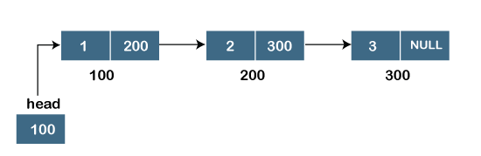
Singly Linked list

Slide 5
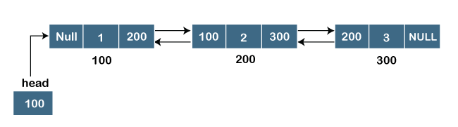
Doubly linked list

Slide 6
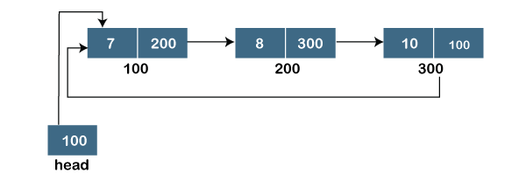
Circular linked list

Slide 7
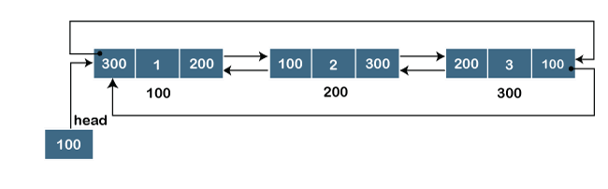
Doubly Circular linked list

Slide 8
Practice Questions LinkedList
Circular LinkedList
Doubly Linked List Deletion of a node
https://leetcode.com/problems/remove-nth-node-from-end-of-list/
https://leetcode.com/problems/linked-list-cycle-ii/
https://leetcode.com/problems/palindrome-linked-list/
https://practice.geeksforgeeks.org/problems/remove-loop-in-linked-list/1
https://practice.geeksforgeeks.org/problems/circular-linked-list/1
https://practice.geeksforgeeks.org/problems/given-a-linked-list-of-0s-1s-and-2s-sort-it/1

Slide 9
Practice Questions Array
https://practice.geeksforgeeks.org/problems/spirally-traversing-a-matrix-1587115621/1
https://practice.geeksforgeeks.org/problems/union-of-two-arrays3538/1
https://leetcode.com/problems/best-time-to-buy-and-sell-stock/
https://practice.geeksforgeeks.org/problems/factorials-of-large-numbers2508/1
https://practice.geeksforgeeks.org/problems/missing-number-in-array1416/1
https://practice.geeksforgeeks.org/problems/rotate-array-by-n-elements-1587115621/1
https://practice.geeksforgeeks.org/problems/array-of-alternate-ve-and-ve-nos1401/1

