Slide 1
Tree Introduction

Slide 2
Introduction to Tree Data Structure
the tree data structure is a kind of hierarchal data arranged in a tree-like structure. It consists of a central node, structural nodes, and sub nodes, which are connected via edges. We can also say that tree data structure has roots, branches, and leaves connected with one another.

Slide 3
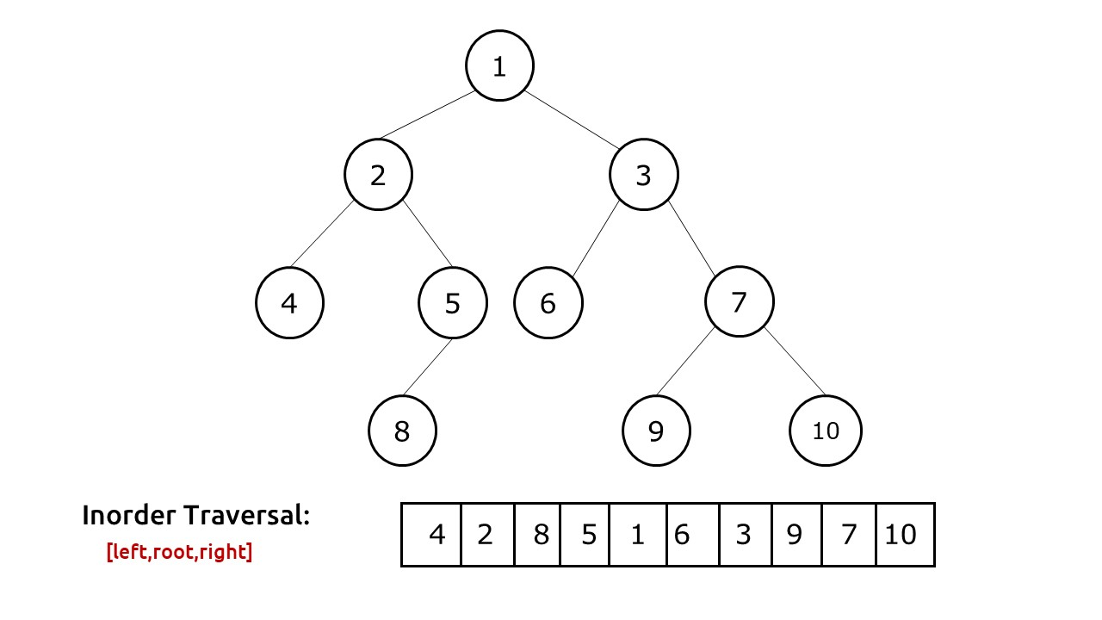
Inorder Traversal of Binary Tree
Problem Statement: Given a Binary Tree. Find and print the inorder traversal of Binary Tree.
Examples:
Input:
Output: The inOrder Traversal is : 4 2 8 5 1 6 3 9 7 10

Slide 4
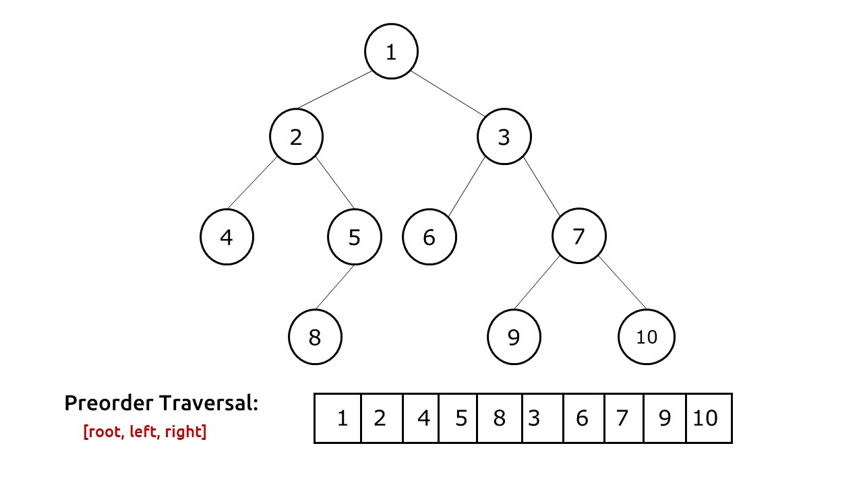
Preorder Traversal of Binary Tree
Problem Statement: Given a binary tree print the preorder traversal of binary tree.
Example:

Slide 5
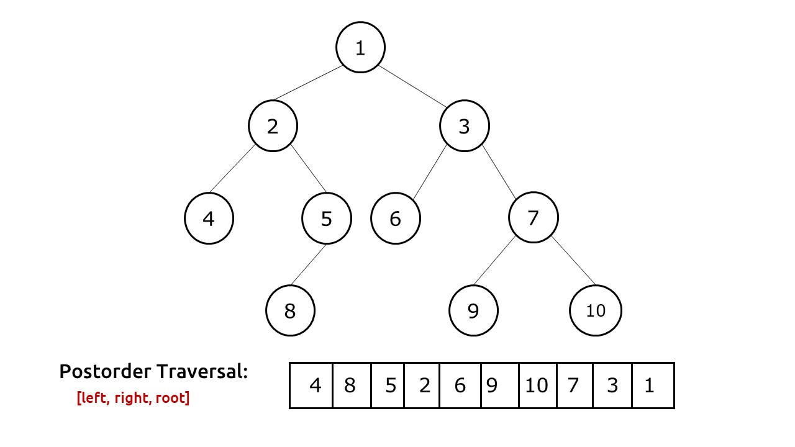
Post-Order Traversal Of Binary Tree
Problem Statement: Write a program for the postorder traversal of a binary tree.
Example:

Slide 6
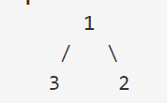
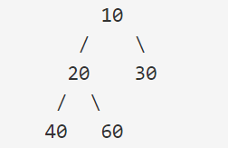
Right/Left view of binary tree
Problem Statement: Given a Binary Tree, find the Right/Left view of it. The right view of a Binary Tree is a set of nodes visible when the tree is viewed from the right side. The left view of a Binary Tree is a set of nodes visible when the tree is viewed from the left side.
Example 1:
Input:
Output: Right view- 1 2 Left view- 1 3
Explanation: Seeing through the left side it sees only 1 and 3 while through the right side we only see 1 and 2.
Example 2:
Input:
Output: Right View- 10 30 60 Left view- 10 20 40

Slide 7
Bottom view of a Binary Tree
Problem Statement: Given a binary tree, print the bottom view from left to right. A node is included in the bottom view if it can be seen when we look at the tree from the bottom.
Example 1:
Input:
Output: 3 1 2
Example 2:
Input:
Output: 40 20 60 30

Slide 8

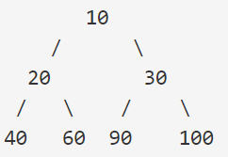
Top view of a Binary Tree
Problem Statement: Given below is a binary tree. The task is to print the top view of the binary tree. The top view of a binary tree is the set of nodes visible when the tree is viewed from the top.
Example 1:
Input:
Output: 2 1 3
Example 2:
Input:
Output: 40 20 10 30 100

Slide 9
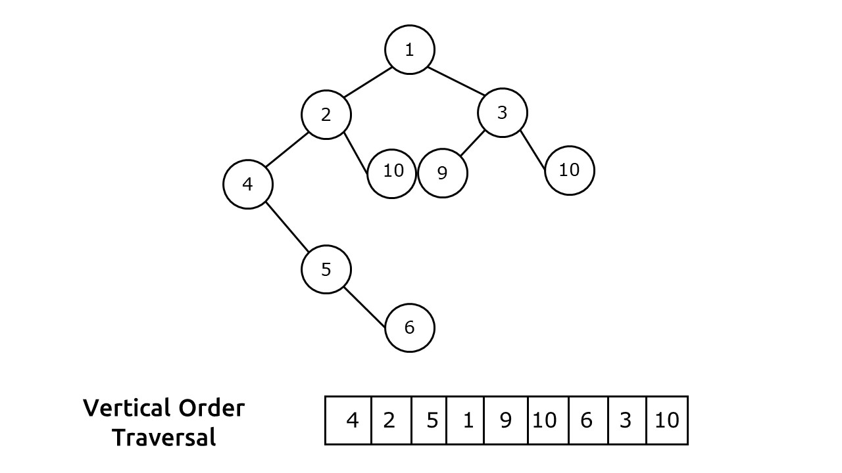
Vertical Order Traversal of Binary Tree
Problem Statement: Vertical Order Traversal Of A Binary Tree. Write a program for Vertical Order Traversal order of a Binary Tree.
Example:

Slide 10
Print Root to Node Path in a Binary Tree
Problem Statement: Print Root to Node Path In A Binary Tree. Write a program to print path from root to a given node in a binary tree.
Problem Description:
We are given a binary tree T and a node V. We need to print a path from the root of the tree to the node.
Note:
No two nodes in the tree have the same data value.
It is assured that the node V is present and a path always exists.
Examples:

Slide 11
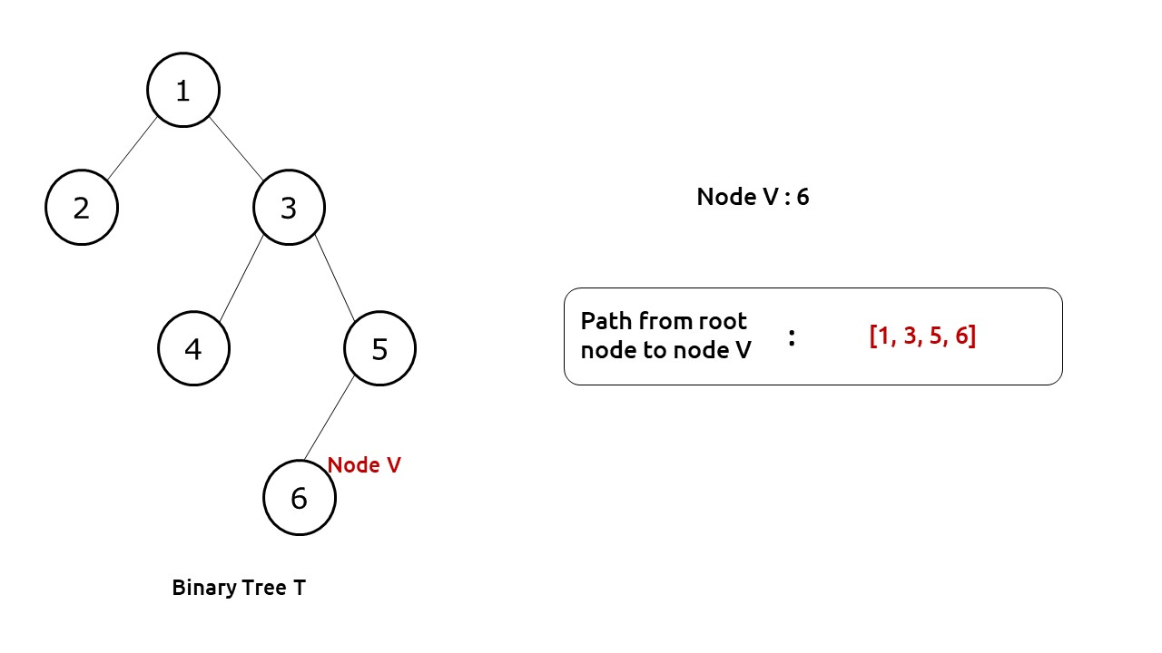

Slide 12
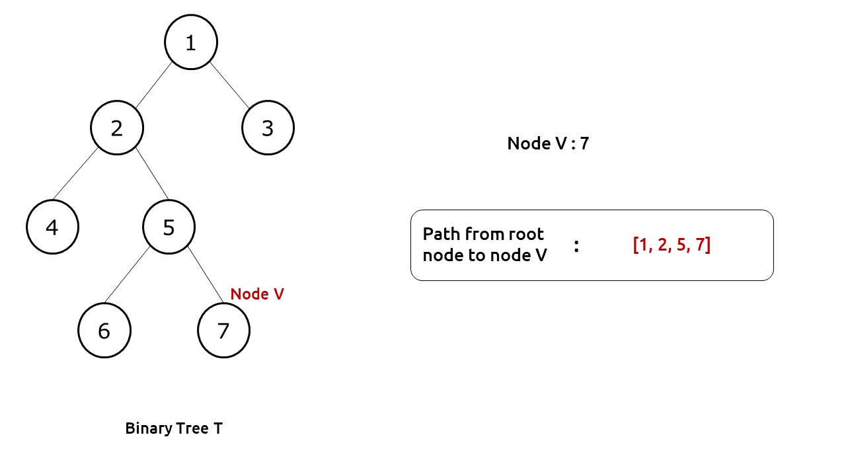

Slide 13
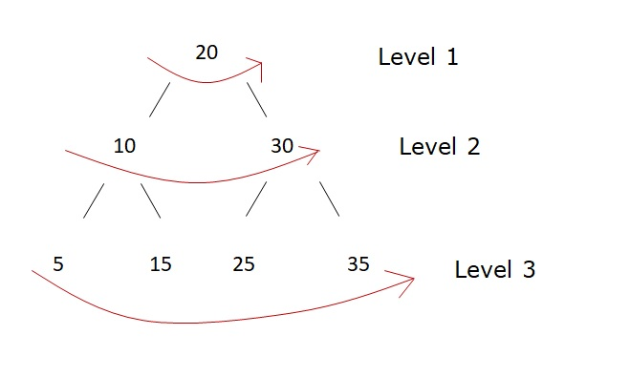
Level Order Traversal of a Binary Tree
Problem Statement: Level order traversal of a binary tree. Given the root node of the tree and you have to print the value of the level of the node by level.
Example 1:
Output:
20 10 30 5 15 25 35

Slide 14
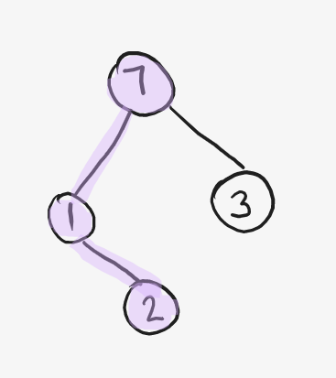

Maximum depth of a Binary Tree
Problem Statement: Find the Maximum Depth of Binary Tree. Maximum Depth is the count of nodes of the longest path from the root node to the leaf node.
Examples:
Input Format: Given the root of Binary Tree
Result: 4
Explanation: Maximum Depth in this tree is 4 if we follow path 5 – 1 – 3 – 8 or 5 – 1 – 3 – 11
Input Format: Given the root of Binary Tree
Result: 3
Explanation: Maximum Depth in this tree is 3 , if we follow path 7 – 1 – 2. If we follow 7 – 3 path then depth is 2 ( not optimal)
Input Format: Given the root of Binary Tree

Slide 15
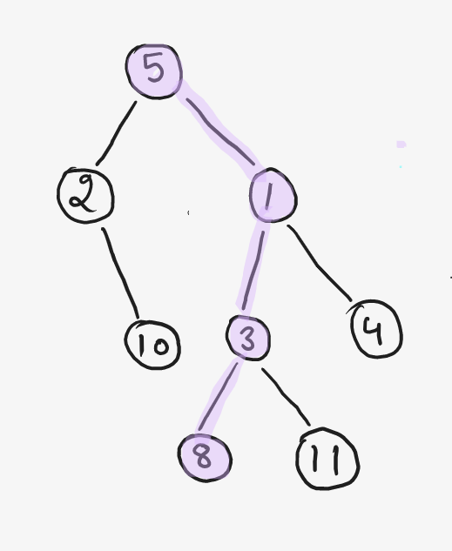

Slide 16
Calculate the Diameter of a Binary Tree
Problem Statement: Find the Diameter of a Binary Tree. Diameter is the length of the longest path between any 2 nodes in the tree and this path may or may not pass from the root.
Example 1:
Input Format: Given the root of Binary Tree
Diameter of a Binary Tree
Result: 4
Explanation: Longest Path available is 7 – 4 – 8 – 1 – 3 of length 4
Example 2:
Input Format: Given the root of Binary Tree
Result: 6
Explanation: Longest Path available is 5 – 3 – 1 – 8 – 0 – 2 – 0 of length 6. ( Path is not Passing from root ).

Slide 17
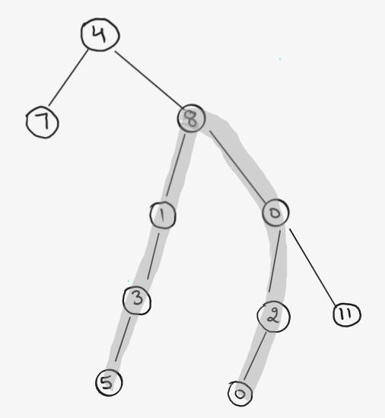
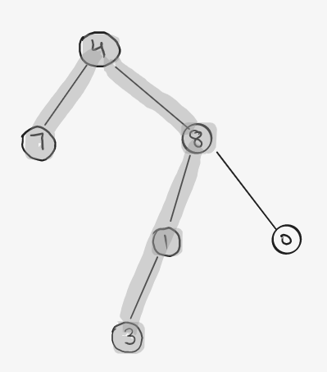

Slide 18
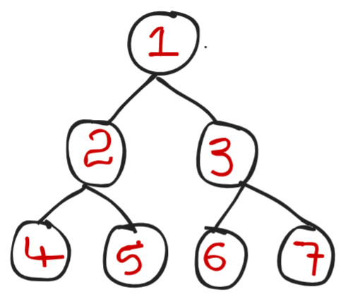
Lowest Common Ancestor for two given Nodes
Problem Statement: Given a binary tree, Find the Lowest Common Ancestor for two given Nodes (x,y).
Lowest Common Ancestor(LCA): The lowest common ancestor is defined between two nodes x and y as the lowest node in T that has both x and y as descendants (where we allow a node to be a descendant of itself.
Examples:
Consider the following Binary Tree
Example 1:
Input: x = 4 , y = 5 Output: 2 Explanation:
All ancestors for 4,5 are 2,1. But we need Lowest Common ancestor, So we will consider lowest and also common ancestor that is 2
Example 2: Input: x = 2 , y = 3 Output: 1
Explanation: Lowest Common Ancestor for x,y i.e for 2,3 is 1
Example 3: Input: x= 6 , y = 7 Output: 3
Explanation: Lowest Common Ancestor for x,y i.e for 6,7 is 3

Slide 19
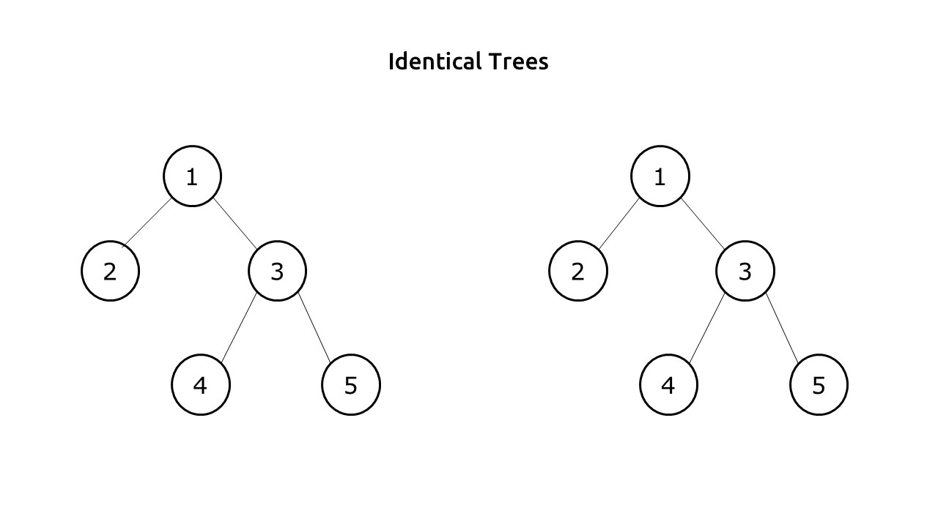
Check if two trees are identical
Problem Statement: Given two Binary Tree. Write a program to check if two trees are identical or not.
Example 1:
Input:
Output: Two Trees are identical

Slide 20
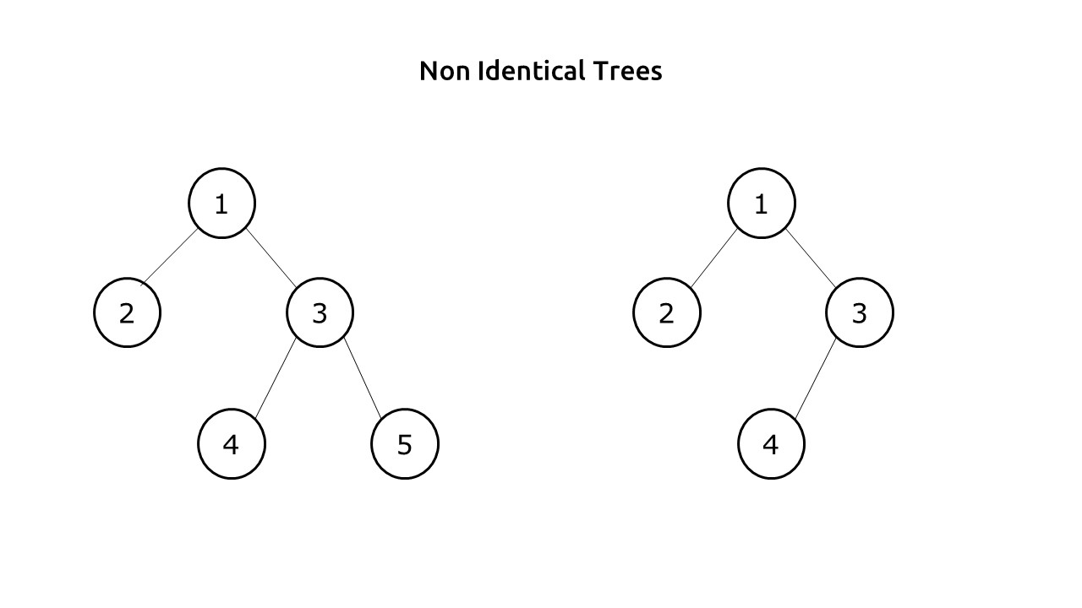

Slide 21
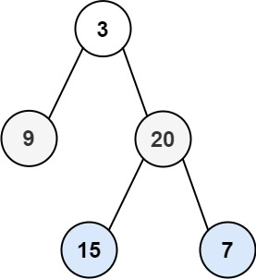
Zig Zag Traversal Of Binary Tree
Problem Statement: Given the root of a binary tree, return the zigzag level order traversal of Binary Tree. (i.e., from left to right, then right to left for the next level and alternate between).
Examples:
Example 1: Input: root = [3,9,20,null,null,15,7]
Output: [[3],[20,9],[15,7]]
Explaination: From the root, we follow this terminology, left to right -> right to left -> left to right and so on so forth.
Example 2: Input: root = [[0]] Output : [[0]]
Explanation: We just have a single node which acts as the root, so going from left to right, we get just one node that is the root node itself.

Slide 22
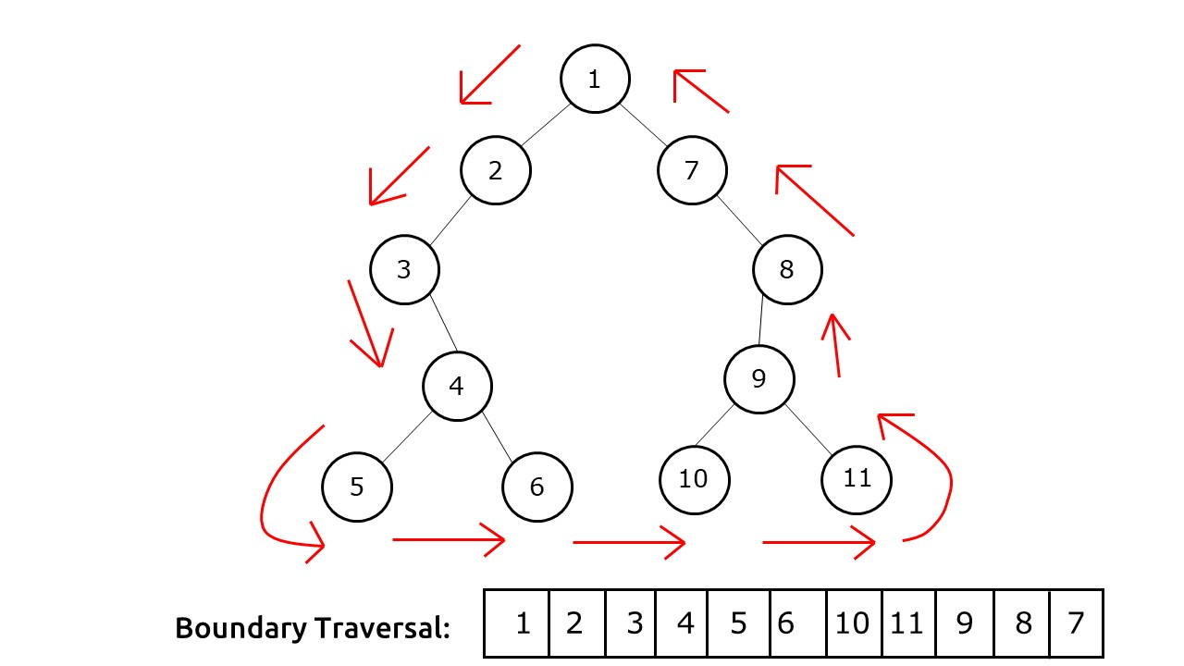
Boundary Traversal of a Binary Tree
Problem Statement: BoundaryTraversal of a binary tree. Write a program for the Anti-Clockwise Boundary traversal of a binary tree.
Example:

Slide 23
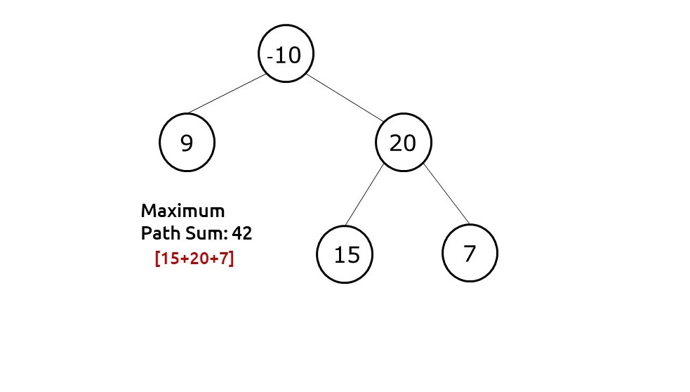
Maximum Sum Path in Binary Tree
Problem Statement: Write a program to find the maximum sum path in a binary tree. A path in a binary tree is a sequence of nodes where every adjacent pair of nodes are connected by an edge. A node can only appear in the sequence at most once. A path need not pass from the root. We need to find the path with the maximum sum in the binary tree.
Example:
Input:
Output: The Max Path Sum for the Tree is 42

Slide 24
Check for Symmetrical Binary Tree
Check for Symmetrical Binary Trees
Write a program to check whether a binary tree is symmetrical or not.
Problem Description:
A symmetrical binary tree is a tree that forms a mirror of itself around the center. In other words, every node in the left subtree will have a mirror image in the right subtree.

Slide 25
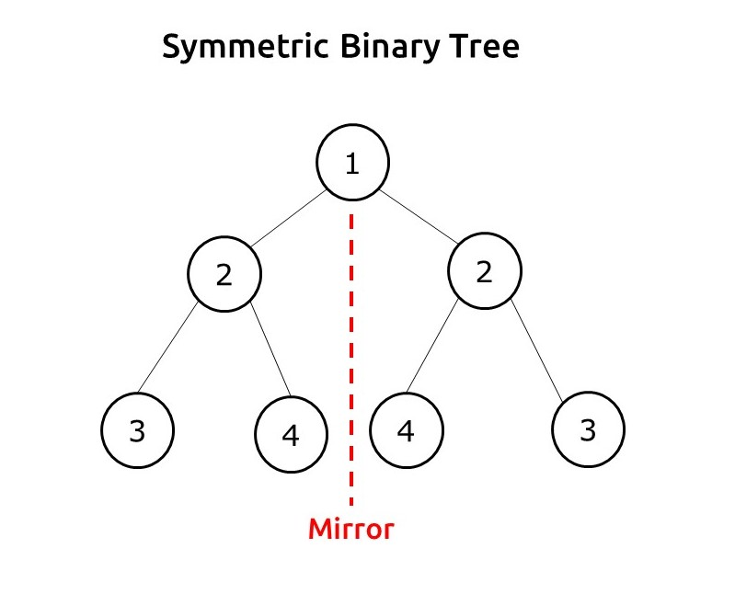

Slide 26
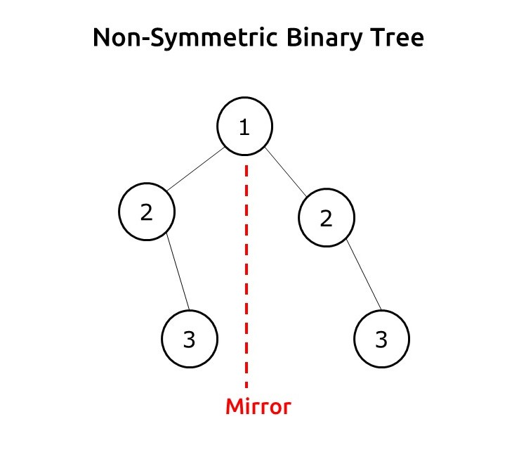

Slide 27
Binary Search Tree
Binary Search Tree is a node-based binary tree data structure which has the following properties:
The left subtree of a node contains only nodes with keys lesser than the node’s key.
The right subtree of a node contains only nodes with keys greater than the node’s key.
The left and right subtree each must also be a binary search tree.
Some Interesting Facts:
Inorder traversal of BST always produces sorted output.
We can construct a BST with only Preorder or Postorder or Level Order traversal. Note that we can always get inorder traversal by sorting the only given traversal.

Slide 28
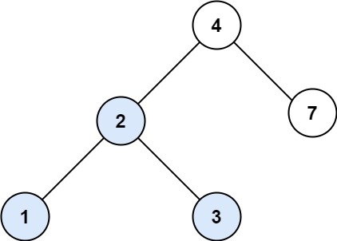
Search in a Binary Search Tree
You are given the root of a binary search tree (BST) and an integer val.
Find the node in the BST that the node's value equals val and return the subtree rooted with that node. If such a node does not exist, return null.
Input: root = [4,2,7,1,3], val = 2 Output: [2,1,3]

Slide 29
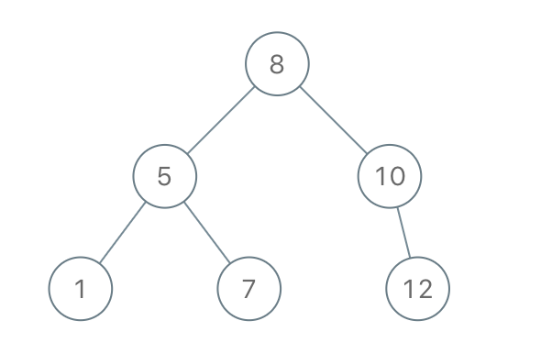
Construct Binary Search Tree from Preorder Traversal
Given an array of integers preorder, which represents the preorder traversal of a BST (i.e., binary search tree), construct the tree and return its root.
It is guaranteed that there is always possible to find a binary search tree with the given requirements for the given test cases.
A binary search tree is a binary tree where for every node, any descendant of Node.left has a value strictly less than Node.val, and any descendant of Node.right has a value strictly greater than Node.val.
A preorder traversal of a binary tree displays the value of the node first, then traverses Node.left, then traverses Node.right.
Input: preorder = [8,5,1,7,10,12] Output: [8,5,10,1,7,null,12]
Example 2:
Input: preorder = [1,3] Output: [1,null,3]

Slide 30
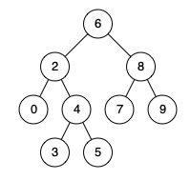
Lowest Common Ancestor of a Binary Search Tree
Given a binary search tree (BST), find the lowest common ancestor (LCA) of two given nodes in the BST.
According to the definition of LCA on Wikipedia: “The lowest common ancestor is defined between two nodes p and q as the lowest node in T that has both p and q as descendants (where we allow a node to be a descendant of itself).”
Input: root = [6,2,8,0,4,7,9,null,null,3,5], p = 2, q = 8 Output: 6 Explanation: The LCA of nodes 2 and 8 is 6.

Slide 31
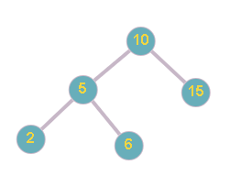
Floor in BST
Problem Statement
Suggest Edit
You are given a BST (Binary search tree) with’ N’ number of nodes and a value ‘X’. Your task is to find the greatest value node of the BST which is smaller than or equal to ‘X’.
Note :‘X’ is not smaller than the smallest node of BST .
For example:

Slide 32
Kth largest/smallest element in Binary Search Tree
Problem statement: Given a binary search tree find the kth largest and smallest element in Binary Search Tree.
Examples:
Input: N=6 Arr=[5,3,6,2,4,1] K=3
Output: Kth largest element is 4 Kth smallest element is 3
Input: N=7 Arr=[10,40,45,20,25,30,50] k=3
Output: Kth largest element is 4 Kth smallest element is 3

Slide 33
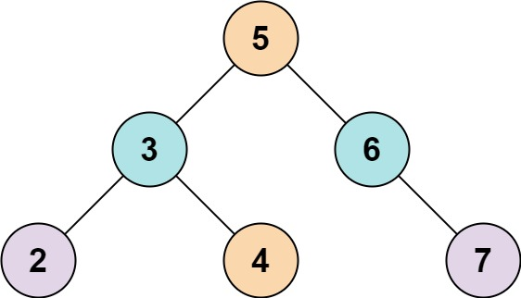
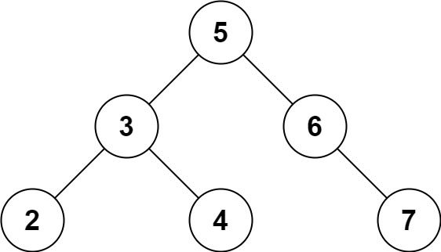
Two Sum IV - Input is a BST
Given the root of a Binary Search Tree and a target number k, return true if there exist two elements in the BST such that their sum is equal to the given target.
Input: root = [5,3,6,2,4,null,7], k = 9 Output: true
Input: root = [5,3,6,2,4,null,7], k = 28 Output: false

