Slide 1
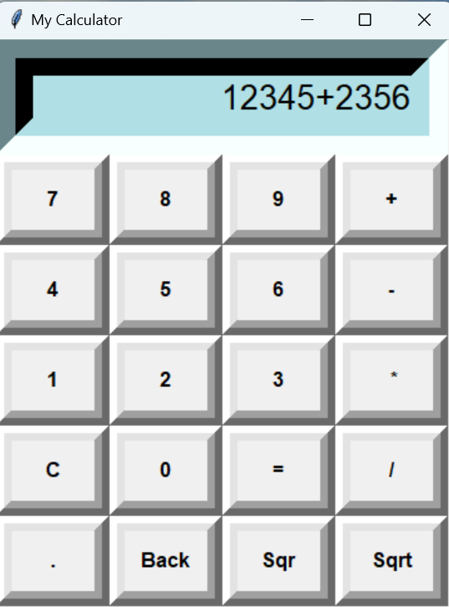

“Design of a GUI Calculator"
Name-Upasna Agrawal
Submission Date-2 sept 2024
Institute and batch: Digicrome
Course name -Post Graduate Program In Data Science & Artificial Intelligence
Project-Python-based calculator

Slide 2
Tools and Technologies
Programming Language: Python
Python libraries : Tkinter
Tkinter: Tkinter is standard GUI library for python which is provide to create a GUI application in easy and faster way.
Development Environment: Visual Studio Code

Slide 3


Key Features
Basic Operators:
Addition
Subtraction
Multiplication
Division
Square root
Square

Slide 4
Explanation of Source Code
The code starts by importing the tkinter library, which provides the necessary tools for creating GUI (graphical user interface) applications.
It then creates a main window for the calculator using the Tk() function from the Tkinter library and assigns it to the variable root.
The root.title() function sets the title of the calculator window to “My Calculator".
We create a global variable called global val which will store the result of the calculation.
Geometry() method is used to set the size of the GUI window.
We have created display as where we can see the result area.

Slide 5
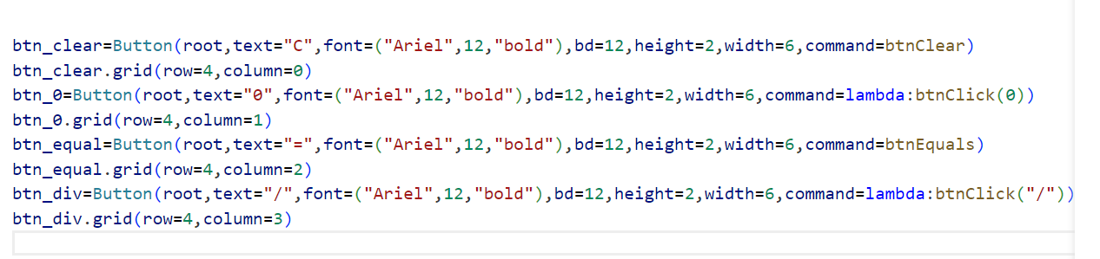
Explanation of Source Code
The code starts with a few basic objects: a Button object, which has properties for text, font, background color, and command; and a grid object.
When the user clicks on one of these buttons, the corresponding command is executed.
Clear() function is used to clear the contents of the text entry box.

Slide 6
Explanation of Source Code
Grid-Using the grid manager is easy to tell the manager in which row and column to place them.
Column span- This is very useful to help get the spacing right for your widgets
Justify- With the help of this result will be display from the right side.
We have created one text variable which I gave the name as Data as “StringVar” and this value will get from get button.

Slide 7
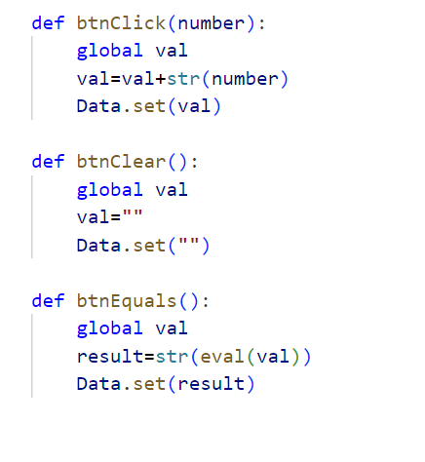
Functions:
For button click : we have defined button click function.
For clear the entry: we have defined button clear function.
For equal function : we have defined button equal function.

Slide 8
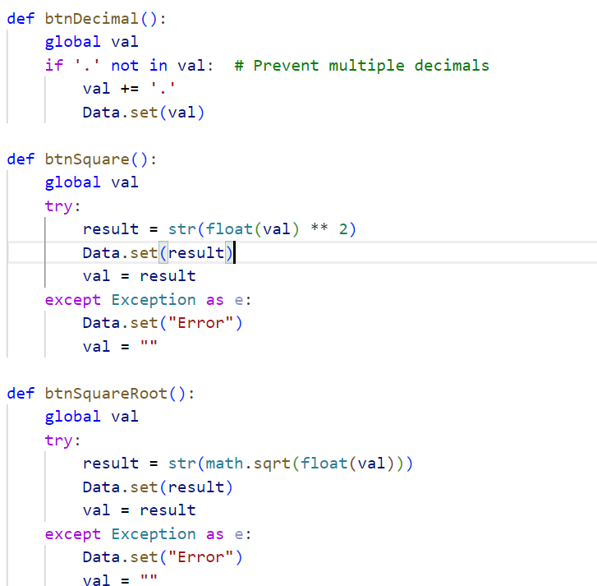
Functions:
For Square : we have defined BtnSquare() for Square function.
For Squareroot: we have defined BtnSquareRoot() for square root function.
For Decimal: we have defined btnDecimal() function.

Slide 9




Thank-You

