Slide 1

Upwork Job Postings Analysis And Recommendation System
Leveraging Data Science for Job Market Insights and Forecasting
Upasna Agrawal

Slide 2

OBJECTIVE SUMMARY
Analyze job market trends using given dataset.
Identify high-demand roles, salary trends, emerging categories.
Provide personalized job recommendations for seekers.
Build an interactive dashboard for real-time visualization of job market analytics.
Understand the impact of remote work trends on job demand and location preferences.
Technologies used: Python, Pandas, Sklearn, Streamlit, Docker.
Feature engineering for job titles
Building a foundation for a job recommendation system.

Slide 3

SITUATIONAL OVERVIEW
Job market influenced by technology, economy, culture.
Need for data-driven insights to navigate dynamics.
Combine historical & current data for predictions & recommendations
Analyzing historical and current job posting data enables prediction of future market trends and emerging job categories.
Rapid changes in skills demand and job roles require real-time analysis to stay updated.
Most jobs had undefined hourly rates (75% reported $0), indicating many fixed-price or negotiable contracts.

Slide 4

PROJECT TASKS & DELIVERABLES OVERVIEW
Correlation analysis between job titles & salaries
Identify emerging job categories
Predict high-demand roles
Compare hourly rates across countries
Build personalized recommendation engine
Track market changes monthly
Analyze remote work trends
Predict future job market trends

Slide 5
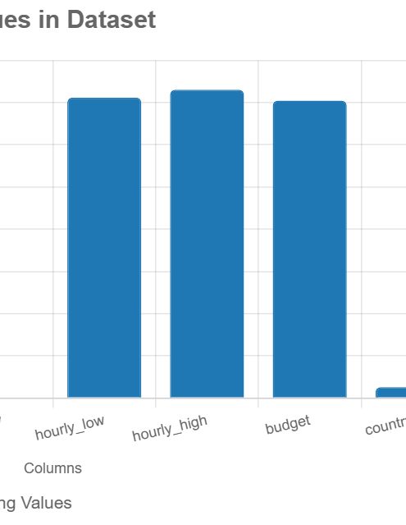
DATASET OVERVIEW
Columns: title: Job title (e.g., "Full Stack Developer").
link: URL to the job posting.
published_date: Date the job was posted.
is_hourly: Boolean indicating hourly or fixed-price jobs.
hourly_low, hourly_high: Hourly rate range.
budget: Fixed-price budget.
country: Client’s country.
Total entries: 244,828.

Slide 6

DATA EXPLORATION
Identified several fields with missing data, especially the hourly rate(low and high) column.
Significant number of rows with missing hourly rate data, which required preprocessing.
Applied preprocessing techniques such as imputation or row removal to handle these null values and ensure data integrity.
Identified top job types with the help of job titles.
Checked correlation between features (e.g., budget vs. hourly rate)
Detected and addressed outliers in budget columns.

Slide 7

DATA EXPLORATION
Salary Distribution Analysis-Majority of entries had $0, indicating non-hourly jobs.
Keyword Correlation with Salary-- Tech-related terms like "Python", "AI", "ML" had higher salary associations.
Used NLP process to clean the title like stop words removal and lower case etc.
High demand for tech roles like web developers and data engineers.
Significant missing data in budget and hourly rates, impacting analysis.

Slide 8
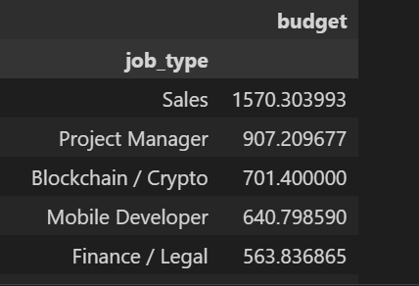
TASK - CORRELATION ANALYSIS
Find out the budget according to job type
Roles like Sales, Project Manager, and Finance/Legal show competitive salaries, suggesting that non-technical skills (e.g., negotiation, management, legal expertise) are also highly valued.
There is a significant disparity in average salaries across job types, with Sales roles earning nearly four times more than roles like Data/AI ML or Marketing.
tech-related roles like Blockchain/Crypto Developer and Mobile Developer are among the higher-paying jobs, reflecting the demand for specialized tech skills.

Slide 9
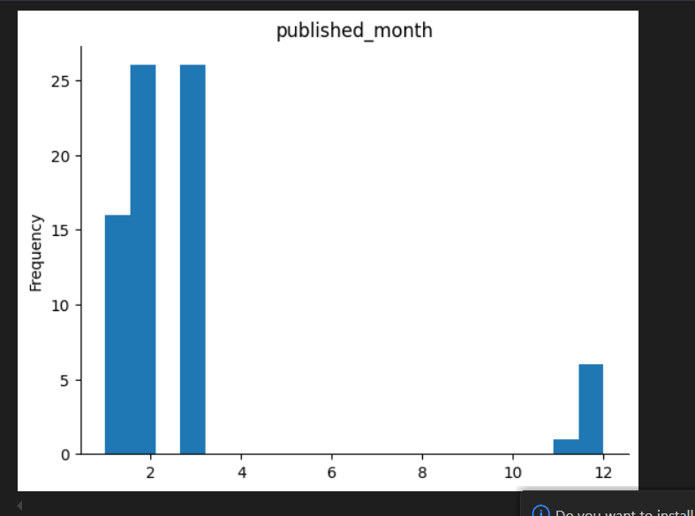
EMERGING JOB CATEGORIES
Analyze postings by month and job type.
chart showing posting frequency trend based on months.
Identify rapidly growing job roles indicating market demand shifts according to month.

Slide 10
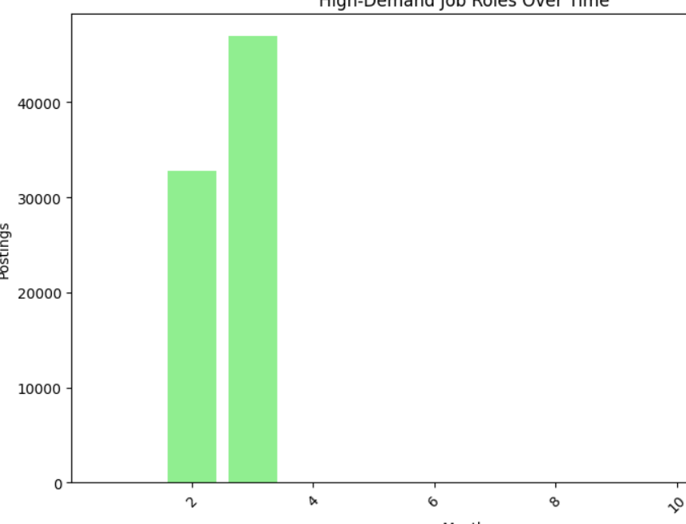
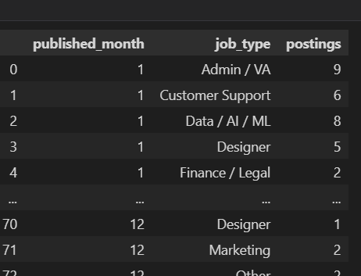
PREDICT HIGH-DEMAND ROLES
Bar chart of total postings by month
Observation: Peaks and troughs in job market activity
Use: Forecasting and planning for talent acquisition

Slide 11
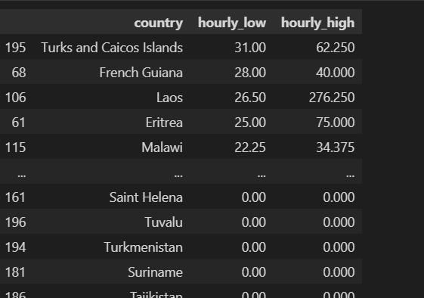
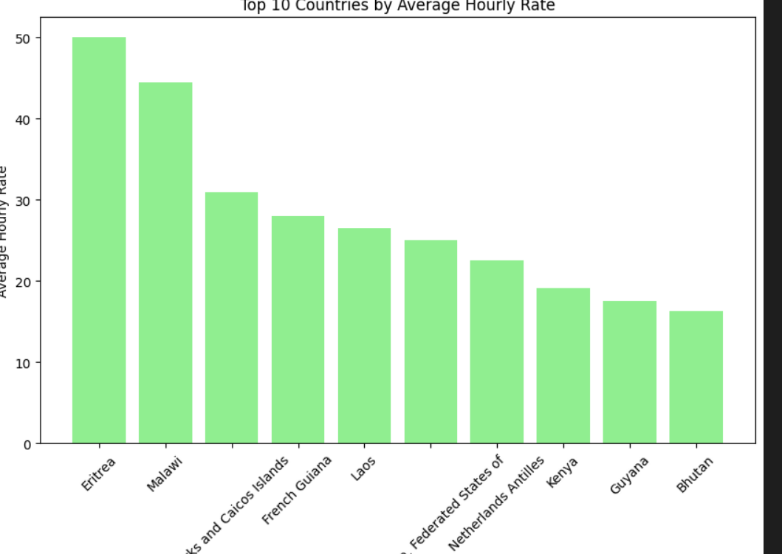
HOURLY RATE COMPARISON
Eritrea and Malawi stand out with notably higher rates, while countries like Bhutan and Guyana offer much lower rates.
This disparity could reflect differences in economic conditions, cost of living, or the types of jobs posted from these regions
Several smaller or less economically prominent countries (e.g., Turks and Caicos Islands, Federated States of Micronesia, Netherlands Antilles) appear in the top 10, which might indicate that clients from these regions are posting high-value, specialized jobs on Upwork.

Slide 12
RECOMMENDATION SYSTEM POTENTIAL
Use NLP to process cleaned title for job categorization.
Match user skills to job titles using techniques like
cosine similarity or clustering.
Incorporate features like country, budget, and is_hourly for personalized recommendations.
Flowchart of recommendation system pipeline: Input: User skills → NLP Processing → Job Matching → Output: Recommended Job. Example: "User with 'Python, Web Development' skills matched to 'Full Stack Developer' jobs."

Slide 13
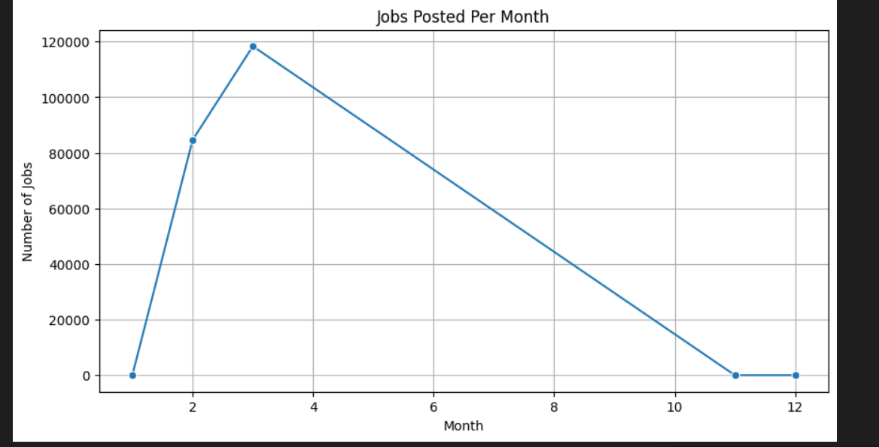
JOB MARKET DYNAMICS DASHBOARD
The number of job postings starts low in January (around 10,000), peaks sharply in March (around 110,000–120,000), and then steadily declines throughout the rest of the year, reaching a low of around 5,000–10,000 by December.
The steady decline from April to December indicates decreasing demand for freelancers over the year. This could be due to project completions, budget exhaustion, or a shift in focus towards in-house hiring as the year progresses.

Slide 14
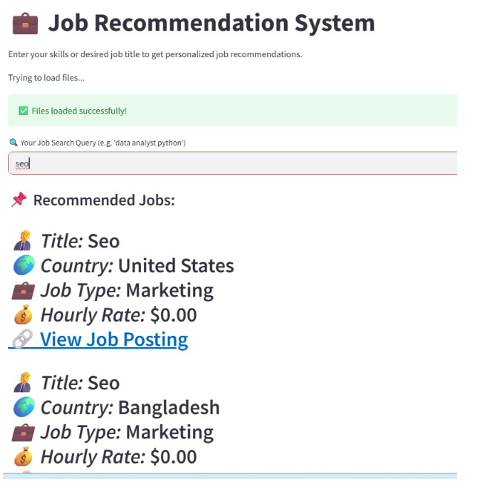
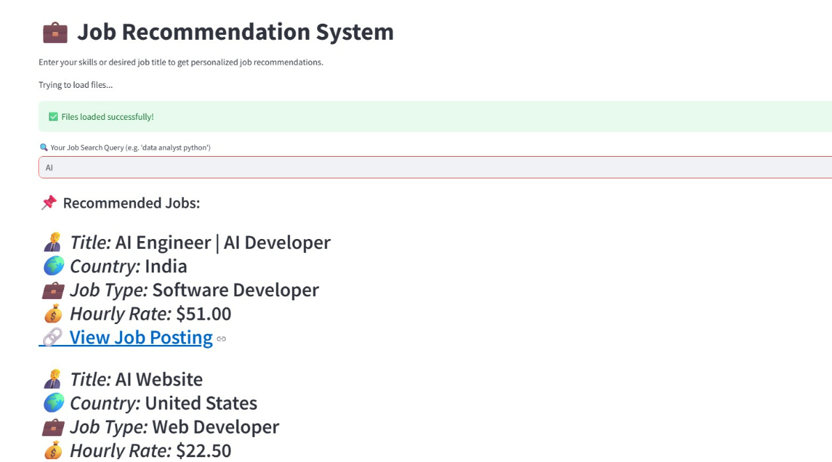
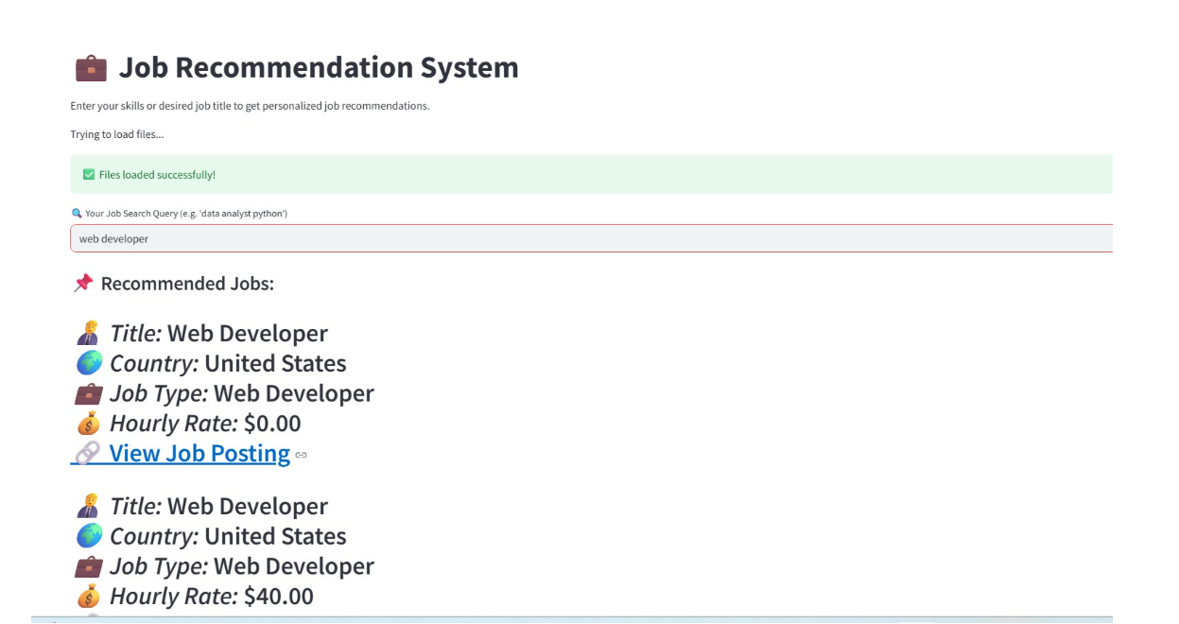
DEPLOYMENT SCREENSHOTS
Few screenshot related successfully deployment with uploaded details .

Slide 15
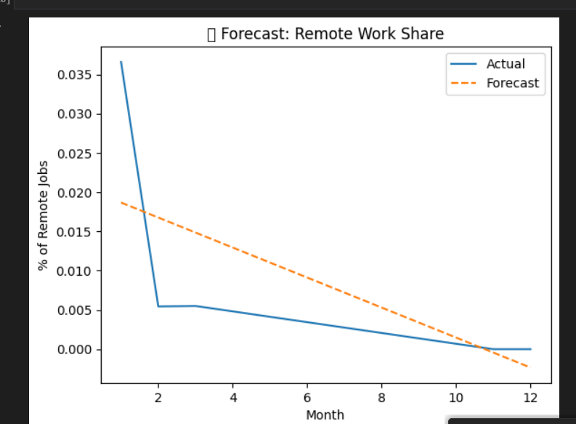
FUTURE JOB MARKET PREDICTION
The percentage of remote jobs starts at approximately 0.035 (3.5%) in Month 2 (February) and remains relatively high initially.
the actual data shows a consistent decline in the percentage of remote jobs from Month 2 to around Month 5–6, dropping to approximately 0.005–0.010 (0.5%–1.0%)

Slide 16
TECHNOLOGY & TOOLS
Data: Job postings dataset
Analytics: Python, SQL, Pandas, Scikit-Learn, TensorFlow
Visualization: Matplotlib, Seaborn, Plot
Containerization: Docker for deployment & scalability

Slide 17
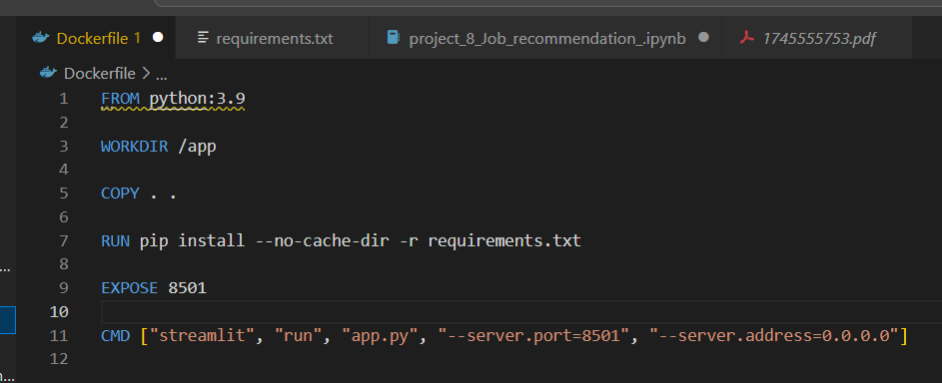
DOCKER INTEGRATION
This organization facilitates easier maintenance and updates, as all relevant files (e.g., requirements.txt, app.py) are copied into /app, streamlining the development and deployment process.
The Dockerize setup with Streamlit provides a foundation for scalability

Slide 18
INSIGHTS AND TRENDS
High demand for tech roles, especially web developers and data engineers.
United States and India are key markets for job postings.
Forecast indicates rising demand for web developers (712 in April, 882 in May 2024).
Missing data in budgets and hourly rates requires careful handling for accurate analysis.

Slide 19
CONCLUSION
Job salaries strongly depend on job type and country
Emerging categories reflect evolving industry needs
Interactive maps enhance geographic salary insights
. Successfully analyzed Upwork job postings and forecasted web developer demand.
Laid foundation for a job recommendation system using NLP and feature engineering.

Slide 20
Thank You

