Slide 1
Analysis of Average Daily Wages of Informal Sector 2006-2012
199362N N.A.N. Senanayake
199306A K.P.U. Anuruddhi
199367J B.M.M. Sonnadara
199352J N.Nilusija
Notes:
Good Morning everyone !!!
We selected the data set of Average Daily Wages of Informal Sector from 2006 - 2012

Slide 2
Introduction
Sectors :
Agriculture Tea
Rubber
Coconut
Paddy
Construction
Carpentry
Masonry
Gender : Male
Female
Period : 2006 - 2012
Notes:
Small description about the data set
http://www.data.gov.lk/dataset/average-daily-wages-informal-sector-2006-2012
The data set was published by the Central Bank of Sri Lanka

Slide 3
Research Questions
What is the percentage wage increase over the years? Does this reflect the inflation rate of the rupee?
Is the wage inequality between male and female decreasing over the years; if so, does proximity to the commercial capital has an effect?
Notes:
We explored the following research questions.
It is very important that the average wages of the employees are being adjusted with time as the inflation rate of the country is varying
2012 inflation rate - 7.6
Next we will check the results we obtained.

Slide 4
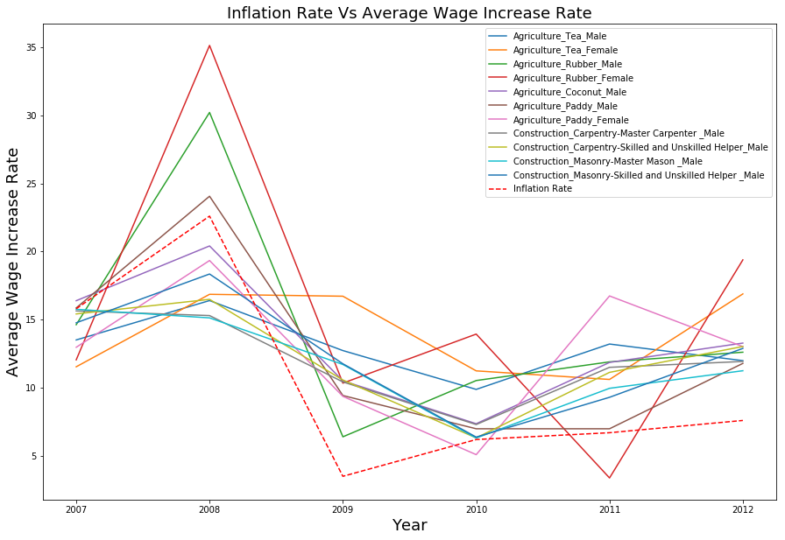
Notes:
We have plotted the variation rate wrt the previous year for the sectors given above for average daily wages. We have considered 11 sectors including both male and female. This is the national (all island) statistics. If we had plotted only the variation rates but not the inflation rate the graph does not make sense except for the variation pattern. Once inflation rate is included to the graph which is the red dotted line we can see how the wage variation flows with the inflation rate. As we can see in the graph the inflation rate is very high and has continued to increase from 2007 to 2008. This is the civil war era in Sri Lanka and the wage rate is not in par with the inflation rate for most of the sectors. After 2008 the inflation rate has dropped and the increase rate is also low comparatively. Even though the inflation rate has increased from 2009 to 2012 as well, we can happily say that the average wage has also increased with a sufficient rate for the workers in the informal sector. Next let’s look at how the average wage increase rate has varied in different provinces for some of the sectors.
What we are trying to analyse next is whether the same pattern can be seen in individual sectors.

Slide 5
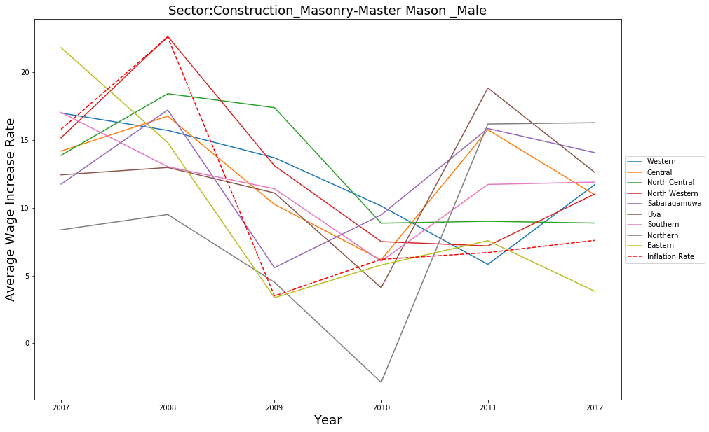
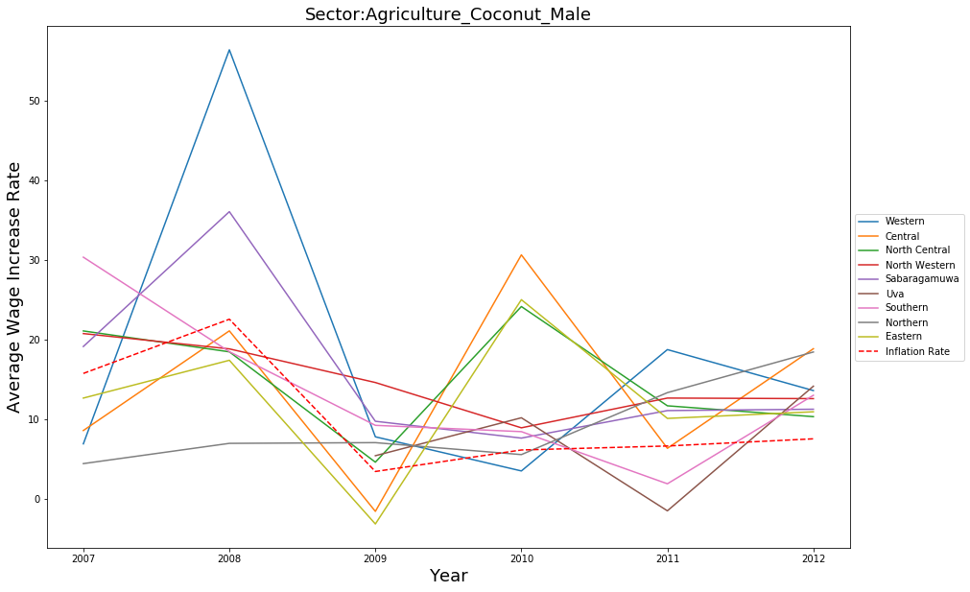
Wage Increase Rate - Sector wise Analysis
Notes:
We further extended our study to province wise analysis for each sector. Given above are the results for only two categories of two sectors. The variation rate for the wages of coconut planters in the agriculture sector has a similar behaviour as the previous graph. For 2007 and 2008 the increase rate is lower than the inflation rate for Central, Northern and Eastern provinces. After 2009 for most of the provinces the wage increase rate is greater than the inflation rate. When we consider the masons in the construction sector until 2008 the wage increase rate is no where near the inflation rate. That is due to less infrastructure development in the country due to war. After 2009 we can see a huge boost in the increase rate with new road and building developments in the country. But for the northern province the increase rate has started to grow only after 2010. We can see that different sectors have different variation rates with the socio-economic situation in the country.

Slide 6
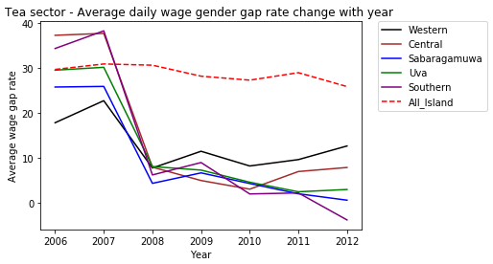
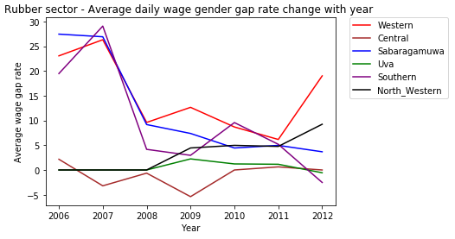
Gender Pay Gap Analysis for Tea and Rubber
Notes:
The other part of our research focused on the behaviour of wage disparity between male and female workers in informal sectors during the period of 2006 - 2012.
Importantly, data separated by genders was only available for Agriculture sector, and in that too, only for industries of Tea, Rubber and Paddy, not Coconut. What we see here is the fluctuation of the gender pay gap for Tea and Rubber industry in the period under consideration, by individual province.
TEA:
The figure on your left shows the fluctuation of gender pay gap for Tea industry for all the provinces. The red-dotted line shows the behaviour when whole island is considered. On the Y axis is the pay gap, which is the wage difference as a percentage of the wage for males.
As you can see, that line starts around 30% on the Y axis against 2006, but has ended up below where it started, around 26% by 2012. This indicates the gender pay gap across the island for daily-waged employees of this industry reduced by nearly 4% across the period.
Other lines show a how the pay gap fluctuation was for each province. Performance of Southern province, shown in purple here, showed the most drastic reduction of gender pay gap during the period. You can see it started around 34% in 2006, but ended at around negative 4%, which means it succeeded in not only eliminating the gap, but surpassing the wage rates of men.
Other provinces also show rapid reductions: for Central province, this was nearly 30%, for Uva province around 26% and in neighbouring Sabaragamuwa province this was a close 25%.
An interesting point noted here is the performance of the Western province, which houses the main commercial and industrial capital. This province was the worst performer when it came to reducing pay gap, only reducing it by 5%, as opposed to the minimum among other provinces: 25%. This seems to show that the distance to the main commercial center or hub of the country does not positively affect wage disparity.
In summary, there is a definite reduction of wage gap throughout the country for when daily-waged employees of Tea industry is concerned, although at different rates in different provinces.
RUBBER:
The figure on your right shows the situation for Rubber industry. Here, the picture is largely positive as well. In Western, Southern and Sabaragamuwa provinces there was a significant wage gap in 2006 that they have managed to reduce by 2012, at least somewhat. Central and Uva provinces did not have much of a pay gap to begin with in 2006, which means they was balance of wages, and they have largely maintained that balance by 2012. .
The only exception is North Western province, which has started with balanced wages (or nearly 0 wage gap), but has developed a pay gap by 2012.
But overall, in the Rubber industry, we see either a decline in wage gap and maintenance of balance wages. .

Slide 7
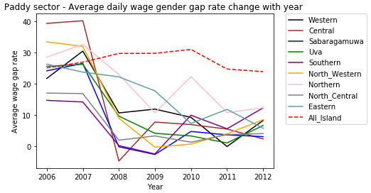
Gender Pay Gap Analysis for Paddy
Notes:
PADDY:
Here, we see the pay gap fluctuation for Paddy industry. What is shown in red dotted line is the pay-gap behaviour for the whole country
It is apparent that wage gap for the whole island has reduced only slightly across the period; it has reduced by only 1.2% from 2006 - 2012
The best performer in reducing pay gap is Central province. I has had a close-to 40% pay gap at 2006, and has managed to reduce it to 2.3% by 2012. The drop is 37.7%.
North Western province also shows a significant improvement reducing the gap from 33.4% to 8.4% during the period, with the drop being 25%
Here, too, Western province was unimpressive: from a start of 21.7% it has dropped only by 13.5% to 8.2% by 2012.
Overall, there is at least a minor reduction in the gender pay gap in the Paddy industry during the period. However, again what is shown is that the geographic closeness to the commercial capital does not act as a catalyst for reduction of gender pay gaps.

Slide 8
Conclusion
Since 2009, majority of the sectors have a higher wage increase rate compared to the inflation rate.
The prevailing socio-economic factors have affected the province wise wage increase rates.
The gender pay gap in agricultural industries in informal sector is slowly decreasing.
In the fields In the three industries for which data was available (tea, rubber, paddy), the tea industry displayed the most rapid closing of the gap, by 4% across 7 years, while the least was displayed by the Paddy industry, with 1.2%.

