Slide 1
Machine learning to improve productivity employees rating in software company

Slide 2
GROUP MEMBER INFORMATION
Rajitha Jaidi -700739766
Prashanth Kumar Vadla– 700744515
Upender Reddy Bokka - 700746118

Slide 3
ROLES AND RESPONSIBILITIES
Rajitha Jaidi – Identifying and documenting necessary papers for project work implementation.
Prashanth Kumar Vadla – Implementation of Classification (Decision tree Algorithm)
Upender Reddy Bokka - The code for loading and collecting data sets was implemented.

Slide 4
MOTIVATION
Software challenge managers compare the actual final touch of activities in opposition to the development reviews filled by project contributors to identify substantial deviations from the estimated schedules and manage software program assignment risks. However, quantitative measurements are restricted due to the layout of mission documents, mostly herbal languages. The proposed approach can successfully recognize entailment from textual content and outperform other textual entailment approaches. The textual entailment approach to venture monitoring and manipulation reduces the assignment value and human effort. It provides a foundation for challenge managers to evaluate the overall performance of every challenge member qualitatively. The employee rating in the company is taken and analyzed with different attributes. The employee ratings are provided based on the project reviews, client feedback, and client satisfaction level with the project.

Slide 5
OBJECTIVES
Objective of the project is to improve the productivity of the company by anlyzin the employee ratings.
Dataset containing the employee rating will be taken into consideration.
Data will be analyzed and visualized for further processing.
Machine learning algorithm libraries are built inside the Colab.

Slide 6
RELATED WORK
Predicting Employee Performance Using Decision Tree Approach" by Sudha Ranjan Ghosh and Sankhadeep Chatterjee: This research paper discusses the application of a decision tree algorithm for predicting employee performance. It demonstrates how decision trees can be used to analyze various factors and make predictions about employee performance based on historical data.
A Decision Tree Approach for Identifying Factors Affecting Employee Performance" by
Rashmi Agrawal and Ramchandra Agrawal: This study focuses on identifying the key
factors that influence employee performance using a decision tree algorithm. It examines
different attributes and constructs a decision tree to determine the relative importance of
each factor.
Predicting Employee Performance Using Decision Trees and Random Forests" by
Abdurrahman Celebi and Naim Terzi: This research paper explores the prediction of
employee performance using decision trees and random forests. It compares the performance
of different decision tree algorithms and discusses the advantages and limitations of each
approach.

Slide 7
PROBLEM STATEMENT
The problem addressed in this study is the analysis and prediction of employee performance using a decision tree algorithm.
Employee performance evaluation plays a crucial role in organizations as it directly impacts productivity, efficiency, and overall success.
However, accurately assessing and predicting employee performance based on various factors can be challenging.

Slide 8
PROPOSED SOLUTION
Our proposed solution for analyzing employee performance utilizes the decision tree algorithm. Decision trees are effective tools for examining and understanding complex relationships within datasets.
In the context of employee performance, the decision tree algorithm can help identify key factors that contribute to individual success or underperformance.
To implement this solution, we would begin by collecting relevant data such as employee demographics, job role, education, experience, and performance metrics. We would then preprocess and prepare the data, ensuring it is in a suitable format for decision tree analysis.
we would construct a decision tree using the collected data. The algorithm would iteratively split the dataset based on different attributes, creating nodes and branches that represent various decision points.

Slide 9
Once the decision tree is constructed, we can interpret it to understand the hierarchy of factors affecting performance. By examining the decision rules at each node, we can gain insights into which attributes have the most significant influence on employee performance.
Furthermore, the decision tree can be utilized to predict future employee performance for new hires or to assess the potential impact of different interventions or changes in the workplace. By inputting relevant attributes into the decision tree, we can obtain predictions or recommendations based on the learned patterns from the training dataset.
In summary, our proposed solution harnesses the power of the decision tree algorithm to analyze employee performance. By constructing a decision tree and interpreting its structure, we can identify key factors, make predictions, and provide actionable insights to enhance employee productivity and organizational success.

Slide 10
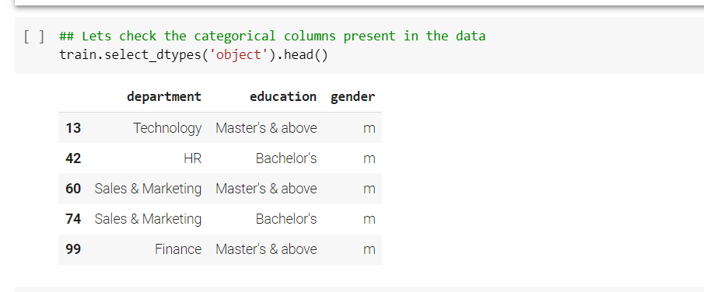
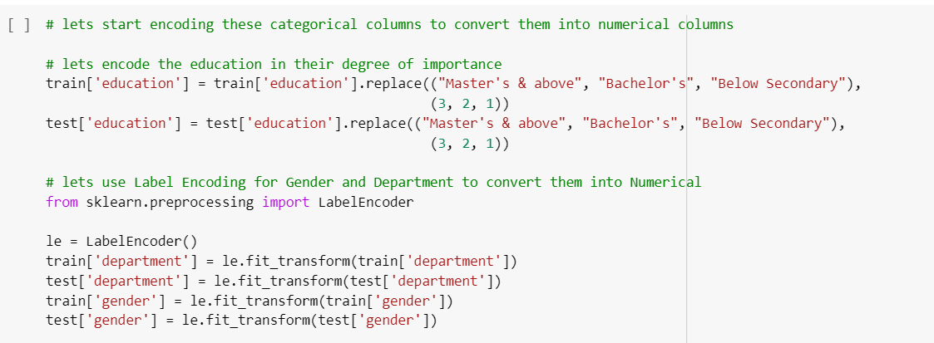
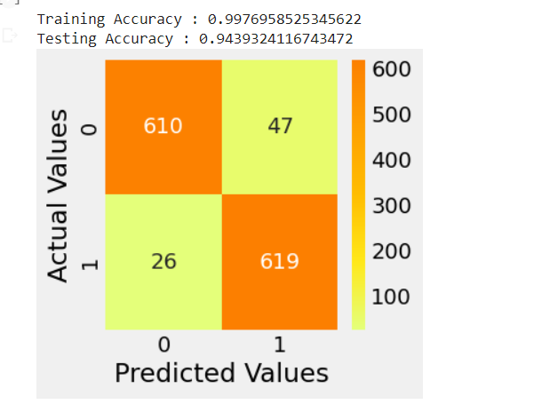
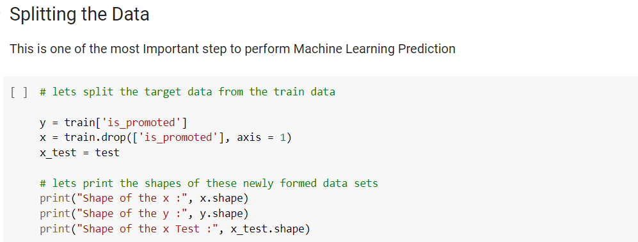
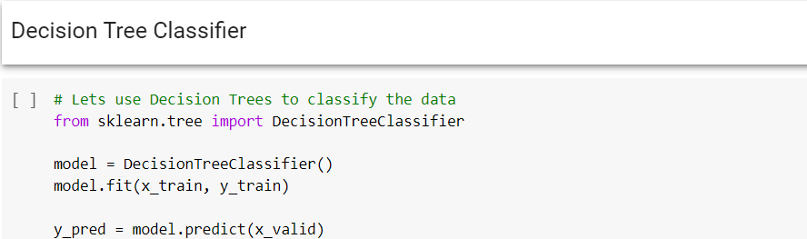
RESULTS/SIMULATION

Slide 11
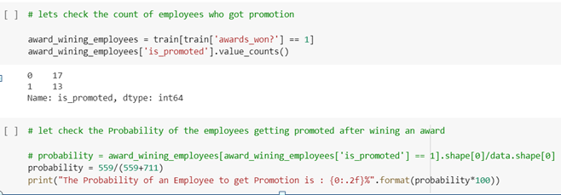
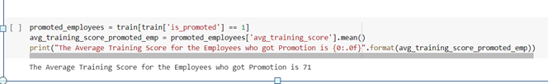

Slide 12
REFERENCES
[1] Kevser Şahinbaş, " Employee Promotion Prediction by using Machine Learning Algorithms for Imbalanced Datase ", n September 14,2022 at from IEEE Xplore©2022 IEEE.
[2] Jung-gu Choi1*, Inhwan Ko2*, Jeongjae Kim1, Yeseul Jeon3, and Sanghoon Han1,2, " Machine Learning Framework for Multi-level Classification of Company Revenue", IEEE 2021.
[3] P. Choudhury, C. Foroughi and B. Larson, "Work- from- anywhere: The productivity effects of geographic flexibility", Strategic Management Journal, vol. 42, no. 4, pp. 655-683, 2021.
[4] Richard Josep, Shreyas Udupa and Sanket Jangale, "Employee Attrition Using Machine Learning And Depression Analysis ", 978-0-7381-1327-2/21/$31.00 ©2021 IEEE.
[5] B. Becker, B. Gerhart, “The Impact of Human Resource Management on Organizational Performance: Progress and Prospects,” Academy of Management Journal, vol. 39, no. 4, pp.779–801, Aug. 1996.

