Slide 1

Predicting the subscription in Bank Marketing Using Logistic Regression, Support Vector Machines, and K-Means Clustering
Vagalagani Upender
12725852
16-06-2023

Slide 2
Introduction
The Problem statement is whether a customer would sign up for a term deposit or not .
Bank marketing has seen a tremendous revolution in recent years, owing mostly to the incorporation of powerful data analytics and machine learning approaches. These technological innovations have transformed the way banks approach marketing by giving them tremendous tools for gaining useful insights into client behavior, preferences, and demands. Therefore, banks are now able to specifically target certain client categories with their marketing strategies and campaigns, improving customer engagement, conversion rates
This paper analyzes customer behavior to predict subscription outcomes from bank marketing campaigns. In this study, we use the "Bank Marketing" dataset. Logistic Regression, Support Vector Machines (SVM), and K-Means clustering are used to predict customers' subscription intentions.

Slide 3
Overview of Dataset
Data set we have obtained from UCI - https://archive.ics.uci.edu/dataset/222/bank+marketing
The data is related with direct marketing campaigns of a Portuguese banking institution. The marketing campaigns were based on phone calls. Often, more than one contact to the same client was required, in order to access if the product (bank term deposit) would be ('yes') or not ('no') subscribed.
We have total 20 inputs against target variable in this data set.
We have 11 categorical and 10 Numeric type features in the data set .
We have no missing values and null values in the data set there is not much to do in data pre processing stage .

Slide 4
Machine Learning Models
Machine learning models play a crucial role in analysing banking data and predicting outcomes. In our analysis, we employed three key techniques: Logistic Regression, Support Vector Machines (SVM), and K-means Clustering.
Logistic Regression:
Logistic Regression is a widely used classification algorithm for predicting binary outcomes.
It models the relationship between the independent variables and the probability of a specific outcome.
Support Vector Machines (SVM):
SVM is a versatile algorithm used for both classification and regression tasks.
SVM separates the data points into different classes using a hyperplane, maximizing the margin between the classes.
SVM can handle both linear and nonlinear relationships between predictors and the target variable through the use of kernel functions.
K-means Clustering:
K-means Clustering is an unsupervised learning algorithm used for data segmentation or grouping.
It partitions the data into k distinct clusters based on similarity.

Slide 5
Model Evaluation
Model evaluation is a critical step in assessing the performance and effectiveness of our machine learning models. In our analysis of the UCI Bank Marketing Calling dataset, we explored two scenarios for model evaluation.
Scenario 1: All Variables against the Target Variable
In this scenario, we used all available variables in the dataset as predictors to build our models.
By including all variables, we aimed to capture a comprehensive view of the dataset and the potential relationships with the target variable.
We trained and evaluated the models using these predictors, measuring their accuracy, precision, recall, and other relevant metrics.
This scenario helps us understand the performance of the models when considering the entirety of the available information.
Scenario 2: Selected Features against the Target Variable
In this scenario, we narrowed down our predictors to a selected set of features that we deemed most relevant or informative.
By carefully selecting features, we aimed to focus on the variables that have the strongest influence on the target variable.
We trained and evaluated the models using only these selected features, again assessing their accuracy, precision, recall, and other performance metrics.

Slide 6
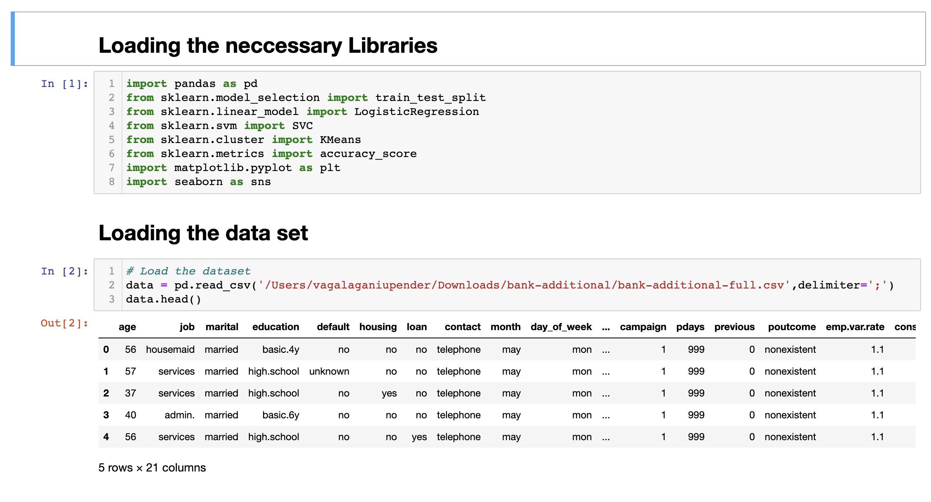
Code Implementation
Loaded the Necessary Libraries.
Using Pandas loaded the data set which is obtained from UCI.

Slide 7
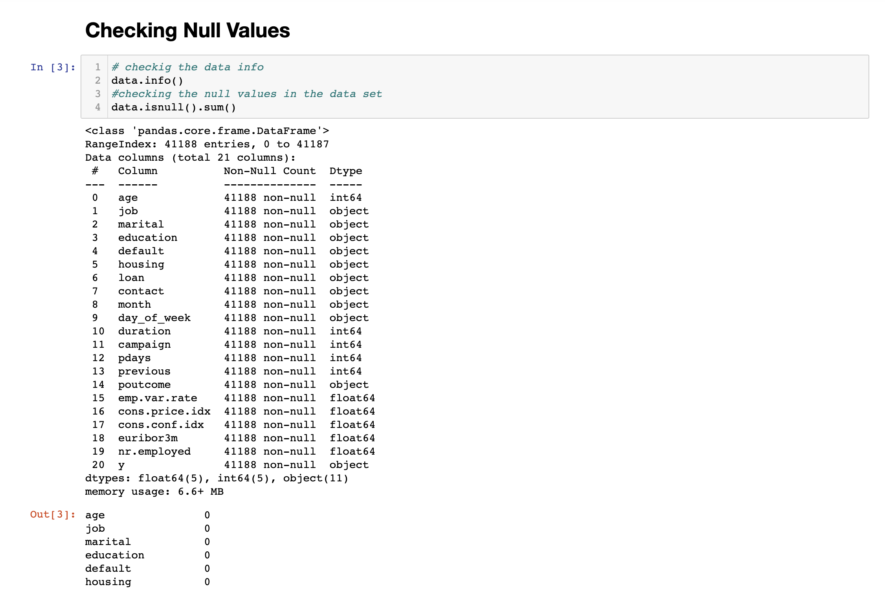
Code Implementation
Checking the Null Values

Slide 8
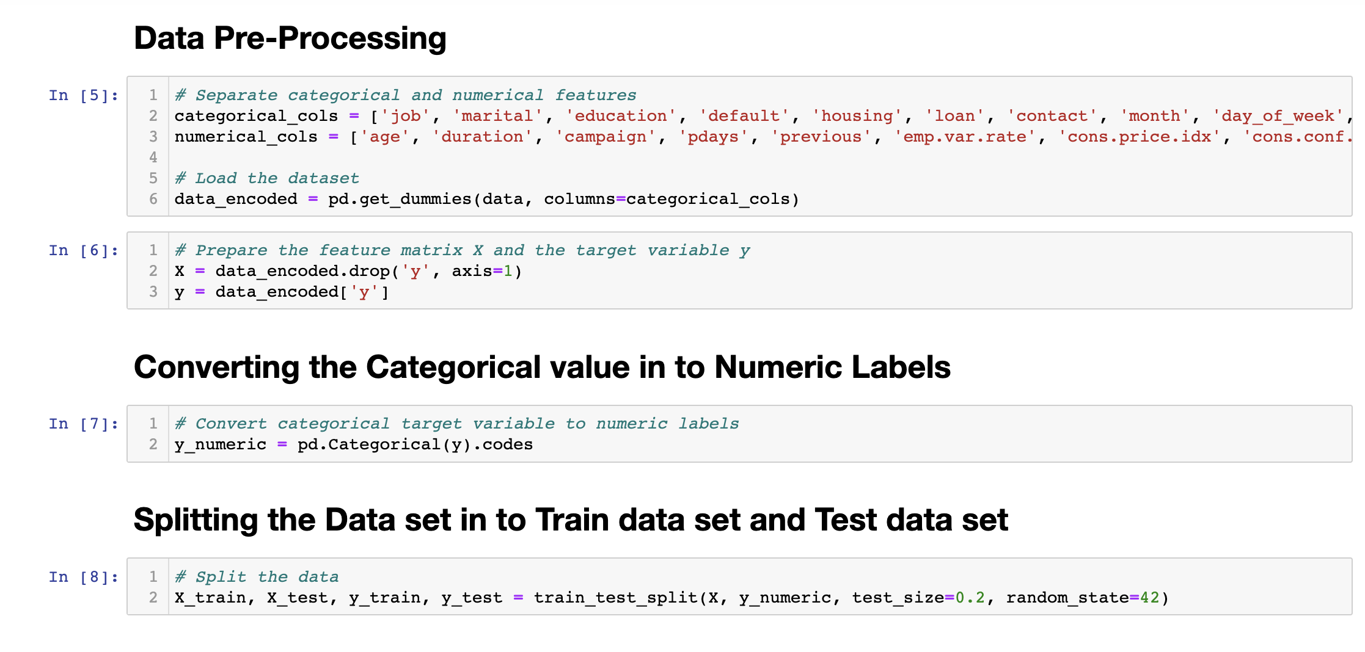
Code Implementation
Data Cleansing and Grouping Categorical columns and Numerical columns.
Encoded the data
Converting the Categorical values into Numeric Labels
Splitting data set into Trained and Test data

Slide 9
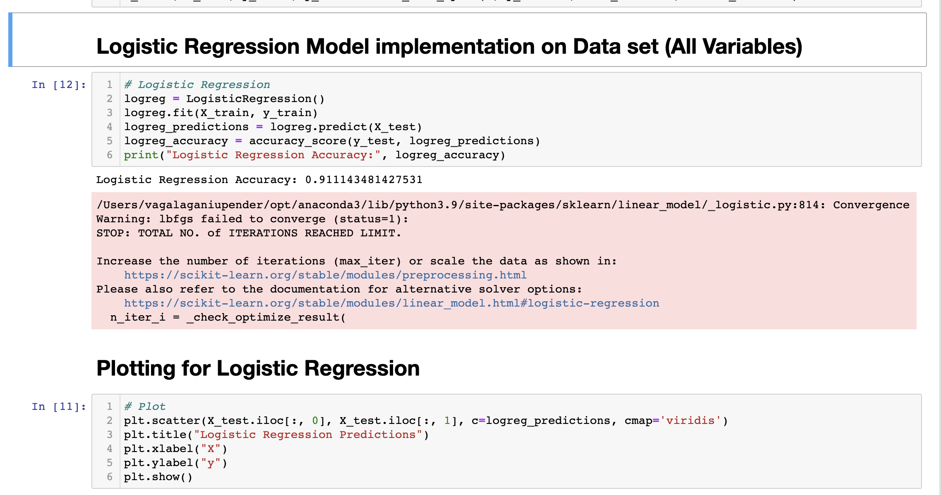
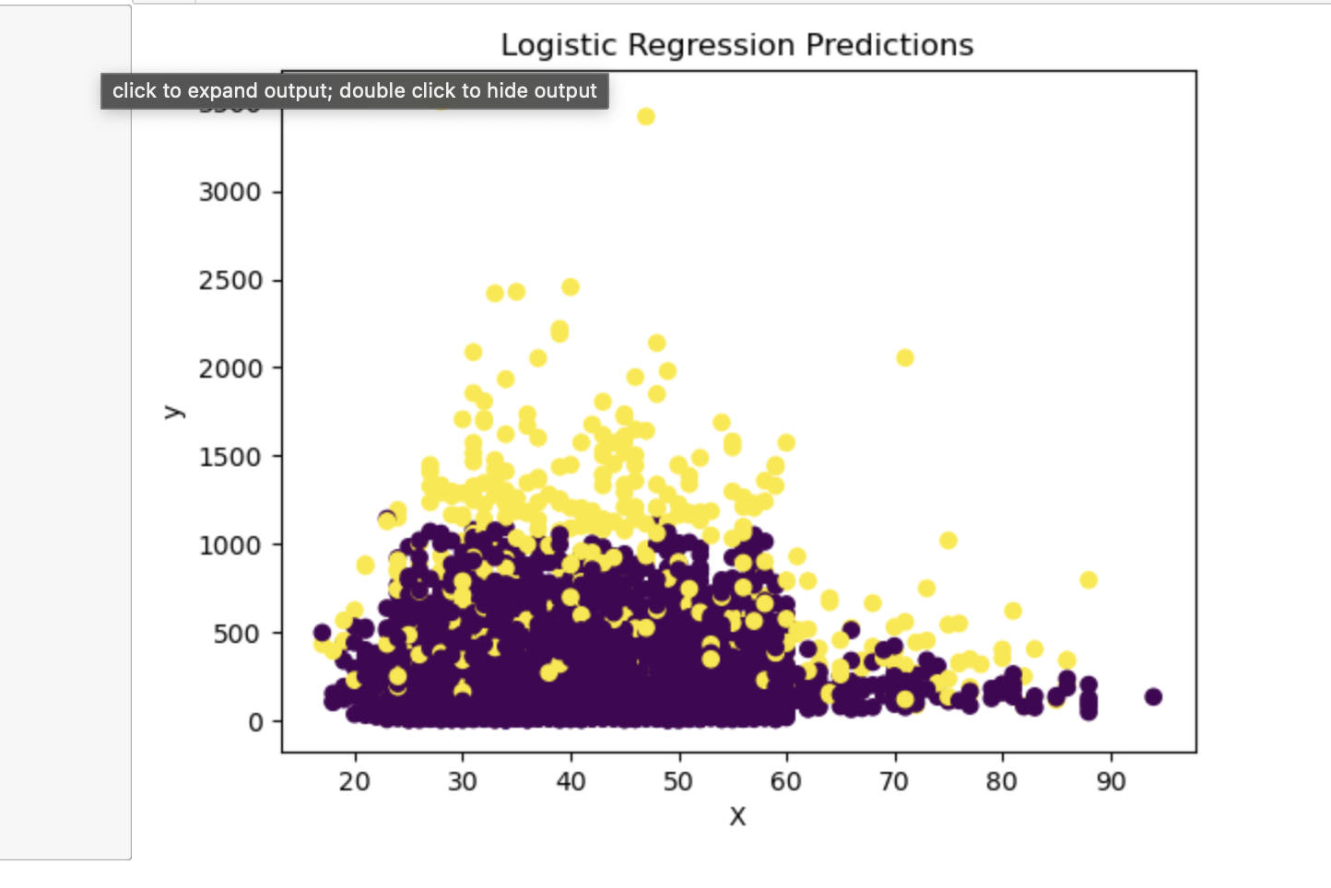
Code Implementation
Logistic Regression Model

Slide 10
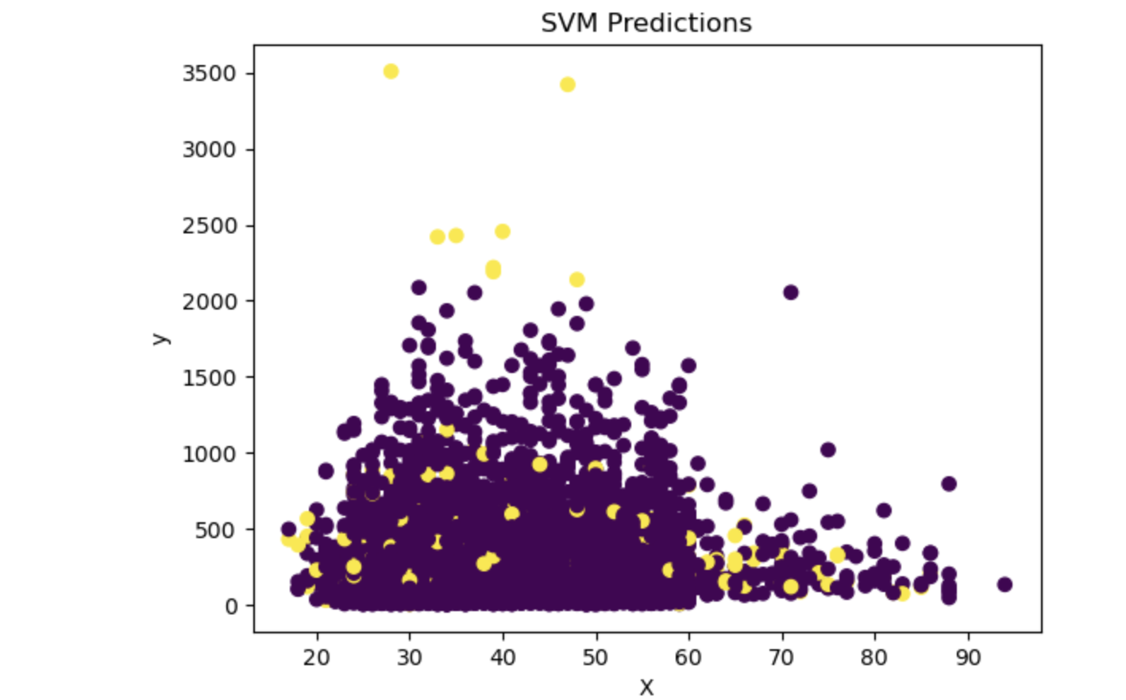
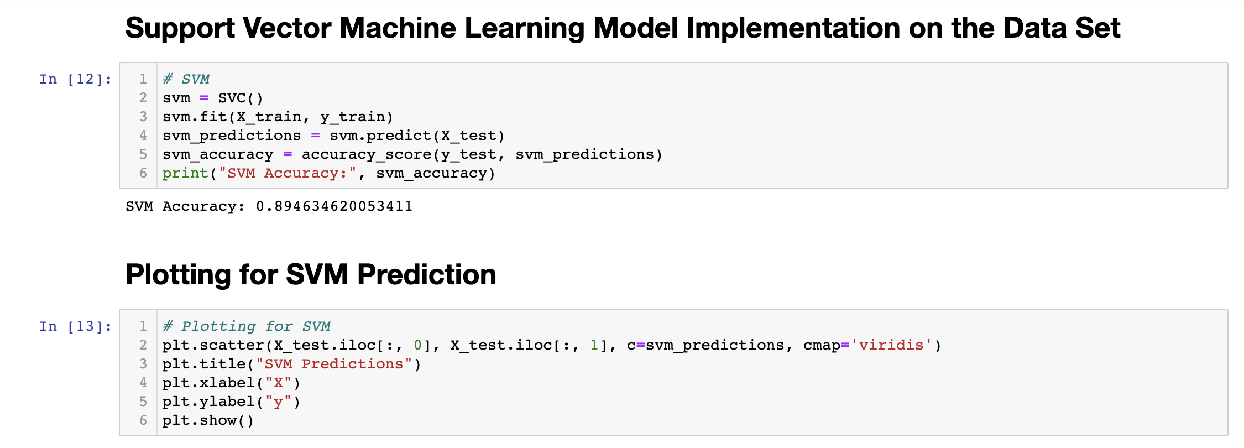
Code Implementation
SVM Model

Slide 11
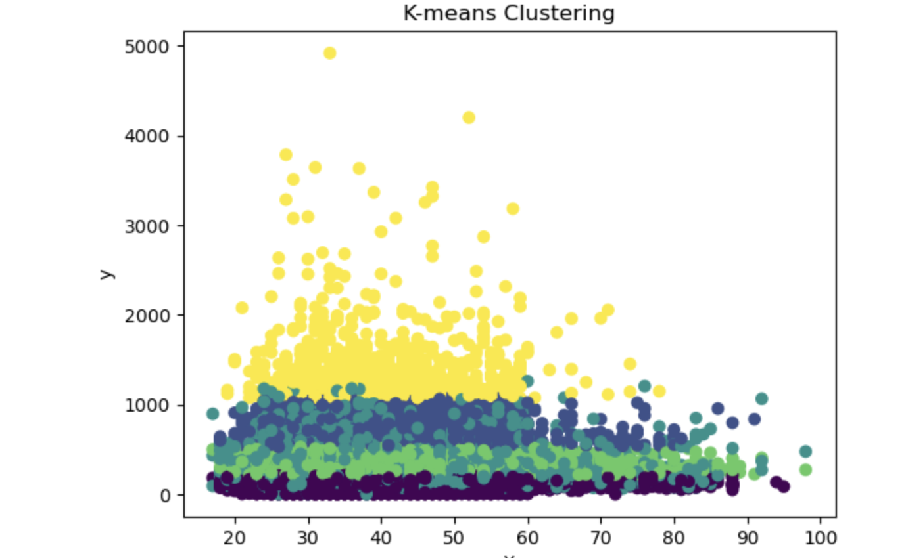
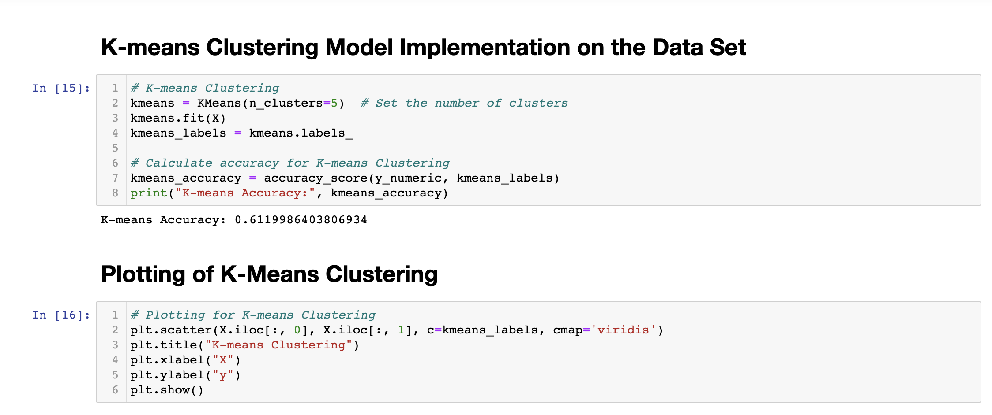
Code Implementation
K-Means Clustering Model

Slide 12
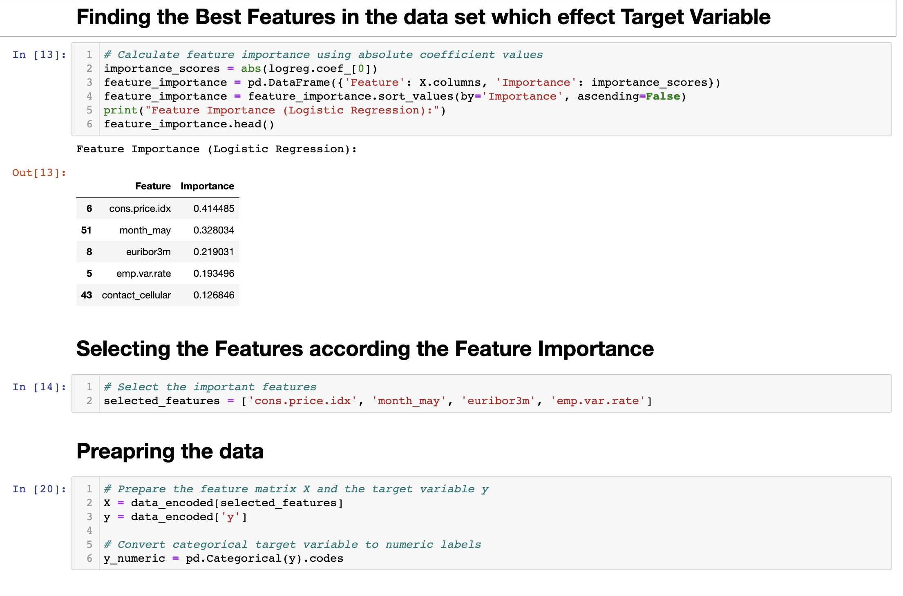
Code Implementation
Finding the features which will effect the target variable in the data set.
Preparing the data for modeling
We have to reproduce all three above machine models using selected features

Slide 13
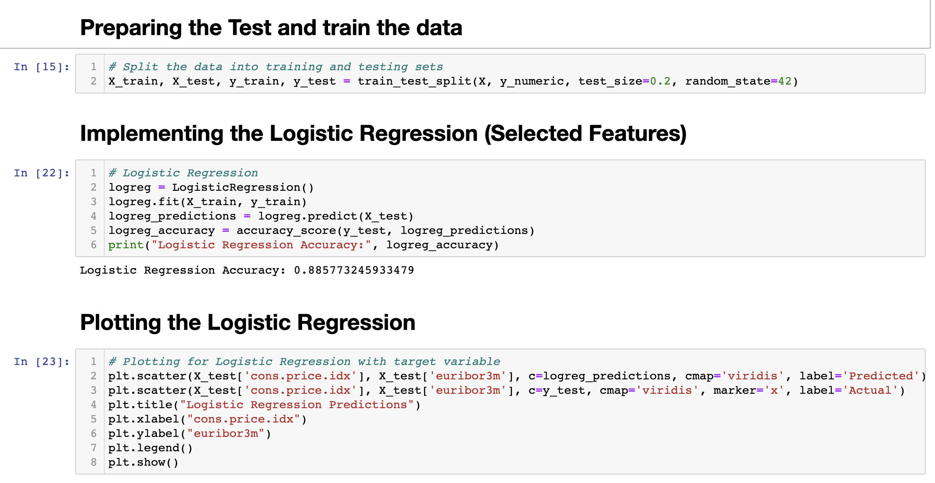
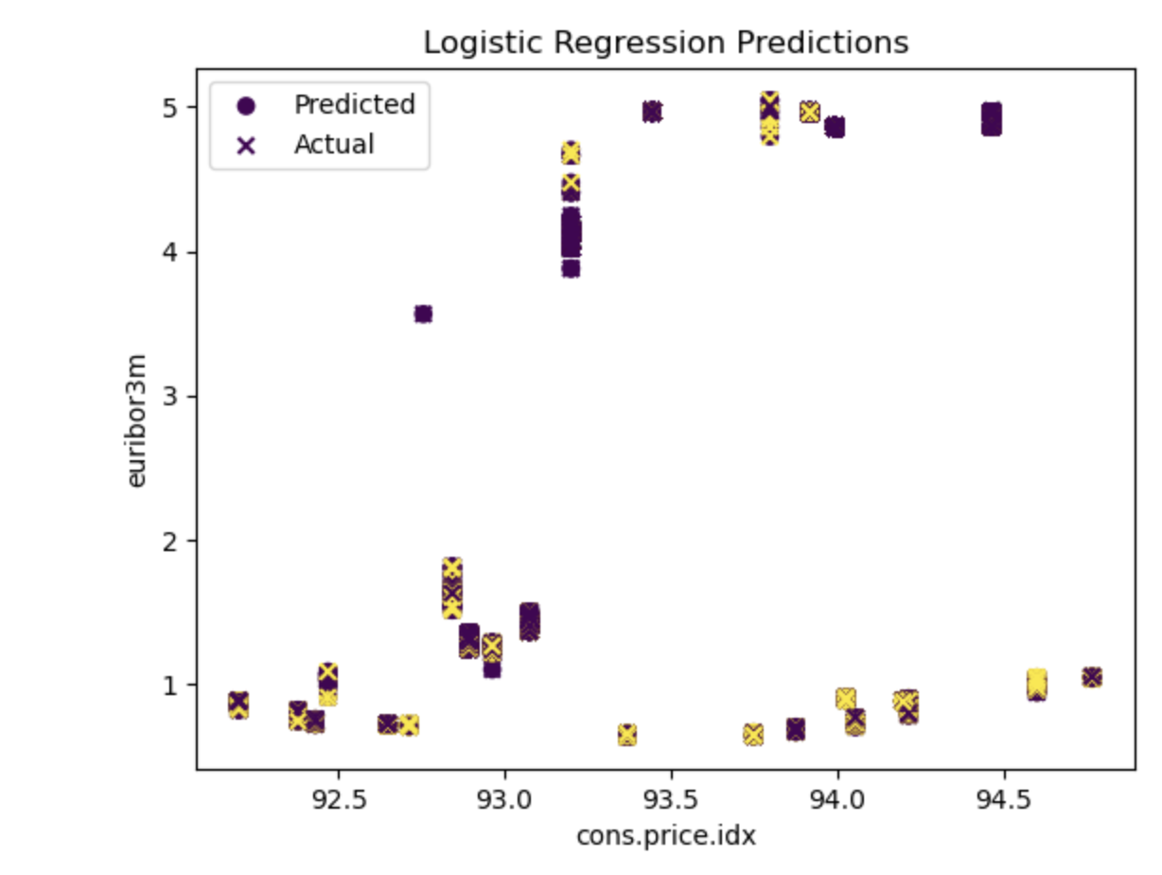
Code Implementation
Implementing the Logistic Regression for selected features against Target Variable.

Slide 14
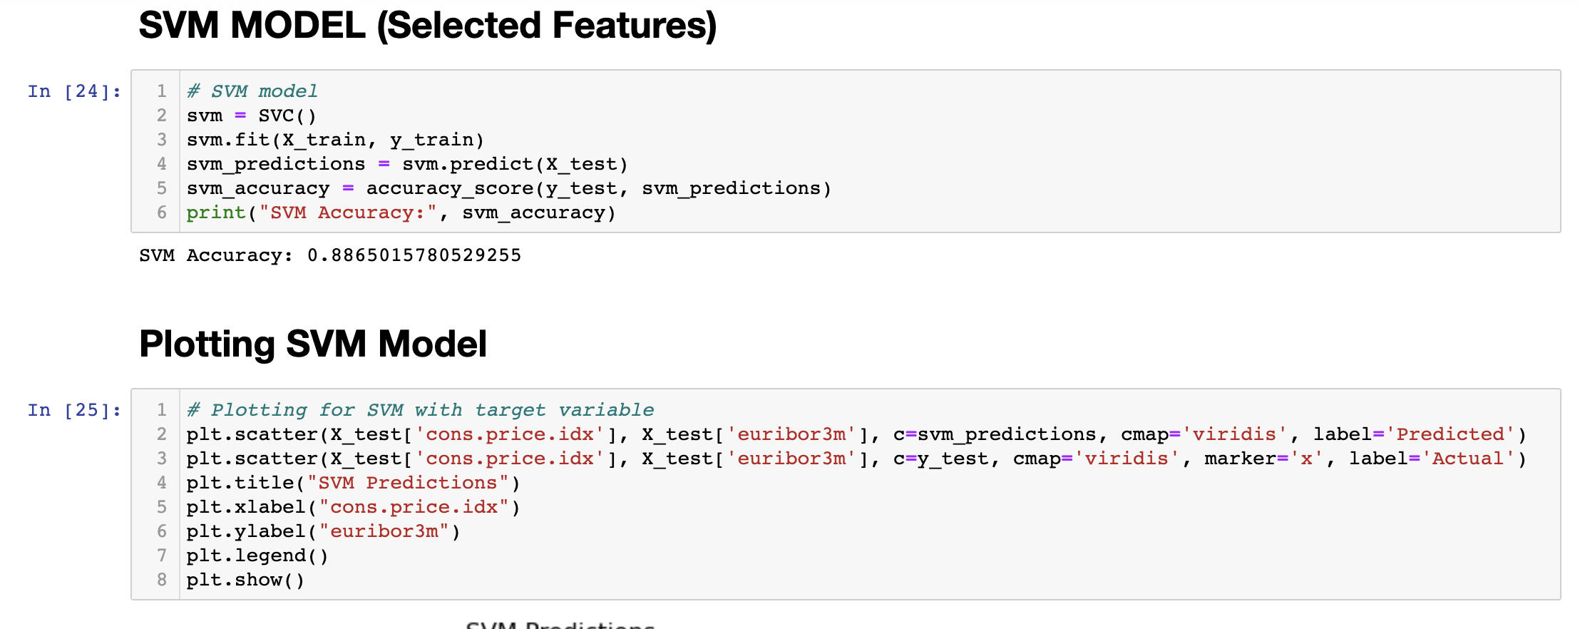
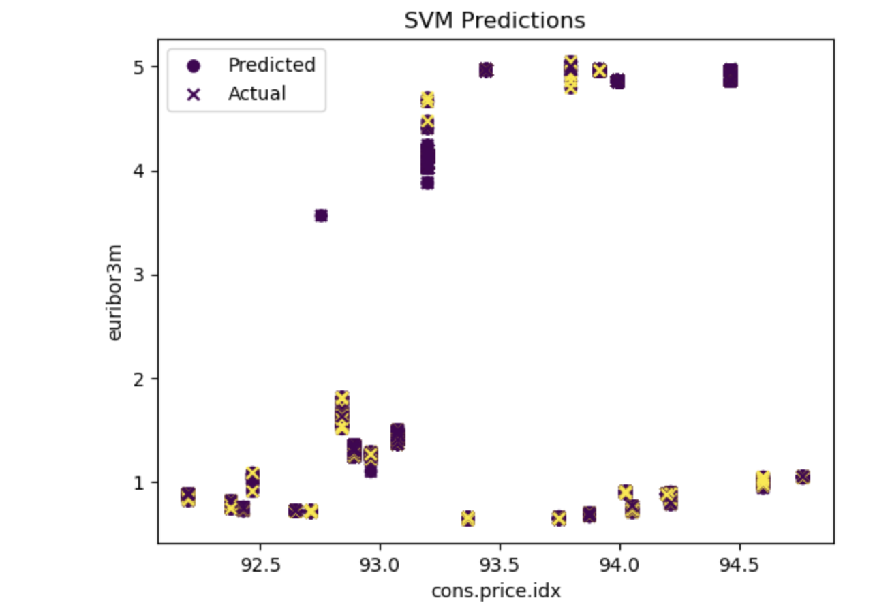
Code Implementation
Implementing the SVM Model for selected features against Target Variable.

Slide 15
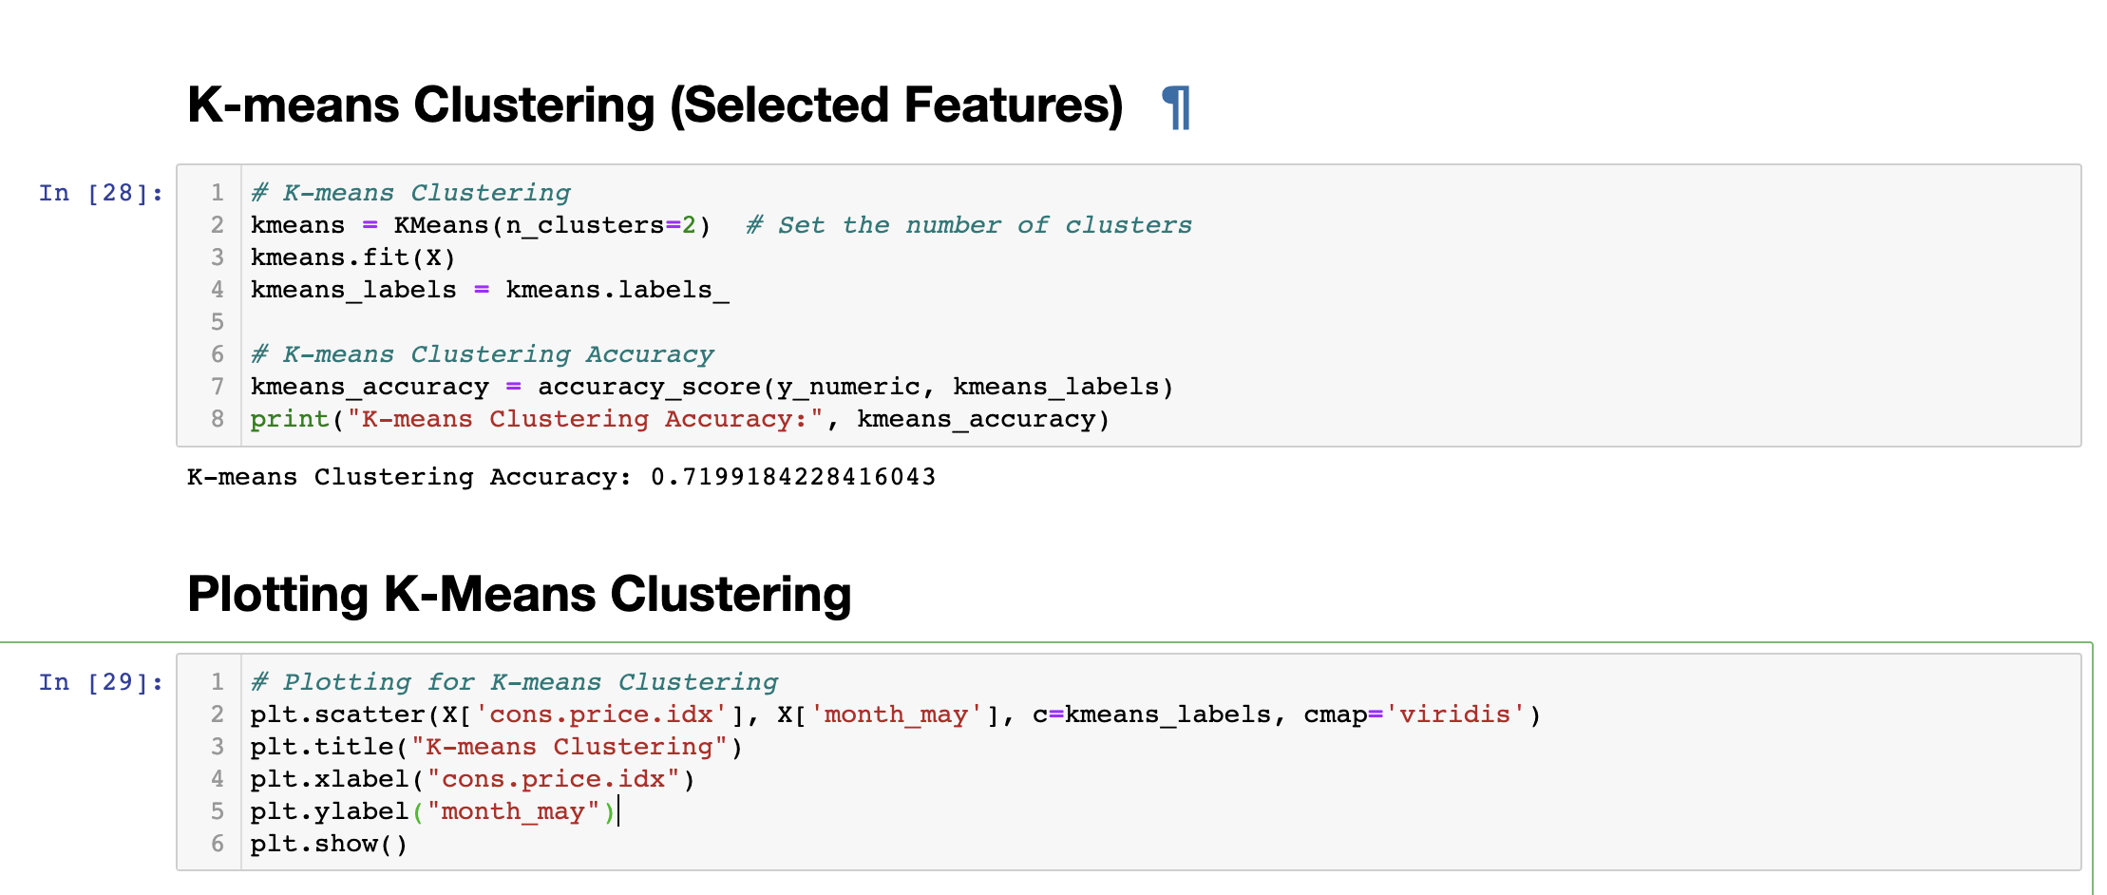
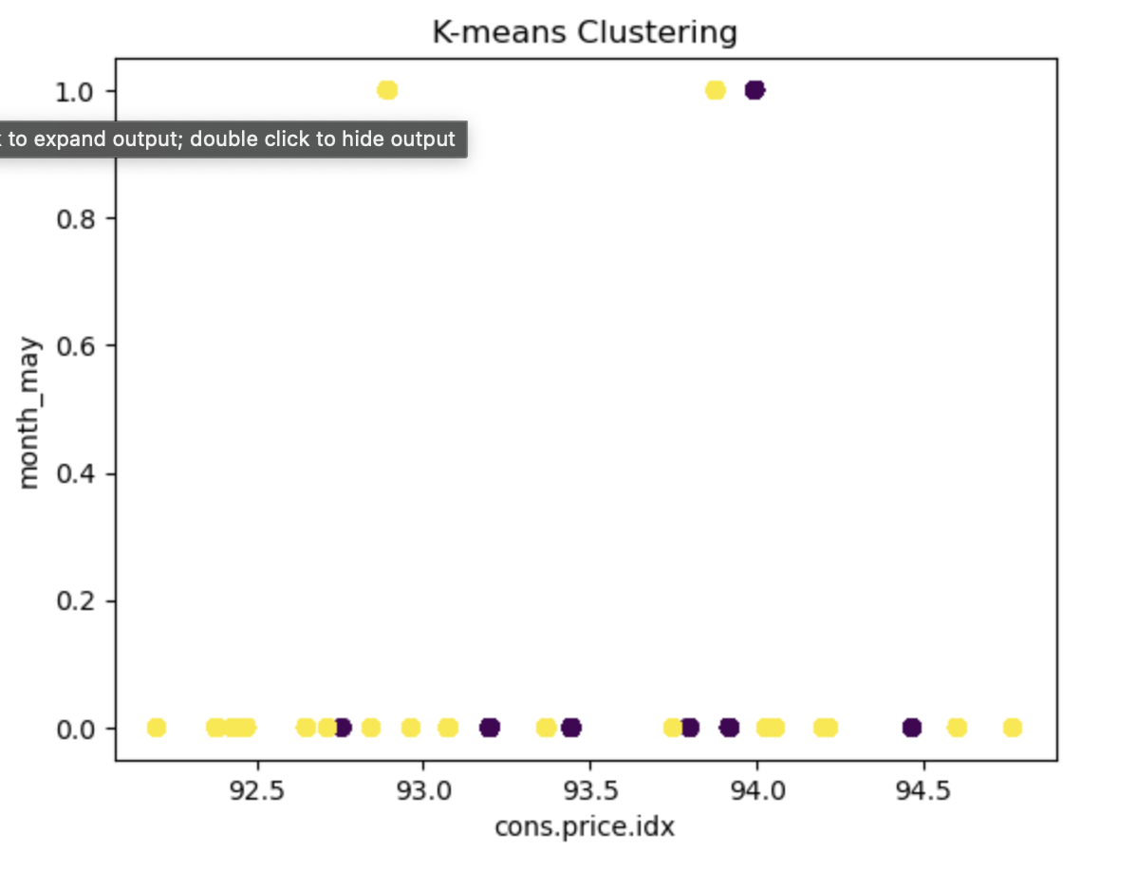
Code Implementation
Implementing the K-Means Model for selected features against Target Variable.

Slide 16
Results
Scenario 1: Using All Variables In this scenario,
Logistic Regression Accuracy: 0.91
SVM Accuracy: 0.89
K-means Clustering Accuracy: 0.61
Based on the accuracy scores, the logistic regression model achieved the highest accuracy of 0.91, followed by the SVM model with an accuracy of 0.89. The K-means clustering model obtained a lower accuracy of 0.61.
This suggests that when using all variables, both logistic regression and SVM outperformed the K-means clustering model in terms of accuracy.
Scenario 2: Using Selected Features
In this scenario, i applied the models using a selected subset of features from the banking dataset.the following accuracy scores were obtained:
Logistic Regression Accuracy: 0.88 SVM Accuracy: 0.88 K-means Clustering Accuracy: 0.72
Explanation: In this scenario, both logistic regression and SVM achieved high accuracy scores, indicating their effectiveness in predicting the target variable using the selected subset of features.

Slide 17
Conclusion
The application of Logistic Regression, SVM, and K-means clustering on the banking dataset provides valuable insights for banks aiming to improve their customer subscription rate. Logistic regression and SVM demonstrate strong predictive performance, with SVM showing promise when using a selected subset of features. K-means clustering offers insights into customer segmentation but may not directly predict the subscription rate.
Bank Rate , Duration of Call ,Month are playing key role in the predicting the outcome.

Slide 18

Thank You

