Slide 1
METAsure Metaverse for Insurance
Cohort 1 – BOG 4 Lecturer: Mr Ashish Mehra
04-Nov-2022

Slide 2
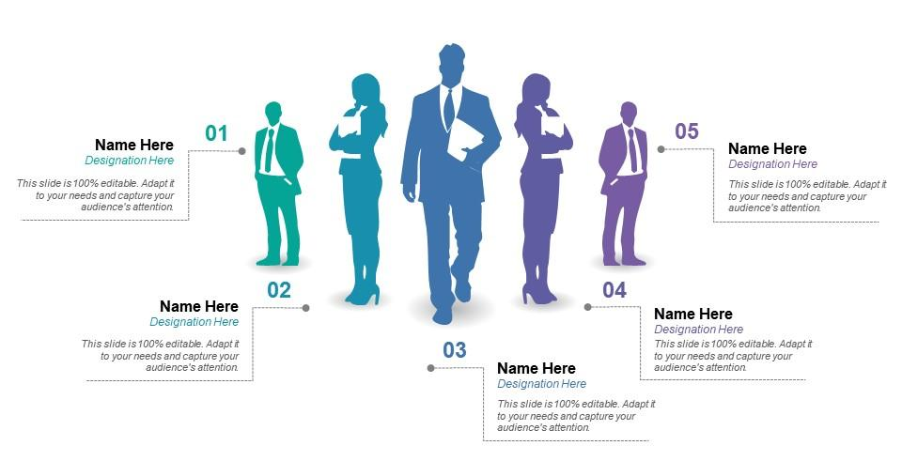

Team with you today
06
Abhishek Kumar
Solution Architect
Yogesh Yadav
Client Partner
Bhavesh Patel
Delivery Partner
Anita Princy Rajakumar
Insurance BA
Upendra Kanuru
Metaverse Architect
Seshadri Pateel
Consultant
Notes:
Questions?
Do you want to tap into virtual-metaverse?

Slide 3
Agenda
Appendix
Next Steps
Metaverse Case Study
METAsure - Business Value
METAsure – Overview
G&T Opportunity - Intro to Metaverse and opportunities
Executive Summary
Notes:
Questions to excite the CMO?
Are you interested to improve customer satisfaction/ NPS by x%?
Are you interested to embark into completely new segment? To drive revenue growth
How can you improve brand value by pioneering new technology?

Slide 4
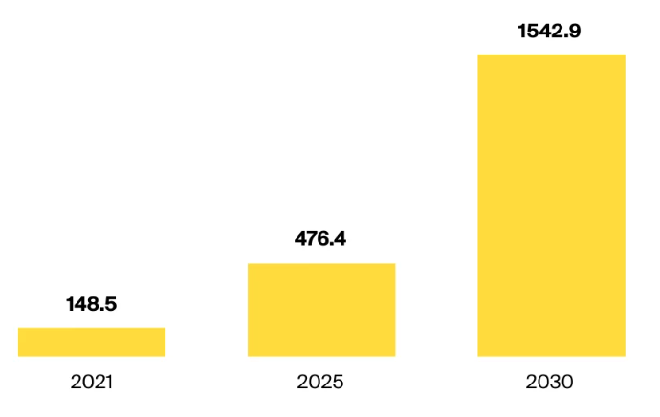
Market Opportunity
Global Metaverse expected market capital
(By Facts and Factors)
In $billion
“In 2022, there’s been over $1 billion in sales of virtual land” Noah Gaynor, co-founder and CEO, Parcel
“The metaverse could provide market opportunities of up to $800 billion by 2024” Bloomberg intelligence
Notes:
According to Facts and Factors, the Global Metaverse Market size was valued at around 210 Billion USD in 2021 and is estimated to grow about 730.5 Billion USD by 2028, at a CAGR of approximately 23.2% between 2022 and 2028.

Slide 5



Executive Summary
Business Challenges
Differentiated Solution
Stagnated Revenue growth
Increase in Operation cost
Demand to improve customer experience
New market segments - Virtual asset insurance
Falling NPS score
Creation of Virtual stores
Virtual avatars and augmentation to improve customer experience
Tapping into Gen-Z base using gaming model
Iterative delivery to gauge pulse improve NPS
Cloud utilization for scalability and reliability
Business Value Generated
Revenue growth, new revenue stream
Improved brand value
Digital twins to reduce physical store footprint and reduce costs
Improved customer engagement

Slide 6
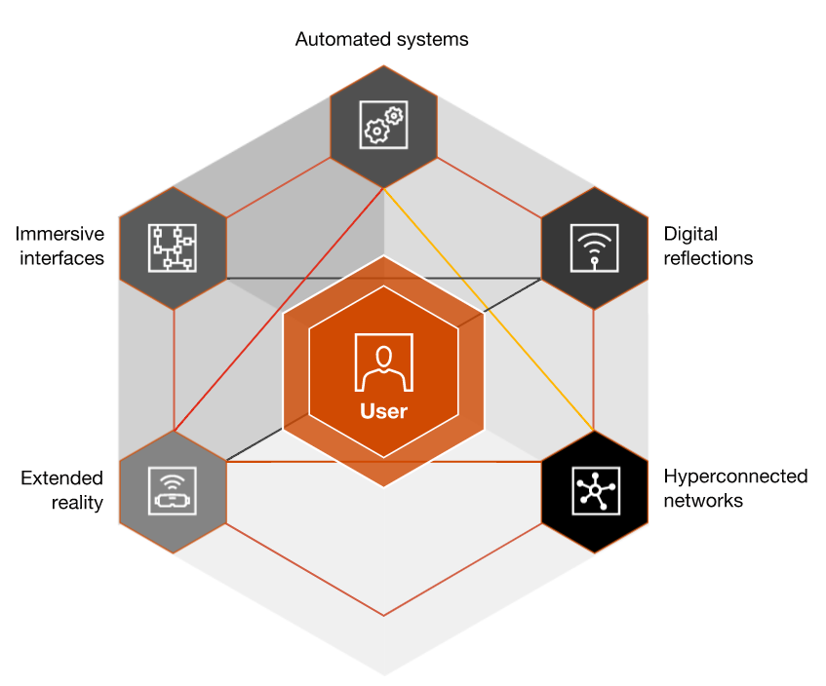








G&T Opportunities
New Acquisition Channels with access to a
new tech Savvy Customer segment
Brand value improvement with sophisticated customer engaging solutions
Optimise costs by digitising damage investigations. ~10% Reduction
Invest in Virtual assets rather than physical asset
New revenue stream by rolling out insurance products for virtual assets

Slide 7
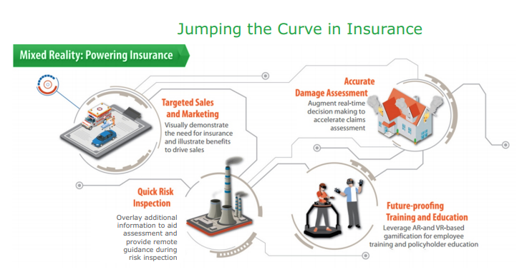
Introduction: METAsure
Revolutionize stakeholder experience with Metaverse AR/VR solutions
3D digital world, with user as avatar, can interact with other as they do in real world
1 avatar of you can meet employees and other go to board meeting
At its inception stage, rapid adoption underway
Relies on digital currencies, no clarity on governance
As per TCS and other Industry leading research, Metaverse has potential to disrupt insurance and every other industry,
thus opening up new opportunities and challenges

Slide 8
METAsure – Business Value
Immersive experience, Simulations, AI Based Product
Recommendations
Avatar Interaction
NFT & Crypto Currency
Virtual Wallets
Hyper-personalized insurance products
Education
Acquisition
Underwriting & Issue
Servicing
Claims
Smart Contract execution, NFT & Crypto Disbursement
Avatars, Conversational
form Filling
Metaverse
Artificial Intelligence and Machine Learning
Rules defined customization
Block Chain, Smart Contracts
Data & Analytics
MetaSure
Avatar Connect
Agile & DevOps Model
Governance
Immediate Contract Issue
Avatar
Support, NFT & Crypto Integration
AI & ML based Decision,
Smart Contracts

Slide 9
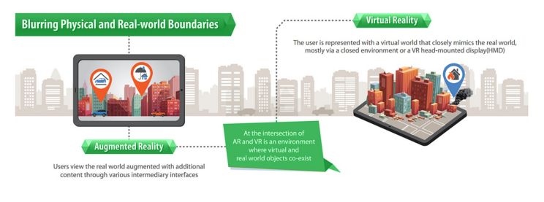
METAsure – Brings Change
65% increase in brand values
(early Adaptor)
50% increase Market shares
(Metaverse segment)
Governance, Security, Privacy
Brand Value
Finance
Why now?
First mover advantage
Rapid growth opportunity with Metaverse
Engagement improvement with Gen-Z
Ease of Hyper personalisation
Risks

Slide 10





Case Study
Business Challenge
Solution Highlights
Tanishq implemented MirrAR, an Augmented Reality software platform in collaboration with StyleDotMe
Zero inventory experience zones
Tanishq sought to improve
customer experience of next-gen for jewelry purchase and browsing
Technology Stack
Value Delivered
Improved customers experience: Touch/Feel, 360-degree view and, AR mirror- to check how it looks on them
Zero inventory experience to reduce security risk
Revenue growth by 12%
MirrAR Augmented Reality
Artificial Intelligence
Inventory manager
Notes:
This AR-based fashiontech startup has revolutionised jewellery shopping with virtual trials in real time (yourstory.com)
A report by Gartner Inc suggests that 100 million users will shop in AR, online and in-store, by the end of this year, giving scope for startups to venture out and succeed in the space. According to MarketsAndMarkets, the AR market in India is estimated to grow from $10.7 billion in 2019 to $72.7 billion by 2024, growing at a CAGR of 46.6 percent.
Tanishq brings its first Augmented Reality experience to customers (retailjewellerindia.com)
Tanishq is implementing MirrAR, an Augmented Reality software platform in collaboration with StyleDotMe, a startup focussed in innovative application of Augmented Reality (AR) and Artificial Intelligence (AI) for providing the next generation experience to consumers in the Gems and Jewellery industry

Slide 11
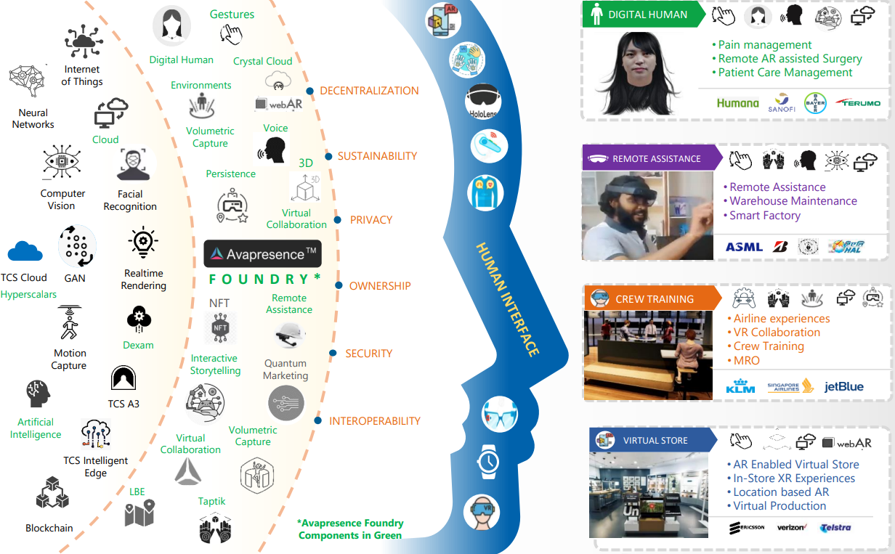




What Next ?
Connect with
Peer CXO’s to introduce METAsure
Next Levels to present METAsure using Avapresence Platform
Co-create an end-to-end Claims system
Invest all along by bringing in
Coin Partners
Experts from other horizons
Center of Excellence Team
Support of
Claims Business SME’s to Identify a Pilot
IT Partner for Infrastructure Support
Funding

Slide 12
POC – Strategic Road Map
Q1/Y1
Q2/Y1
Q3/Y1
Q4/Y1
H1/Y2
H/Y2
Y3
Y4
Governance
Setup METASure Governance Board
Ongoing governance and monitoring
Identify Business and technical KPIs/SLAs
Setup new Business, IT Org structure
New Insurance products for virtual world
6. Iteratively roll out insurance products for virtual world
M1: Check for business outcomes of the pilot
M2:Check point for Business value verification
Standard Services
Initial Planning and team setup
PoC
Technical concepts
1. Roll out Virtual store for a customer segment
4. Iteratively reduce physical stores and increase virtual foot print
Build METASure Foundation, Pilot
2. Drive Marketing campaigns
5. Identify new use cases, and innovative solutions to continue to differentiate
Competency Building
3. Capture learnings
Joint funding
Customer funded

Slide 13
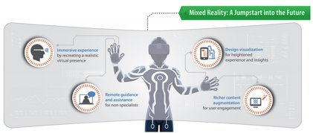
Thank You Let’s Meet in METAsure

Slide 14
Appendix

Slide 15
References
Financial Sector Metaverse Share
JP Morgan is first bank to enter the metaverse with a virtual ‘Onyx lounge’
Bank of America is First in Industry to Launch Virtual Reality Training Program in Nearly 4,300 Financial Centers
HSBC moves into the metaverse
https://www.thehindubusinessline.com/money-and-banking/union-bank-launches-metaverse-virtual-lounge-andopen-banking-sandbox-environment/article65616081.ece
https://www.pwc.com/jp/en/knowledge/column/metaverse-impact-on-the-insurance-industry.html
TCS Metaverse Capabilities
https://www.ceoinsightsindia.com/news/tcs-involves-tata-group-companies-to-deploy-metaverse-solutions-nwid-9775.html
https://www.tata.com/newsroom/careers/unbearable-lightness-metaverse-tcs

Slide 16
References
Case Studies
https://www.insiderintelligence.com/content/qa-metlife-evolving-cmo-trends-insurance
TCS Tanisq Case Studyw
https://next.ergo.com/en/Trends/2022/metaverse-meta-virtual-reality-opportunities-challenges-financial-insurance
https://www.lexology.com/library/detail.aspx?g=ad47743d-aaa6-478a-8f6d-a509b61ff056#:~:text=Part%20marketing%2C%20part%20strategy%2C%20a,and%20appearance%20in%20the%20metaverse.
https://www.cmo.com.au/article/699492/marketing-metaverse/
Banking Simulation - https://youtu.be/A4MKUpvu2vo
This AR-based fashiontech startup has revolutionised jewellery shopping with virtual trials in real time (yourstory.com)

