Slide 1
Agent-based Retrieval-Augmented Generation (RAG) chatbot
- U Upendra

Slide 2
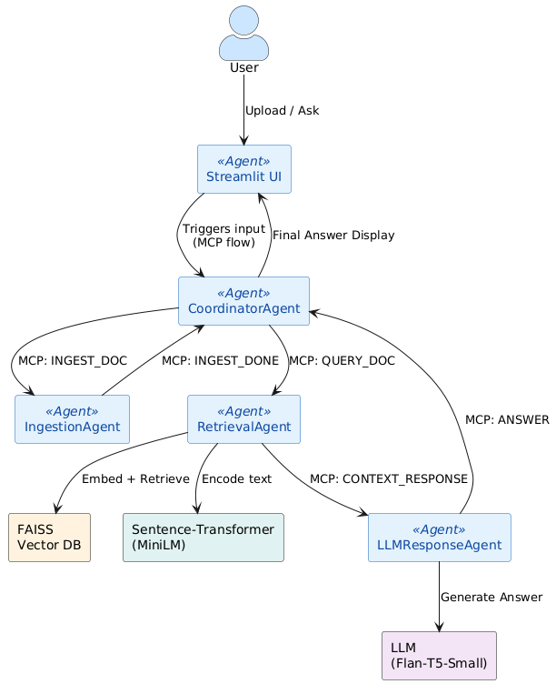
Architecture
Agent-based architecture with MCP integration
Streamlit UI acts as the frontend, allowing users to upload documents and ask questions interactively.
A central CoordinatorAgent receives input and uses the Model Context Protocol (MCP) to route messages between agents.
The IngestionAgent extracts and chunks document text using PDF, DOCX, or TXT parsers.
The RetrievalAgent embeds these chunks using a SentenceTransformer (e.g., MiniLM) and stores them in FAISS for semantic search.
The LLMResponseAgent takes top-matching chunks + query and uses an LLM (e.g., Flan-T5-Small) to generate a contextual answer.

Slide 3
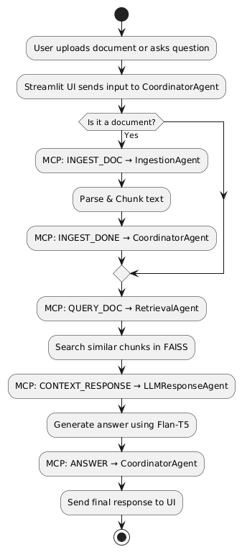
Flowchart
System flow diagram (with message passing)
User Interaction: The user starts by uploading a document or asking a question using the Streamlit UI.
Coordinator Agent: All inputs are first handled by the CoordinatorAgent, which routes them based on message type using the MCP (Model Context Protocol).
Ingestion Process: If a document is uploaded, it's passed to IngestionAgent which extracts and chunks the text and signals completion.
Query Handling: On a query, the RetrievalAgent searches for relevant chunks using FAISS + embeddings, then forwards context to the LLMResponseAgent.
Answer Generation: The LLMResponseAgent invokes the Flan-T5 model to generate a human-like response, which is sent back to the UI for display.

Slide 4
Tech Stack Used
Layer | Technology Used
Frontend | Streamlit
Agents | IngestionAgent, RetrievalAgent, LLMResponseAgent
Embedding Model | sentence-transformers/all-MiniLM-L6-v2
Vector DB | FAISS
LLM | google/flan-t5-small (Hugging Face)
Parsing Tools | PyMuPDF, python-docx
Search Fallback | DuckDuckGo Search (optional)
Architecture | Agent-based with MCP Protocol

Slide 5
Challenges & Improvements
Challenges
Model Selection: Had to balance accuracy vs size — large models like Mistral caused out-of-memory issues.
RAM Constraints: Initial LLMs required >8GB RAM, forcing switch to lighter alternatives like Flan-T5.
Gated Models: Hugging Face models like Mistral-7B failed due to access/login restrictions.
Improvements
Multi-document support – Enable users to upload and chat with multiple documents simultaneously.
Switchable LLMs – Let users choose between lightweight or powerful models depending on system capability.
Enhanced UI features – Add chat export, chunk highlighting, and citation-backed answers.

Slide 6
Thank You

