Slide 1
End-to-End AI-Driven Recruitment Pipeline with Real-Time Interview Insights and Cultural Fit Scoring
Uppari Upendra

Slide 2
Introduction
Objective
Automate and streamline the hiring process using AI.
Reduce manual effort in resume screening and interview scheduling.
Ensure fair, unbiased, and efficient candidate selection.
How It Works?
Resume Screening – AI extracts relevant skills and experience.
Interview Question Generation – AI creates job-specific questions.
Interview Process – AI-assisted interviews or human-conducted ones.
Decision Making – AI analyzes performance & selects/rejects candidates.
Email Notification – HR receives an automated email with the decision.
Impact: Saves time, improves efficiency, and reduces hiring bias.

Slide 3
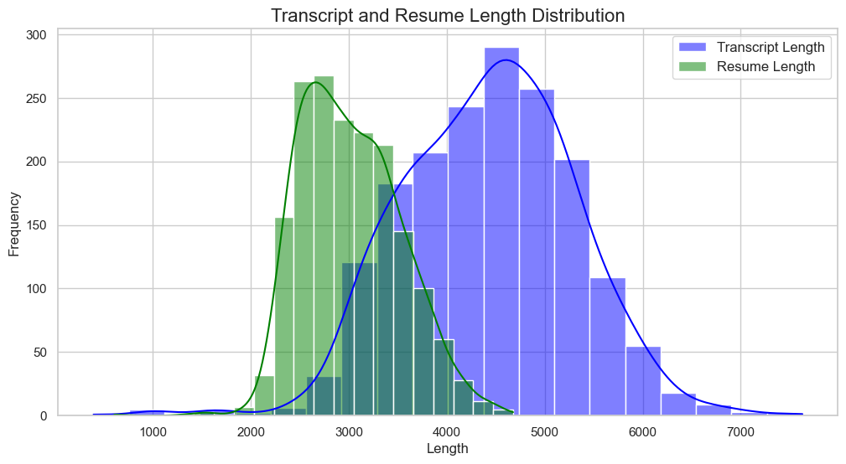
Exploratory Data Analysis (EDA) - Resume & Job Description Stats
Dataset Overview: Includes resumes, job descriptions, interview transcripts, hiring decisions, etc.
Plots to include:
Distribution of resumes across job roles – Highlights most common roles.
Word cloud of resume keywords – Shows frequently appearing terms in resumes and JDs.
Insights:
Some resumes have insufficient details.
Keywords in JDs often do not match those in resumes.

Slide 4
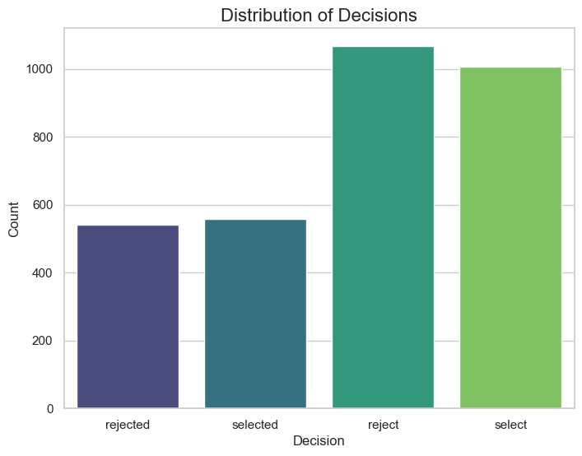
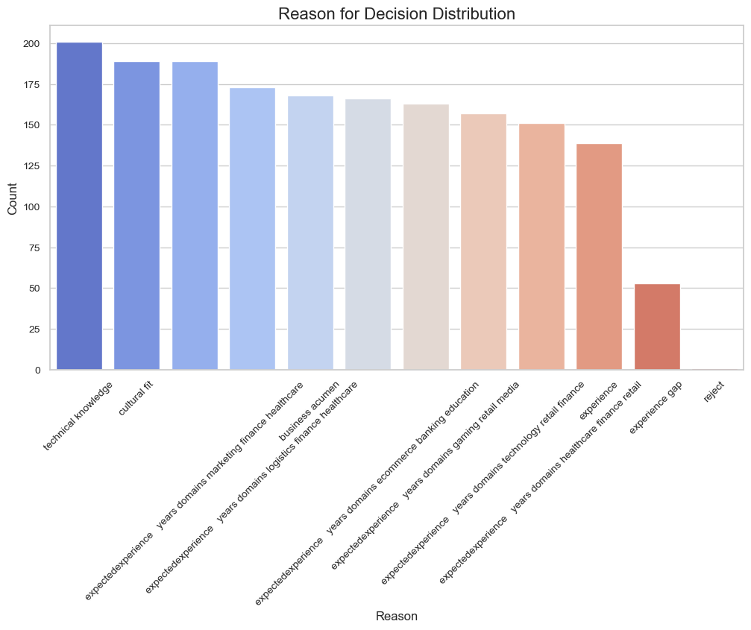
Exploratory Data Analysis (EDA) - Candidate Statistics
Plots to include:
Resume length distribution – Shows variations in resume word count.
Decision outcome bar chart – Selected vs. Rejected candidates.
Insights:
Resume length alone does not determine selection.
Candidates with highly relevant experience tend to be selected.
AI-based resume screening improves efficiency in shortlisting candidates.

Slide 5
Model Training – Input & Output Variables
Input Variables:
Resume text, Job Description text, Interview transcript.
Extracted features: TF-IDF, cosine similarity, BERT embeddings, resume length, keyword frequency.
Output Variable:
Binary classification – Selected (1) or Rejected (0).
Goal: Predict whether a candidate should be shortlisted for the next round.

Slide 6
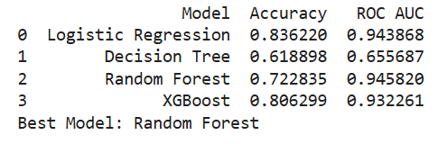
Classical ML Models – XGBoost, Random Forest, Logistic Regression
Models Tried:
Logistic Regression – Basic baseline model.
Random Forest – Handles non-linearity well.
XGBoost – Boosting improves accuracy.
Decision Tree – Boosting improves accuracy.
Results & Metrics:
XGBoost, Logistic regression & Random Forest performed best with highest
Best Model:
Random Forest with 0.945 accuracy

Slide 7
Deep Learning Model – BERT-based Neural Network
Why BERT?
Understands text context better than traditional ML models.
Captures deep semantic meaning from resumes and job descriptions.
Approach:
Converted text data into BERT embeddings.
Used a fully connected neural network (NN) to classify candidates.
Results:
Improved performance in cases where text meaning was crucial.
Outperformed traditional ML models on complex job descriptions.

Slide 8
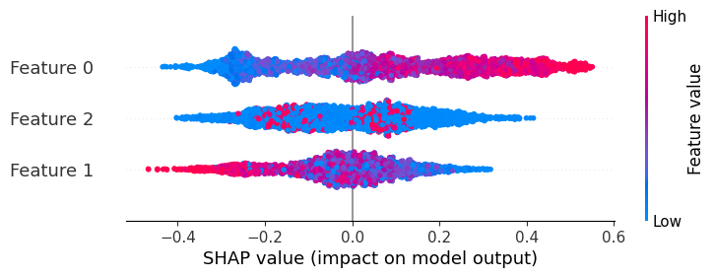
Shap Analysis (Post-model analysis)
What is SHAP?
SHAP (SHapley Additive exPlanations) explains model decisions.
Beeswarm Plot:
Shows which features contributed most to hiring decisions.
Feature Importance Insights:
Resume-job description similarity was the most influential factor.
Interview performance strongly impacted decisions.

Slide 9
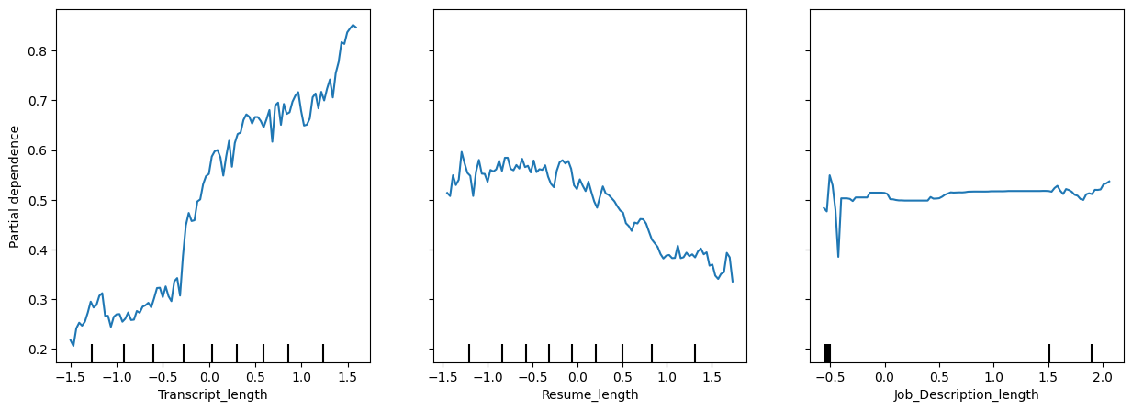
SHAp Analysis: Key Findings
Partial Dependence Plots (PDP) Analysis:
Transcript Length: Positive correlation; longer, detailed responses increase selection chances.
Resume Length: Negative correlation; excessively long resumes reduce selection likelihood.
Job Description Length: Minimal impact on selection probability, suggesting other dominant factors.

Slide 10
Resume Screening Technique
How It Works?
Extracts text from resumes & job descriptions.
Computes TF-IDF & cosine similarity for matching.
Uses BERT embeddings for deeper text understanding.
Ranks candidates based on similarity scores.
Impact:
Shortlists candidates efficiently.
Filters out irrelevant resumes automatically.

Slide 11
Prediction & Automated Email
Steps:
Model predicts selected/rejected candidates.
AI drafts personalized emails for selected & rejected candidates.
SMTP is used to send emails automatically.
Example Emails:
“Congratulations! You’ve been selected for the next round.”
“Thank you for applying, but we’ve chosen to proceed with other candidates.”
Impact:
Saves HR time.
Improves communication & transparency in hiring.

Slide 12
Conclusion
AI-Powered Hiring Flowchart
📂 Collect resumes → 🏗 Screen resumes (AI) → 🎤 AI/HR interviews → 📊 AI decision-making → 📧 Automated email notification.
Future Scope:
AI-driven Talent Search: Find candidates from LinkedIn & job portals.
Enhanced Model Features: Include social media presence, project portfolio evaluation.
Fraud Detection: AI video monitoring during interviews to prevent cheating.

Slide 13
Thank You

