Slide 1
TRINETRA
SPYING ROBOT IN THE FIED OF WAR

Slide 2
Team Members and Guide
Chillimuntha Upendra Sai 20BEV7001
Chakka Lavish Vamsi Raja 20BEV7004
Vadlamudi Kavya Sri 20BEV7005
Dr. Neeraj Kumar Misra

Slide 3
Contents
Abstract
Introduction
Block Diagram
Hardware and Software components
Advantages and disadvantages
Conclusion
References

Slide 4
Abstract
Design a robot to survey human activities in areas of conflict and border regions to minimize enemy incursions and risks to human life. Our robot has a wireless camera with night vision technology to transmit real-time video footage. It will provide valuable intelligence to the defense industry by reducing loss of life and preventing illegal activities.

Slide 5
Introduction
The Spy Robot using is an advanced technology that has been designed to provide a safe and efficient way of monitoring war fields. It is capable of gathering real-time information, which can be used to make informed decisions, and can be customized to meet the specific needs of different military operations.

Slide 6

Block Diagram
Solar Panel
Charge Control
Power Supply
Arduino Mega
Buzzer
Smoke sensor
Servo Motor
Laser Diode
Gas Sensor
Motor Driver
Motor
Fire Sensor
GSP Module
Thing Speak Cloud
Metal Sensor
WIFI Module
ESP32 Camera
User

Slide 7
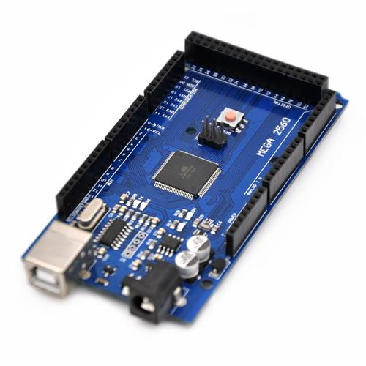
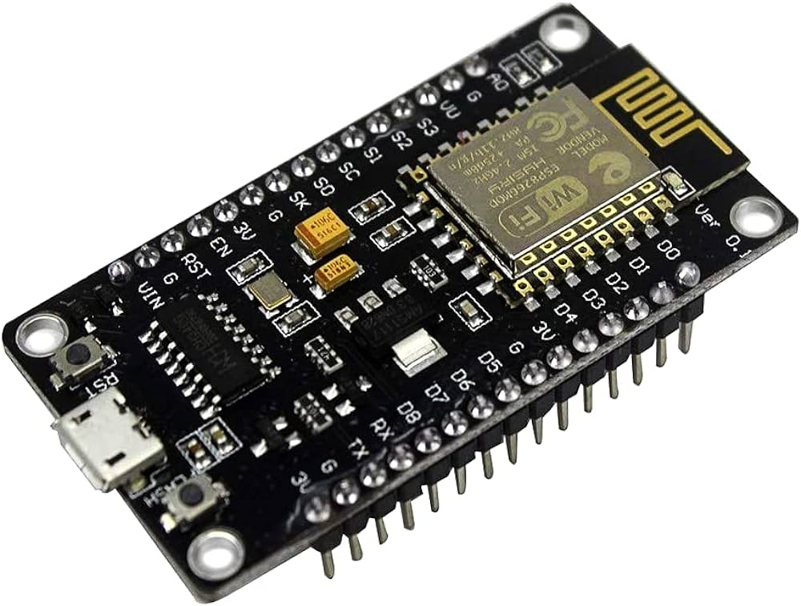
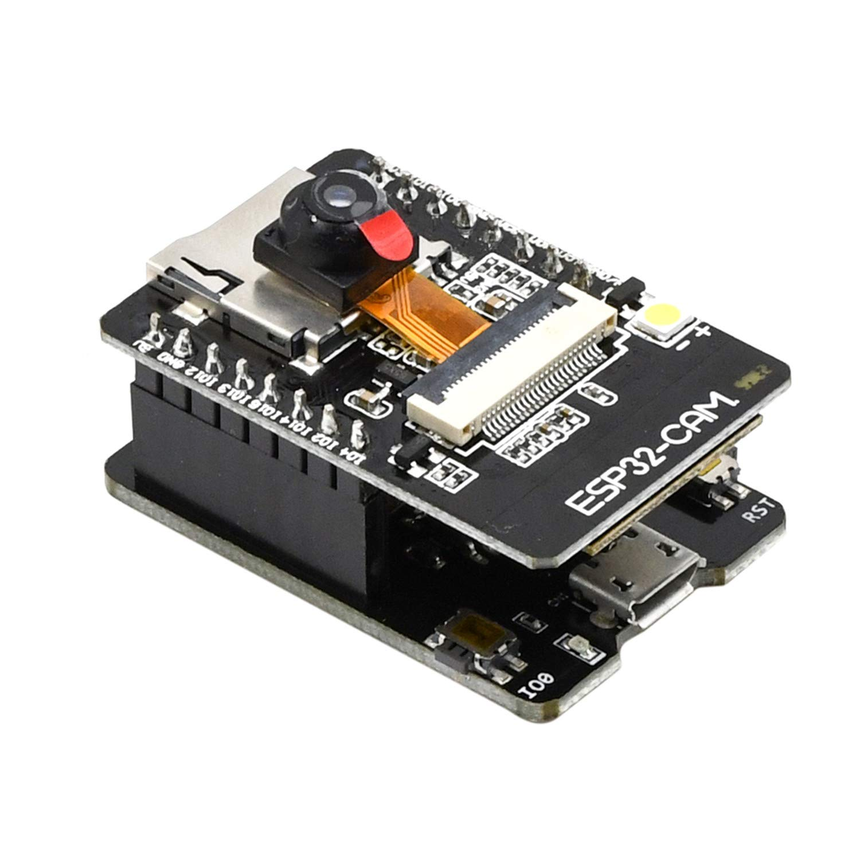
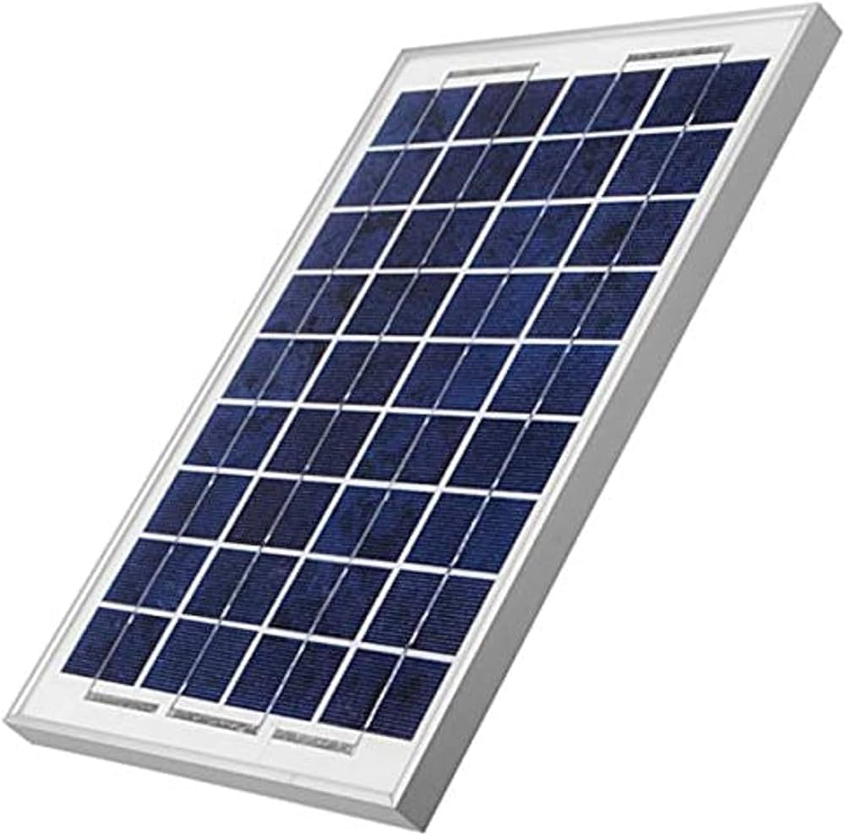
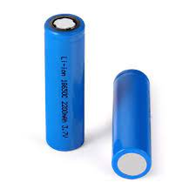
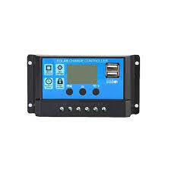
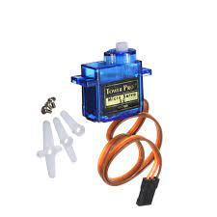
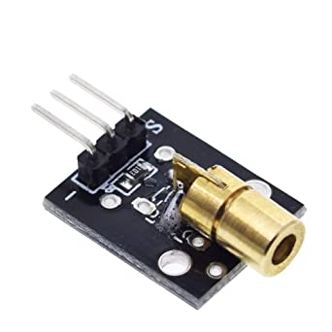
Hardware Components
Arduino Mega :The Arduino Mega 2560 is a microcontroller board based on the ATmega2560 microcontroller.
It has 54 digital input/output (I/O) pins (of which 14 can be used as PWM outputs), 16 analog inputs, 4 UARTs (hardware serial ports), a 16 MHz crystal oscillator, a USB connection, a power jack, an ICSP header, and a reset button.
The Mega is compatible with most shields designed for the Arduino Uno or Diecimila.

Slide 8
Hardware Components
Charge Controller: A charge controller, charge regulator or battery regulator limits the rate at which electric current is added to or drawn from electric batteries to protect against electrical overload, overcharging, and may protect against overvoltage.

Slide 9
Hardware Components
Servo Motor: A servo motor is a rotary actuator featuring a motor, feedback device (such as a potentiometer or encoder), and a control circuit. It excels in providing precise control over angular position, velocity, and acceleration. Servo motors are widely used in applications like robotics and automation due to their accuracy and ability to maintain specific positions. They operate in a closed-loop system, continuously adjusting motor movement based on feedback, making them essential in scenarios requiring precise and controlled motion.

Slide 10
Hardware Components
Solar Panel:Solar panels, also known as photovoltaic (PV) panels, are devices that convert sunlight into electricity. They consist of solar cells made of semiconductor materials, typically silicon. When sunlight hits these cells, it excites electrons, creating an electric current. The generated electricity can be used directly or stored in batteries for later use. Solar panels are a key component of solar energy systems, providing a clean and renewable source of power.

Slide 11
Hardware Components
Power supply: Using lithium-ion batteries offer a compact, efficient, and rechargeable energy solution for various applications. Lithium-ion batteries have become popular due to their high energy density, lightweight nature, and longer lifespan compared to traditional batteries. In power supply systems, lithium-ion batteries are often used to store energy generated from renewable sources like solar panels or wind turbines.

Slide 12
Hardware Components
ESP32 WIFI Module: The ESP32 is a versatile Wi-Fi module developed by Espressif Systems, widely used in IoT (Internet of Things) applications. Here are some key points about the ESP32 Wi-Fi module:
Wireless Connectivity
Dual-Core Processor
Low Power Consumption
Integrated Wi-Fi and Bluetooth Stack
Rich Peripheral Set
Development Framework
Community Support
Arduino Compatibility
Cost-Effective

Slide 13
Hardware Components
ESP32 Camera: The ESP32 Camera combines the capabilities of the ESP32 microcontroller with a camera module, offering a versatile solution for image and video capture in IoT applications with the added benefit of wireless connectivity.

Slide 14
Hardware Components
Laser Diode: Laser diodes are semiconductor devices that emit coherent light and find widespread use in a variety of technological applications due to their compact size, efficiency, and modulation capabilities.

Slide 15
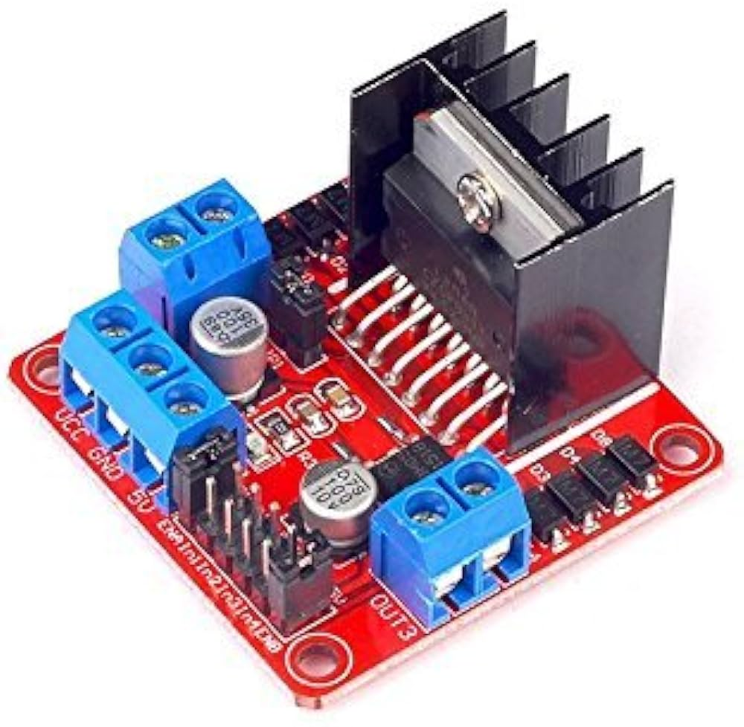
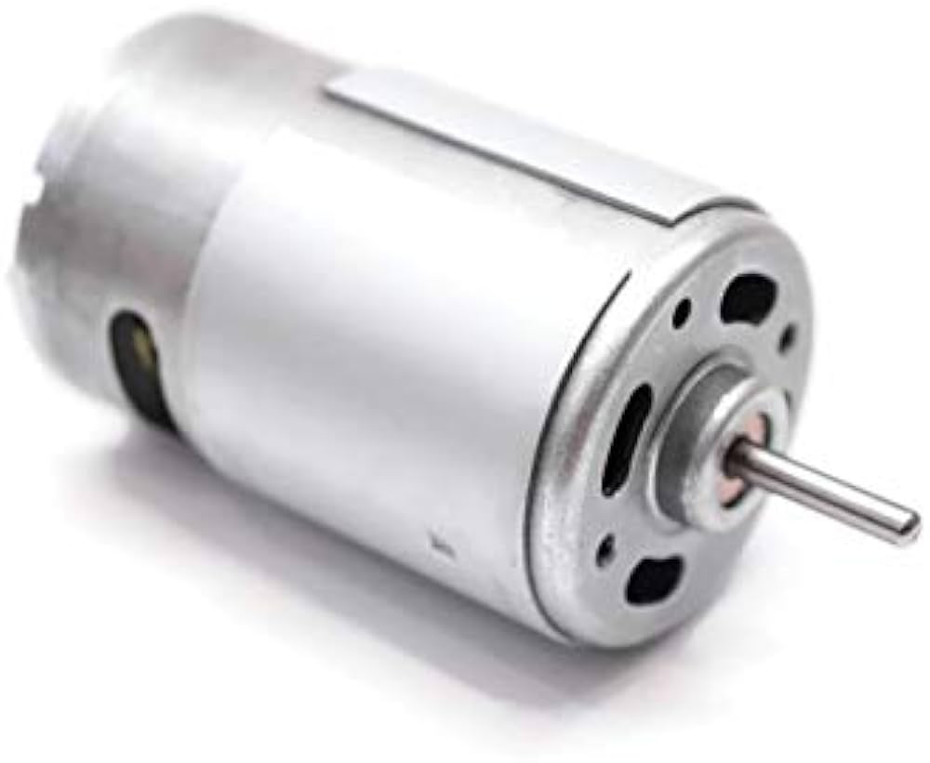
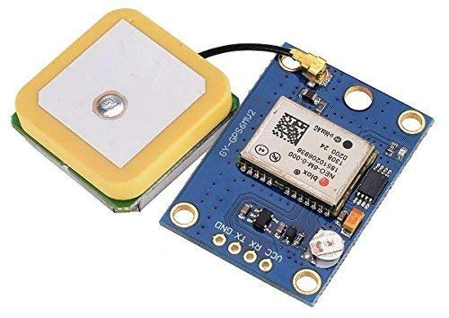
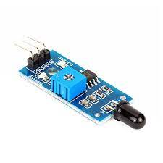
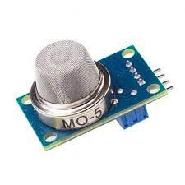
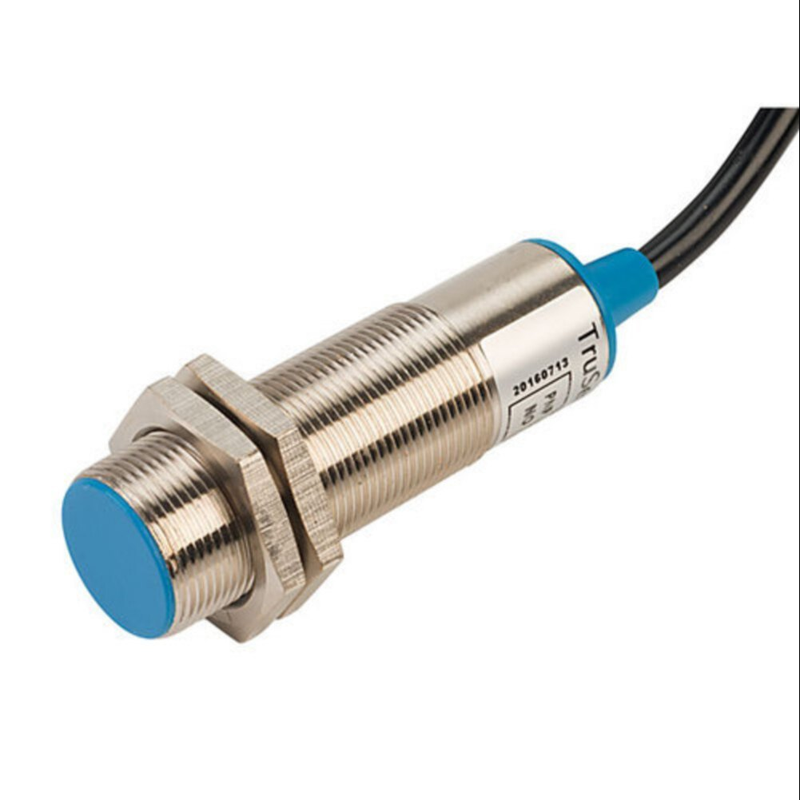
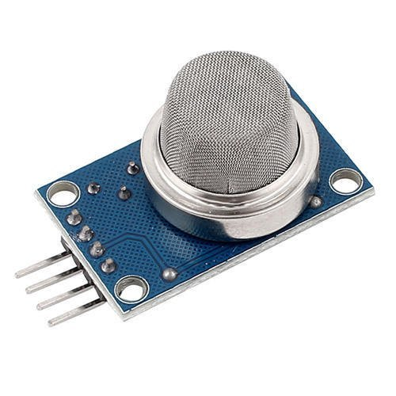
Hardware Components
Motor Driver: Motor drivers are crucial components in electronic systems that enable the control of electric motors, providing the necessary functionality for diverse applications that involve motorized movement.

Slide 16
Hardware Components
Metal Sensor: Metal detectors are devices that use electromagnetic principles to detect the presence of metal objects. They find applications in security, archaeology, and industry, providing a non-intrusive and efficient way to identify metallic items in various environments.

Slide 17
Hardware Components
GPS Module: GPS modules play a crucial role in providing accurate location information for a wide range of applications, from navigation and tracking to time synchronization, enhancing the functionality of devices and systems across various industries.

Slide 18
Hardware Components
Fire Sensor: Fire sensors are vital safety devices that use various technologies to detect the presence of smoke or fire. Their prompt detection and alarm activation contribute significantly to fire prevention and the safety of occupants in residential and commercial spaces.

Slide 19
Hardware Components
Smoke Sensor: Smoke sensors play a crucial role in fire detection and early warning systems. Their ability to quickly identify the presence of smoke contributes significantly to fire safety by allowing occupants to evacuate promptly and emergency services to respond swiftly.

Slide 20
Hardware Components
Motor: 12V DC motors are versatile components widely used in various applications due to their compatibility with common power sources and their ability to efficiently convert electrical energy into mechanical motion.

Slide 21
Hardware Components
Gas sensor: It play a crucial role in monitoring and ensuring safety in various environments. Their ability to detect specific gases allows for early detection of potential hazards and contributes to the overall safety and well-being of individuals and communities.

Slide 22
Circuit Diagram

Slide 23
Working

Slide 24
Software
Arduino IDE :-
The Arduino Integrated Development Environment - or Arduino Software (IDE) - contains a text editor for writing code, a message area, a text console, a toolbar with buttons for common functions and a series of menus. It connects to the Arduino and Genuino hardware to upload programs and communicate with them.
Thingspeak :-
ThingSpeak is IoT platform for user to gather real-time data; for instance, climate information, location data and other device data. In different channels in ThingSpeak, you can summarize information and visualize data online in charts and analyze useful information
MIT App Inventor :-
MIT App Inventor is a high-level block-based visual programming language, originally built by Google and now maintained by the Massachusetts Institute of Technology. It allows newcomers to create computer applications for two operating systems: Android and iOS

Slide 25
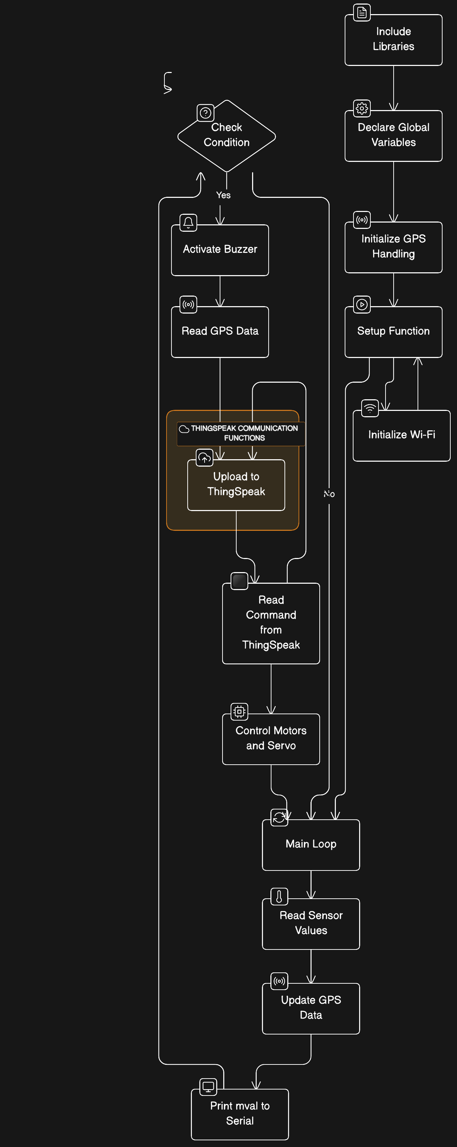
The code includes the Servo library to control a servo motor and defines pins for various components.
A TinyGPS library is used to parse GPS data received through the Serial port.
The `read_gps` function continuously reads GPS data for one second and updates the latitude and longitude variables.
In the `setup` function, components like the servo, LEDs, motors, and Serial communication are initialized.
The `loop` function is the main execution loop, where GPS data is read, analog and digital sensor values are obtained, and IoT data is uploaded to ThingSpeak.
The code checks if a certain condition (always true in this case) is met and executes a block of code that includes activating a buzzer, reading GPS again, and uploading IoT data.
Motor control commands are received from the IoT platform and used to control four motors in different configurations.
A special command ('6') activates a servo motor, causing it to move back and forth in a sweeping motion.
Another command ('5') turns off the LED and sets the servo motor position to 0.
The `wifi_init` function initializes the ESP8266 module for Wi-Fi communication with a predefined SSID and password.
The `upload_iot` function constructs an HTTP GET request with sensor data and GPS coordinates, then sends it to ThingSpeak for storage and visualization.
The `read_iot` function sends a request to ThingSpeak to retrieve the last value of a specific field and returns the received character.
The code relies on the ThingSpeak IoT platform, and the specific ThingSpeak channel and API key are hardcoded.
Serial communication is used for debugging and communicating with the ESP8266 module.

Slide 26
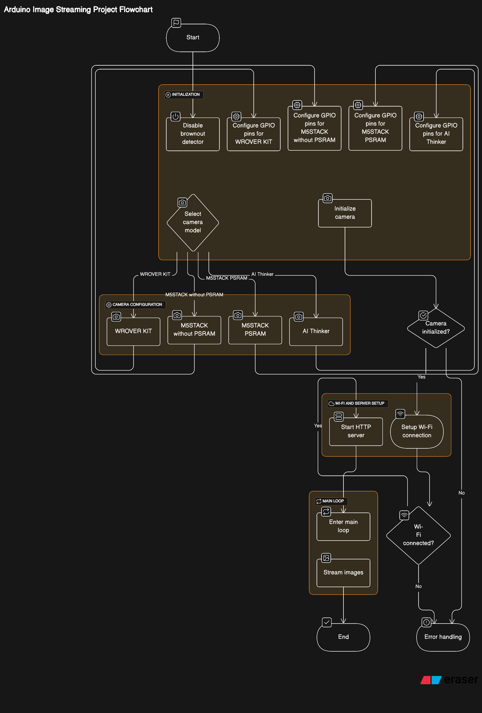
1. Initialization: Start by setting up camera-related libraries and including necessary header files.
2. Network Credentials: Define Wi-Fi network credentials (`ssid` and `password`) for establishing a connection.
3. Camera Model Configuration: Choose the camera model by uncommenting specific `#define` statements based on the hardware in use.
4. Pin Configuration: Configure GPIO pins according to the selected camera model for proper hardware interaction.
5. HTTP Server Setup: Configure HTTP server settings, specifying content types and boundaries for communication.
6. Stream Handler Function: The `stream_handler` function manages HTTP requests, capturing camera frames, handling errors, converting frames to JPEG format, and sending data as HTTP responses.
7. Start Camera Server: The `startCameraServer` function configures and initiates the HTTP server, registering the stream handler for serving camera feeds.
8. Setup Function: In the setup phase, disable the brownout detector, initialize Serial communication, configure camera settings, establish a Wi-Fi connection, and start the camera server. Print relevant information such as connection status and camera stream URL.
9. Loop Function: The loop function is minimal, with a small delay (`delay(1)`), as the main functionality is handled by the HTTP server and camera stream handler.

Slide 27
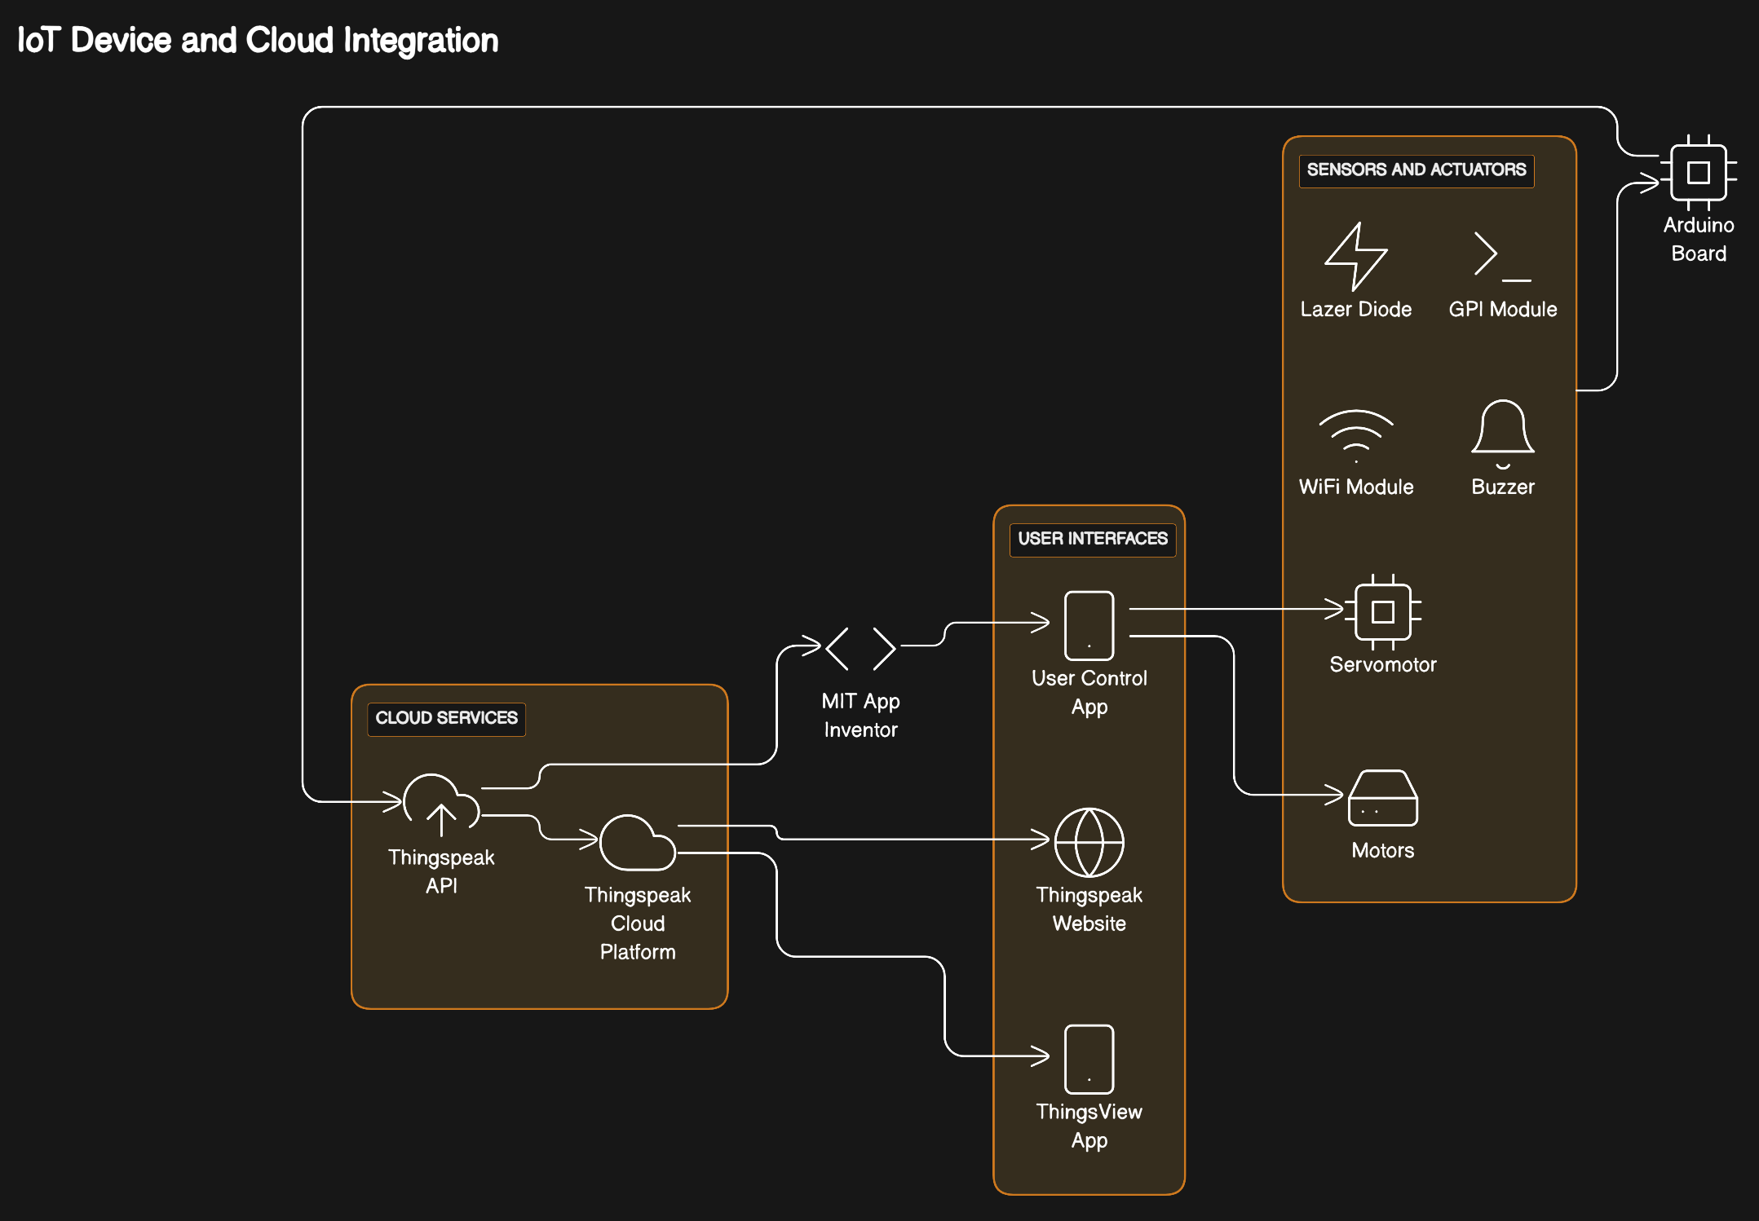

Slide 28
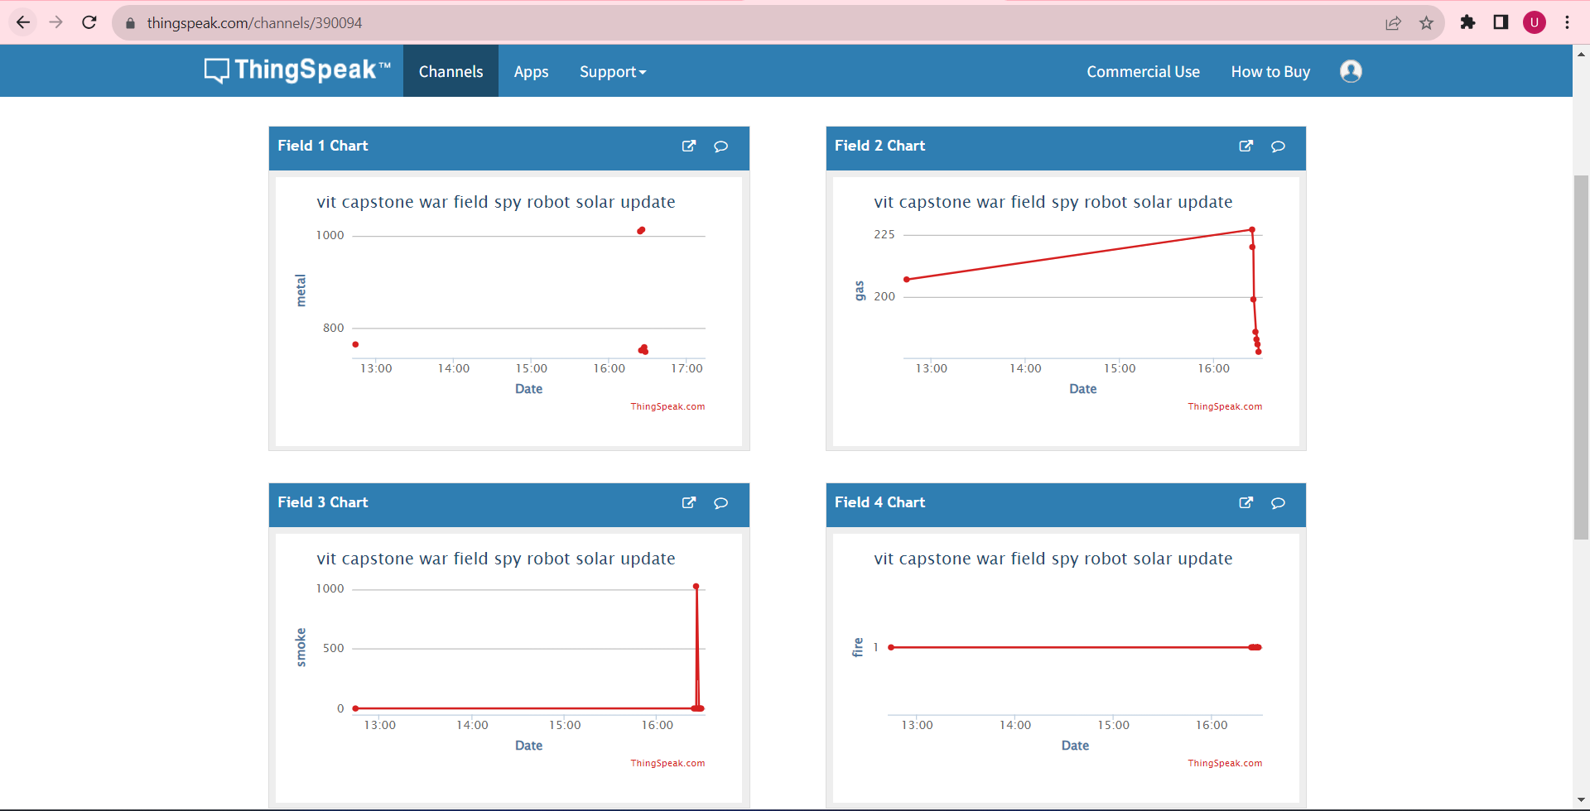
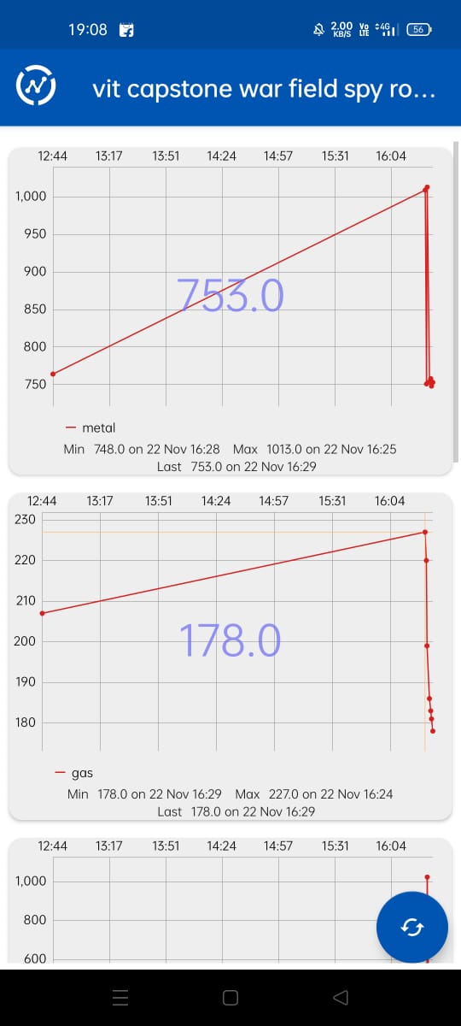
Web View
ThingView app
display
Thingspeak Configuration
Step 1 Go to https://thingspeak.com/, register an account and login to the platform
Step 2 Choose Channels -> My Channels -> New Channel
Step 3 Input Channel name, Field1 , then click “Save Channel”
• Channel name: vit capstone war field spy robot
• Field 1: metal
Step 4 You will see a chat for data field1
Step 5 Open your web browser, go to https://thingspeak.com , select your channel > “API Keys” ，copy the API key as follows:
Step 6 Use this API Keys in MIT App Inventor and Arduino IDE to upload data.
Step 7 Install ThingView Application , Add Channel Number //Our Channel No.“390094” .
Step 8 Refresh Application, All data is synchronous timely.
Step 9 Same data is also display in web view.
Step 10 Open your web browser,go to https://thingspeak.com/channels/390094

Slide 29
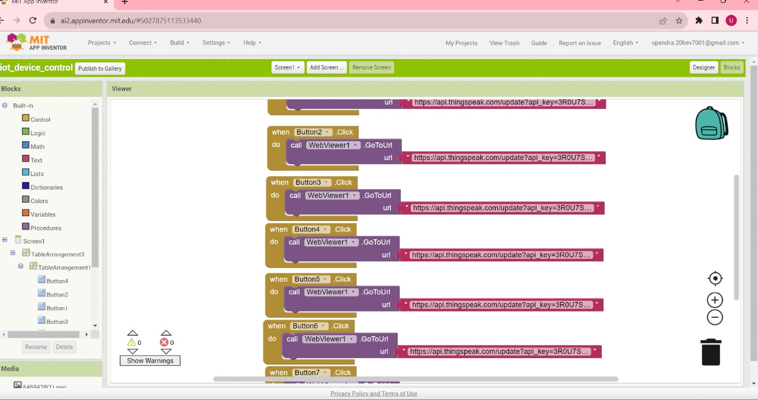
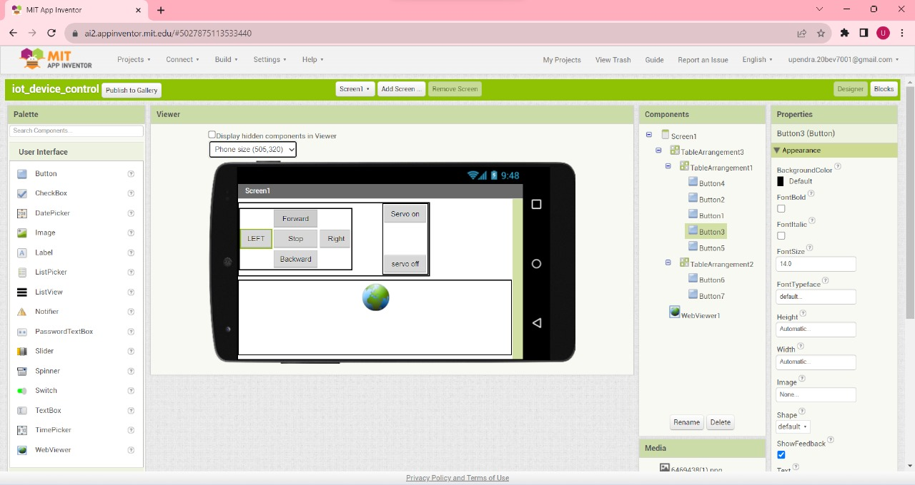
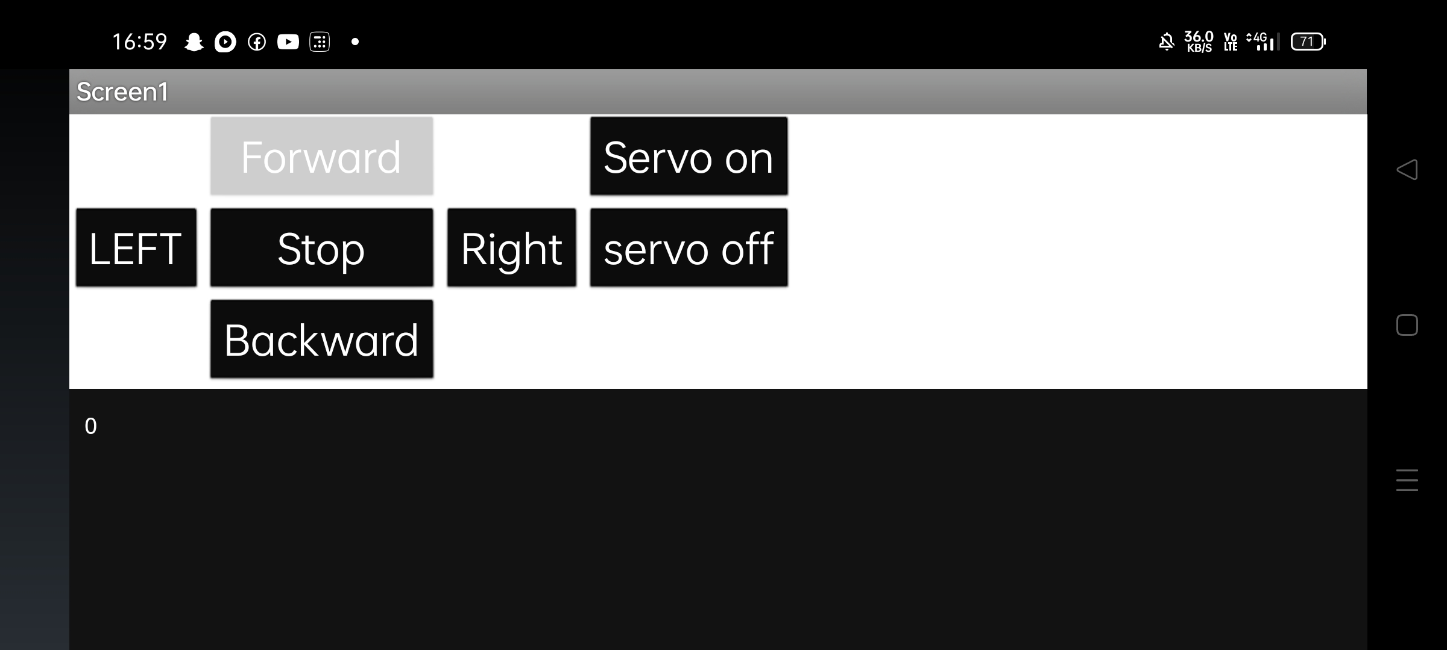
Design View
Layout Design
App deployment in Android

Slide 30
Advantages and disadvantages

Slide 31
Conclusion
The overall program combines sensor readings, motor control, Wi-Fi communication, and servo motor control to create an IoT-enabled system, integration of camera functionality, and HTTP server capabilities in an Arduino project.

Slide 32
References

