Slide 1
COVID-02 Project Internet & Applications Karteris Antonios el12076

Slide 2
Goal
1
Parse the Cord-19 Dataset;
Find and display all articles that mention a specific drug, provided by the user

Slide 3
Problem Formulation
2
Receive the input query from the user,
Use a java servlet to pass the query to javascript functions,
Parse through the .csv file row-by-row using PapaParse,
Search through the row and through the linked PMC/PDF files for mentions of the search query,
If no mentions were found, discard the row
Repeat 3 – 4 for all rows
Serve the final table
(Optional) Serve an Articles/Year chart using Highcharts

Slide 4
Implementation
3
Our project consists of:
A JSP (HTML) & CSS front-end,
Javascript code that performs the parsing and searching,
A Java servlet that allows the communication of the above.

Slide 5
Implementation
3
The main implementation consists of 3 separate JavaScript files:
script.js: contains the 3 main functions that comprise the implementation: parseCSV, addRow, findOccurrences.
macros.js: contains several smaller “helper” functions.
chart.js: contains the code that generates the Articles/Year chart at the end of each search.

Slide 6
parseCSV() function
3.i
Initializes all variables
Parses the metadata.csv file row-by-row, where each row represents one article.
For each row, calls the addRow() function, passing the row itself and the search query.
When the parsing is complete, displays the results and calls the function createChart() to create the Articles/Year chart.

Slide 7
addRow() function
3.ii
Calls the findOccurrences() function for each article in order to find occurrences of the search query.
If any occurrences were found, formats the text fields of the row accordingly, and adds them to the final table.
Also, creates two additional columns that record the number of occurrences of our search query and the fields where it was found, and adds them to the final table.

Slide 8
findOccurrences() function
3.iii
Searches through the specified columns (Title, Abstract) of the article for the search query.
Searches through the linked pmc/pdf files (if they exist) for the search query.
Forms and returns an array that contains a counter of occurrences for each part of the article (Title, Abstract, Full Text)

Slide 9
Execution
4
The project was loaded and tested on an Apache Server running on my personal machine.
Machine Specs:
CPU: Intel Core i3-380m @ 2.53 GHz
RAM: 4GB DDR3
Storage: 500GB Hitachi HDD
Operating System: Windows 10 LTSC, 64-bit

Slide 10
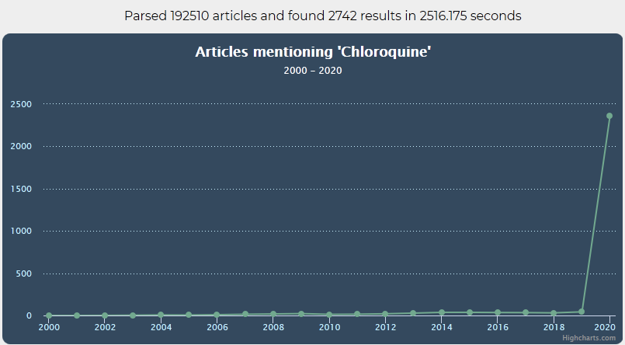
Some tests
5

Slide 11
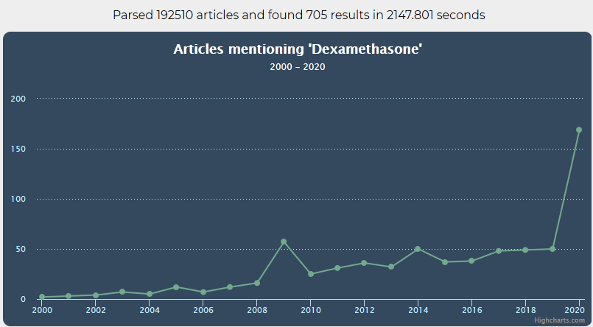
Some tests
5

Slide 12
Final Notes & Links
6
The implementation is based on pure JavaScript code – no jQuery was used.
The repository for this project can be found at the following link:
https://github.com/UphillD/InA-COVID-02
A demonstration can be found at the following link:
https://youtu.be/ZlfYjq8xDwo
Due to my machine being extremely outdated, we can safely consider the execution times noted in the previous slides to be a worst-case scenario.

Slide 13
Thank you for your time!
A presentation by A. Karteris
el12076
akarteris21@gmail.com el12076@mail.ntua.gr

