Slide 1
Geography CBA
Nathan O’Connor

Slide 2
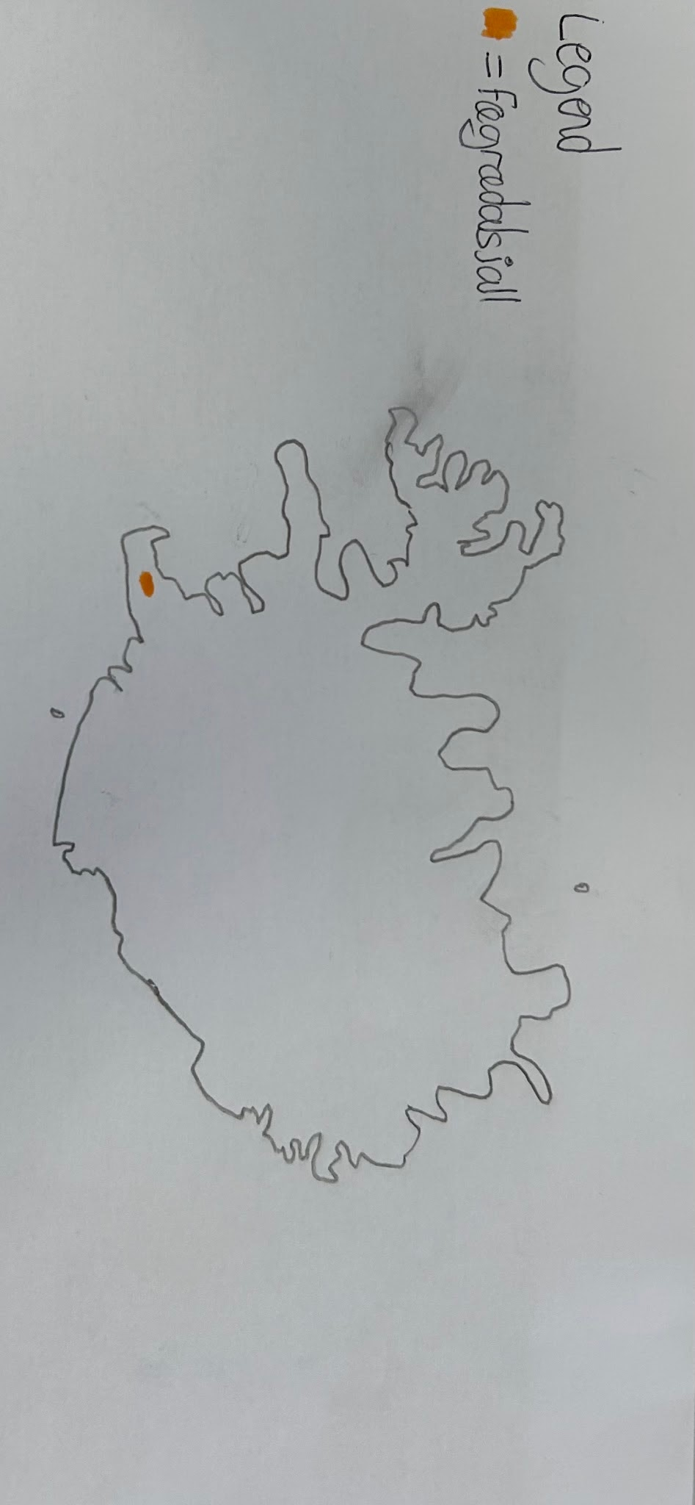
Map of Iceland

Slide 3

Key Q&A’s
Name of volcano: Fagradalsfjall
Date & time: Friday 19th of March 2021, at 20:45
What happened: The volcano erupted
Who was affected: The townspeople of Grindavík were affected because they had to evacuate their homes.
How did they respond to the event: Warnings were issued regarding the gas and lava, nearby towns such as Gríndavik were evacuated.
Where did this event occur: Reykjanes peninsula, Iceland

Slide 4
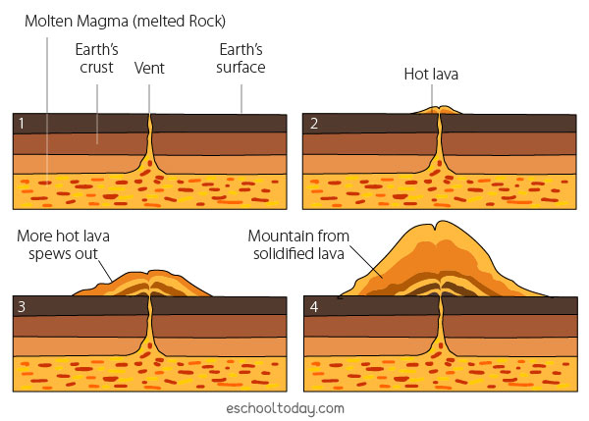
How volcanoes form
Volcanoes form at destructive plate boundaries.
The two plates collide and the heavier oceanic plate sinks below the lighter continental plate and melts in the mantle.
As it melts, a blob of magma breaks off and rises up through cracks (faults) in the crust.
Over time, this magma can erupt and begin to form a volcanic mountain.

Slide 5
Processes of volcanic activities
The magma is stored underground in a magma chamber. The gases build up in the magma chamber.
The pressure builds up and magma erupts out of the vent through an opening called a crater.
When magma reaches the earth’s surface, it is known as lava.
Over time, layers of ash and lava harden and build up around the vent to form a cone shaped mountain.

Slide 6
Volcanic life cycle
Active:
An active volcano erupts regularly, e.g. Mount Etna, Italy
Dormant:
A dormant volcano has not erupted for some time, e.g. Mount St. Helens, USA
Extinct:
Has not erupted in historic times, e.g. Slemish, Co. Antrim

Slide 7
Benefits of volcanic areas
Volcanoes can be both both beneficial and detrimental to a country.
Benefits:
Geothermal energy can be harnessed from volcanoes.
Soil quality in volcanic areas can be excellent
Land formation - Many islands & archipelagos have been formed by volcanic eruptions
Tourist attractions - Volcanoes can be mesmerizing when viewed from a distance

Slide 8
Drawbacks of volcanoes
Volcanic eruptions can lead to volcanic mudflows called lahars
Aeroplanes may need to be grounded due to ash clouds from volcanoes
Volcanic ash can render areas temporarily uninhabitable
Lava can move VERY fast (up to 100km/h) and destroy buildings
Volcanic eruptions can kill people

Slide 9
Local impacts of this volcanic event
The blue lagoon geothermal spa in the Reykjanes peninsula was shut down and evacuated due to a car park full of lava
The nearby town of Grindavík was evacuated
The risk of lava flowing across roads increased
Lava flows covered an estimated 3 km of land

Slide 10
Global impacts of this volcanic event
The eruption received coverage by several news agencies worldwide
Between 430 to 1,510 kilotonnes of sulfur dioxide were released into the atmosphere by the eruption. While this is a small amount compared to other historic eruptions, Sulfur dioxide can affect both the climate and human health.
The eruption was valuable to scientists studying lava-flow behaviour due to the moderately safe nature of the eruption site.

Slide 11
Sustainability of this event on tourism in the local area
While the eruption was ongoing, over 356,000 tourists visited the site
Two trails were set up by local authorities for viewing of the volcanic activity, out of the two trails, trail A was favoured by tourists because it offered more scenic views of the eruption. Managing the trail became difficult since it had to be modified several times to accommodate the constant foot traffic.
The volcanic tourism / geotourism creates thousands of jobs and generates billions of euros of revenue.

Slide 12
Sustainability on local agriculture & infrastructure
While this specific eruption had little effect on agriculture due to the fact that it happened in a mostly uninhabited area, volcanic soil is good for farming due to its high mineral content.
While the aforementioned effects sound good there can still be some undesirable effects. E.g. volcanic ash causing respiratory problems in livestock.
While this event did lead to evacuations, etc; Iceland’s volcanic land is great for powering geothermal power plants, Geothermal energy is also a sustainable form of energy.

Slide 13
Conclusion
This eruption was a great example of one that was handled well by citizens and the government, it was treated as a research/tourism opportunity rather than just something to be afraid of.
I think that this eruption, and its response set a good example to other countries to deal with volcanic eruptions systematically, without disrupting much activity within the country.

Slide 14
Bibliography
“Geography in the news” booklet (2026) DGS Geography department
Fitzharris, Tara & Lydon, Peter. (2018) Real World Geography. Folens
Vally, H & Misso, NL. (2012) Adverse reactions to the sulphite additives. Gastroenterol Hepatol Bed Bench
Barsotti, S, et al. (2021) The eruption in Fagradalsfjall (2021, Iceland): how the operational monitoring and the volcanic hazard assessment contributed to its safe access. Nat Hazards 116, 3063–3092.

Slide 15
Bibliography
Pagneux, E. (2026) Access to the Fagradalsfjall 2021–2023 volcanic eruptions: a case-study of pedestrian routes mapping with least-cost-path analyses. Nat Hazards 122, 93
Pfeffer, M, et al. (2024) SO2 emission rates and incorporation into the air pollution dispersion forecast during the 2021 eruption of Fagradalsfjall, Iceland. Journal of Volcanology and Geothermal Research Volume 449

Slide 16
Bibliography
Phillips, J. et al. (2019) Dynamic and extensive risk arising from volcanic ash impacts on agriculture. United Nations Office for Disaster Risk Reduction (UNDRR).
NASA Earth observatory. (2021) Fagradalsfjall Continues to Erupt, available: https://science.nasa.gov/earth/earth-observatory/fagradalsfjall-continues-to-erupt-148510/ [accessed 8th October 2026]
Watson, J. (1997) Pyroclastic Flows, available: https://pubs.usgs.gov/gip/msh//pyroclastic.html [accessed 8th October 2026]

Slide 17
Bibliography
CITYPNG (2026) 3D White Man Near Red Question Mark HD PNG [rendered 3d model], available: https://www.citypng.com/png-download/28741 [accessed 8th October 2026]
Qa Qooking (2025) Volcanic Landforms Diagram [diagram], available: https://qaqooking.wiki/all/how-to/volcanic-landforms-diagram [accessed 8th October 2026]

