Slide 1
Research problem
Based on minimax for mulation's adversarial training is necessary for the robustness of the training model, but this adversarial training strategy is to generate adversarial samples for training through PGD -10. This sample is too "strong" so that the samples under the current model are completely classified the other side of the border.
Therefore, the author conducted research on suitable adversarial samples and proposed a new formula for friendly adversarial training: instead of using the most adversarial data to maximize the loss, use the least adversarial data (i.e., friendly adversarial data) for training to minimize losses.

Slide 2
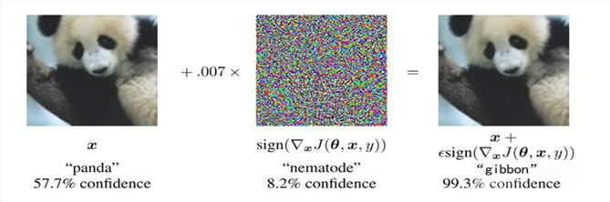
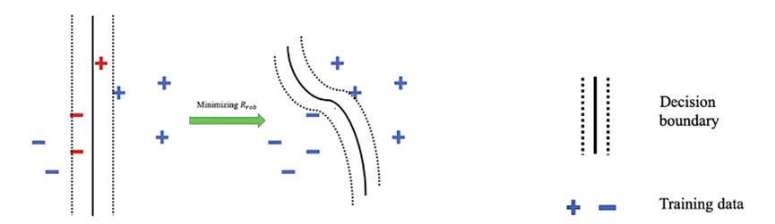
Background , importance and applications
Background：
Adversarial data = input natural data of deep neural network + artificial noise
Adversarial learning is by far the most effective way to improve adversarial robustness.
Importance：
using friendly adversarial data for training can effectively improve the classification accuracy, thereby improving the accuracy of the neural network.
Applications：
The safety-critical nature of certain fields, such as medicine and autonomous driving, has a great demand for the adversarial resistance of deep neural networks

Slide 3

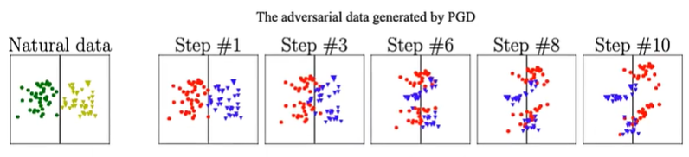
Method Used
First, the author examines the foundation of traditional adversarial learning.
Secondly, in response to these problems, the author questioned the traditional adversarial learning model.
Therefore, the author proposes a new adversarial learning formula, which is called the min - min formulation.

Slide 4
Innovation and highlights
Innovation:The innovation of this article is that the author has improved the existing adversarial learning method and used his own innovative set of formulas to screen the training data.
Highlights:
a) Compared with traditional adversarial learning, friendly adversarial learning alleviates the cross - over mixture problem.
b) Compared with traditional adversarial learning, friendly adversarial learning is more time-saving.
c) Compared with traditional adversarial learning, friendly adversarial learning can achieve a larger protection radius.

Slide 5
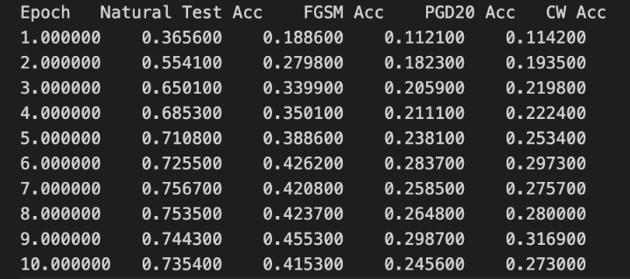
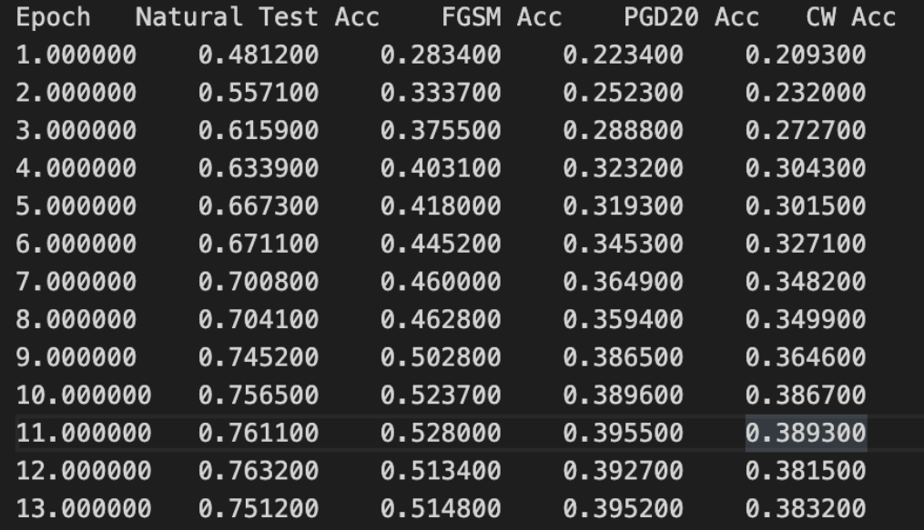
Result display and reflections
Result display:
Reflections:
Further explore alternative methods for generating friendly adversarial data
Incorporate transfer learning
Consider the adaptability to different tasks and datasets
Combine different adversarial training strategies
Consider domain-specific optimization strategies
FAT
FAT_for_TRADES

