Slide 1

Uply Media Inc.
Messenger.Crypto
Overview
by
Durmuş Gülbahar

Slide 2
Table of Contents :
• Overview of application
• Ideas for Frontend of application.
- Sending NFT/Emoji and offering to NFTs/Emojis in chat.
- Profile Panel
- Staking
• Summarize of backend
• Smart Contracts
• IPFS
• Bridge between Blockchain and Application (Ethers.js)

Slide 3
Messenger.Crypto
Frontend
Backend
IPFS
Smart Contracts
Bridge
(Ethers.js)

Slide 4
- Main idea of the application is a decentralized chat application without central authority,
no need to worry about censorship and full anonymously.
- People can exchange their currencies with local currency CHATR.
- User can send gifts and buying emojis with local currency CHATR.
- Additionally, our wallet will charge a 2% transaction fee for all transactions. The native token will be a gas-saving ERC-20 token that will be offered for people to buy and stake tokens to grow the project.

Slide 5
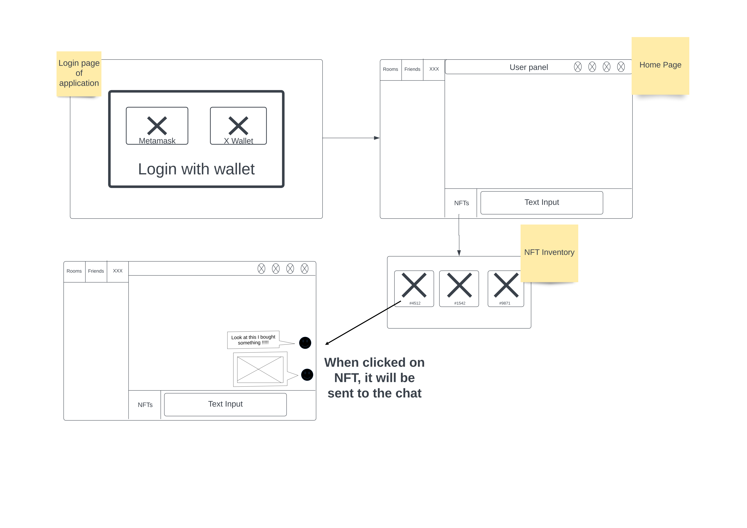
Frontend
Sending NFT/Emojis in chat

Slide 6
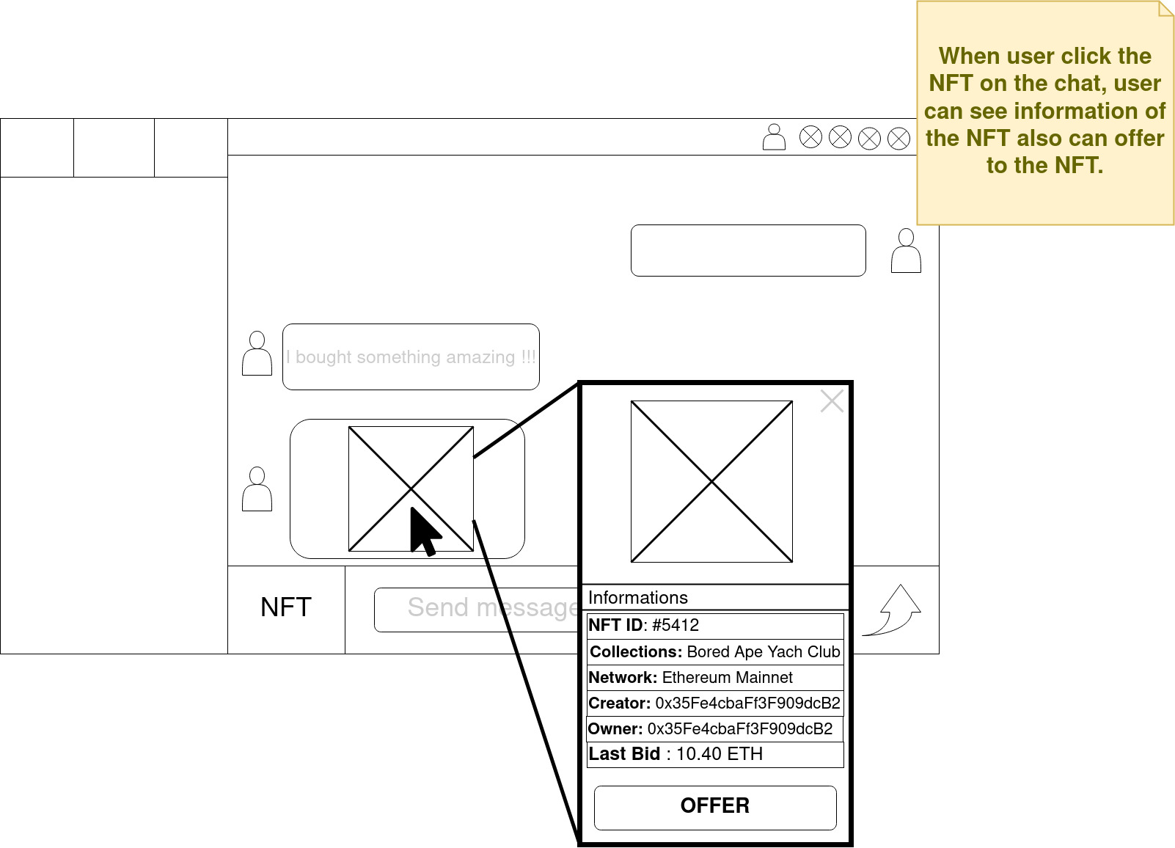
Frontend
After implemented chatting and creating group chats on IPFS smoothly. We will implement NFT trade and sending emojis as NFT.

Slide 7
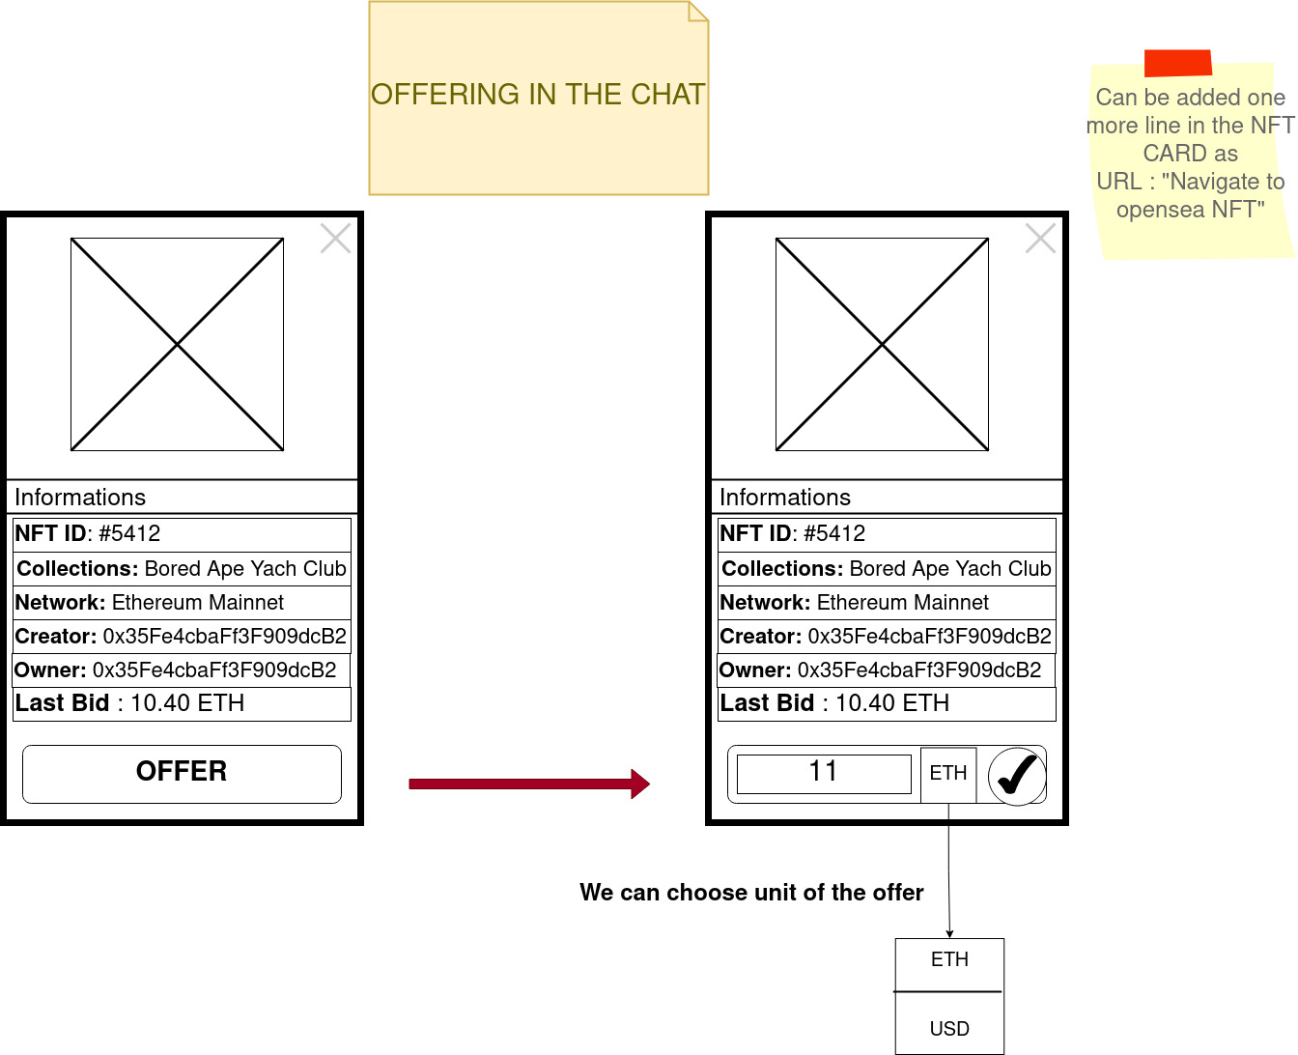
Frontend
- To be fast and close to the real-life chatting and trading, we can use NFT Cards.

Slide 8
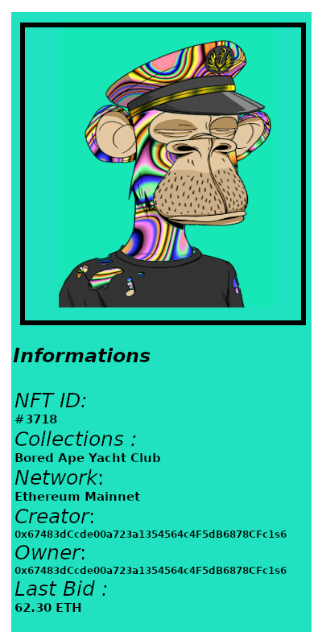
Frontend
- An Example of NFT Cards would be shown in chat. Includes informations of NFT’s

Slide 9
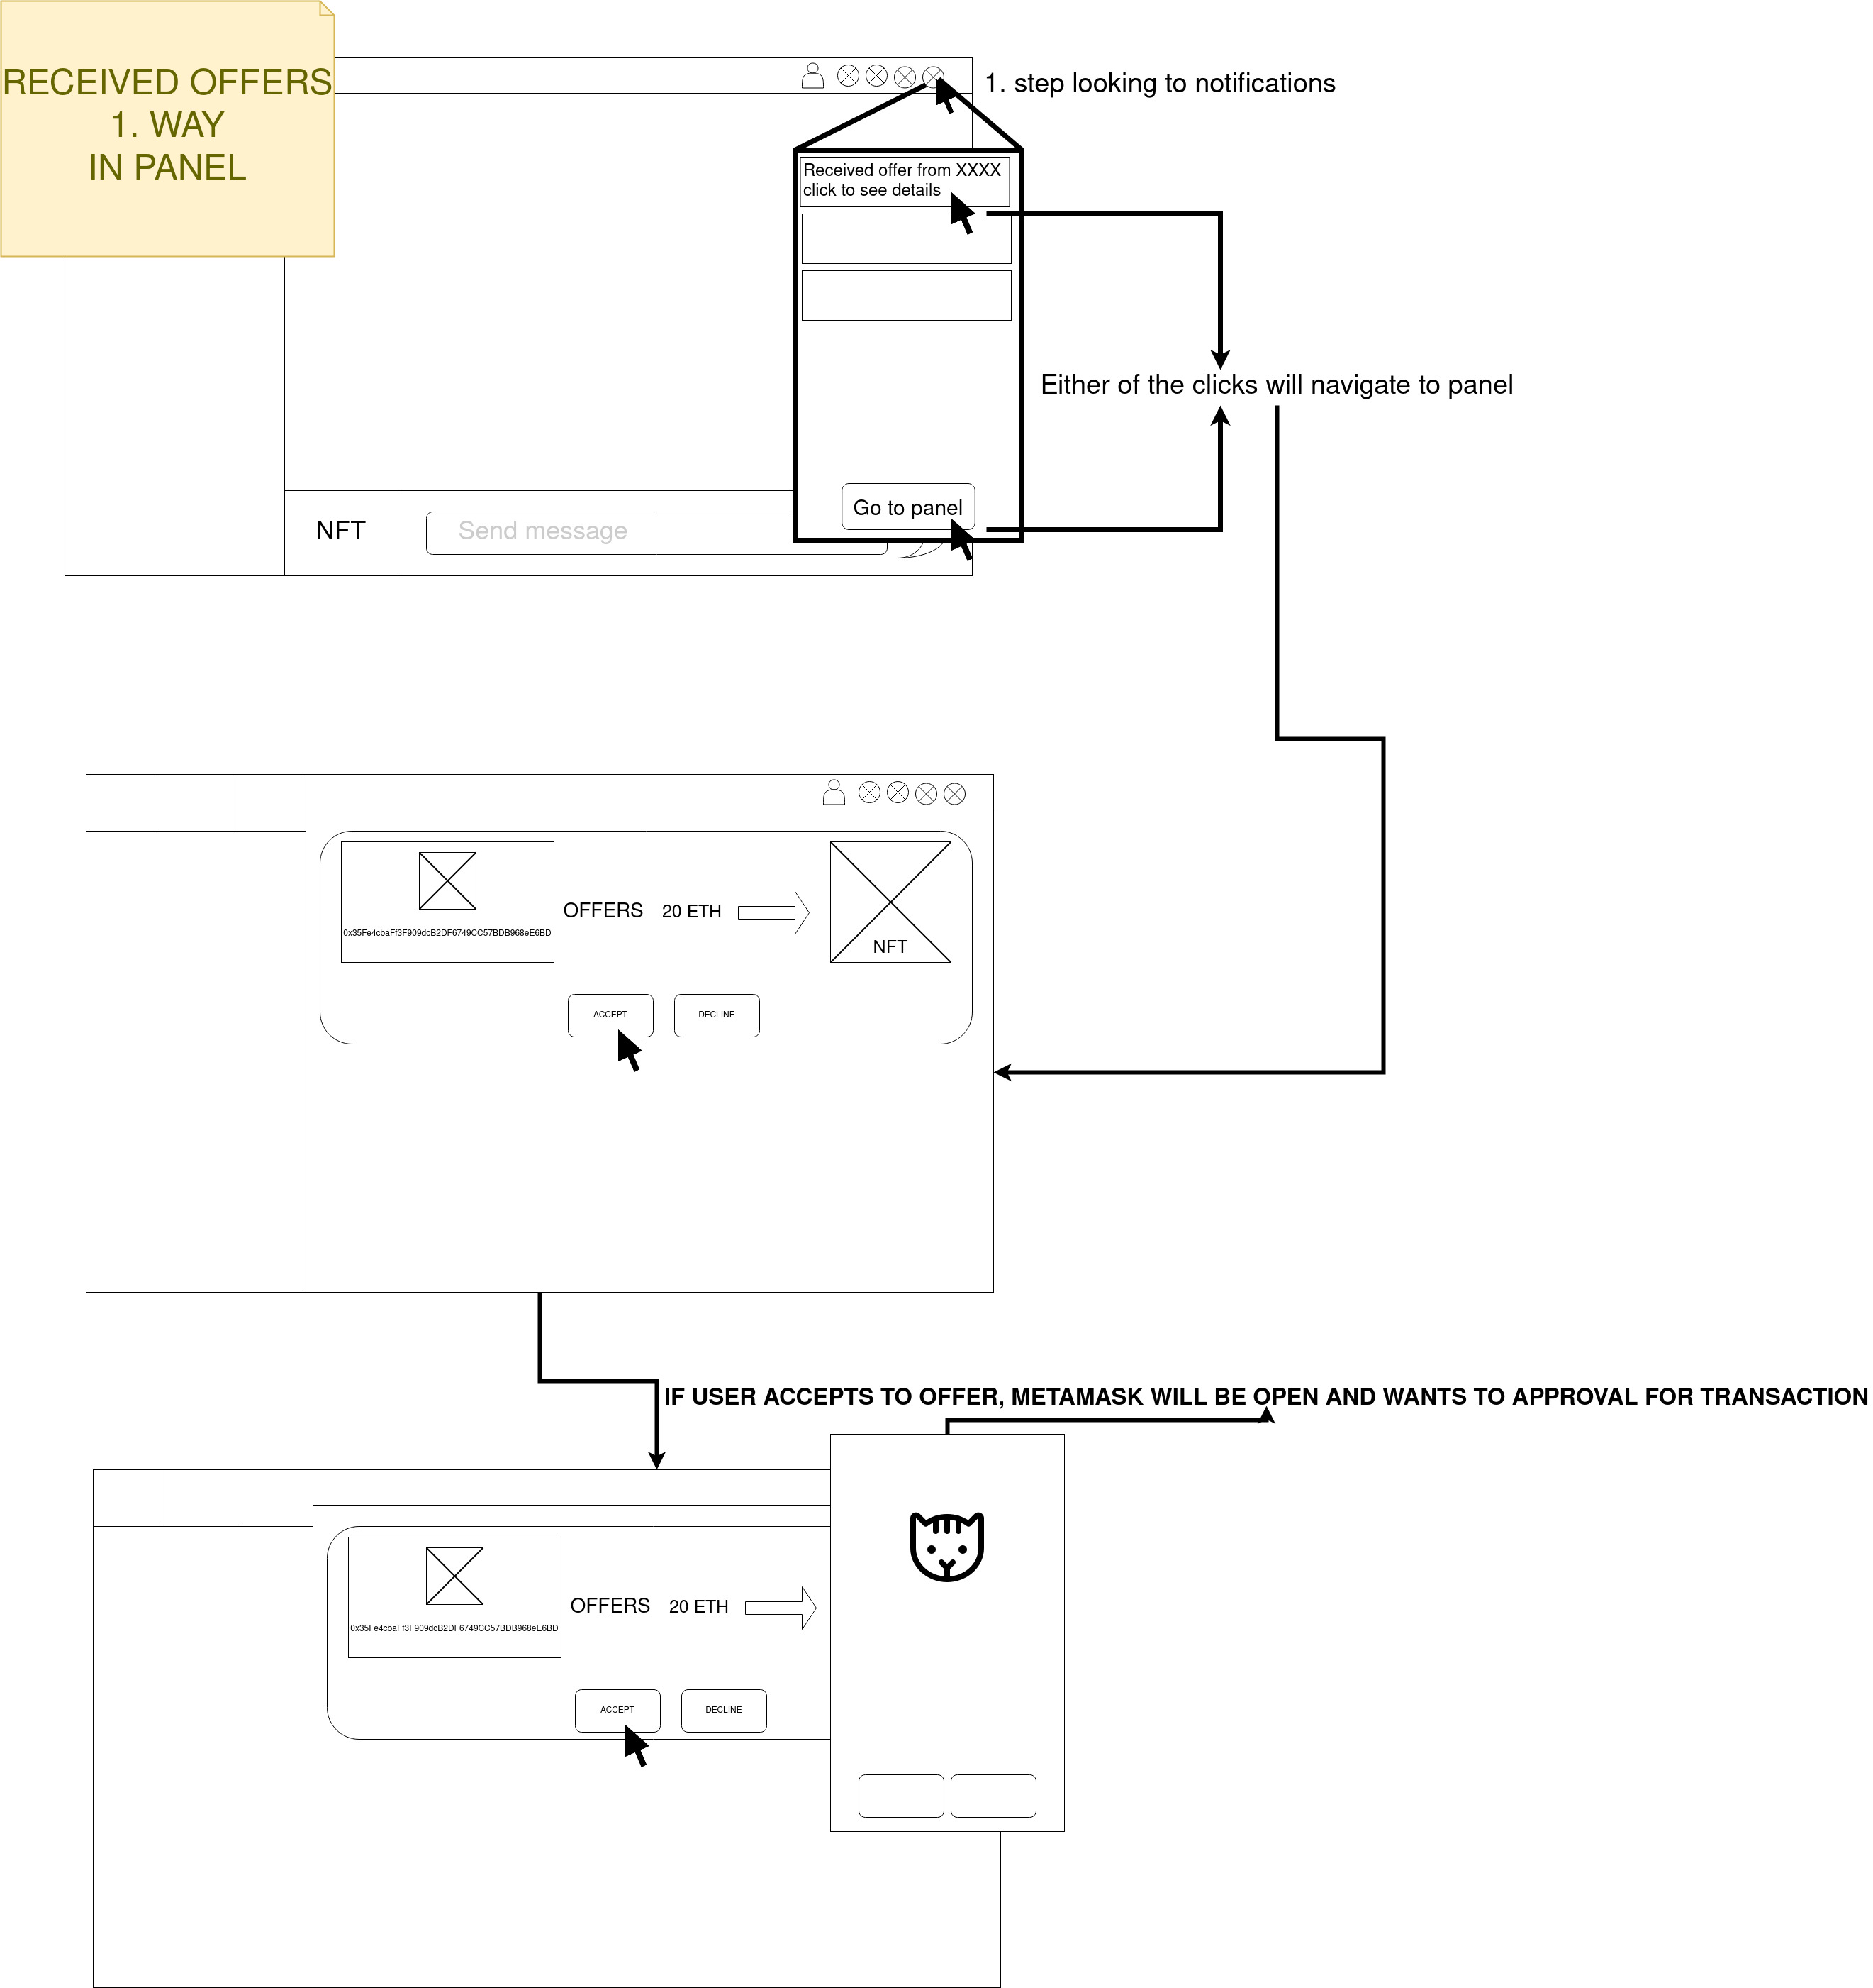

Slide 10
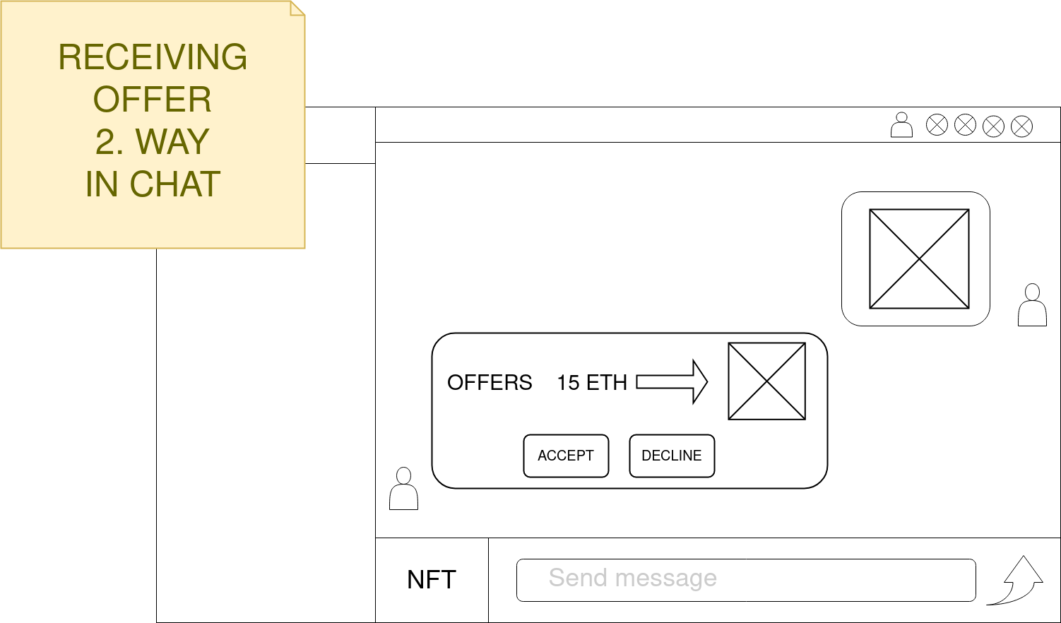
Frontend

Slide 11
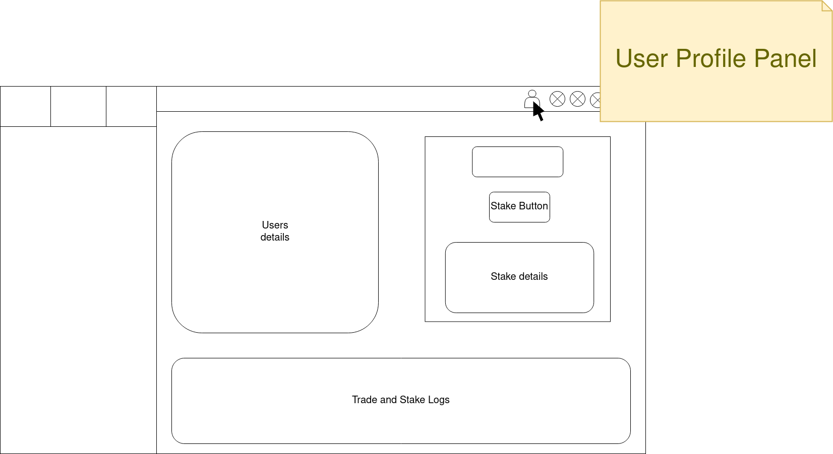
Frontend
Staking

Slide 12
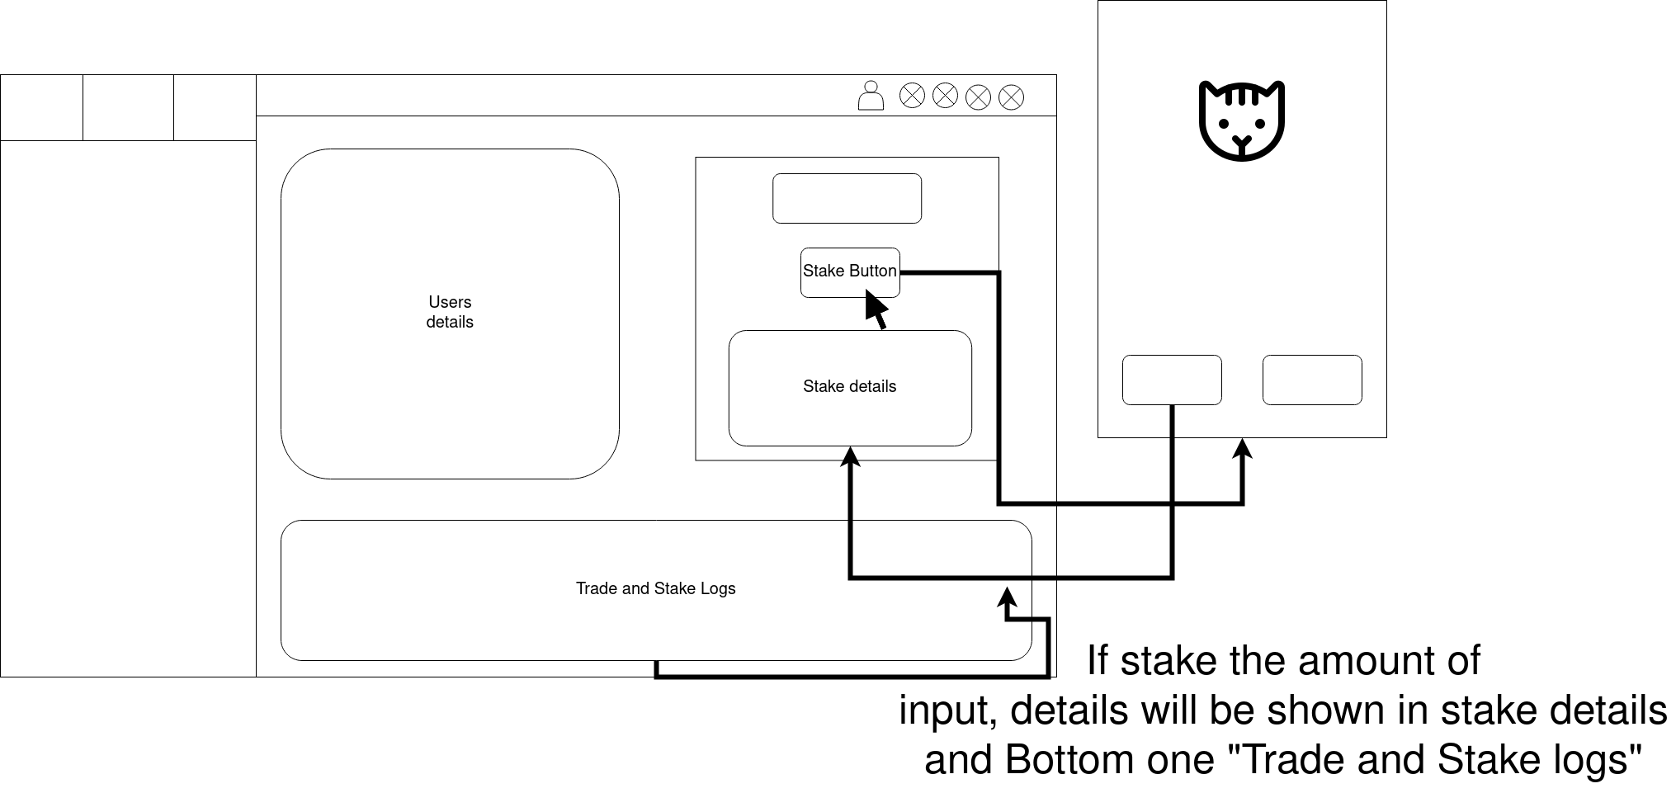
Frontend

Slide 13
Backend (Smart Contracts)
- We need to interact with Blockchain in Application for these :
1- Login
2- NFT/Emoji Trade approval
3- Buying something from applications and sending gifts
4- Staking
5- Fetching data
5.1 – NFT/Emoji inventory
5.2 – Staking informations and Logs
So we need 4 main smart contract on Polygon Network runs the application.

Slide 14
Backend (Smart Contracts)
1. Smart Contract is Staking-Trading Token :
There will be workflow in soon.

Slide 15
Backend (Smart Contracts)
2. Smart Contract is Trading NFTs / Sending Emojis, Gifts :
There will be workflow in soon.

Slide 16
Backend (IPFS)
- Chat, groups and application, user details will be stored on IPFS.
- NFT/Emoji inventory, stake amounts will be stored on Blockchain.
To solve the chat problem on IPFS, I found 2 main applications that working currently.
1- https://berty.tech/
2- https://devfolio.co/projects/ipfs-chat-58ec
I will follow these protocols and documents to create a chat application.

Slide 17
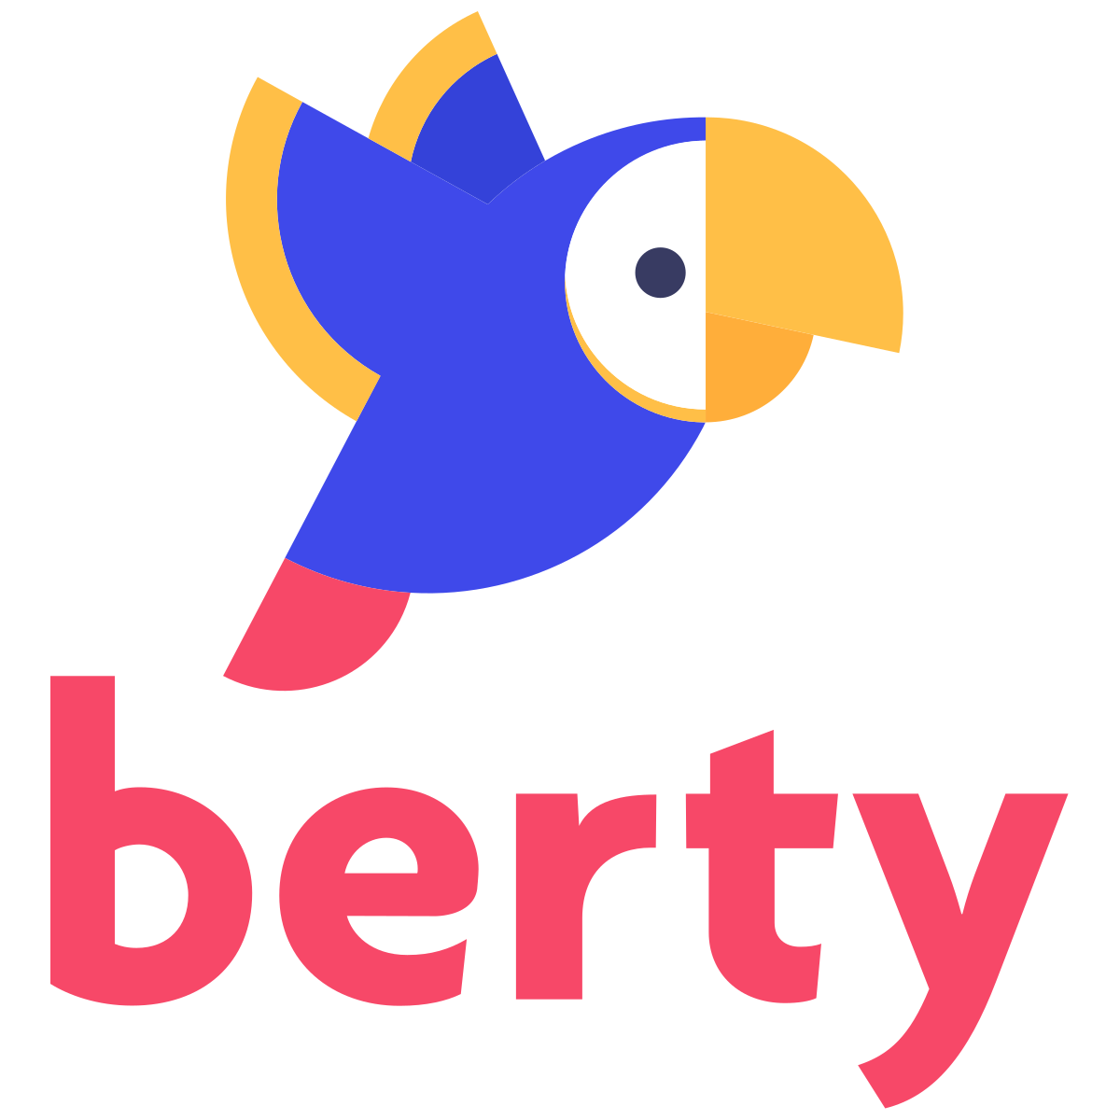
Backend (IPFS)
-Berty.tech deployed on IPFS chat application. P2P and creates groups.
- I will follow this app docs advanced steps.
https://berty.tech/

Slide 18
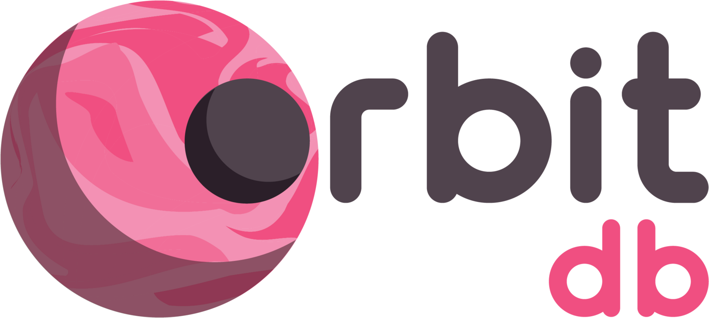
Backend (IPFS)
1-OrbitDB is a serverless, distributed, peer-to-peer database. OrbitDB uses IPFS as its data storage and IPFS Pubsub to automatically sync databases with peers. It's an eventually consistent database that uses CRDTs for conflict-free database merges making OrbitDB an excellent choice for decentralized apps (dApps), blockchain applications and local-first web applications.
- If nodes go offline, chat history will be stored.
https://orbitdb.org/

Slide 19
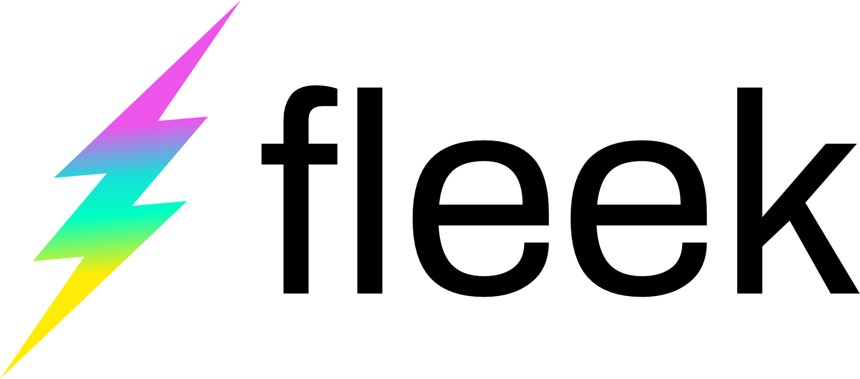
Backend (IPFS)
I will use Fleek to deploy test applications and Messenger.Crypto
-It is also deployed on IPFS
http://bafybeiarrje6j344nfquzi6fxc4eqs3lmjdohgqq4tekukze4shs3rswhe.ipfs.localhost:8080/

Slide 20

Backend (Bridge)
Bridge is Ethers.js. A Javascript provider library to connect and fetching data between Blockchain and Web applications.
https://docs.ethers.io/v5/getting-started/

