Slide 1
7.3-4 Solving Linear Recurrence Relations
7.3 Homogeneous Recurrence Relations
7.4 Nonhomogeneous Recurrence Relations

Slide 2
7.3 Solving Linear Recurrence Relations
Some of these recurrence relations can be solved using iteration or some other ad hoc technique.
However, one important class of recurrence relations can be explicitly solved in a systematic way. These are recurrence relations that express the terms of a sequence as linear combinations of previous terms.
Definition 1: A linear homogeneous recurrence relation of degree k with constant coefficients is a recurrence relation of the form
a_{n}= c₁a_{n-1} + c₂a_{n-2}+ . . .+ c_{k}a_{n-k}
Where c₁, c₂, . . .,c_{k} are real numbers, c_{k} ≠ 0.

Slide 3
Solving Linear Recurrence Relations
The recurrence relation in the definition is linear because the right-hand side is a sum of previous terms of the sequence each multiplied by a function of n.
The recurrence relation is homogeneous because no terms occur that are not multiples of the a_{j}’s.
The coefficients of the terms of the sequence are all constants, rather than functions that depend on n.
The degree is k because a_{n} is expressed in terms of the previous k terms of the sequence.
A consequence of the second principle of mathematical induction is that a sequence satisfying the recurrence relation in the definition is uniquely determined by this recurrence relation and the k initial conditions
a₀ =C₀, a₁=C₁,. . . , a_{k-1}=C_{k-1}

Slide 4
Solving Linear Recurrence Relations
Example 1: the recurrence relation P_{n}=(1.11)P_{n-1} is a linear homogeneous recurrence relation of degree one.
The recurrence relation f_{n}=f_{n-1} +f_{n-2} (Fibonacci) is a linear homogeneous recurrence relation of degree two.
The recurrence relation a_{n}=a_{n-5} is (poses as!) a linear homogeneous recurrence relation of degree five.
Counter Examples: The recurrence relation
a_{n}= a_{n-1}+a_{n-2}² is nonlinear. The recurrence relation
H_{n} = 2H_{n-1} +1 is nonhomogeneous. The recurrence relation B_{n} =nB_{n-1} is not with constant coefficients.

Slide 5
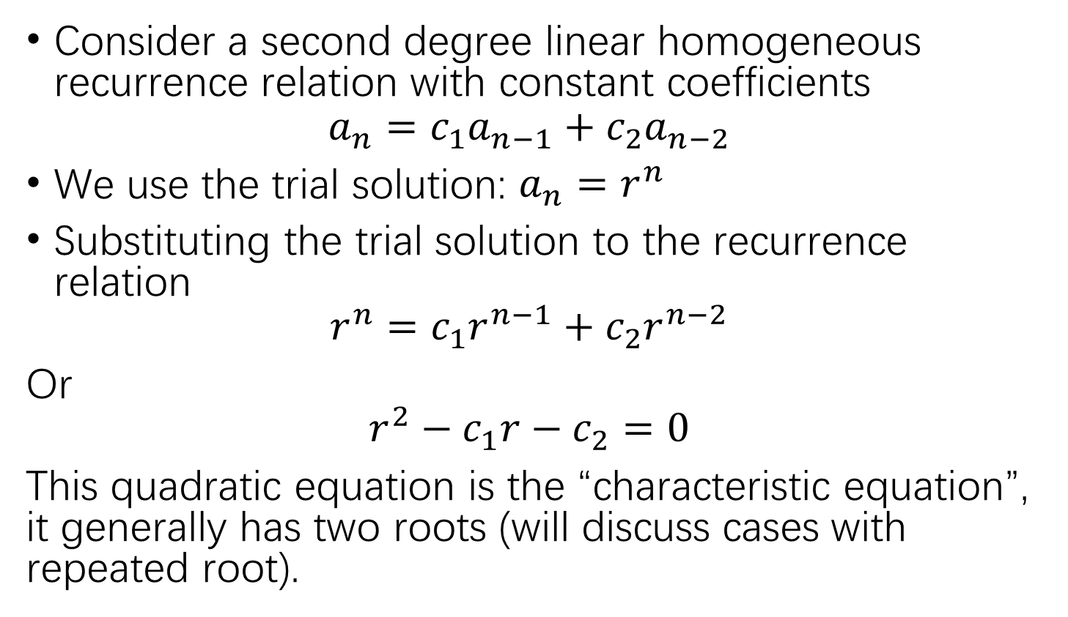
Solving Linear Recurrence Relations
Consider a second degree linear homogeneous recurrence relation with constant coefficients
$$a_{n}=c_{1}a_{n−1}+c_{2}a_{n−2}$$
We use the trial solution: $a_{n}=r^{n}$
Substituting the trial solution to the recurrence relation
$$r^{n}=c_{1}r^{n−1}+c_{2}r^{n−2}$$
Or
$$r^{2}−c_{1}r−c_{2}=0$$
This quadratic equation is the “characteristic equation”, it generally has two roots (will discuss cases with repeated root).

Slide 6
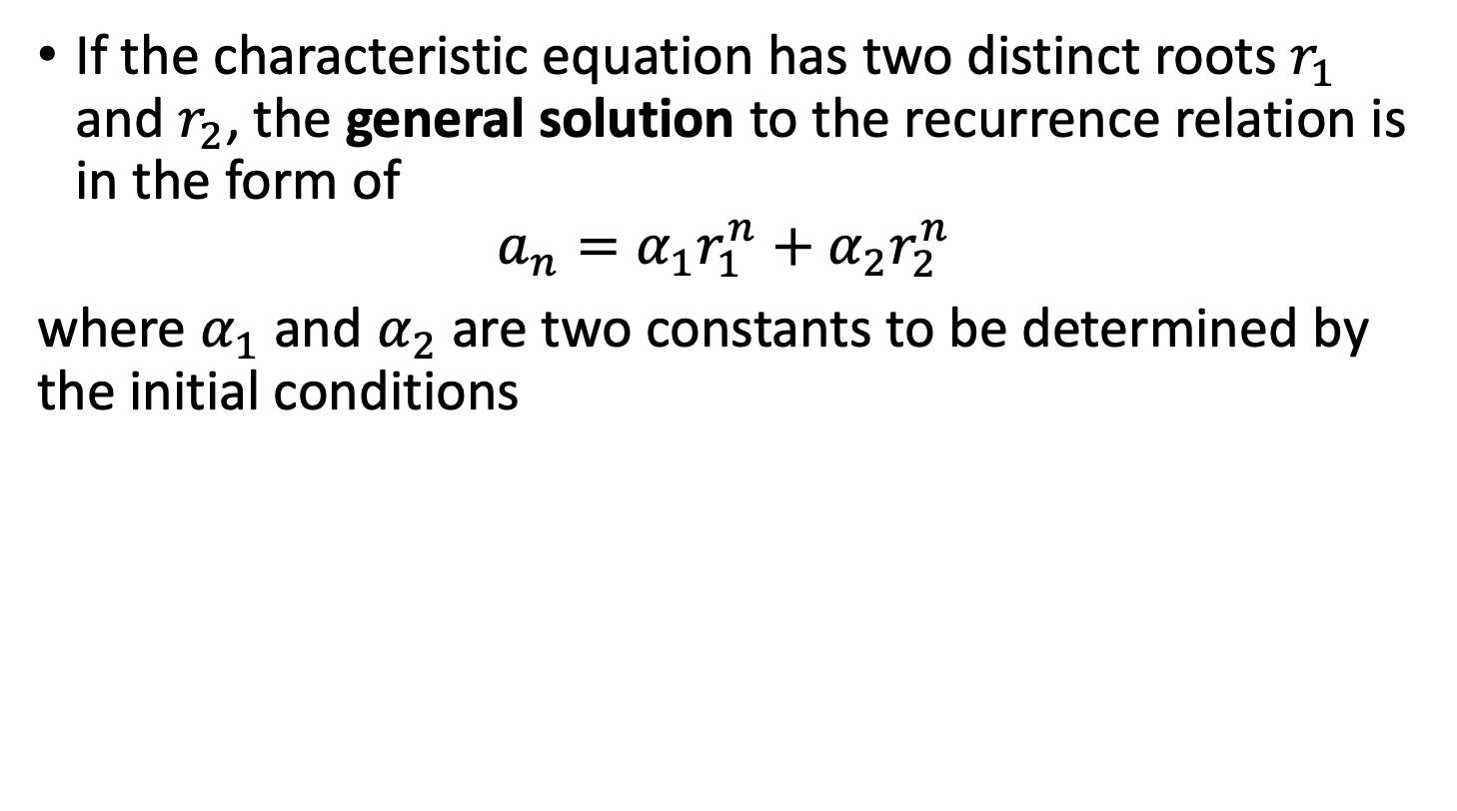
Solving Linear Recurrence Relations
If the characteristic equation has two distinct roots $r_{1}$ and $r_{2}$, the general solution to the recurrence relation is in the form of
$$a_{n}=α_{1}r_{1}^{n}+α_{2}r_{2}^{n}$$
where $α_{1}$ and $α_{2}$ are two constants to be determined by the initial conditions

Slide 7


Solving Linear Homogeneous Recurrence Relations with Constant Coefficients
Example: what is the solution of the recurrence relation
a_{n} = a_{n-1} + 2a_{n-2}
With a₀= 2 and a₁= 7 ?
$$a_{n}=r^{n}$$
$$r^{2}=r+2$$

Slide 8

Solving Linear Homogeneous Recurrence Relations with Constant Coefficients
$$a_{n}=3{×2}^{n}−{\left(−1\right)}^{n}$$

Slide 9

Solving Linear Homogeneous Recurrence Relations with Constant Coefficients
Example: Fibonacci recurrence relation
$$f_{n}=f_{n−1}+f_{n−2}, f_{0}=0, { f}_{1}=1$$
The characteristic equation is
$$r^{2}−r−1=0$$
$$r_{1,2}=\frac{1±\sqrt{5}}{2}$$

Slide 10
Solving Linear Homogeneous Recurrence Relations with Constant Coefficients

Slide 11
Solving Linear Homogeneous Recurrence Relations with Constant Coefficients: equal roots
Theorem 2: Let c₁ and c₂ be real numbers with c₂ ≠0. Suppose that r² - c₁r - c₂ = 0 has only one root r₀.
A sequence {a_{n}} is a solution of the recurrence relation a_{n} = c₁a_{n-1} + c₂a_{n-2}
has the form of solution:
a_{n}= α₁r₀^{n}+ α₂nr₀^{n}
for n=0, 1, 2,. . .,where α₁ and α₂ are constants to be determined by the initial conditions

Slide 12
Solving Linear Homogeneous Recurrence Relations with Constant Coefficients
Theorem 3: Let c₁ , c₂ ,. . ., c_{k} be real numbers. Suppose that the characteristic equation
r^{k} - c₁r^{k-1} - . . . - c_{k} = 0
has k distinct roots r₁, r₂,. . .,r_{k}. Then a sequence {a_{n}} is a solution of the recurrence relation
a_{n} = c₁a_{n-1} + c₂a_{n-2} +. . . + c_{k}a_{n-k}
if and only if
a_{n} = α₁r₁^{n} + α₂r₂^{n} +. . .+ α_{k}r_{k}^{n}
for n=0, 1, 2,. . .,where α₁, α_{2 ,} . . ., α_{k} are constants.

Slide 13
Solving Linear Homogeneous Recurrence Relations with Constant Coefficients
Example: Find the solution to the recurrence relation
a_{n} = 6a_{n-1} - 11a_{n-2} + 6a_{n-3}
With the initial conditions a₀=2 and a₁=5, and a₂=15.

Slide 14
Example 6: Find the solution to the recurrence relation a_{n} = 6a_{n-1} - 11a_{n-2} + 6a_{n-3}
With the initial conditions a₀=2 and a₁=5, and a₂=15.

Slide 15
Solving Linear Homogeneous Recurrence Relations with Constant Coefficients
Theorem 4: Let c₁ , c₂ ,. . ., c_{k} be real numbers. Suppose that the characteristic equation
r^{k}-c₁r^{k-1}-. . .- c_{k}= 0
has t distinct roots r₁, r₂,. . .,r_{t} with multiplicities m₁, m₂,. . .,m_{t} , respectively, so that m_{i} ≧ 1 for
i= 1, 2,. . ., t and m₁+ m₂+. . .+m_{t} =k. Then a sequence {a_{n}} is a solution of the recurrence relation
a_{n}=c₁a_{n-1}+c₂a_{n-2} +. . . +c_{k}a_{n-k}
if and only if
a_{n}= ( α_{1 , 0}+ α_{1, 1}n +. . .+ α_{1, m1-1}n^{m1-1}) r₁^{n}
+ ( α_{2 , 0}+ α_{2 , 1}n +. . .+ α_{2, m2-1}n^{m2-1}) r₂^{n}
+ … +( α_{t , 0} + α_{t , 1}n +. . .+ α_{t, mt-1}n^{mt-1}) r_{t}^{n}
for n=0, 1, 2,. . .,where α₁, α_{2 ,} . . ., α_{k} are constants

Slide 16
Solving Linear Homogeneous Recurrence Relations with Constant Coefficients
Example: Suppose that the roots of the characteristic equation of a linear homogeneous recurrence relation are 2, 2, 2, 5, 5, and 9 (that is, there are three roots, the root 2 with multiplicity three, the root 5 with multiplicity two, and the root 9 with multiplicity one).
What is the form of the general solution?

Slide 17
Solving Linear Homogeneous Recurrence Relations with Constant Coefficients
Example 8: Find the solution to the recurrence relation a_{n} = -3a_{n-1} - 3a_{n-2} - a_{n-3}
With the initial conditions a₀=1 and a₁=-2, and a₂=-1.

Slide 18
Solving Linear Homogeneous Recurrence Relations with Constant Coefficients
Example 8: Find the solution to the recurrence relation a_{n} = -3a_{n-1} - 3a_{n-2} - a_{n-3}
With the initial conditions a₀=1 and a₁=-2, and a₂=-1.

Slide 19
7.4 Linear Nonhomogeneous Recurrence Relations with Constant Coefficients
Linear nonhomogeneous recurrence relation with constant coefficients,
a_{n} = c₁a_{n-1} + c₂a_{n-2} +. . . + c_{k}a_{n-k} + F(n)
Where c₁ , c₂ ,. . ., c_{k} be real numbers and F(n) is a function not identically zero depending only on n.
The recurrence relation
a_{n} = c₁a_{n-1} + c₂a_{n-2} +. . . + c_{k}a_{n-k}
is called the associated homogeneous recurrence relation.

Slide 20
Linear Nonhomogeneous Recurrence Relations with Constant Coefficients
Example 9: Each of the recurrence relations
a_{n} = a_{n-1} + 2^{n} ,
a_{n} = a_{n-1} + a_{n-2} +n²+ n +1 ,
a_{n} = 3a_{n-1} +n3^{n}
a_{n} = a_{n-1} + a_{n-2} + a_{n-3} + n! ,
is a linear nonhomogeneous recurrence relation with constant coefficients. The associated linear homogeneous recurrence relations are
a_{n} = a_{n-1} ,
a_{n} = a_{n-1} + a_{n-2} ,
a_{n} = 3a_{n-1}
a_{n} = a_{n-1} + a_{n-2} + a_{n-3}
respectively.

Slide 21
Linear Nonhomogeneous Recurrence Relations with Constant Coefficients
Theorem 5: if {a_{n}^{(p)}} is a particular solution of the nonhomogeneous linear recurrence relation with constant coefficients
a_{n} = c₁a_{n-1} + c₂a_{n-2} +. . . + c_{k}a_{n-k} + F(n)
Then every solution is of the form {a_{n}^{(p)}+ a_{n}^{(h)} } , where {a_{n}^{(h)}} is a solution of the associated homogeneous recurrence relation
a_{n} = c₁a_{n-1} + c₂a_{n-2} +. . . + c_{k}a_{n-k}

Slide 22
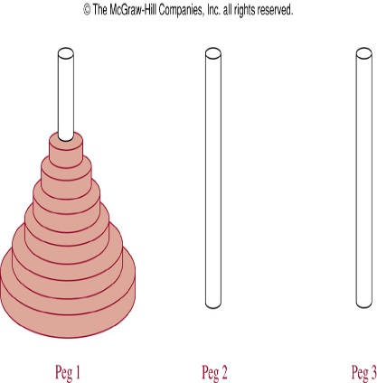
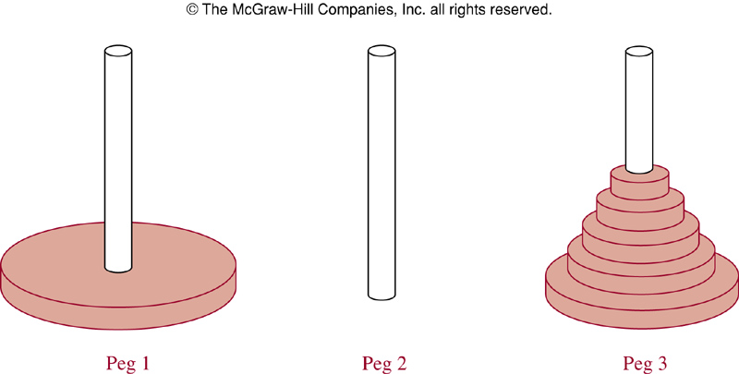
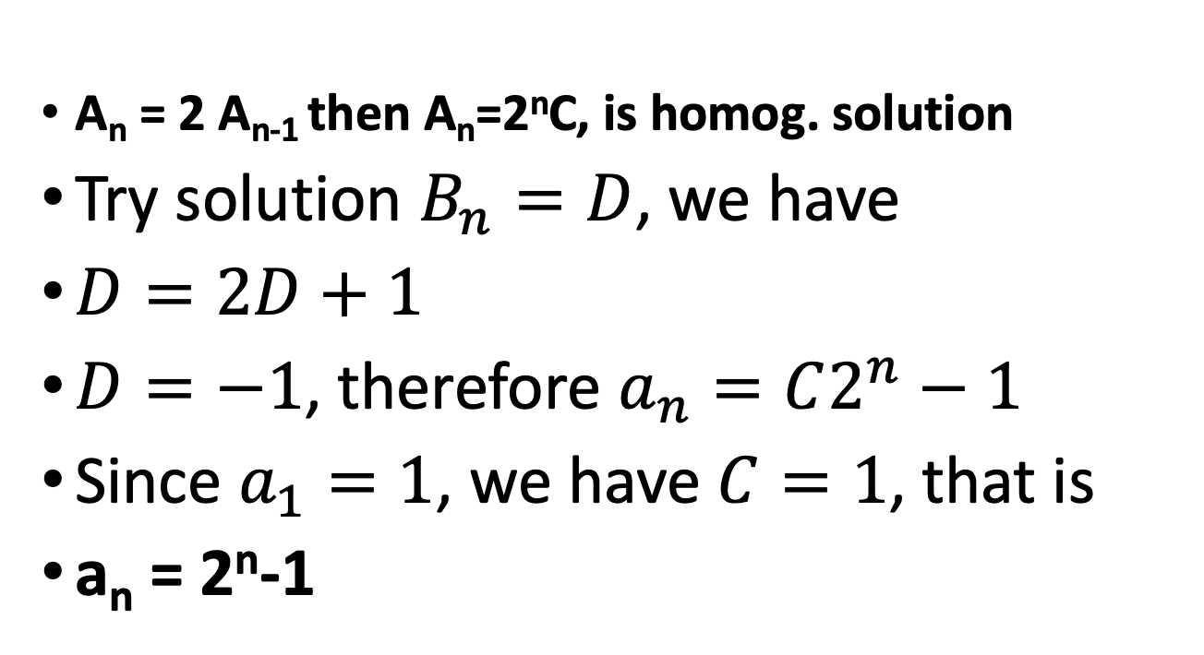
Solving the Towers of Hanoi
a_{n} = 2 a_{n-1} + 1:
1, 3, 7, 15, 31, 63,…
A_{n} = 2 A_{n-1} then A_{n}=2^{n}C, is homog. solution
Try solution $B_{n}=D$, we have
$D=2D+1$
$D=−1$, therefore $a_{n}=C2^{n}−1$
Since $a_{1}=1$, we have $C=1$, that is
a_{n} = 2^{n}-1

Slide 23
Linear Nonhomogeneous Recurrence Relations with Constant Coefficients
Example 10: Find all solutions of the recurrence relation a_{n} = 3a_{n-1} + 2n.
What is the solution with a₁= 3?

Slide 24
Linear Nonhomogeneous Recurrence Relations with Constant Coefficients
Example 10: Find all solutions of the recurrence relation a_{n} = 3a_{n-1} + 2n.
What is the solution with a₁= 3?

Slide 25
Linear Nonhomogeneous Recurrence Relations with Constant Coefficients
Example 11: Find all solution of the recurrence relation a_{n} =5a_{n-1} - 6a_{n-2} + 7^{n}

Slide 26
Linear Nonhomogeneous Recurrence Relations with Constant Coefficients
Example 11: Find all solution of the recurrence relation a_{n} =5a_{n-1} - 6a_{n-2} + 7^{n}

Slide 27
Linear Nonhomogeneous Recurrence Relations with Constant Coefficients
Theorem 6: Suppose {a_{n}} satisfies the linear nonhomogeneous recurrence relation
a_{n} = c₁a_{n-1} + c₂a_{n-2} +. . . + c_{k}a_{n-k} + F(n)
Where c₁ , c₂ ,. . ., c_{k} be real numbers and
F(n) = (b₁n^{t} + b_{t-1}n^{t-1} +. . .+ b₁n + b₀ )*s^{n}
Where b₁ , b₂ ,. . ., b_{t} and s are real numbers. When s is not a root of the characteristic equation of the associated linear homogeneous recurrence relation, there is a particular solution of the form
(p₁n^{t} + p_{t-1}n^{t-1} +. . .+ p₁n + p₀ )*s^{n}
When s is a root of this characteristic equation and its multiplicity is m, there is a particular solution of the form
n^{m} (p₁n^{t} + p_{t-1}n^{t-1} +. . .+ p₁n + p₀ )*s^{n}

Slide 28
Linear Nonhomogeneous Recurrence Relations with Constant Coefficients
Example 12: What form does a particular solution for the linear nonhomogeneous recurrence relation
a_{n} = 6a_{n-1} - 9a_{n-2} + F(n)
have if
F(n) = 3^{n} , (try an²3^{n})
F(n) = n²2^{n} , (try (an²+bn+c)2^{n})
F(n) = (n² +1)3^{n} (try n²(an²+bn+c)3^{n})?
hint: r²-6r+9=(r-3)² so (a+bn)3^{n} is homog. soln

