Slide 1
Chapter 19 MAGNETIC FIELD AND
MAGNETIC FORCES
19.1 Magnetism
19.2 Magnetic Field
19.3 Magnetic Field Lines and Magnetic Flux
19.4 Motion of Charged Particles in a Magnetic Field
19.5 Applications of Motion of Charged Particles
19.6 Magnetic Force on a Current-Carrying Conductor
19.7 Force and Torque on a Current Loop
19.8 The Hall Effect

Slide 2
Goals for chapter 19
The properties of magnets, and how magnets interact with each other.
The nature of the force that a moving charged particl experiences in a magnetic field.
How magnetic field lines are different from electric field lines.
How to analyze the motion of a charged particle in a magnetic field.
Some practical applications of magnetic fields in chemistry and physics.
How to analyze magnetic forces oncurrent-carrying conductors.
How current loops behave when placed in a magnetic field

Slide 3
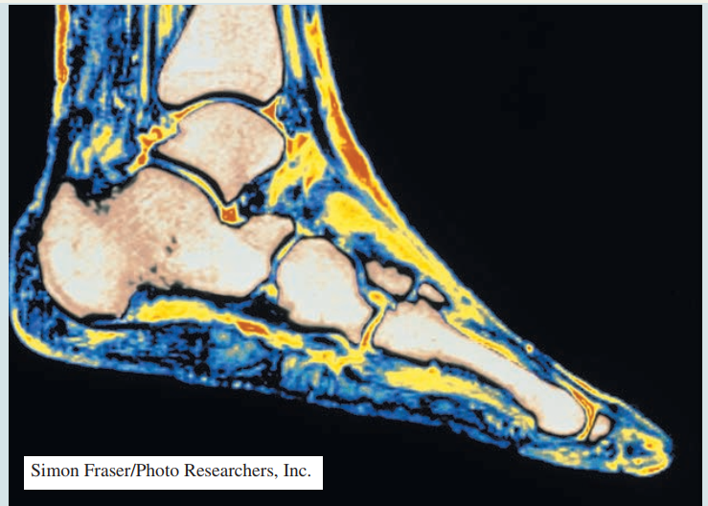
Introduction
  Magnetic resonance imaging (MRI) makes it possible to see details of soft tis- sue (such as in the foot shown here) that aren’t visible in x-ray images. Yet soft tissue isn’t a magnetic material (it’s not attracted to a magnet). How does MRI work?

Slide 4
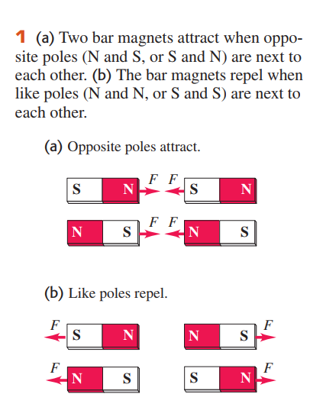
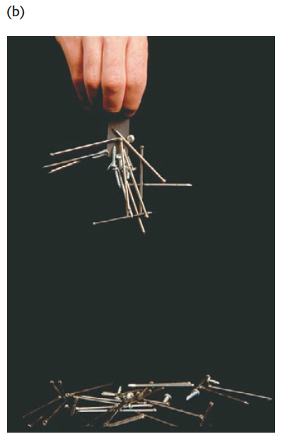
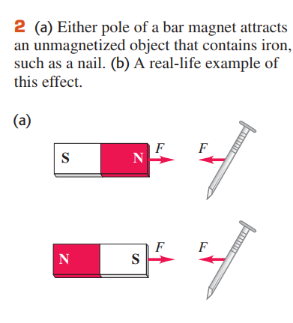
19.1 Magnetism

Slide 5
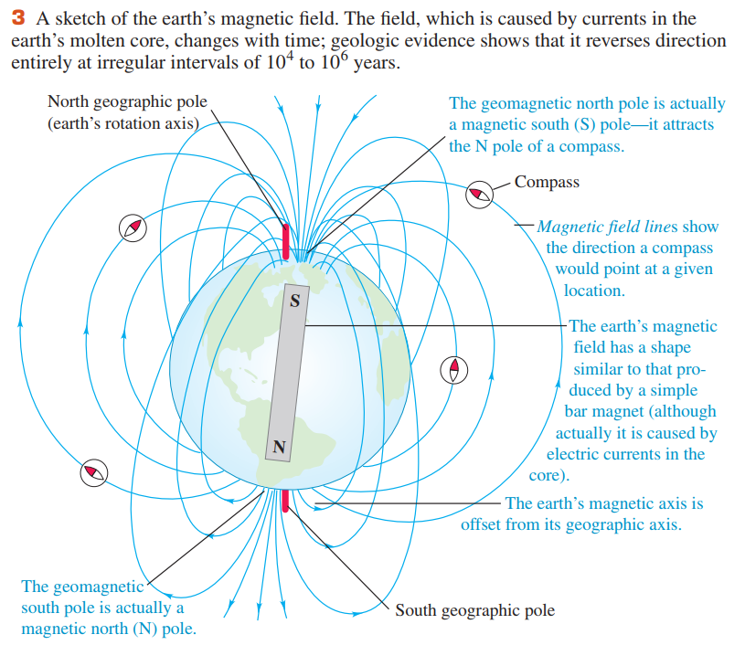

Slide 6
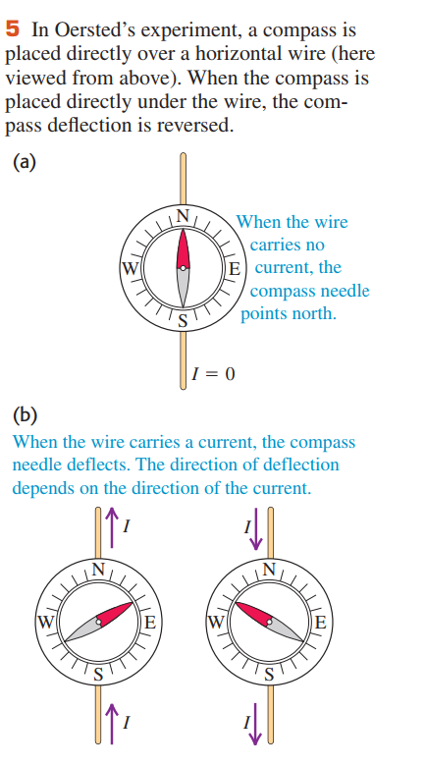
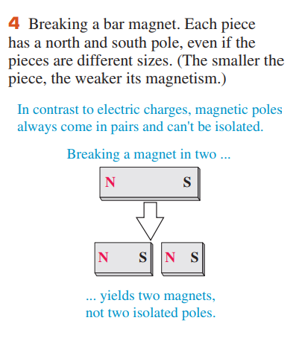
Magnetic Poles Versus Electric Charge
  The existence of an isolated magnetic pole, or magnetic monopole, would have sweeping implications for theoretical physics

Slide 7
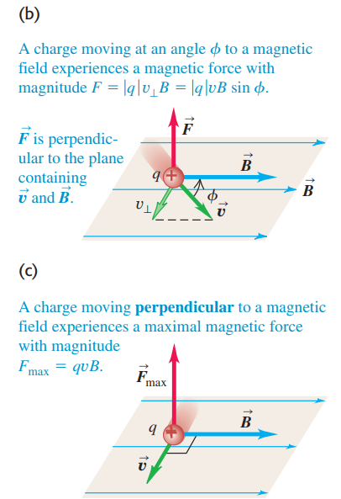
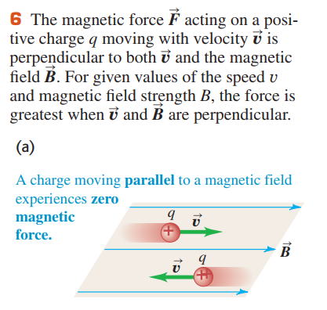
19.2 Magnetic Field
  Like electric field, magnetic field is a vector field—that is, a vector quantity associated with each point in space.

Slide 8

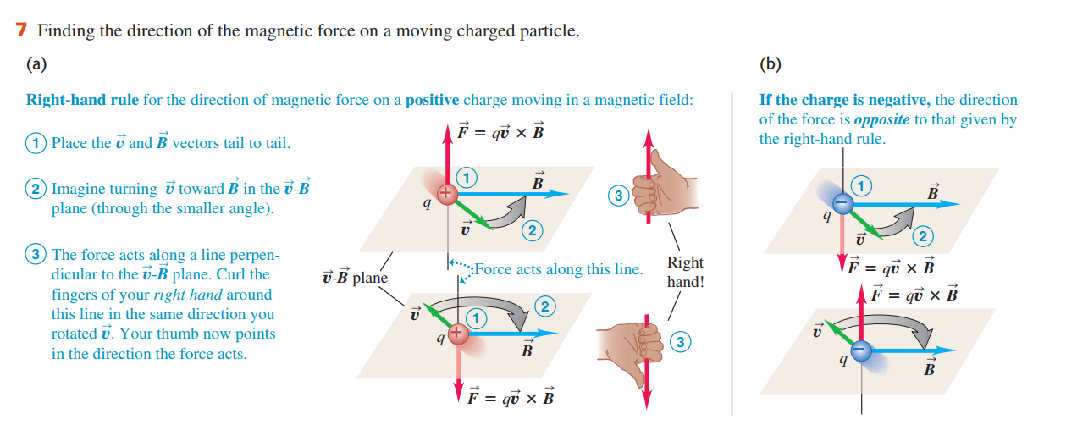

Slide 9
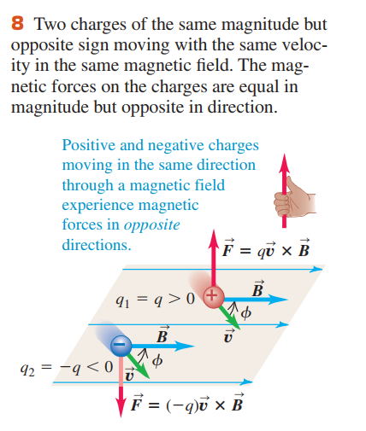




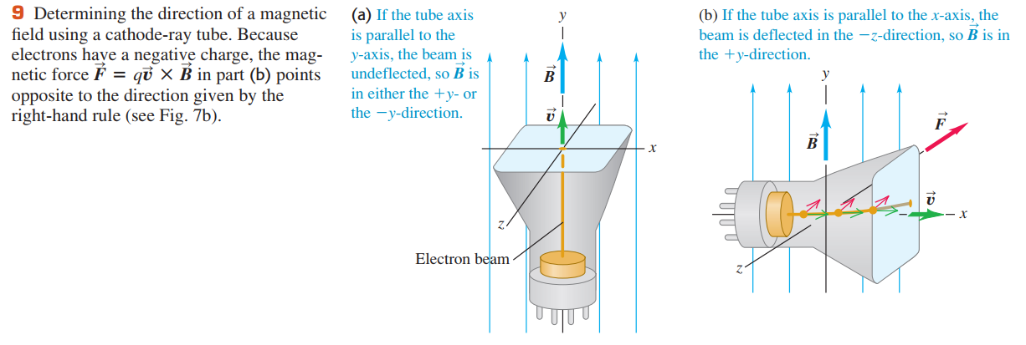

Slide 10
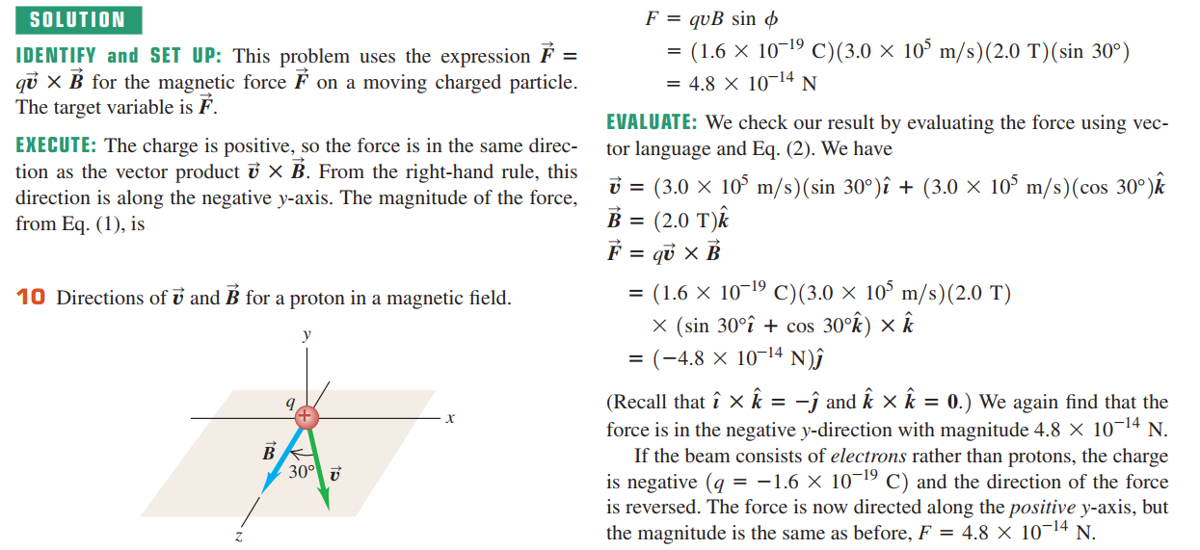
Example 19.1 Magnetic force on a proton

Slide 11
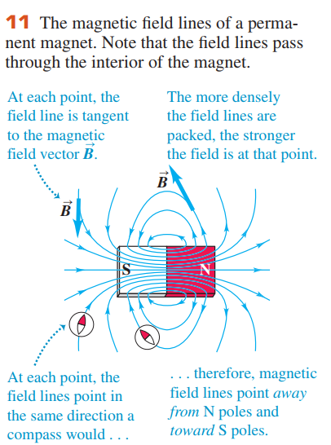
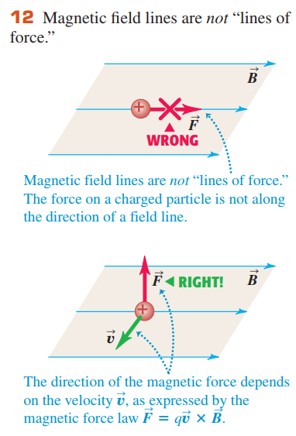
19.3 Magnetic Field Lines and Magnetic Flux
  We can represent any magnetic field by magnetic field lines, just as we did for the earth’s magnetic field.

Slide 12
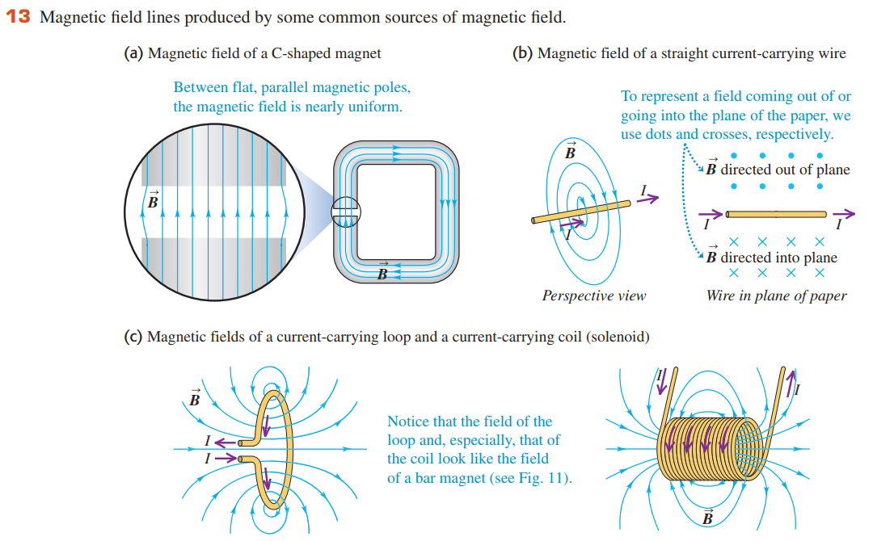
Magnetic Flux and Gauss’s Law for Magnetism

Slide 13
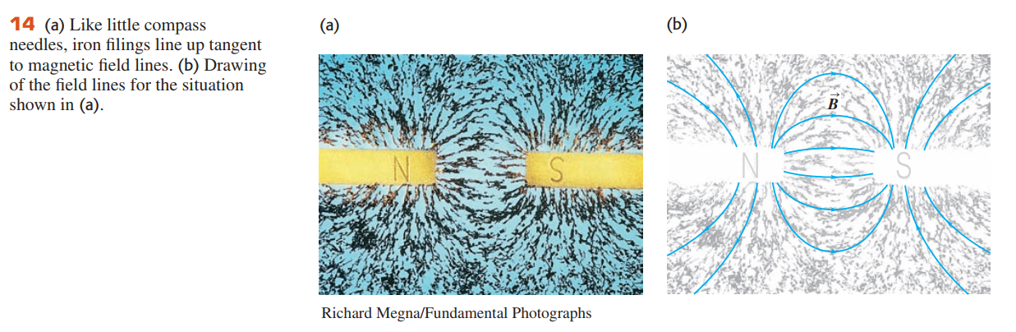
Magnetic Flux and Gauss’s Law for Magnetism

Slide 14


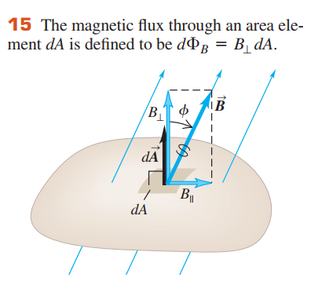






Slide 15
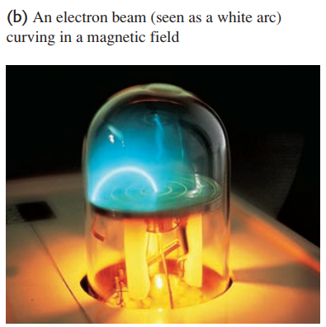

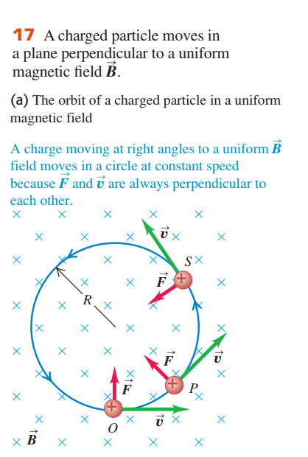


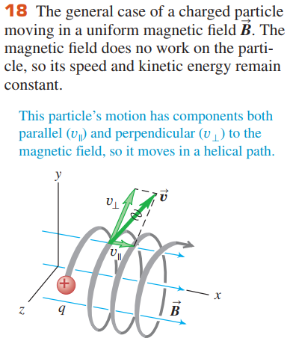



Slide 16
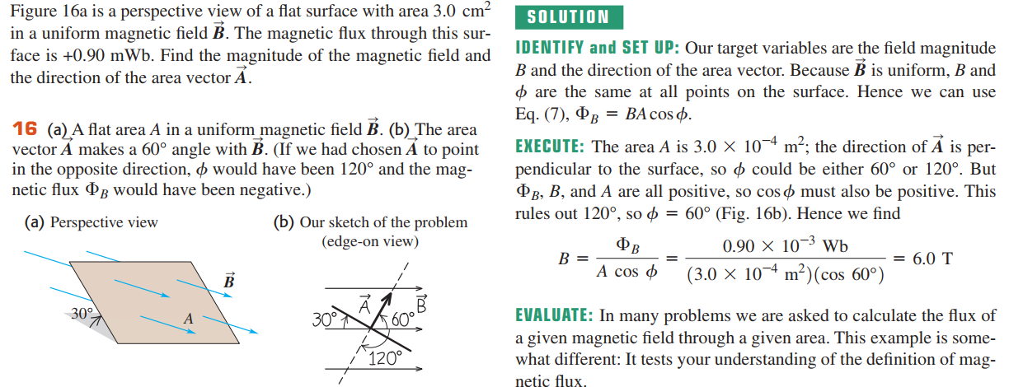
Example 19.2 Magnetic flux calculations

Slide 17
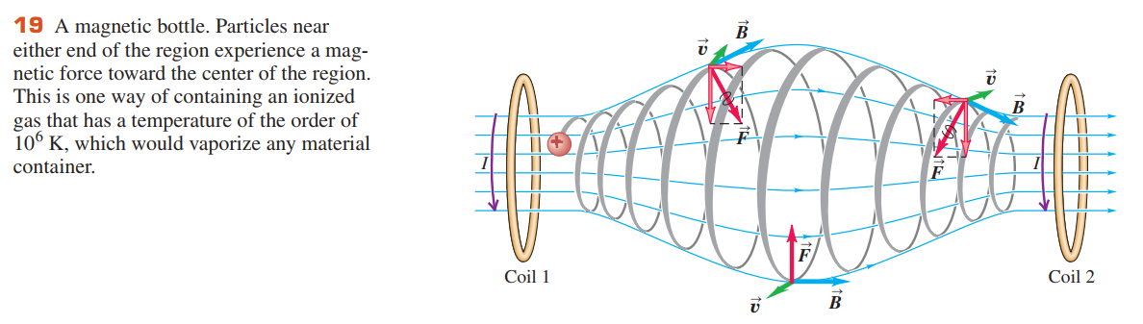
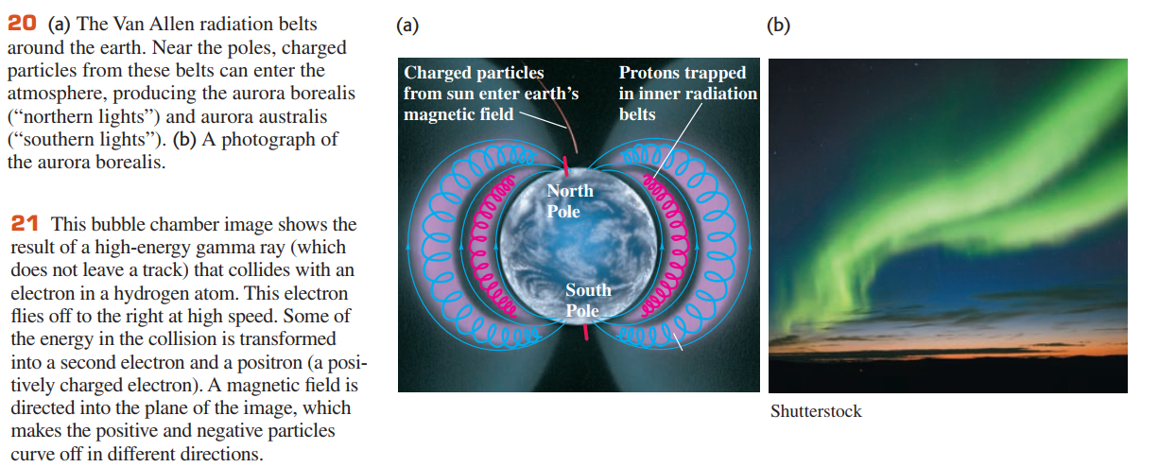
Motion of Charged Particles in a Magnetic Field

Slide 18
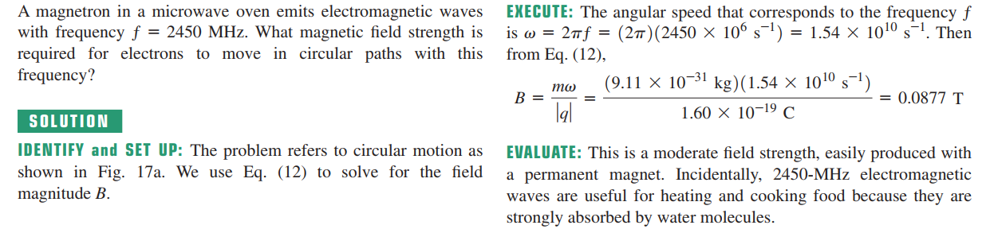
Example 19.3 Electron motion in a magnetron

Slide 19
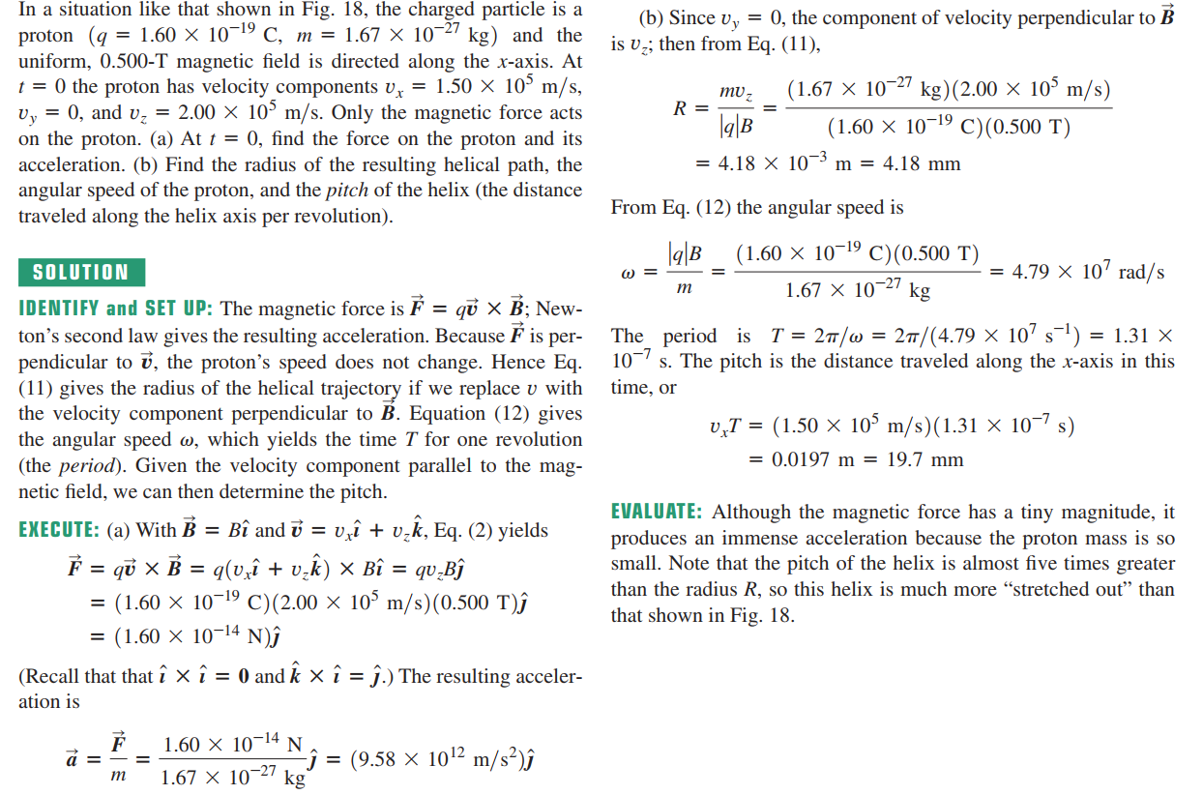
Example 19.4 Helical particle motion in a magnetic field

Slide 20

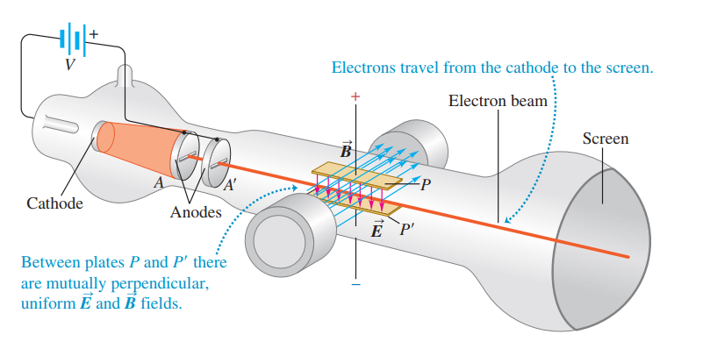



19.5 Applications of Motion of Charged Particles
  Velocity Selector
  Thomson’s e/m Experiment

Slide 21
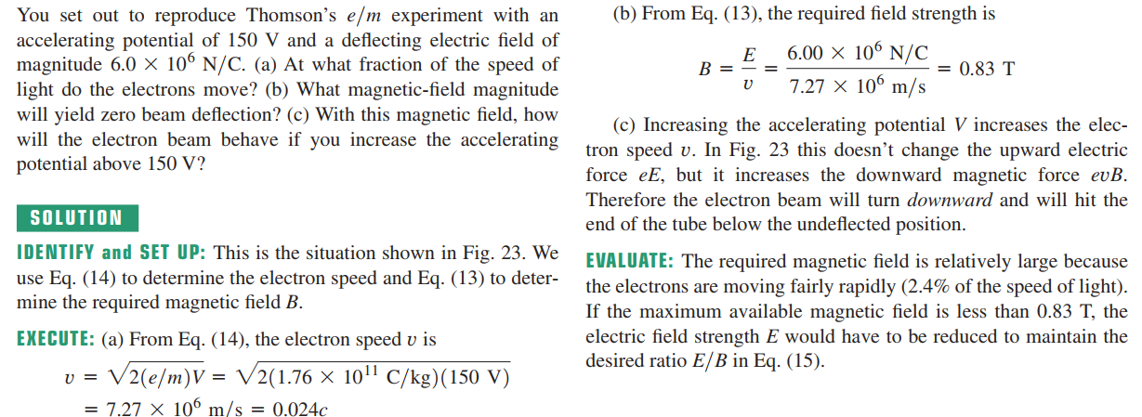
Example 19.5 An demonstration experiment

Slide 22
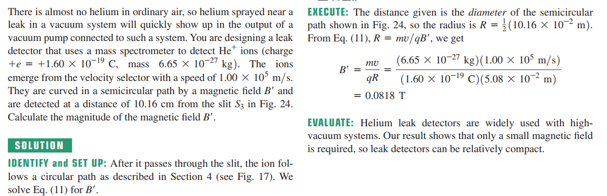
Example 19.6 Finding leaks in a vacuum system

Slide 23
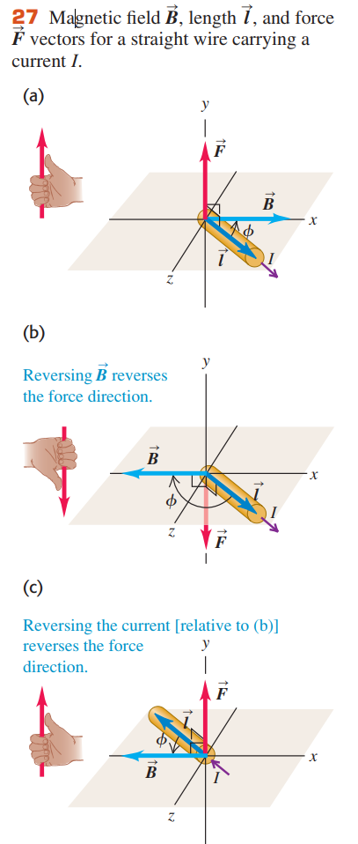
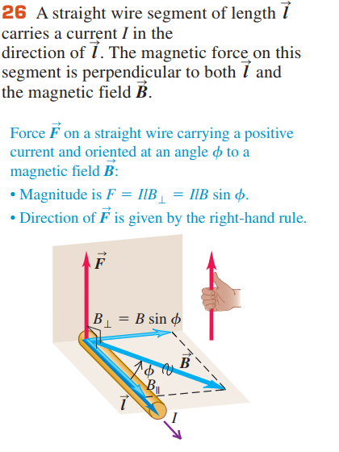





19.6 Magnetic Force on a Current-Carrying Conductor

Slide 24
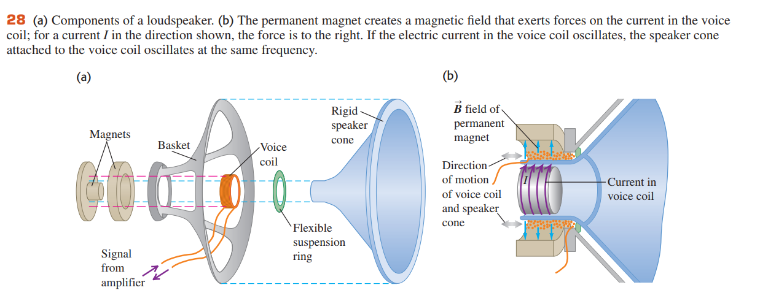

Slide 25
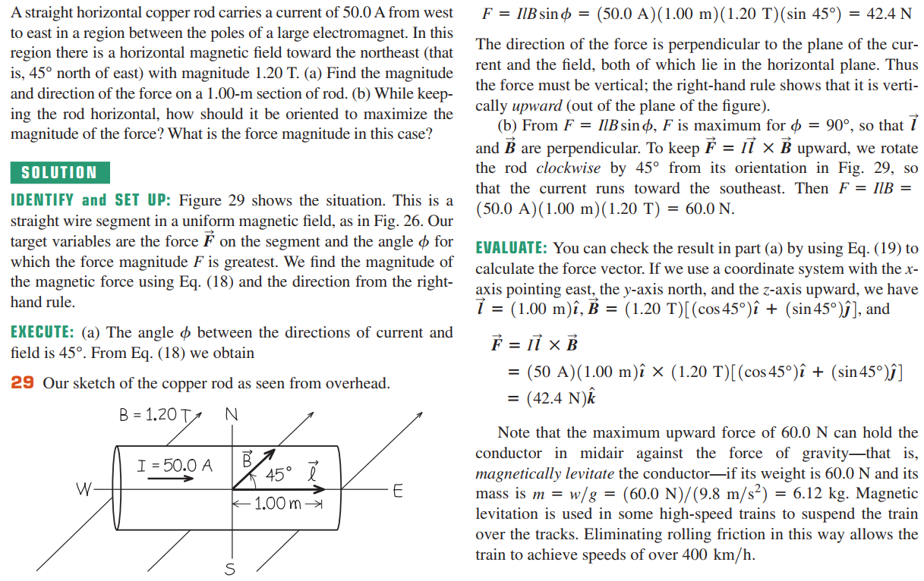
Example 19.7 Magnetic force on a straight conductor

Slide 26
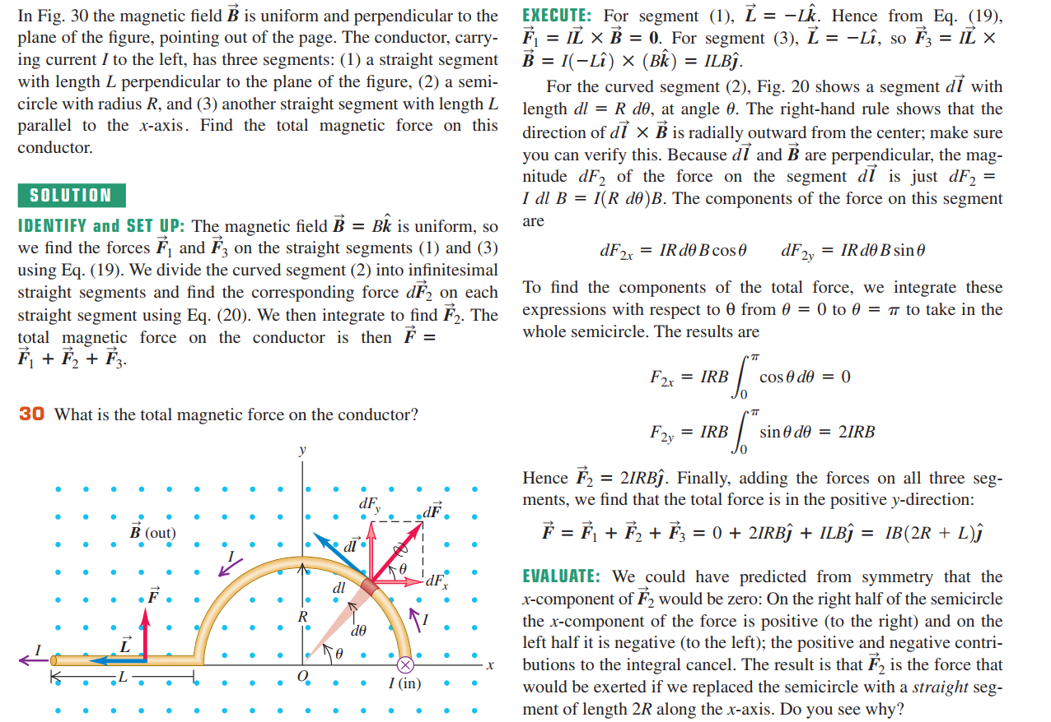
Example 19.8 Magnetic force on a curved conductor

Slide 27
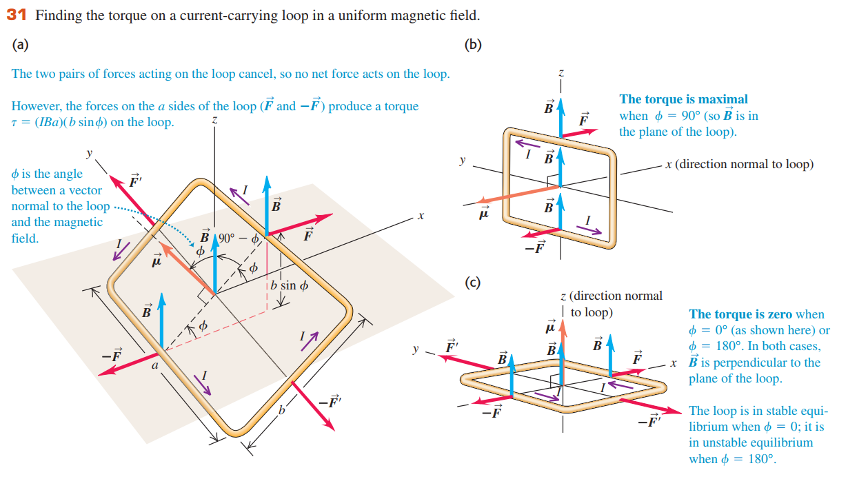
19.7 Force and Torque on a Current Loop

Slide 28





  The force on this side has magnitude
  The product IA is called the magnetic dipole moment or magnetic moment of the loop, for which we use the symbol μ.

Slide 29
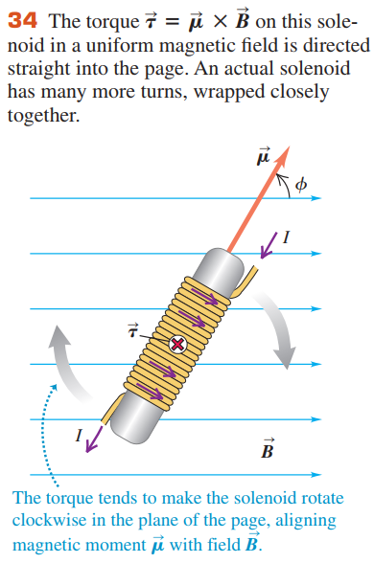
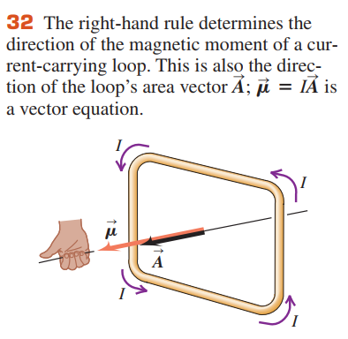
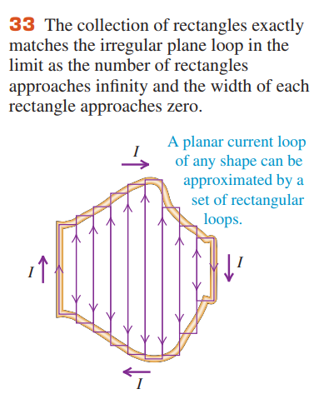


Slide 30
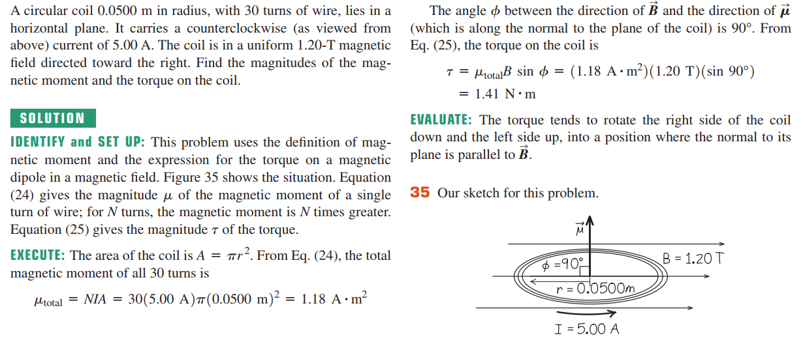
Example 19.9 Magnetic torque on a circular coil

Slide 31
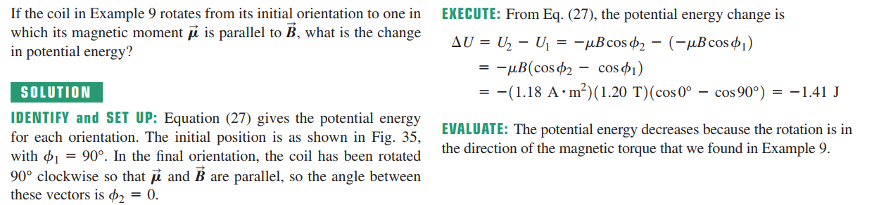
Example 19.10 Potential energy for a coil in a magnetic field

Slide 32
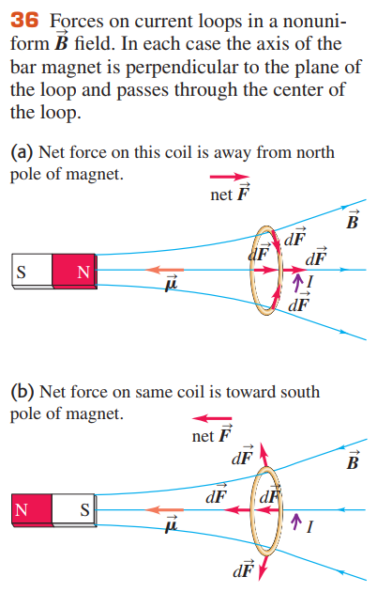
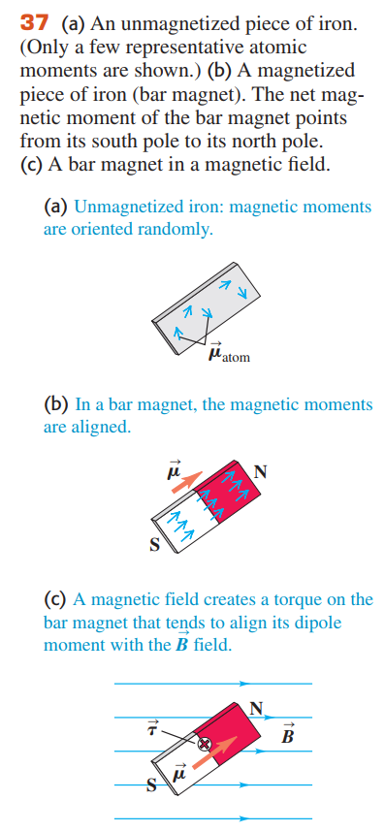
Magnetic Dipole in a Nonuniform Magnetic Field

Slide 33
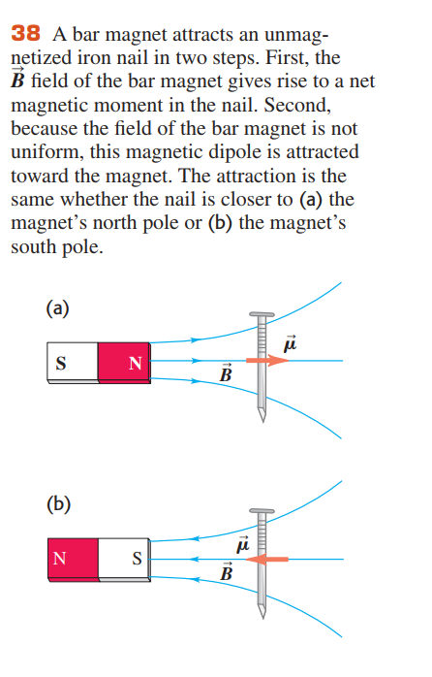

Slide 34
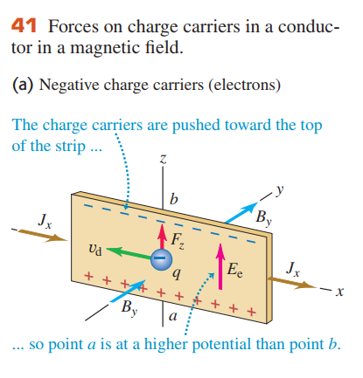
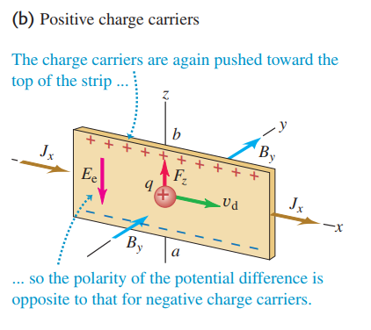
19.8 The Hall Effect
  This electric field causes a transverse potential difference between opposite edges of the strip, called the Hall voltage or the Hall emf.

