Slide 1
Chapter 21 ELECTROMAGNETIC
INDUCTION
21.1 Induction Experiments
21.2 Faraday’ s Law
21.3 Lenz’ s Law
21.4 Motional Electromotive Force
21.5 Induced Electric Fields
21.6 Eddy Currents
21.7 Displacement Current and Maxwell’ s Equations
21.8 Superconductivity

Slide 2
Goals for chapter 21
The experimental evidence that a changing magnetic field induces an emf.
How Faraday’s law relates theinduced emf in a loop to the change in magnetic flux through the loop.
How to determine the direction of an induced emf.
How to calculate the emf induced in a conductor moving through a magnetic field.
How a changing magnetic flux generates an electric field that is very different from that produced by an arrangement of charges.
The four fundamental equations that completely describe both electricity and magnetism.

Slide 3

Introduction
  When a credit card is “swiped” through a card reader, the information coded in a magnetic pattern on the back of the card is transmitted to the cardholder’s bank. Why is it necessary to swipe the card rather than holding itmotionless in the card reader’s slot?

Slide 4
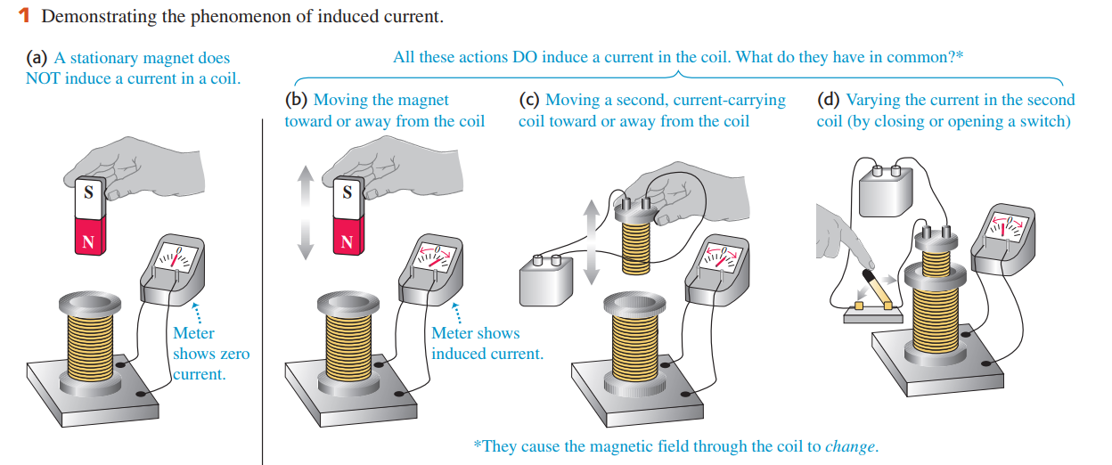
21.1 Induction Experiments
  If we keep the magnet stationary and move the coil, we again detect a current during the motion. We call this an induced current, and the corresponding emf required to cause this current is called an induced emf.

Slide 5
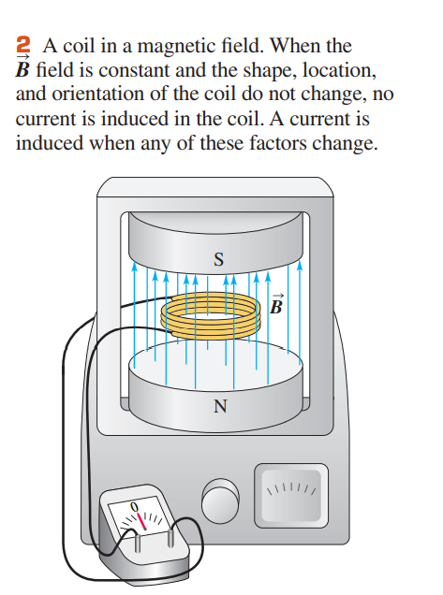
  1. When there is no current in the electromagnet, so that , the galvanometer shows no current.
  2. When the electromagnet is turned on, there is a momentary current through the meter as increases.
  3. When levels off at a steady value, the current drops to zero, no matter how large is.
  4. With the coil in a horizontal plane, we squeeze it so as to decrease the cross-sectional area of the coil. The meter detects current only during thedeformation, not before or after. When we increase the area to return the coil to its original shape, there is current in the opposite direction, but only while the area of the coil is changing.
  5. If we rotate the coil a few degrees about a horizontal axis, the meter detects current during the rotation, in the same direction as when we decreased the area. When we rotate the coil back, there is a current in the opposite direction during this rotation.

Slide 6
  6. If we jerk the coil out of the magnetic field, there is a current during the motion, in the same direction as when we decreased the area.
  7. If we decrease the number of turns in the coil by unwinding one or more turns, there is a current during the unwinding, in the same direction as when we decreased the area. If we wind more turns onto the coil, there is a current in the opposite direction during the winding.
  8. When the magnet is turned off, there is a momentary current in the direction opposite to the current when it was turned on.
  9. The faster we carry out any of these changes, the greater the current.
  10. If all these experiments are repeated with a coil that has the same shape but different material and different resistance, the current in each case is inversely proportional to the total circuit resistance. This shows that the induced emfs that are causing the current do not depend on the material of the coil but only on its shape and the magnetic field.

Slide 7
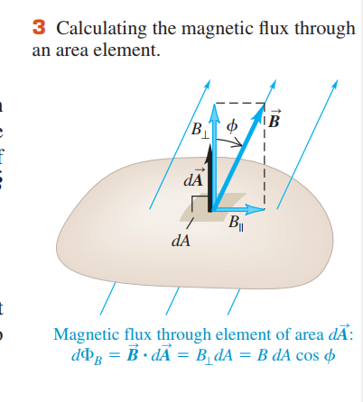

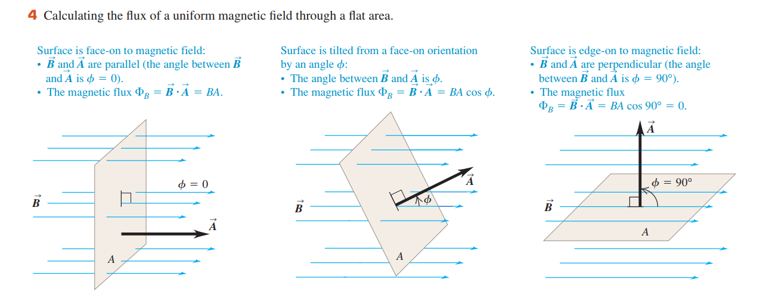
21.2 Faraday’ s Law
  The common element in all induction effects is changing magnetic flux through a circuit.

Slide 8



  Faraday’s law of induction states:
  In symbols, Faraday’s law is

Slide 9
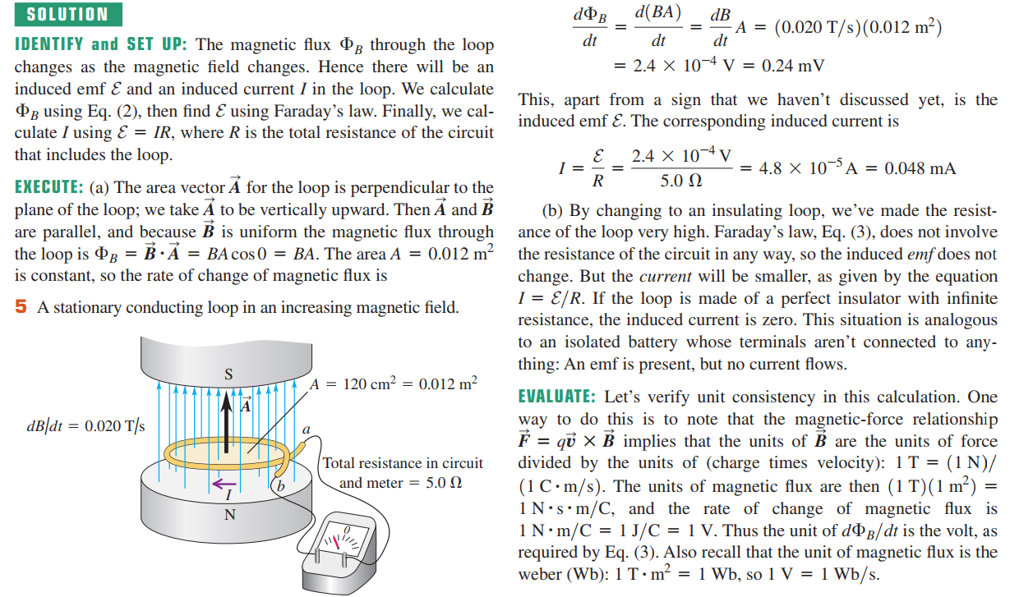
Example 21.1 Emf and current induced in a loop

Slide 10


Direction of Induced emf
  Here’s the procedure:
  1. Define a positive direction for the vector area
  2. From the directions of and the magnetic field determine the sign of the magnetic flux and its rate of change .
  3. Determine the sign of the induced emf or current. If the flux is increasing, so is positive, then the induced emf or current is negative; if the flux is decreasing, is negative and the induced emf or current is positive.
  4. Finally, determine the direction of the induced emf or current using your right hand. Curl the fingers of your right hand around the vector, with your right thumb in the direction of . If the induced emf or current in the circuit is positive, it is in the same direction as your curled fingers; if the induced emf or current is negative, it is in the opposite direction.

Slide 11
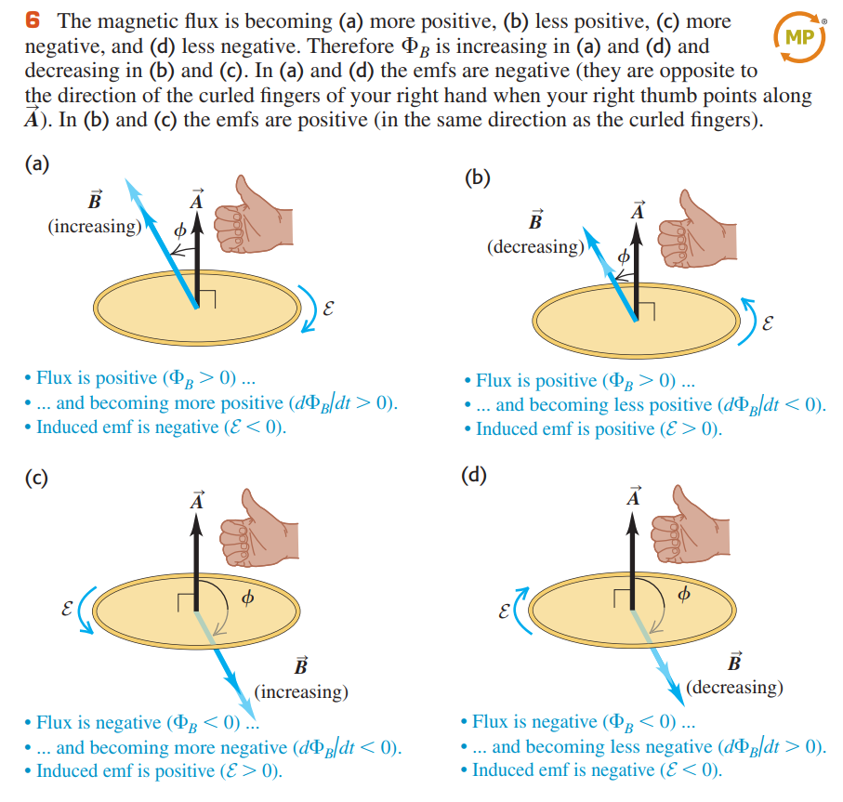

  the total emf in a coil with N turns is

Slide 12
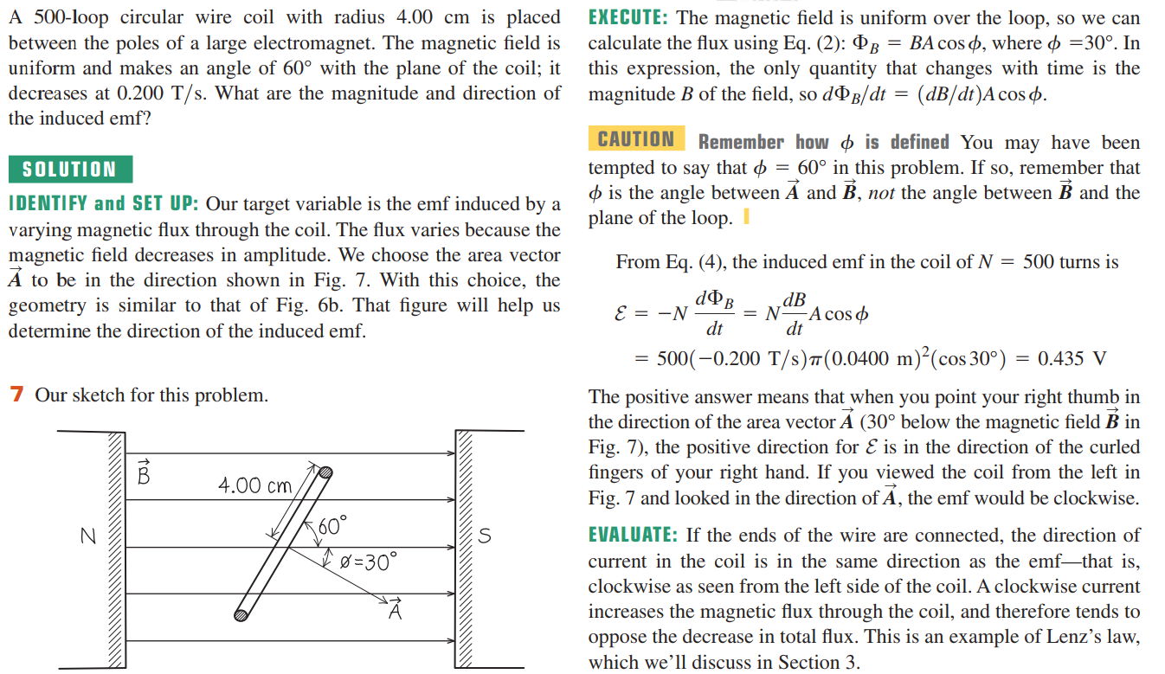
Example 21.2 Magnitude and direction of an induced emf

Slide 13
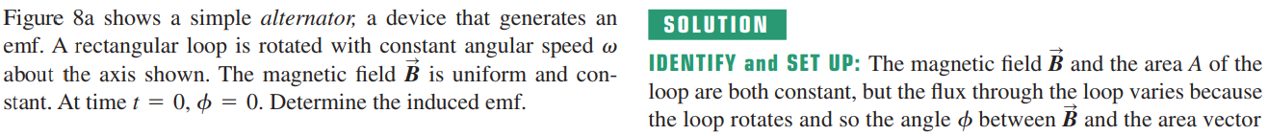
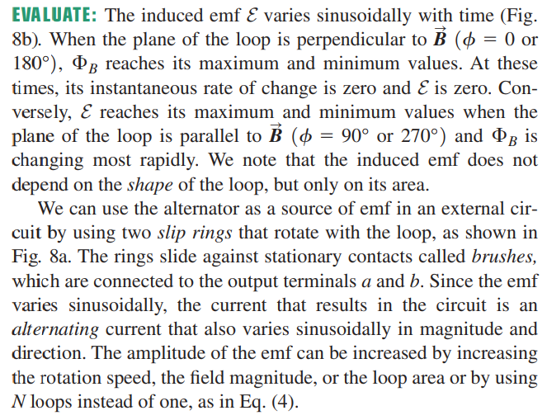
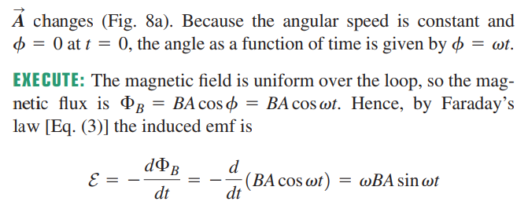
Example 21.3 Generator I: A simple alternator

Slide 14
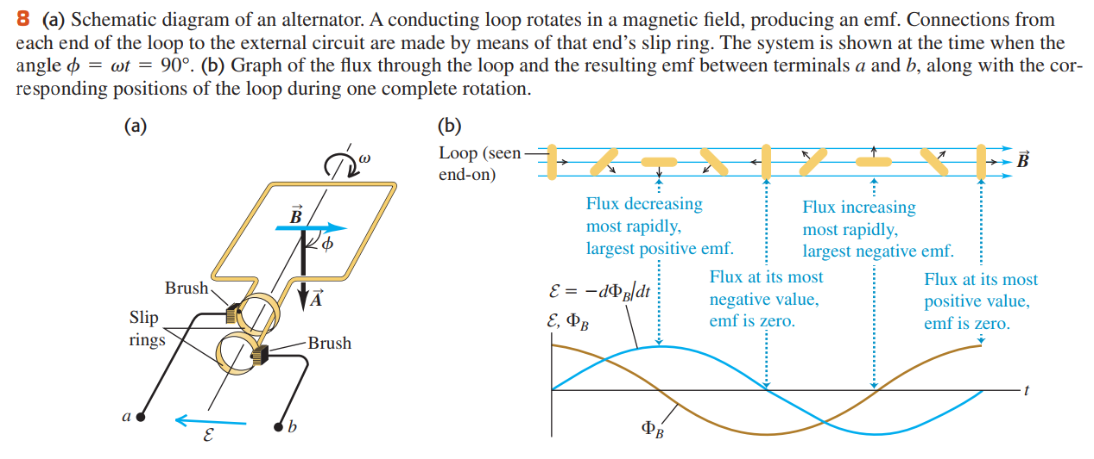

Slide 15
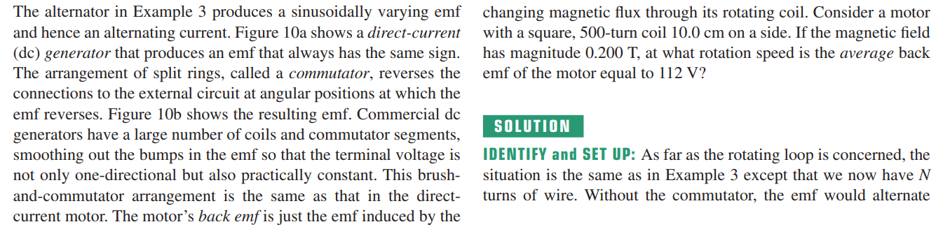
Example 21.4 Generator II: A DC generator and back emf in a motor

Slide 16
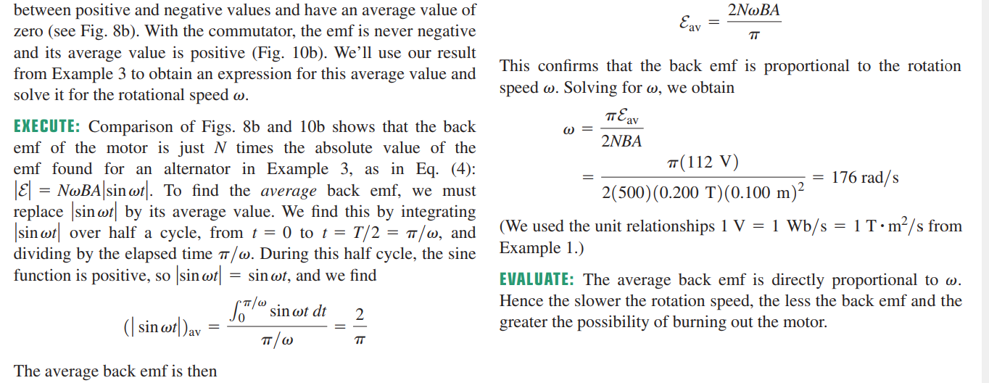
Example 21.4 Generator II: A DC generator and back emf in a motor

Slide 17
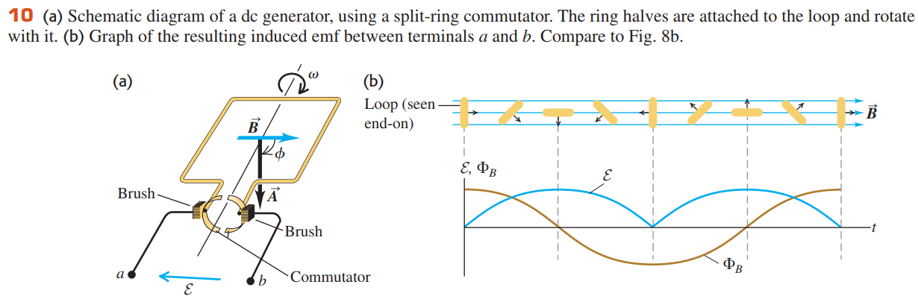

Slide 18
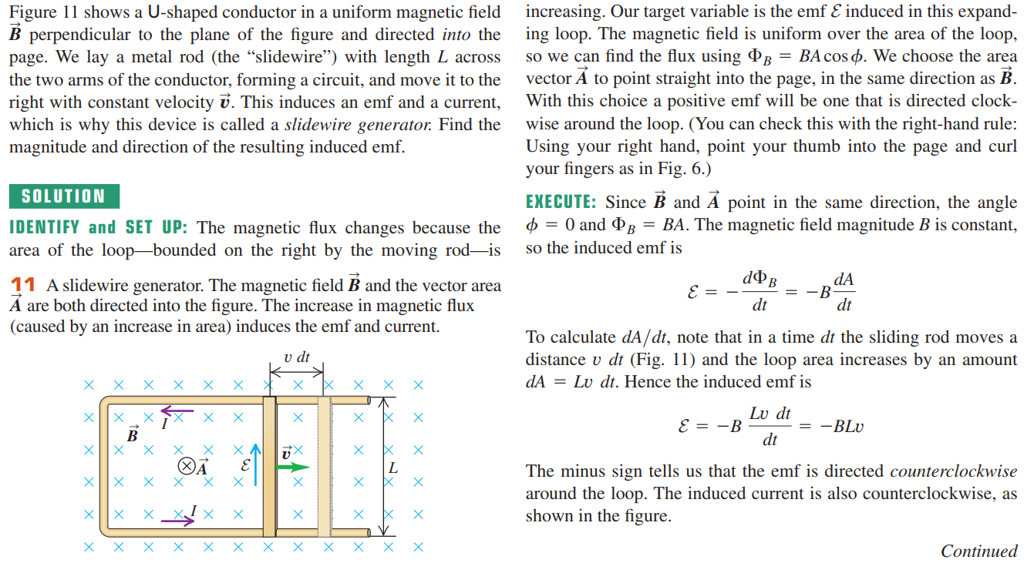
Example 21.5 Generator III: The slidewire generator

Slide 19
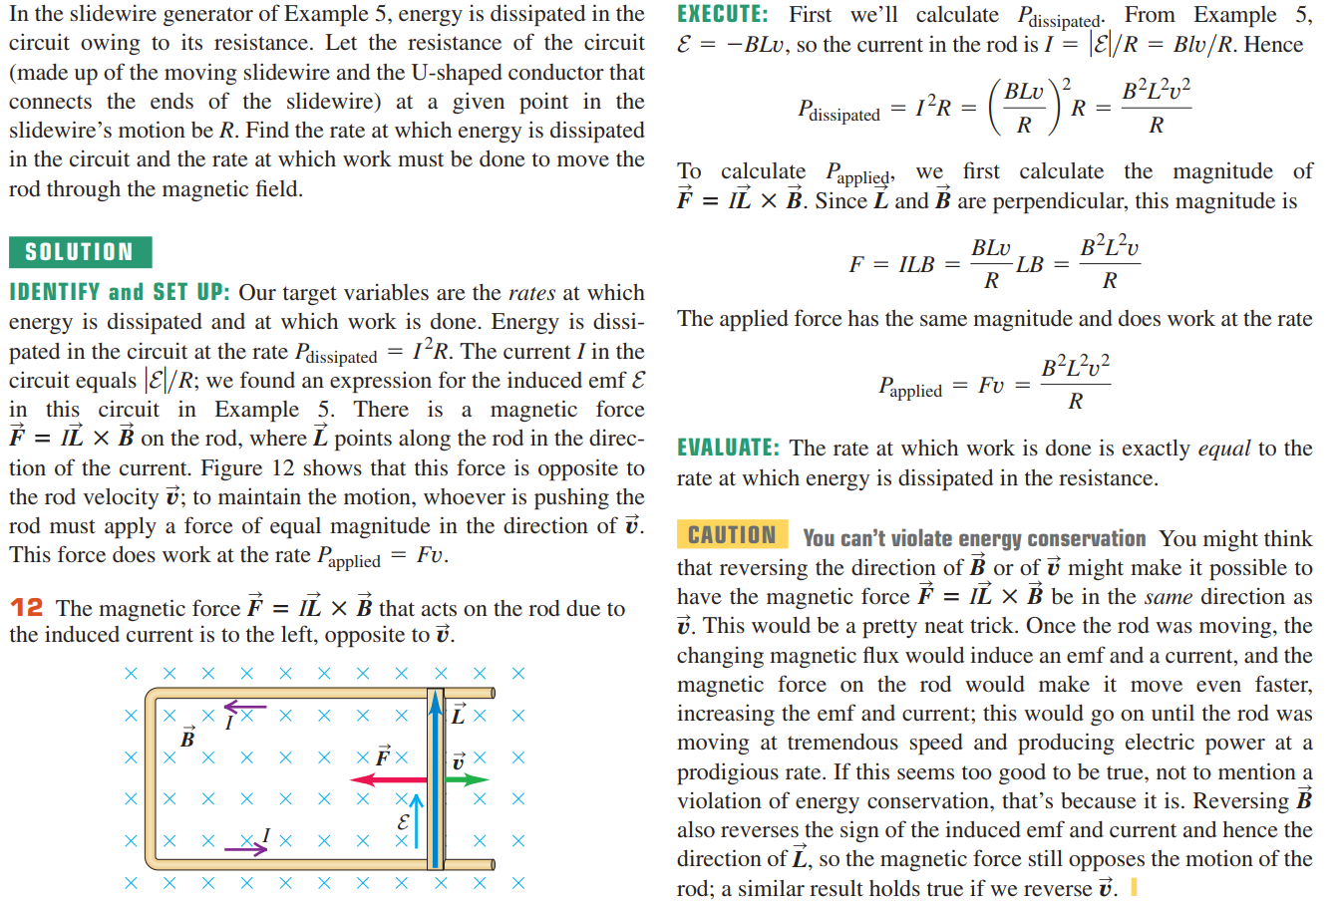
Example 21.6 Work and power in the slidewire generator

Slide 20
21.3 Lenz’ s Law
  Lenz’s law state
  Within the area bounded by the circuit, this field is opposite to the original field if the original field is increasing but is in the same direction as the original field if the latter is decreasing. That is, the induced current opposes the change in flux through the circuit.

Slide 21
Conceptual Example 21.7 Lenz’s law and the
slidewire generator

Slide 22
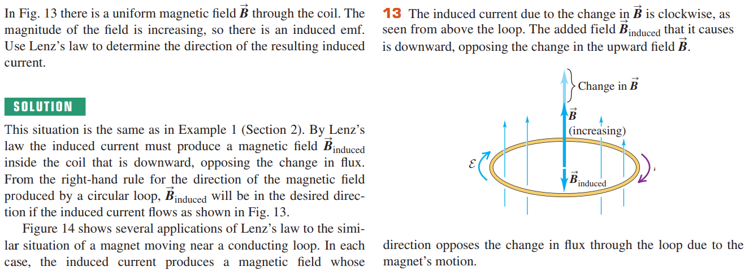
Conceptual Example 21.8 Lenz’s law and the
direction of induced current

Slide 23
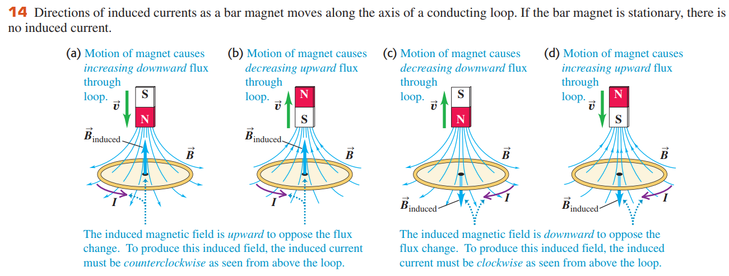

Slide 24
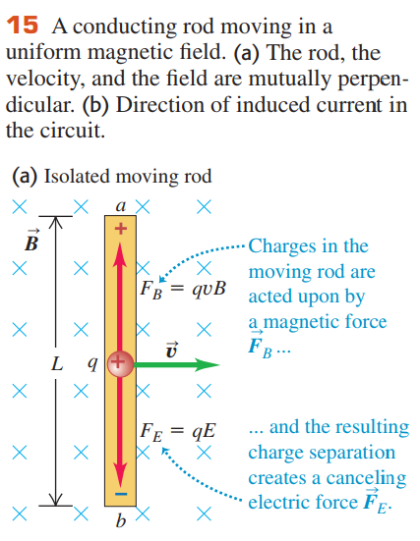


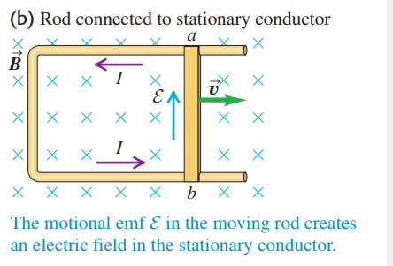
21.4 Motional Electromotive Force
  We call this emf a motional electromotive force

Slide 25

Motional emf: General Form
  For any closed conducting loop, the total emf is

Slide 26
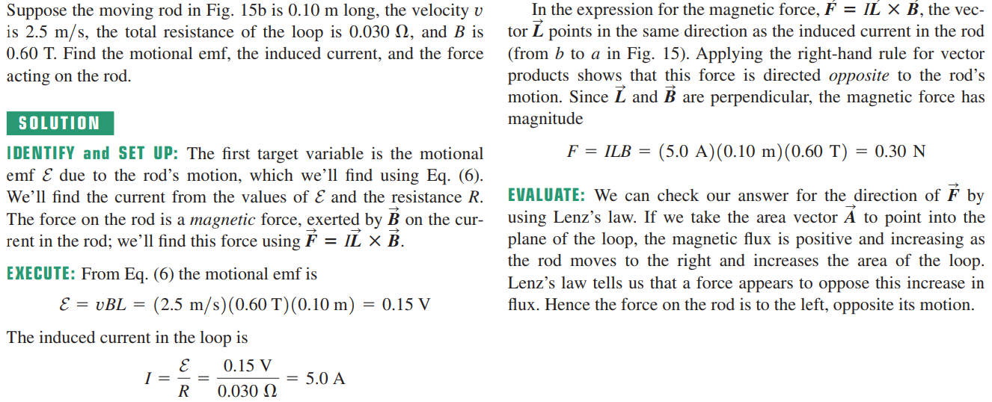
Example 21.9 Motional emf in the slidewire generator

Slide 27
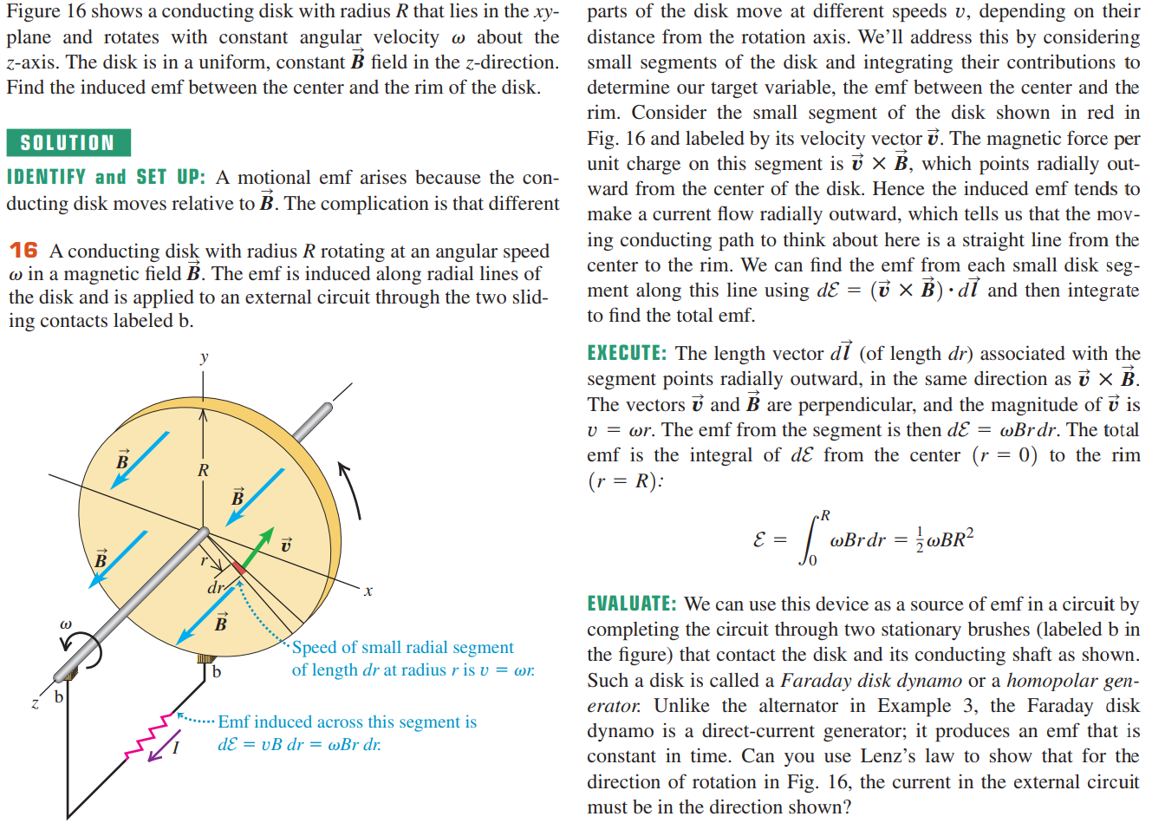
Example 21.10 The Faraday disk dynamo

Slide 28

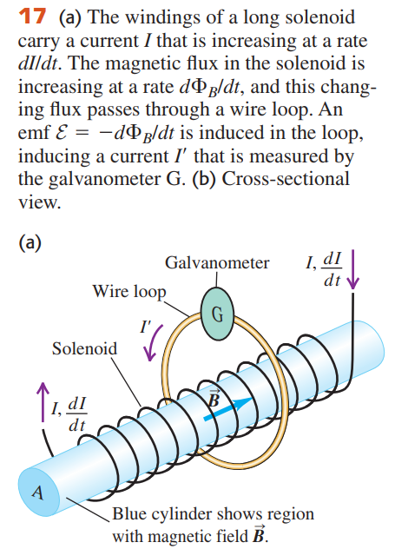

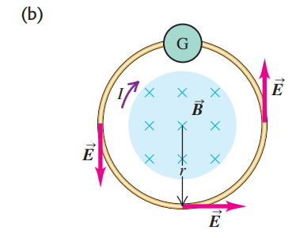




21.5 Induced Electric Fields
  It can’t be a magnetic force because the loop isn’t even in a magnetic field. We are forced to conclude that there has to be an induced electric field in the conductor caused by the changing magnetic flux.

Slide 29
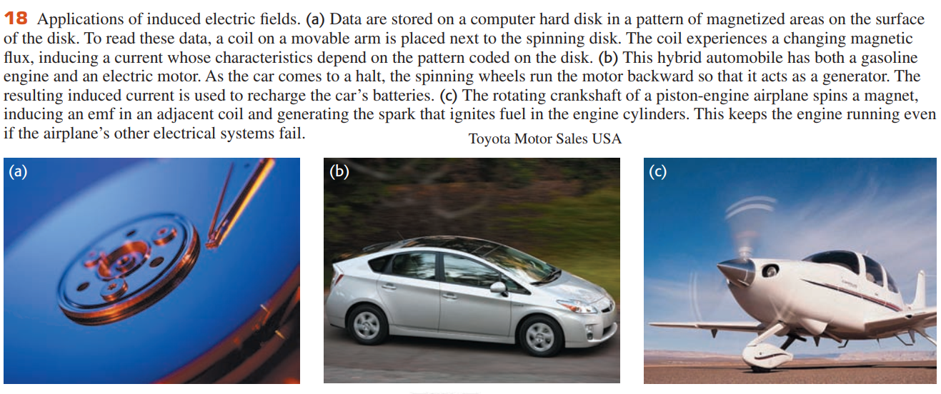
Nonelectrostatic Electric Fields

Slide 30
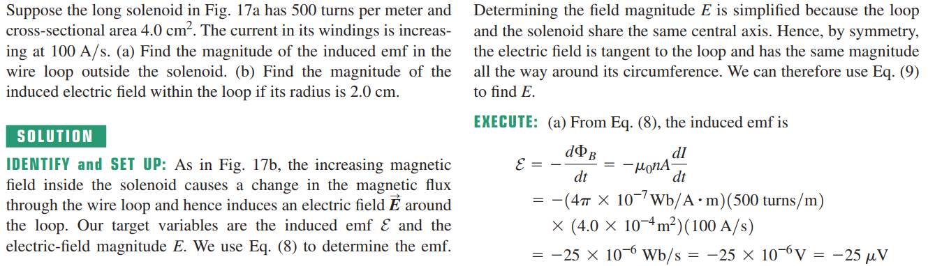
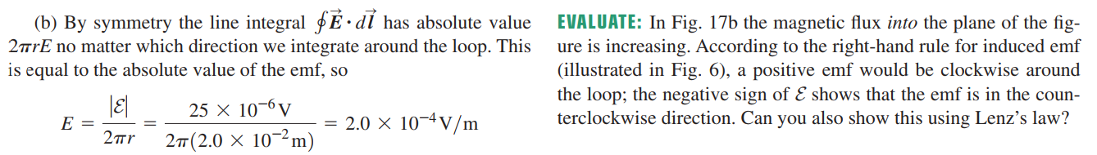
Example 21.11 Induced electric fields

Slide 31
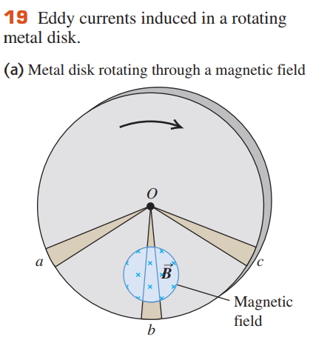
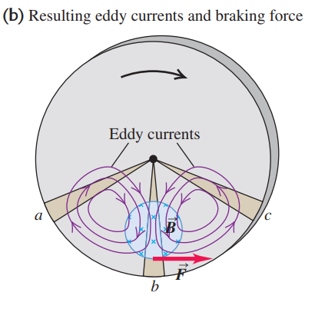
21.6 Eddy Currents
  we call these eddy currents:

Slide 32
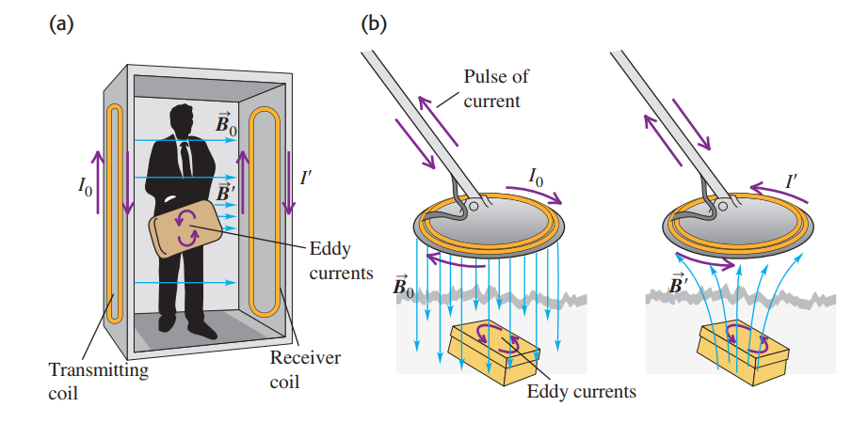
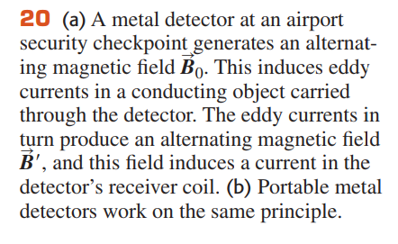

Slide 33
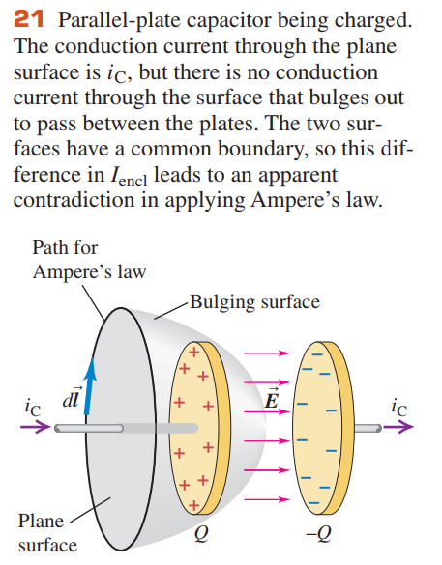






21.7 Displacement Current and Maxwell’s Equations
  Generalizing Ampere’s Law:

Slide 34
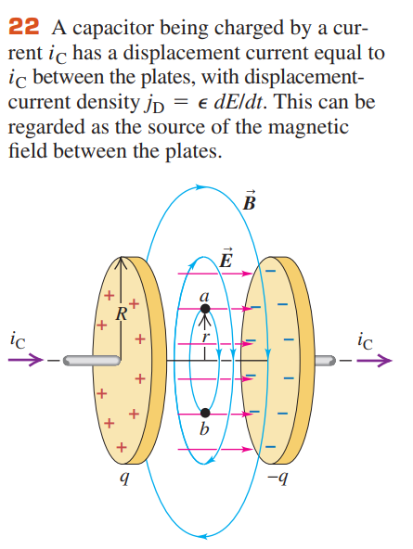
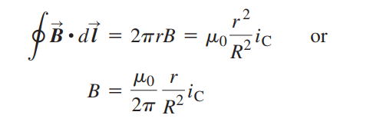
The Reality of Displacement Current

Slide 35




Maxwell’s Equations of Electromagnetism
  The first is simply Gauss’s law for electric fields,
  The second is the analogous relationship for magnetic fields

Slide 36



  The third equation is Ampere’s law including displacement current.
  The fourth and final equation is Faraday’s law.

Slide 37
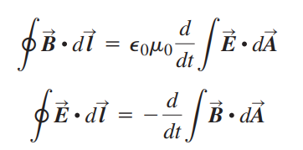

Symmetry in Maxwell’s Equations

Slide 38
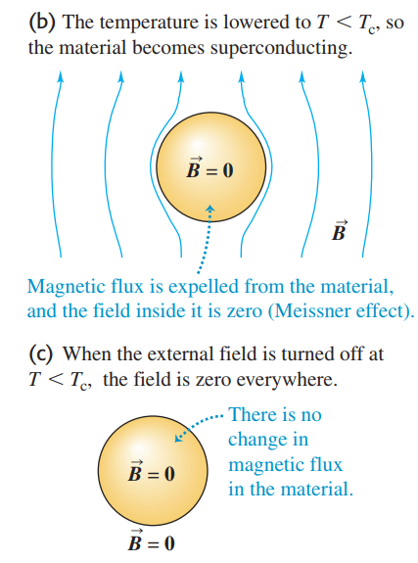
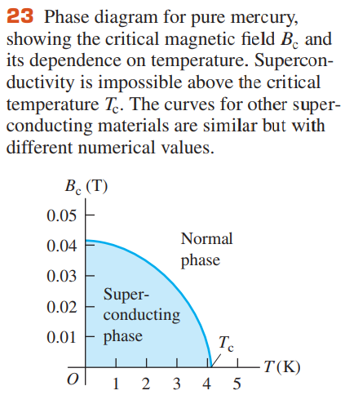
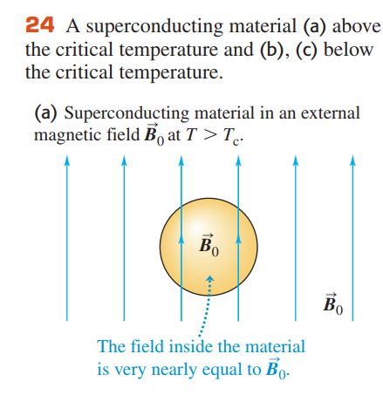
21.8 Superconductivity
The Meissner Effect

