Slide 1

Operating System
What?
…
Why?
· A fundamental course.
· 30%midterm+ 30%final+40%（…）
How?

Slide 2
Chapter 1: Introduction

Slide 3
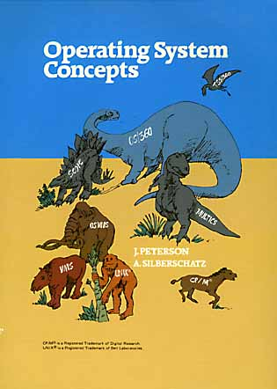
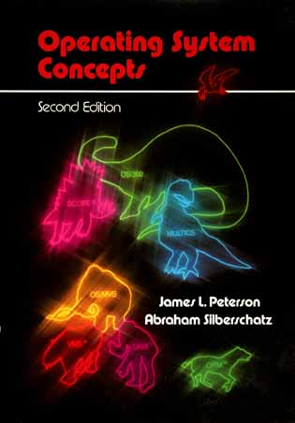
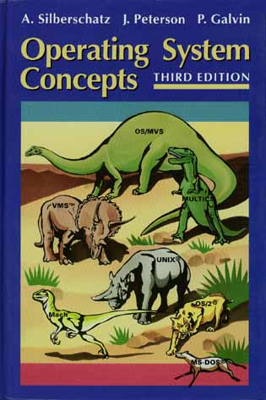
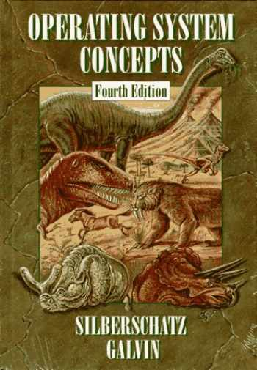
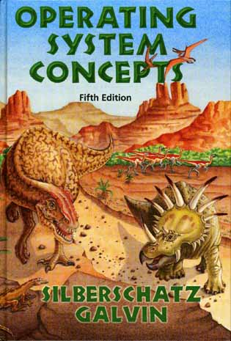
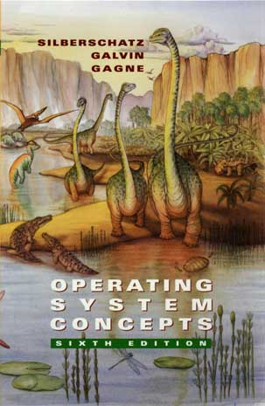
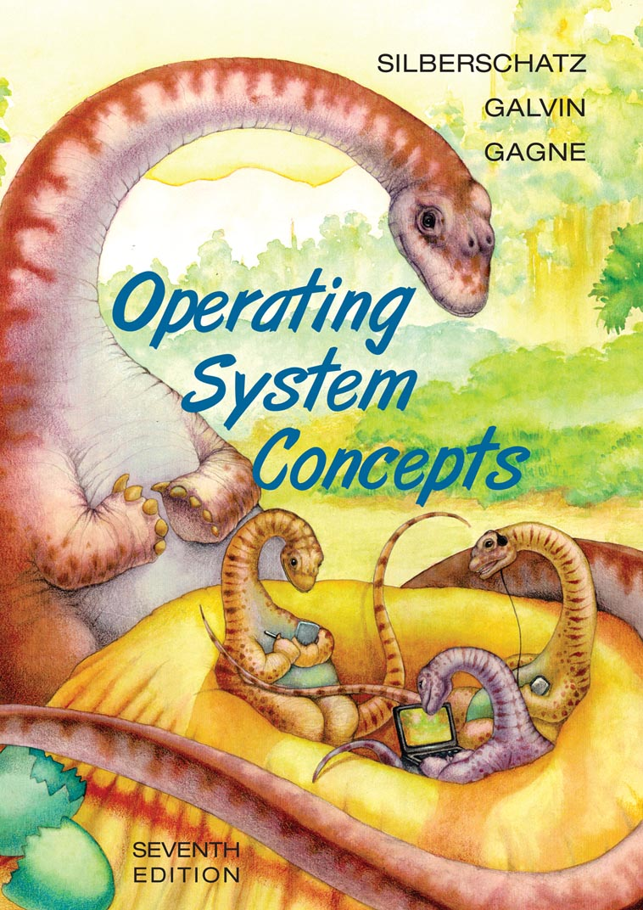
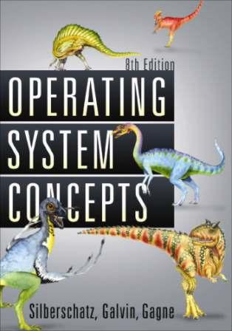
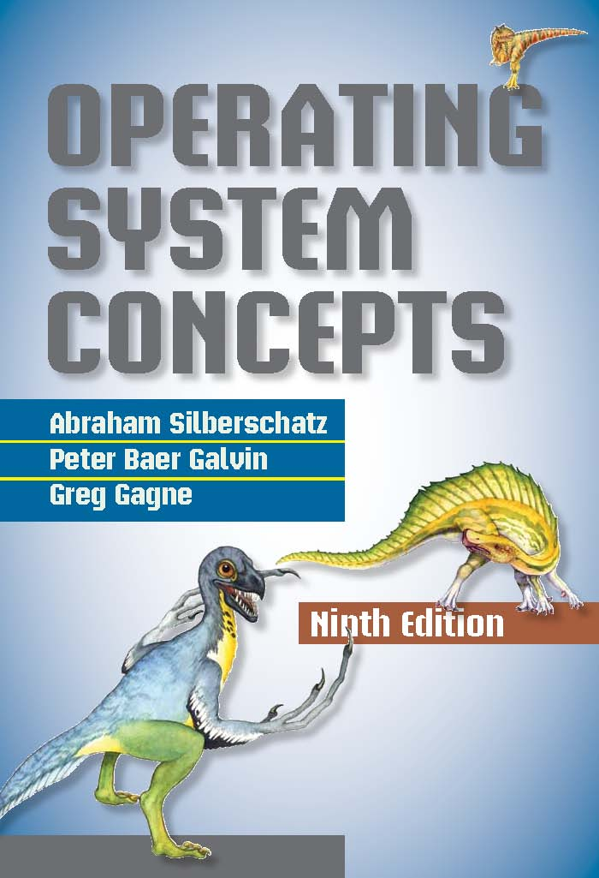
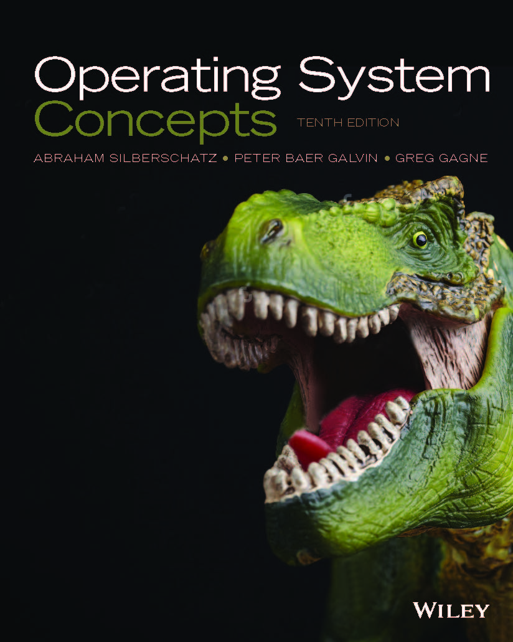
The dinosaur book
https://www.os-book.com/

Slide 4
Chapter 1: Objectives
To describe the basic organization of computer systems
To provide a grand tour of the major components of operating systems
To give an overview of the many types of computing environments
To explore several open-source operating systems

Slide 5
What is an Operating System?
A program that acts as an intermediary between a user of a computer and the computer hardware
Operating system goals:
  Execute user programs and make solving user problems easier
  Make the computer system convenient to user
  Use the computer hardware in an efficient manner

Slide 6
Computer System Structure
Computer system can be divided into four components:
  Hardware – provides basic computing resources
    CPU, memory, I/O devices
  Operating system
    Controls and coordinates use of hardware among various applications and users
  Application programs – define the ways in which the system resources are used to solve the computing problems of the users
    Word processors, compilers, web browsers, database systems, video games
  Users
    People, machines, other computers

Slide 7

Four Components of a Computer System

Slide 8
What Operating Systems Do
Depends on the point of view
Users want convenience, ease of use
  Don’t care about resource utilization
But shared computer such as mainframe or minicomputer must keep all users happy
Users of dedicate systems such as workstations have dedicated resources but frequently use shared resources from servers
Handheld computers are resource poor, optimized for usability and battery life
Mobile user interfaces such as touch screens, voice recognition
Some computers have little or no user interface, such as embedded computers in devices and automobiles
Run primarily without user intervention

Slide 9
Operating System Definition
（SYSTEM VIEW）
OS is a resource allocator
  Manages all resources
  Decides between conflicting requests for efficient and fair resource use
OS is a control program
  Controls execution of programs to prevent errors and improper use of the computer

Slide 10
Operating System Definition (Cont.)
No universally accepted definition
“Everything a vendor ships when you order an operating system” is good approximation
  But varies wildly
“The one program running at all times on the computer” is the kernel. Everything else is either a system program (ships with the operating system) or an application program.

Slide 11
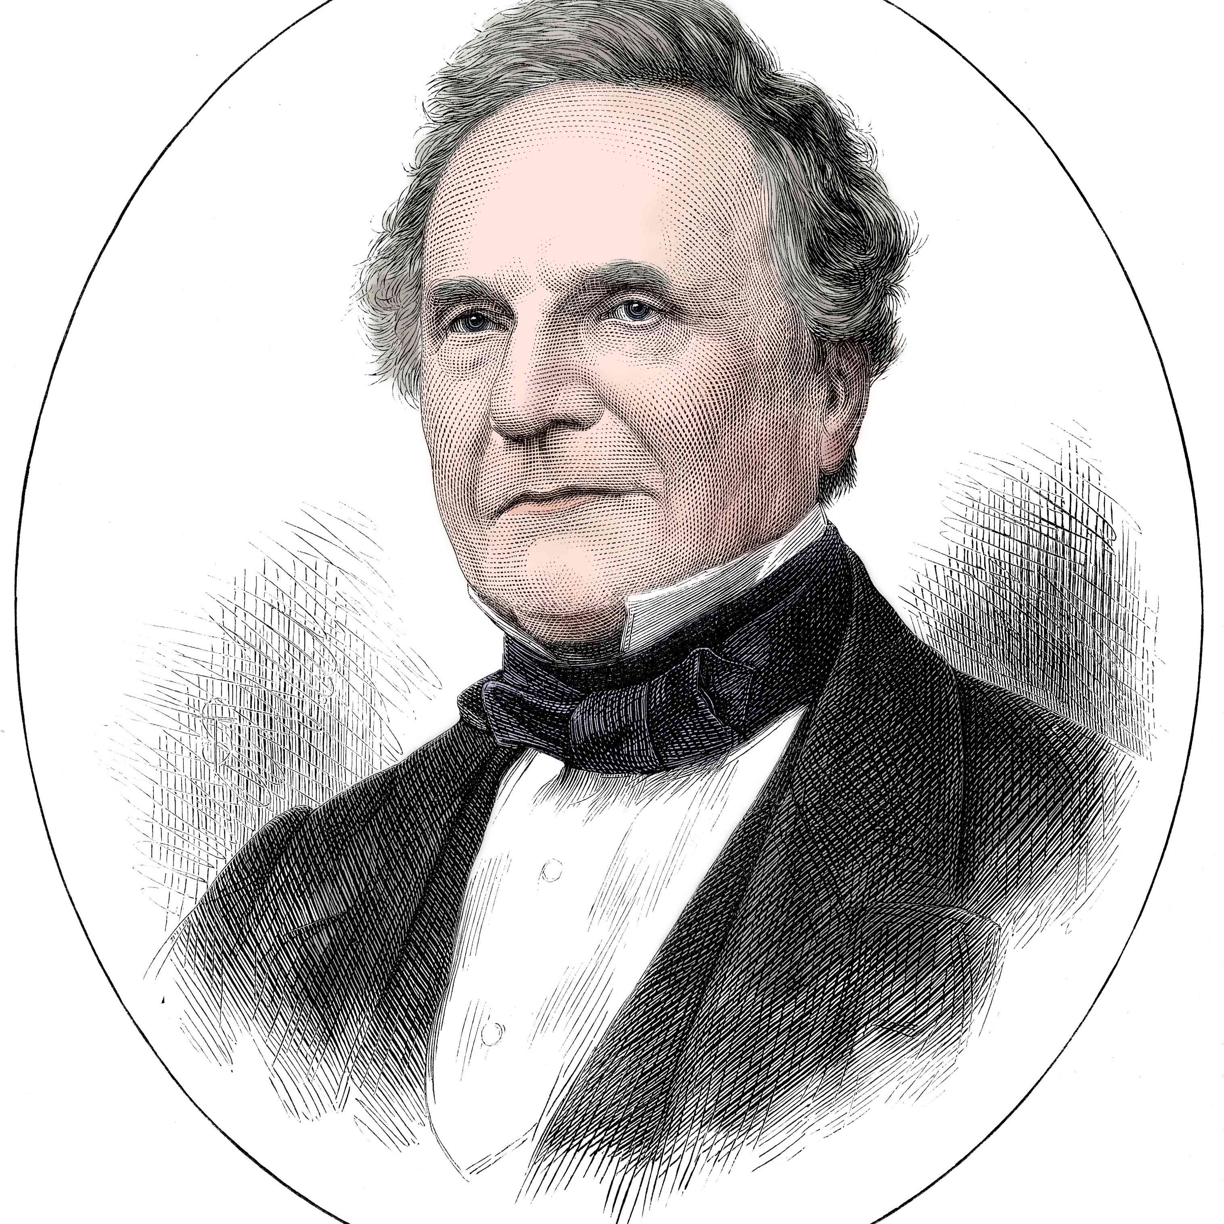
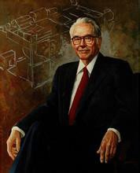
History
Charles Babbageu(1791-1871)
John Vincent Atanasoff (1903-1995)
Notes:
0th 代这个词用来指代计算的发展时期，即查尔斯·巴贝奇（Charles Babbage）发明了分析引擎，后来约翰·阿塔纳索夫（John Atanasoff）在 1940 年创造了计算机。这一时期的硬件组件技术 是电子真空管。 这一代计算机没有可用的操作系统，计算机程序是用机器语言编写的。 这一代的计算机效率低下，并且依赖于作为操作员的各个程序员的不同能力。

Slide 12
History (Cont.)
1st （1951-1956）:
Simple Batch Processing System ( UNIVAC I @1951; IBM 701)
2nd (1956-1964)
first OS: GMOS (by IBM)
-> Compatible Time-Sharing System (by MIT)
3rd (1964-1979)
multi-programmed Batch Processing System
(System/360 by IBM @1964)
4th (1979- )
Windows、Linux、MacOS…

Slide 13

Computer System Organization
Computer-system operation
  One or more CPUs, device controllers connect through common bus providing access to shared memory
  Concurrent execution of CPUs and devices competing for memory cycles

Slide 14
Computer-System Operation
I/O devices and the CPU can execute concurrently
Each device controller is in charge of a particular device type
Each device controller has a local buffer
CPU moves data from/to main memory to/from local buffers
I/O is from the device to local buffer of controller
Device controller informs CPU that it has finished its operation by causing an interrupt

Slide 15

Interrupt Timeline
P0 need the printer: sent I/O request (interrupt 1);
I/O device (driver) handle it: idle->transferring.
Transfer done, a interrupt 2 from I/O device (driver) to CPU.
CPU get interrupt 2, stop and handle interrupt 2

Slide 16
Common Functions of Interrupts
Interrupt
Hardware: Sending signals to CPU usually by system bus
Software: Triggering system call
Interrupt transfers control to the interrupt service routine generally, through the interrupt vector, which contains the addresses of all the service routines
Interrupt architecture must save the address of the interrupted instruction
A trap or exception is a software-generated interrupt caused either by an error or a user request
An operating system is interrupt driven

Slide 17
*Direct Memory Access Structure
Used for high-speed I/O devices able to transmit information at close to memory speeds
Device controller transfers blocks of data from buffer storage directly to main memory without CPU intervention
Only one interrupt is generated per block, rather than the one interrupt per byte

Slide 18
Storage Definitions and Notation Review
The basic unit of computer storage is the bit. A bit can contain one of two values, 0 and 1. All other storage in a computer is based on collections of bits. Given enough bits, it is amazing how many things a computer can represent: numbers, letters, images, movies, sounds, documents, and programs, to name a few. A byte is 8 bits, and on most computers it is the smallest convenient chunk of storage. For example, most computers don’t have an instruction to move a bit but do have one to move a byte. A less common term is word, which is a given computer architecture’s native unit of data. A word is made up of one or more bytes. For example, a computer that has 64-bit registers and 64-bit memory addressing typically has 64-bit (8-byte) words. A computer executes many operations in its native word size rather than a byte at a time.
Computer storage, along with most computer throughput, is generally measured and manipulated in bytes and collections of bytes. A kilobyte, or KB, is 1,024 bytes; a megabyte, or MB, is 1,024² bytes; a gigabyte, or GB, is 1,024³ bytes; a terabyte, or TB, is 1,024⁴ bytes; and a petabyte, or PB, is 1,024⁵ bytes. Computer manufacturers often round off these numbers and say that a megabyte is 1 million bytes and a gigabyte is 1 billion bytes. Networking measurements are an exception to this general rule; they are given in bits (because networks move data a bit at a time).

Slide 19
Storage Structure
Main memory – only large storage media that the CPU can access directly
  Random access
  Typically volatile
Secondary storage – extension of main memory that provides large nonvolatile storage capacity
Magnetic disks – rigid metal or glass platters covered with magnetic recording material
  Disk surface is logically divided into tracks, which are subdivided into sectors
  The disk controller determines the logical interaction between the device and the computer
Solid-state disks – faster than magnetic disks, nonvolatile
  Various technologies
  Becoming more popular

Slide 20
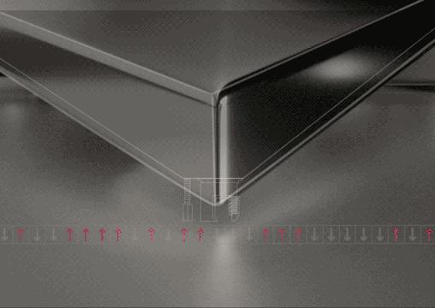
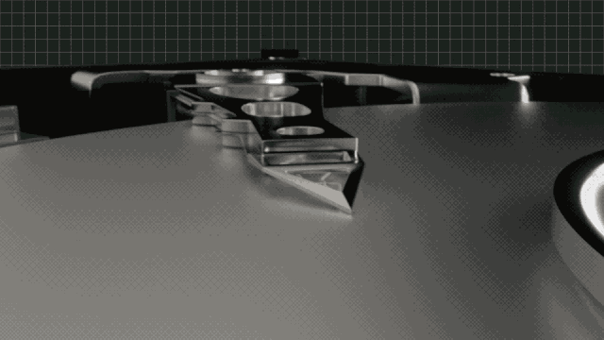
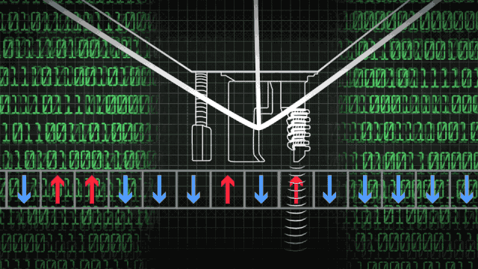
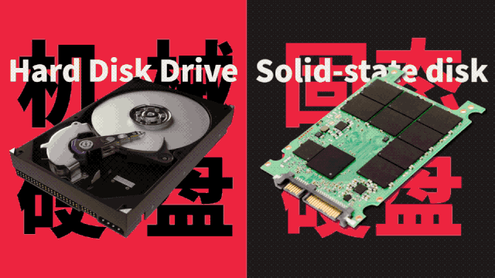
Magnetic disks & Solid-state disk
https://www.cnblogs.com/xinxianquan/p/17802648.html

Slide 21
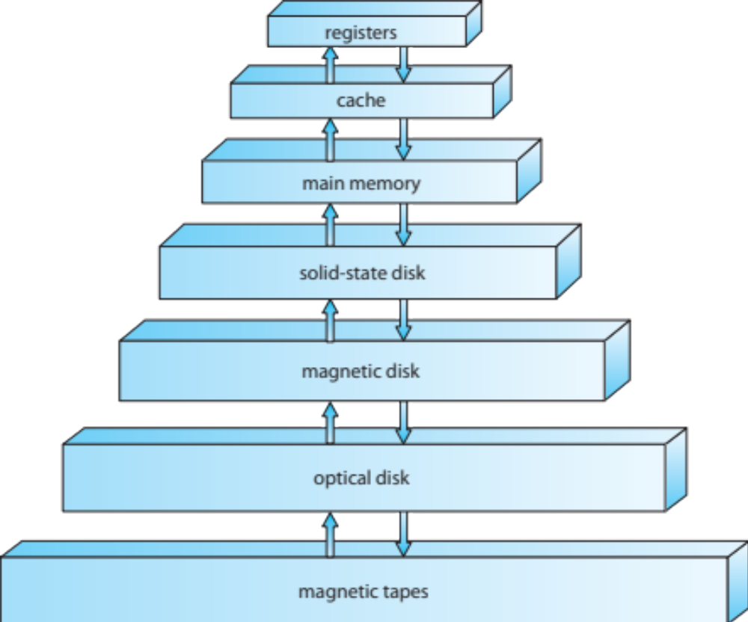
Storage-Device Hierarchy

Slide 22
Storage Hierarchy
Storage systems organized in hierarchy
  Speed
  Cost
  Volatility
Caching – copying information into faster storage system; main memory can be viewed as a cache for secondary storage
Device Driver for each device controller to manage I/O
  Provides uniform interface between controller and kernel

Slide 23
Caching
Important principle, performed at many levels in a computer (in hardware, operating system, software)
Information in use copied from slower to faster storage temporarily
Faster storage (cache) checked first to determine if information is there
  If it is, information used directly from the cache (fast)
  If not, data copied to cache and used there
Cache smaller than storage being cached
  Cache management important design problem
  Cache size and replacement policy

Slide 24

How a Modern Computer Works
A von Neumann architecture

Slide 25
Computer-System Architecture
Most systems use a single general-purpose processor (PDAs through mainframes)
  Most systems have special-purpose processors as well
Multiprocessors systems growing in use and importance
  Also known as parallel systems, tightly-coupled systems
  Advantages include:
    Increased throughput
    Economy of scale
    Increased reliability – graceful degradation or fault tolerance
  Two types:
    Asymmetric Multiprocessing– each processor is assigned a specie task.
    Symmetric Multiprocessing– each processor performs all tasks
Notes:
Personal Digital Assistant

Slide 26
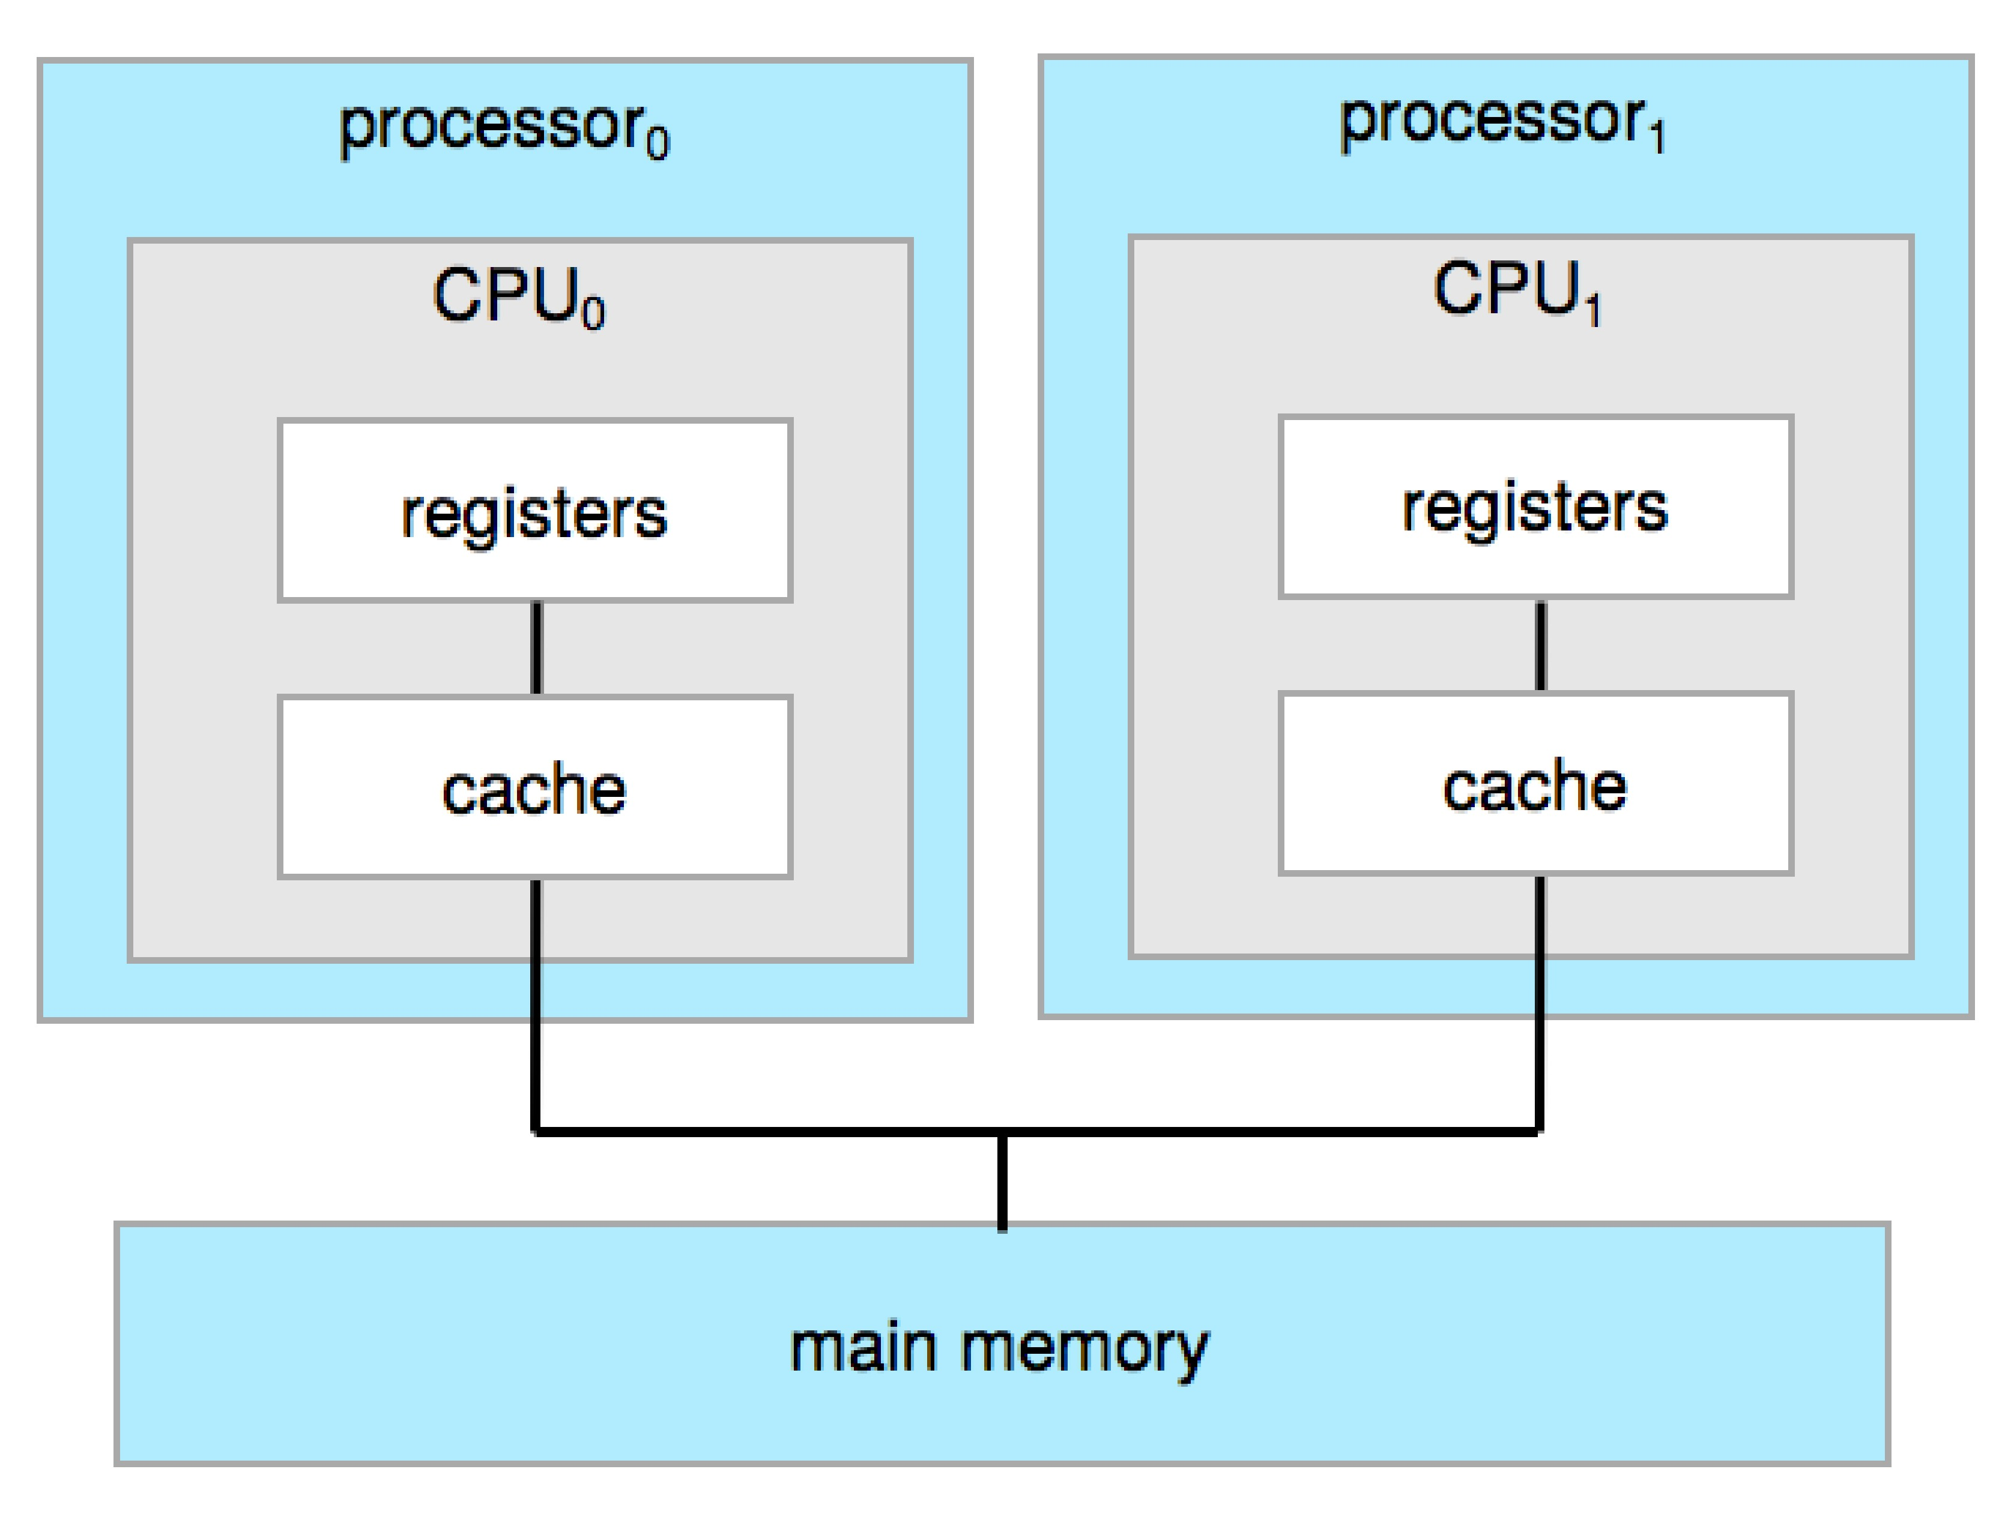
Symmetric Multiprocessing Architecture

Slide 27
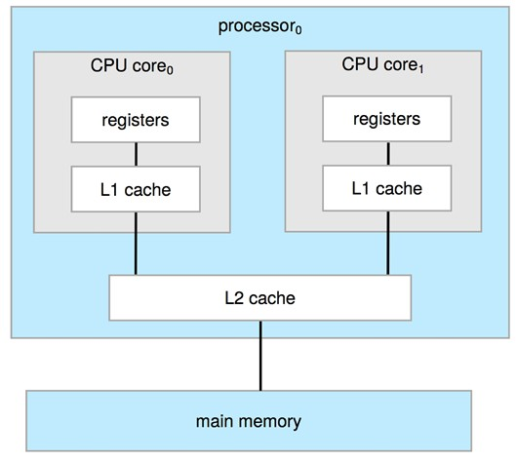
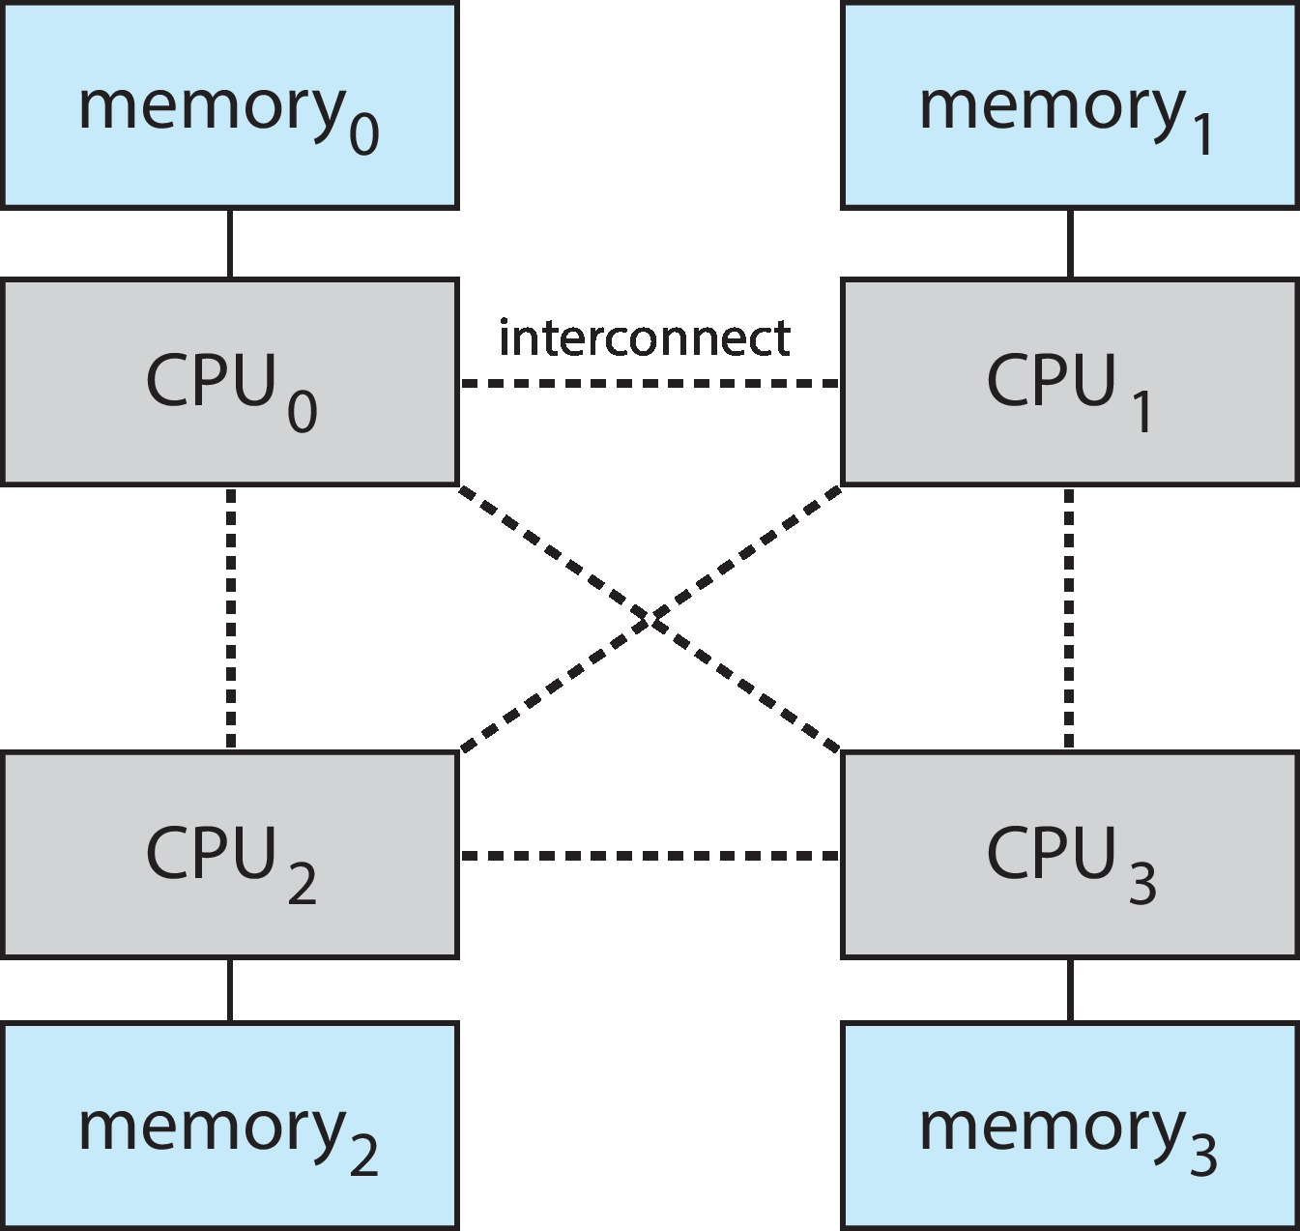
A Multi-Core Design
UMA(uniform memory access) and NUMA (non-uniform memory access) architecture variations
Multi-chip and multicore
Systems containing all chips vs. blade servers
  Chassis containing multiple separate systems
NUMA

Slide 28
Clustered Systems
Like multiprocessor systems, but multiple systems working together
  Usually sharing storage via a storage-area network (SAN)
  Provides a high-availability service which survives failures
    Asymmetric clustering has one machine in hot-standby mode
    Symmetric clustering has multiple nodes running applications, monitoring each other
  Some clusters are for high-performance computing (HPC)
    Applications must be written to use parallelization
  Some have distributed lock manager (DLM) to avoid conflicting operations

Slide 29
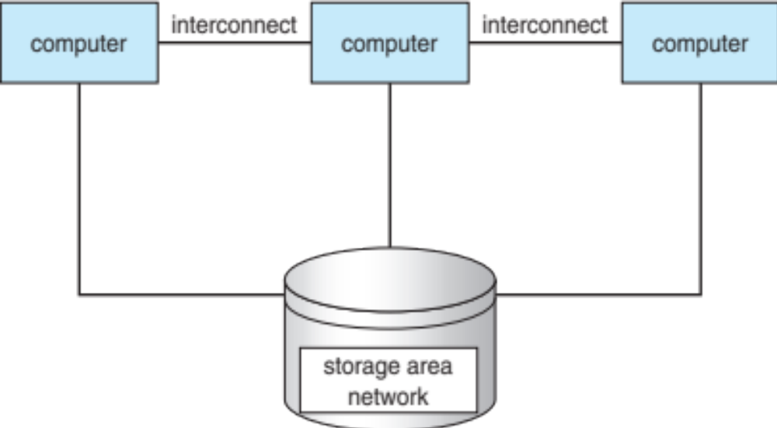
Clustered Systems

Slide 30
Operating System Structure
Multiprogramming needed for efficiency
  Single user cannot keep CPU and I/O devices busy at all times
  Multiprogramming organizes jobs (code and data) so CPU always has one to execute
  A subset of total jobs in system is kept in memory
  One job selected and run via job scheduling
  When it has to wait (for I/O for example), OS switches to another job
Timesharing (multitasking) is logical extension in which CPU switches jobs so frequently that users can interact with each job while it is running, creating interactive computing
  Response time should be < 1 second
  Each user has at least one program executing in memory process
  If several jobs ready to run at the same time  CPU scheduling
  If processes don’t fit in memory, swapping moves them in and out to run
  Virtual memory allows execution of processes not completely in memory

Slide 31

Memory Layout for Multiprogrammed System

Slide 32
Operating-System Operations
Interrupt driven
Software error or request creates exception or trap
  Division by zero, request for operating system service
Other process problems include infinite loop, processes modifying each other or the operating system
Dual-mode operation allows OS to protect itself and other system components
  User mode and kernel mode
  Mode bit provided by hardware
    Provides ability to distinguish when system is running user code or kernel code
    Some instructions designated as privileged, only executable in kernel mode
    System call changes mode to kernel, return from call resets it to user
Increasingly CPUs support multi-mode operations
  i.e. virtual machine manager (VMM) mode for guest VMs

Slide 33

Transition from User to Kernel Mode
Timer to prevent infinite loop / process hogging resources
  Set interrupt after specific period
  Operating system decrements counter
  When counter zero generate an interrupt
  Set up before scheduling process to regain control or terminate program that exceeds allotted time
Time out!

Slide 34
Timer
Timer to prevent infinite loop (or process hogging resources)
  Timer is set to interrupt the computer after some time period
  Keep a counter that is decremented by the physical clock
  Operating system set the counter (privileged instruction)
  When counter zero generate an interrupt
  Set up before scheduling process to regain control or terminate program that exceeds allotted time

Slide 35
Process Management
A process is a program in execution. It is a unit of work within the system. Program is a passive entity, process is an active entity.
Process needs resources to accomplish its task
  CPU, memory, I/O, files
  Initialization data
Process termination requires reclaim of any reusable resources
Single-threaded process has one program counter specifying location of next instruction to execute
  Process executes instructions sequentially, one at a time, until completion
Multi-threaded process has one program counter per thread
Typically system has many processes, some user, some operating system running concurrently on one or more CPUs
  Concurrency by multiplexing the CPUs among the processes / threads

Slide 36
Process Management Activities
The operating system is responsible for the following activities in connection with process management:
Creating and deleting both user and system processes
Suspending and resuming processes
Providing mechanisms for process synchronization
Providing mechanisms for process communication
Providing mechanisms for deadlock handling

Slide 37
Storage Management
OS provides uniform, logical view of information storage
  Abstracts physical properties to logical storage unit - file
  Each medium is controlled by device (i.e., disk drive, tape drive)
    Varying properties include access speed, capacity, data-transfer rate, access method (sequential or random)
File-System management
  Files usually organized into directories
  Access control on most systems to determine who can access what
  OS activities include
    Creating and deleting files and directories
    Primitives to manipulate files and dirs
    Mapping files onto secondary storage
    Backup files onto stable (non-volatile) storage media

Slide 38
Memory Management
All data in memory before and after processing
All instructions in memory in order to execute
Memory management determines what is in memory when
  Optimizing CPU utilization and computer response to users
Memory management activities
  Keeping track of which parts of memory are currently being used and by whom
  Deciding which processes (or parts thereof) and data to move into and out of memory
  Allocating and deallocating memory space as needed

Slide 39
Mass-Storage Management
Usually disks used to store data that does not fit in main memory or data that must be kept for a “long” period of time
Proper management is of central importance
Entire speed of computer operation hinges on disk subsystem and its algorithms
OS activities
  Free-space management
  Storage allocation
  Disk scheduling
Some storage need not be fast
  Tertiary storage includes optical storage, magnetic tape
  Still must be managed – by OS or applications
  Varies between WORM (write-once, read-many-times) and RW (read-write)

Slide 40

Performance of Various Levels of Storage
Movement between levels of storage hierarchy can be explicit or implicit

Slide 41

Migration of Integer A from Disk to Register
Multitasking environments must be careful to use most recent value, no matter where it is stored in the storage hierarchy
Multiprocessor environment must provide cache coherency in hardware such that all CPUs have the most recent value in their cache
Distributed environment situation even more complex
  Several copies of a datum can exist
  Various solutions covered in Chapter 17

Slide 42
I/O Subsystem
One purpose of OS is to hide peculiarities of hardware devices from the user
I/O subsystem responsible for
  Memory management of I/O including buffering (storing data temporarily while it is being transferred), caching (storing parts of data in faster storage for performance), spooling (the overlapping of output of one job with input of other jobs)
  General device-driver interface
  Drivers for specific hardware devices

Slide 43
Protection and Security
Protection – any mechanism for controlling access of processes or users to resources defined by the OS
Security – defense of the system against internal and external attacks
  Huge range, including denial-of-service, worms, viruses, identity theft, theft of service
Systems generally first distinguish among users, to determine who can do what
  User identities (user IDs, security IDs) include name and associated number, one per user
  User ID then associated with all files, processes of that user to determine access control
  Group identifier (group ID) allows set of users to be defined and controls managed, then also associated with each process, file
  Privilege escalation allows user to change to effective ID with more rights

Slide 44



Kernel Data Structures
Many similar to standard programming data structures
Singly linked list
Doubly linked list
Circular linked list

Slide 45
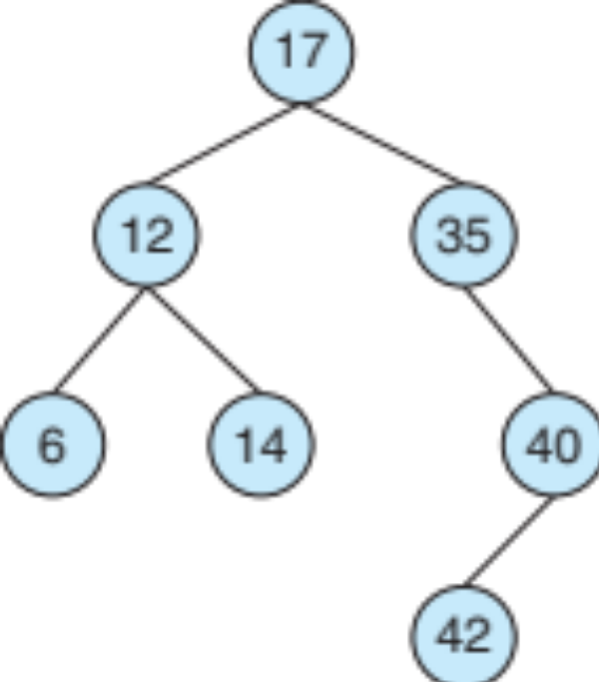
Kernel Data Structures
Binary search tree
left <= right
  Search performance is O(n)
  Balanced binary search tree is O(lg n)

Slide 46

Kernel Data Structures
Hash function can create a hash map
Bitmap – string of n binary digits representing the status of n items
Linux data structures defined in include files <linux/list.h>, <linux/kfifo.h>, <linux/rbtree.h>

Slide 47

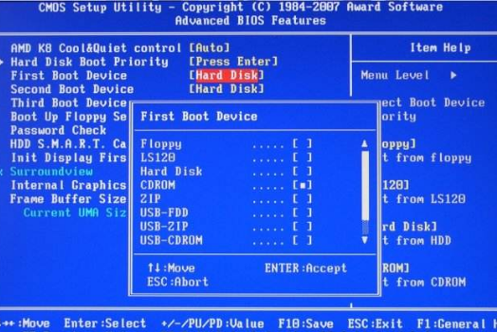


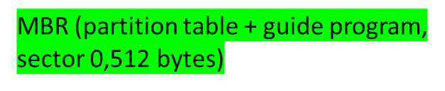


Computer Startup
bootstrap program is loaded at power-up or reboot
  Typically stored in ROM or EPROM, generally known as firmware
  Initializes all aspects of system
  Loads operating system kernel and starts execution
*0xffff0 (Reset Vector)
Load“loader0”
Load loader1- bootstrap program
*GPT（GUID Partition Table）
*kernel takes over control of the computer
https://www.bookstack.cn/read/webxiaohua-gitbook/1.-ni-guan-zhe-po-wan-yi-jiao-cpu.md

Slide 48
Computing Environments - Traditional
Stand-alone general purpose machines
But blurred as most systems interconnect with others (i.e. the Internet)
Portals provide web access to internal systems
Network computers (thin clients) are like Web terminals
Mobile computers interconnect via wireless networks
Networking becoming ubiquitous – even home systems use firewalls to protect home computers from Internet attacks

Slide 49
Computing Environments - Mobile
Handheld smartphones, tablets, etc
What is the functional difference between them and a “traditional” laptop?
Extra feature – more OS features (GPS, gyroscope)
Allows new types of apps like augmented reality
Use IEEE 802.11 wireless, or cellular data networks for connectivity
Leaders are Apple iOS and Google Android

Slide 50
Computing Environments – Distributed
Distributed
  Collection of separate, possibly heterogeneous, systems networked together
    Network is a communications path, TCP/IP most common
      Local Area Network (LAN)
      Wide Area Network (WAN)
      Metropolitan Area Network (MAN)
      Personal Area Network (PAN)
  Network Operating System provides features between systems across network
    Communication scheme allows systems to exchange messages
    Illusion of a single system

Slide 51

Computing Environments – Client-Server
Client-Server Computing
  Dumb terminals supplanted by smart PCs
  Many systems now servers, responding to requests generated by clients
    Compute-server system provides an interface to client to request services (i.e., database)
    File-server system provides interface for clients to store and retrieve files

Slide 52

Computing Environments - Peer-to-Peer
Another model of distributed system
P2P does not distinguish clients and servers
  Instead all nodes are considered peers
  May each act as client, server or both
  Node must join P2P network
    Registers its service with central lookup service on network, or
    Broadcast request for service and respond to requests for service via discovery protocol
  Examples include Napster and Gnutella, Voice over IP (VoIP) such as Skype

Slide 53
Computing Environments - Virtualization
Allows operating systems to run applications within other OSes
  Vast and growing industry
Emulation used when source CPU type different from target type (i.e. PowerPC to Intel x86)
  Generally slowest method
  When computer language not compiled to native code – Interpretation
Virtualization – OS natively compiled for CPU, running guest OSes also natively compiled
  Consider VMware running WinXP guests, each running applications, all on native WinXP host OS
  VMM provides virtualization services

Slide 54
Computing Environments - Virtualization
Use cases involve laptops and desktops running multiple OSes for exploration or compatibility
  Apple laptop running Mac OS X host, Windows as a guest
  Developing apps for multiple OSes without having multiple systems
  QA testing applications without having multiple systems
  Executing and managing compute environments within data centers
VMM can run natively, in which case they are also the host
  There is no general purpose host then (VMware ESX and Citrix XenServer)

Slide 55

Computing Environments - Virtualization

Slide 56
Computing Environments – Cloud Computing
Delivers computing, storage, even apps as a service across a network
Logical extension of virtualization as based on virtualization
  Amazon EC2 has thousands of servers, millions of VMs, PBs of storage available across the Internet, pay based on usage
Many types
  Public cloud – available via Internet to anyone willing to pay
  Private cloud – run by a company for the company’s own use
  Hybrid cloud – includes both public and private cloud components
  Software as a Service (SaaS) – one or more applications available via the Internet (i.e. word processor)
  Platform as a Service (PaaS) – software stack ready for application use via the Internet (i.e a database server)
  Infrastructure as a Service (IaaS) – servers or storage available over Internet (i.e. storage available for backup use)

Slide 57

Computing Environments – Cloud Computing
Cloud compute environments composed of traditional OSes, plus VMMs, plus cloud management tools
  Internet connectivity requires security like firewalls
  Load balancers spread traffic across multiple applications

Slide 58
Computing Environments – Real-Time Embedded Systems
Real-time embedded systems most prevalent form of computers
  Vary considerable, special purpose, limited purpose OS, real-time OS
  Use expanding
Many other special computing environments as well
  Some have OSes, some perform tasks without an OS
Real-time OS has well-defined fixed time constraints
  Processing must be done within constraint
  Correct operation only if constraints met

Slide 59
Open-Source Operating Systems
Operating systems made available in source-code format rather than just binary closed-source
Counter to the copy protection and Digital Rights Management (DRM) movement
Started by Free Software Foundation (FSF), which has “copyleft” GNU Public License (GPL)
Examples include GNU/Linux and BSD UNIX (including core of Mac OS X), and many more
Can use VMM like VMware Player (Free on Windows), Virtualbox (open source and free on many platforms - http://www.virtualbox.com)
  Use to run guest operating systems for exploration

Slide 60
[Operating System学习笔记] Chapter 1 introduction (1)_common functions of interrupts interrupt transfe-CSDN博客

