Slide 1
ISE305: Database Design and Practice
Logical Database Design
Fusheng Wang
Department of Computer Science
Department of Biomedical Informatics
Stony Brook University

Slide 2
Overview of Database Design

Slide 3
Objectives of Database Management
Data availability—make an integrated collection of data available to a wide variety of users
Data integrity—insure correctness and validity
Privacy (the goal) and security (the means)
Management control—DBA: lifecycle control, training, maintenance
Data independence (a relative term) -- avoids reprogramming of applications, allows easier conversion and reorganization
  Physical data independence—program unaffected by changes in the storage structure or access methods
  Logical data independence—program unaffected by changes in the schema

Slide 4
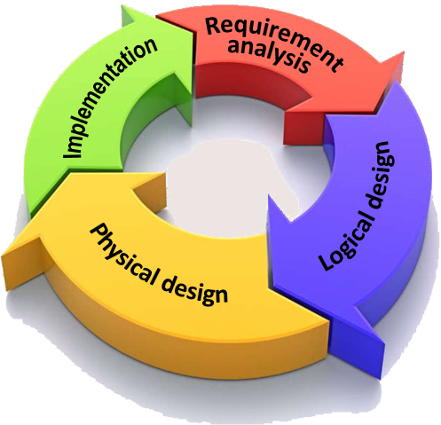
Database Life Cycle
Requirements analysis
  data required for processing
  natural data relationships
  software platform (OS, DBMS)
Logical database design
  conceptual modeling
  view integration
  transformation of conceptual data model to tables
  normalization of tables
Physical database design
  selection of indexes (access methods)
  partitioning and clustering
Database implementation, monitoring, & modification
Introduction

Slide 5
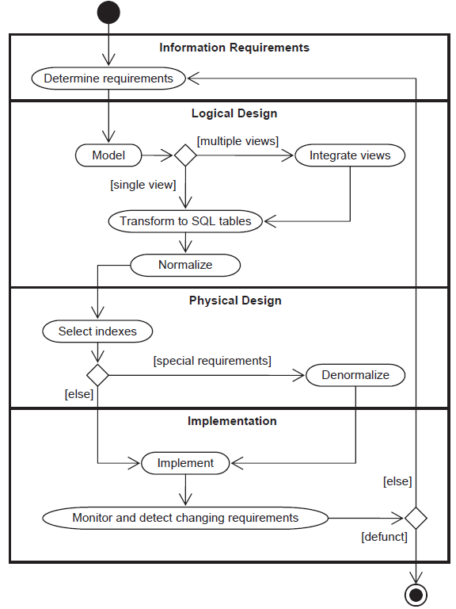
Database Life Cycle

Slide 6
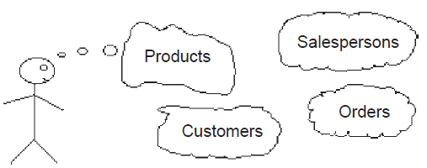
Requirements Analysis
Purpose: identify the real-world situation in enough detail to be able to define database components. Collect two types of data
  natural data: input to the database
  processing data: output from the database
Data and process dictionary entries
  entity description
  attribute description
  relationship description
  Process (application) description
Interviews
  interviews at different levels: management, employee, end user

Slide 7
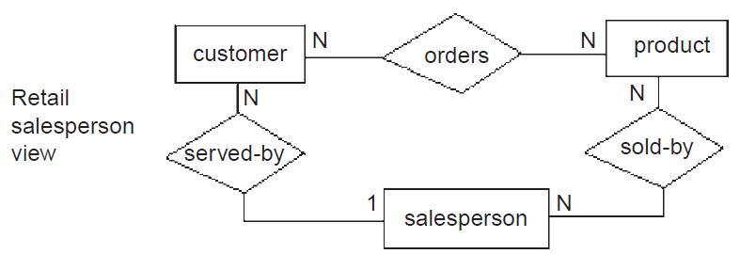
Conceptual Data Modeling
The data requirements are analyzed and modeled by using an ER or UML diagram

Slide 8
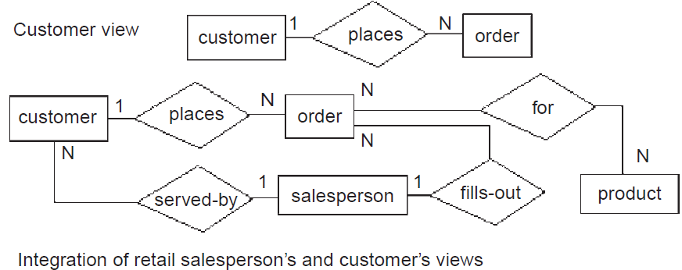
View Integration
Multiple views of the model are consolidated into a single model

Slide 9
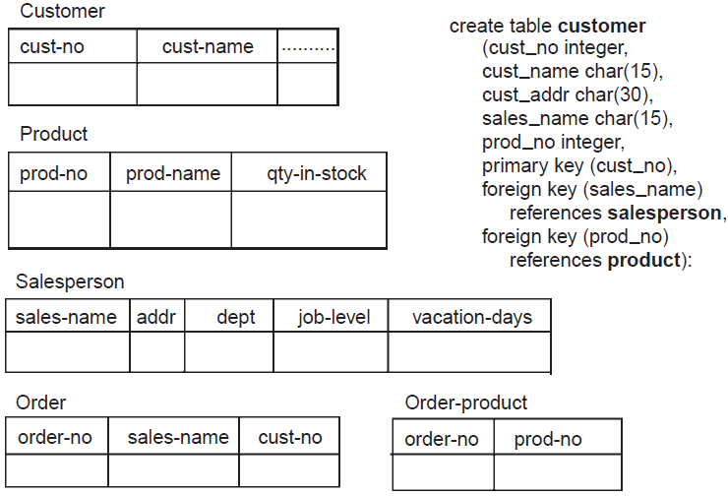
Transformation of the Conceptual Data Model to SQL Tables
Based on data modeling constructs and mapping rules, each relationship and its associated entities are transformed into a set of DBMS-specific candidate relational tables

Slide 10
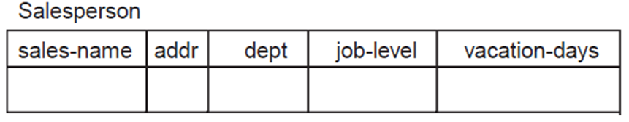
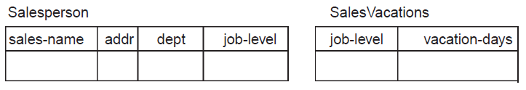
Normalization of SQL Tables
Decomposition of tables and removal of update anomalies

Slide 11
Physical Design
The purpose of physical design is to then optimize performance
  Indexing
  Clustering
  Partitioning
  Materialized views
  Denormalization

Slide 12
Database Implementation, Monitoring, and Modification
Database created with the data definition language (DDL)
The data manipulation language (DML) can be used to query and update the database, as well as to set up indexes and establish constraints
Monitoring indicates whether performance requirements are being met; If not, modifications should be made

Slide 13
Conceptual Modeling and ER Model

Slide 14
Conceptual Data Modeling
Driving component of logical database design
The goal is to capture real-world data requirements in a simple and meaningful way
Schema diagrams were formalized in the 1960s by Charles Bachman
The entity-relationship (ER) approach was first presented in 1976 by Peter Chen
The Unified Modeling Language (UML) was introduced in 1997 by Grady Booch and James Rumbaugh, now a standard for specifying and documenting large-scale software systems
  The data modeling component has many similarities with ER model

Slide 15
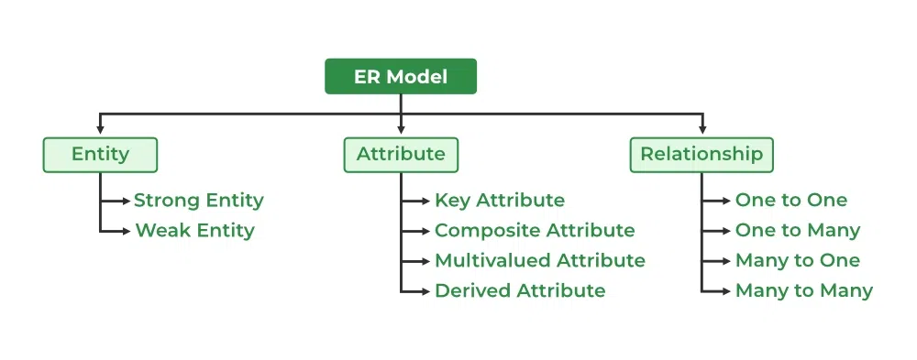
Basic ER Modeling Concepts
Entity - a class of real world objects having common characteristics and properties about which we wish to record information
Relationship - an association among two or more entities
  degree - number of entities associated in the relationship (binary, ternary, other n-ary)
  connectivity - one-to-one, one-to-many, many to one, many-to-many
  existence dependency (constraint) -optional/mandatory
Introduction

Slide 16
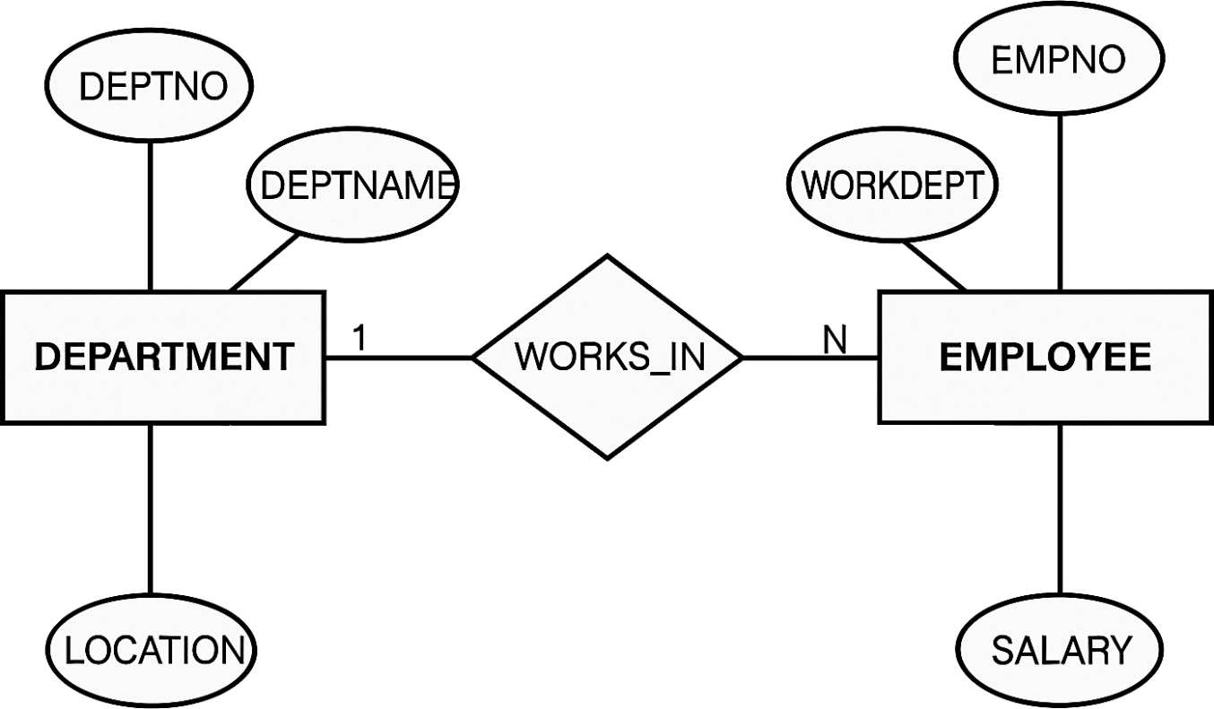
Basic ER Modeling Concepts (cont’d)
Attribute: a characteristic of an entity or relationship
  Identifier - uniquely determines an instance of an entity
  Identity dependence - when a portion of an identifier is inherited from another entity
  Multi-valued - same attribute having many values for one entity
  Surrogate - system created and controlled unique key (e.g. Oracle’s “create sequence”)

Slide 17
Basic ER Modeling Concepts (cont’d)
by Peter Chen’ Notation
(first - original)
ER Model

Slide 18
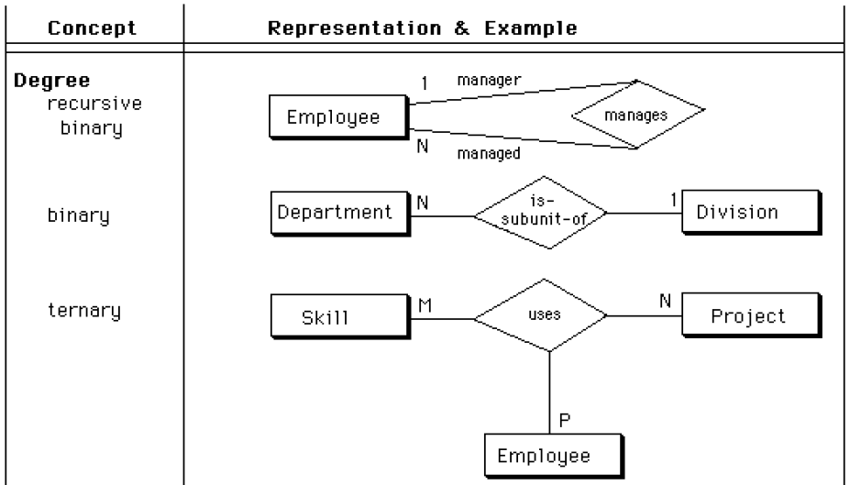
Degree of Relationship
The number of entities that have taken part in the relationship
ER Model
Notes:
Roles in a relationship: an entity set can appear two or more times in a relationship

Slide 19
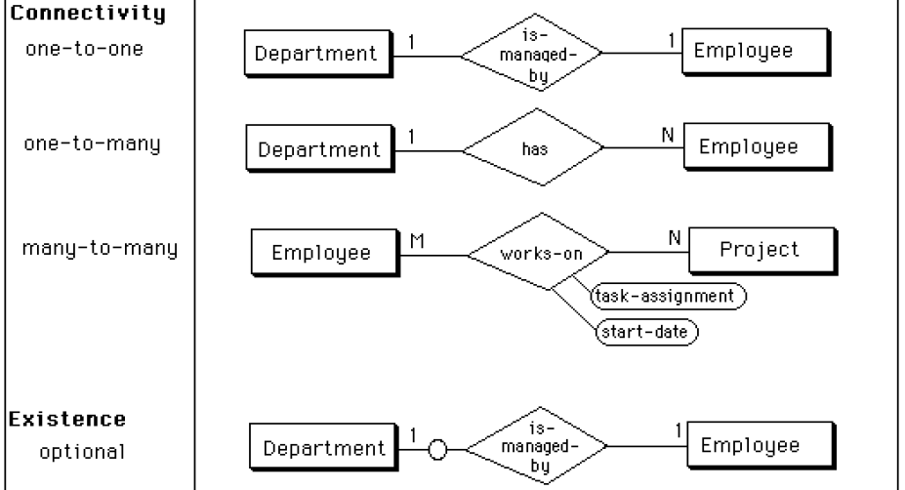
Connectivity and Existence
ER Model

Slide 20
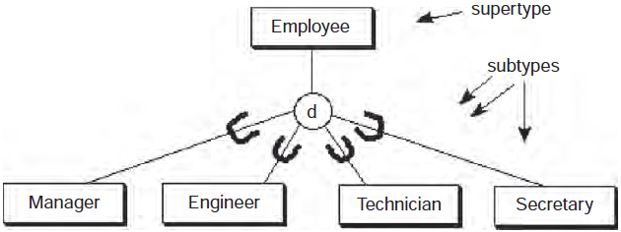
Generalization: Supertypes and Subtypes
Similarities are generalized to a super-class entity, differences are specialized to a subclass entity
Subclass inherits the primary key of the super-class, super-class has common nonkey attributes, each subclass has specialized non-key attributes
Overlapping
subtypes
Disjoint subtypes
ER Model

Slide 21
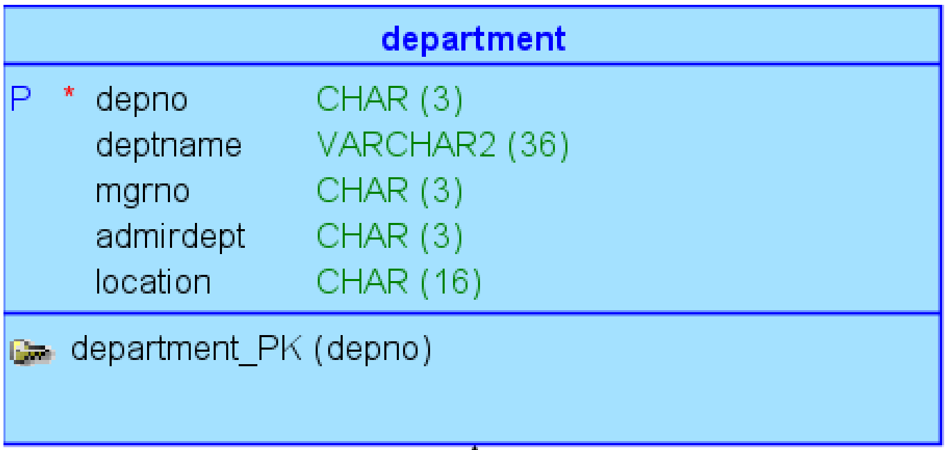
Crow’s Foot Notation
Known as IE notation (most popular)
Entity: represented by a rectangle, with its name on the top. The name is singular (entity) rather than plural (entities)
ER Model

Slide 22
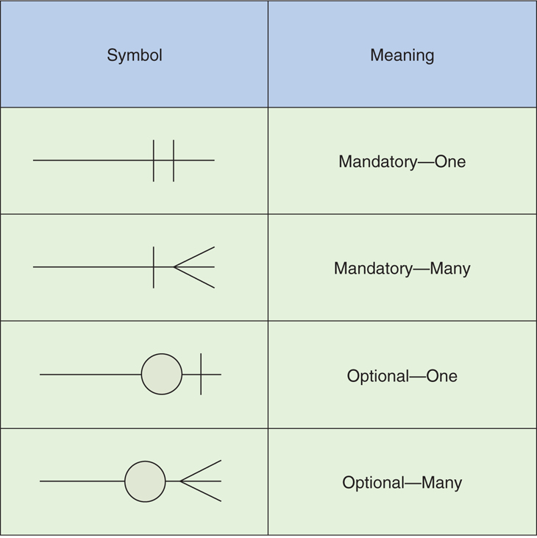
Cardinality
1-to-1 relationship
1-to-M relationship
M-to-N relationship
ER Model

Slide 23
Logical Model Implementation

Slide 24
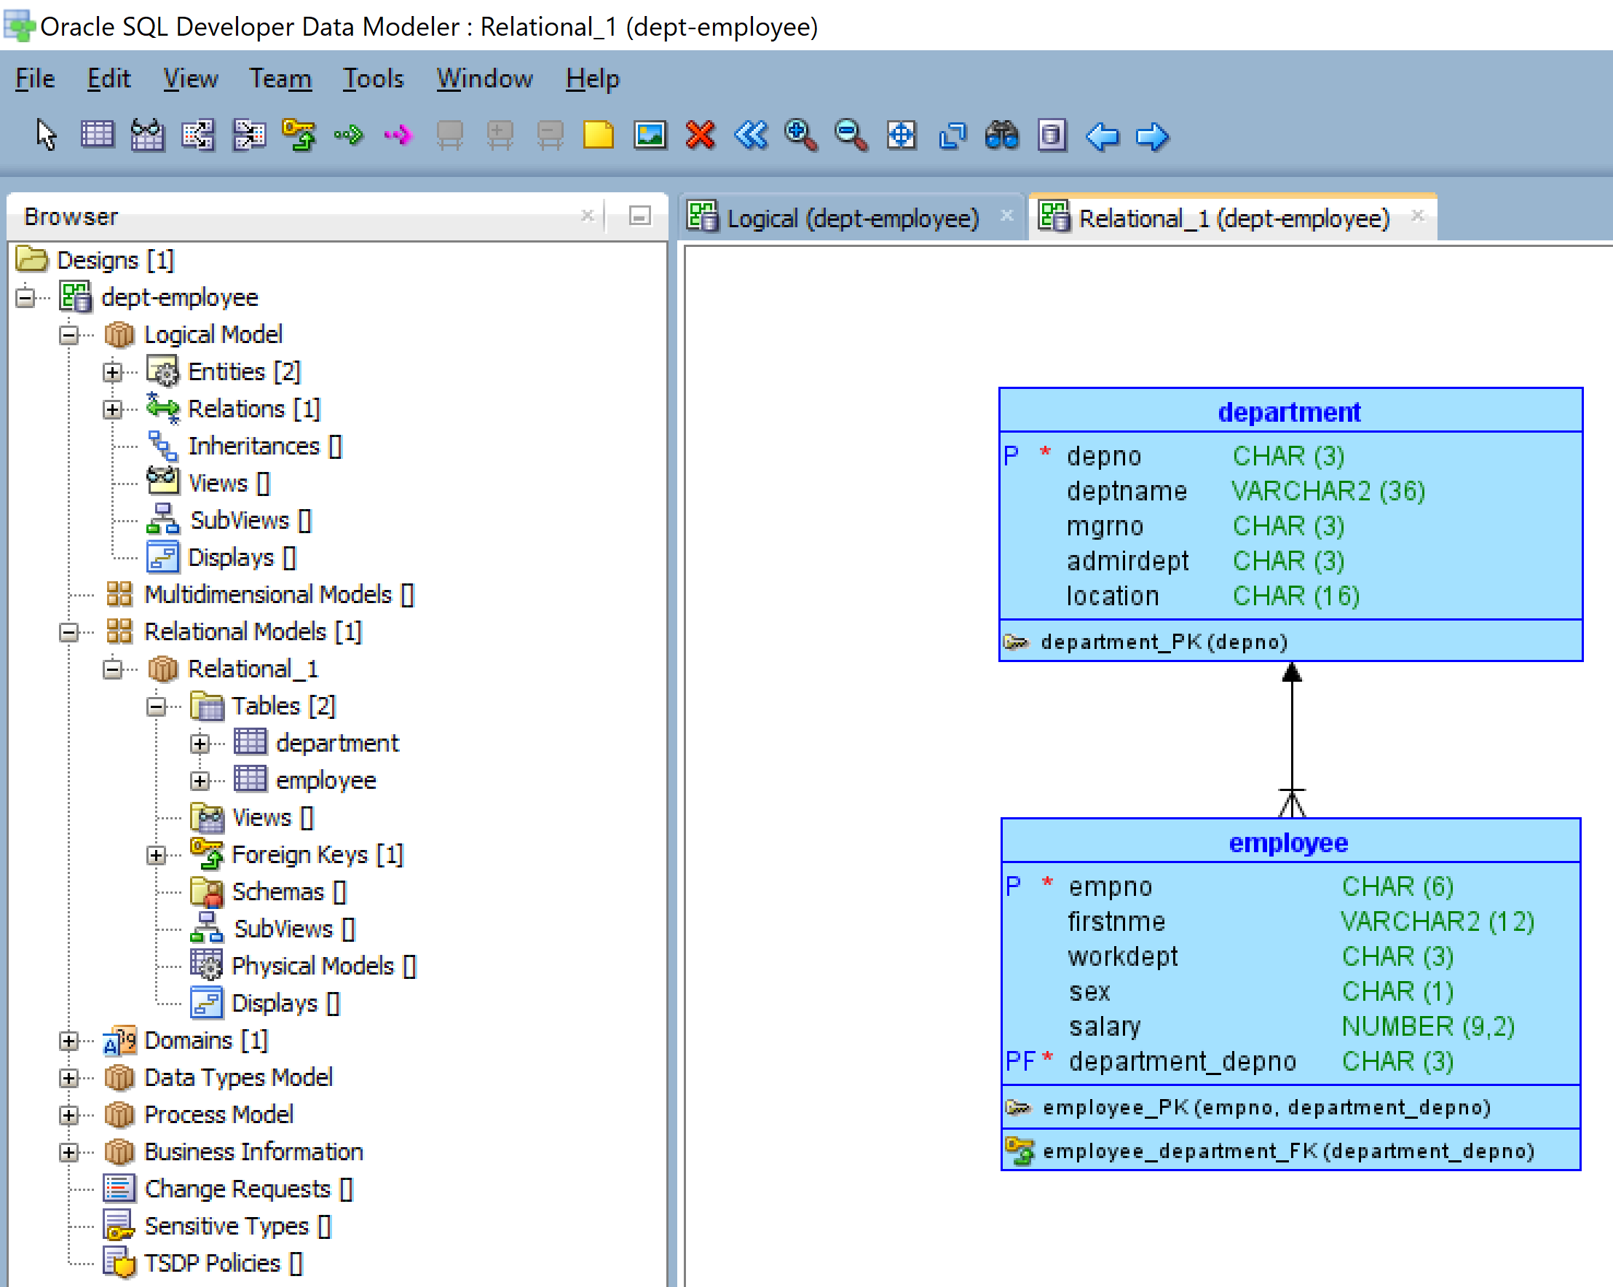
Data Modeling Tools (CASE Tools)
Oracle SQL Developer Data Modeler (free)
ERWin Data Modeler (by Quest)
ER/Studio (by IDERA)
IBM InfoSphere Data Architect
Visual Paradigm
MySQL Workbench (free)
dbdiagram.io
Lucidchart (free with limited features)
ER Model

Slide 25
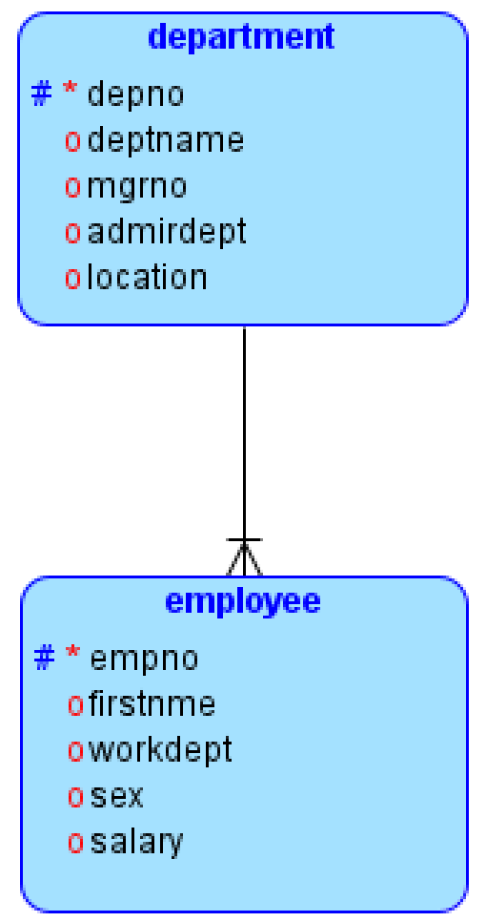
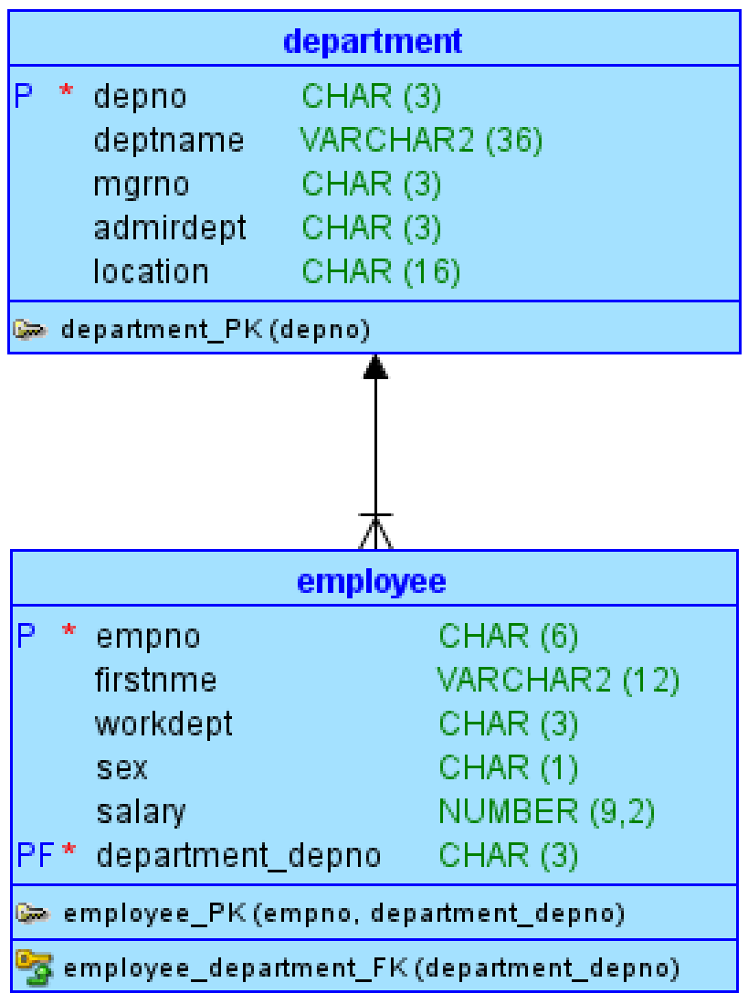
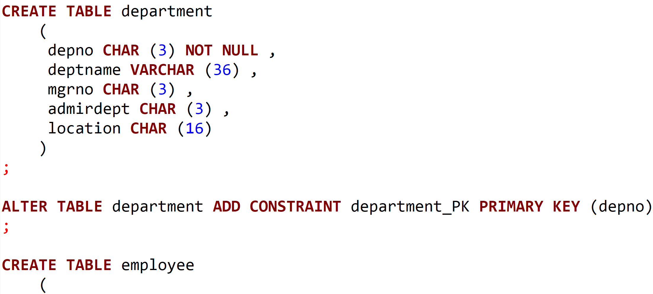
Example Model – from ER to Relational Model (Using Oracle Data Modeler)
Logical model
Relational model
SQL DDL
File > Engineer to Relational Model
File > Export > DDL File...
ER Model

Slide 26
Transforming Logical Model into Physical Model - Entity
Example: entity table
Entity: copy everything (name, attributes, primary key)
CREATE TABLE employee (
empno CHAR(6) NOT NULL,-- primary key
firstnme VARCHAR(12) NOT NULL,
lastname VARCHAR(15) NOT NULL,
workdept CHAR(3),
...);
Example: weak entity → copy parent PK as FK
CREATE TABLE dependent (
  empno CHAR(6) NOT NULL,-- FK from employee
  dependent_name VARCHAR(15) NOT NULL,
  birthdate DATE,
  relationship VARCHAR(10),
  PRIMARY KEY (empno, dependent_name),
  FOREIGN KEY (empno) REFERENCES employee(empno)
  );
  Weak entity: copy parent PK as FK)
ER Model

Slide 27
Transforming Logical Model into Physical Model (SQL Tables)
Relationship: one-to-many
(add FK to many side or child side)
CREATE TABLE employee (
empno CHAR(6) NOT NULL, --primary key
firstnme VARCHAR(12) NOT NULL,
lastname VARCHAR(15) NOT NULL,
workdept CHAR(3),
...
FOREIGN KEY (workdept) REFERENCES
department(deptno) );
Relationship: one-to-one
(add FK to either side)
CREATE TABLE parking_spot (
spot_id CHAR(4) PRIMARY KEY,
empno CHAR(6) UNIQUE,
FOREIGN KEY (empno)
REFERENCES employee(empno) );
ER Model

Slide 28
Transforming ER into Physical Model: Relationship M:N
Many-to-Many Relationship → Create Junction Table
Create a new table for relationship: both PKs will be FKs
e.g.,: --employees can work on many projects, and each project can have many employees
CREATE TABLE works_on (
empno CHAR(6) NOT NULL,
projno CHAR(6) NOT NULL,
hours DECIMAL(5,2),
PRIMARY KEY (empno, projno),
FOREIGN KEY (empno) REFERENCES employee(empno),
FOREIGN KEY (projno) REFERENCES project(projno)
);
ER Model

Slide 29
Transforming ER into Physical Model: Self-Referencing
Recursive Relationship → Self-referencing FK
Rule: Table has a foreign key pointing to itself
e.g.,: --an employee may be supervised by another employee:
CREATE TABLE employee (
empno CHAR(6) PRIMARY KEY,
...
supervisor CHAR(6),
FOREIGN KEY (supervisor) REFERENCES employee(empno)
);
ER Model

Slide 30
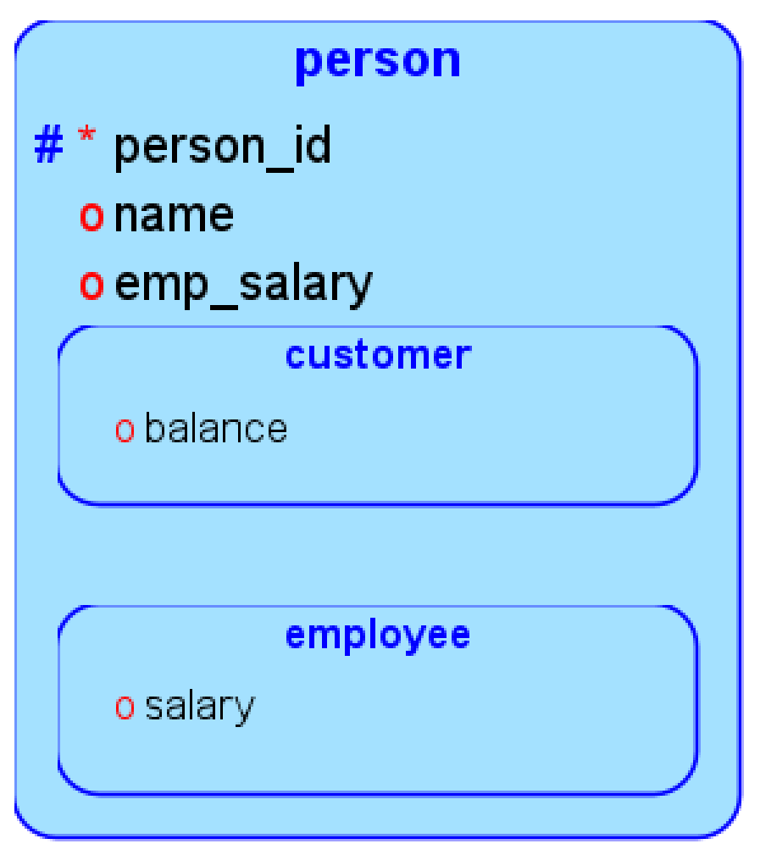
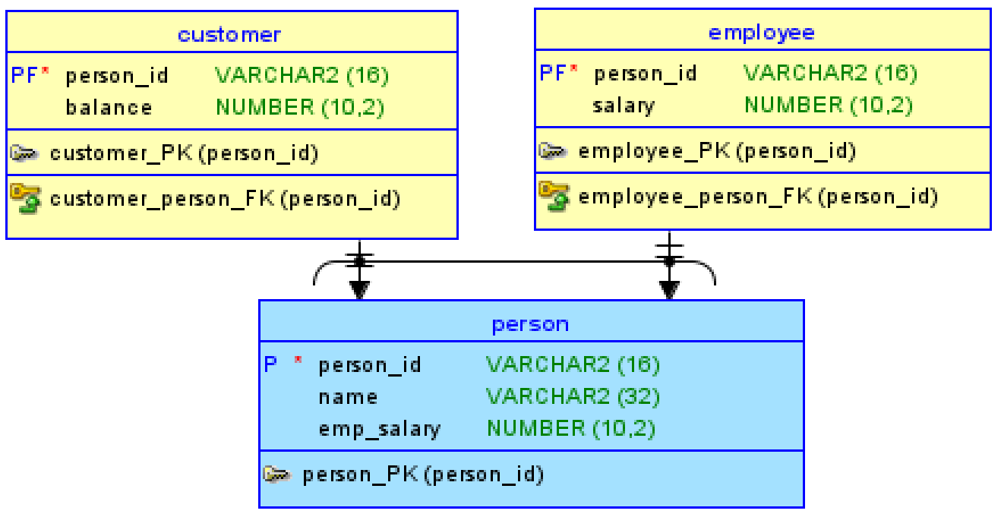
Transforming ER into Physical Model: Subtyping: Roll-Down
Super-subtype: three options: roll-up, roll-down, separate
Roll-Down (Separate Tables for Each Subtype)
CREATE TABLE person (
person_id VARCHAR(16) NOT NULL PRIMARY KEY,
"name" VARCHAR(32),
emp_salary DECIMAL(10,2) );
CREATE TABLE customer (
person_id VARCHAR(16) NOT NULL PRIMARY KEY,
balance DECIMAL(10,2),
FOREIGN KEY (person_id)
REFERENCES person(person_id) );
CREATE TABLE employee (
person_id VARCHAR(16) NOT NULL PRIMARY KEY,
salary DECIMAL(10,2),
FOREIGN KEY (person_id)
REFERENCES person(person_id) );
logical model
relational
model
SQL DDL
ER Model

Slide 31
Transforming ER into Physical Model: Subtyping: Roll-Up
Roll-Up (Single Table with Type Column)
logical model
CREATE TABLE person (
person_id INT PRIMARY KEY,
name VARCHAR(50),
type CHAR(1), -- 'E' for employee, 'C' for customer
emp_salary DECIMAL(10,2),
cust_balance DECIMAL(10,2)
);
SQL DDL
ER Model

Slide 32
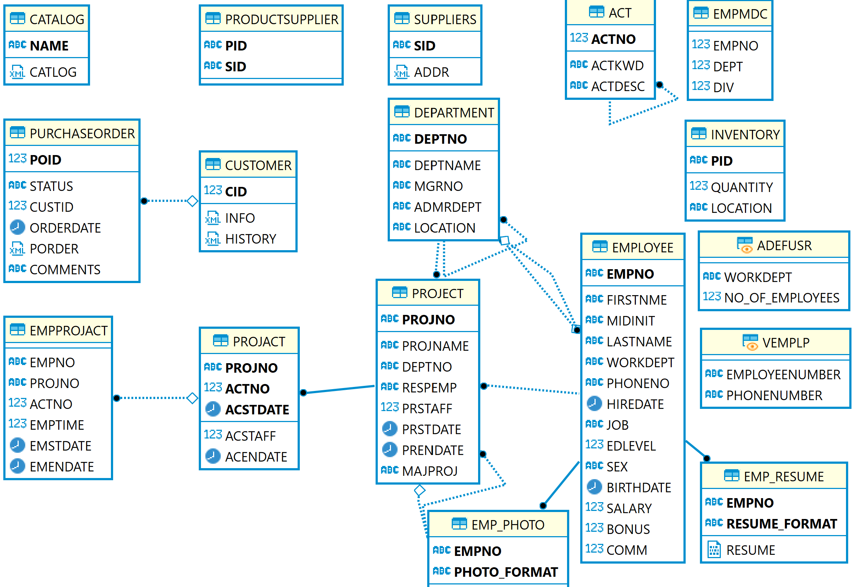
Reverse Engineering: Generate ER Diagram for a Database Schema
(DBeaver)
ER Model

Slide 33
Logical Database Design Use Case:
Managing and Querying Whole Slide Images

Slide 34
Background
High-resolution whole slide images provide rich information about morphological and functional characteristics of biological systems
  Large dimension: 100k x 100k
  Rich information of micro-anatomic objects
Use of whole slide images
  Image analysis: quantitative and reproducible measurements of micro-anatomical objects
  Human assessment: markups and annotations
  Algorithm evaluation: algorithm validation and algorithm comparison
Example: https://cancer.digitalslidearchive.org/#!/CDSA/brca/TCGA-A1-A0SE

Slide 35
Requirements
Archive and share digital pathology images
Search images at multi-granularities: patient, study, image, tile, and region
Search images based on image characteristics or annotations
Convenient query interfaces

Slide 36
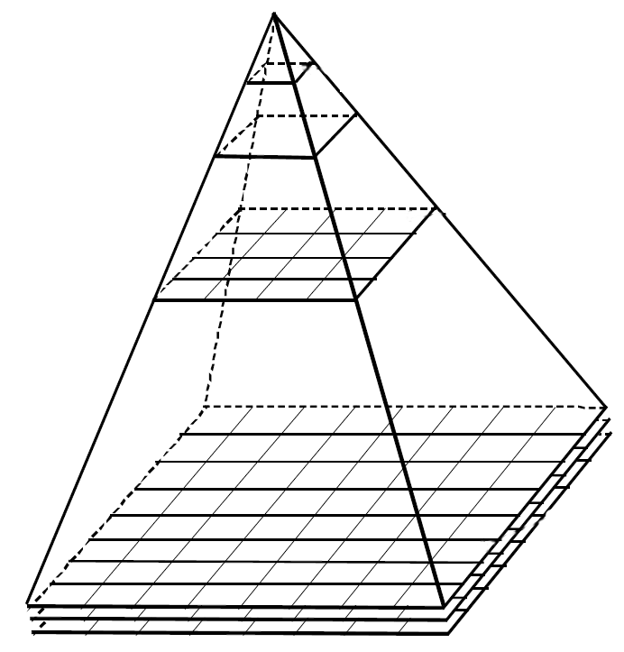
Support of Multiple Granularities in WSI
Low resolution
image tiles
Region
Tiled image
Whole slide baseline image

Slide 37
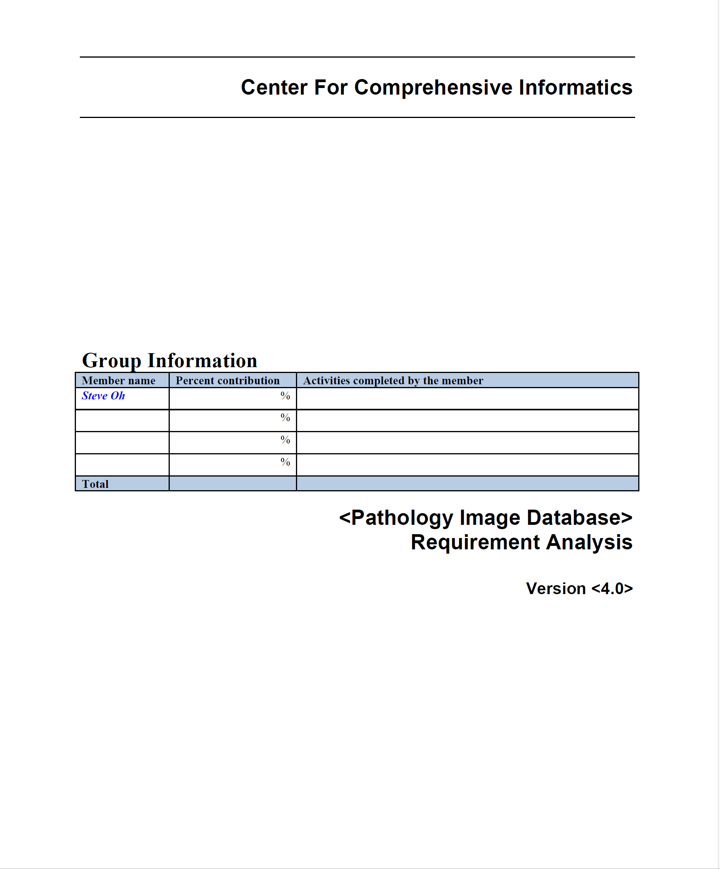
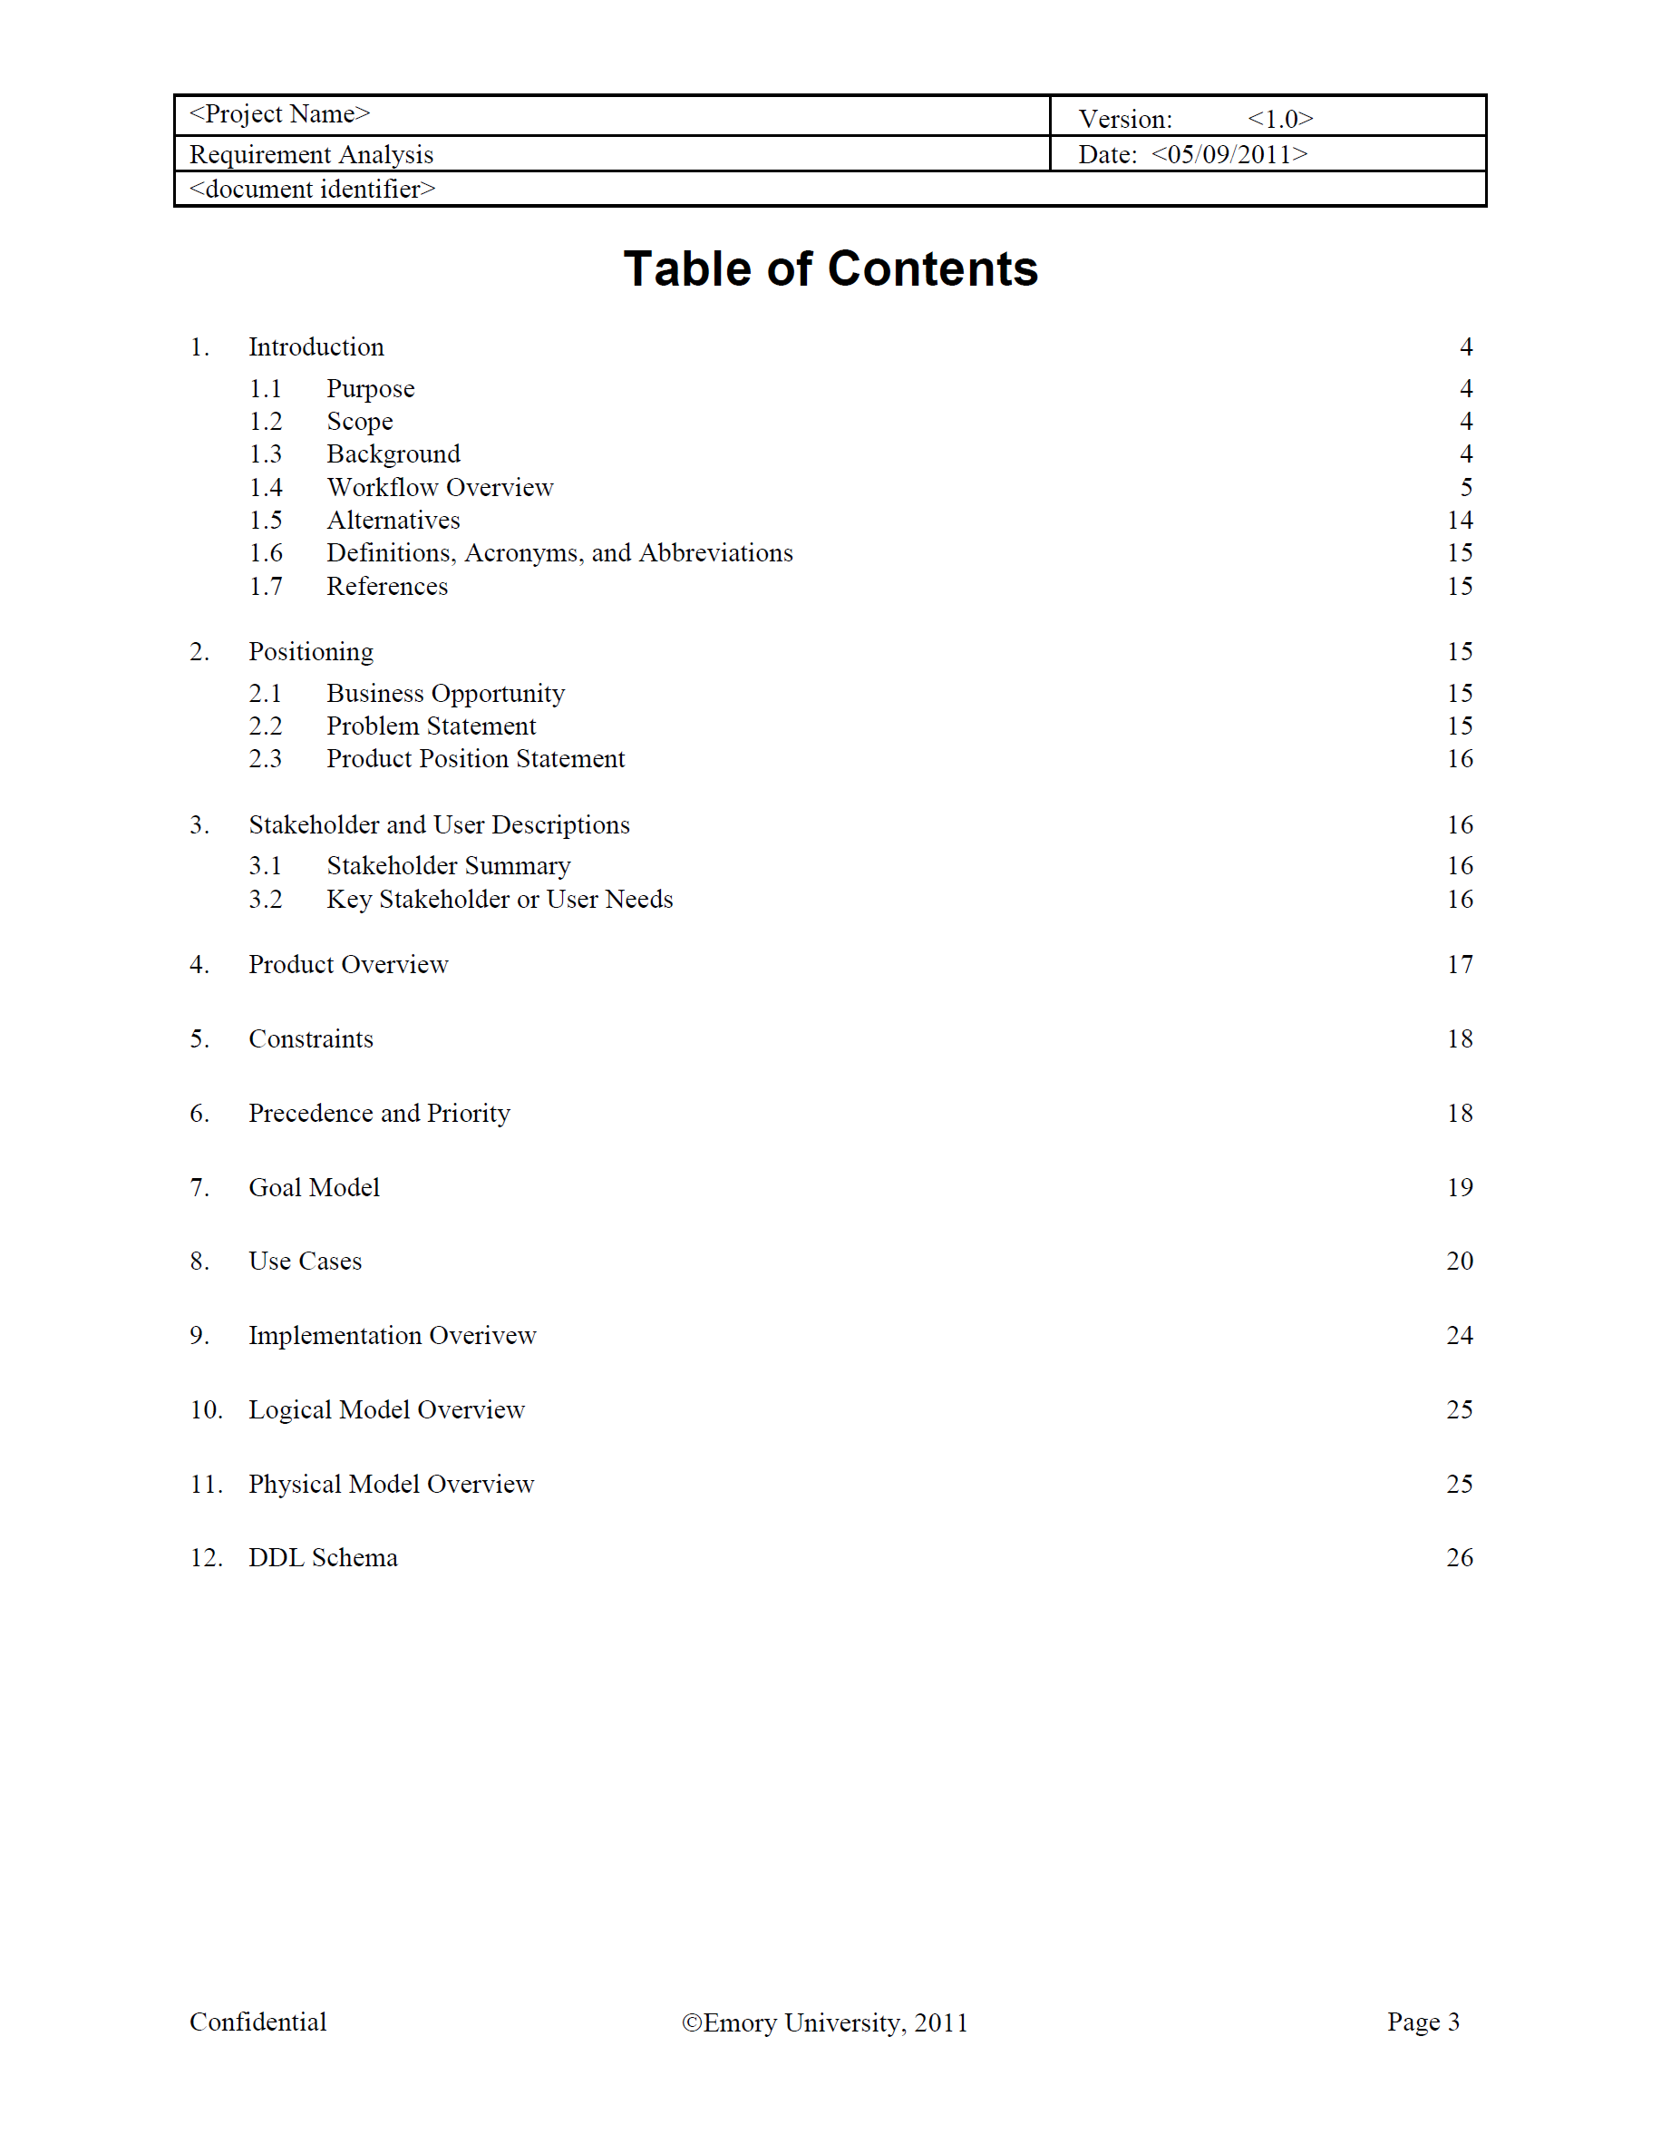
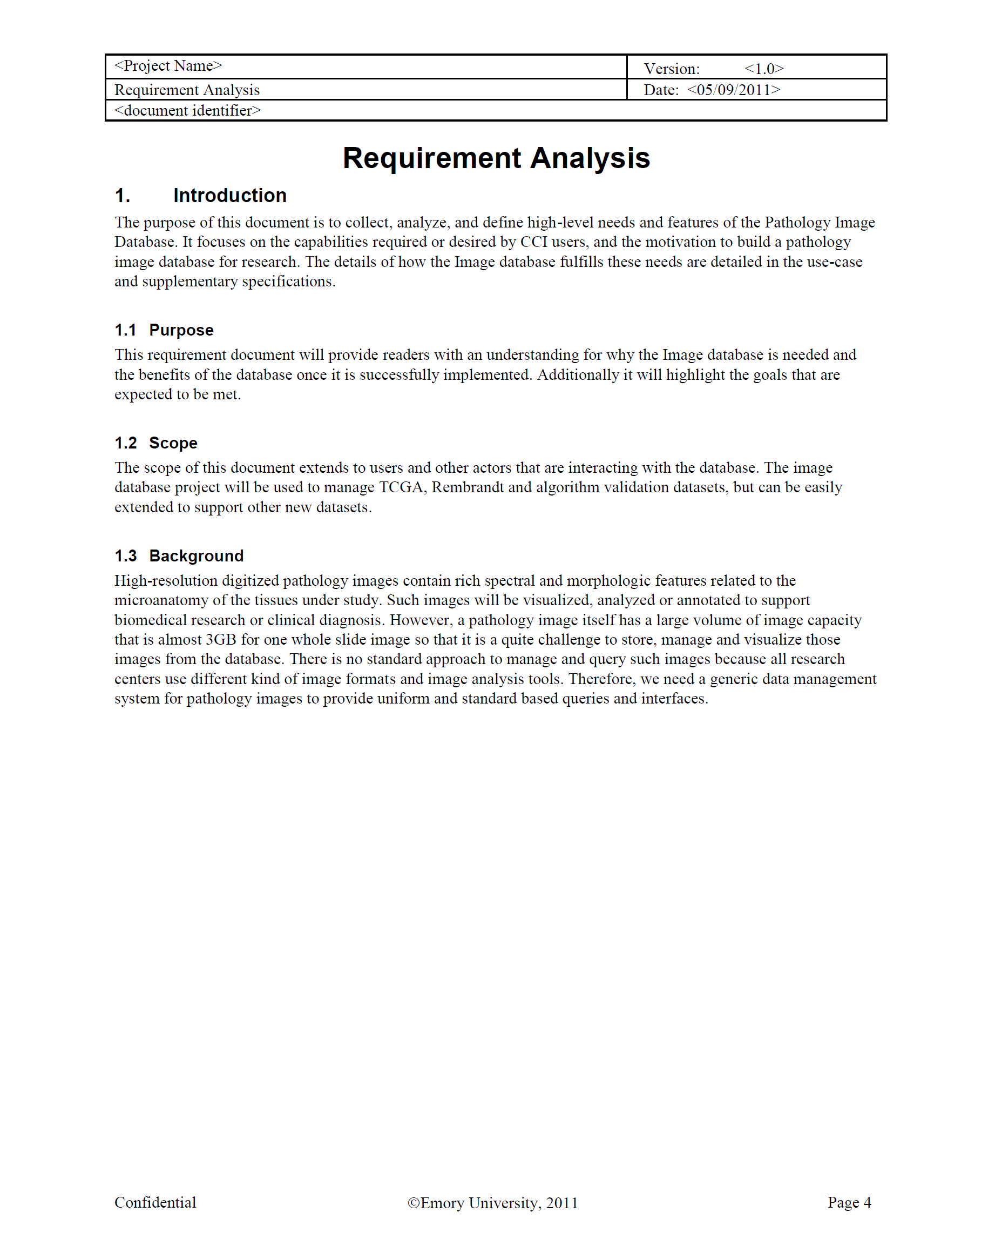
Requirement Analysis

Slide 38
Data Model: Goals
Represent metadata and provenance information
  Study/experiment, acquisition, image metadata
Harmonization with related standards or open models: compatible with DICOM “pyramid” model
Manage original whole slide images
Model pyramid tiled images
Integrate images with analytical results: PAIS

Slide 39
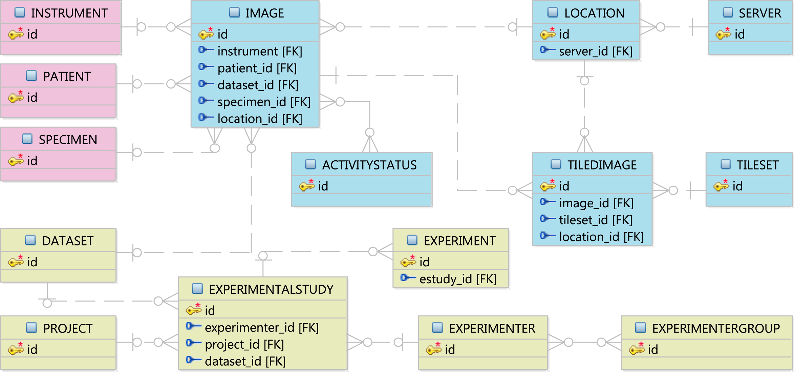
Logical Model

Slide 40
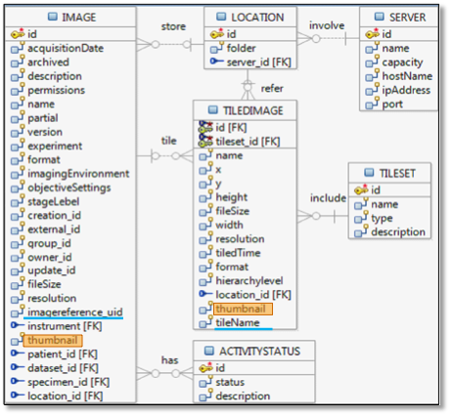
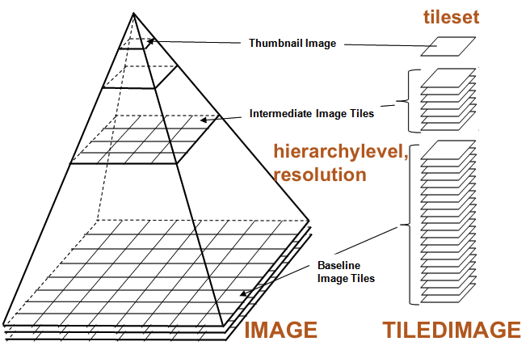
Logical Model: Image Related Entities

Slide 41
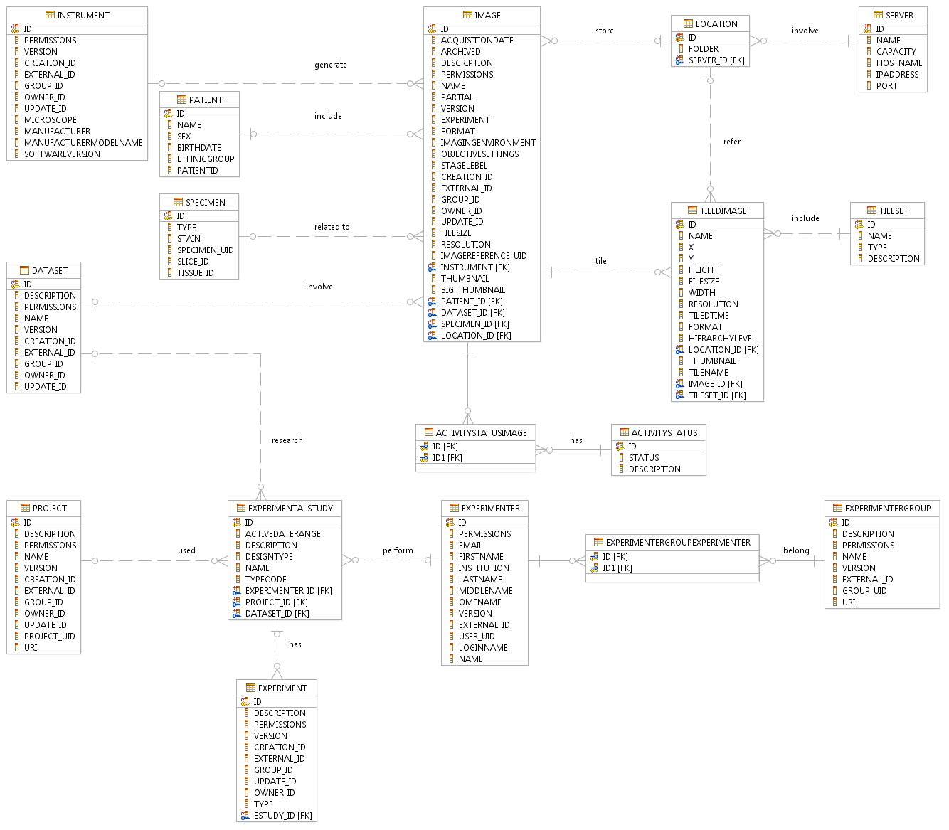
Physical Model
Physical model derived from logical model, by considering database schema normalization
Image file representation
  Large images: file references
  Thumbnails: BLOB data type in
  DBMS
17 relations (tables)
SQL scripts

Slide 42
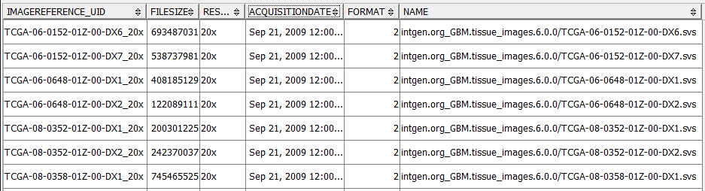
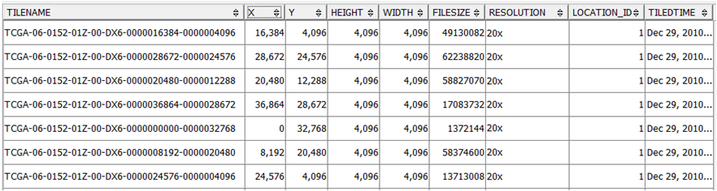
Example Tables
IMAGE
TILEDIMAGE

Slide 43
Architecture of Pathology Image Database
Human annotations
Image Analysis
Tiled
Images
Whole Slide Images
Analytical results
Tiling
PAIS Document Generator
Metadata Configuration
PAIS Documents
PAIS Data Loading Tool
Image
Loading Tool
Database
Database
SQL
Image Viewer
Structured Data Management
Image Metadata Management
JDBC
Image Analysis
Spatial Data Management
Image Files
Query Interfaces
User Defined Functions
Application Server
Data Sharing
PAIS Database
Image Database (PIDB)

Slide 44
Image Loading Tool
Collect image files and tiled image files from folders
Generate provenance metadata from configuration or naming conventions
Extract image metadata by parsing images
  OpenSlide for original whole slide images
  Java Advanced Imaging for tiled images
Process images to generate thumbnails to be loaded

Slide 45
Support of Powerful Queries
Support of comprehensive queries on images, analytical results and metadata
Query types:
  Study/patient level
  Image level
  Tile level
  Region level
  Integrated queries of analytical results and images
Return: structured data or binary objects

Slide 46
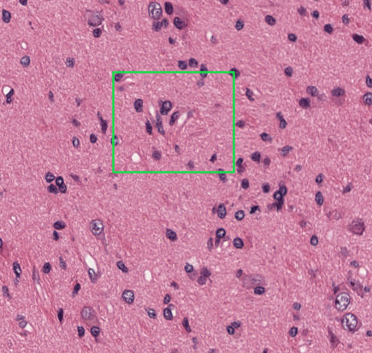
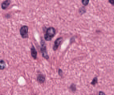
User Defined Functions
Integrate image manipulation into DBMS as user defined functions (UDF) for expressive queries through SQL
Implemented in C++ or Java
Example UDF: given a window, extract the region as an image from a whole slide image
getRegionImage(imageuid,format,x0,y0,width,height)

Slide 47
Complexity of Queries: Overlay Query Example
SELECT PI.GETREGIONIMAGE(‘TCGA-27-1836-01Z-DX2_20x’, ‘JPG’,
4096, 16384, 800, 800)
FROM PAIS.WHOLESLIDEIMAGEREFERENCE
WHERE pais_uid = ‘TCGA-27-1836-01Z-DX2_20x_20x_NS-MORPH_1’;
PIDB: extract a region as an image
SELECT pais.plgn2str(polygon) AS boundary
FROM pais.markup_polygon
WHERE pais_uid= ‘TCGA-27-1836-01Z-DX2_20x_20x_NS-MORPH_1’
AND tilename = ‘TCGA-27-1836-01Z-DX2_0000004096-0000016384’
AND DB2GSE.ST_Contains( DB2GSE.ST_Polygon(
CAST(‘polygon( (4096 16384, 4896 16384, 4896 17184, 4096
17184, 4096 16384))’ AS VARCHAR(30000) ), 100), polygon) = 1;
PAIS: retrieve boundaries of nuclei in the region

Slide 48
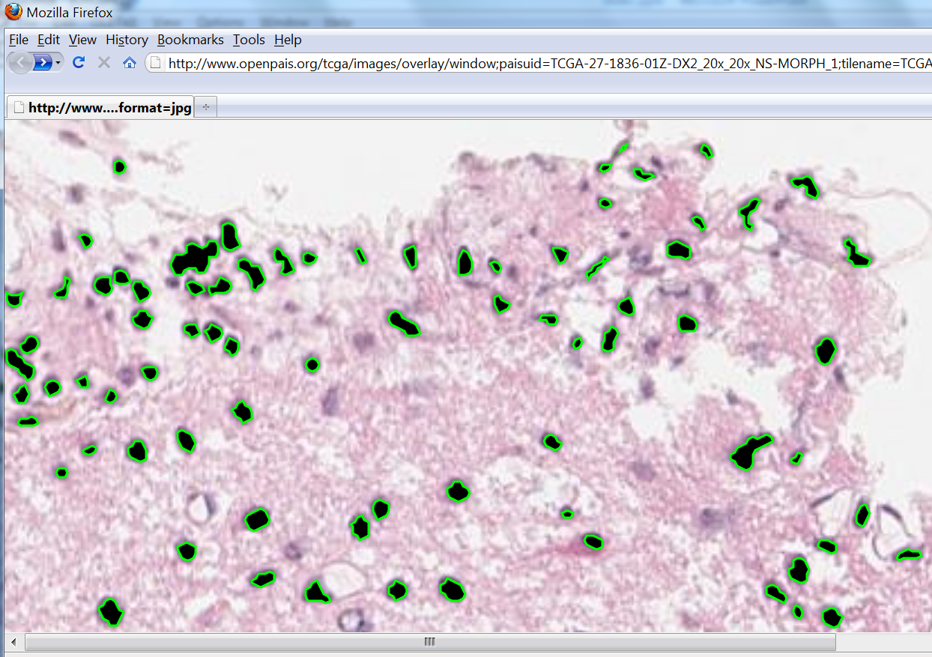
Example: Overlay Markups on a Region Image

Slide 49
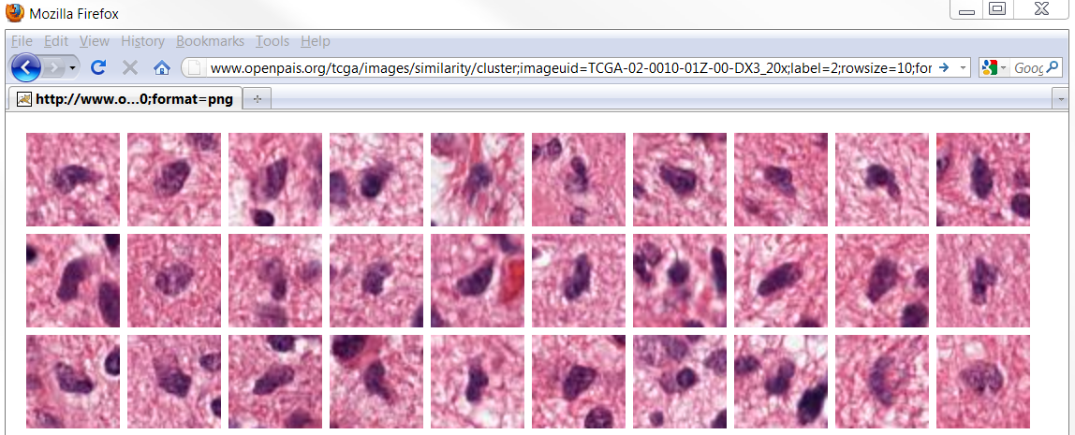
Example: Similarity Query Based on Clustering

Slide 50
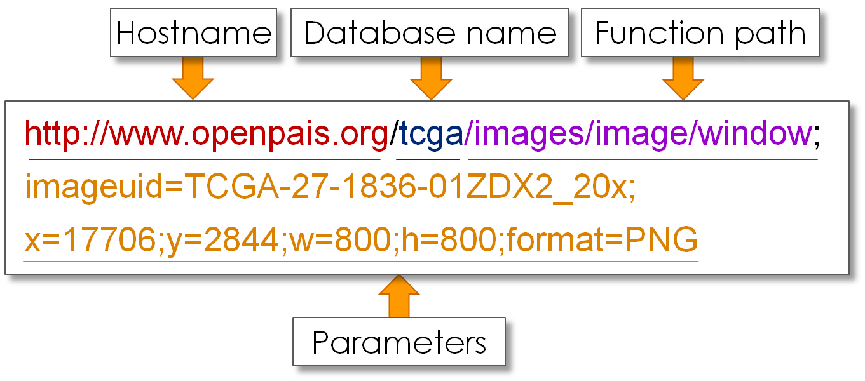
RESTful Web APIs
Complexity of queries: queries may need multiple SQL queries with additional programming
PIDB and PAIS provide a set of RESTful Web APIs
  Expressive: data viewed as resources by URIs
  Efficient: implemented with HTTP

Slide 51
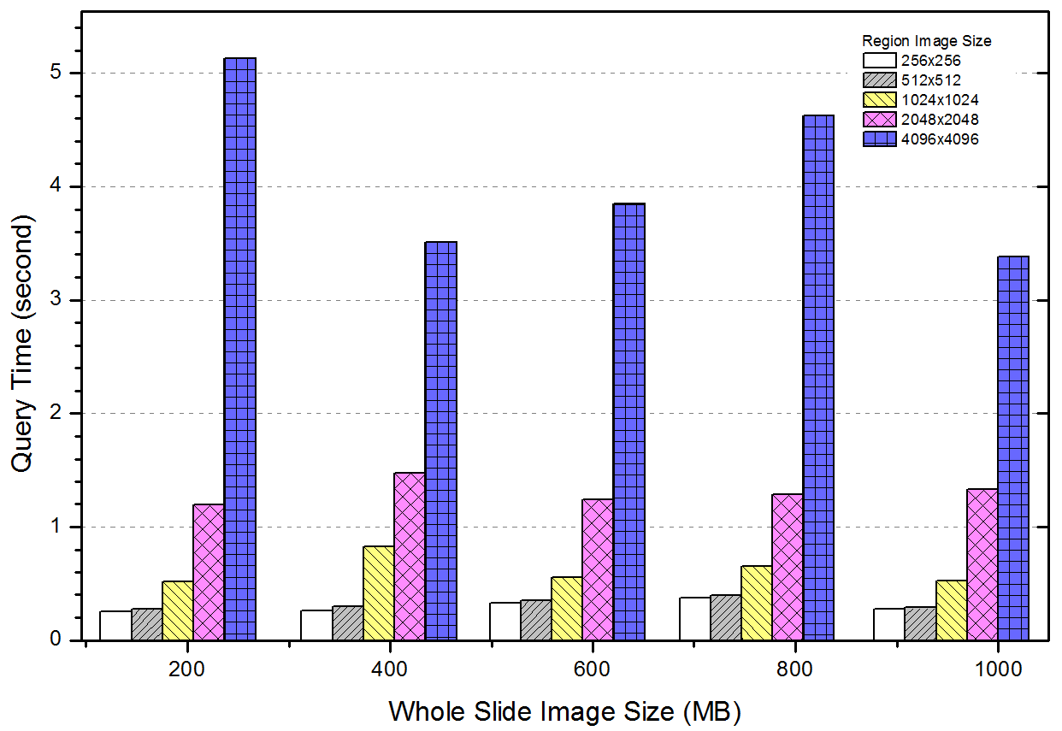
Implementation and Evaluation
DBMS: IBM DB2
Web APIs: Apache Tomcat
Image manipulation: OpenSlide, JAI
Deployment for In Silico brain
tumor study at Emory University

Slide 52
PAIS (Pathology Analytical Imaging Standards): V1.0
PAIS Logical Model
62 UML classes
markups, annotations, imageReferences, provenance
Semantic enabled
PAIS Data Representation
XML
PAIS Data Management
Loading, managing and querying and
sharing data
RDBMS + SDBMS + parallel DBMS

Slide 53
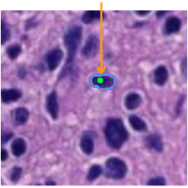
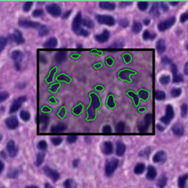
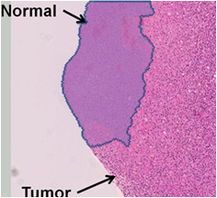
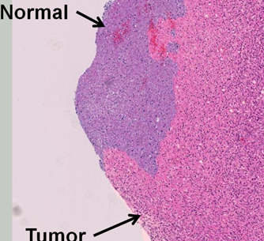
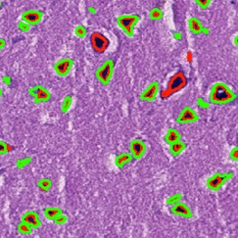
PAIS Queries
Markup queries
  Density, centroids, boundaries, etc.
Feature queries
  Mean features, histogram, covariance, etc
Spatial queries
Point
Window
Containment
Cross-matching

Slide 54
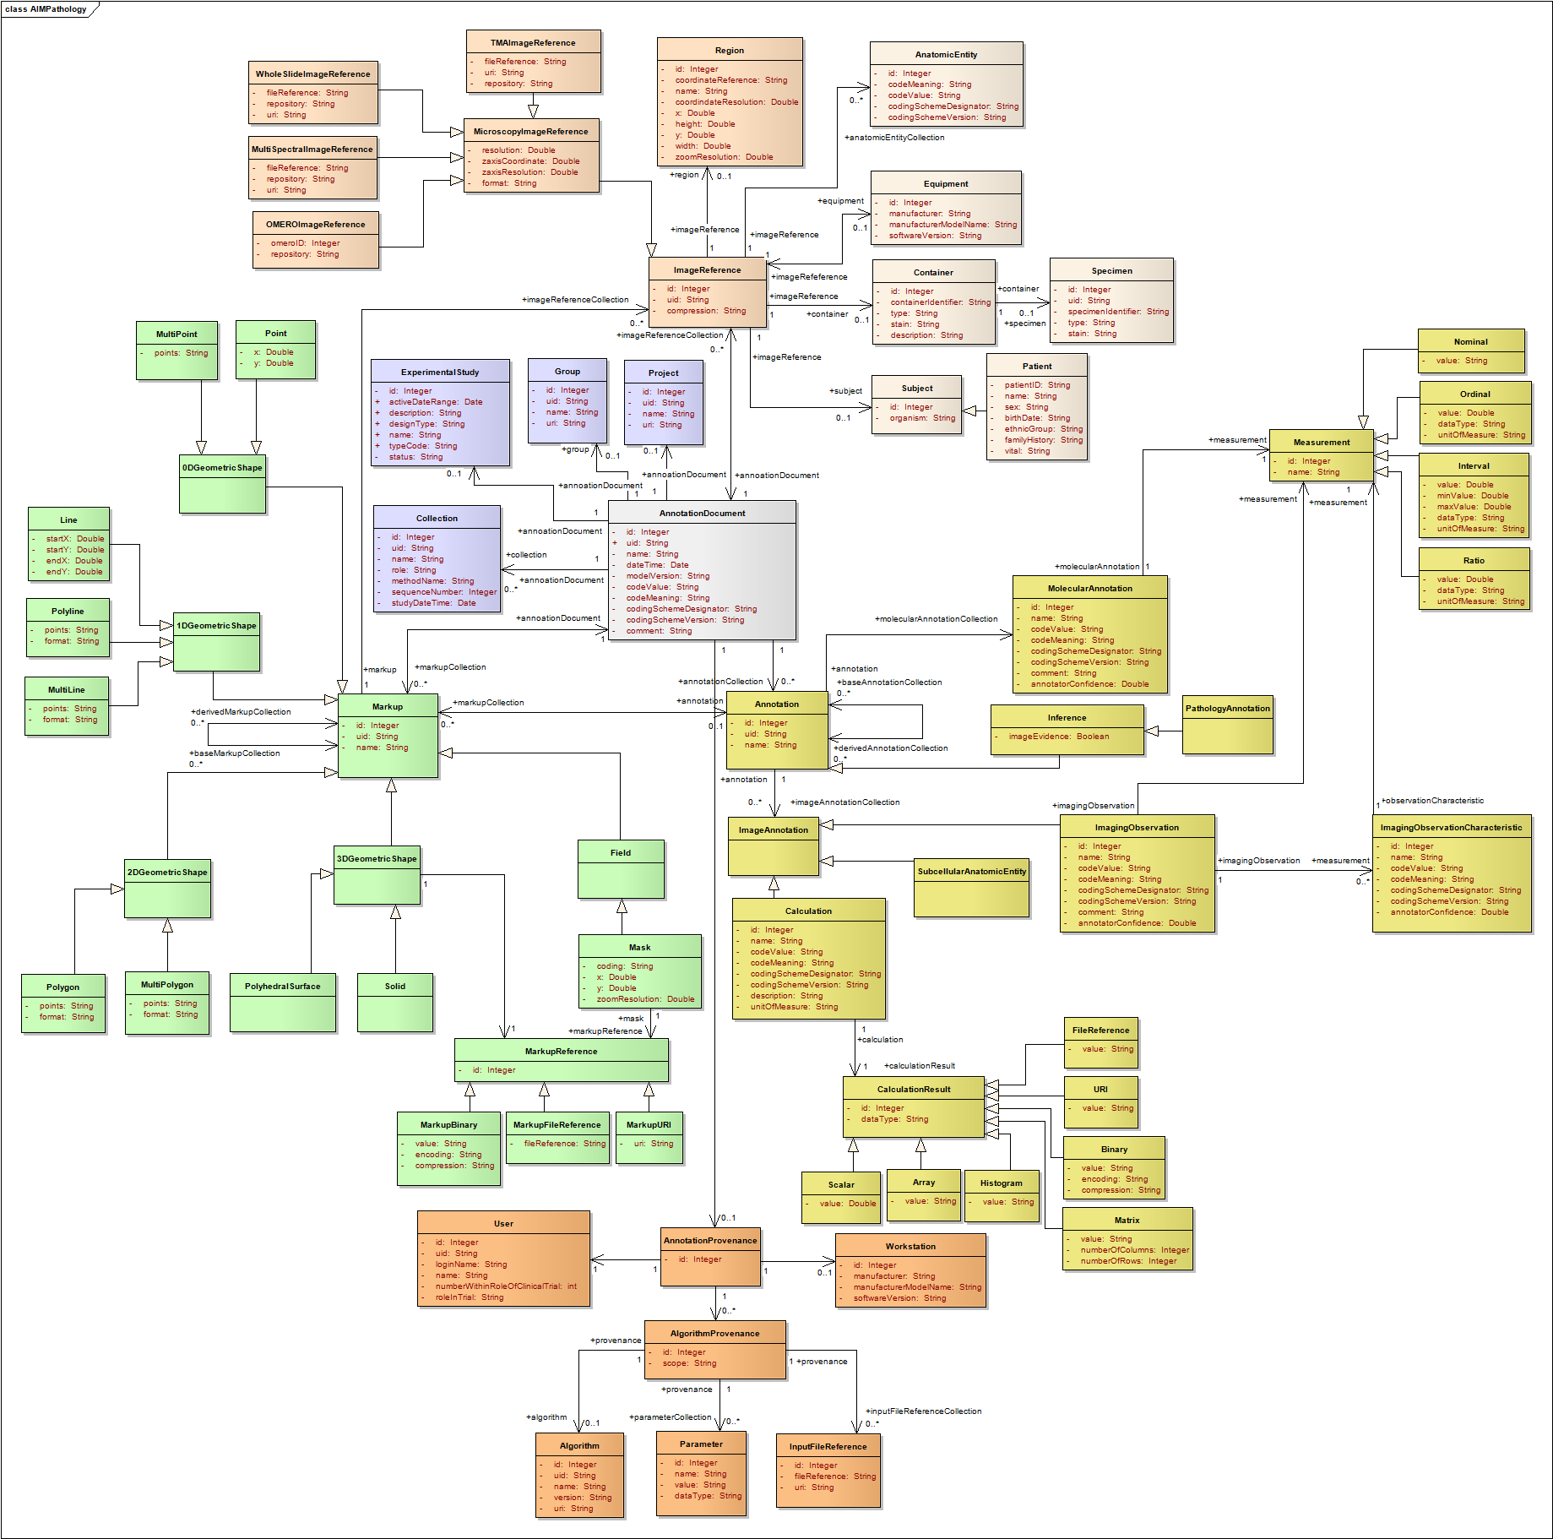
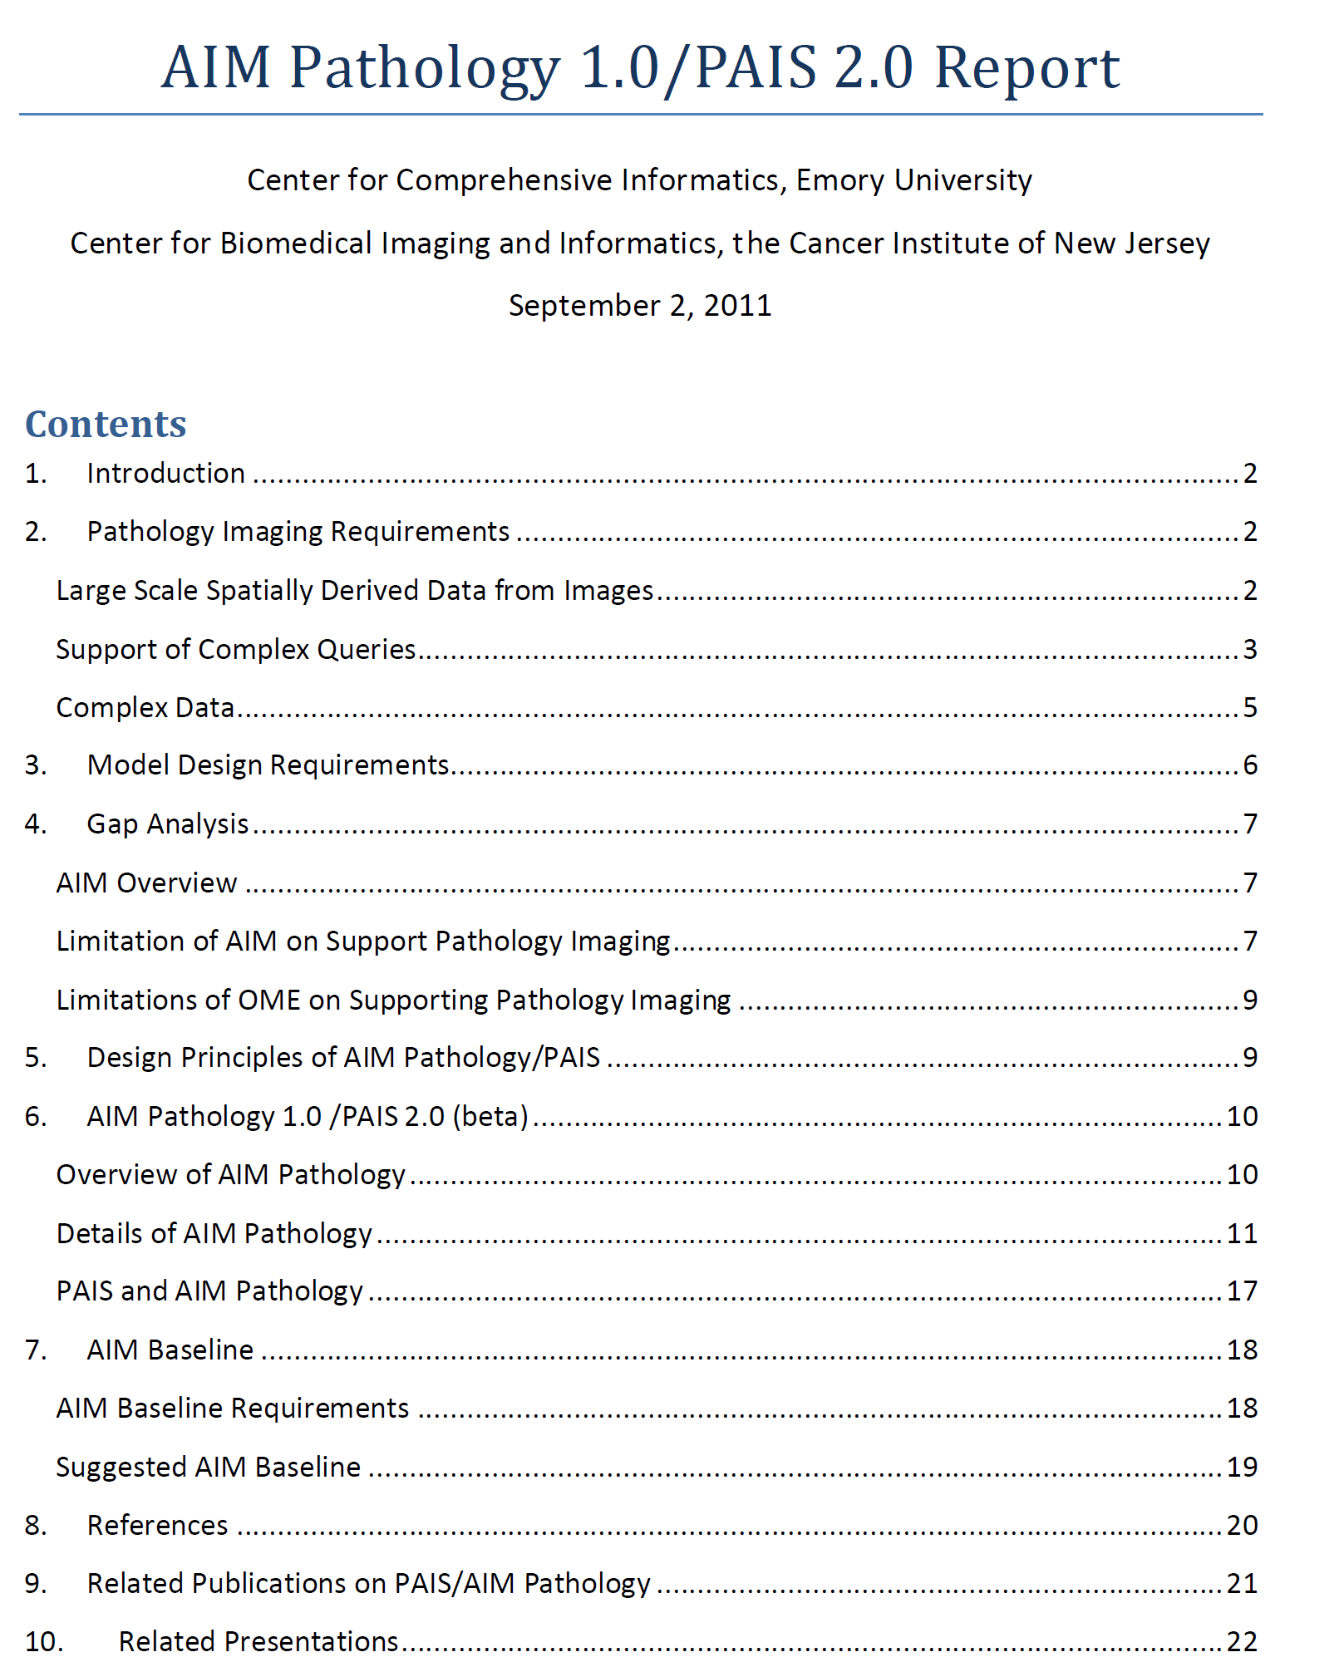
PAIS 2.0

Slide 55

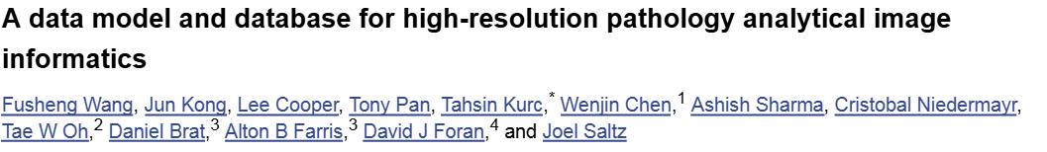
More Information

