Slide 1
ISE 331: Computer Security Fundamentals
Spring 2026
Class Overview
Amir Rahmati, Xinrui Yu

Slide 2
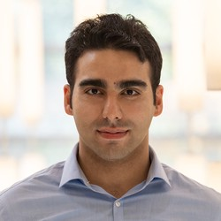

whoami
2007
2011
2013
2017
2018

Slide 3

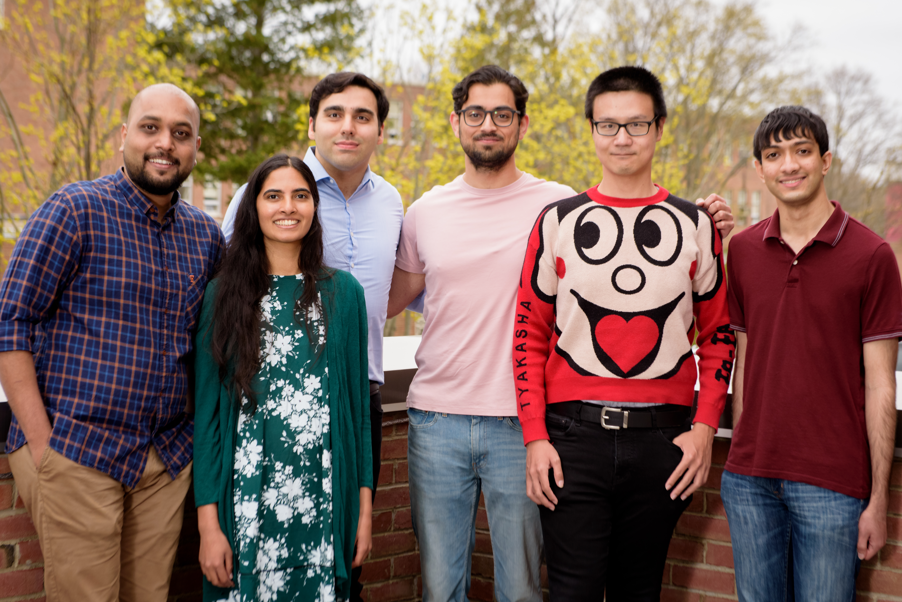

https://amir.rahmati.com
Tackling Security Challenges of Emerging Technologies
Before They Become Main-Stream
Internet of Things
Machine Learning
Augmented Reality
…

Slide 4
What are we going to do?
Learn how to secure Computer Systems
  Current state of the art
  How we got here
  Future directions
Learn skills that you need as an engineer
  Evaluating the security of real systems
  Building defense

Slide 5
Class Topics
The Basics
    Symmetric/Asymmetric Encryption
    MACs & Hashes
    PKI & SSL/TLS
    Authentication & Access Control
Web Security
    Browser, Web Apps, Web Tracking
Network Security
    DNS, BGP, Firewalls, IDS, Internet Censorship
Software Security
    Shellcode, Memory Errors, ROP
    Reverse Engineering, Program Analysis, Symbolic Execution
System Security
    Side Channels, HW Security, ML Security

Slide 6
Grading
Homework Assignments | 30%
Quizes | 20%
Midterm Exam | 20%
Final Exam | 30%

Slide 7
Homework - 30%
7 Lab-Style Homeworks
      Cryptography
      Web Security
      Network Security
      Software Security
      System Security

Slide 8
Quizes - 20%
Every two weeks

Slide 9
Midterm Exam - 20%

Slide 10
Final Exam - 30%

Slide 11
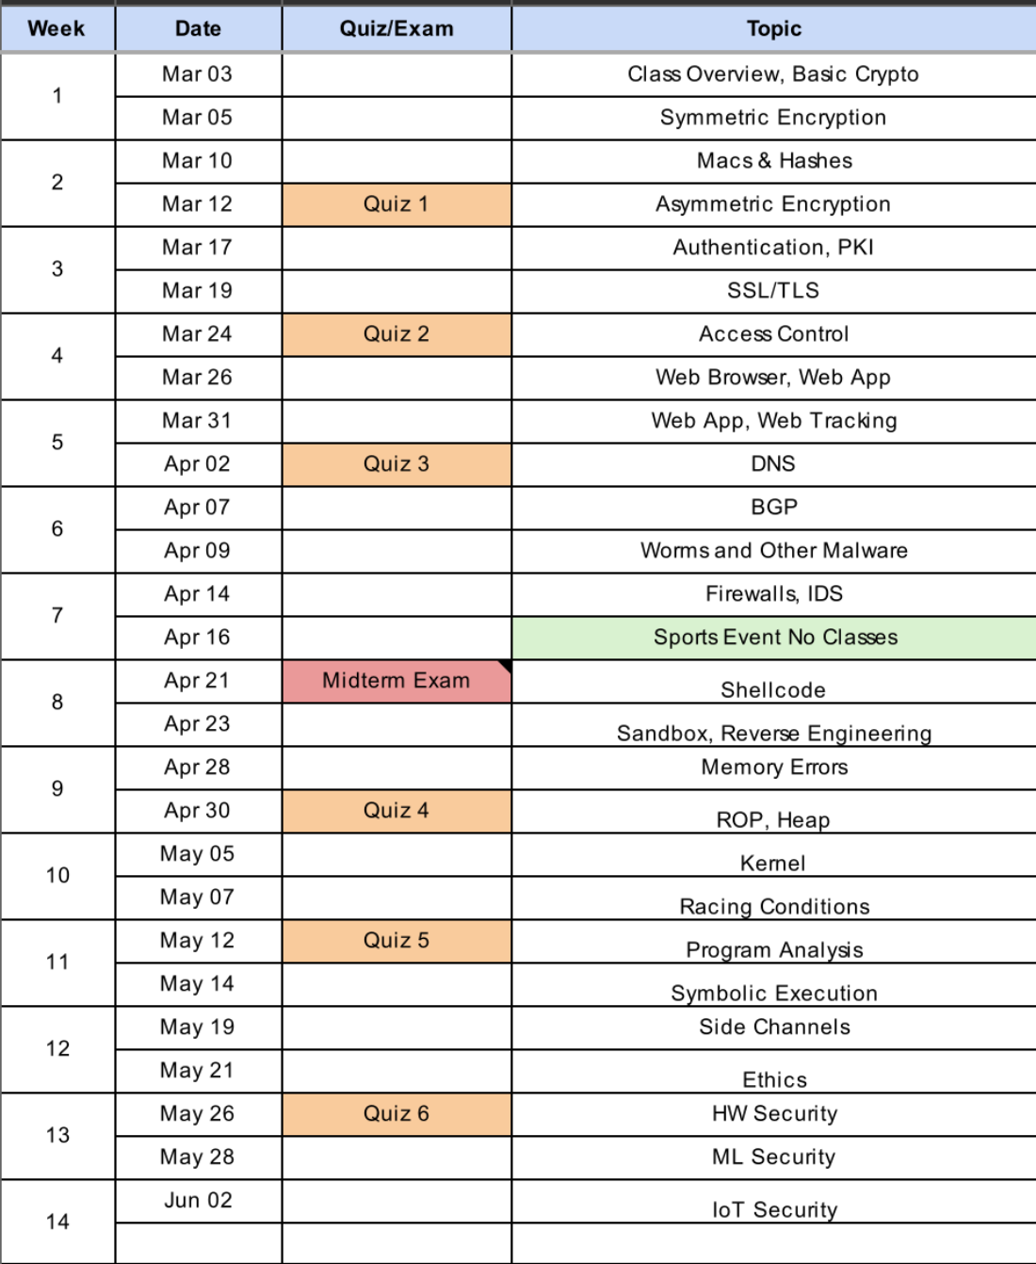
Class Schedule
Notes:
Xinrui Yu

Slide 12
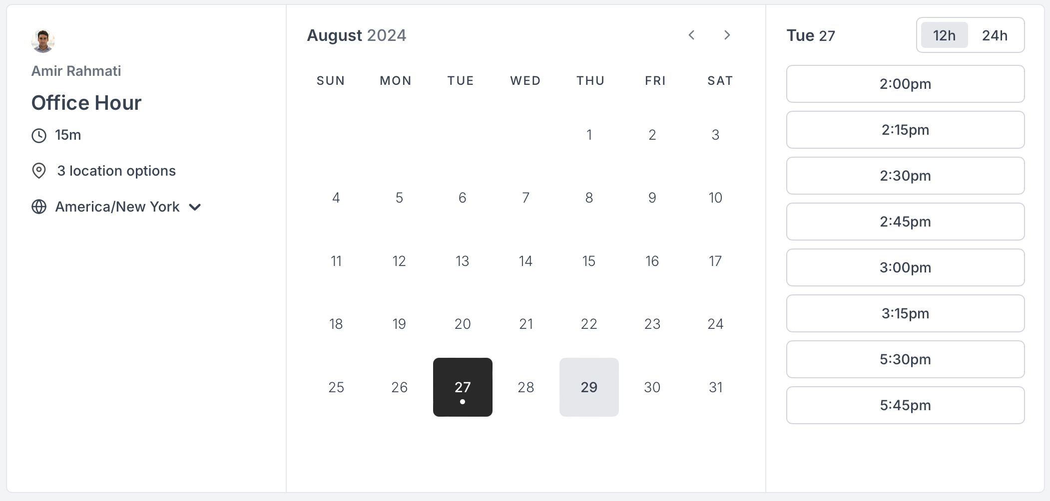
If you need to reach me
Email | amir.rahmati@stonybrook.edu
My Office Hours | https://cal.com/rahmati/office-hour

Slide 13
Develop a Security Mindset
Computer Security is unlike any other field
Adversarial Relationships
Security of …
Rational paranoia
Notes:
Multidisciplinary by nature

Slide 14
Good Luck!
See you in person soon!
Notes:
Xinrui Yu

