Slide 1


Presentation
Quantity of corn people comsume

Slide 2


01
The pie chart
02
The Data
03
Trend
04
Summarize

Slide 3
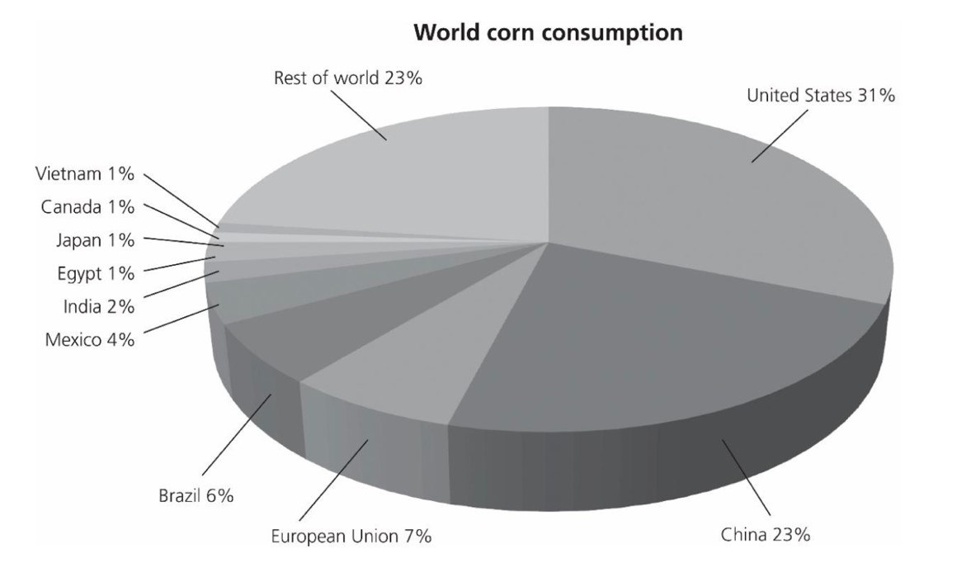
Pie chart of quantity
TITLE

Slide 4

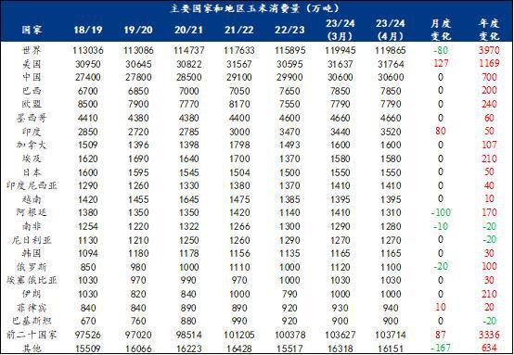
Data
Consumption of US is
slowly increasing
Consumption of China is
qiuckly increasing
Consumption of other country increased very slow or even decreased

Slide 5
Trend
Us and China will keep slowly increasing
Consumption in Mexico will sustained increase
Rest country in World’s part will decrease soon

Slide 6
Summarize
US is the biggest corn consumption country all time
US and China consumed 54% corn in the world
In developing countries have a big corn market

Slide 7



