Slide 1
ISE305: Database Design and Practice
Complex Queries
Fusheng Wang
Department of Computer Science
Department of Biomedical Informatics

Slide 2
Common Table Expressions
and Recursive Queries

Slide 3
Table Expressions
A table expression is a SQL statement used within another SQL statement
  Nested table expressions (NTE)
  Common table expressions (CTE)
Nested table expression: acts as a temporary table
Return the max salary for each dept:
SELECT * FROM
(SELECT WORKDEPT, MAX(SALARY) AS MAXSAL
FROM EMPLOYEE
GROUP BY WORKDEPT) AS T2;
Common table expressions
Notes:
you can reference a common table expression many times in the same SQL statement

Slide 4
Common Table Expressions
A common table expression is a named subquery defined in a WITH clause; or a named temporary table retained during the SQL statement
All references to a temporary table (in a given SQL statement) return the same result
Cyclic references are not allowed
WITH T2 AS
(SELECT WORKDEPT, MAX(SALARY)
AS MAXSAL
FROM EMPLOYEE
GROUP BY WORKDEPT)
SELECT * FROM T2;
SELECT * FROM
(SELECT WORKDEPT, MAX(SALARY)
AS MAXSAL
FROM EMPLOYEE
GROUP BY WORKDEPT) AS T2;
Common table expressions
Notes:
you can reference a common table expression many times in the same SQL statement

Slide 5
Common Table Expressions
Return the max dept average salary:
WITH AVSAL (WORKDEPT, AVGSAL) AS
(SELECT WORKDEPT,
AVG(SALARY) as AVGSAL
FROM EMPLOYEE
GROUP BY WORKDEPT)
SELECT MAX(AVGSAL) AS MAXAVGSAL
FROM AVSAL;
Nested table expression:
SELECT *
FROM
(SELECT MAX(avg_sal) AS max_avg
FROM (SELECT dept,
AVG(salary) AS avg_sal
FROM staff
GROUP BY dept
) AS temp1
) AS temp2;
Common table expressions
Notes:
you can reference a common table expression many times in the same SQL statement

Slide 6
Common Table Expressions
WITH cte1 AS (...), cte2 AS (...) SELECT ...
--Find the departments where the average salary of employees is greater than $80K, and also list all employees in those departments along with their department name
WITH dept_avg_salary AS (
SELECT workdept, AVG(salary) AS avg_salary
FROM employee
GROUP BY workdept
),
high_salary_depts AS (
SELECT d.deptno, d.deptname
FROM dept_avg_salary das, department d
WHERE das.workdept = d.deptno
AND das.avg_salary > 80000
)
SELECT e.empno, e.firstnme, e.lastname, e.salary, h.deptname
FROM employee e, high_salary_depts h
WHERE e.workdept = h.deptno;
Notes:
WITH cte1 AS (...), cte2 AS (...) SELECT ...

Slide 7
Recursive Queries
In math/cs, a class of objects or methods exhibit recursive behavior when they can be defined by two properties:
  A simple base case (or cases), and
  A set of rules which reduce all other cases toward the base case
A recursive SQL has a reference to the relation itself
Recursive queries

Slide 8
Examples for Problems Requiring Recursion
Ancestors: given relation parent(p, c) find all the ancestors of person X
  (Reachability in or transitive closure of a graph)
Parts explosion: given relation compound(super, sub, count), compute a complete bill of materials needed to produce one part P
Path queries: given relation edge(from, to, distance), compute shortest path from A to B
Challenges
  Without recursion, a non-recursive non-iterative program can perform only a fixed number of joins with itself
Recursive queries

Slide 9
Recursive queries in SQL:1999
Prior to the SQL:1999 standard, the limitations of SQL to handle self-referencing relationships were well known: “Bill of materials” and “Traveling Salesman”.
Recursive SQL in SQL:1999 not only provides navigating self-referencing relationships, but also introducing a looping construct (similar to a DO WHILE loop) in SQL
Constructs to support recursive queries
  Common Table Expression (CTE)
  Recursive Common Table Expression (RCTE): an extension of a CTE, that references itself
Recursive queries
Notes:
START WITH and CONNECT BY in Oracle SQL:
http://www.adp-gmbh.ch/ora/sql/connect_by.html

Slide 10
Example
CREATE TABLE assembly (
part VARCHAR (64) NOT NULL,
subpart VARCHAR (64) );
INSERT INTO assembly VALUES ('1', '1a');
INSERT INTO assembly VALUES ('1', '1b');
INSERT INTO assembly VALUES ('1a', '1aC');
INSERT INTO assembly VALUES ('1a', '1aD');
INSERT INTO assembly VALUES ('1b', '1bE');
INSERT INTO assembly VALUES ('1b', '1bF');
INSERT INTO assembly VALUES ('1aC', '1aCx');
1
1a
1aC
1aD
1b
1bE
1bF
1aCx

Slide 11
Example Recursive Queries
Find the parts using “top tube’ (i.e., ancestor parts of ‘1aCx’)
from table assembly (part, subpart)
WITH RECURSIVE all_super (major, minor) AS
( SELECT part, subpart
FROM assembly
UNION ALL
SELECT assb.part, alls.minor
FROM assembly AS assb,all_super AS alls
WHERE assb.subpart = alls.major)
SELECT * FROM all_super
WHERE minor = '1aCx’;
Recursive queries

Slide 12
Example Recursive Queries with IBM Db2 Syntax
WITH all_super (major, minor) AS
( SELECT part, subpart
FROM assembly
UNION ALL
SELECT assb.part, alls.minor
FROM assembly AS assb,all_super AS alls
WHERE assb.subpart = alls.major)
SELECT * FROM all_super
WHERE minor = '1aCx’;
Recursive clause is ignored
Recursive queries
Notes:
UNION: only keeps unique records
UNION ALL: keeps all records, including duplicates
Another recursive SQL example: https://www.ibm.com/support/knowledgecenter/SSEPGG_9.7.0/com.ibm.db2.luw.apdv.sample.doc/doc/clp/s-flt-db2.html

Slide 13
Example
1
1a
1aC
1aD
1b
1bE
1bF
1aCx
CREATE TABLE assembly (
part VARCHAR (64) NOT NULL,
subpart VARCHAR (64) );
INSERT INTO assembly VALUES ('1', '1a');
INSERT INTO assembly VALUES ('1', '1b');
INSERT INTO assembly VALUES ('1a', '1aC');
INSERT INTO assembly VALUES ('1a', '1aD');
INSERT INTO assembly VALUES ('1b', '1bE');
INSERT INTO assembly VALUES ('1b', '1bF');
INSERT INTO assembly VALUES ('1aC', '1aCx');
WITH RECURSIVE all_super (major, minor) AS
( SELECT part, subpart
FROM assembly
UNION ALL
SELECT assb.part, alls.minor
FROM assembly AS assb,all_super AS alls
WHERE assb.subpart = alls.major)
SELECT * FROM all_super
WHERE minor = '1aCx’;

Slide 14
Execution of Recursive Queries
Create initial result set (query on base tables)
Recursion based on the existing result set (temporary result table)
Final query to return final result set (termination)
Limit recursion depth: use a `WHERE` condition to prevent infinite recursion and control the depth of recursion
  MySQL defaults to a maximum recursion depth of 262,144, which can be adjusted
Recursive queries

Slide 15
Recursive Query Discussion
SQL-99 only requires "linear" recursion: each FROM has at most one reference to a recursively-defined relation
Provide a loop like iteration in SQL
Many use cases: BOM, social network (find n-th connection in a social network), etc
Implemented by major DBMS vendors: DB2, SQL Server, Sybase, PostgreSQL, Snowflake, etc, with different flavors
Recursive queries

Slide 16
Alternative Oracle Recursive Query Example (Hierarchical Query; Non-Standard)
Example Table:
  employee(employee_id, last_name, manager_id, level)
SELECT last_name, employee_id,manager_id,level
FROM employees START WITH employee_id = 100
CONNECT BY PRIOR employee_id = manager_id
ORDER SIBLINGS BY last_name;
LAST_NAME EMPLOYEE_ID MANAGER_ID LEVEL
------------------------- ----------- ---------- ----------
King 100 1
Cambrault 148 100 2
Bates 172 148 3
Bloom 169 148 3
Fox 170 148 3
Kumar 173 148 3
Ozer 168 148 3
Smith 171 148 3
Recursive queries
Notes:
http://docs.oracle.com/cd/B12037_01/server.101/b10759/queries003.htm

Slide 17
OLAP Queries
(Online Analytical Processing Queries)

Slide 18
Introduction of Decision Support
Increasingly, organizations are analyzing current and historical data to identify useful patterns and support business strategies
Emphasis is on complex, interactive, exploratory analysis of very large datasets created by integrating data from across all parts of an enterprise; data is fairly static
  Data Warehousing: consolidate data from many sources in one large repository
  On-Line Analytic Processing (OLAP): mostly long queries
  On-line Transaction Processing (OLTP): short update transactions
OLAP queries

Slide 19
Concepts
Data Warehousing: Consolidate data from many sources in one large repository
  ETL (extract, transform, load), periodic synchronization of replicas
  Semantic integration
  Data cleaning
OLAP:
  Complex SQL queries and views
  Queries based on spreadsheet-style operations and “multidimensional” view of data
  Interactive and “online” queries
OLAP queries

Slide 20
OLAP Introduction
OLAP data is modeled multi-dimensionally
It can be modeled as dimension attributes and measure attributes:
  Given a relation used for data analysis, we can identify some of its attributes as measure attributes, since they measure some value and can be aggregated upon (e.g., number of sales)
  Some of the other attributes of the relation are identified as dimension attributes, since they define the dimensions on which measure attributes and summaries of measure attributes are viewed. e.g., month, year, state, county, city…
OLAP queries

Slide 21
The Star Schema
The star schema consists of one or more fact tables referencing any number of dimension tables
OLAP queries
Notes:
with the dimension tables surrounding the central fact table.

Slide 22
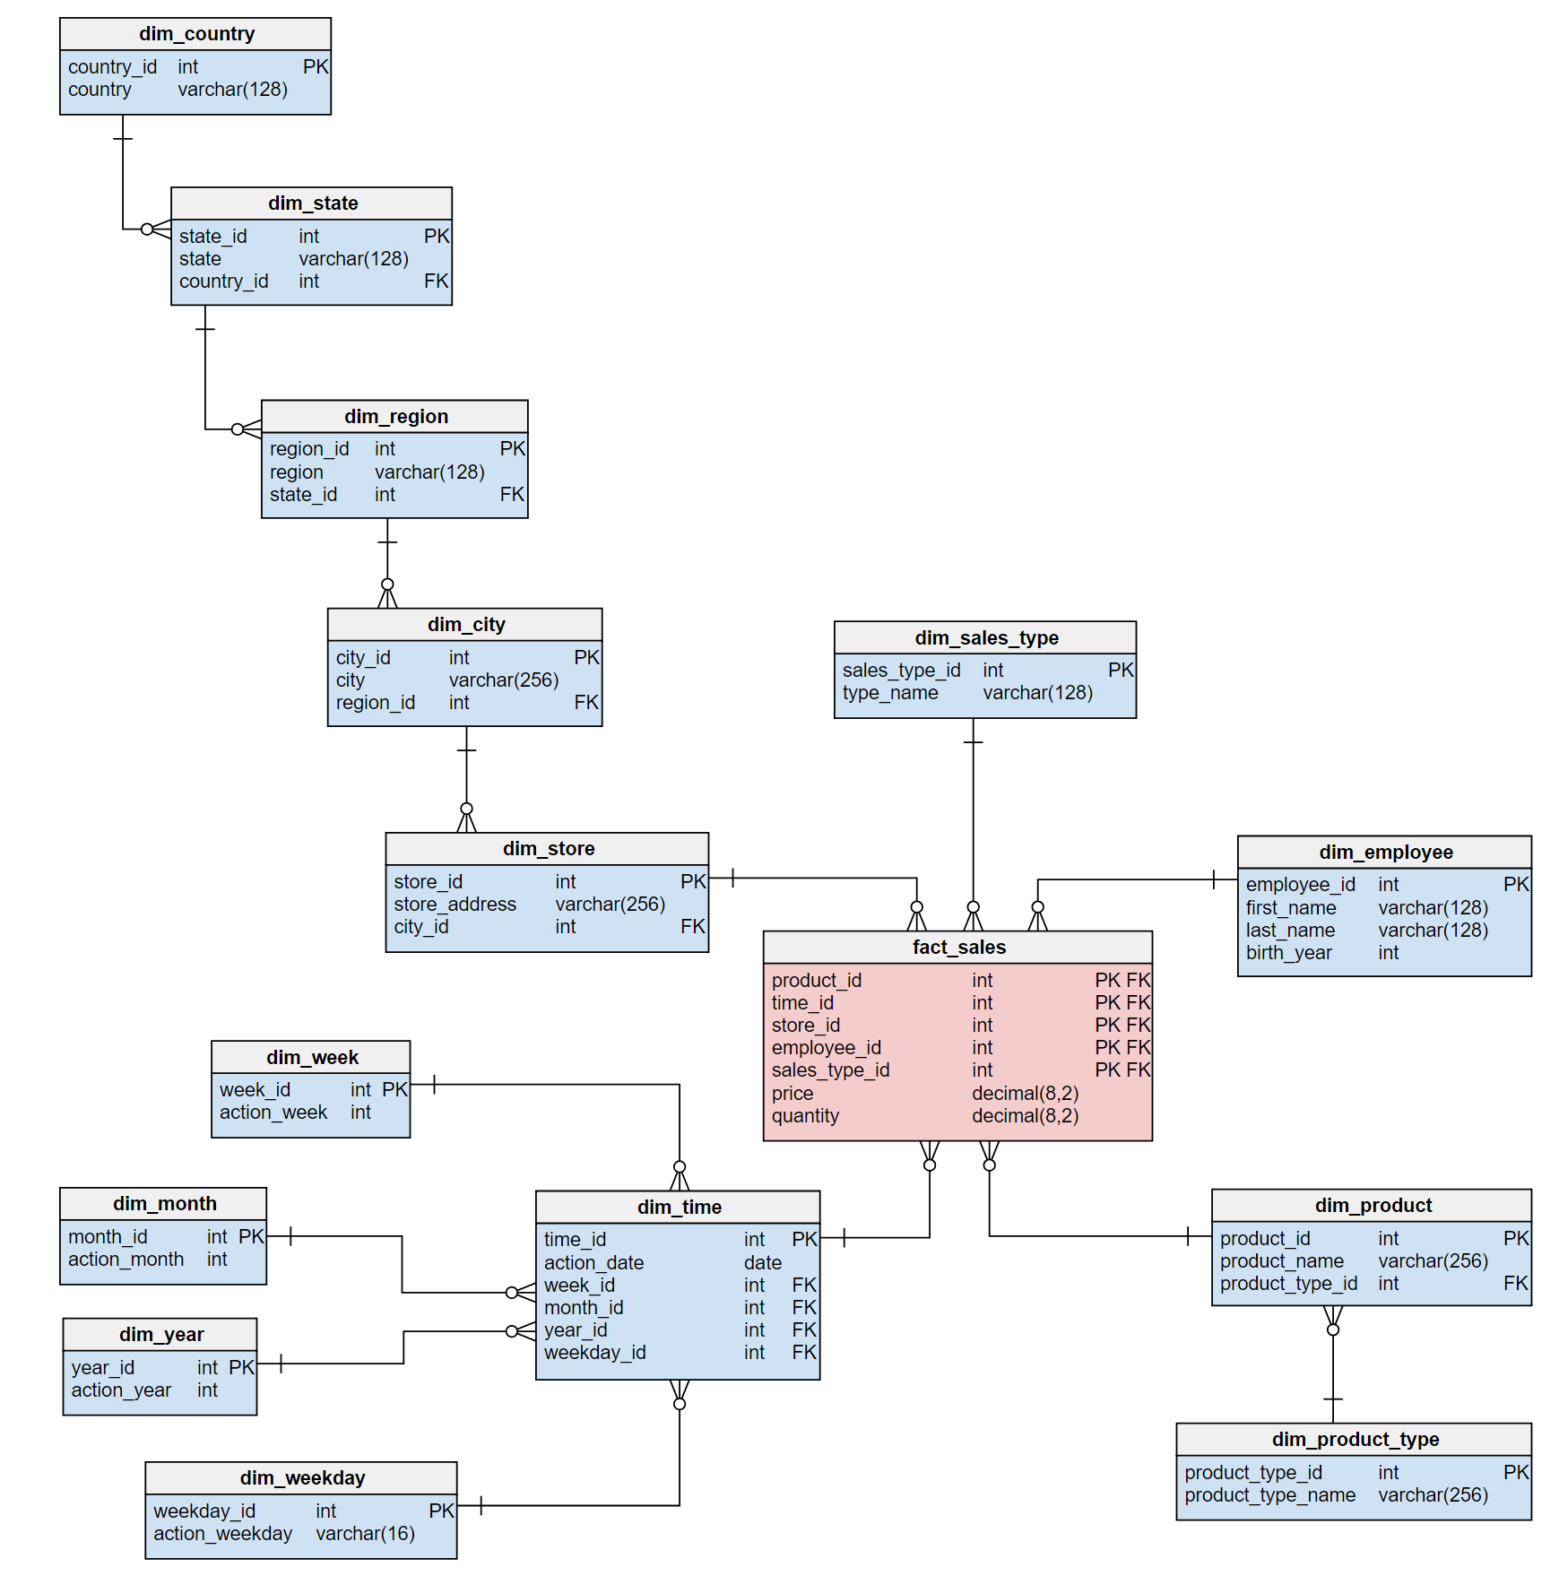
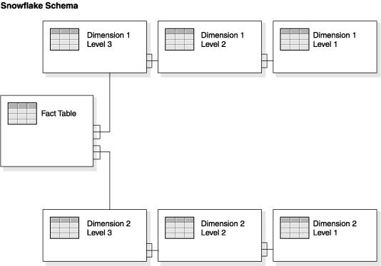
Snowflake Schema
Snowflake schemas further separate the different levels of a hierarchy into separate normalized tables
OLAP queries
Notes:
The fact table has the same dimensions as it does in the star schema example. The most important difference is that the dimension tables in the snowflake schema are normalized. Interestingly, the process of normalizing dimension tables is called snowflaking.
Snowflake schemas will use less space to store dimension tables. This is because as a rule any normalized database produces far fewer redundant records .
Denormalized data models increase the chances of data integrity problems. These issues will complicate future modifications and maintenance as well.

Slide 23
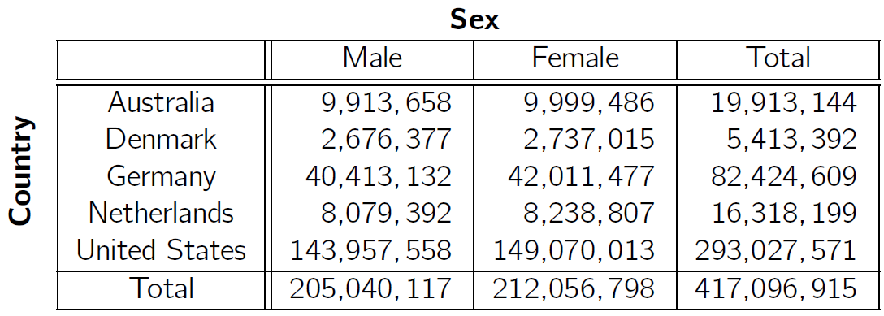
Cross Tabulation
A cross tabulation is a table where:
  values of one of the dimension attributes form the row headers,
  values of another dimension attribute form the column headers,
  and values in individual cells are (aggregates of) the values of the dimension attributes that specify the cell
OLAP queries

Slide 24
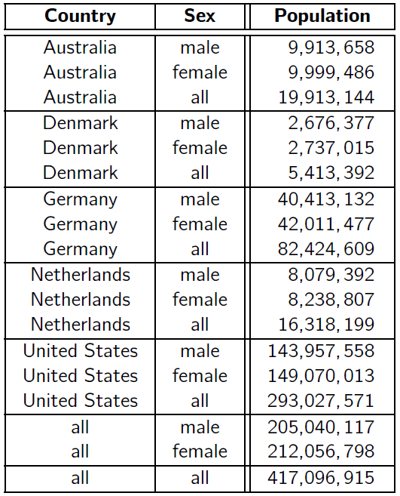
Cross Tabulation and its Relational Representation
In relational DBMSs cross tabulations are represented as relations:
  The value “all” is used to represent aggregates
The SQL 1999 standard uses null values in place of “all”
OLAP queries

Slide 25
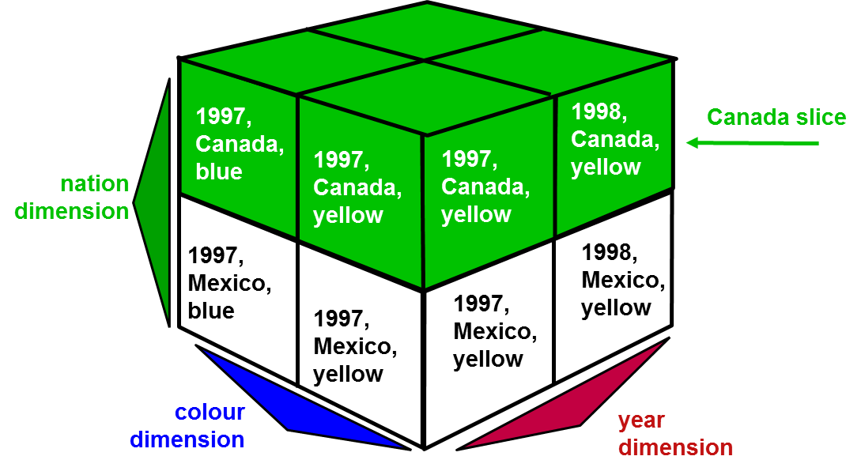
OLAP Terminology
A dimension is an axis along which data is organized
A slice is the portion of the table that contains all the rows that have a specific value for one of the dimensions
  Dice: a slice on more than two dimensions
OLAP queries

Slide 26
OLAP Terminology (2)
Pivoting: changing the dimensions to provide an alternative presentation of data, allows an analyst to rotate the cube in space to see its various faces
Rollup: moving from finer-granularity data to a coarser granularity: summarizing the data along a dimension
Drill down: moving from coarse granularity data to fine granularity data: navigate among levels of data ranging from the most summarized (up) to the most detailed (down)
OLAP queries

Slide 27
Extended Aggregation
OLAP data is modeled multi-dimensionally: dimension attributes and measure attributes
GROUP BY and GROUPING SETS statements are used to group individual rows into combined sets based on the value in one, or more columns
ROLLUP and CUBE statements are short-hand forms of particular types of GROUPING SETS statement
The ROLLUP, CUBE, or GROUPING SETS operators can generate the same result set as when you use UNION ALL to combine single grouping queries; however, using one of the GROUP BY operators is usually more efficient
OLAP queries

Slide 28
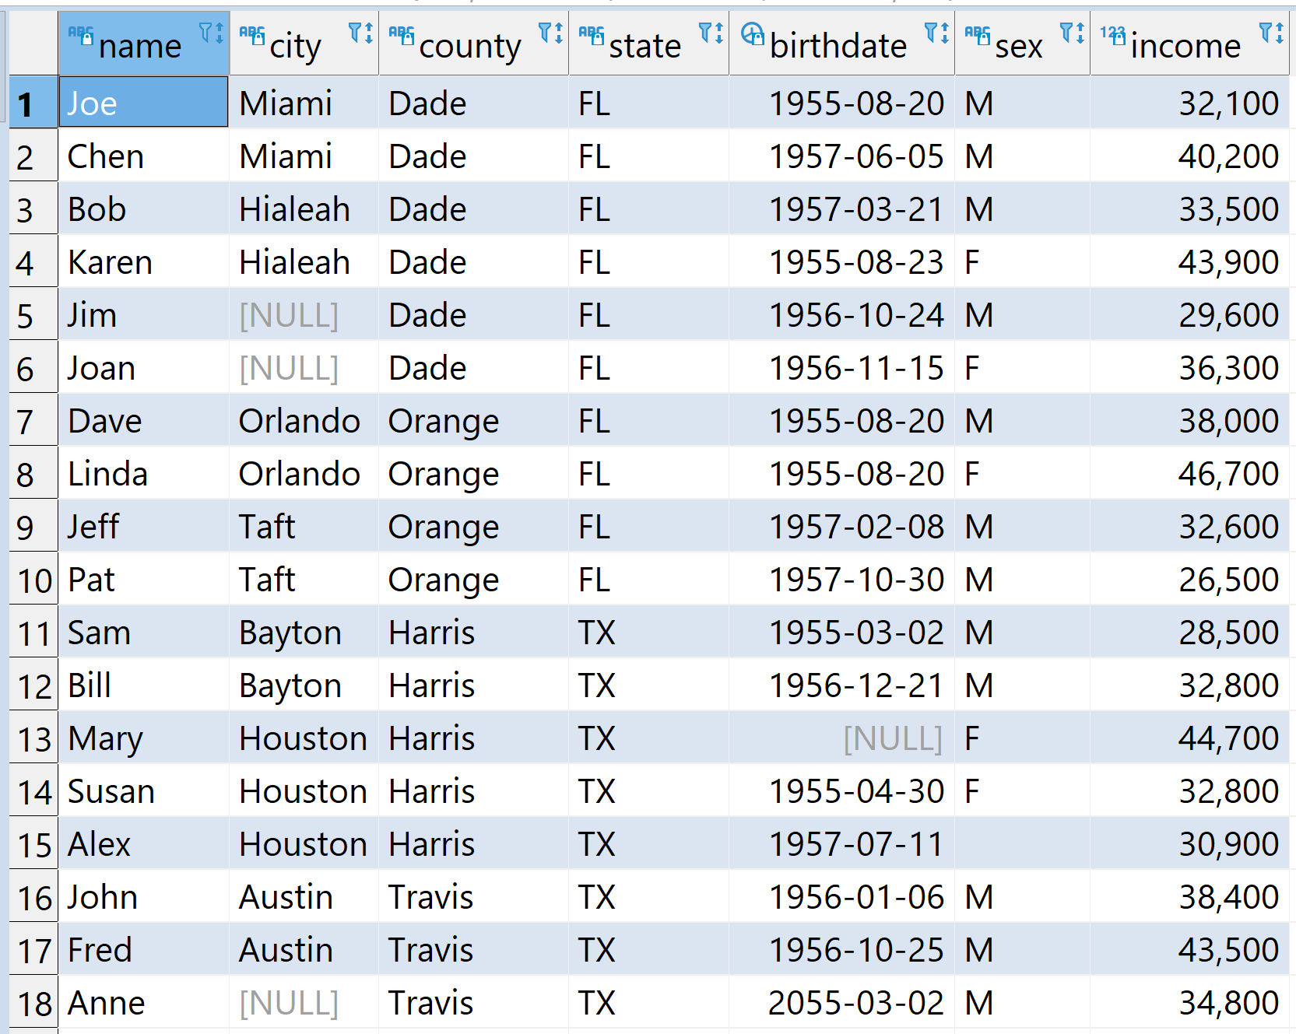
Example Census Database
OLAP queries

Slide 29
ROLLUP
ROLLUP operation generates union on every prefix of specified list of attributes with multiple levels of a hierarchy – providing sub-total rows in addition to the ’regular’ grouped rows
GROUP BY ROLLUP (a,b,c) is equivalent to:
GROUP BY GROUPING SETS ( (a,b,c) (a,b) (a) () )
e.g.: The total population and the average income in each city, county, and state, and the census as a whole:
Optimized query performance: a single scan instead of multiple scans of the table
SELECT state, county, city,
COUNT (*) AS population,
AVG(income) AS avg_income
FROM census
GROUP BY ROLLUP (state, county, city);
GROUPING SETS (
(state, county, city)
(state, county)
(state) () )
OLAP queries

Slide 30
ROLLUP (MySQL Alternative)
SELECT state, county, city,
COUNT (*) AS population,
AVG(income) AS avg_income
FROM census
GROUP BY state, county, city WITH ROLLUP;
Usually a single scan of the table

Slide 31
UNION (Multiple Table Scans!)
SELECT state, county, city, COUNT(*) AS population, AVG(income) AS avg_income
FROM census
GROUP BY state, county, city
UNION ALL
SELECT state, county, NULL AS city, COUNT(*) AS population, AVG(income) AS avg_income
FROM census
GROUP BY state, county
UNION ALL
SELECT state, NULL AS county, NULL AS city, COUNT(*) AS population, AVG(income) AS avg_income
FROM census
GROUP BY state
UNION ALL
SELECT NULL AS state, NULL AS county, NULL AS city,
COUNT(*) AS population, AVG(income) AS avg_income FROM census;
Notes:
NULL AS state, NULL AS county, NULL AS city:
These are placeholders to align with the structure of the result set.

Slide 32
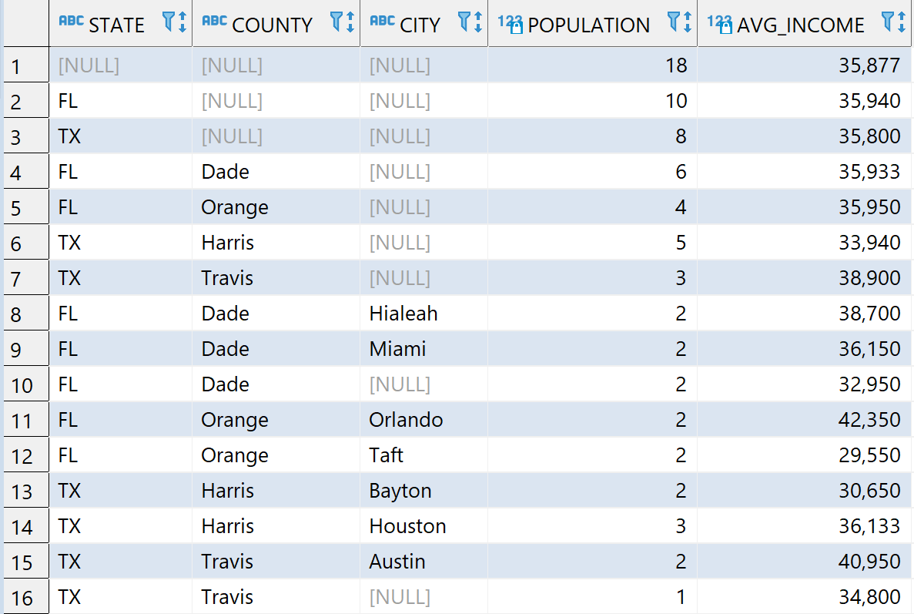
Example ROLLUP Query Result
OLAP queries

Slide 33
Getting Rid of NULLs
SELECT
CASE grouping (state)
WHEN 1 THEN '(-all-)' ELSE state END AS state,
CASE grouping (county) WHEN 1 THEN '(-all-)'
ELSE county END AS county,
CASE grouping (city) WHEN 1 THEN '(-all-)' ELSE city
END AS city,
count(*) AS pop, avg(income) AS avg_income
FROM census
GROUP BY ROLLUP (state, county, city)
ORDER BY state, county, city;
OLAP queries

Slide 34
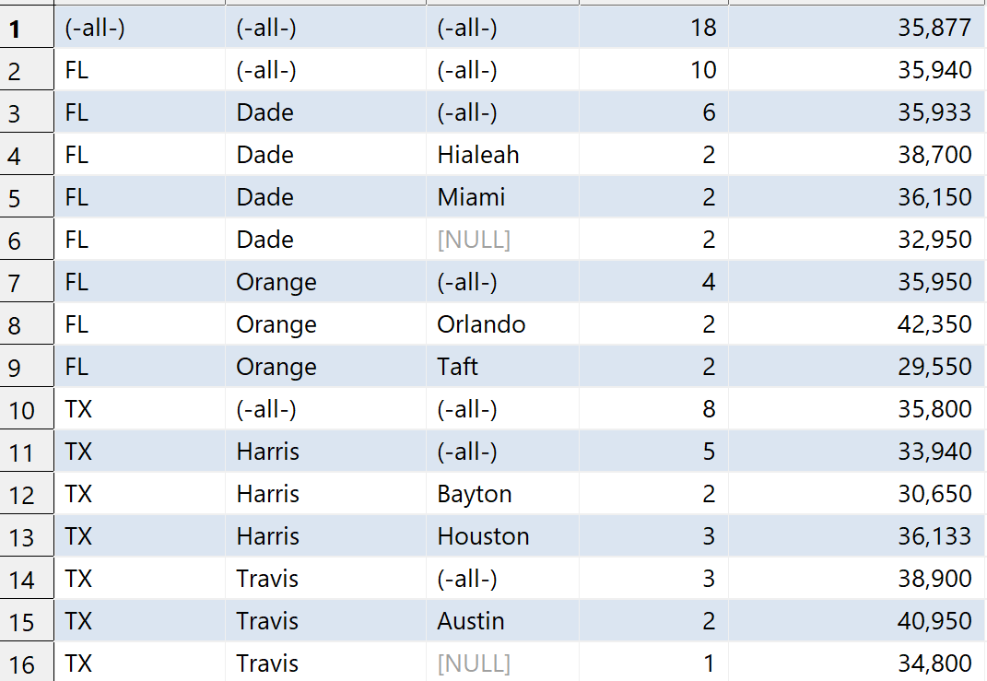
Getting Rid of NULLs: Result
OLAP queries

Slide 35
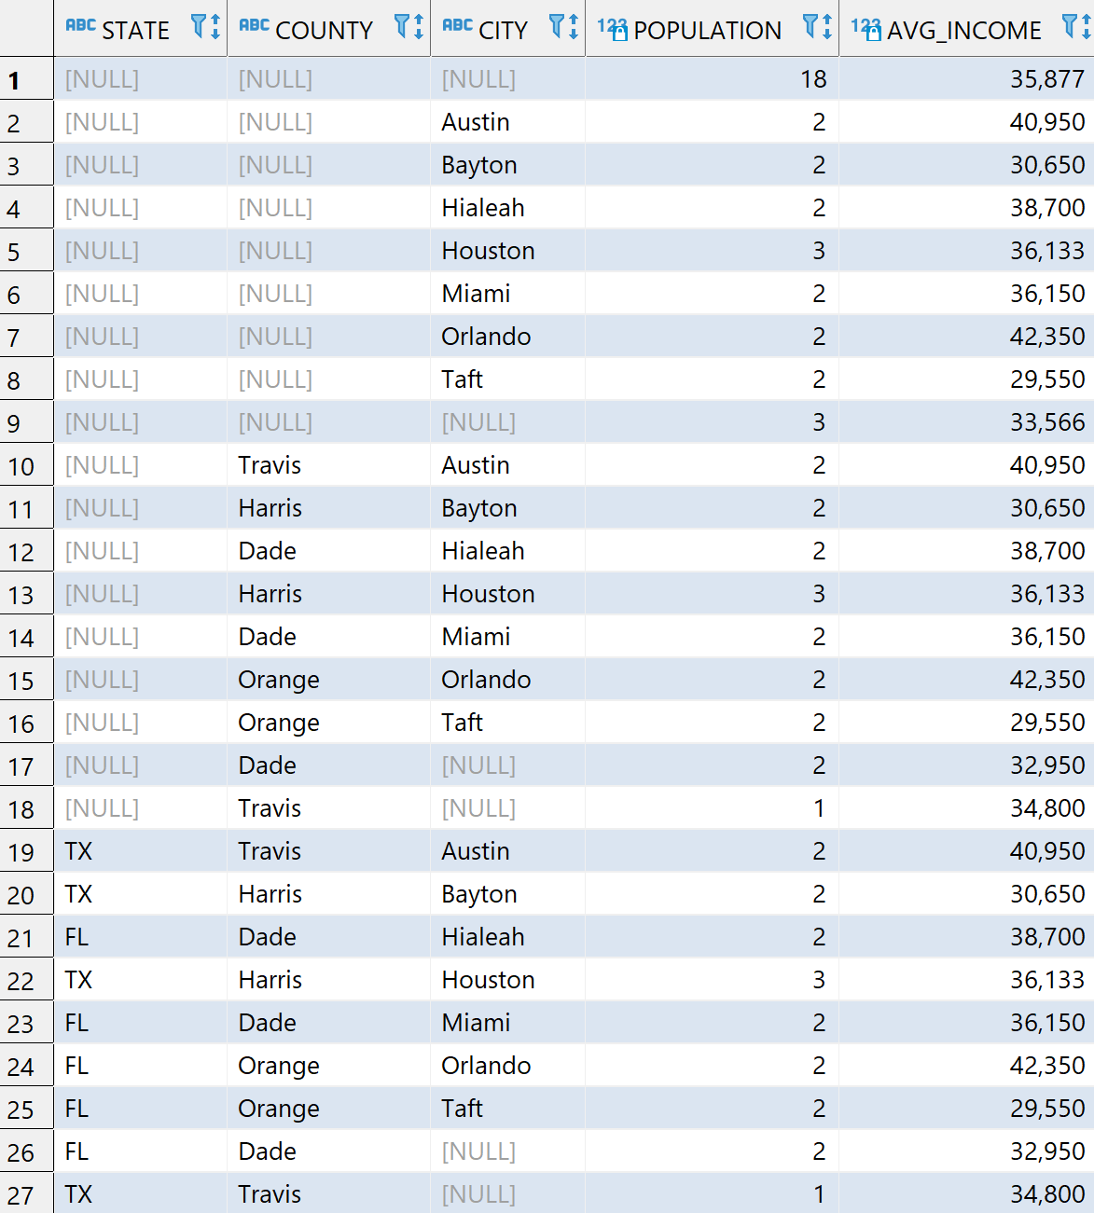
How about Changing the Order of Columns?
GROUPING SETS( (state, county, city) (state, county) (state) () )
SELECT state, county, city,
COUNT (*) AS population,
AVG(income) AS avg_income
FROM census
GROUP BY ROLLUP (state, county, city);
≠
SELECT state, county, city,
COUNT (*) AS population,
AVG(income) AS avg_income
FROM census
GROUP BY ROLLUP (city, county, state);
GROUPING SETS( (city, county, state) (city, county) (city) () )

Slide 36
CUBE
CUBE operation computes union of GROUP BY's on every subset of the specified attributes
e.g.: effect of gender and birth date on income
GROUP BY CUBE (a,b,c) is equivalent to
GROUP BY GROUPING SETS
( (a,b,c) (a,b) (a,c) (b,c) (a) (b) (c) () )
SELECT sex, year(birthdate) AS birth_year,
MAX (income) AS max_income
FROM census
GROUP BY CUBE(sex, year(birthdate) );
OLAP queries

Slide 37
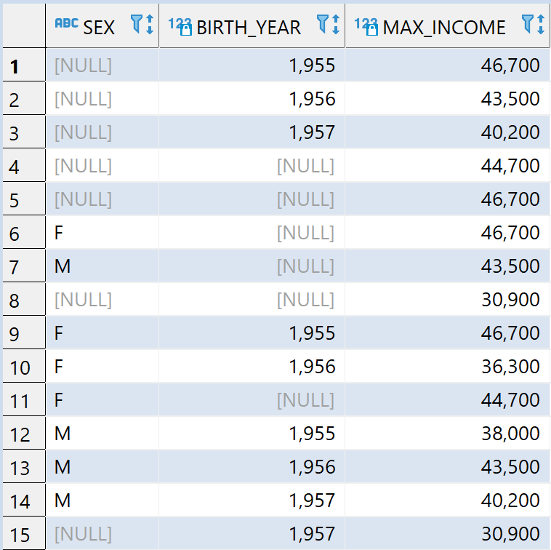
Example Cube Query Result
GROUP BY CUBE(sex, year(birthdate) )
GROUP BY GROUPING SETS(
(sex, year(birthdate))
(sex)
(year(birthdate))
()
)
OLAP queries

Slide 38
Grouping Sets
GROUPING SETS statement enables us to get multiple GROUP BY result sets using a single statement
Nested (i.e., in secondary parenthesis), and non-nested GROUPING SETS sub-phrases can be distinguished:
  Nested list of columns works as a simple GROUP BY: ((…))
  Non-nested list of columns works as separate simple GROUP BY statements, which are then combined in an implied UNION ALL
  (.,.,)
OLAP queries

Slide 39
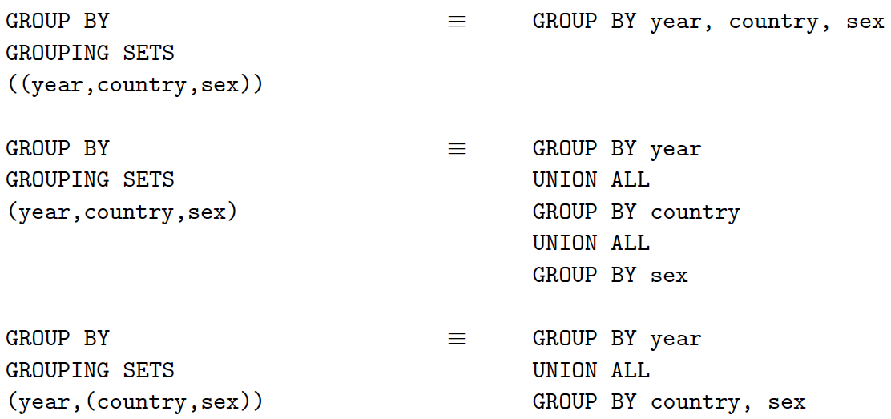
Grouping Sets
OLAP queries

Slide 40
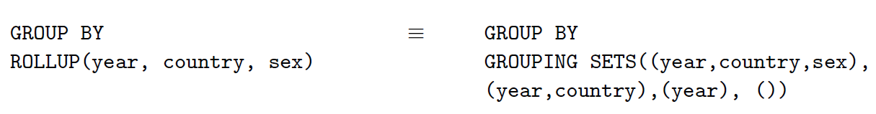
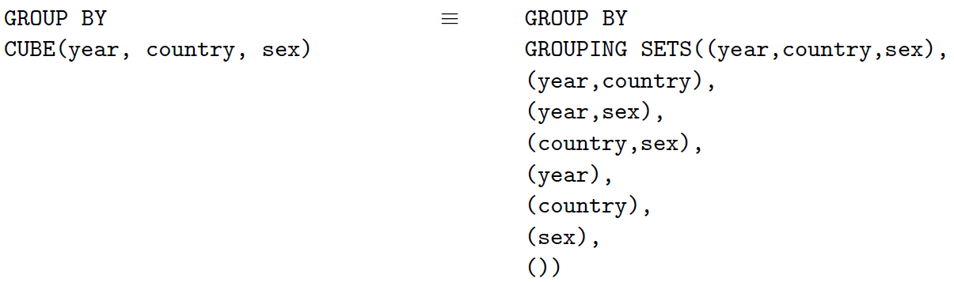
Grouping Sets
ROLLUP and CUBE statements are short-hand forms of particular types of GROUPING SETS statement
CUBE expression displays a cross tab of the sub-totals for any specified fields. Example:
CUBE is supported by major RDBMS
except MySQL and SQLLite
OLAP queries

Slide 41
Overview
Recursive queries
Super groups
Aggregate/ statistics functions
Pivoting
Ranking
Windowing
Materialized query tables

Slide 42
Pivoting Queries

Slide 43
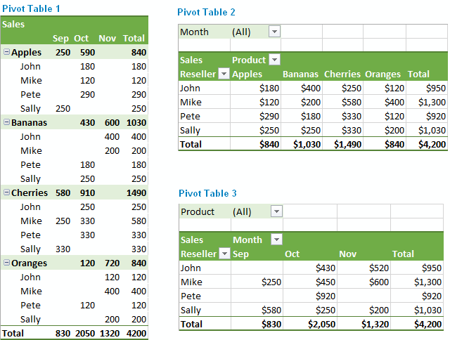
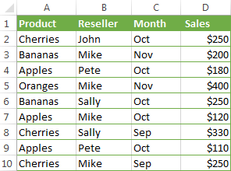
Pivoting a Table (Transpose)
Summarize and reorganize selected columns and rows of data in a spreadsheet or database table to obtain a desired report
Credit: Svetlana Cheusheva
Pivoting
Notes:
https://www.ablebits.com/office-addins-blog/excel-pivot-table-tutorial/

Slide 44
Pivoting in SQL: FILTER for GROUP BY
Transpose data from multiple rows into columns of a single row
FILTER is used on an aggregate function to limit the values used in an aggregation
SELECT reseller,
SUM(sales) FILTER (WHERE product = 'Apples') AS apples_sales,
SUM(sales) FILTER (WHERE product = 'Bananas') AS bananas_sales,
SUM(sales) FILTER (WHERE product = 'Cherries') AS cherries_sales,
SUM(sales) FILTER (WHERE product = 'Oranges') AS oranges_sales,
SUM(sales) AS total_sales
FROM pivotsales
GROUP BY reseller;
reseller | apples_sales | bananas_sales | cherries_sales | oranges_sales | total_sales
John | 0 | 0 | 250 | 0 | 250
Mike | 120 | 200 | 250 | 400 | 970
Pete | 290 | 0 | 0 | 0 | 290
Sally | 0 | 250 | 330 | 0 | 580

Slide 45
FILTER for GROUP BY
pivotsales(reseller, product, month, sales)
For reach reseller, return the total sales, total sales of “Cherries”, total sales in fall, avg sales in October, and count of sales that is more than 200.
SELECT reseller,
SUM(sales) AS total_sales,
SUM(sales) FILTER (WHERE product = 'Cherries') AS cherries_sales,
SUM(sales) FILTER (WHERE month IN ('Sep', 'Oct', 'Nov')) AS fall_season_sales,
AVG(sales) FILTER (WHERE month = 'Oct') AS avg_oct_sales,
COUNT(*) FILTER (WHERE sales > 200) AS high_sales_count
FROM pivotsales
GROUP BY reseller
ORDER BY total_sales DESC;
reseller | total_sales | cherries_sales | fall_season_sales | avg_oct_sales | high_sales_count
Mike | 970 | 250 | 970 | 160 | 2
Sally | 580 | 330 | 580 | 250 | 2
Pete | 290 | 0 | 290 | 145 | 0
John | 250 | 250 | 250 | NULL | 1
Pivoting

Slide 46
DBMS with FILTER Support
✅ Supports FILTER:
PostgreSQL, SQLite, MariaDB, IBM DB2, DuckDB, Trino, Presto, Amazon Redshift, CockroachDB, etc
❌ Does NOT support FILTER:
MySQL, Oracle, SQL Server, etc

Slide 47
Pivoting in SQL: Case
SELECT reseller,
SUM(CASE WHEN product = 'Apples' THEN sales ELSE 0 END) AS apples_sales,
SUM(CASE WHEN product = 'Bananas' THEN sales ELSE 0 END) AS bananas_sales,
SUM(CASE WHEN product = 'Cherries' THEN sales ELSE 0 END) AS cherries_sales,
SUM(CASE WHEN product = 'Oranges' THEN sales ELSE 0 END) AS oranges_sales,
SUM(sales) AS total_sales
FROM pivotsales
GROUP BY reseller;
reseller | apples_sales | bananas_sales | cherries_sales | oranges_sales | total_sales
John | 0 | 0 | 250 | 0 | 250
Mike | 120 | 200 | 250 | 400 | 970
Pete | 290 | 0 | 0 | 0 | 290
Sally | 0 | 250 | 330 | 0 | 580
Pivoting

Slide 48
Pivoting in SQL: PIVOT Clause
PIVOT: rotate a table by turning the unique values from one column in the input expression into multiple columns and aggregating results
Supported: Apache Spark, Snowflake, Oracle, Microsoft SQL Server, TeraData
SELECT
FROM pivotsales
PIVOT (SUM (sales) for product
IN ('Apples', 'Bananas', 'Cherries', 'Oranges'))
ORDER BY reseller;
SELECT reseler,
'Apples' AS Apples, 'Bananas' AS Bananas,
'Cherries' AS Cherries, 'Oranges' AS Oranges
FROM pivotsales
PIVOT (SUM (sales) for product
IN ('Apples', 'Bananas', 'Cherries', 'Oranges’) )
ORDER BY reseller;
Pivoting
Notes:
https://docs.snowflake.com/en/sql-reference/constructs/pivot.html
https://www.databricks.com/blog/2018/11/01/sql-pivot-converting-rows-to-columns.html

Slide 49
Aggregate and Statistical Functions

Slide 50
Aggregations: Number-Based
Name | Description | Example
SUM() | Calculates the total sum of numeric values | SELECT SUM(salary) FROM employees; → 250000
AVG() | Computes the arithmetic mean | SELECT AVG(salary) FROM employees; → 75000
MIN() | Returns the smallest value | SELECT MIN(salary) FROM employees; → 50000
MAX() | Returns the largest value | SELECT MAX(salary) FROM employees; → 100000
BIT_AND() | Bitwise AND operation | SELECT BIT_AND(likes) FROM userlikes; → 64 (binary 01)
BIT_OR() | Bitwise OR operation | SELECT BIT_OR(likes) FROM userlikes; → 7 (binary 111)
SELECT city, bit_and(likes)
FROM userlikes
GROUP BY city
city | likes | likes (binary)
Los Angeles | 0 | 00000000
Sacramento | 0 | 00000000
San Francisco | 0 | 00000000
San Jose | 64 | 01000000
Santa Barbara | 192 | 11000000
Operation | Binary Result | Decimal Result
bit_or | 11000000 | 192
bit_and | 01000000 | 64

Slide 51
Aggregations: Statistics-Based
Name | Description | Example
STDDEV() | Standard deviation of values | SELECT STDDEV(salary) FROM employees;
VARIANCE() | Statistical variance | SELECT VARIANCE(salary) FROM employees;
COVARIANCE() (COVAR_POP() ) | Covariance across entire population | SELECT COVARIANCE(SALARY, BONUS) FROM EMPLOYEE;
COVAR_SAMP() | Covariance across a sample of the population | SELECT COVAR_SAMP(revenue, marketing_spend) FROM customers TABLESAMPLE SYSTEM(10); --10% sampling
PERCENTILE_CONT() | Median (interpolated) | SELECT PERCENTILE_CONT(0.5) WITHIN GROUP (ORDER BY salary); → 75000
PERCENTILE_DISC() | 90th percentile (actual value) | SELECT PERCENTILE_DISC(0.9) WITHIN GROUP (ORDER BY salary)
MEDIAN() | Middle value | SELECT MEDIAN(salary) FROM employees;
Variance = Σ(xᵢ - mean)² / (n - 1) # sample variance
STDDEV() = SQRT(VARIANCE() )
MEDIAN(): (1, 5, 7, 8,100) : 7 AVG(): 24.2
COVAR_POP(X,Y) = Σ[(xᵢ - μₓ)(yᵢ - μᵧ)] / N
Notes:
STDDEV() = SQRT(VARIANCE())

Slide 52
Aggregations: Statistics-Based: Percentile
--Example 1: Median Salary (50th Percentile)
-- Continuous median (may interpolate)
SELECT PERCENTILE_CONT(0.5) WITHIN GROUP
(ORDER BY salary)
FROM employee;
-- Returns: 50000 (no interpolation needed)
-- Discrete median
SELECT PERCENTILE_DISC(0.5) WITHIN GROUP
(ORDER BY salary)
FROM employee;
-- Returns: 50000
--Example 2: 90th Percentile
-- Continuous (interpolates
-- between 55000 and 80000)
SELECT PERCENTILE_CONT(0.9) WITHIN GROUP
(ORDER BY salary)
FROM employees
-- Returns: 72500 (calculated value)
-- Discrete (returns first value at
-- or exceeding 90th %ile)
SELECT PERCENTILE_DISC(0.9) WITHIN GROUP
(ORDER BY salary)
FROM employees
Returns: 80000 (the smallest actual salary such that at least 90% of salaries are less than or equal to it)
Salary:
30000, 45000, 50000, 55000, 80000
Notes:
PERCENTILE_CONT(0.9): This computes the 90th percentile of salaries.If 90% of the salaries fall below $72,500, and there's no exact $72,500 salary, it will interpolate between, say, $55,000 and $80,000 to return a value like $72,500.
PERCENTILE_DISC (Discrete Percentile): Returns the first actual value in the dataset that reaches or exceeds the desired percentile.
This returns the smallest actual salary such that at least 90% of salaries are less than or equal to it.

Slide 53
Aggregate Functions: String Based
Name | Description | Example
GROUP_CONCAT() | Concatenates strings (MySQL) | SELECT GROUP_CONCAT(name SEPARATOR ', ') FROM employee; → "Alice, Bob, Carol"
STRING_AGG() | Concatenates with delimiter (PostgreSQL) | SELECT STRING_AGG(name, '; ') FROM employee; → "Alice; Bob; Carol"
LISTAGG() | Oracle string aggregation | SELECT LISTAGG(name, ‘,’) FROM employee;
JSON_ARRAYAGG() | Aggregates values from multiple rows into a JSON array | SELECT JSON_ARRAYAGG(name) FROM employee; → ["Alice", "Bob", "Carol"]
XMLAgg | Aggregate XML element | SELECT department, XMLAGG(XMLELEMENT(NAME emp, name)) AS emp_list FROM employees
Aggregate
Notes:
https://www.ibm.com/support/knowledgecenter/en/SSEPEK_11.0.0/sqlref/src/tpc/db2z_aggregatefunctionsintro.html
https://www.ibm.com/support/knowledgecenter/en/SS6NHC/com.ibm.swg.im.dashdb.sql.ref.doc/doc/r0011043.html

Slide 54
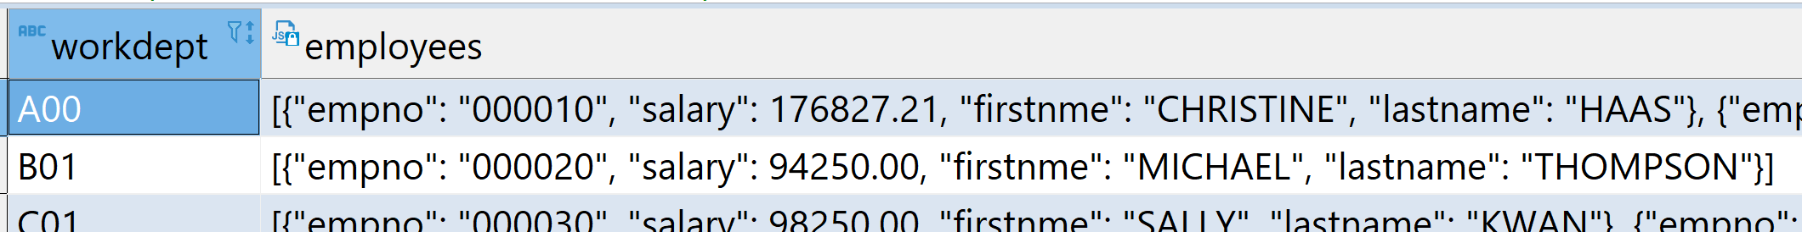
JSON_ARRAYAGG Example
JSON_ARRAYAGG(): supported by MySQL, Oracle, PostgreSQL, Db2, SQL Server, SQLLite, etc
SELECT workdept, JSON_ARRAYAGG(
JSON_OBJECT(
'empno',empno, 'firstnme',firstnme, 'lastname',lastname, 'salary',salary
)
) AS employees
FROM employee
GROUP BY workdept;
Aggregate
Notes:
https://www.ibm.com/support/knowledgecenter/en/SSEPEK_11.0.0/sqlref/src/tpc/db2z_aggregatefunctionsintro.html
https://www.ibm.com/support/knowledgecenter/en/SS6NHC/com.ibm.swg.im.dashdb.sql.ref.doc/doc/r0011043.html

Slide 55
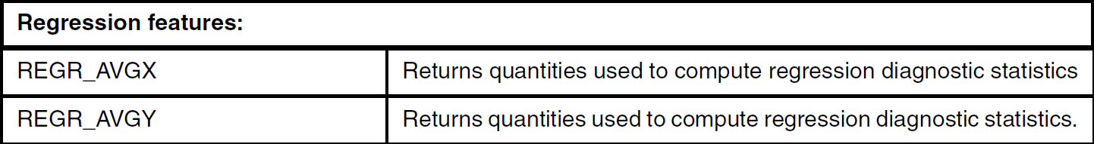
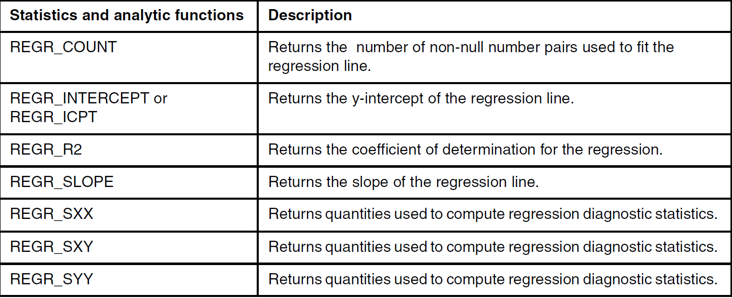
Aggregations: Regression
Y = aX+b
(a: regression
coefficient
or slope;
b: intercept
)
Aggregate
Notes:
https://www.ibm.com/support/knowledgecenter/en/SSEPEK_11.0.0/sqlref/src/tpc/db2z_aggregatefunctionsintro.html
https://www.ibm.com/support/knowledgecenter/en/SS6NHC/com.ibm.swg.im.dashdb.sql.ref.doc/doc/r0011043.html

Slide 56
Regression Example
Y = aX+b
(a: regression coefficient or slope; b: intercept)
SELECT
REGR_SLOPE(revenue, ad_spend) AS slope,
REGR_INTERCEPT(revenue, ad_spend) AS intercept,
REGR_R2(revenue, ad_spend) AS r_squared,
REGR_COUNT(revenue, ad_spend) AS data_points
FROM marketing_campaigns;
| SLOPE | INTERCEPT | R_SQUARED | DATA_POINTS |
|--------|-----------|-----------|-------------|
| 2.75 | 1500.00 | 0.89 | 120 |
Aggregate

Slide 57
OVER Based Partitioning Queries

Slide 58
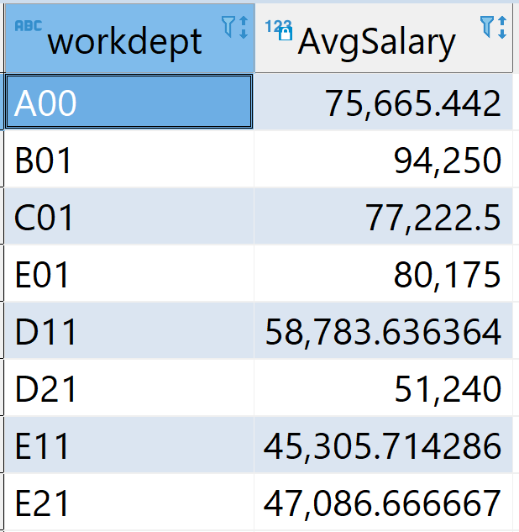
Traditional GROUP BY
One result record per group, e.g., workdept
workdept | firstname | lastname | salary
A00 | CHRISTINE | HAAS | 176827.21
A00 | GREG | ORLANDO | 39250.00
A00 | DIAN | HEMMINGER | 46500.00
A00 | VINCENZO | LUCCHESSI | 66500.00
A00 | SEAN | O'CONNELL | 49250.00
B01 | MICHAEL | THOMPSON | 94250.00
C01 | SALLY | KWAN | 98250.00
C01 | DELORES | QUINTANA | 73800.00
C01 | HEATHER | NICHOLLS | 68420.00
C01 | KIM | NATZ | 68420.00
D11 | IRVING | STERN | 72250.00
D11 | REBA | JOHN | 69840.00
D11 | JENNIFER | LUTZ | 49840.00
D11 | BRUCE | ADAMSON | 55280.00
partition
Avg
Dept
Salary
SELECT workdept, AVG(salary) AS AvgSalary
FROM employee
GROUP BY workdept;

Slide 59
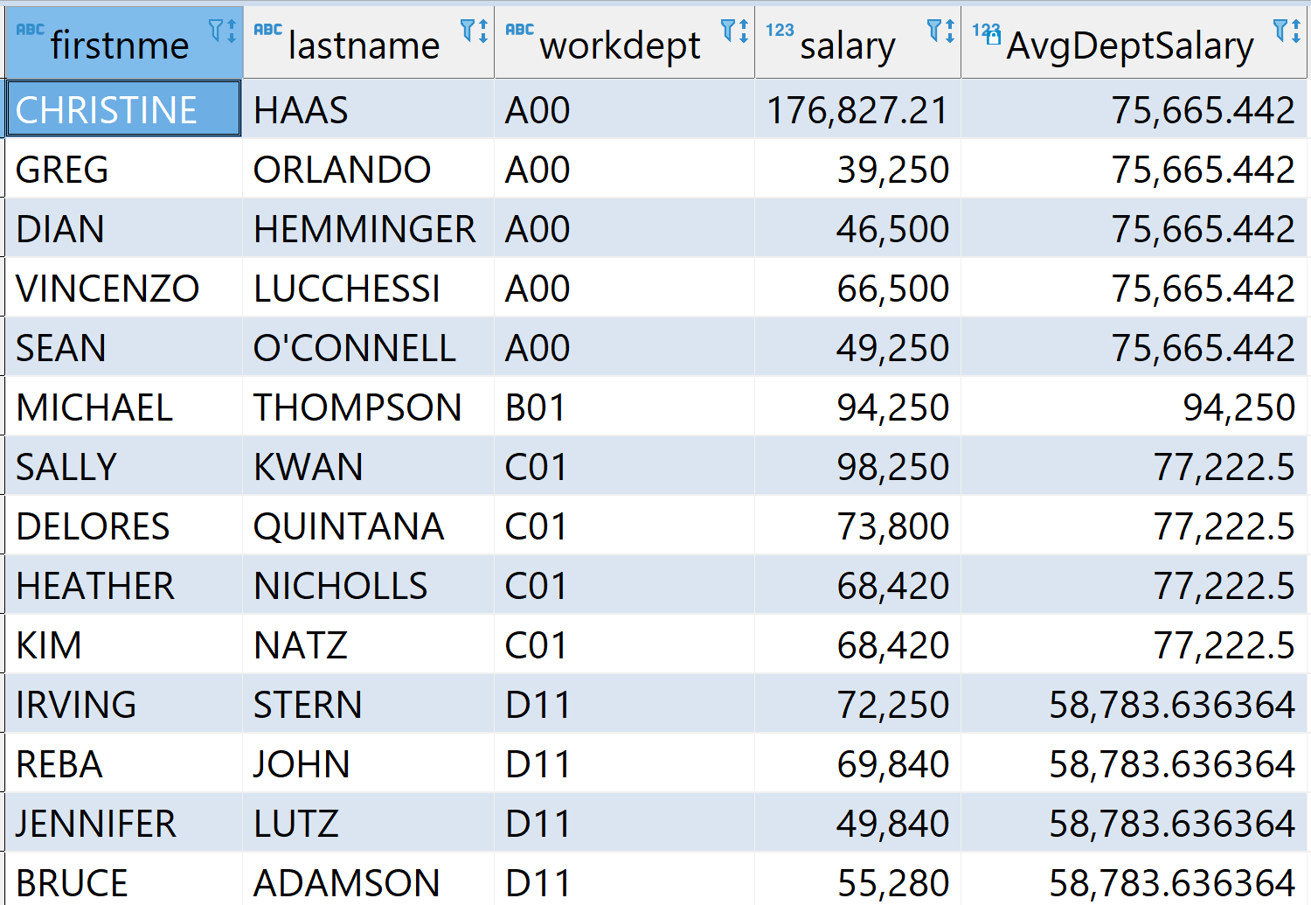
OVER Clause
An OVER clause in SQL defines a group of rows (window) for calculations, without collapsing the results into a single row
workdept | firstname | lastname | salary
A00 | CHRISTINE | HAAS | 176827.21
A00 | GREG | ORLANDO | 39250.00
A00 | DIAN | HEMMINGER | 46500.00
A00 | VINCENZO | LUCCHESSI | 66500.00
A00 | SEAN | O'CONNELL | 49250.00
B01 | MICHAEL | THOMPSON | 94250.00
C01 | SALLY | KWAN | 98250.00
C01 | DELORES | QUINTANA | 73800.00
C01 | HEATHER | NICHOLLS | 68420.00
C01 | KIM | NATZ | 68420.00
D11 | IRVING | STERN | 72250.00
D11 | REBA | JOHN | 69840.00
D11 | JENNIFER | LUTZ | 49840.00
D11 | BRUCE | ADAMSON | 55280.00
partition
avg
dept
salary
SELECT firstnme, lastname, workdept, salary, AVG(salary)
OVER (PARTITION BY workdept) AS AvgDeptSalary
FROM employee;

Slide 60
Grouping versus OVER
Grouping (BY) returns one result per partition (e.g., workdept)
  Partition can only be based on an existing attribute
  Result is aggregation for each partition (or grouped columns(s))
  One result by partition/group
OVER provides additional ranking and aggregation for each partition or window, and combines such information for each tuple (e.g., employee)
  One result per record
  Partition could be not only attribute values, but also windows
  Beyond aggregation
Ranking

Slide 61
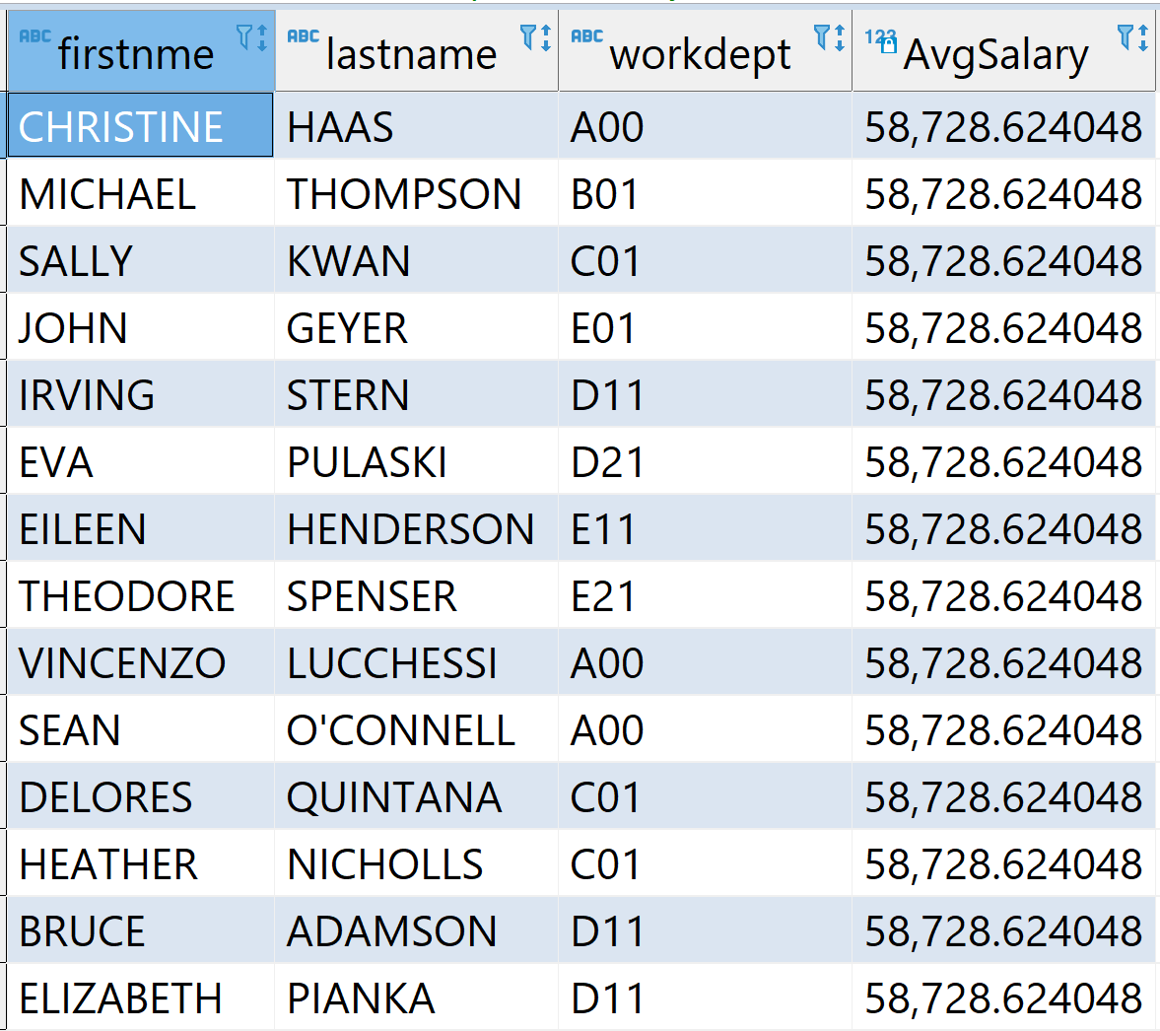
OVER vs GROUP BY
What does this query do?
SELECT firstnme, lastname, workdept,
AVG(salary) OVER () AS AvgSalary
FROM employee;

Slide 62
Ranking Queries

Slide 63
Ranking
The RANK and DENSE_RANK functions enable one to rank the rows returned by a query, the result is of type BIGINT
ORDER BY CLAUSE over ranking value is required
For RANK, if multiple rows have equal values (e.g., 200, 200, 100), they all get the same rank (can be tied, e.g., 1, 1, 3)
DENSE_RANK does not leave gaps (e.g., 1, 2, 3)
ROW_NUMBER: computes the sequential row number of the row within the window
Ranking
Notes:
http://publib.boulder.ibm.com/infocenter/db2luw/v9r7/index.jsp?topic=/com.ibm.db2.luw.sql.ref.doc/doc/r0023461.html

Slide 64
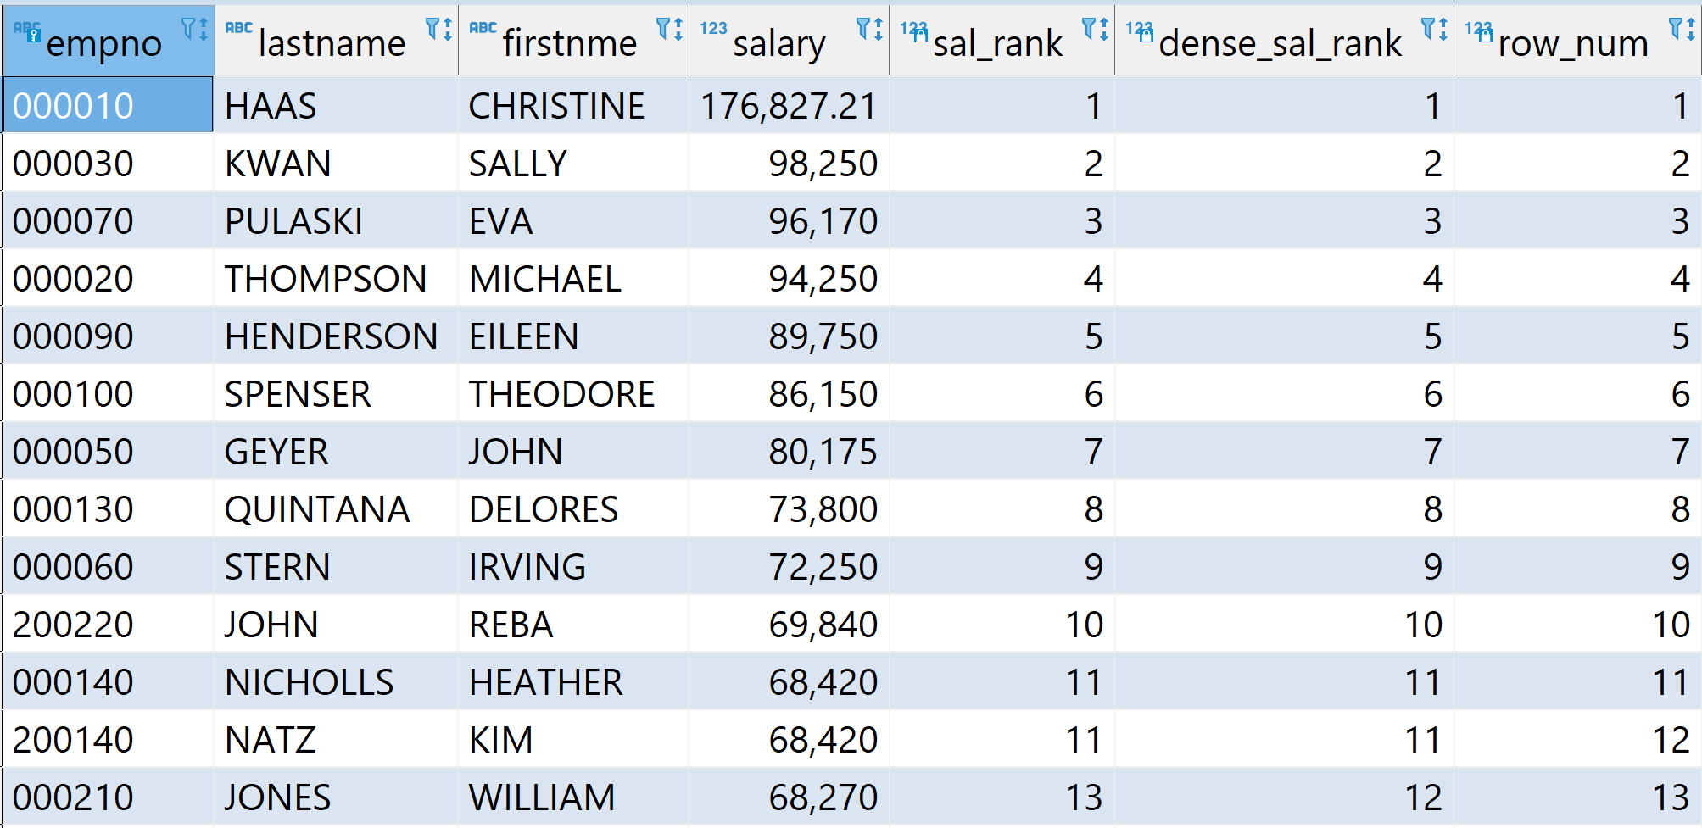
Example RANK Query
Return the rank of employees based on salary
SELECT empno, lastname, firstnme, salary,
RANK() OVER (ORDER BY salary DESC) AS sal_rank,
DENSE_RANK() OVER (ORDER BY salary DESC) AS dense_sal_rank,
ROW_NUMBER() OVER (ORDER BY salary DESC) AS row_num
FROM EMPLOYEE;
Ranking
employee(empno, lastname, firstnme, salary, bonus, dept)

Slide 65
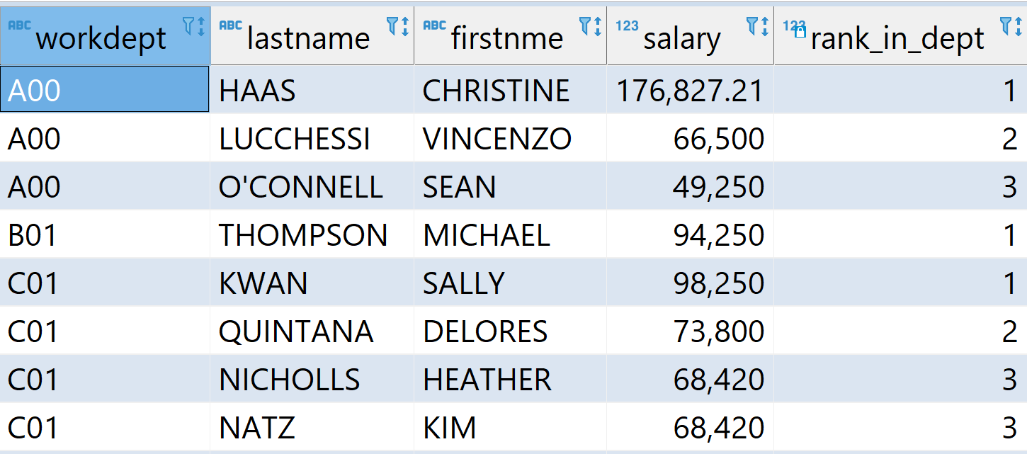
RANKING with PARITION
PARTITION BY clause allows for subdividing the rows into partitions. Similar to GROUP BY except it is local to the window set
Find employees whose salaries ranked top 3 within each department
WITH salary_rank_by_dept AS (
SELECT workdept, lastname, firstnme, salary,
RANK() OVER (PARTITION BY workdept ORDER BY salary DESC) AS rank_in_dept
FROM employee)
SELECT workdept, lastname, firstnme, salary, rank_in_dept
FROM salary_rank_by_dept
WHERE rank_in_dept <=3;
Ranking

Slide 66
Top N Queries
Top N queries can be specified using rank queries
Many flavors to return the first N rows after the result is generated
It can’t handle the tie case, and not portable to different database systems.
  In case there is no tie, you can use it to return correct results.
MySQL:
SELECT ... LIMIT 10
MS SQL Server:
SELECT TOP 10 ...
Sybase:
SET ROWCOUNT 10 SELECT ...
DB2:
FETCH FIRST 10 ROWS ONLY
Oracle:
WHERE ROWNUM <= 10
Snowflake: select TOP 4 c1 from testtable;
Ranking
MySQL: … limit 10;

Slide 67
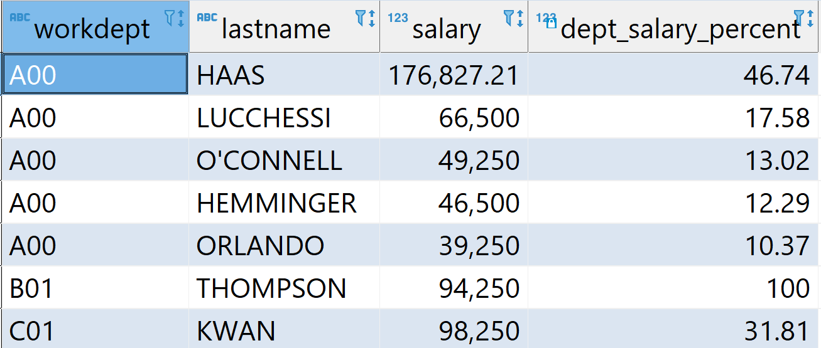
OVER with Aggregates
OVER clause can take advantage of aggregate functions (SUM, AVG, CORRELATION, etc) and operates on the range of rows in the window and returns a single aggregate value for the range
e.g., find the percentage of each employee’s salary to the dept total
SELECT workdept, lastname, salary,
CAST(salary * 100 / SUM(salary) OVER (PARTITION BY workdept)
AS DECIMAL(5,2))
AS dept_salary_percent
FROM employee
ORDER BY workdept, dept_salary_percent DESC;
Ranking
Notes:
SELECT WORKDEPT, LASTNAME, SALARY, DECIMAL (SALARY, 15, 0) *100/SUM (SALARY)
OVER (PARTITION BY WORKDEPT) AS DEPT_SALARY_PERCENT
FROM EMPLOYEE
WHERE WORKDEPT IN ('A00', 'A11' , 'C01', 'D1', 'D11')
ORDER BY WORKDEPT, DEPT_SALARY_PERCENT DESC;

Slide 68
Alternative Approach: Using Common Table Expression
Find the percentage of each employee’s salary to the dept total:
WITH SUM_DEPT_SALARY AS (
SELECT WORKDEPT, SUM(SALARY) AS SUM_SALARY
FROM EMPLOYEE
GROUP BY WORKDEPT
)
SELECT e.WORKDEPT, e.LASTNAME, e.SALARY,
SALARY*100/a.SUM_SALARY AS DEPT_SALARY_PERCENT
FROM EMPLOYEE e, SUM_DEPT_SALARY a
WHERE e.WORKDEPT = a.WORKDEPT
ORDER BY e.WORKDEPT, DEPT_SALARY_PERCENT DESC;
Ranking
Notes:
WITH SUM_DEPT_SALARY AS (
SELECT WORKDEPT, SUM(SALARY) AS SUM_SALARY
FROM EMPLOYEE
GROUP BY WORKDEPT
)
SELECT WORKDEPT, LASTNAME, SALARY,
DECIMAL (SALARY, 15,0)*100/a.SUM_SALARY
FROM EMPLOYEE e and SUM_DEPT_SALARY a
WHERE e.WORKDEPT = a.WORKDEPT AND
e.WORKDEPT IN ('A01', 'A11', 'B01',
'C01', 'D1', 'D11');

Slide 69
Summary of Partitioning (OVER) Based Operations
Category | Functions
Aggregates | SUM(), AVG(), COUNT(), MIN(), MAX() e.g., SUM(salary) OVER (PARTITION BY workdept)
Ranking | ROW_NUMBER(), RANK(), DENSE_RANK(), NTILE() e.g.,: RANK() OVER (PARTITION BY workdept ORDER BY salary DESC)
Offsets | LAG(), LEAD(), FIRST_VALUE(), LAST_VALUE() e.g.: FIRST_VALUE(salary) OVER (PARTITION BY workdept ORDER BY hiredate)
Distributions | PERCENT_RANK(), CUME_DIST(), NTH_VALUE() PERCENT_RANK() OVER (PARTITION BY workdept ORDER BY salary)
NTILE(n) | Divides rows into n buckets | NTILE(4) OVER (ORDER BY sales)
LAG(expr, offset, default) | Value from previous row | LAG(salary, 1, 0) OVER (PARTITION BY dept ORDER BY id)
LEAD(expr, offset, default) | Value from next row | LEAD(score) OVER (ORDER BY test_date)
FIRST_VALUE() | First value in the window frame | FIRST_VALUE(salary) OVER (PARTITION BY dept ORDER BY hire_date)
LAST_VALUE() | Last value in the window frame | LAST_VALUE(score) OVER (ORDER BY date ROWS BETWEEN UNBOUNDED PRECEDING AND UNBOUNDED FOLLOWING)
PERCENT_RANK() | Relative rank (0 to 1) | PERCENT_RANK() OVER (PARTITION BY dept ORDER BY salary)
CUME_DIST() | Cumulative distribution (0 to 1) | CUME_DIST() OVER (ORDER BY score)
NTH_VALUE(expr, n) | Returns the nth value in window | NTH_VALUE(score, 2) OVER (ORDER BY date)

Slide 70
Moving Window

Slide 71
Windowing
Work on a "window" of matching rows. This window can be defined as:
  All matching rows
  All matching rows within a partition
  Sliding windows: some moving subset of the matching rows (within a partition, if defined)
A moving window has to have an ORDER BY clause so that the set of matching rows can be determined
Window size partitions
  UNBOUNDED PRECEDING: all of the preceding rows for cumulative rows
  Number PRECEDING: The "n" preceding rows
  UNBOUNDED FOLLOWING: all of the following rows
  Number FOLLOWING: the "n" following rows
  CURRENT ROW: only the current row
Windowing
Notes:
https://www.ibm.com/support/knowledgecenter/SSEPGG_11.5.0/com.ibm.db2.luw.sql.ref.doc/doc/r0023461.html

Slide 72
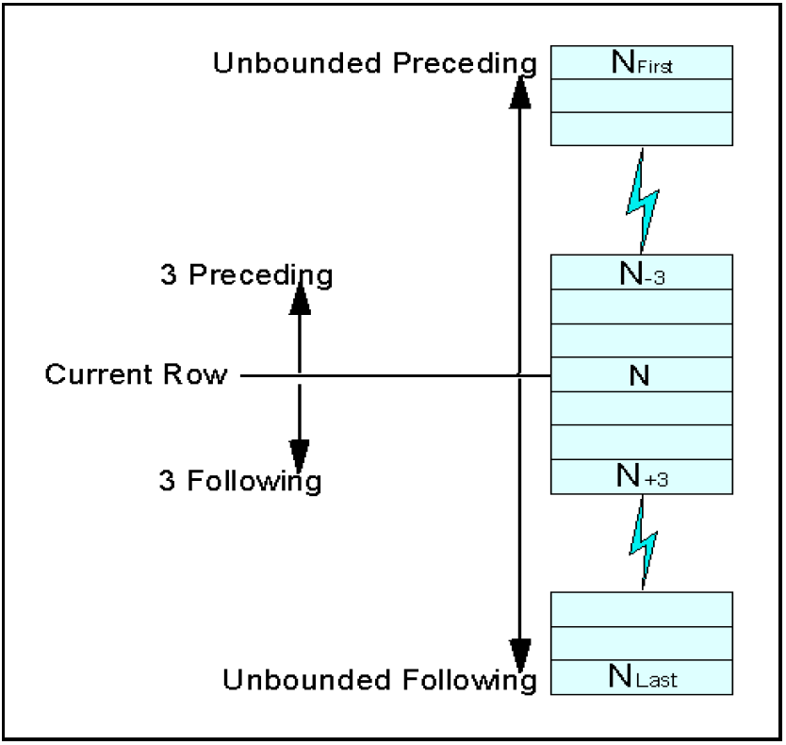
Windowing Relationships
Attribute order
row (or range)
Windowing

Slide 73
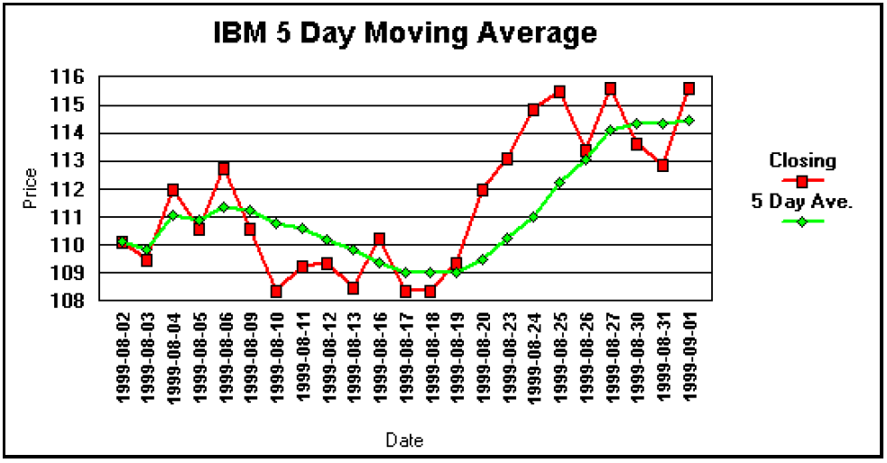
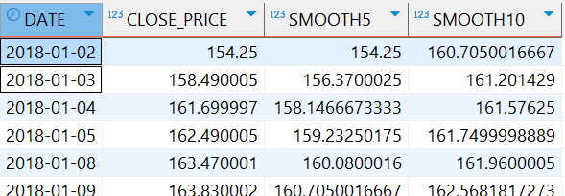
A Window Example: Moving Average
e.g., IBM stock five day moving average
SELECT date, close_price,
avg (close_price) OVER (ORDER BY DATE ROWS 5 PRECEDING) AS SMOOTH5,
avg (close_price) OVER
(ORDER BY DATE ROWS BETWEEN 5 PRECEDING AND 5 FOLLOWING) AS SMOOTH10
FROM stocktab;
Windowing

Slide 74
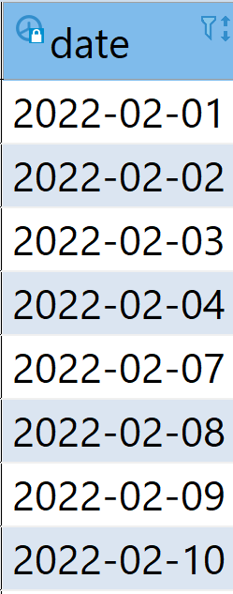
Rows versus Range
A moving window of rows to be evaluated (relative to the current row) can be defined using either the ROW or RANGE expressions
ROWS: refer to the "n" rows in the table before and/or after (within the partition), as defined by the ORDER BY
RANGE: refer to those rows before and/or after (within the partition) that are within a range (e.g., 5 days) of the current row, as defined by the ORDER BY
SELECT DATE,SYMBOL,CLOSE_PRICE,AVG(CLOSE_PRICE) OVER
(ORDER BY DATE RANGE 5 PRECEDING) AS SMOOTH
FROM STOCKTAB
WHERE SYMBOL = 'IBM';
5 rows
5 days
Windowing
Notes:
Other databases have similar OVER based queries for Windows.
e.g.: Oracle:
https://blogs.oracle.com/oraclemagazine/a-window-into-the-world-of-analytic-functions

Slide 75
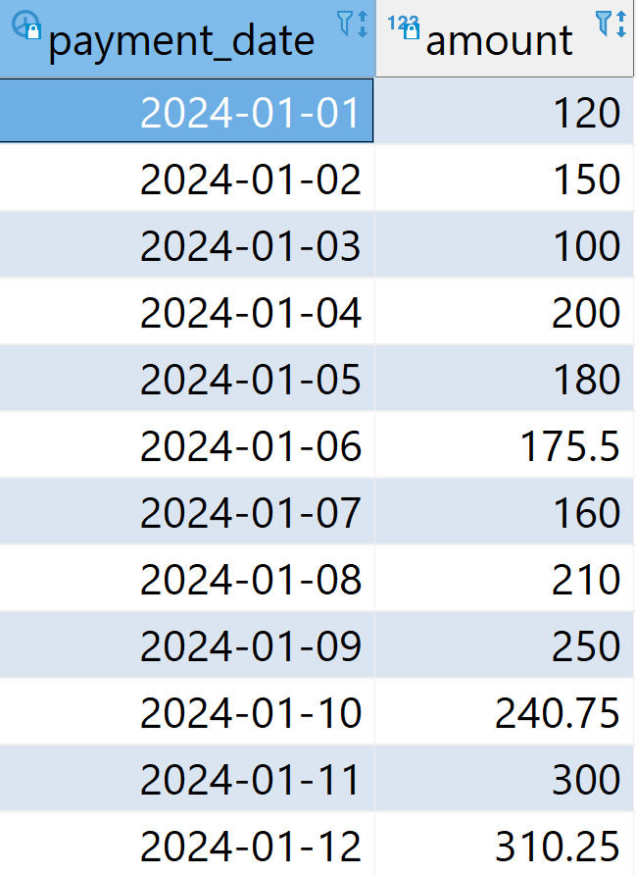
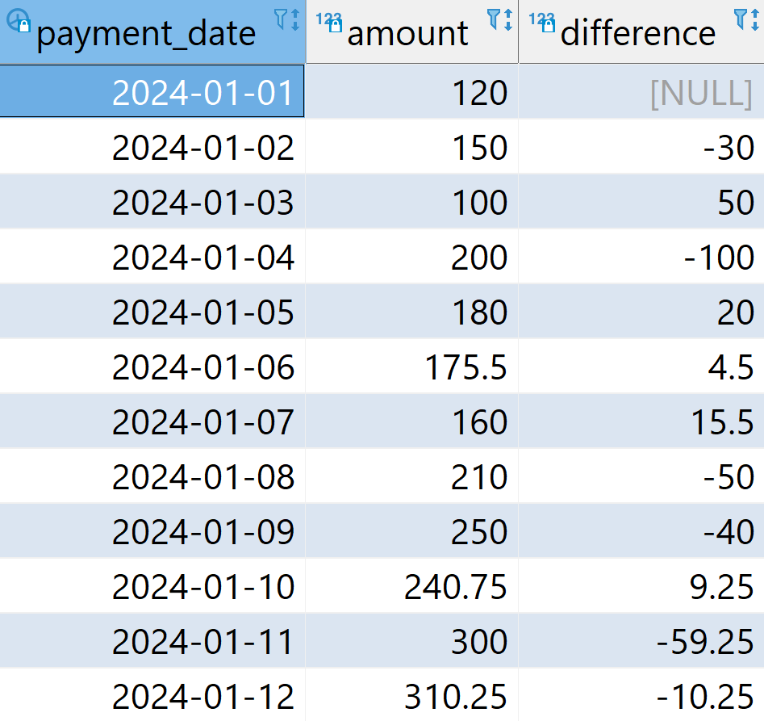
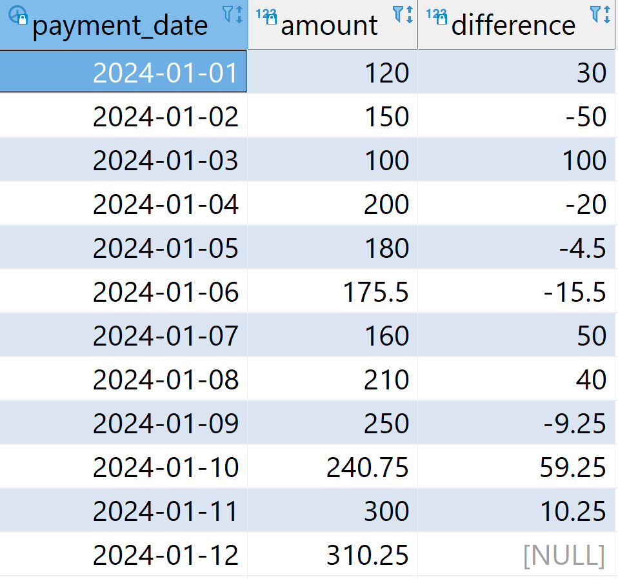
LAG/LEAD
Lag: window function that lets you look back at a previous row's value
e.g., the difference in the amounts paid between each day and the last one
Lead: diff in the amounts paid between each day and the next one
SELECT payment_date, amount, LAG(amount)
OVER (ORDER BY payment_date) - amount AS diff
FROM payment p
ORDER BY payment_date;
payment
lag
lead

Slide 76
Overview
Recursive queries
Super groups
Pivoting
Aggregate/ statistics functions
Ranking
Windowing
Materialized query tables/materialized views

Slide 77
Materialized Query Tables/Materialized Views

Slide 78
Materialized Query Table/Materialized View
Materialized view/materialized query table(MQT) is a database object that contains the results of a query
Basic idea:
  Query results caching - pre-compute and store (in database tables) the results of frequently issued queries
  Query optimizer automatically and transparently replace portions of future queries with direct references to the pre-computed (i.e., materialized) results
Standard technique in data warehousing, also known as aggregate tables and aggregate (re-)routing, or as materialized views
Materialized views
Notes:
http://www.ibm.com/developerworks/data/library/techarticle/0208kuznetsov/0208kuznetsov.html
http://download.oracle.com/docs/cd/B10500_01/server.920/a96520/mv.htm
http://www.benjaminarai.com/benjamin_arai/index.php?display=/postgresql_materialized_views.php

Slide 79
Usages of MQTs – At a High Level
Aggregate data over one or more dimensions
Join and aggregate data over a group of tables
Data from a commonly accessed subset of data, that is, from a "hot" horizontal or vertical database partition
Materialized views
Notes:
Repartitioned data from a table, or part of a table, in a partitioned database environment

Slide 80
How Query Can Be Routed to MQT
Knowledge of MQTs is integrated into the SQL compiler
SELECT t.month_id,
f.store_id,
p.group_id,
sum(amount) as total_sales
FROM sales f, product p, time t
WHERE f.date_id = t.date_id
AND f.product_id = p.product_id
GROUP BY t.month_id, f.store_id,
p.group_id
MQT_SalesByMthStrGrp
Original Query
SELECT t.month_id,
f.store_id,
p.group_id,
sum(amount) as total_sales
FROM sales f, product p, time t
WHERE f.date_id = t.date_id AND
f.product_id = p.product_id
AND t.month_id = 200812
GROUP BY t.month_id, f.store_id, p.group_id
Rewritten Query
SELECT m.month_id,
m.store_id,
m.group_id,
m.total_sales
FROM MQT_SalesByMthStrGrp m
WHERE m.month_id = 200812
Route Query to MQT
Materialized views

Slide 81
MQT Creation
MQTs are created using the CREATE TABLE statement
Immediately after creation, the MQT is empty and not accessible. It is populated using the REFRESH TABLE statement
After running the REFRESH, the MQT becomes accessible
CREATE TABLE MQT_SalesByMthStrGrp AS
(SELECT t.month_id,
f.store_id,
p.group_id,
sum(amount) as total_sales
FROM sales f, product p, time t
WHERE f.date_id = t.date_id AND
f.product_id = p.product_id
GROUP BY t.month_id, f.store_id, p.group_id)
DATA INITIALLY DEFERRED
REFRESH DEFERRED;
REFRESH TABLE MQT_SalesByMthStrGrp;
RUNSTATS ON TABLE petrus.MQT_SalesByMthStrGrp
WITH DISTRIBUTION AND DETAILED INDEXES ALL;
Materialized views

Slide 82
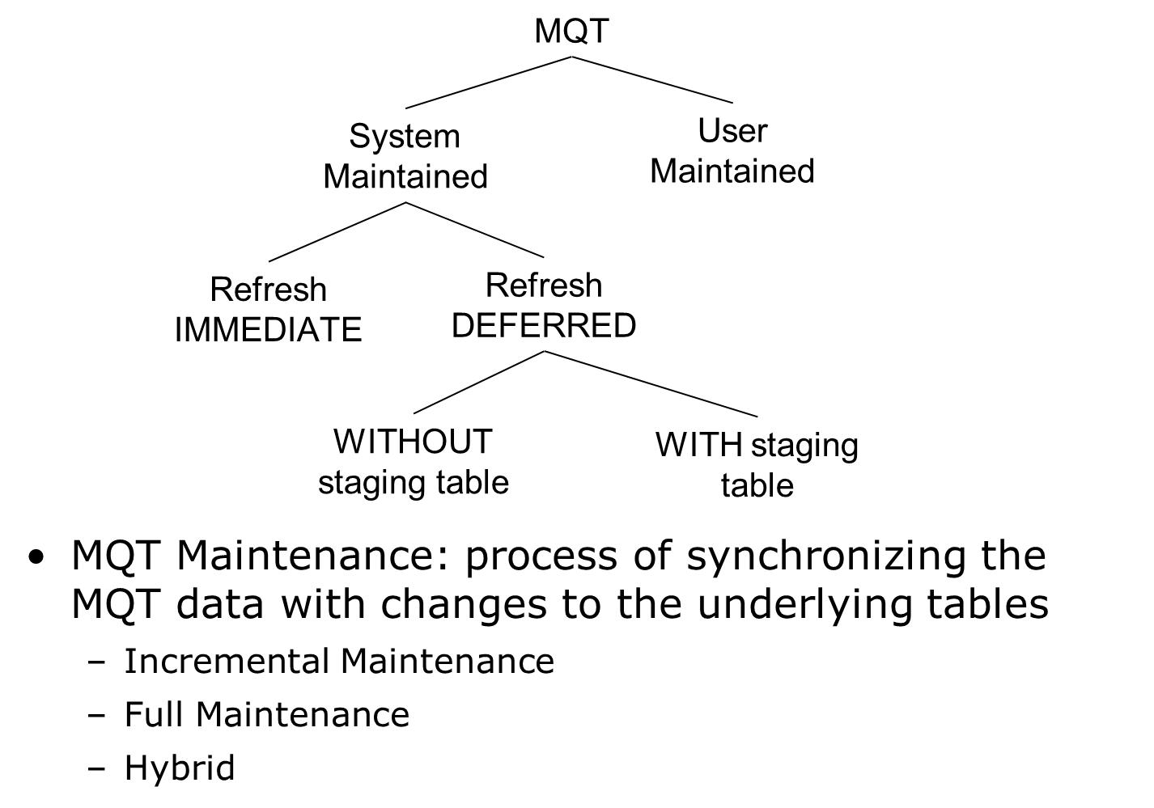
Types of MQTs
https://www.ibm.com/docs/en/db2/12.1?topic=tables-materialized-query
Materialized views
Notes:
https://www.ibm.com/docs/en/db2/12.1?topic=tables-materialized-query

Slide 83
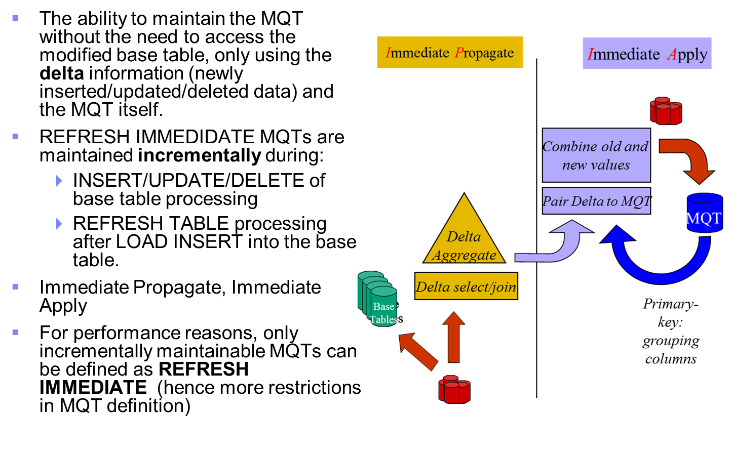
Incremental Maintenance: Apply Changes Immediately
Materialized views

Slide 84
Full Maintenance: Fully Rebuilt by Re-evaluating Query
MQTs are fully rebuilt by re-evaluating the query in the MQT definition
REFRESH DEFERRED MQTs (without staging table):
  not maintained during INSERT/UPDATE/DELETE operations on the base table.
  synchronized with base table using the REFRESH TABLE statement
MQT
Aggregate
select/join
base
base
base
Base
Tables
tables
tables
tables
Materialized views

Slide 85
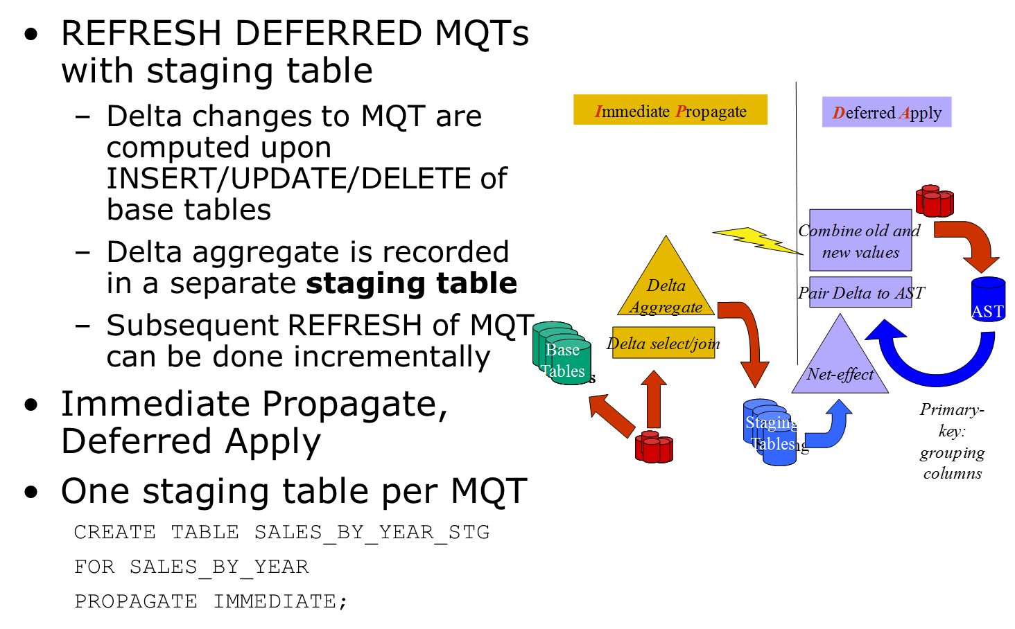
Hybrid - Immediate Propagate, Deferred Applied
Materialized views

Slide 86
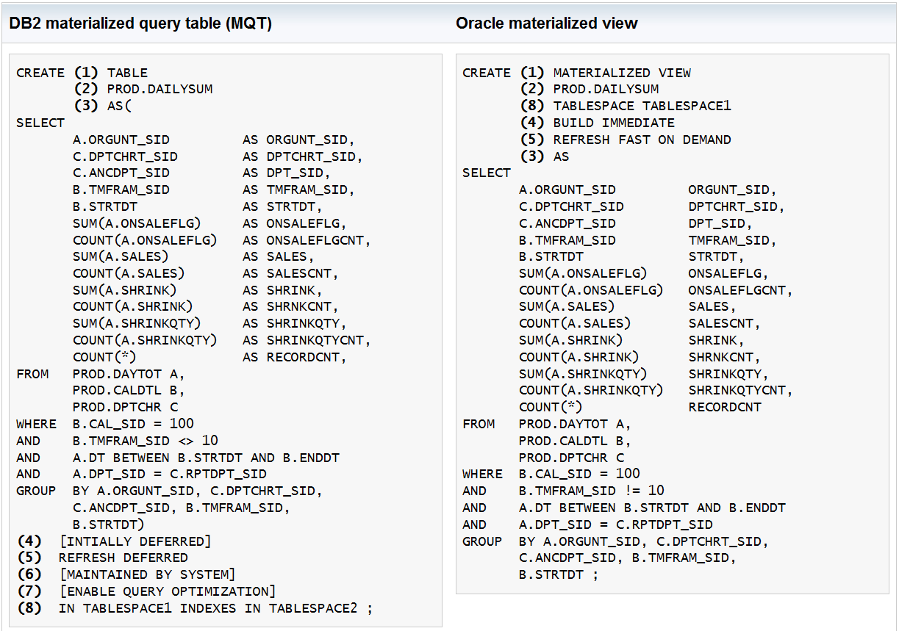
DB2 MQT vs Oracle Materialized Views
MysQL doesn’t support materialized view
Materialized views

Slide 87
Support of Materialized Views
Oracle Database, Microsoft SQL Server, IBM Db2, SAP HANA, PostgreSQL, Amazon Redshift, Google BigQuery, Snowflake, Azure SQL Database
(Note: MySQL, MariaDB, and SQLite have partial or workaround solutions but lack native materialized view support.)

Slide 88
Summary
OLAP supergroups and analytical functions are highly efficient as often a single table scan is needed
Materialized view provides caching and maintenance of summary results for optimizing queries
More complex data analysis such as data mining/statistics could be supported by:
  User defined aggregate (UDA) (Teradata, MS SQL Server, Oracle, etc, performance varies)
  Stored procedures
  User defined functions (UDF) could be an alternative solution

