Slide 1

CSE 331: Computer Security Fundamentals
Spring 2026
Class Overview
Amir Rahmati
Xinrui Yu

Slide 2
Join the Class on Teams!
Invitation code:
bc83shx
Everything is on Teams: Syllabus, Textbook, Slides, Homework
Slides will be uploaded after each class.
If you have questions, send me a message on Teams
Check your Teams often!

Slide 3
How do you define Computer Security?
“Computer security studies how systems can achieve their goal in the presence of an adversary.”
An intelligence that actively tries to cause the system to misbehave.

Slide 4
The Security Mindset
What does it mean
to make a system
Secure
?

Slide 5
Key Properties: The CIA Triad
Confidentiality: the property, that information is not made available or disclosed to unauthorized individuals, entities, or processes
Integrity: The property that sensitive data has not been modified or deleted in an unauthorized and undetected manner
Availability: Ensuring timely and reliable access to and use of information.

Slide 6
Are These Enough?
Privacy: The right of an entity, acting in its own behalf, to determine the degree to which it will interact with its environment, including the degree to which the entity is willing to share information about itself with others.
Anonymity: The state of being not identifiable within a set of subjects, the anonymity set.
Notes:
Anonymity: mask.
Privacy: one-to-one conversation.

Slide 7
Threat Model

Slide 8
Thinking Like an Attacker
Look for weakest links.
Identify assumptions that security depends on.
    Are they false?
Think outside the box
    Don’t be constrained by system designer’s worldview.
Practice thinking like an attacker:
    what does it means for the system to be secure?
    How could it be exploited by an attacker?

Slide 9
Why Study Attacks?
Identify vulnerabilities so they can be fixed.
Create incentives for vendors to be careful.
Learn about new classes of threats.
Determine what we need to defend against.
Help designers build stronger systems.
Help users more accurately evaluate risk.

Slide 10
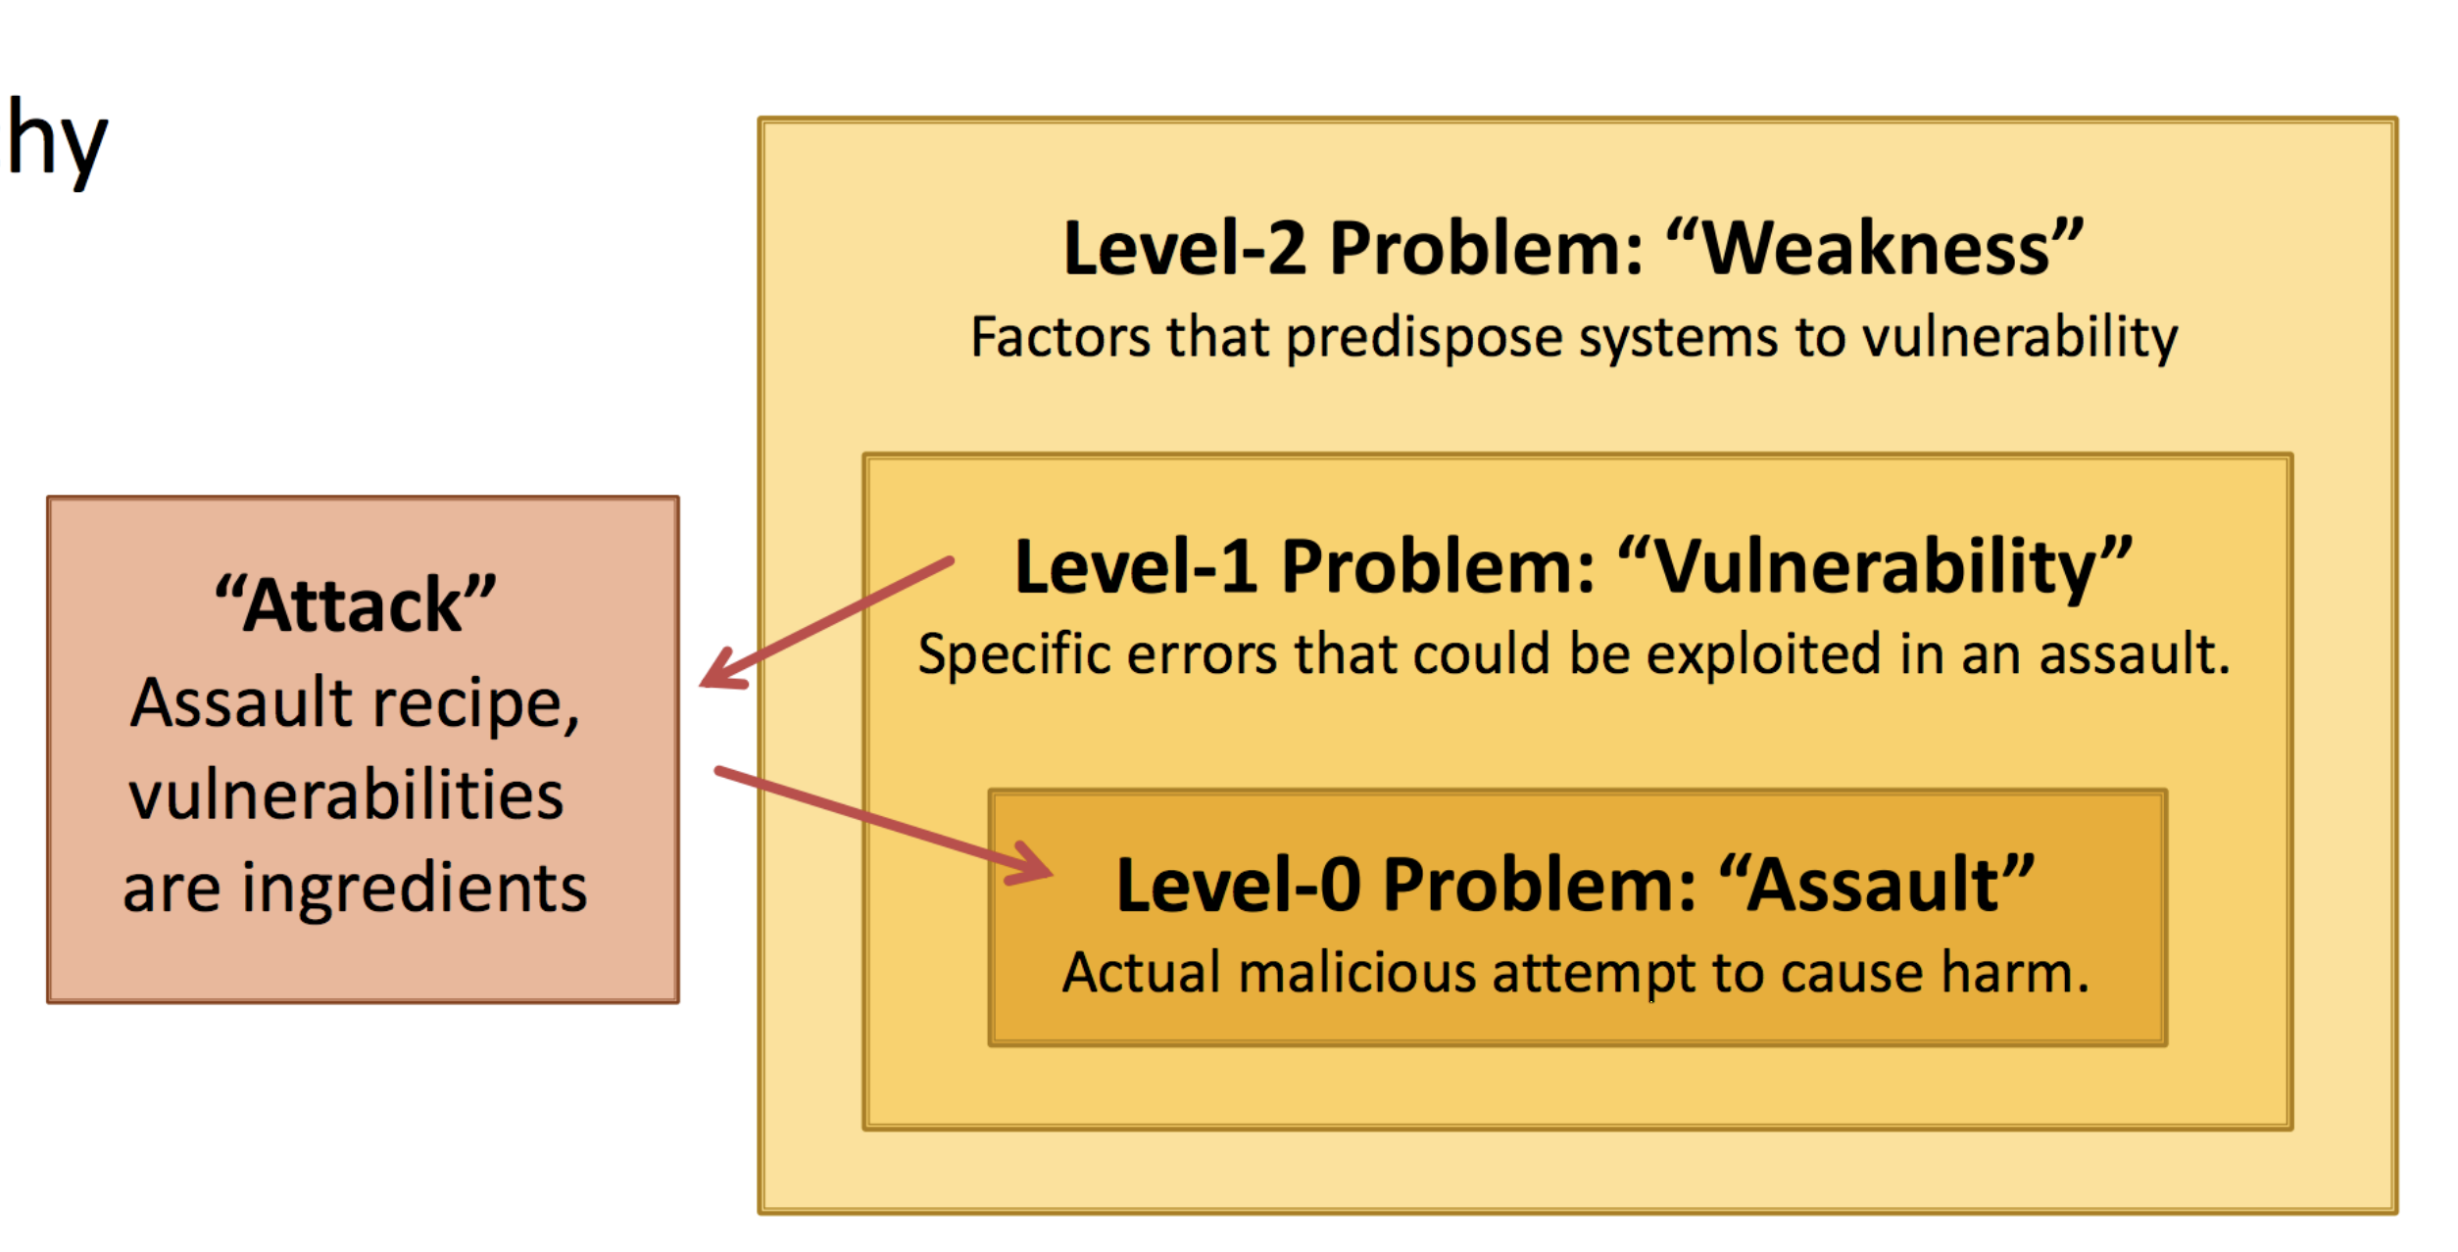
The Attacker Process

Slide 11
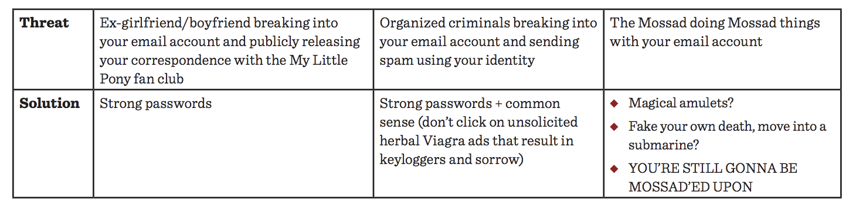
The World of Ours

Slide 12
The $5 Wrench

Slide 13
Play Fair!
Breaking into systems is illegal!
Unauthorized data access is illegal!
Computer Fraud and Abuse Act (CFAA)
http://www.justice.gov/criminal/cybercrime/docs/ccmanual.pdf
Practice on your own systems or controlled environment

Slide 14
Thinking as a Defender
Security policy
    What are we trying to protect?
    What properties are we trying to enforce?
Countermeasures
    Costs vs. Benefits?
    Technical vs. nontechnical?
Challenge is to think rationally and rigorously about risk.
Rational paranoia.

Slide 15
Cost - Benefit Analysis
The Pintos Memo
fuel system modifications
$11 cost per car X 12.5M cars
= $137M
human life
180 serious injuries per year X $275K cost per person
= $49.5M.

Slide 16
Many Things Can Go Wrong
Software bugs or design issues
Hardware bugs or design issues
Humans (social engineering)
Unintended characteristics
(e.g., side channels, poor sources of randomness)
Everything can be compromised.
There is no such thing as complete security.
Only degrees of security.

Slide 17
Designing Defenses
Identify the weaknesses of your design
  Focus on correcting them
Trusted components
    Parts that must function correctly for the system to be secure.
Attack surface
    Parts of the system exposed to the attacker
Complexity and Obscurity

Slide 18
End Result
“Design a mechanism
based on the threat model
that allow us to achieve our goal.”

Slide 19


The Never-Ending Cycle
Attacks
Defenses

