Slide 1
Chapter 25 INTERFERENCE
25.1 Interference and Coherent Sources
25.2 Two-Source Interference of Light
25.3 Intensity in Interference Patterns
25.4 Interference in Thin Films
25.5 The Michelson Interferometer

Slide 2
Goals for chapter 3
What happens when two waves combine, or interfere, in space.
How to understand the interference pattern formed by the interference of
two coherent light waves.
How to calculate the intensity at various points in an interference pattern.
How interference occurs when light reflects from the two surfaces of a
thin film.
How interference makes it possible to measure extremely small
distances.

Slide 3

Soapy water is colorless, but when blown into bubbles it shows vibrant colors. How does the thickness of the bubble walls determine the particular colors that appear?

Slide 4
25.1 Interference and Coherent Sources
The term interference refers to any situation in which two or more waves overlap in space. When this occurs, the total wave at any point at any instant of time is governed by the principle of superposition. This principle also applies to electromagnetic waves and is the most important principle in all of physical optics. The principle of superposition states:
When two or more waves overlap, the resultant displacement at any point and at any instant is found by adding the instantaneous displacements that would be produced at the point by the individual waves if each were present alone.

Slide 5
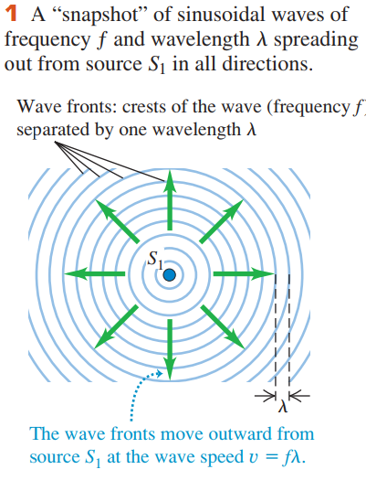
Interference in Two or Three Dimensions
Interference effects are most easily seen when we combine sinusoidal waves with a single frequency f and wavelength λ.

Slide 6
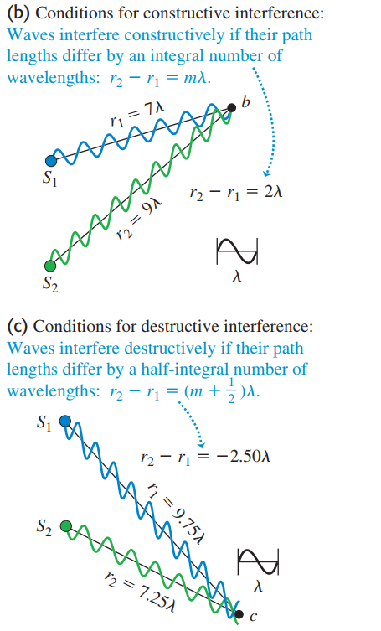
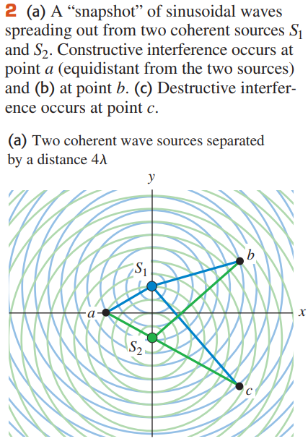
Constructive and Destructive Interference
In general, when waves from two or more sources arrive at a point in phase, they reinforce each other: The amplitude of the resultant wave is the sum of the amplitudes of the individual waves. This is called constructive interference

Slide 7


In general, when waves from two or more sources arrive at a point in phase, they reinforce each other: The amplitude of the resultant wave is the sum of the amplitudes of the individual waves. This is called constructive interference.
If the individual amplitudes are equal, then the total amplitude is zero! This cancellation or partial cancellation of the individual waves is called destructive interference.

Slide 8
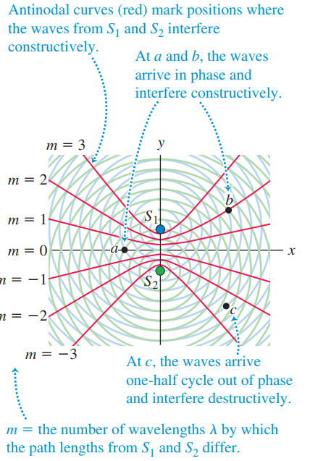
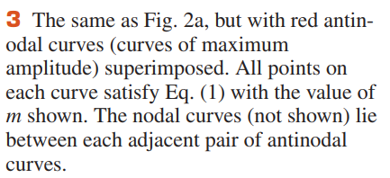
These curves are called antinodal curves.

Slide 9
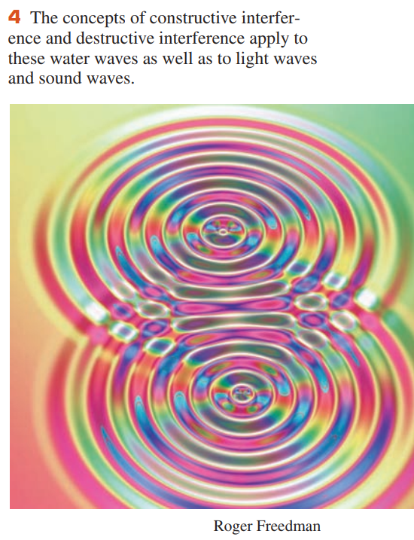
25.2 Two-Source Interference of Light
The interference pattern produced by two coherent sources of water waves of the same wavelength can be readily seen in a ripple tank with a shallow layer of water

Slide 10
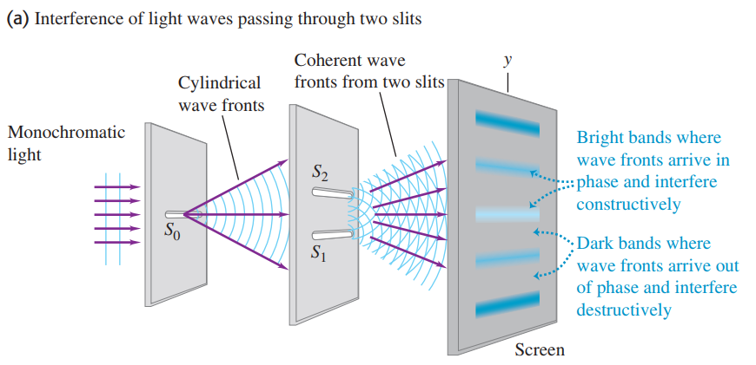
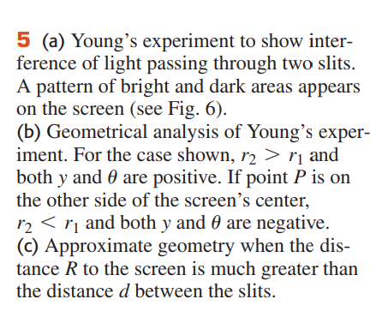
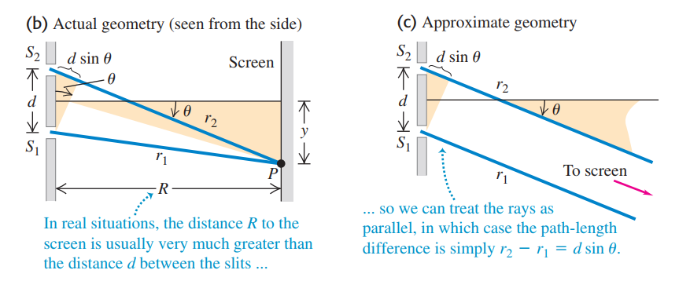


Slide 11
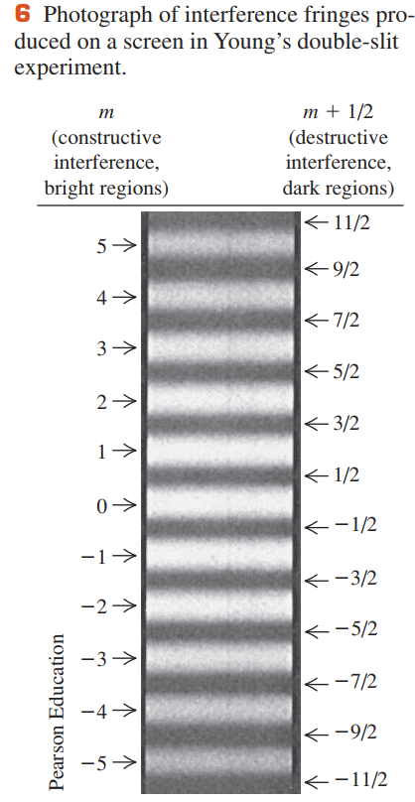




Constructive and Destructive Two-Slit Interference

Slide 12
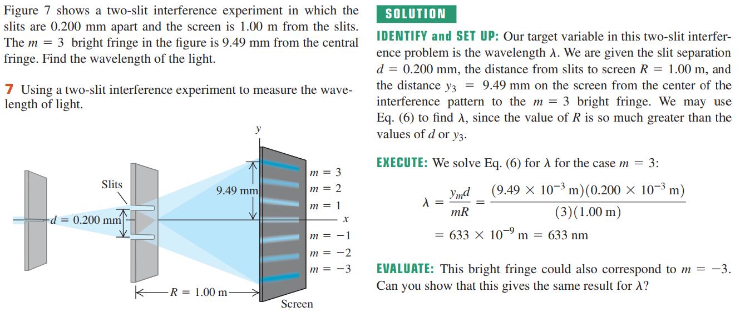
Example 25.1 Two-slit interference

Slide 13
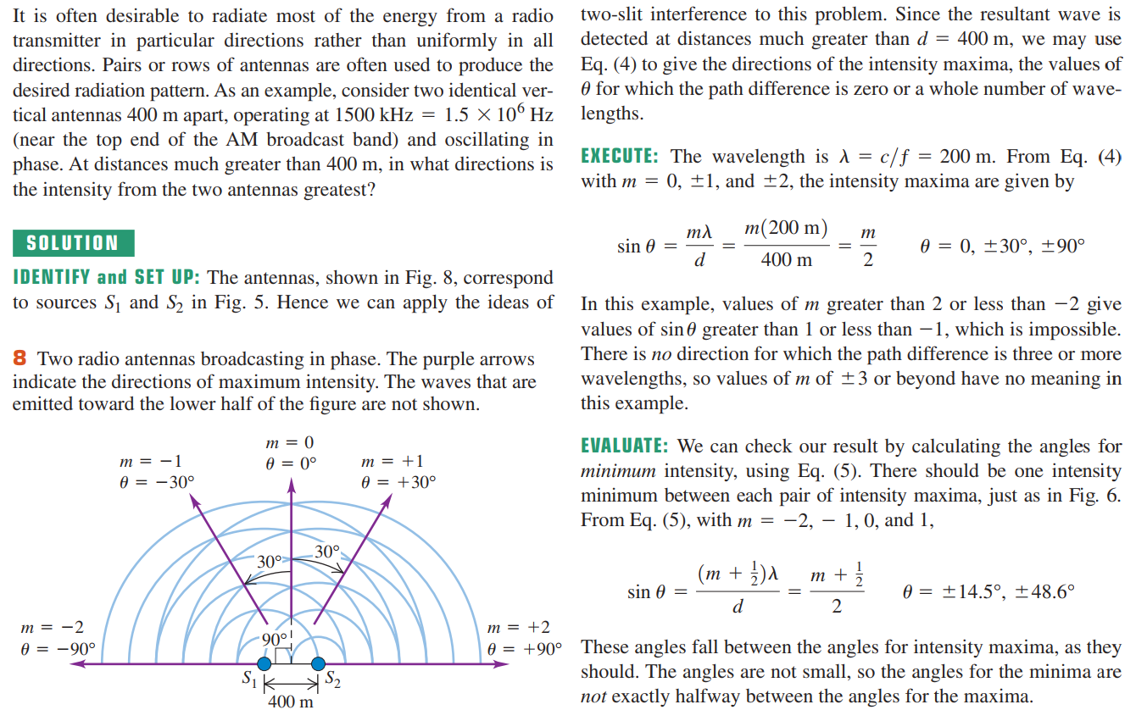
Example 25.2 Broadcast pattern of a radio station

Slide 14
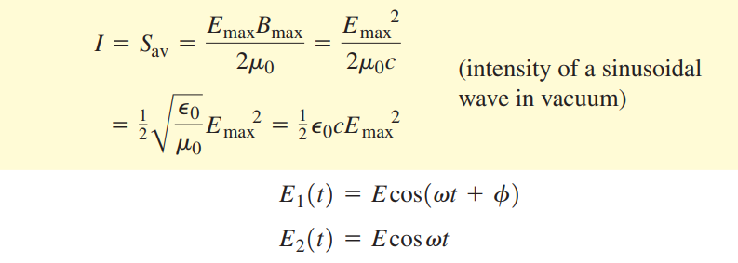
25.3 Intensity in Interference Patterns

Slide 15
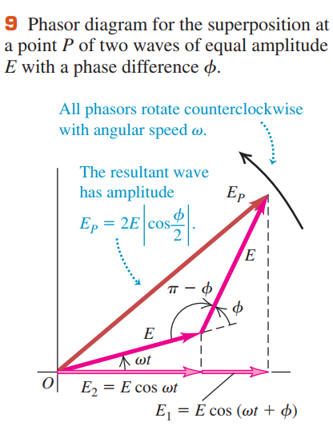




Amplitude in Two-Source Interference
Each sinusoidal function is represented by a rotating vector (phasor) whose projection on the horizontal axis at any instant represents the instantaneous value of the sinusoidal function

Slide 16




Intensity in Two-Source Interference

Slide 17






Phase Difference and Path Difference

Slide 18
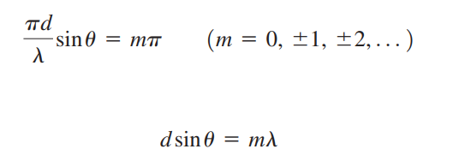

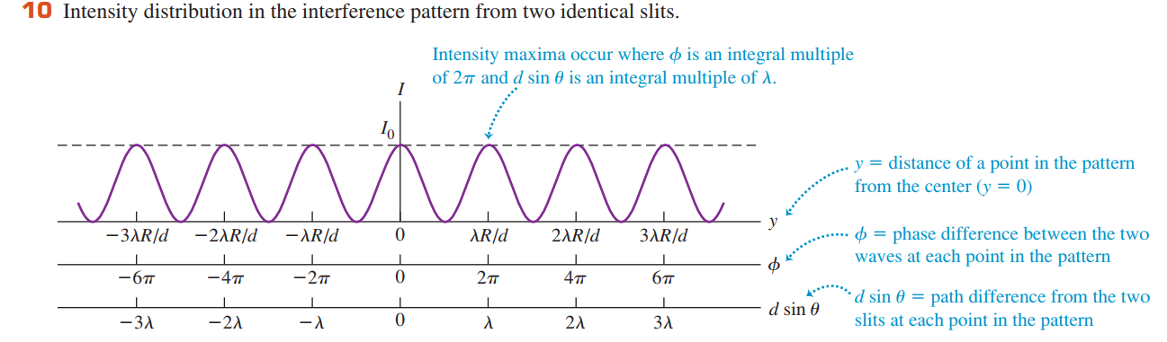

Slide 19
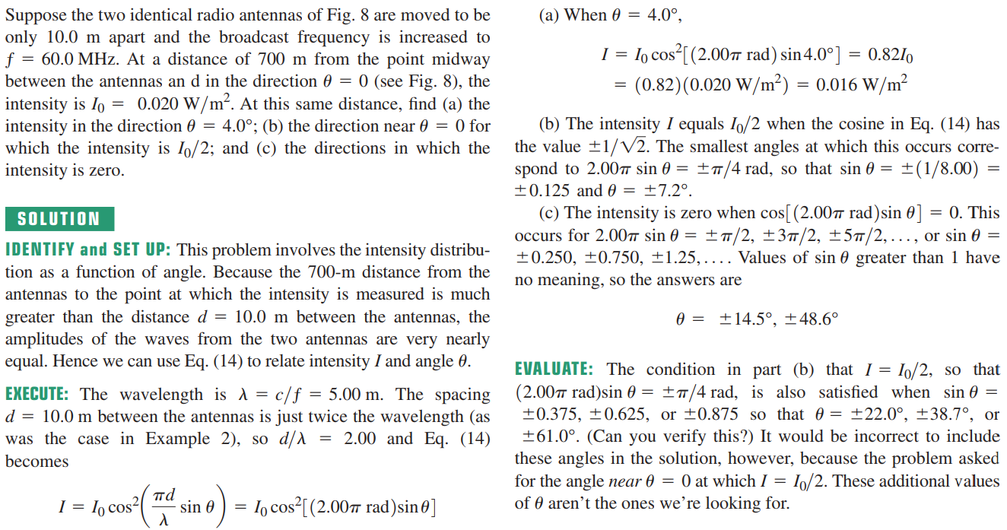
Example 25.3 A directional transmitting antenna array

Slide 20
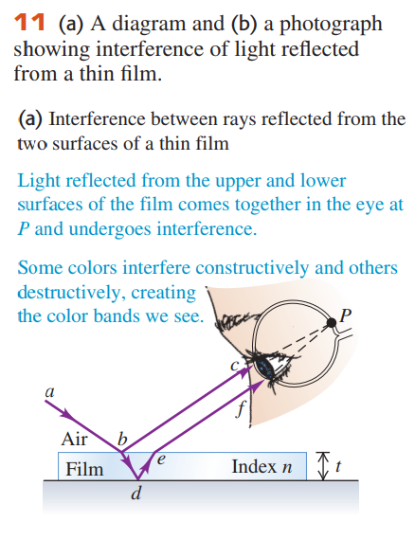
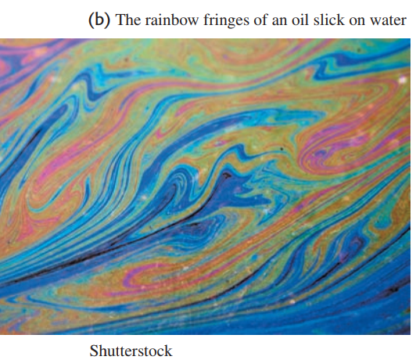
25.4 Interference in Thin Films
The complex shapes of the colored rings in each photograph result from variations in the thickness of the film.

Slide 21
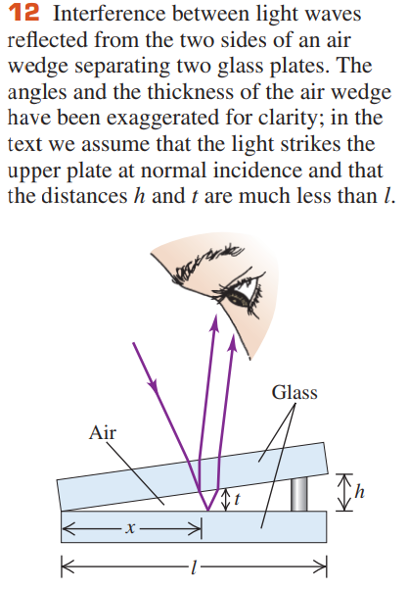

Thin-Film Interference and Phase Shifts During Reflection
The amplitude E_{r} of the wave reflected from the interface is proportional to the amplitude E_{i} of the incident wave and is given by

Slide 22
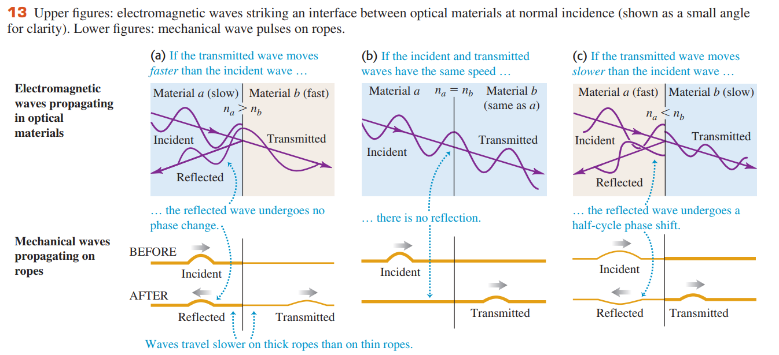

Slide 23
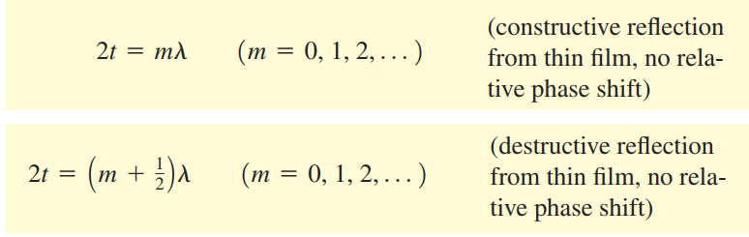
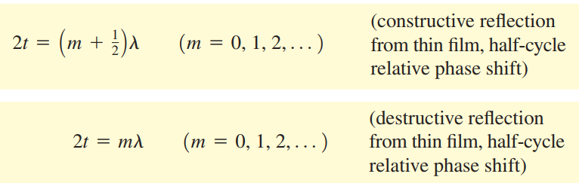
We can summarize this discussion mathematically. If the film has thickness t, the light is at normal incidence and has wavelength λ in the film; if neither or both of the reflected waves from the two surfaces have a half-cycle reflection phase shift, the conditions for constructive and destructive interference are
If one of the two waves has a half-cycle reflection phase shift, the conditions for constructive and destructive interference are reversed

Slide 24
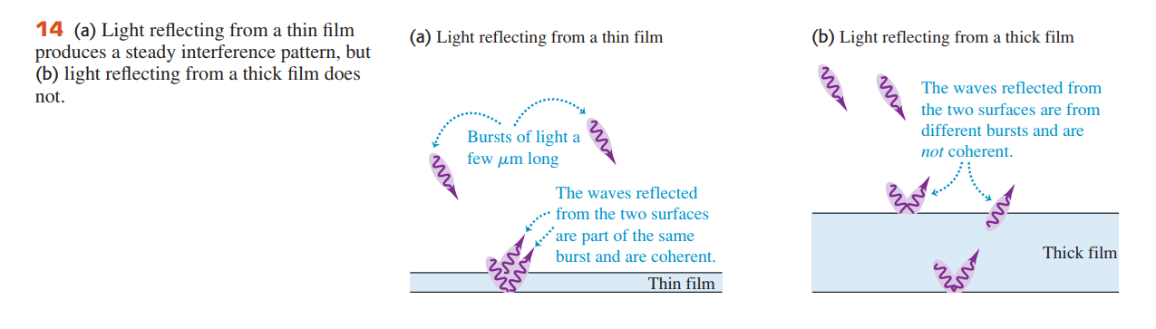

Slide 25
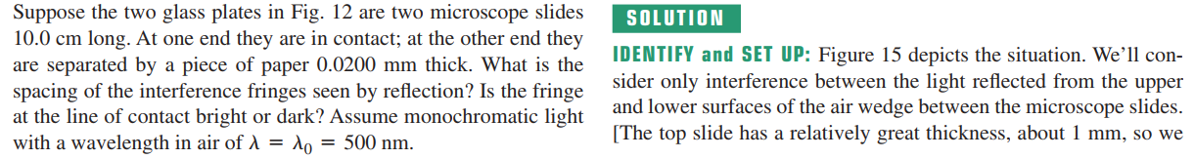
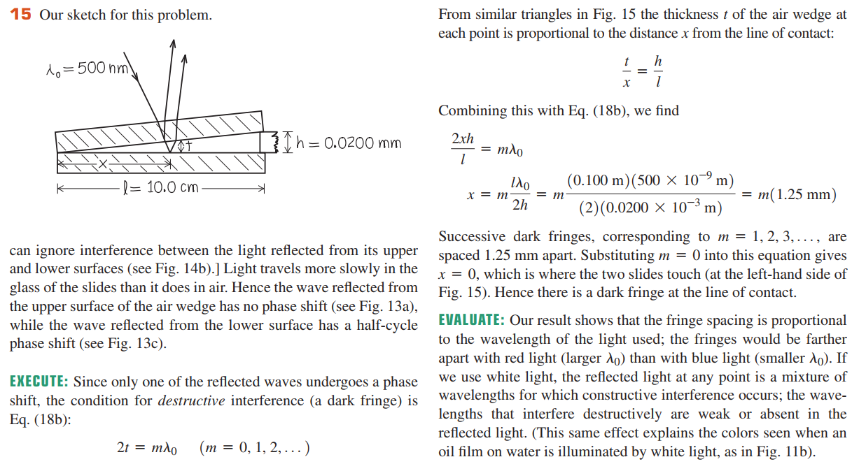
Example 25.4 Thin-film interference I

Slide 26
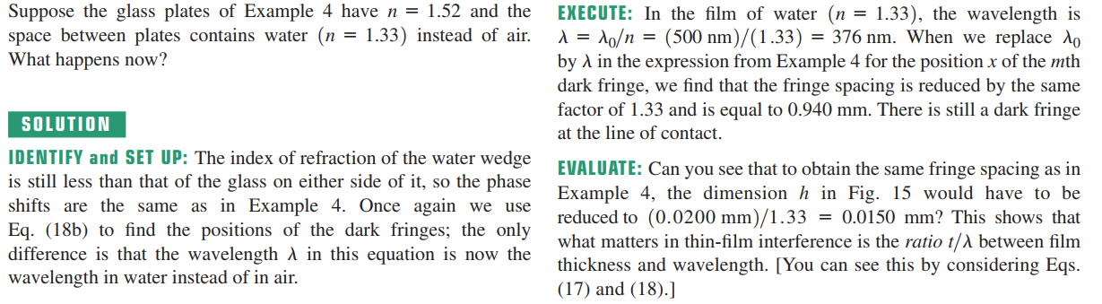
Example 25.5 Thin-film interference II

Slide 27
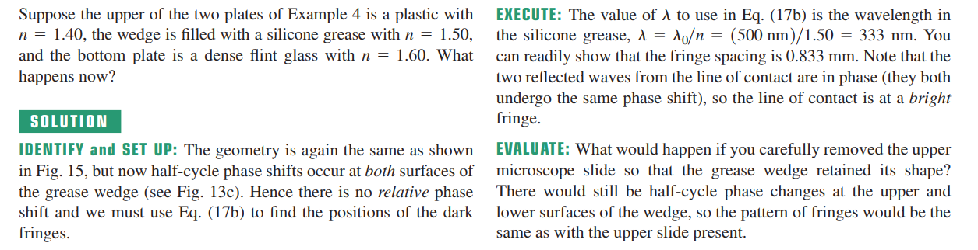
Example 25.6 Thin-film interference III

Slide 28

Example 25.7 Thin-film versus thin films
We have emphasized interference effects in rather thin films. Suppose the film in
Figure25.10 is a layer of water(n=1.33) 1.00cm thick on top of a glass surface with
n =1.52. What will you see if this rather thick film is illminated from above?
_{Solution}
IDENTIFY and SER UP: As in Example 25.6, half-cycle phase changes accur at
both the top and bottom sufaces of the film.
EXECUTE: Equation(25.17) gives the condition for constructive interference in the reflected waves. Hence the wavelengths in air that undergo constructive interference are given by
where n is theindex of refraction of water.
Because t = 1. 00 cm is large in comparison to the wavelengths of visibel light, the values of m in this equation will be large. For instance, using m=40000 in the first equation tells us that light
will be strongly reflected if it has a wavelength in air of
$$λ_{0}=nλ=\frac{2nt}{m}$$

Slide 29
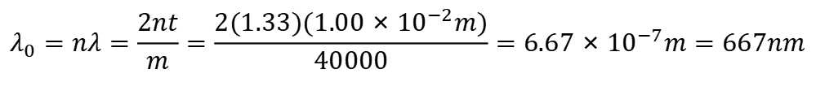
$$λ_{0}=nλ=\frac{2nt}{m}=\frac{2(1.33)(1.00×{10}^{−2}m)}{40000}=6.67×{10}^{−7}m=667nm$$
corresponding to orange-red light. You might be tempted to conclude that this thick film would appear strongly orange-red ; However,there will also be
strong reflection of a slightly longer wavelength corresponding to m=39999 and of a slightly shorter wavelength corresponding to m=40001. These wavelengths differ from each other by only one part in 40000, or (667nm)/(40000)=0.017 nm. This is a much smaller wavelength appears to be emphasized more than any other in the light that is reflected from a thick film. If you shine white light on this thick film, the reflected light appears white
EVALUATE: It’s useful to compare this situation to a thin film that is no more than a few wavelengths in thickness.

Slide 30
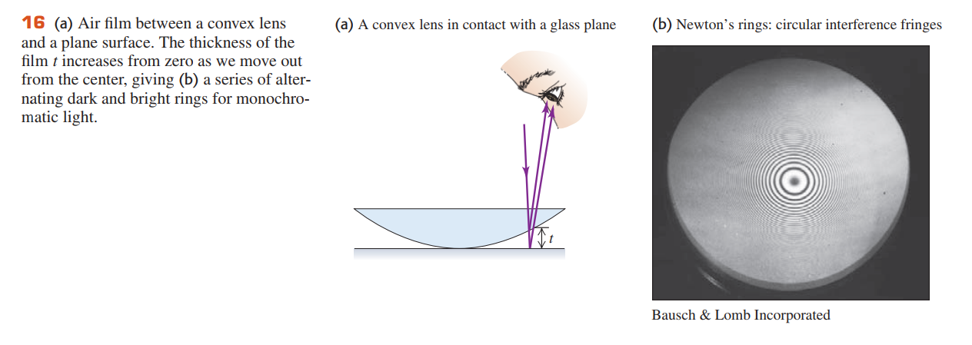
Figure 16a shows the convex surface of a lens in contact with a plane glass plate.
A thin film of air is formed between the two surfaces. When you view the setup with monochromatic light, you see circular interference fringes.

Slide 31
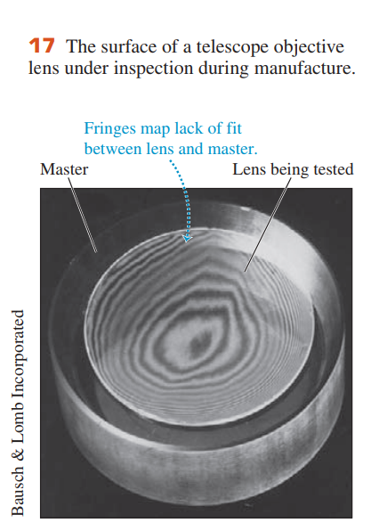
Newton’s Rings
The lower, larger-diameter, thicker disk is the correctly shaped master, and the smaller, upper disk is the lens under test. The “contour lines” are Newton’s interference fringes; each one indicates an additional distance between the specimen and the master of one half-wavelength.

Slide 32
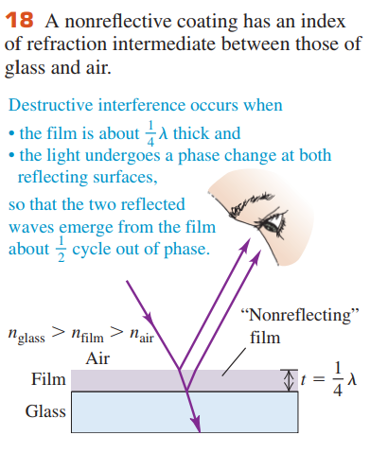
Nonreflective and Reflective Coatings
Nonreflective coatings for lens surfaces make use of thin-film interference. A thin layer or film of hard transparent material with an index of refraction smaller than that of the glass is deposited on the lens surface,

Slide 33
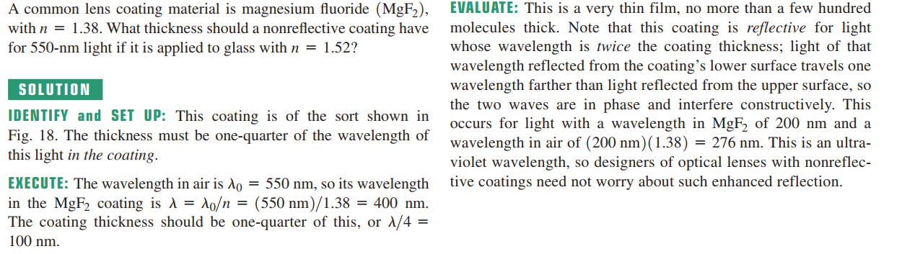
Example 25.8 A nonreflective coating

Slide 34
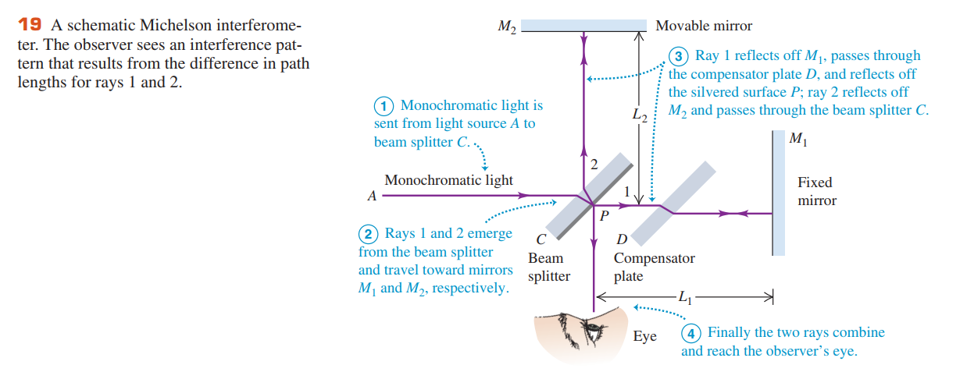

25.5 The Michelson Interferometer

