Slide 1
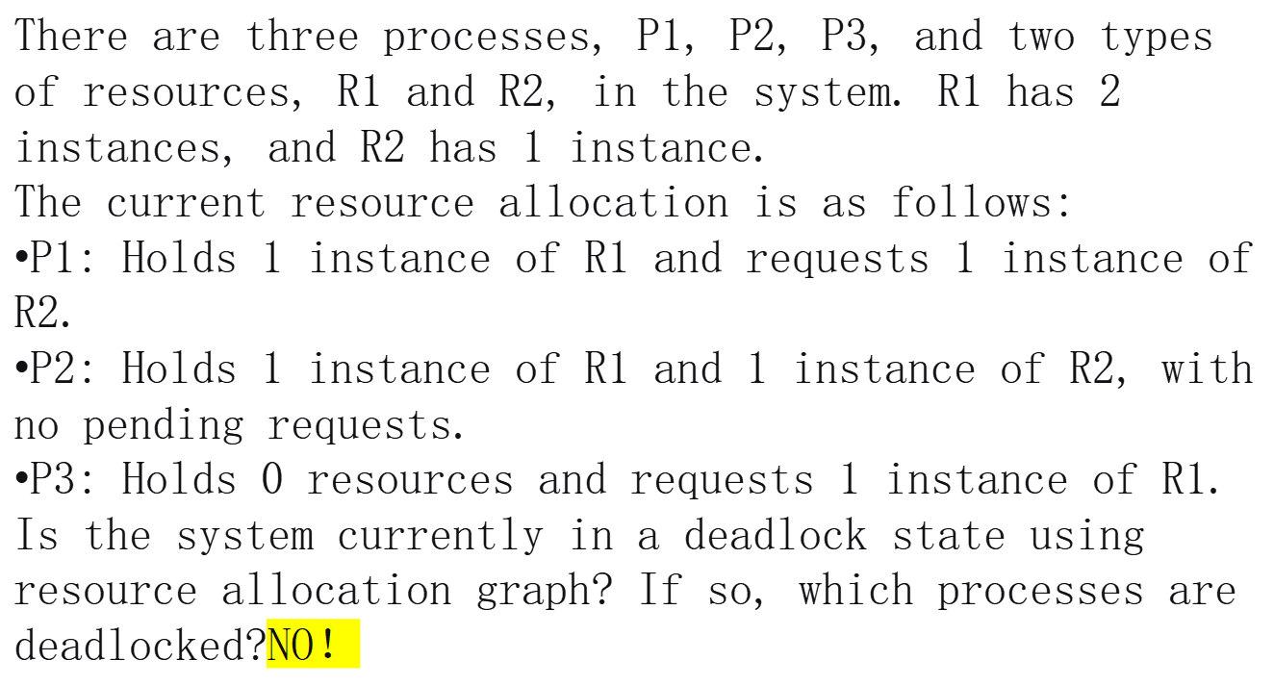
Practice1

Slide 2
R1
P1
P2
P3
R2

Slide 4
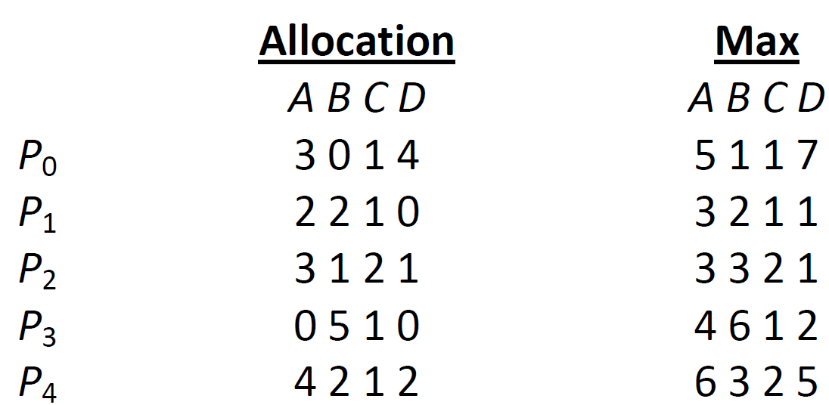
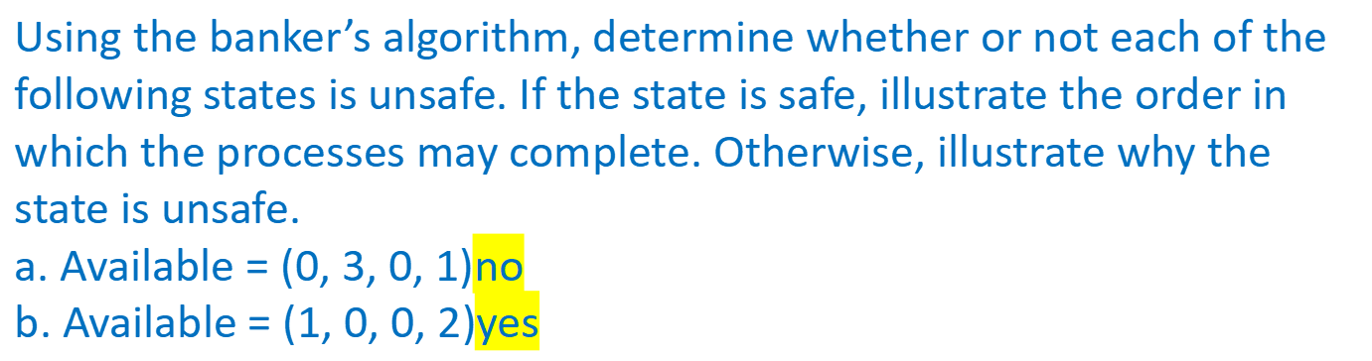
practice2
Consider the following snapshot of a system:

Slide 5
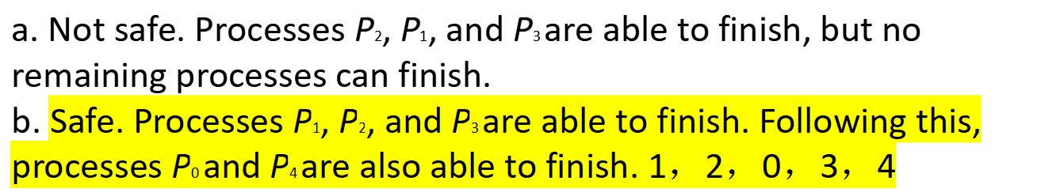
Practice2(Cont.)

Slide 7
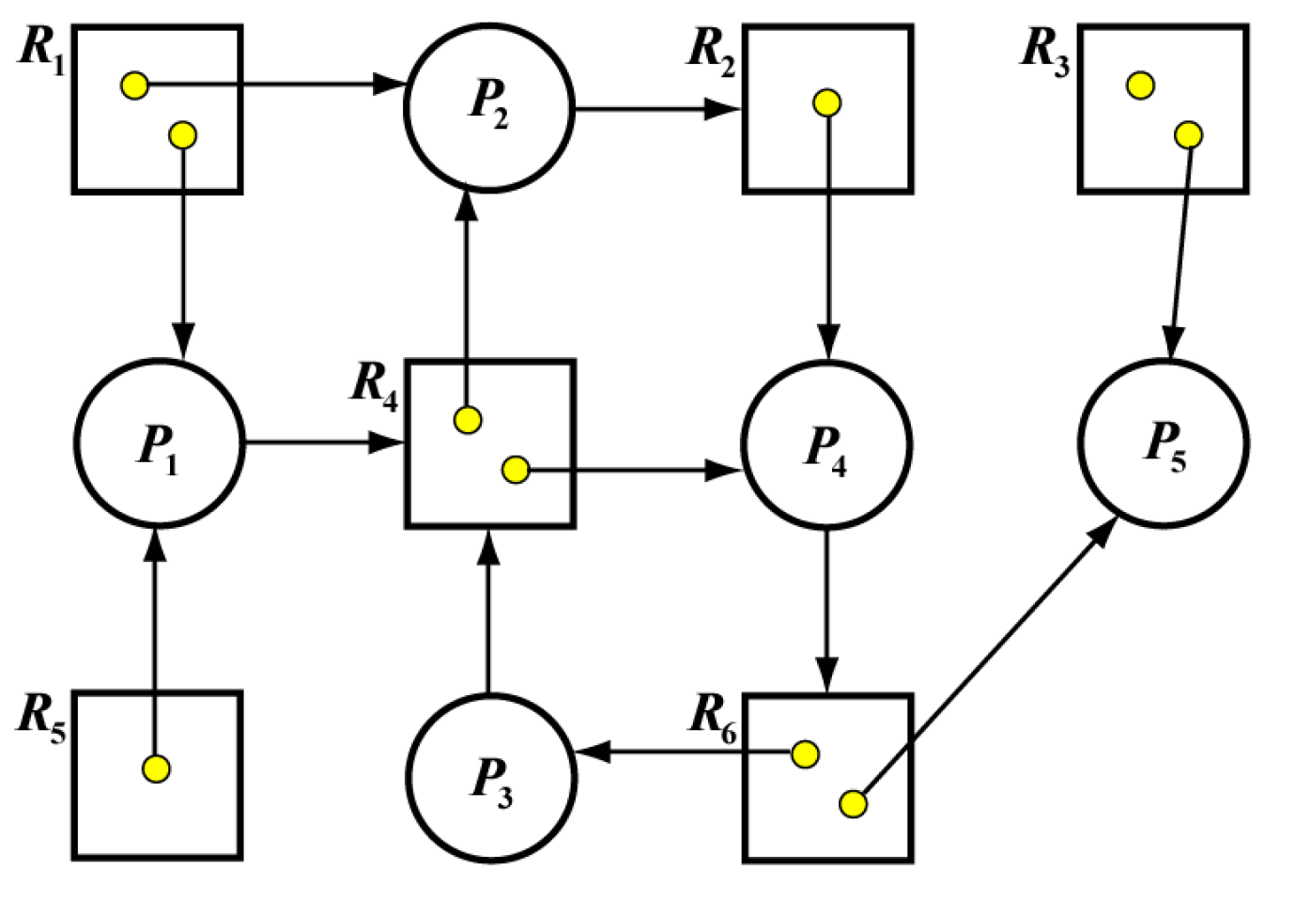
Practice3
Consider the following resource allocation graph.
Do the following problems:
(a) Convert it to the matrix representation (i.e., Allocation, Request and Available).
(b) Do a step-by-step execution of the deadlock detection algorithm. For each step, add and remove the directed edges, and redraw the resource allocation graph.
(c) Is there a deadlock? If there is a deadlock, which processes are involved?

Slide 8
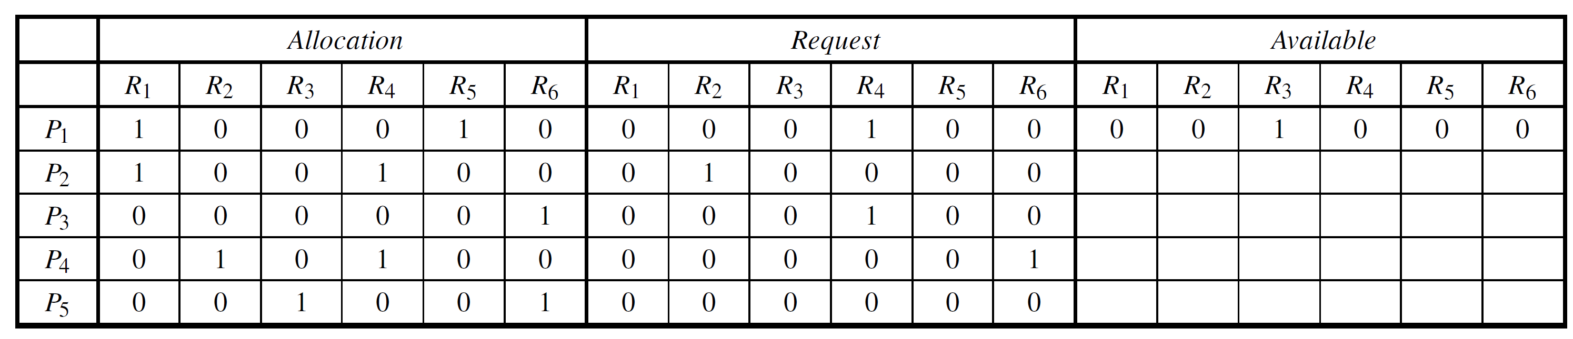
Practice3(Cont.)
(a)Note that the given resource allocation graph has cycles: P2 ->R2->P4 ->R6 ->P3 ->R4 ->P2 and P4 ->R6 ->P3 ->R4 ->P4. The following is the corresponding matrix representation（与a问题无关）

Slide 9
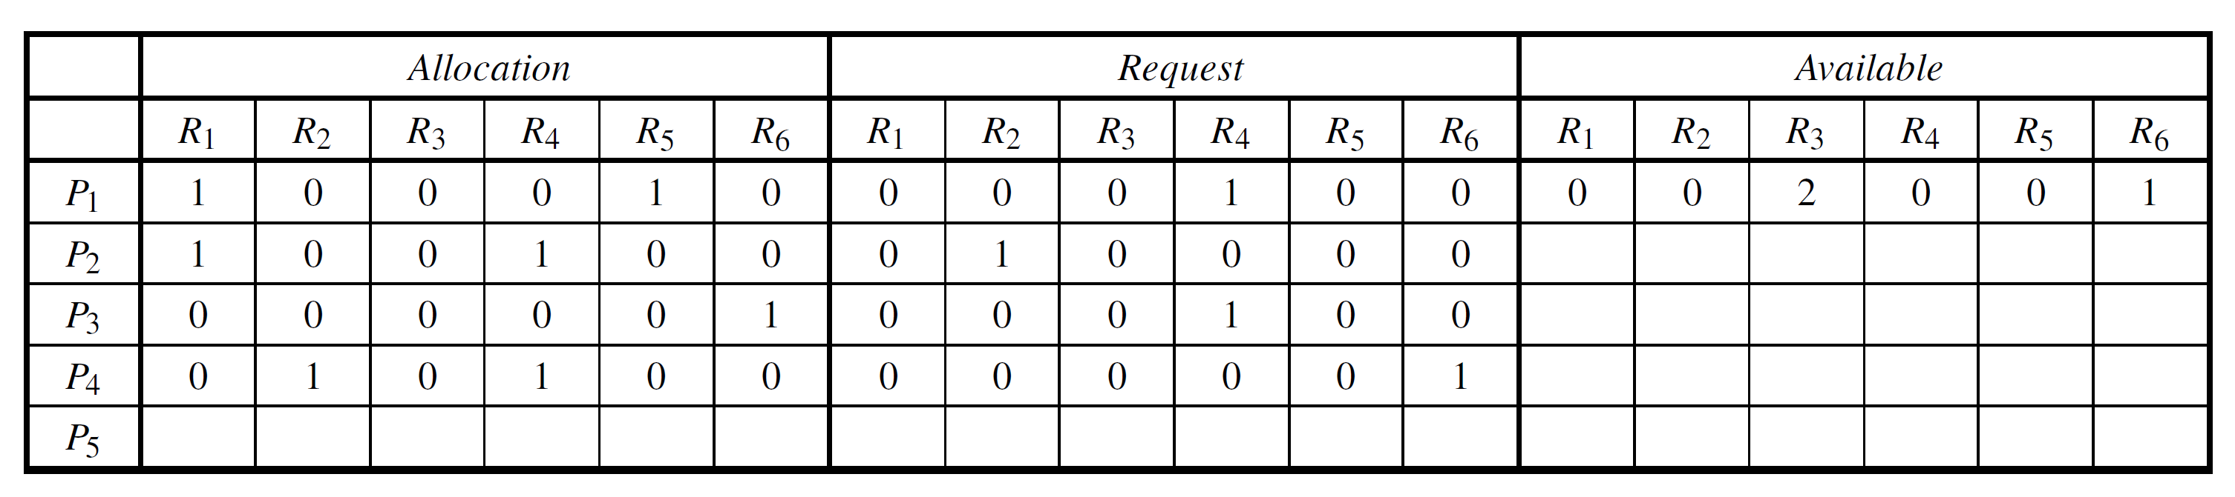
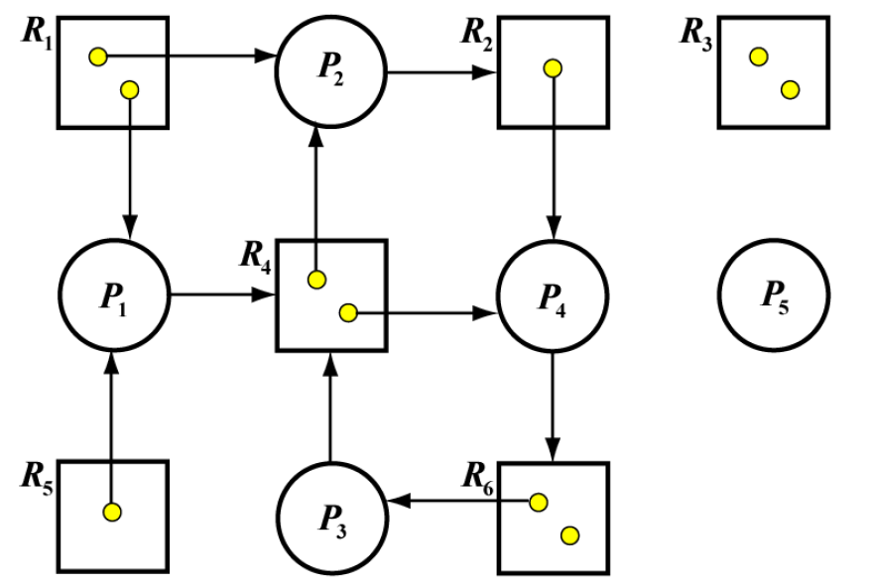
Practice3(Cont.)
（b）We can run the system based on the deadlock detection algorithm. Note that other than R3 there is no instance available in R1, R2, R4, R5 and R6. The only runnable process is P5. Because P5’s Request = [0,0,0,0,0,0] Available= [0,0,1,0,0,0,we can run P5 and reclaim its allocated resource. The new Available becomes Available = old Available + P5’s Allocation = [0,0,1,0,0,0]+[0,0,1,0,0,1] = [0,0,2,0,0,1].

Slide 10
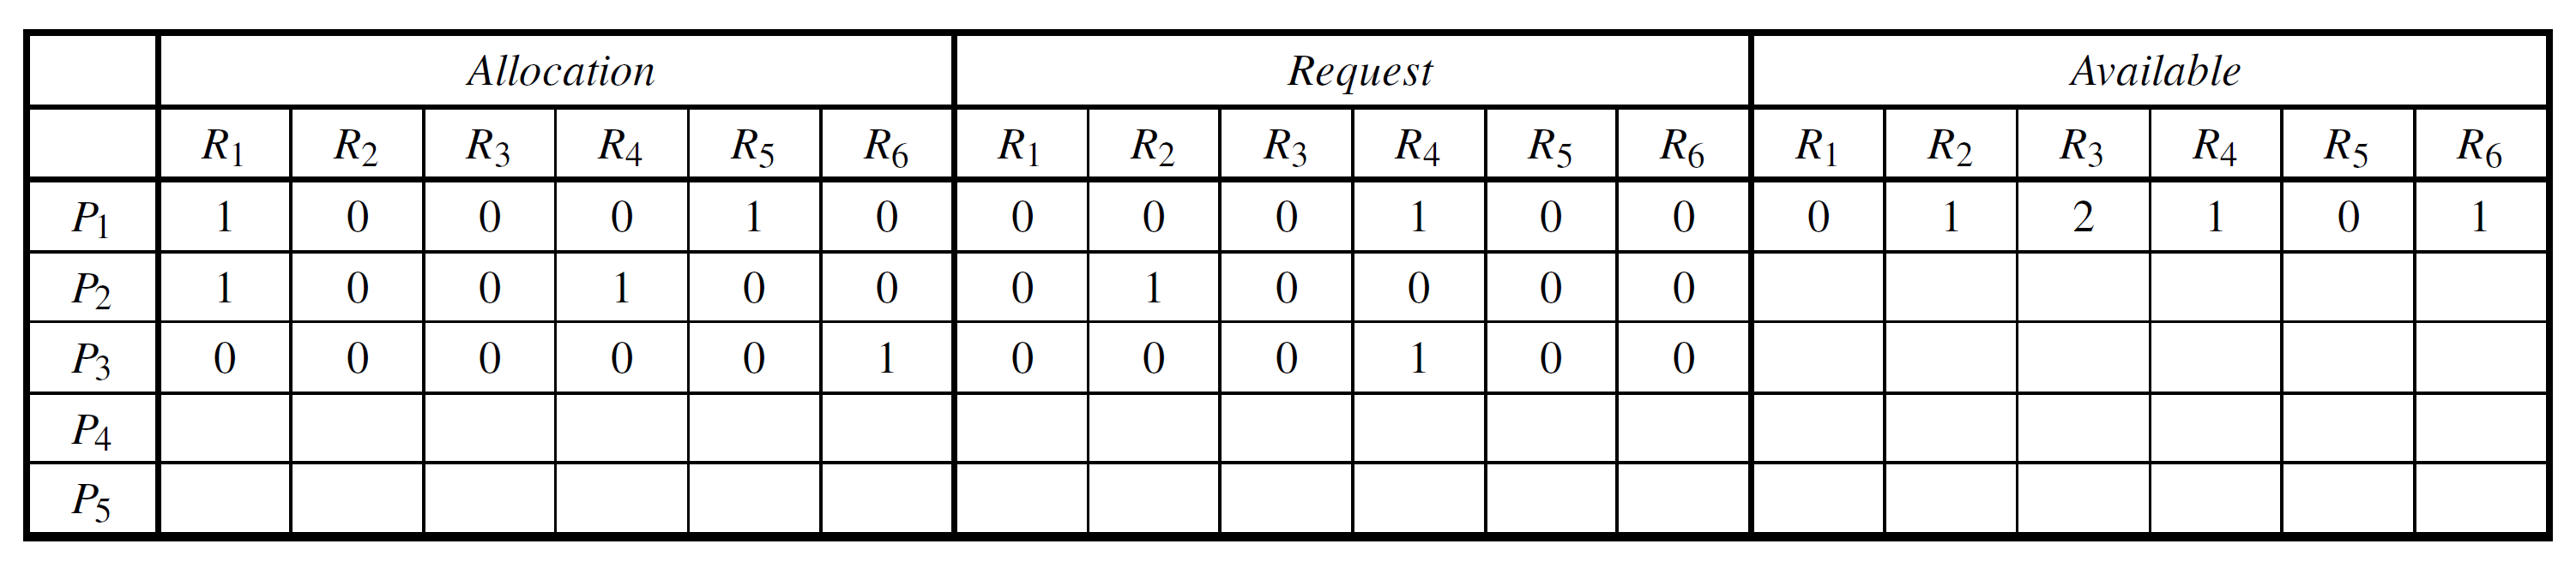
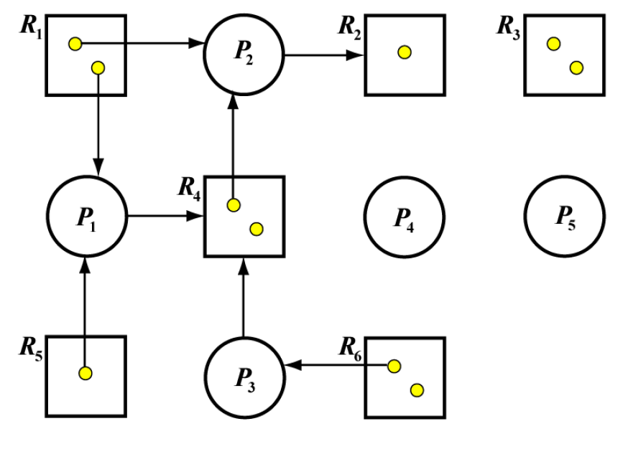
Practice3(Cont.)
Because the current Available = [0,0,2,0,0,1] P4’s Request = [0,0,0,0,0,1], we can run P4 and reclaim P4’s allocation [0,1,0,1,0,0]. The new matrix representation is:
The new version of resource allocation graph is:

Slide 11
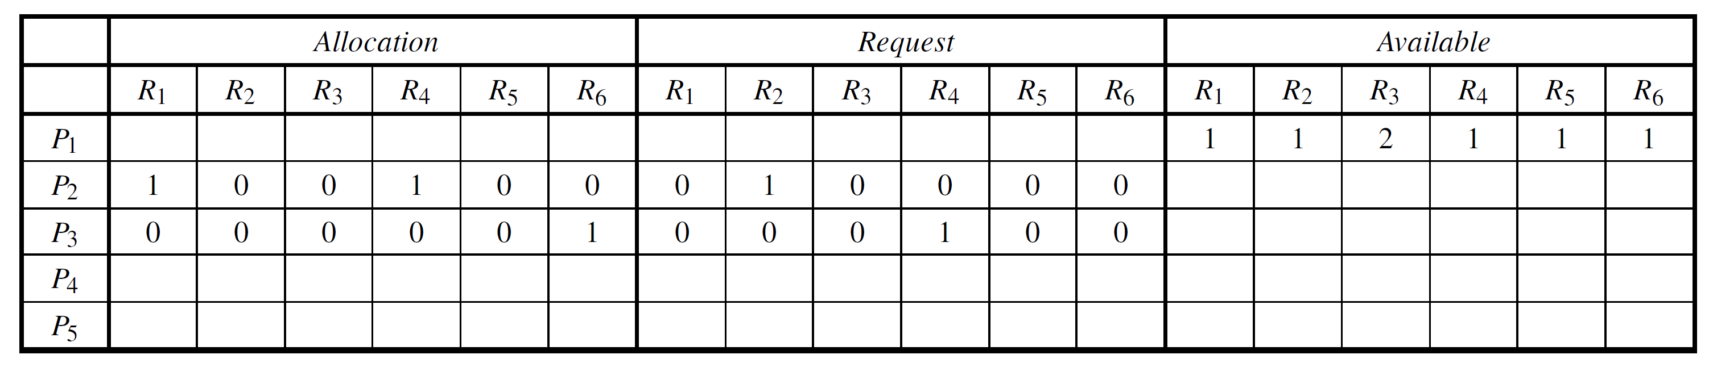
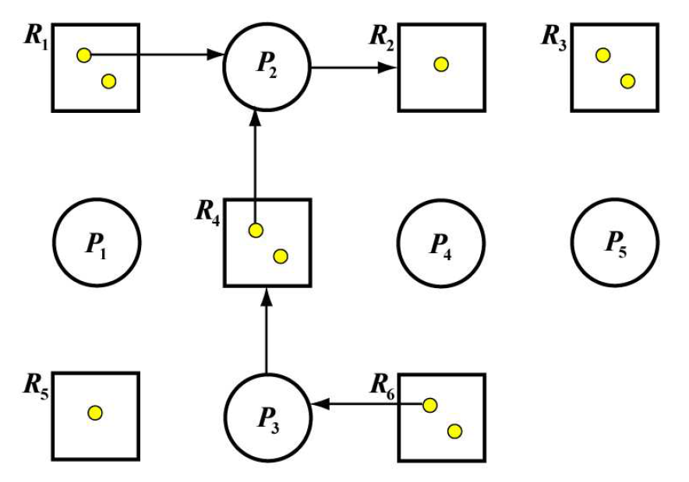
Practice3(Cont.)
Now we can run P1 because P1’s Request = [0,0,0,1,0,0] Available= [0,1,2,1,0,1]. After P1 finishes its work, the new Available=old Available=[0,1,2,1,0,1]+P1’s Allocation =[1,0,0,0,1,0]=[1,1,2,1,1]. Thus, we have the following new matrix representation:
The resource allocation graph becomes:

Slide 12
Practice3(Cont.)
Next, we run P2 followed by P3. In this way, all processes can run and obtain and release the needed resources. Consequently, there is no deadlock in the system. Thus, even though there are cycles in the given resource allocation graph, there is no deadlock!
have cycle！=deadlock
deadlock-->have cycle

