Slide 1
Given five memory partitions of 100 KB, 500 KB, 200 KB, 300 KB, and 600 KB (in order), how would each of the first-fit, best-fit, and worst-fit algorithms place processes of 212 KB, 417 KB, 112 KB, and 426 KB (in order)?Which algorithm makes the most efficient use of memory?
Answer:
1. First-fit:
212K is put in 500K partition
417K is put in 600K partition
112K is put in 288K partition (new partition 288K = 500K − 212K)
426K must wait
2. Best-fit:
212K is put in 300K partition
417K is put in 500K partition
112K is put in 200K partition
426K is put in 600K partition
3. Worst-fit:
212K is put in 600K partition
417K is put in 500K partition
112K is put in 388K partition
426K must wait
In this example, best-fit turns out to be the best.

Slide 2
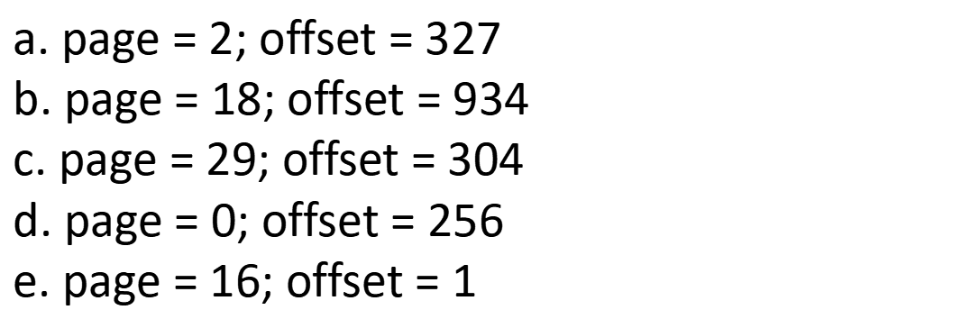
Assuming a 1 KB page size, what are the page numbers and offsets for the following address references (provided as decimal numbers):
a. 2375
b. 19366
c. 30000
d. 256
e. 16385

Slide 3
Consider a logical address space of 32 pages with 1024 words per page; mapped onto a physical memory of 16 frames.
a. How many bits are required in the logical address?
b. How many bits are required in the physical address?
Answer:
a. （2⁵ = 32） + (2¹⁰ = 1024 )= 15 bits.
b. （2⁴= 16） + (2¹⁰ = 1024 )= 14 bits.

Slide 4
Consider a paging system with the page table stored in memory.
a. If a memory reference takes 200 nanoseconds, how long does a paged memory reference take?
b. If we add TLBs（快表，作为快速检索内存位置的索引）, and 75 percent of all page-table references are found in the TLBs, what is the effective memory reference time? (Assume that finding a page-table entry in the TLBs takes zero time, if the entry is there.)
a. 400 nanoseconds: 200 nanoseconds to access the page table and 200 nanoseconds to access the word in memory.
b. Effective access time = 0.75 × (200 nanoseconds) + 0.25 × (400 nanoseconds) = 250 nanoseconds.

Slide 5
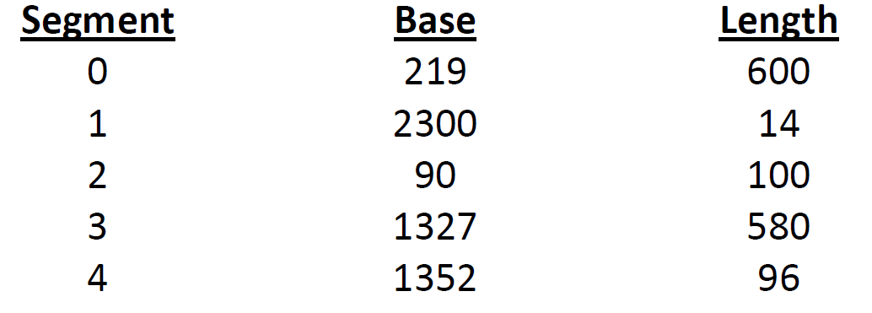
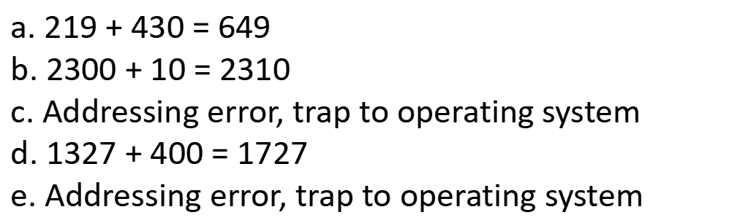
Consider the following segment table:
What are the physical addresses for the following logical addresses?
a. 0,430
b. 1,10
c. 2,500
d. 3,400
e. 4,112

