Slide 1
AMS 311
Lecture 1
Xing Peng

Slide 2
Text
A First Course in Probability, 10th ed, by Sheldon Ross

Slide 3
Homework
Biweekly (roughly)
Total of 9 assignments
Grades
Homework, attendance, class questions=40 points
Midterm exam=30 points
Final exam=30 pints

Slide 4
Background
Combinatorics: AMS 301
Counting, permutations, combinations
Introductory probability/statistics: AMS 310
Axioms of probability, basics
Conditional probability
Random variables: discrete, continuous
Expectation, variance

Slide 5
A Puzzle
You are a prisoner sentenced to death. The Emperor offers you a chance to live by playing a simple game. He gives you 50 black marbles, 50 white marbles and 2 empty bowls. He then says, "Divide these 100 marbles into these 2 bowls. You can divide them any way you like as long as you use all the marbles. Then I will blindfold you and mix the bowls around. You then can choose one bowl and remove ONE marble. If the marble is WHITE you will live, but if the marble is BLACK... you will die." How do you divide the marbles up so that you have the greatest probability of choosing a WHITE marble?
Notes:
Life or Death? The Emporeer’s Proposition
http://www.braingle.com/Probability.html

Slide 6
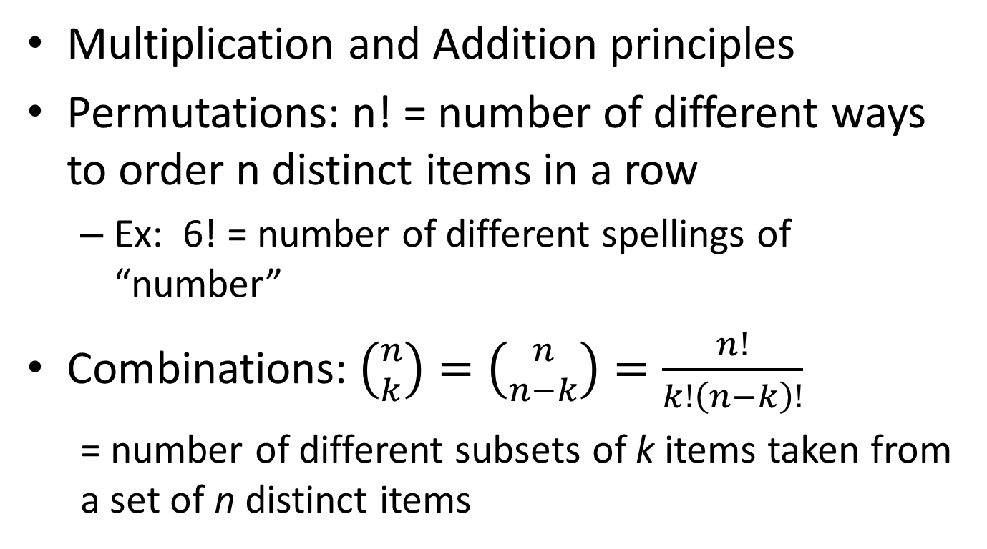
Review of Basic Counting
Multiplication and Addition principles
Permutations: n! = number of different ways to order n distinct items in a row
Ex: 6! = number of different spellings of “number”
Combinations: $\left({n \atop k}\right)=\left({n \atop n−k}\right)=\frac{n!}{k!\left(n−k\right)!}$
= number of different subsets of k items taken from a set of n distinct items

Slide 7
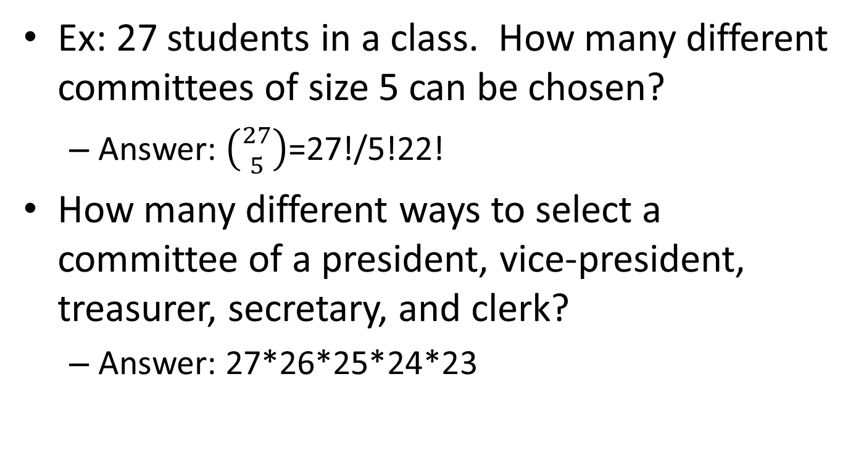
Combinations
Ex: 27 students in a class. How many different committees of size 5 can be chosen?
Answer: $\left({27 \atop 5}\right)$=27!/5!22!
How many different ways to select a committee of a president, vice-president, treasurer, secretary, and clerk?
Answer: 27*26*25*24*23

Slide 8

Binomial Theorem
${\left(x+y\right)}^{n}=\sum_{k=0}^{n}{\left({n \atop k}\right)x^{k}y^{n−k}}$

Slide 9

Subsets
2^{n} = # of different subsets (of any size) of an n-element set
= $\sum_{k=0}^{n}{\left({n \atop k}\right)}$1^{k} 1^{n-k} = (1+1)^{n} = 2^{n} = $\sum_{k=0}^{n}{\left({n \atop k}\right)}$

Slide 10
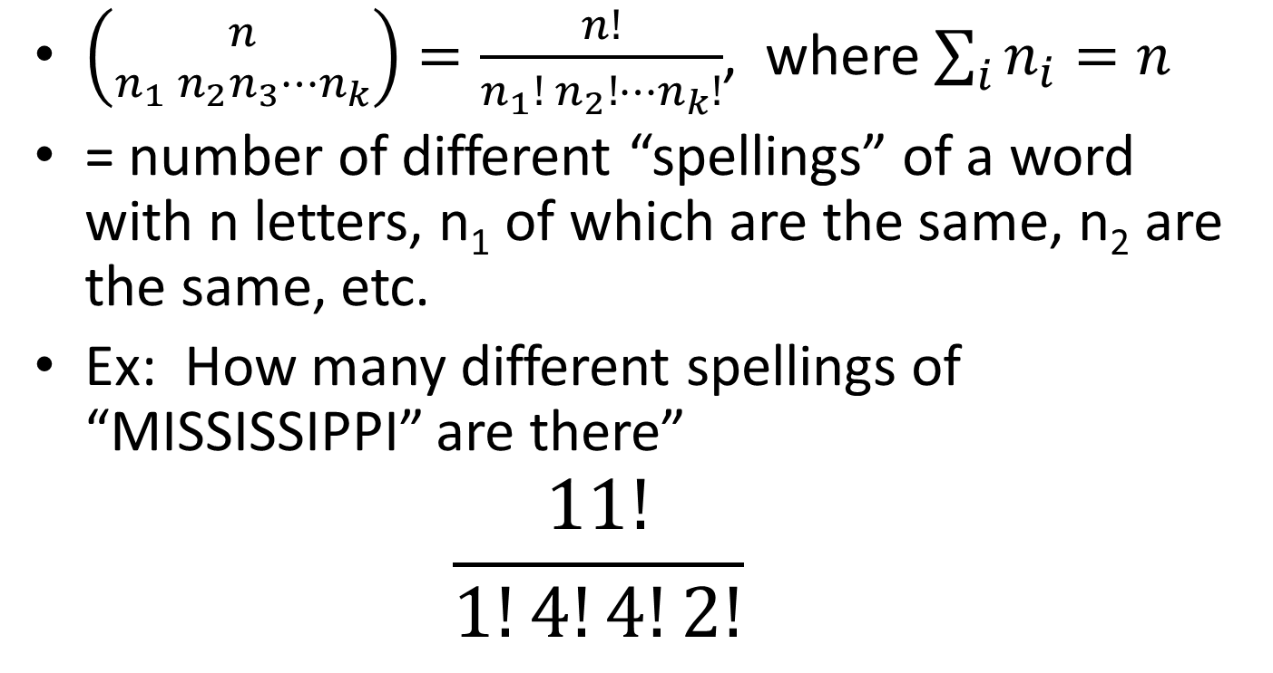
Multinomial Coefficients
$\left({n \atop n_{1} n_{2}n_{3}⋯n_{k}}\right)=\frac{n!}{n_{1}! n_{2}!⋯n_{k}!}$, where $\sum_{i}{n_{i}=n}$
= number of different “spellings” of a word with n letters, n₁ of which are the same, n₂ are the same, etc.
Ex: How many different spellings of “MISSISSIPPI” are there”
$$\frac{11!}{1!4!4!2!}$$

Slide 11
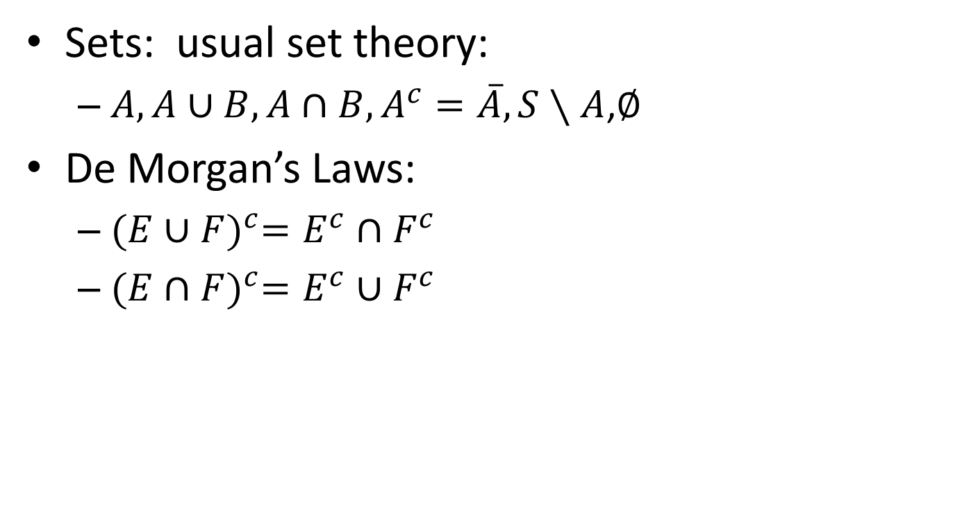
Basic Set Theory
Sets: usual set theory:
$A, A∪B, A∩B, A^{c}=\overline{A}, S∖A$,$∅$
De Morgan’s Laws:
${(E∪F)}^{c}=E^{c}∩F^{c}$
${(E∩F)}^{c}=E^{c}∪F^{c}$

Slide 12
Sample Space
Consider an experiment
Definition: The sample space, S, is the set of all possible outcomes of the experiment.

Slide 13
Examples of S
Experiment: Have a baby
S={b,g} (assumes a single child, of a single gender)
Experiment: Roll a die
S = {1,2,3,4,5,6}
Experiment: Flip a coin
S = {H,T}
Experiment: Measure lifetime of a ligthbulb
S = {x : 0≤x<∞} (nonnegative real numbers)

Slide 14
Examples of S
Experiment: Roll a pair of dice
S={ (1,1), (1,2), …,(1,6),(2,1),…,(2,6),…,(6,1),…,(6,6)}
Experiment: Select 2 marbles (with replacement) from a box having 1 red, 1 blue, 1 green marble
S = {RR, RG, RB, GR, GG, GB, BR, BG, BB}
|S| = 3*3=9
Experiment: Select 2 marbles (w/o replacement) from a box having 1 red, 1 blue, 1 green marble
S = {RG, RB, GR, GB, BR, BG}
|S| = 3*2=6

Slide 15
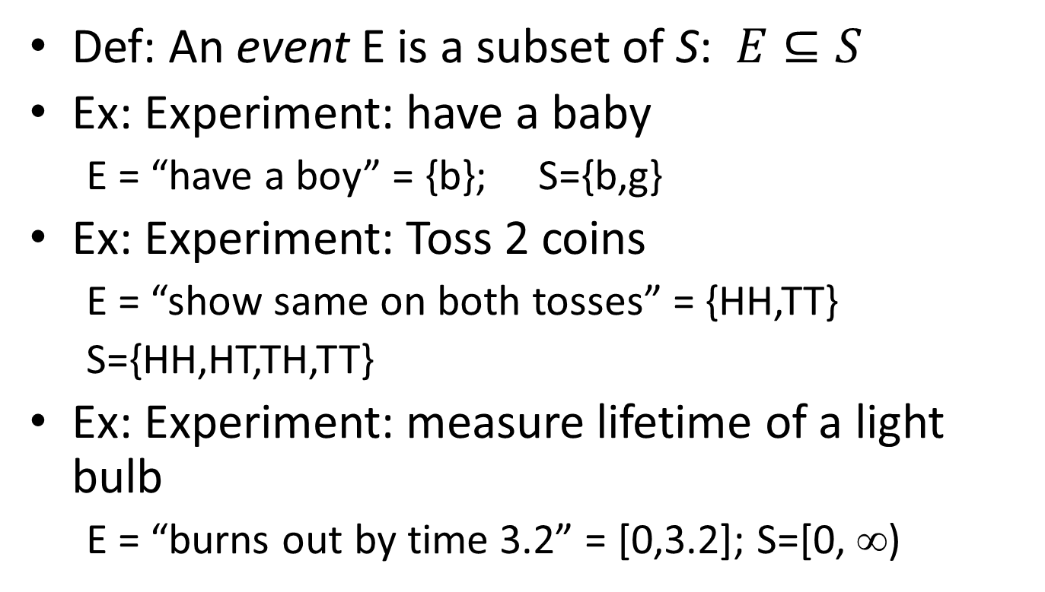
Events
Def: An event E is a subset of S: $E⊆S$
Ex: Experiment: have a baby
E = “have a boy” = {b}; S={b,g}
Ex: Experiment: Toss 2 coins
E = “show same on both tosses” = {HH,TT}
S={HH,HT,TH,TT}
Ex: Experiment: measure lifetime of a light bulb
E = “burns out by time 3.2” = [0,3.2]; S=[0, ∞)

Slide 16
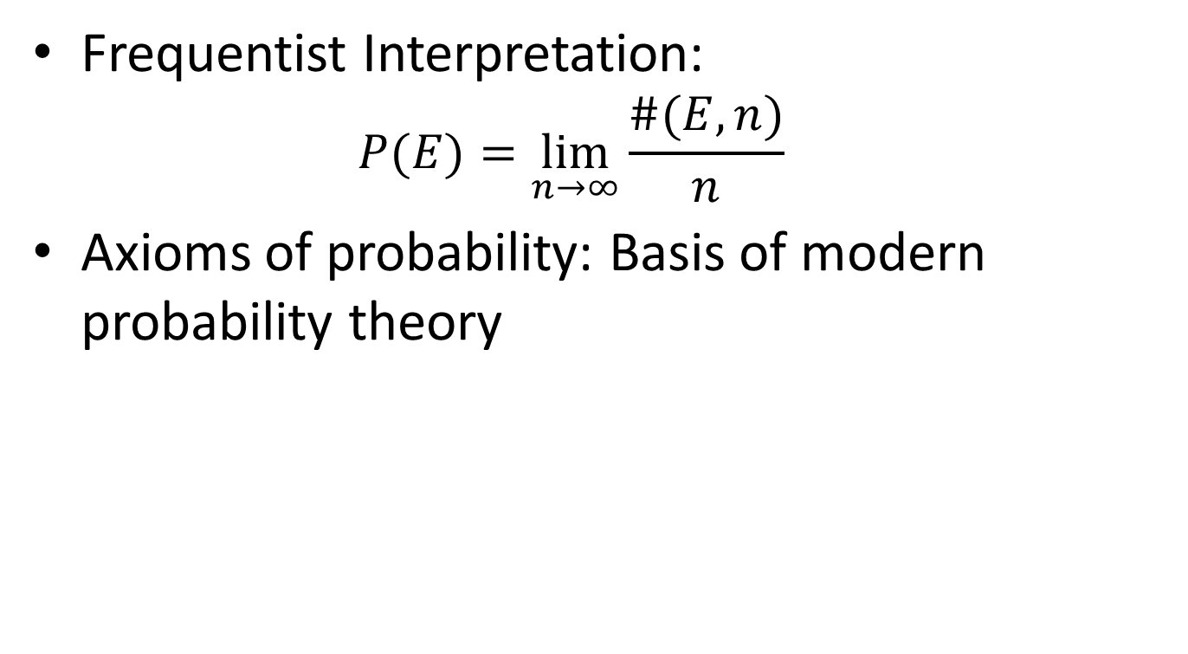
Defining Probability P(E)
Frequentist Interpretation:
$$P(E)=\lim_{n→∞}{\frac{\#(E,n)}{n}}$$
Axioms of probability: Basis of modern probability theory

Slide 17
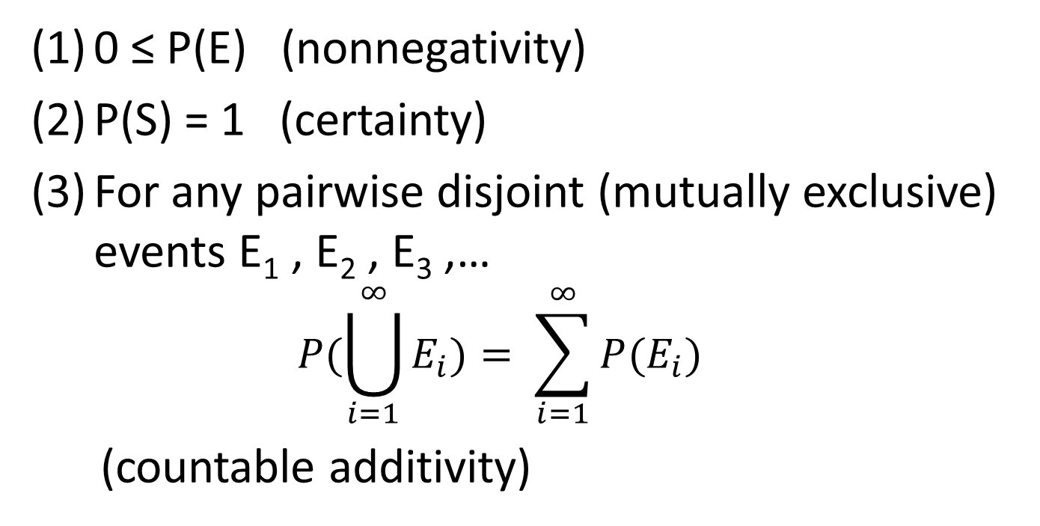
Axioms of Probability
Let S be a sample space for an experiment. A function P defined on the events of S is called a probability measure if it satisfies the following 3 conditions:
0 ≤ P(E) (nonnegativity)
P(S) = 1 (certainty)
For any pairwise disjoint (mutually exclusive) events E₁ , E₂ , E₃ ,…
$$P(\bigcup_{i=1}^{∞}{E_{i})= \sum_{i=1}^{∞}{P(E_{i})}}$$
(countable additivity)
Note: Do not need P(E) ≤ 1; this
Follows from the axioms
More formally: We must speak of “σ-algebras” and require E to be “measurable”
[Andrey Kolmogorov]
We then say that P(E) is the “probability of event E”

Slide 18
Fact (1) [Prop 4.1]
P(E^{c}) = 1 - P(E)
Why?
1 = P(S) = P(E ∪ E^{c} ) = P(E) + P(E^{c})
Ex: Toss coin 5 times.
S = {HHHHH,HHHHT,…,TTTTT}
P(“at least 1 head in 5 tosses”) = 1-P(“no head in 5 tosses”) = 1-P({TTTTT}) = 1-(1/32) = 31/32
Axiom(2)
Axiom(3)

Slide 19

Fact (2) [Prop 4.2]
If $E⊆F$ then $P\left(E\right)≤P(F)$
Why?
Corollary: P(E) ≤ 1 (since E is contained in S)

Slide 20

Fact (3) [Prop 4.3]
$P\left(E∪F\right)=P\left(E\right)+P\left(F\right)−P(E∩F)$
Why?
Corollary: $P\left(E∪F\right)≤P\left(E\right)+P(F)$

Slide 21
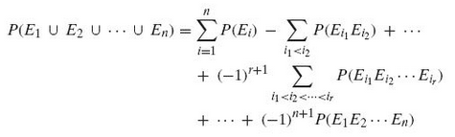
Fact (4) [Prop 4.4]

Slide 22

Fact (5)
$P\left(∅\right)=0$
Why?
$$1=P\left(S\right)=P\left(S∪∅\right)=P\left(S\right)+P\left(∅\right)=1+P(∅)$$

Slide 23
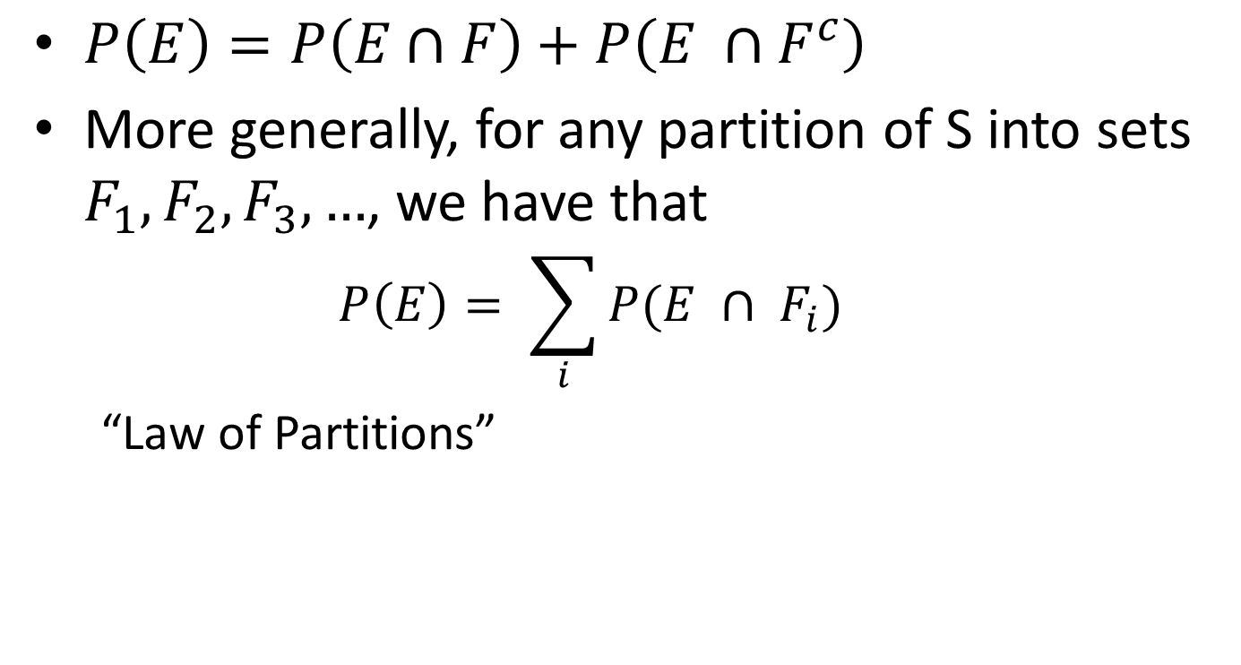
Fact (6)
$P\left(E\right)=P\left(E∩F\right)+P\left(E ∩F^{c}\right)$
More generally, for any partition of S into sets $F_{1}, F_{2}, F_{3},…$, we have that
$$P\left(E\right)= \sum_{i}{P(E ∩ F_{i})}$$
“Law of Partitions”

Slide 24
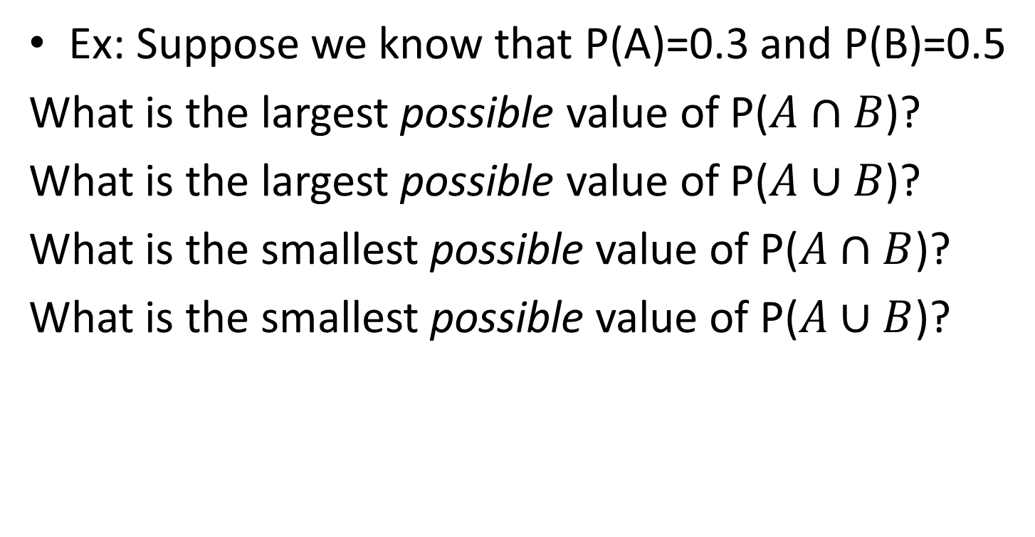
Example
Ex: Suppose we know that P(A)=0.3 and P(B)=0.5
What is the largest possible value of P($A∩B$)?
What is the largest possible value of P($A∪B$)?
What is the smallest possible value of P($A∩B$)?
What is the smallest possible value of P($A∪B$)?
Notes:
Did this for them, 8/29/13

Slide 25
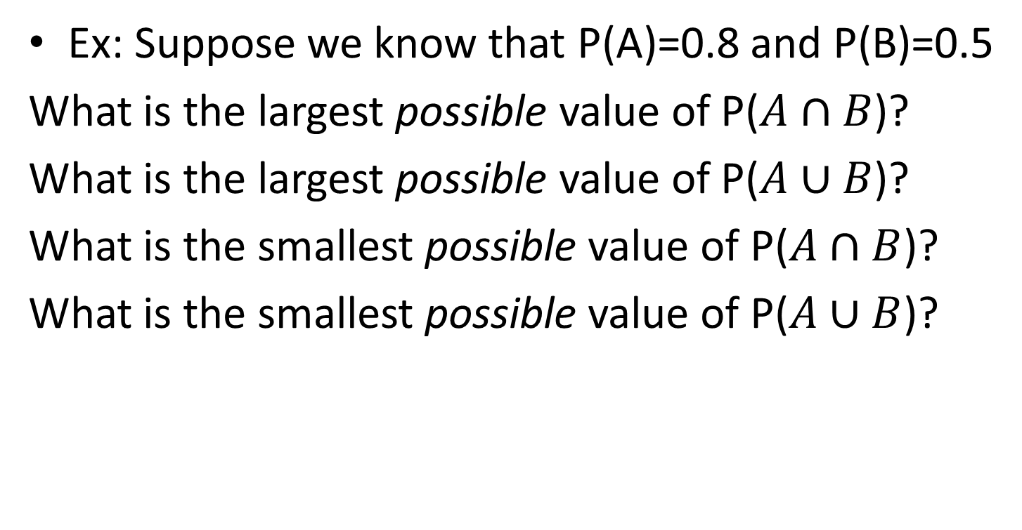
Example
Ex: Suppose we know that P(A)=0.8 and P(B)=0.5
What is the largest possible value of P($A∩B$)?
What is the largest possible value of P($A∪B$)?
What is the smallest possible value of P($A∩B$)?
What is the smallest possible value of P($A∪B$)?

Slide 26
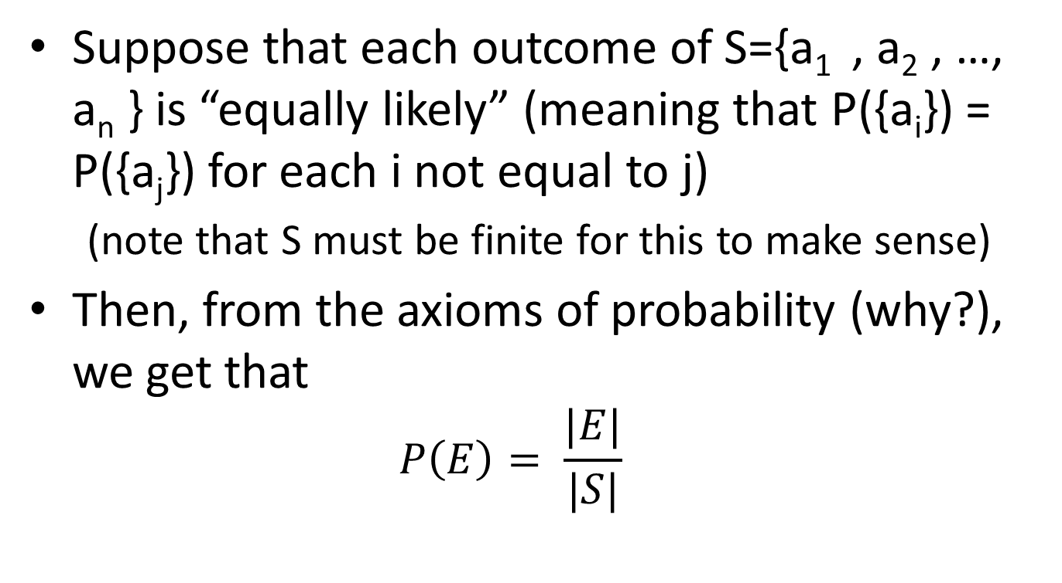
Sample Spaces with Equally Likely Outcomes
Suppose that each outcome of S={a₁ , a₂ , …, a_{n} } is “equally likely” (meaning that P({a_{i}}) = P({a_{j}}) for each i not equal to j)
(note that S must be finite for this to make sense)
Then, from the axioms of probability (why?), we get that
$$P\left(E\right)= \frac{|E|}{|S|}$$

Slide 27
Example
Roll 2 dice (red, blue)
Let E = “at least one 4”, A=“red is 4”, and B=“blue is 4”
Find P(E) = P(A∪B)
S={(1,1),(1,2),…,(6,6)}, with |S|=36 equally likely outcomes (assuming 2 fair dice); here, “(i,j)” means that the red die is I and the blue die is j
P(A) = P({(4,1),(4,2),…,(4,6)}) = 6/36 = 1/6
P(B) = P({(1,4),(2,4),…,(6,4)}) = 6/36 = 1/6
A∩B = {(4,4)}, so P(A∩B) = 1/36
E=A∪B, so P(E) = P(A)+P(B)-P(A∩B) = 1/6+1/6-1/36=11/36
(or, do directly, using A∪B = {(1,4),(2,4),…,(4,6),…,(6,4)}, a set with 11 elements)

Slide 28
Example: Urn Problems
Given a box (or “urn”) with r red balls and b blue balls in it, select k balls at random and examine their colors
Without replacement vs. With replacement
Balls are distinct or not.

Slide 29
Example: Urn Problems
Box of 12 red and 8 blue balls; select 4 without replacement
Find P(we get exactly 2 balls of each color)
S = ?
Let E = “we get exactly 2 balls of each color”
Want: P(E)

Slide 30
Example: Urn Problems
Box of 12 red and 8 blue balls; select 4 without replacement
Find P(we get exactly 2 balls of each color)
S = ?
One solution: Treat the 20 balls as distinct: imagine painting little numbers on them to label them as r₁, r₂, …, r₁₂, b₁, b₂, …, b₈
Let S = the set of all 4-element subsets of {r₁, r₂, …, r₁₂, b₁, b₂, …, b₈}
So, S = { {r₂,r₇,r₈,b₃}, {…}, … }
(here we think of the 20 balls as distinct, and we consider S to be a set of subsets (unordered) )

Slide 31
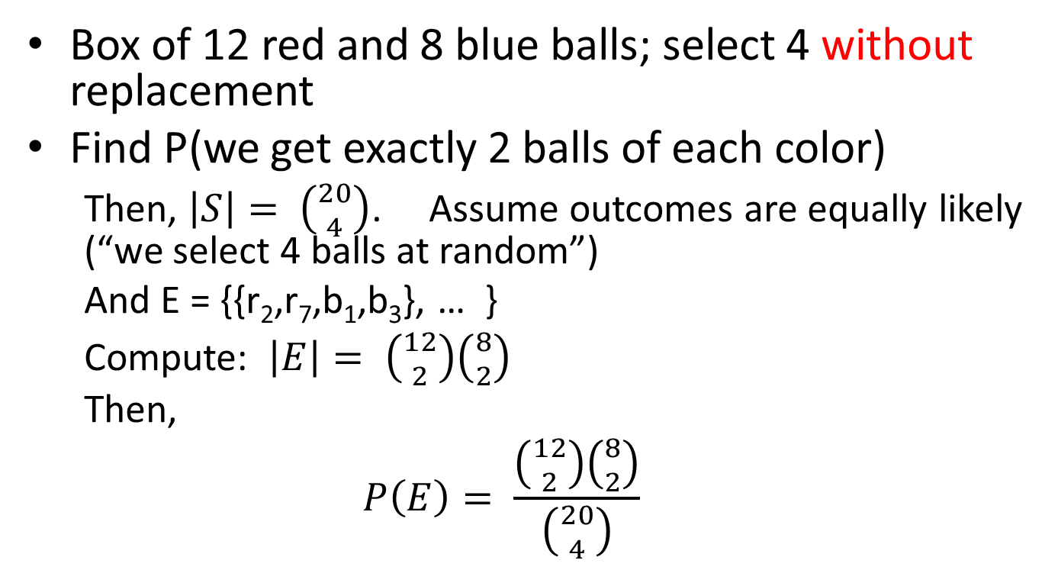
Example: Urn Problems
Box of 12 red and 8 blue balls; select 4 without replacement
Find P(we get exactly 2 balls of each color)
Then, $\left|S\right|= \left({20 \atop 4}\right)$. Assume outcomes are equally likely (“we select 4 balls at random”)
And E = {{r₂,r₇,b₁,b₃}, … }
Compute: $\left|E\right|= \left({12 \atop 2}\right)\left({8 \atop 2}\right)$
Then,
$$P\left(E\right)= \frac{\left({12 \atop 2}\right)\left({8 \atop 2}\right)}{\left({20 \atop 4}\right)}$$

Slide 32
Example: Urn Problems
Box of 12 red and 8 blue balls; select 4 without replacement
Find P(we get exactly 2 balls of each color)
Now, try other definitions of S:
balls are not distinct (no “numbers”), and we consider the 4 selected balls to be unordered
balls are not distinct (no “numbers”), and we consider the 4 selected balls to be ordered
balls are distinct (“numbers”), and we consider the 4 selected balls to be ordered

Slide 33
Example
Pick 5 cards at random from a deck of 52.
Find P(“get exactly 2 spades”)
Notes:
Did in class, 8/29/13

Slide 34
Example
Deal 4 cards: 2 to you, 2 to the dealer
Find P(“neither of you is dealt a blackjack”)

Slide 35
Example
Deal a poker player 5 cards from a standard deck of 52
Find P(“he gets a straight”)
Find P(“he gets a full house”)

Slide 36
Example
Roll 2 dice
Find P(“sum is 10”)
Find P(“sum is 7”)

Slide 37
Example
Urn with 5 red, 6 blue, 8 green balls
Select 3 at random without replacement
Find P(“all the same color”) = P(E)
Find P(“all different colors”) = P(F)
Notes:
To do next time, 9/5/13

Slide 38
Example
Urn with 5 red, 6 blue, 8 green balls
Select 3 at random with replacement
Find P(“all the same color”) = P(E)
Find P(“all different colors”) = P(F)

Slide 39
Example
Birthday problem: Room with n people.
Let E = “some 2 people in the room have the same birthday”
Find P(E), for various n

Slide 40
Example
[#47, Chap 2, Ross] If there are 12 strangers in a room, what is the probability that no two of them celebrate their birthday in the same month?
Notes:
9th edition: page 51

Slide 41
Example
Deal 52 cards: 13 to each of 4 bridge players
Find P(“one player gets all 13 spades”)

Slide 42
Example
8 people (4 married couples) sit in a row in a random order
Find P(“each couple sits together”)

Slide 43
Example
Mixed up shoes: 10 pairs of shoes in a closet. Pick 8 shoes at random
Find P(“there is no complete pair among 8”)
Find P(“exactly one pair among the 8”)

